Slide 1
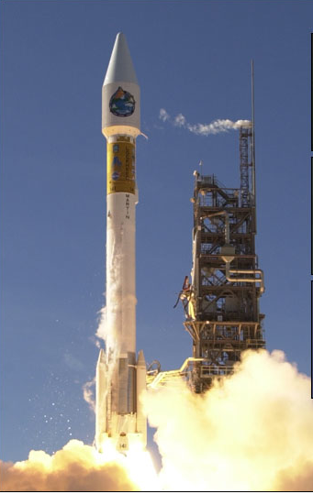
Validation strategy for aerosol
retrievals of the future
Lorraine Remer and J. Vanderlei Martins
Dec. 1999

Slide 2
Today’s Quiz:
When did the MODIS aerosol group begin
validating their products?

Slide 3
Answer: 1991

Slide 4
That’s when Brent received funding for
“the sunphotometers”

Slide 5
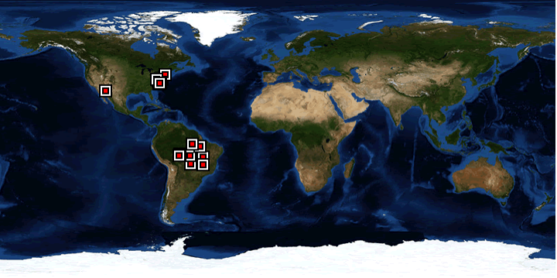
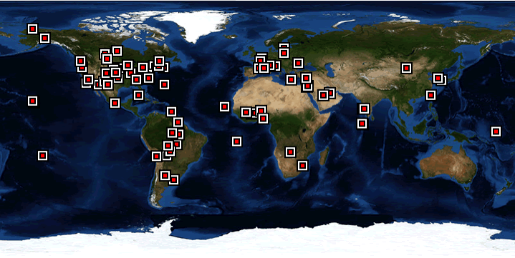
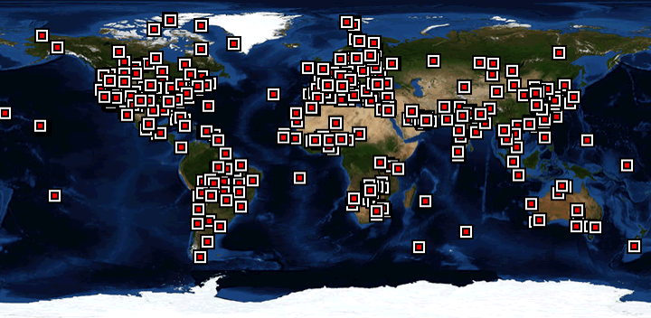
As MODIS aerosol
algorithms were developed
AERONET grew.
1993
2000
2010
accumulative

Slide 6
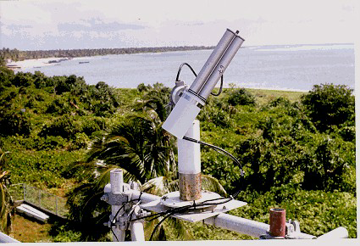
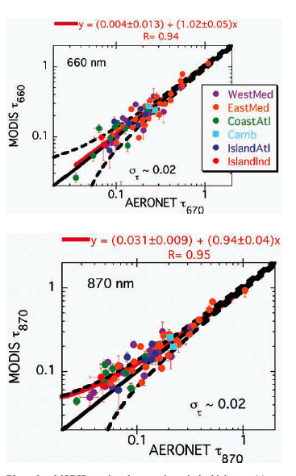
Ocean
Validation
Collection 002
N=69
Within 10 months of launch
(8 months of first obs)
we had ‘validation’
Remer et al. 2002

Slide 7
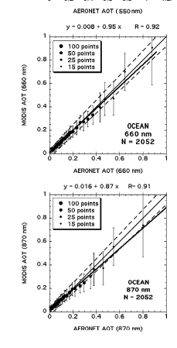
Collection 004
Collection 005
Remer et al. (2008)
Validation strategy must be
Conceived in advance of launch
Remer et al. (2005)

Slide 8
Now we are transitioning from the
MODIS-MISR-OMI-PARASOL era
into something different.
Starting with Glory-APS launch later this year

Slide 9
Quiz Question 2:
If MODIS swath width is 2330 km,
and MISR swath width is 380 km,
what is the swath width for Glory APS?

Slide 10
Quiz Question 2:
If MODIS swath width is 2330 km,
and MISR swath width is 380 km,
what is the swath width for Glory APS?
Answer: 6 km ( 1 pixel wide) at nadir

Slide 11
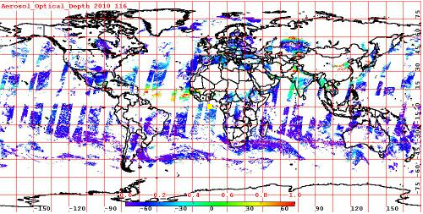
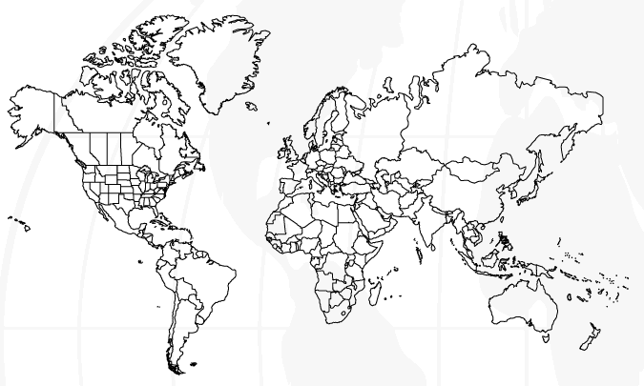
1 day of MODIS Dark Target data
1 day of Glory-APS aerosol data

Slide 12
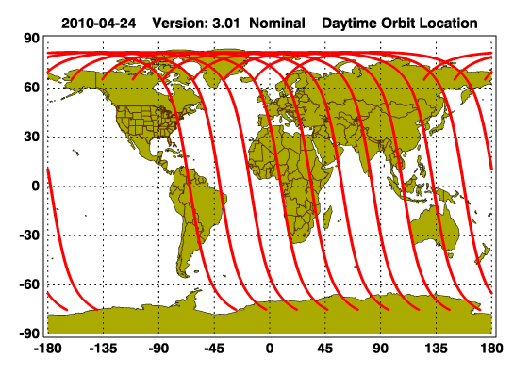
1 day of MODIS Dark Target data
1 day of Glory-APS aerosol data

Slide 13
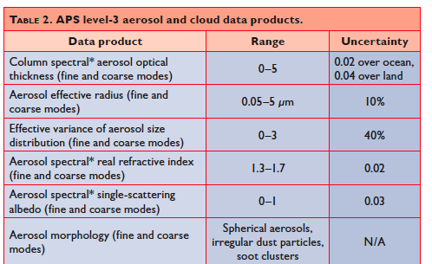
MODIS uncertainty
0.03 /5% over ocean 0.05 / 15% over land
25% over ocean, combined modes
NA
NA
NA
NA
APS is promising
a precision and
array of products
not previously
possible
Mishchenko et al. (2007)

Slide 14
Obviously, aircraft will be needed, but with what
instrumentation?
“ An ideal in situ instrument to verify the APS microphysical
retrievals would be a high-accuracy airborne
polarization nephelometer performing measurements
at several widely separated wavelengths and over the
entire range of scattering angles, but such an instrument
has yet to be fielded.”
--- Mishchenko et al. (2007)

Slide 15
Imaging Nephelometer (I-Neph)
and the Open I-Neph
J. Vanderlei Martins, Gergely Dolgos, Lorraine Remer
Proposed Features:
High sensitivity (down to Rayleigh Scattering)
Large Angular coverage from ~1.5 to 178.5 deg
High Angular resolution ~0.5deg
Full polarization measurements
Provide direct measurement of phase function and full phase matrix
Inversion of size distribution, average particle shape, and particle refractive
index
Fast measurement mode may allow for cirrus particle counting
Current prototype: measure phase function in a laboratory setup with sensitivity
down to Rayleigh scattering

Slide 16
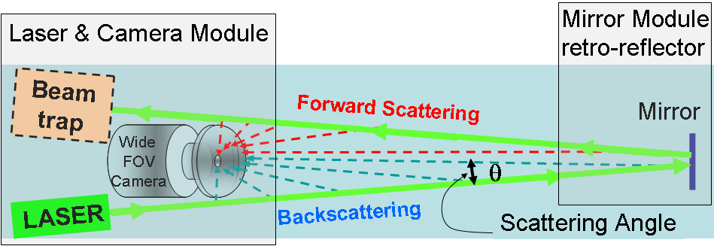
Current Lab Prototype
Example of actual
measurement
Proposed
Open-Cell System

Slide 17
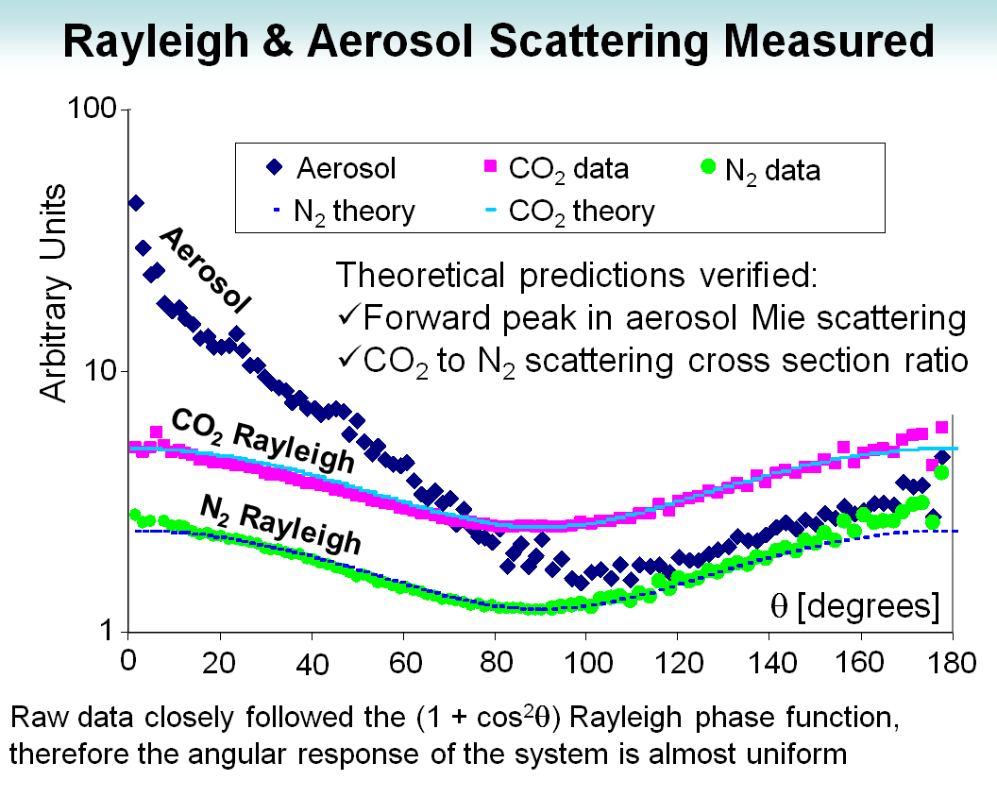
(Unpolarized Measurements)

Slide 18
Polarized Rayleigh Scattering
measured with early I-Nepth Prototype
Blue dots: direct measurements
Black dots: mirrored for graphical representation
Red line: Rayleigh scattering theory

Slide 19
Current I-Neph plans for two systems:
(1) Open-I-Neph, supported by DOE
(2) Inside-the-plane I-Neph to fly on the Langley B-200 (proposed)
Also, proposed for Glory validation in the Amazon on board
the INPE Bandeirante

Slide 20
Terra launch began a new era of
aerosol remote sensing.
Today we are starting again on
new journeys.
There is new creativity at work:
- mission design (ACE)
- instrument development
- algorithm creation
- validation strategies
All based on a 20 year foundation
of solid science and experience
Happy 10th birthday Terra!

