Slide 1
Multi-decadal VARIATIONS of aerosols and their POSSIBLE effect on surface radiation
Mian Chin
Thomas Diehl, Qian Tan, Tom Kucsera, Hongbin Yu, Huisheng Bian, Sarah Strode, Christina Hsu, Lorraine Remer, Robert Levy, Ralph Kahn, Xuepeng Zhao, Michael Mishchenko, Omar Torres, Brent Holben, Joseph Prospero, Martin Wild, Yun Qian, David Streets, Paul Stackhouse, William Rossow
AeroCenter seminar, November 7 2012
Notes:
Presentation slide for courses, classes, lectures et al.

Slide 2
Introduction
Aerosols have important effects on climate, air quality, hydrological cycles, and ecosystems
Historic emission inventories have estimated large trends in anthropogenic emission that are closely tied to economic growth, population density, and technology development
Long-term observations of aerosols and surface radiation seem to mirror the aerosol emission trends, implying a close link of aerosol forcing to solar “dimming”
This work analyzes the variations of aerosols in the last three decades (1980 to 2009) in different world regions and estimate the aerosol effects on surface radiation

Slide 3
Part 1: 30-year variation of AOD and species concentrations
Part 2: Aerosol effects on SW downward radiation at surface
Annual and regional averaged AOD over land and ocean regions from AVHRR, TOMS, SeaWiFS, MISR, MODIS, and GOCART from 1980 to 2009
Monthly AOD at AERONET sites from late 1990s to 2009 from AERONET and GOCART
Concentration of aerosol species and precursors from the IMPROVE, EMEP, U Miami network and GOCART in the past three decades
Relationship between emission, aerosol concentrations, and AOD
SW downward radiation at the surface from GEBA, BSRN, and CMA networks and GOCART
SW downward radiation at the surface from satellite-based products of SRB and ISCCP and GOCART
All sky and clear sky conditions, separating direct and diffuse radiation
Aerosol effects on the changes of solar radiation reaching the surface

Slide 4
GOCART model simulation
GOCART model off-line simulations using MERRA meteorology, 1980-2009
2.5°lon ×2°lat, 72 levels
Anthropogenic emissions: A2-ACCMIP (Granier et al., 2011; Diehl et al., 2012):
ACCMIP historic emissions, 1980-2000
RCP8.5 projected emissions, 2001-2009
Annual emissions interpolated between 1980, 1990, 2000, 2005, 2010
Biomass burning emissions: A2-ACCMIP (Granier et al., 2011; Diehl et al., 2012):
RETRO, 1980-1996
GFED v2, 1997-2008
GFED v2+RCP8.5, 2009
Volcanic emissions (Diehl et al., 2012):
Smithsonian Global Volcanism Program database of volcanic activity (volcanic location, eruption duration, VEI)
TOMS and OMI SO2 amount
Literature
Biogenic emissions:
DMS from the ocean (climatology monthly variable seawater DMS, 10-m wind speed)
OC from monoterpene oxidation (climatology, monthly variable)
Dust emissions: Calculated on-line
Dust source function constructed from AVHRR NDVI with 15-day resolution, topographic feature, landcover information (Kim et al., 2012)
Sea salt emissions: Calculated on-line
Oxidant fields (OH, H₂O₂, NO₃): GEOS-5 CCM simulation (Strode et al., 201x)
Free GCM run forced by SST and sea ice, ACCMIP decadal emissions
GMI combo chemistry

Slide 5
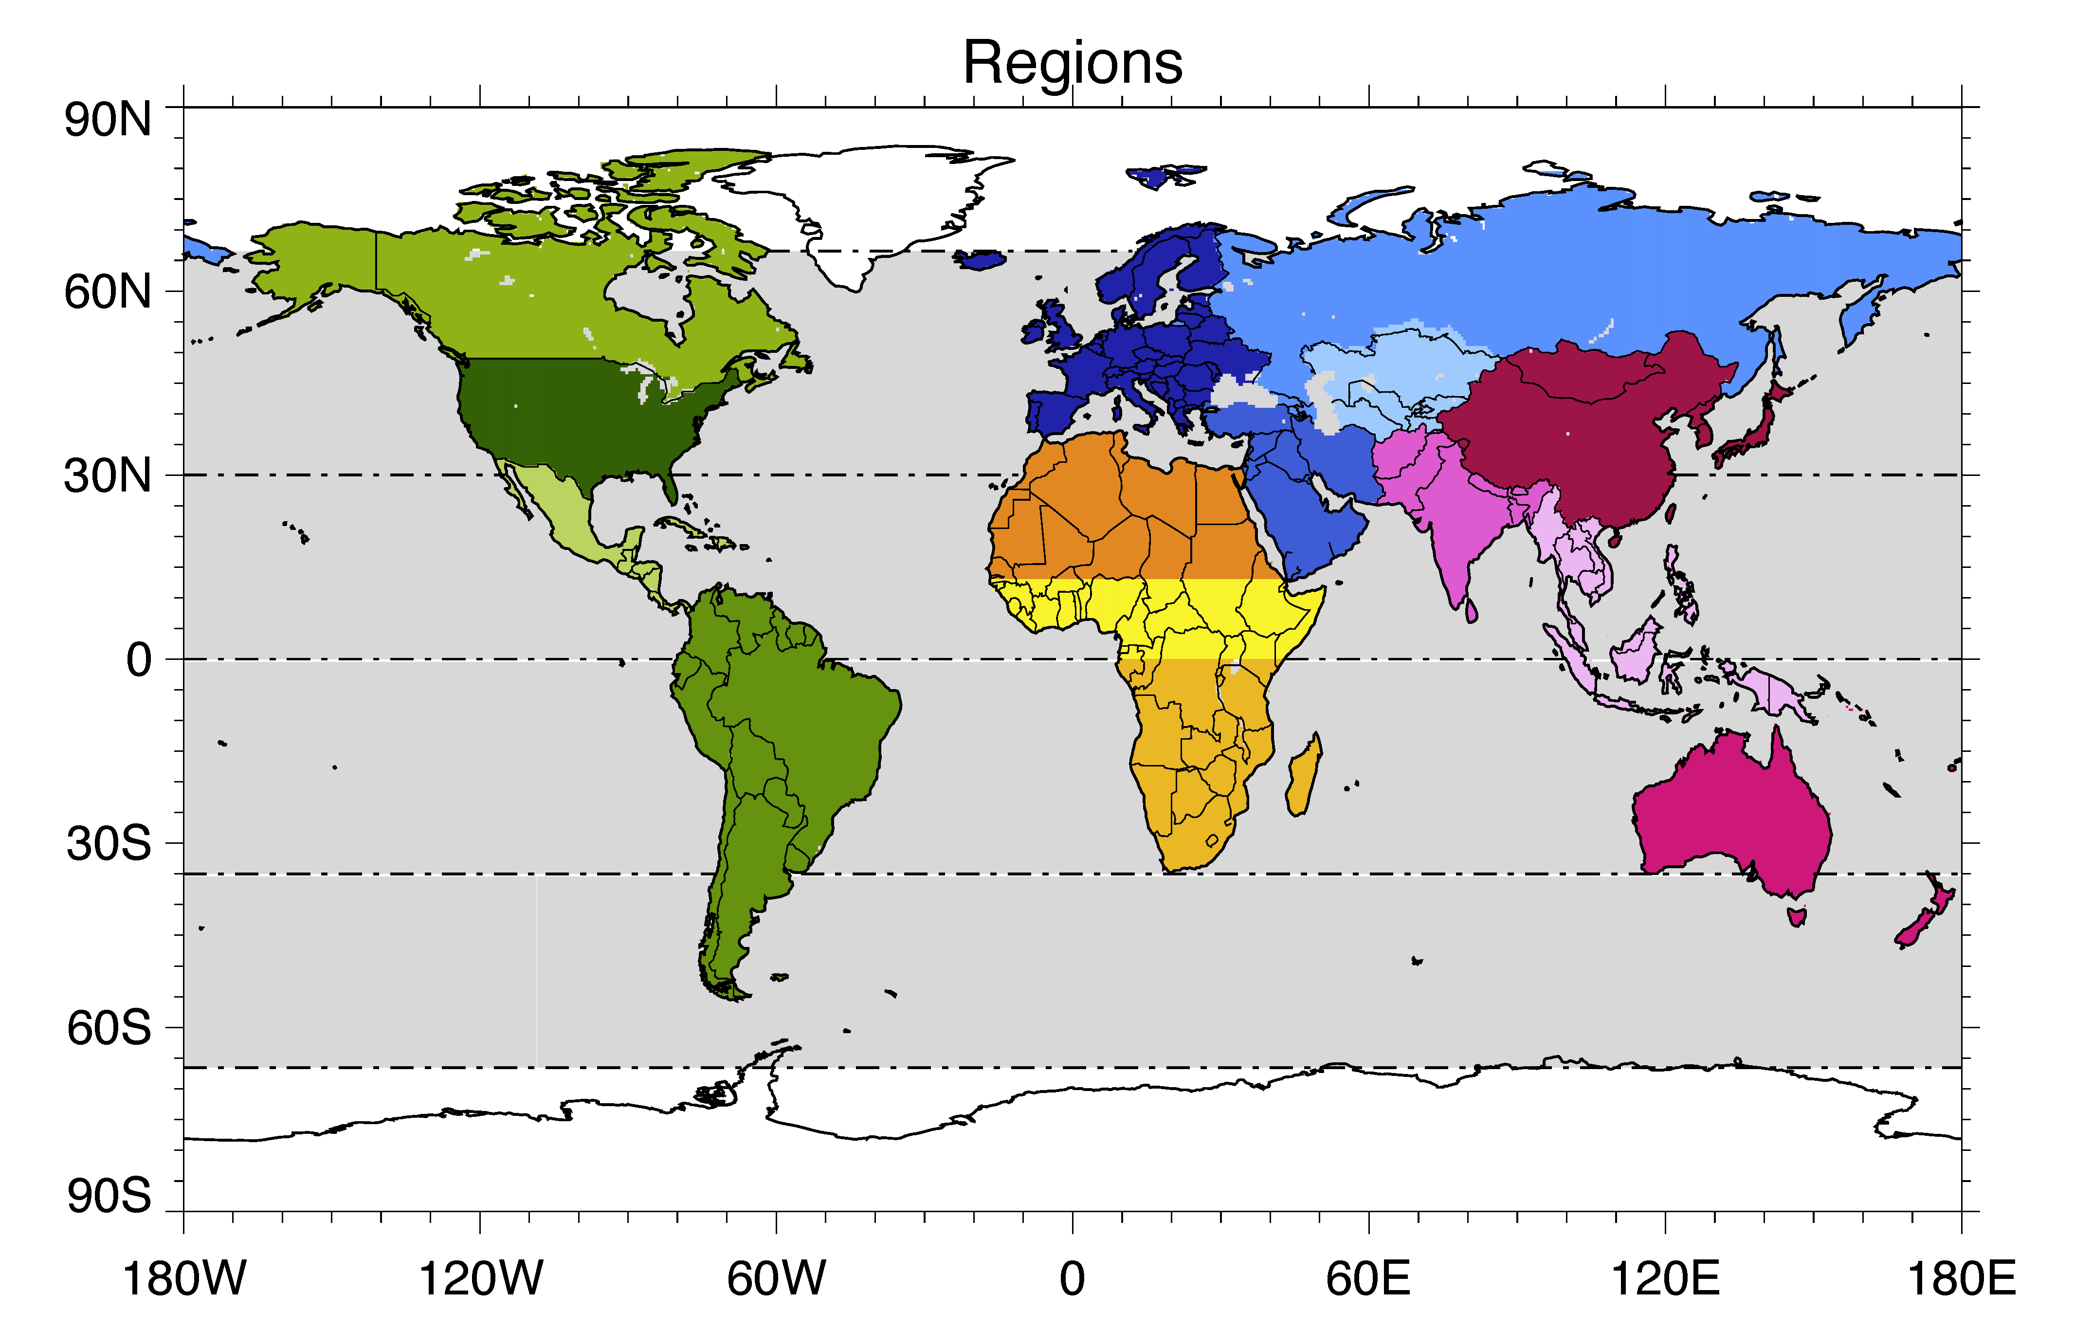
Land and ocean regions
Land: CAN USA CAM SAM EUR RUS CAS MDE SAS EAS SEA ANZ NAF CAF SAF | Canada USA Central America South America Europe Russia & Georgia Central Asia Middle East South Asia East Asia Southeast Asia Australia & New Zealand Northern Africa Central Africa Southern Africa
Ocean: ENP ECP ESP NAT CAT SAT NIN SIN WNP WCP WSP SOU | Eastern North Pacific Eastern Central Pacific Eastern South Pacific Northern North Atlantic Central North Atlantic South Atlantic Northern Indian Southern Indian Western North Pacific Western Central Pacific Western South Pacific Southern Ocean
15 land regions, 12 ocean regions
CAN
RUS
EUR
CAS
ENP
USA
NAT
EAS
WNP
NAF
MDE
SAS
CAM
CAT
ECP
CAF
NIN
WCP
SEA
SAM
SAF
ESP
SAT
SIN
ANZ
WSP
SOU
(Note: Regions in red fonts will be shown in more detail.)

Slide 6
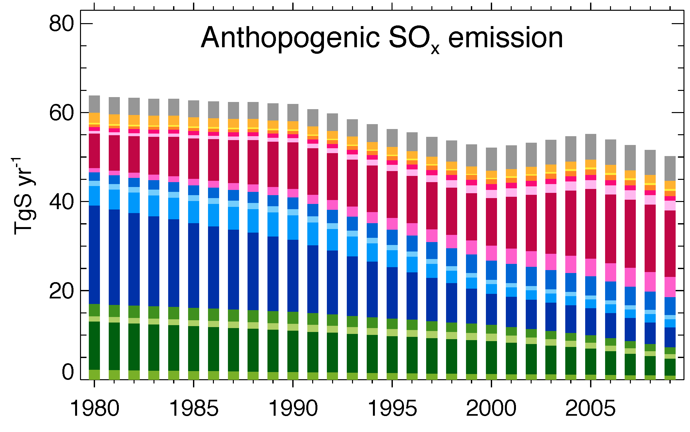
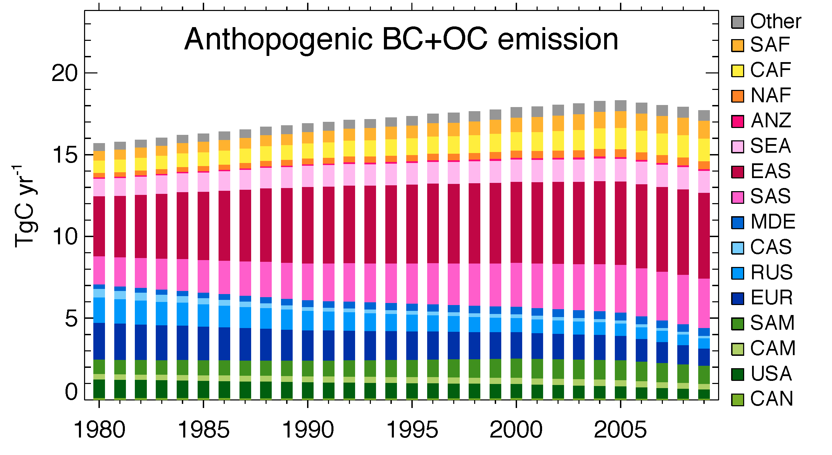
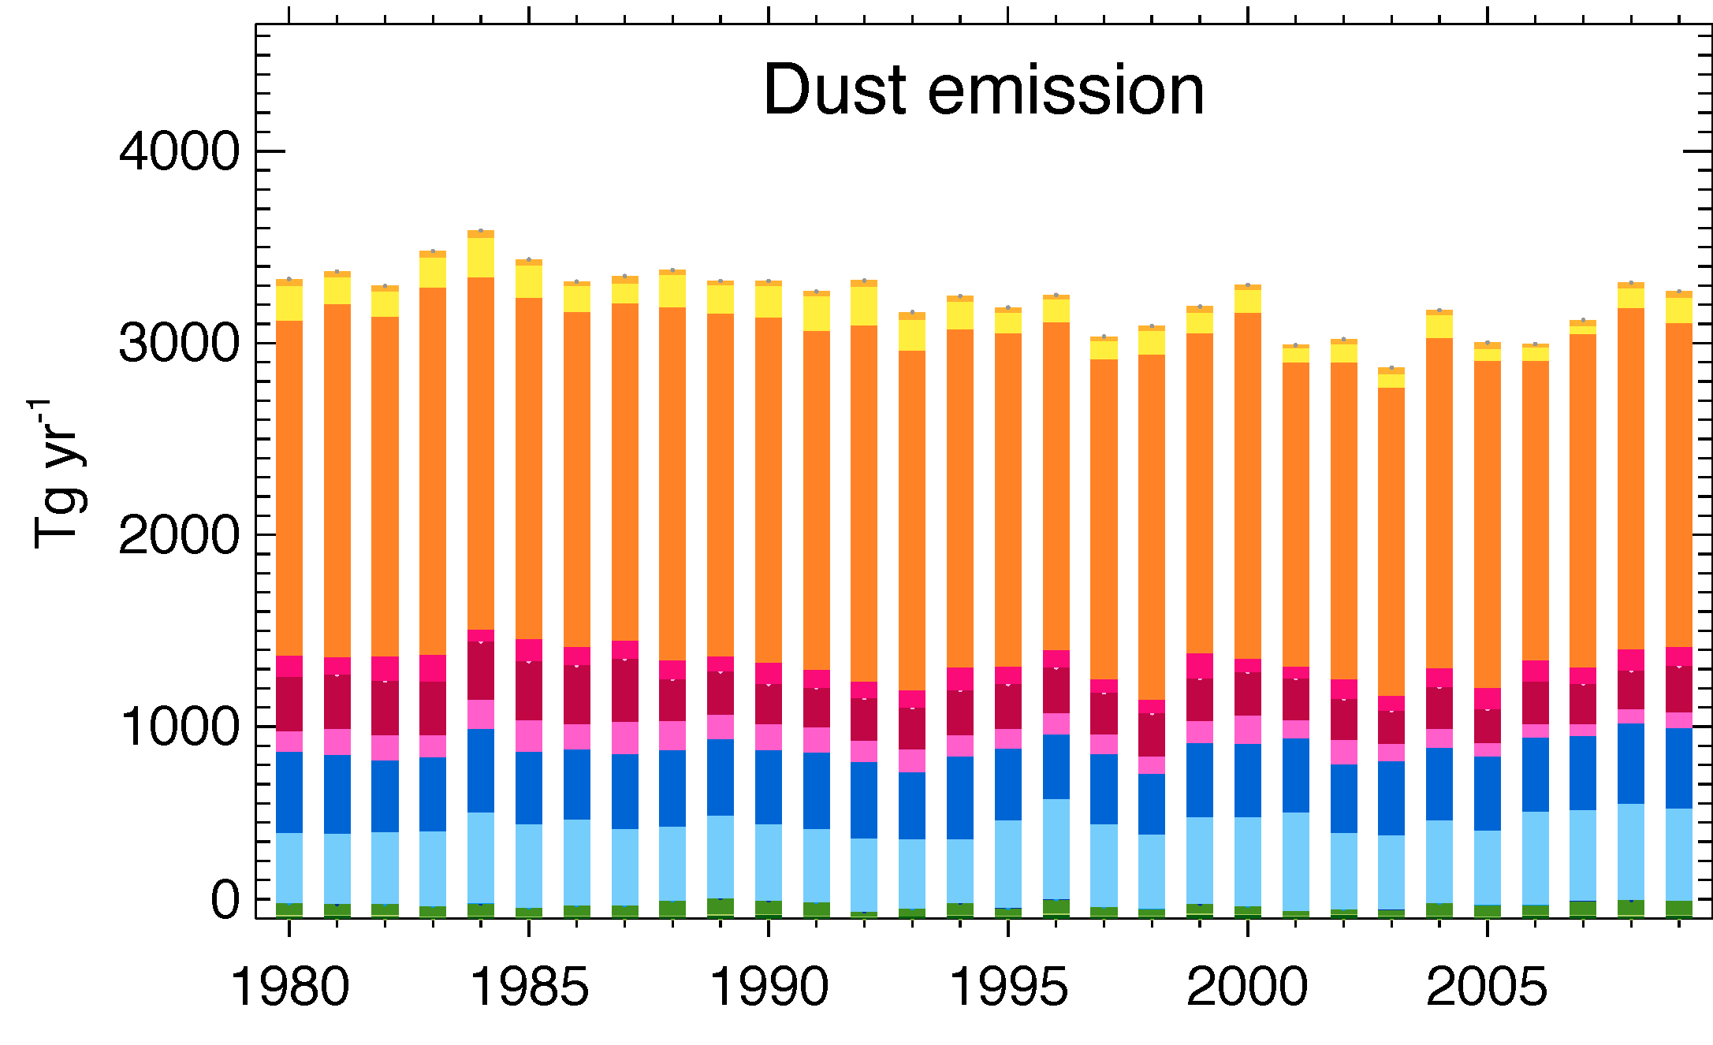
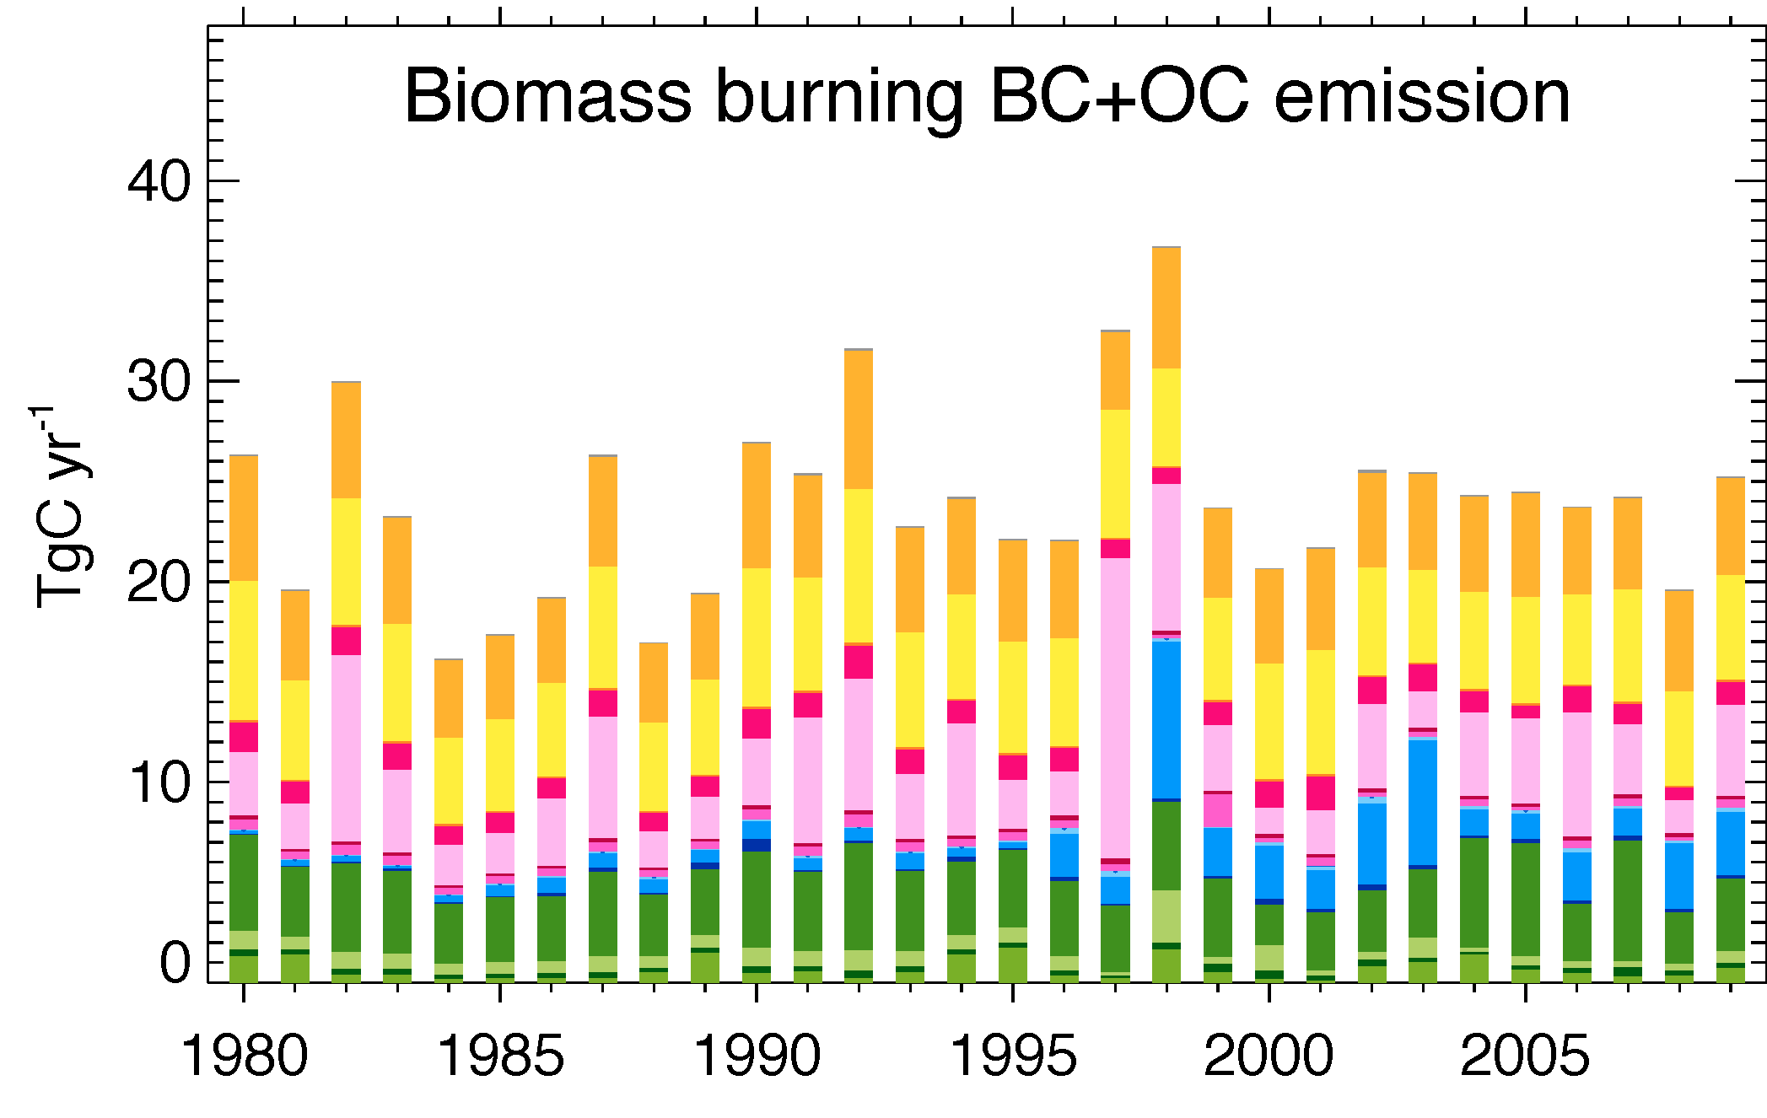
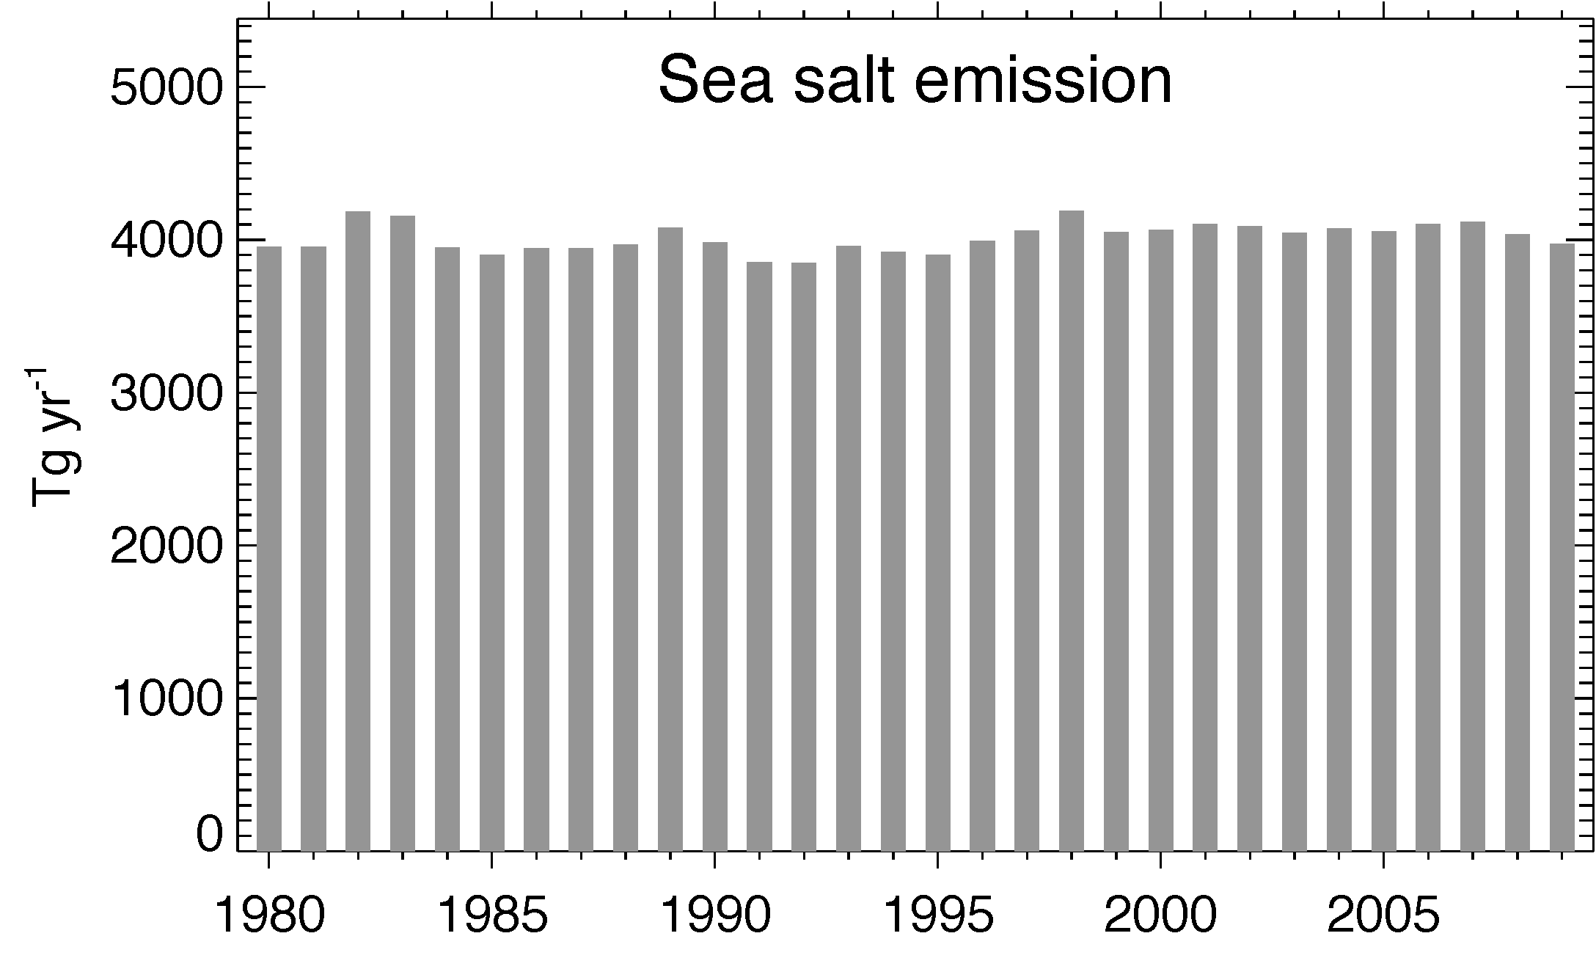
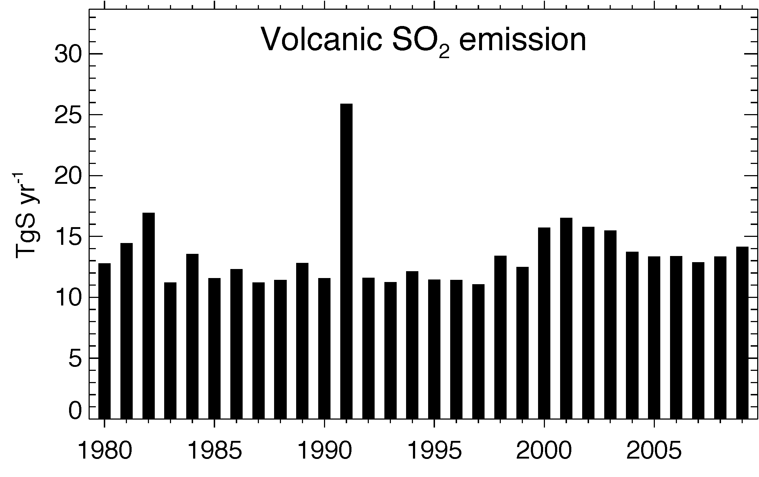
Emissions 1980-2009
Anthropogenic emission:
Decreased over North America and Europe, increased over Asia and other regions
Biomass burning and natural emissions:
Varying from year to year and place to place
EAS
EUR
USA

Slide 7
Regional AOD trends – from satellites and GOCART
Satellite data | Abbr. | Spatial Coverage | Period used | Reference
TOMS | TOMS | Land + ocean | 1980-2001 | Torres et al., 2002
AVHRR – NOAA PATMOSx | AVH-n | Ocean | 1981-2004 | Zhao et al., 2004
AVHRR – GISS GACP | AVH-g | Ocean | 1981-2006 | Mishchenko et al., 2007
SeaWiFS | SeaW | Land + ocean | 1997-2009 | Hsu et al., 2012; Sayer et al., 2012
MISR | MISR | Land + ocean | 2000-2009 | Kahn et al., 2010, etc.
MODIS-Terra (including DB) | MOD-t | Land + ocean | 2000-2009 | Remer et al., 2008; Levy et al., 2010
MODIS-Aqua (including DB) | MOD-a | Land + ocean | 2002-2008 | Remer et al., 2008; Levy et al., 2010

Slide 8
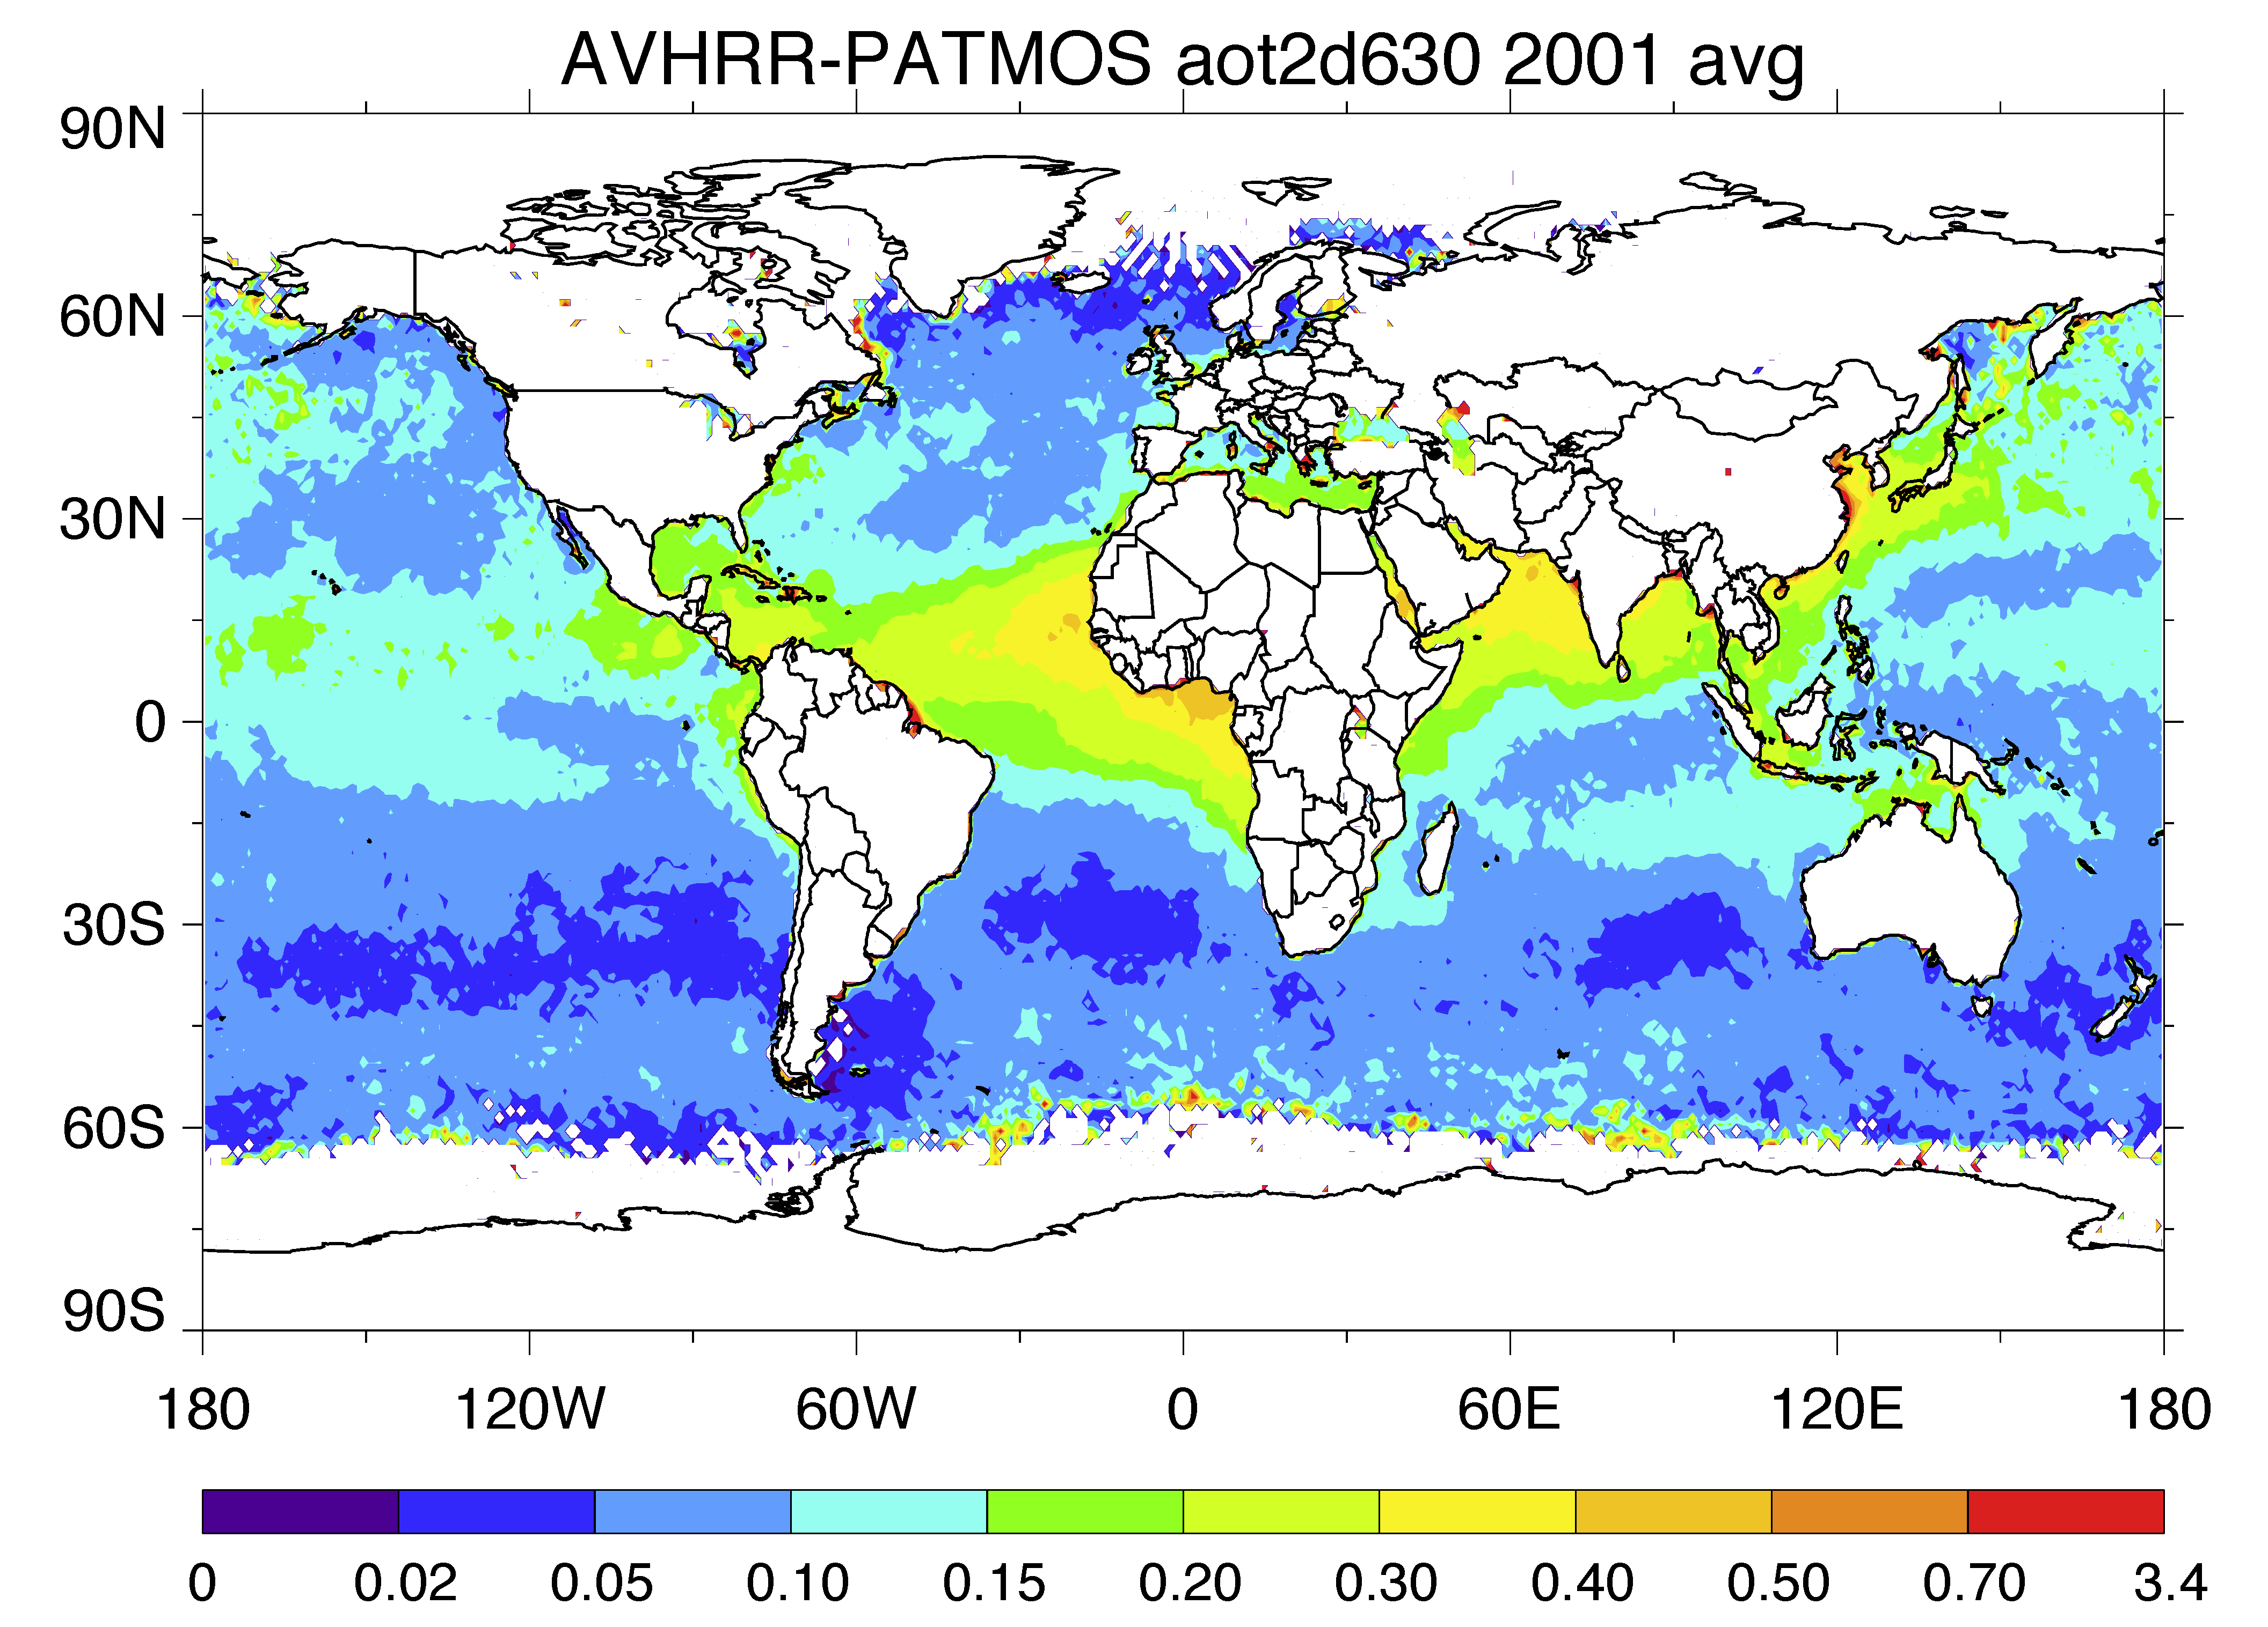
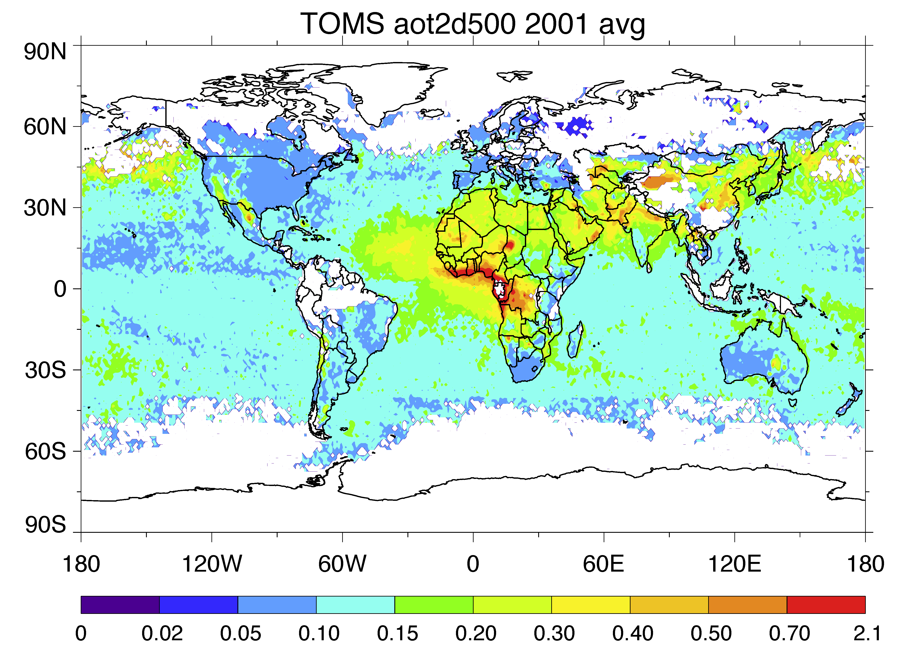
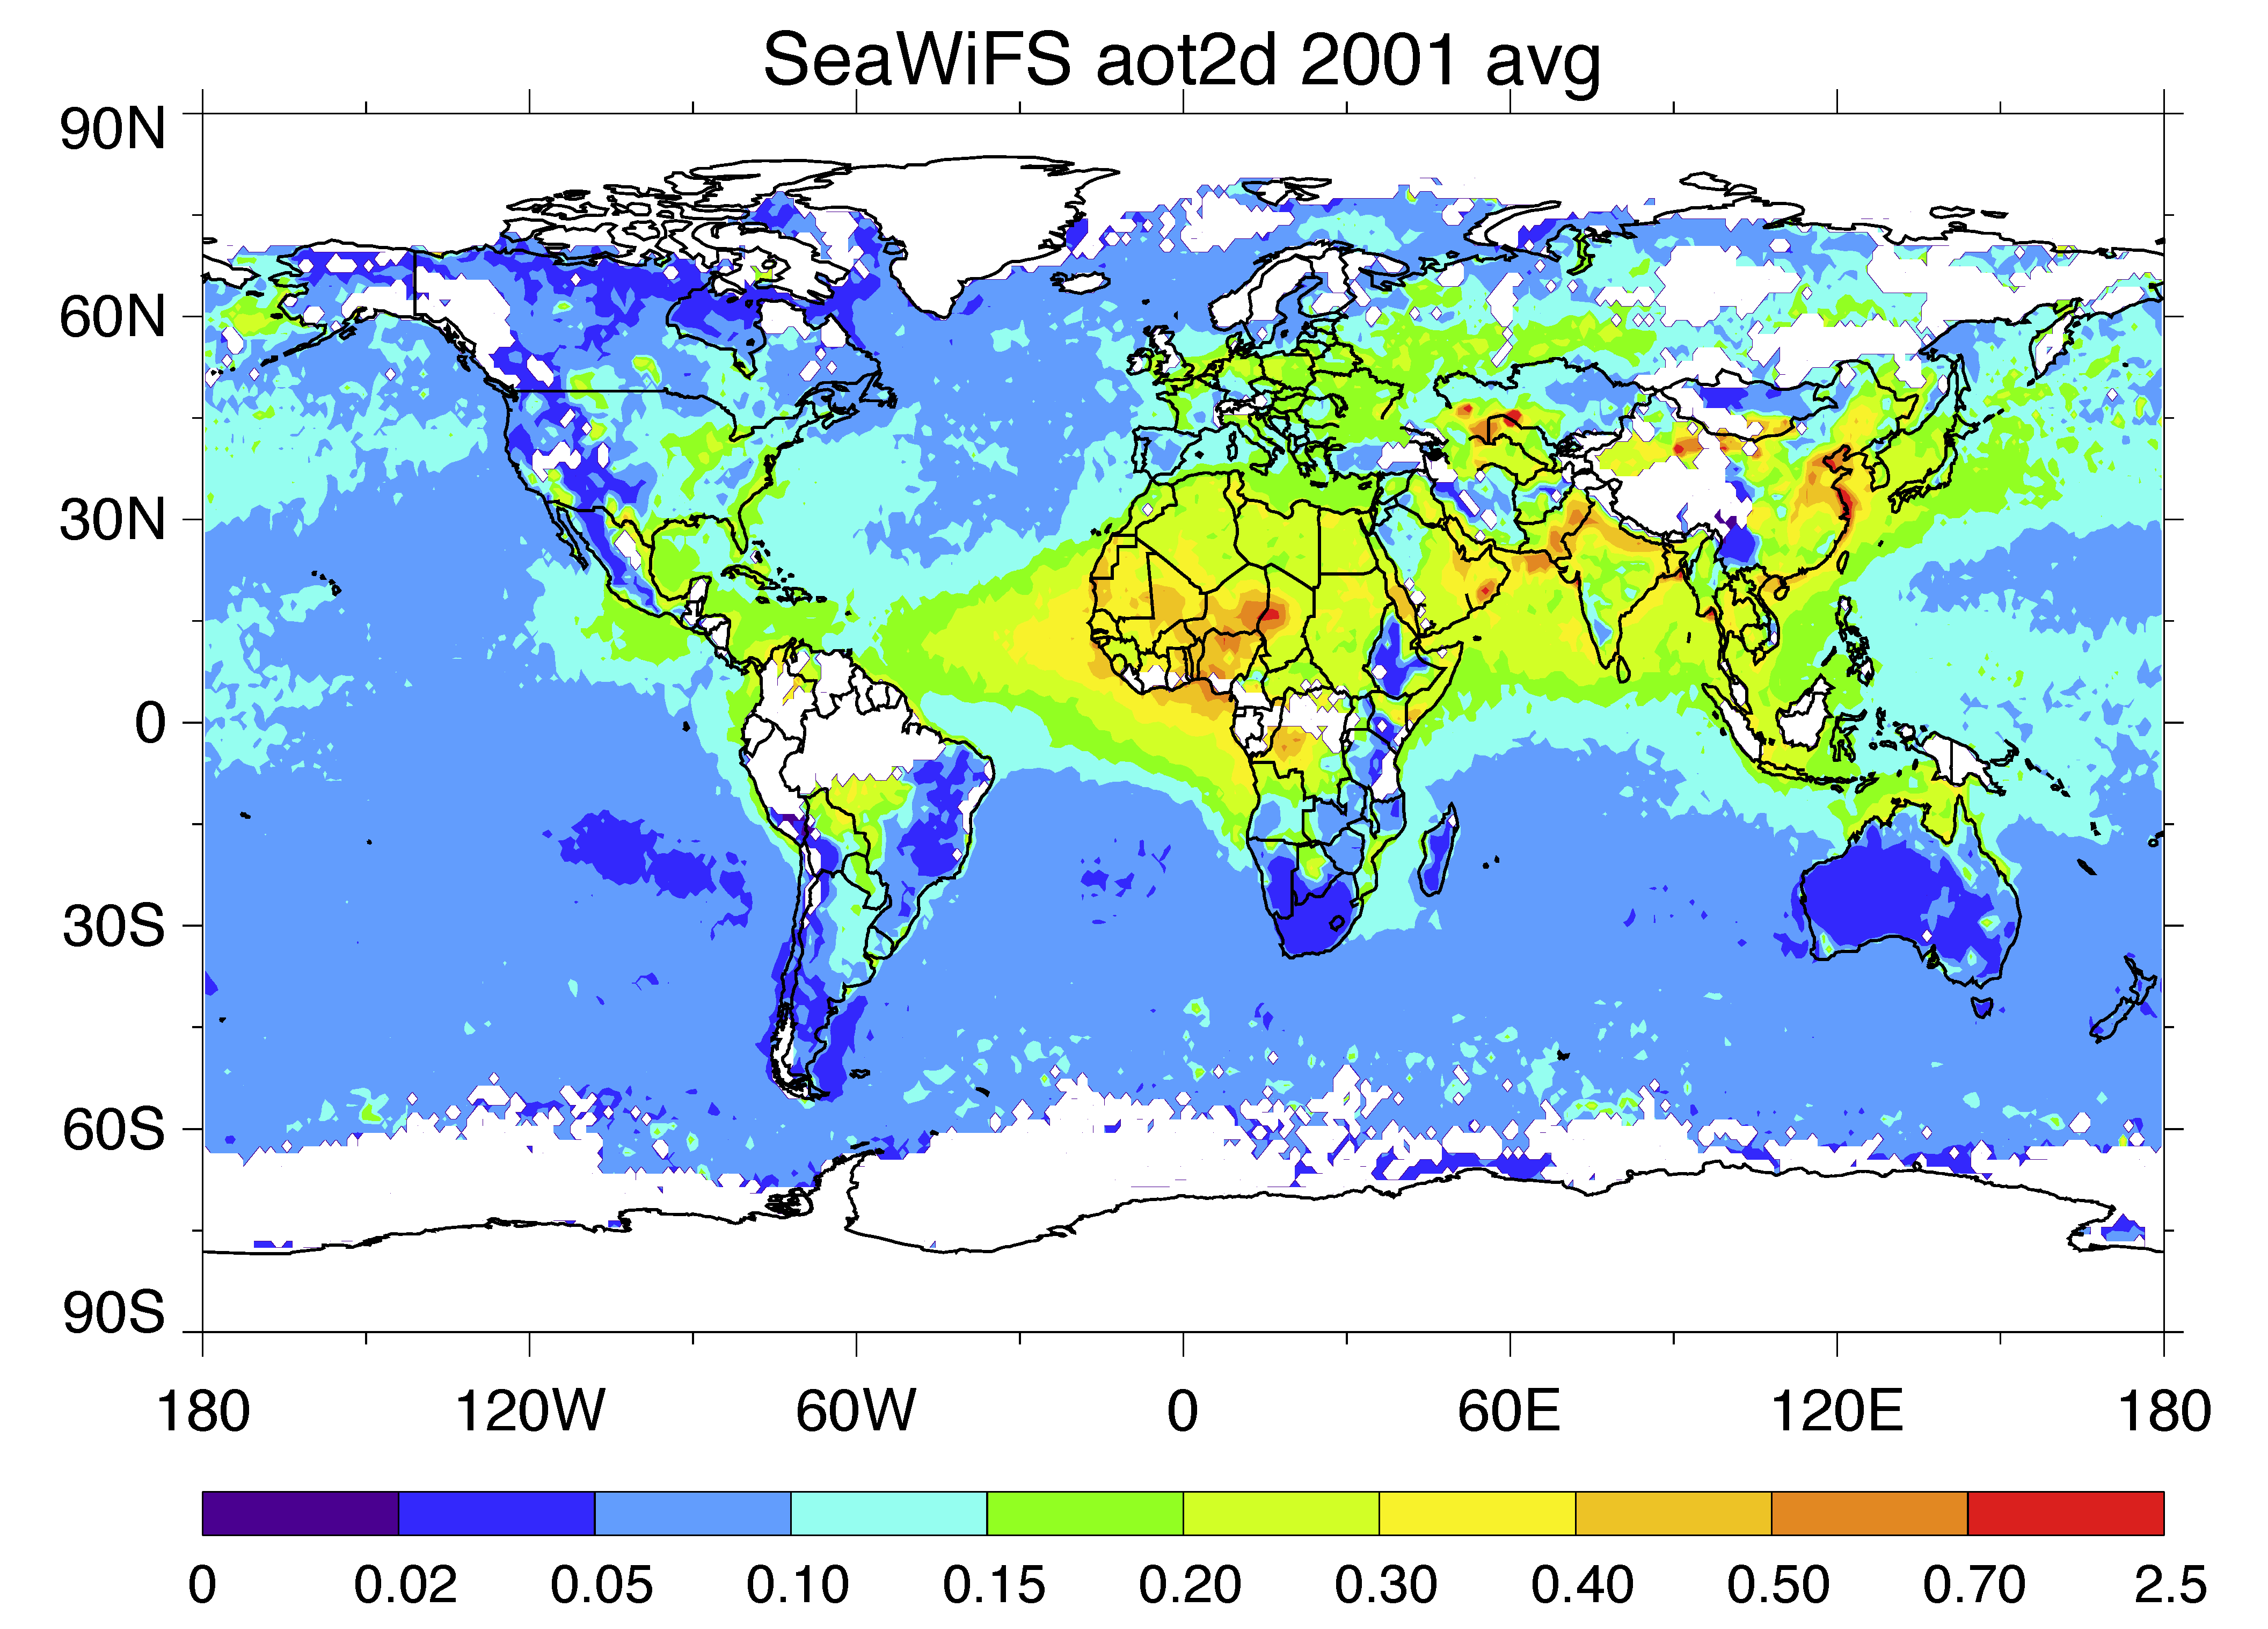
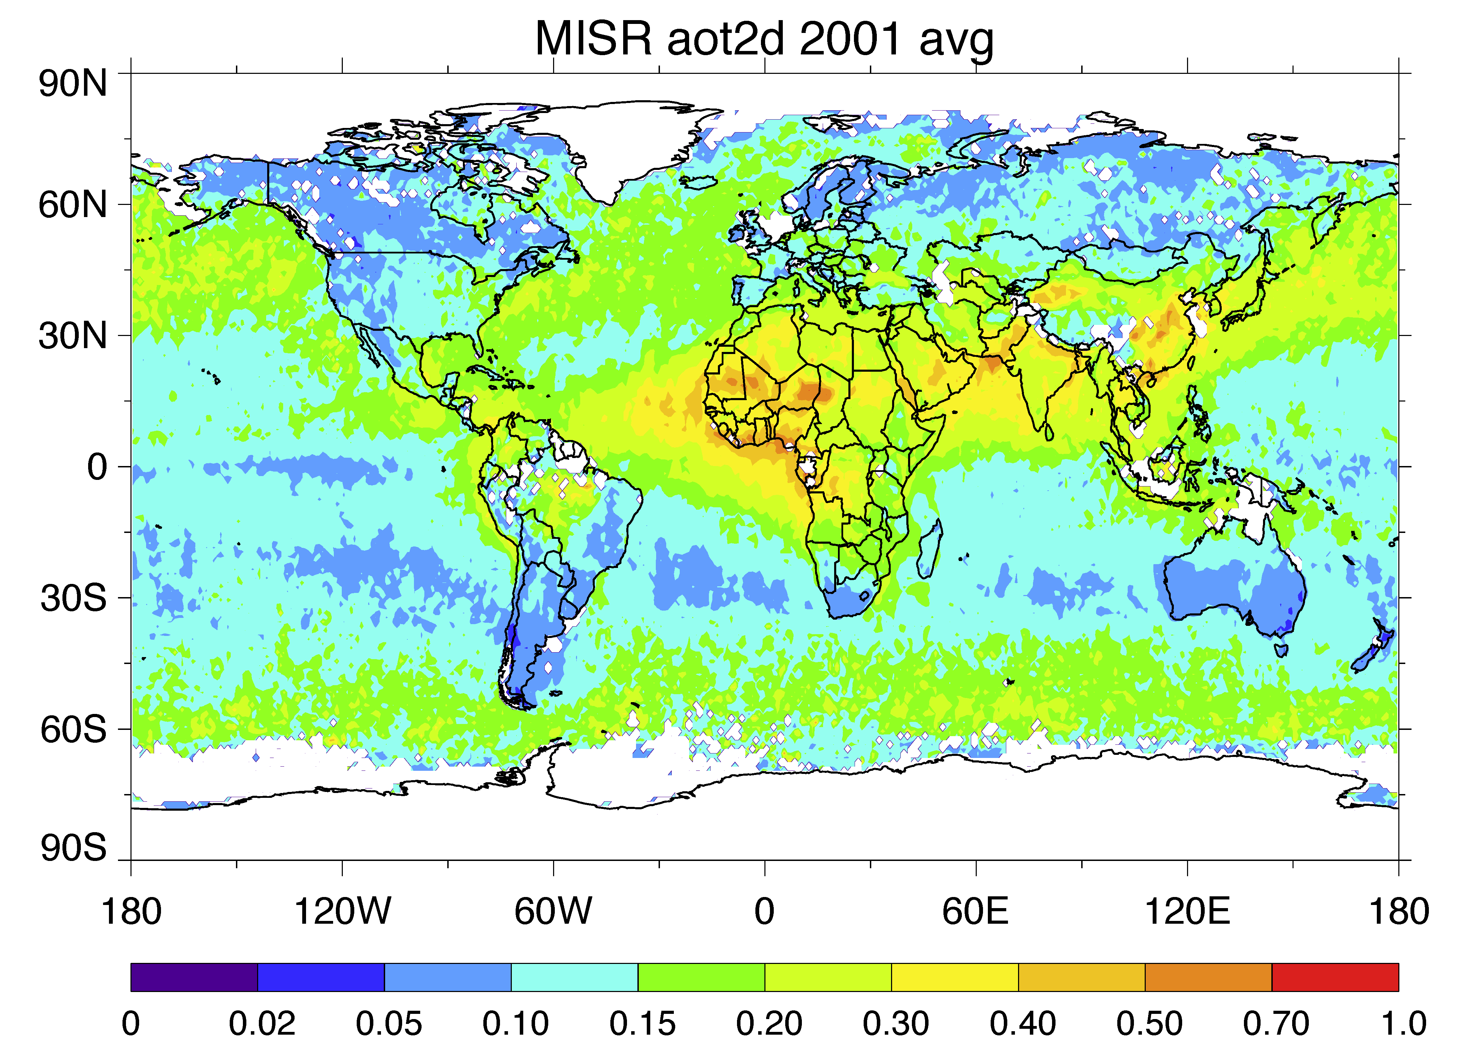
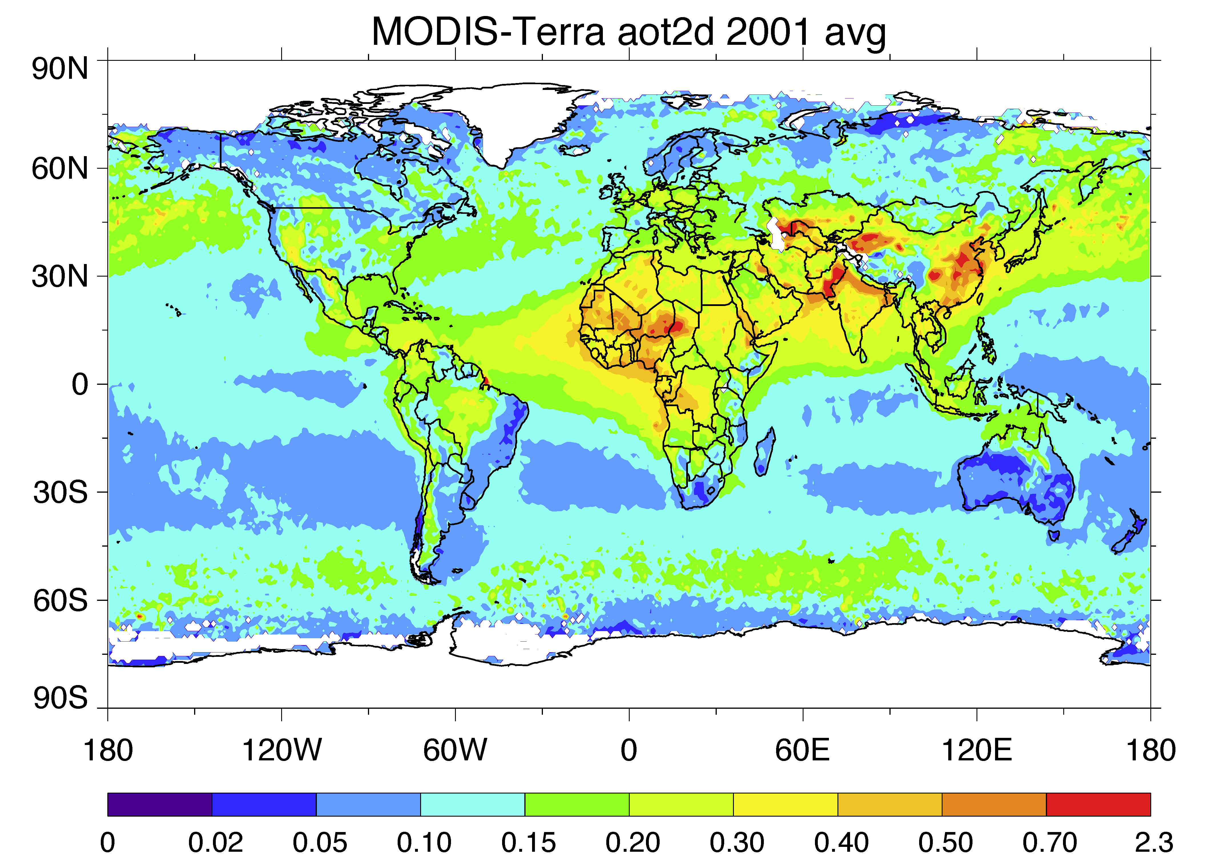
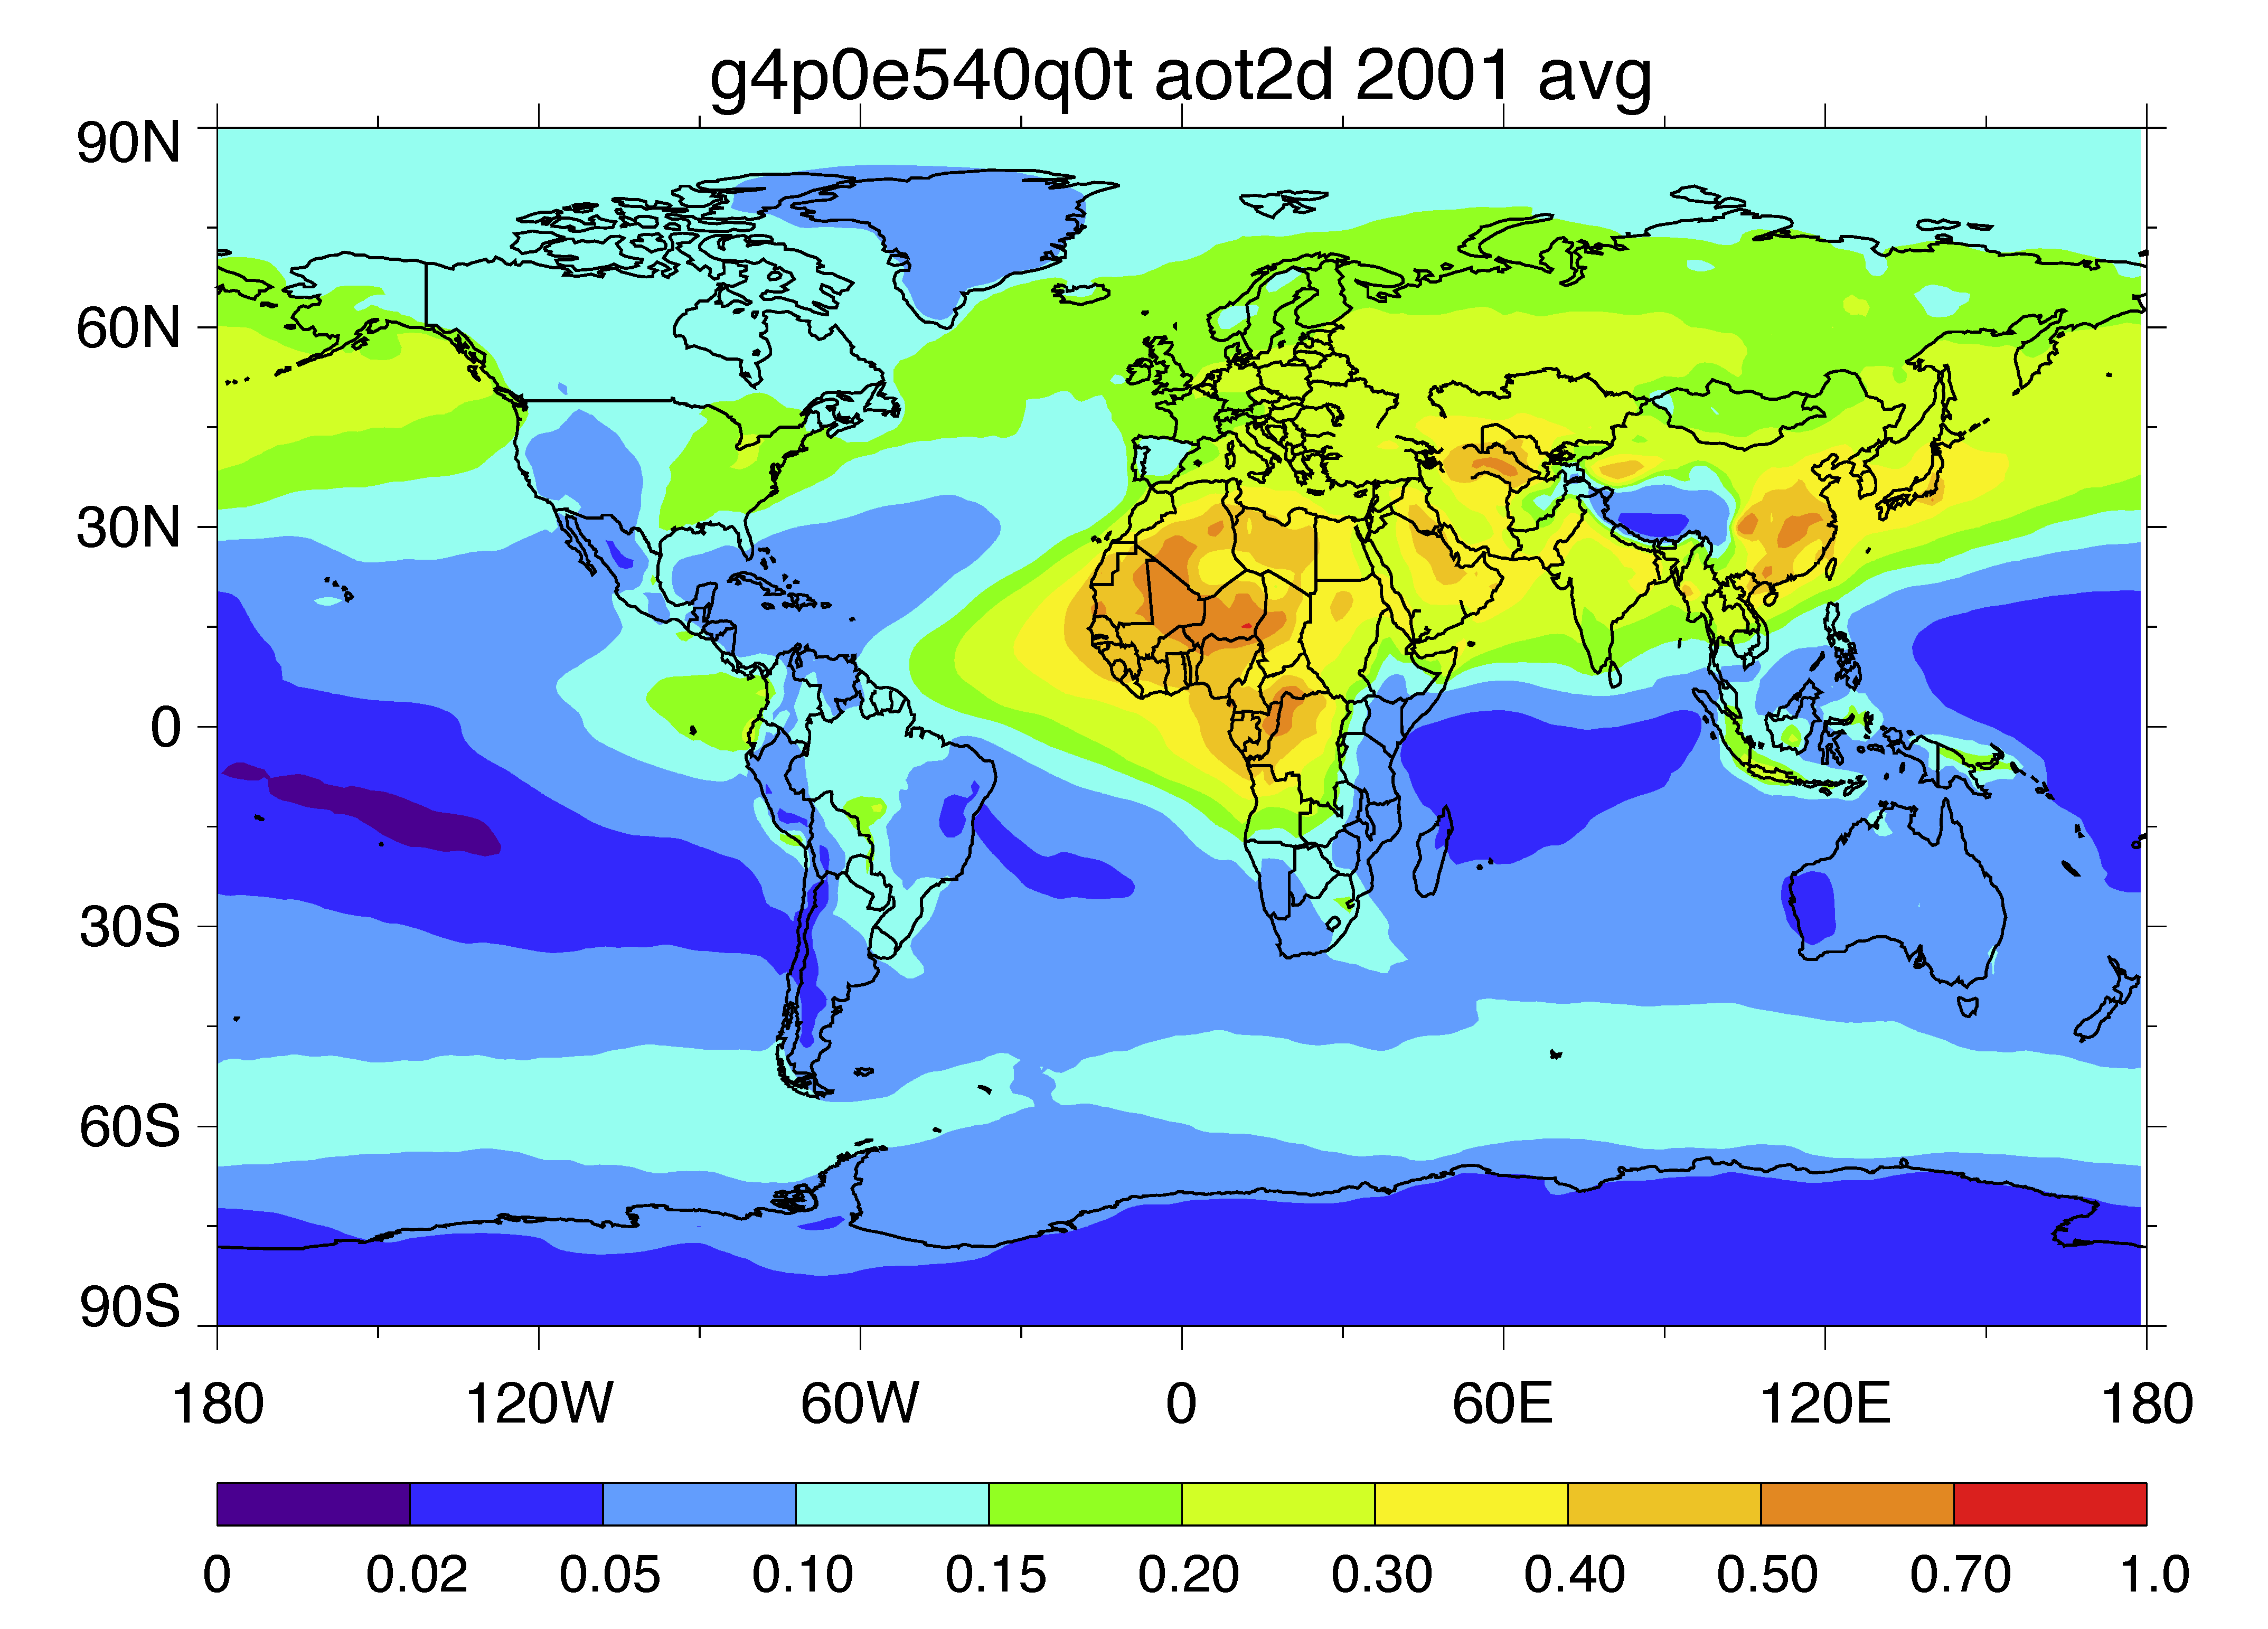
Global distribution of AOD (2001) from satellites and GOCART
AVHRR-PATMOSx 2001
TOMS 2001
SeaWiFS 2001
Available 1981-2005
Available 1979-2001
Available 1997-2010
MISR 2001
MODIS-Terra 2001
GOCART 2001
Available 2000-present
Available 2000-present
Available 1980-2009

Slide 9
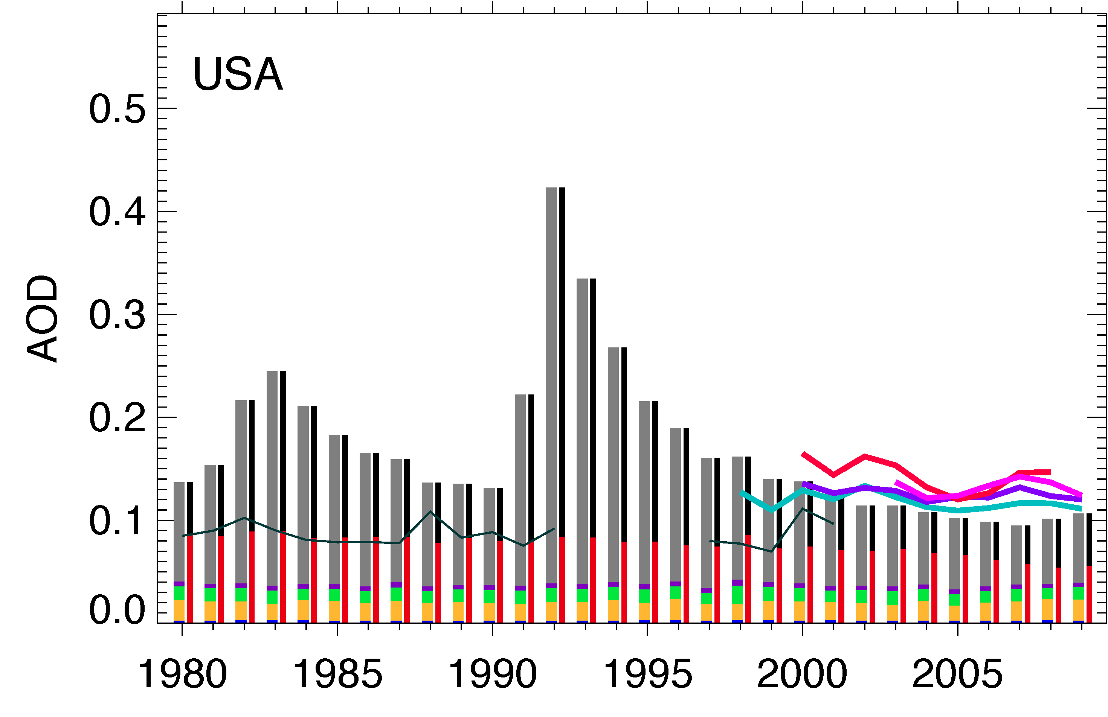
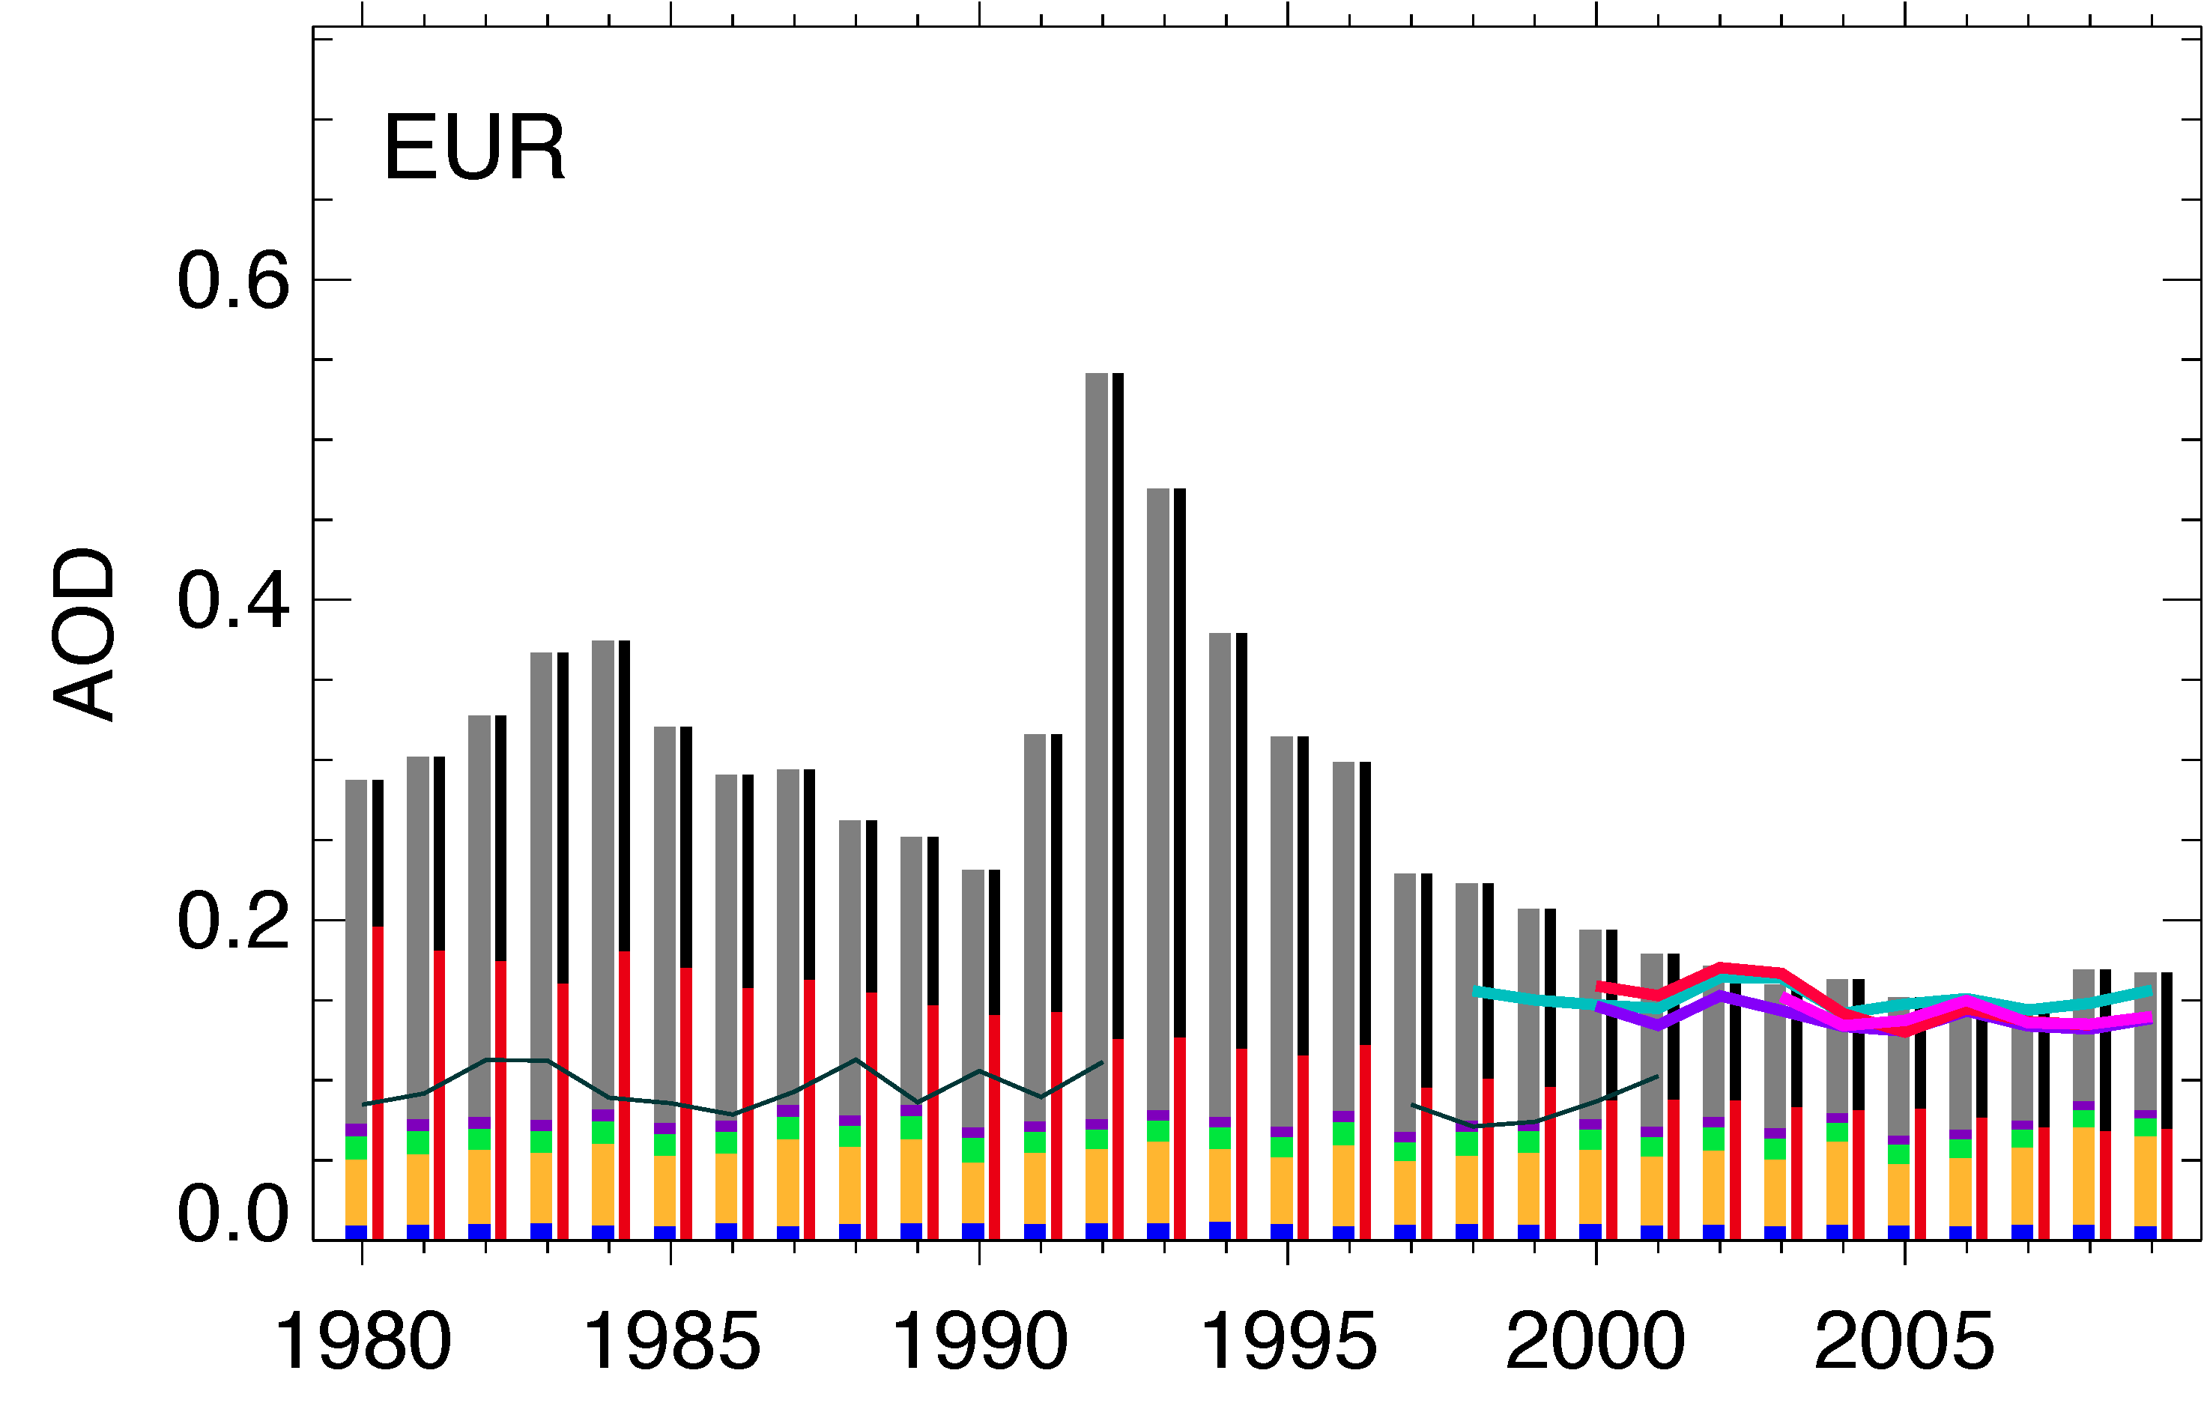
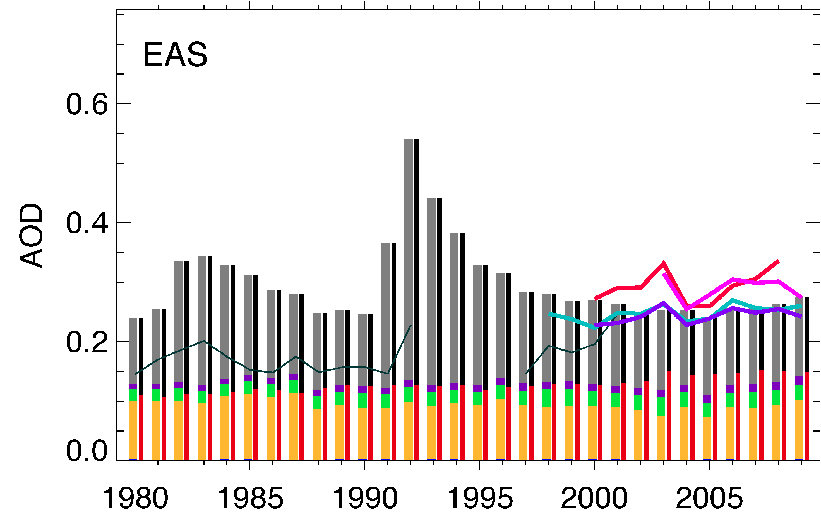
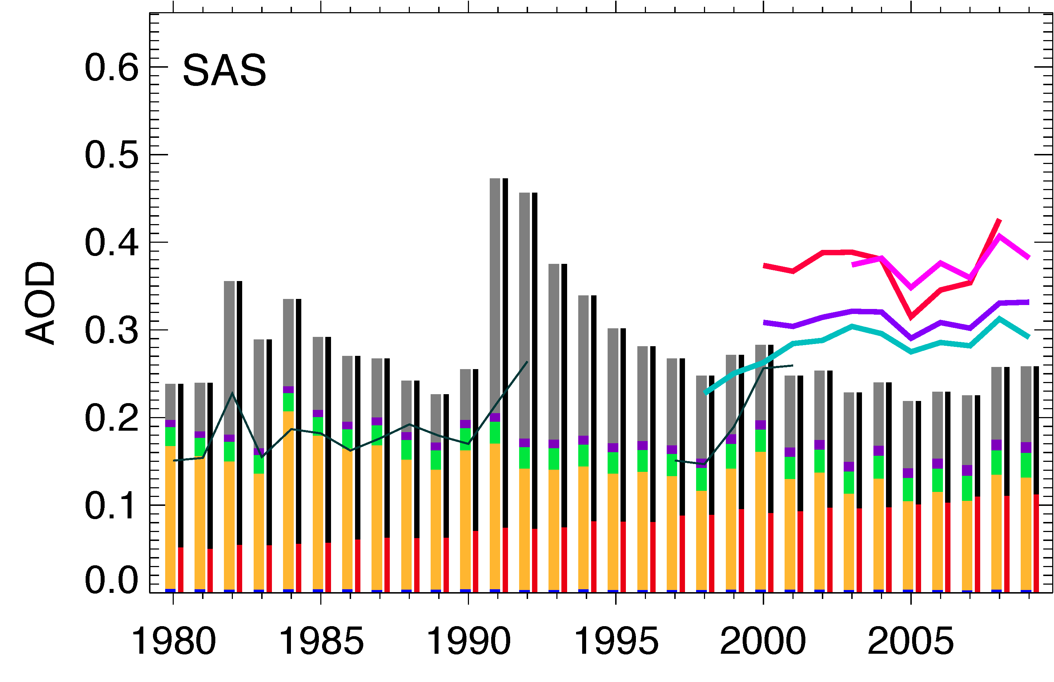
Regional AOD trends over land – USA, Europe, East Asia, South Asia
USA and Europe:
Anthropogenic decrease
Overall decrease
East Asia:
Anthro increase
Overall increase
South Asia:
Anthro increase
Dust decrease
Overall some increase
TOMS
AVHRR-PATMOS
AVHRR-GACP
SeaWiFS
MODIS-Terra
MODIS-Aqua
MISR
GOCART
SS DU OM BC SU
AN+BB Natural

Slide 10
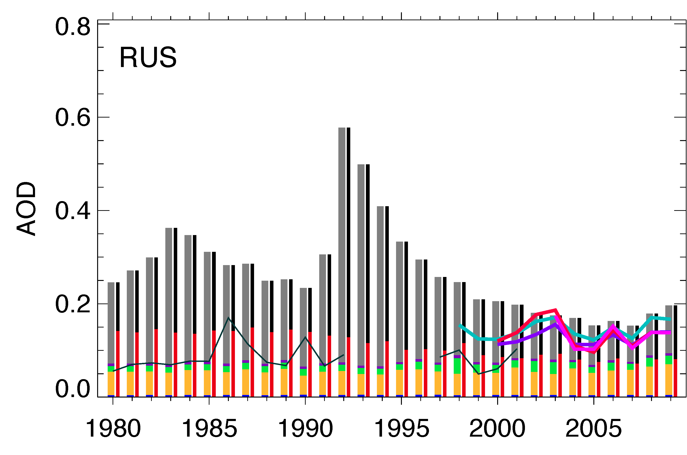
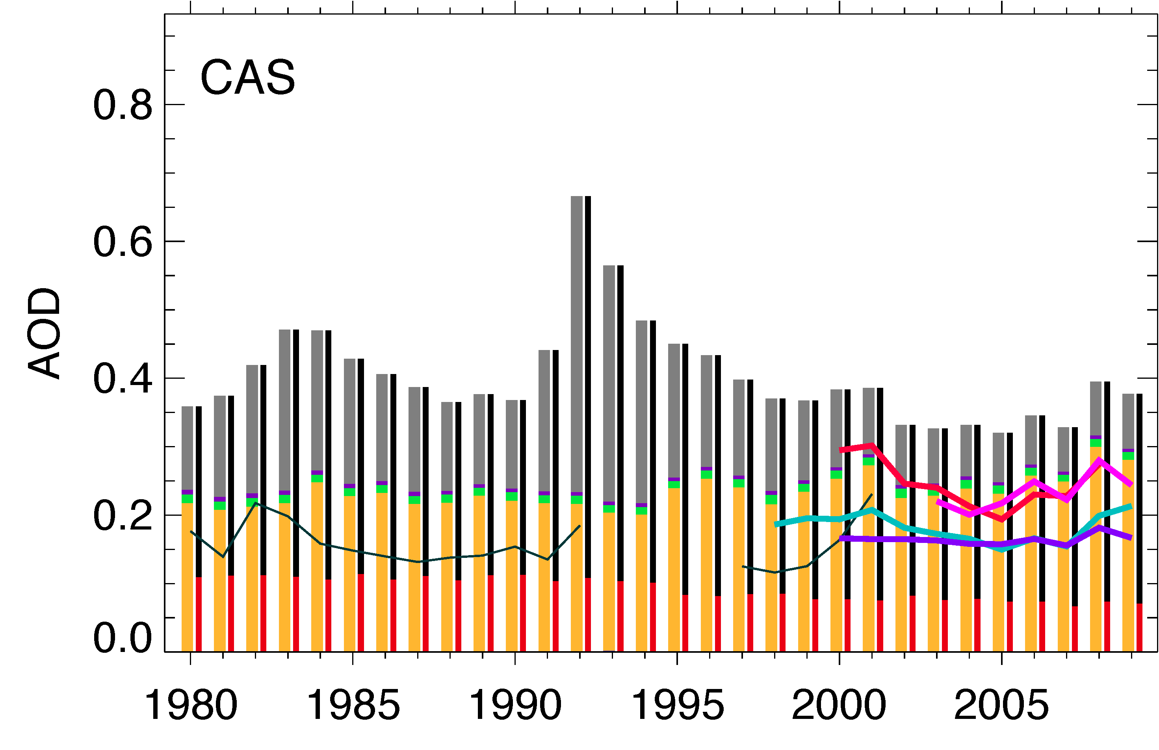
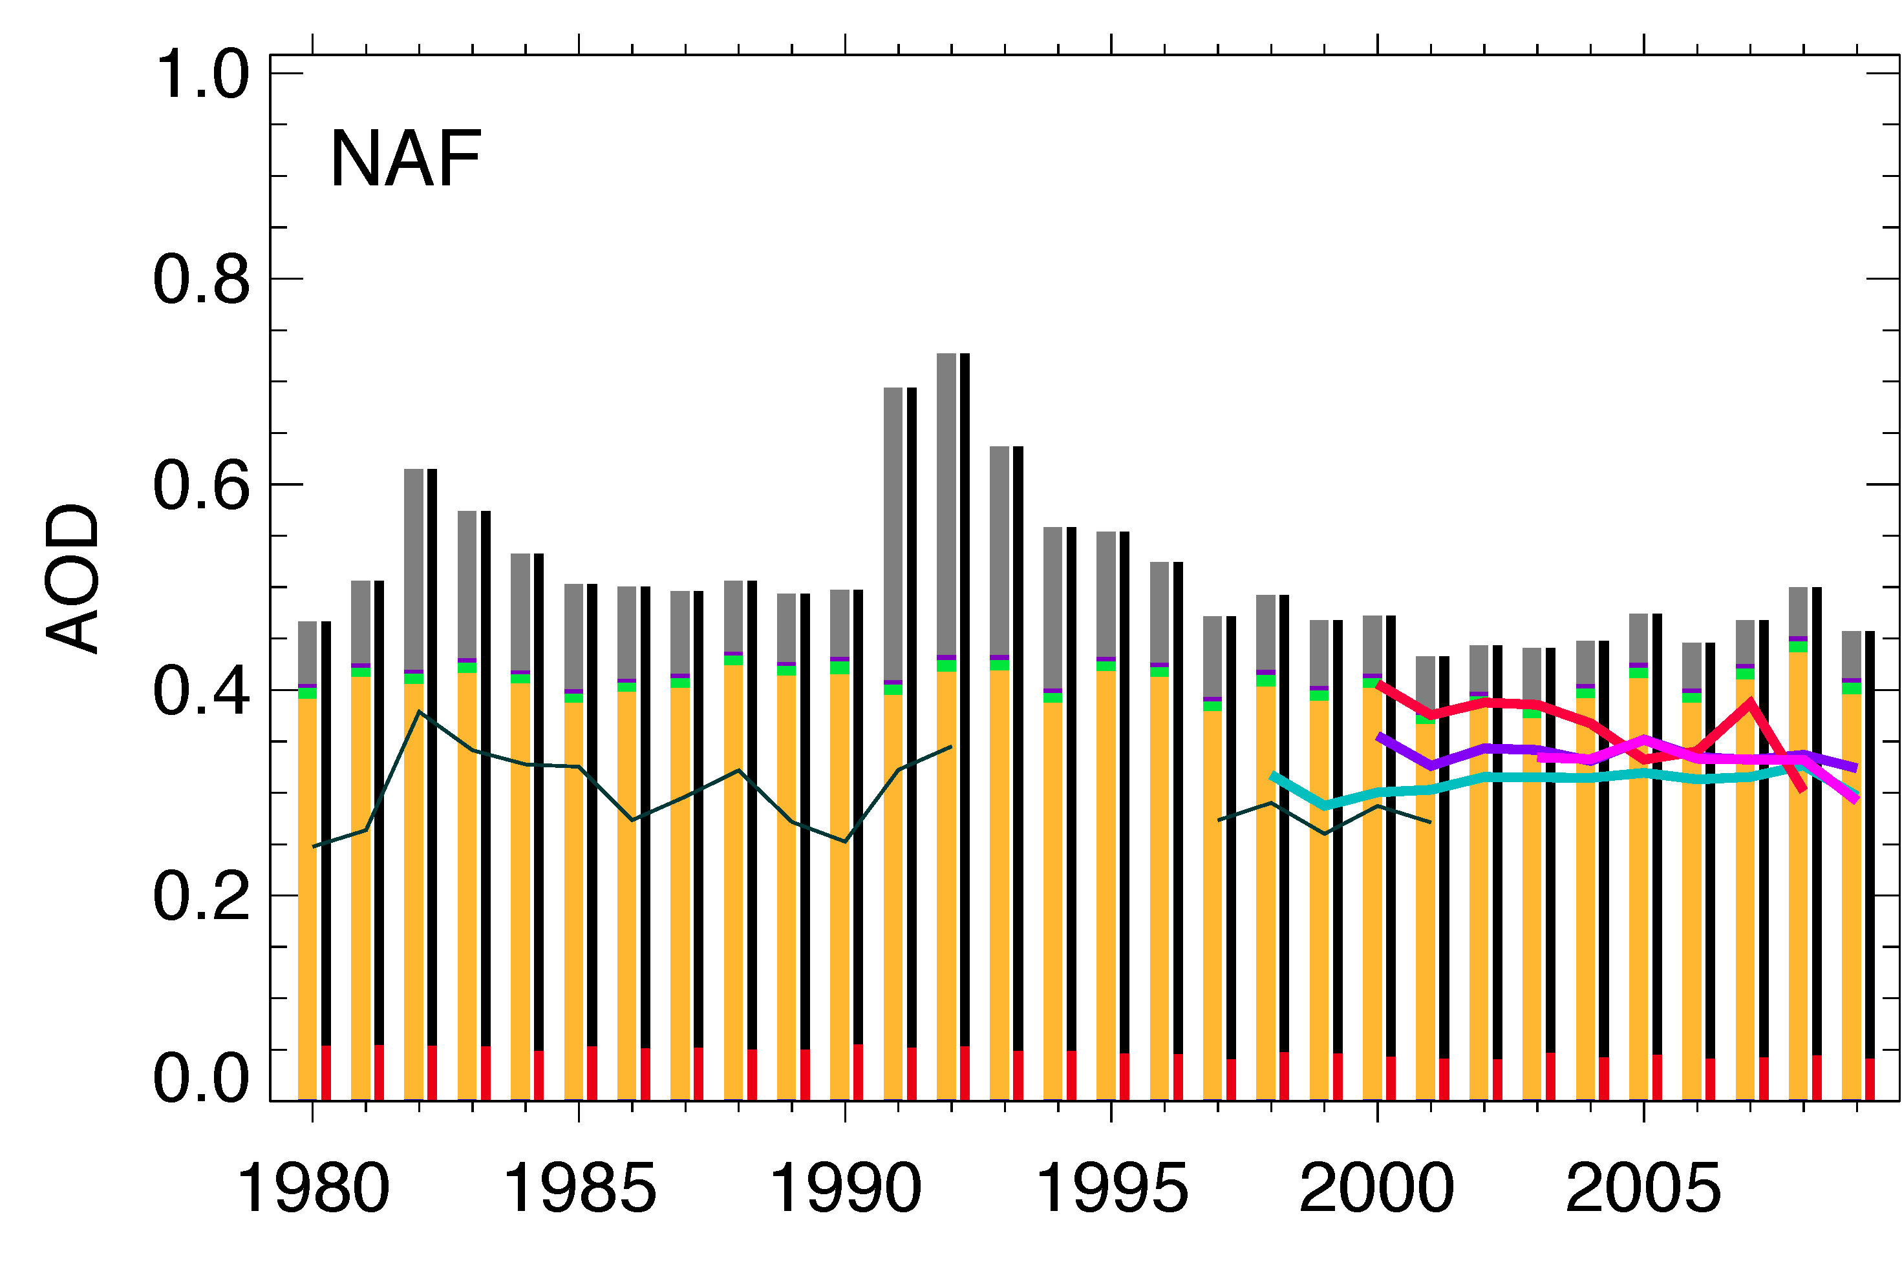
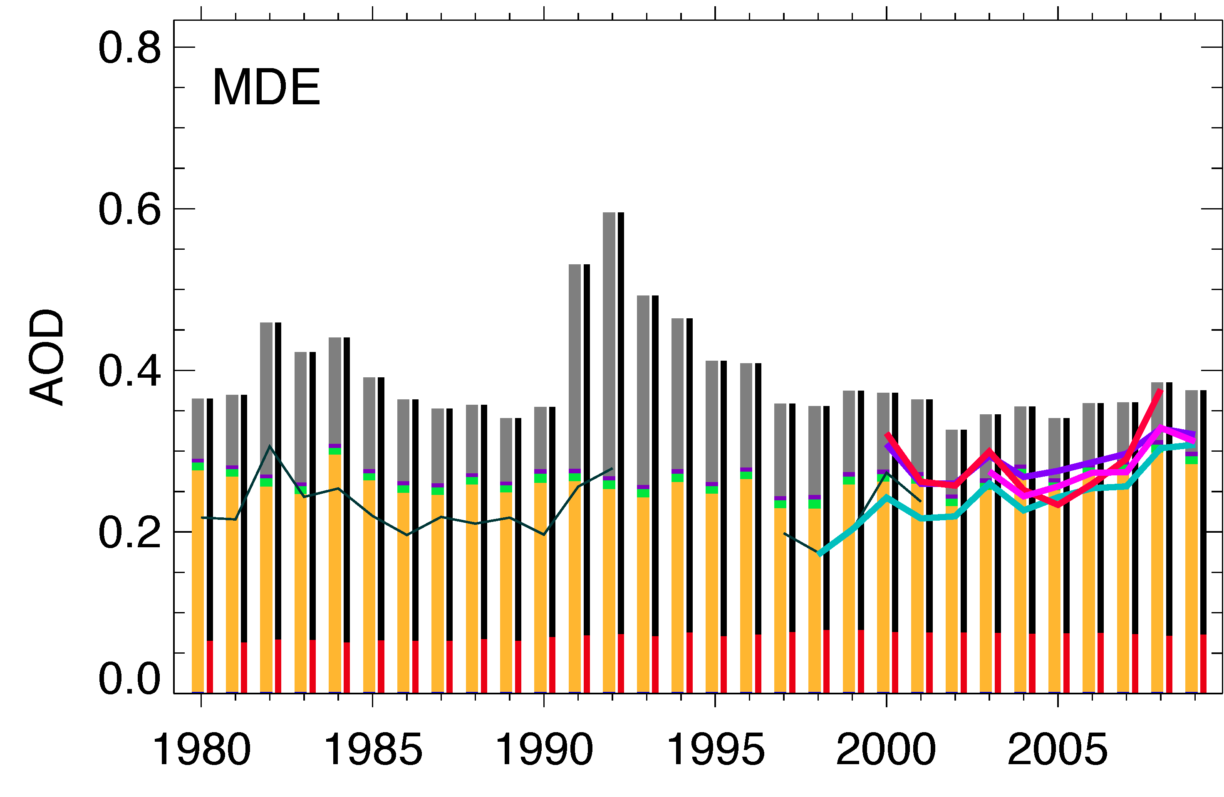
Regional AOD trends over land – Russia, Central Asia, N Africa, Middle East
Russia:
Anthropogenic decrease
Overall decrease
Central Asia:
Anthropogenic decrease
Dust increase
Overall some decrease
North Africa:
Dust and antrho some decrease
Overall decrease
Middle East:
Dust increase
Overall increase
TOMS
AVHRR-PATMOS
AVHRR-GACP
SeaWiFS
MODIS-Terra
MODIS-Aqua
MISR
GOCART
SS DU OM BC SU
AN+BB Natural

Slide 11
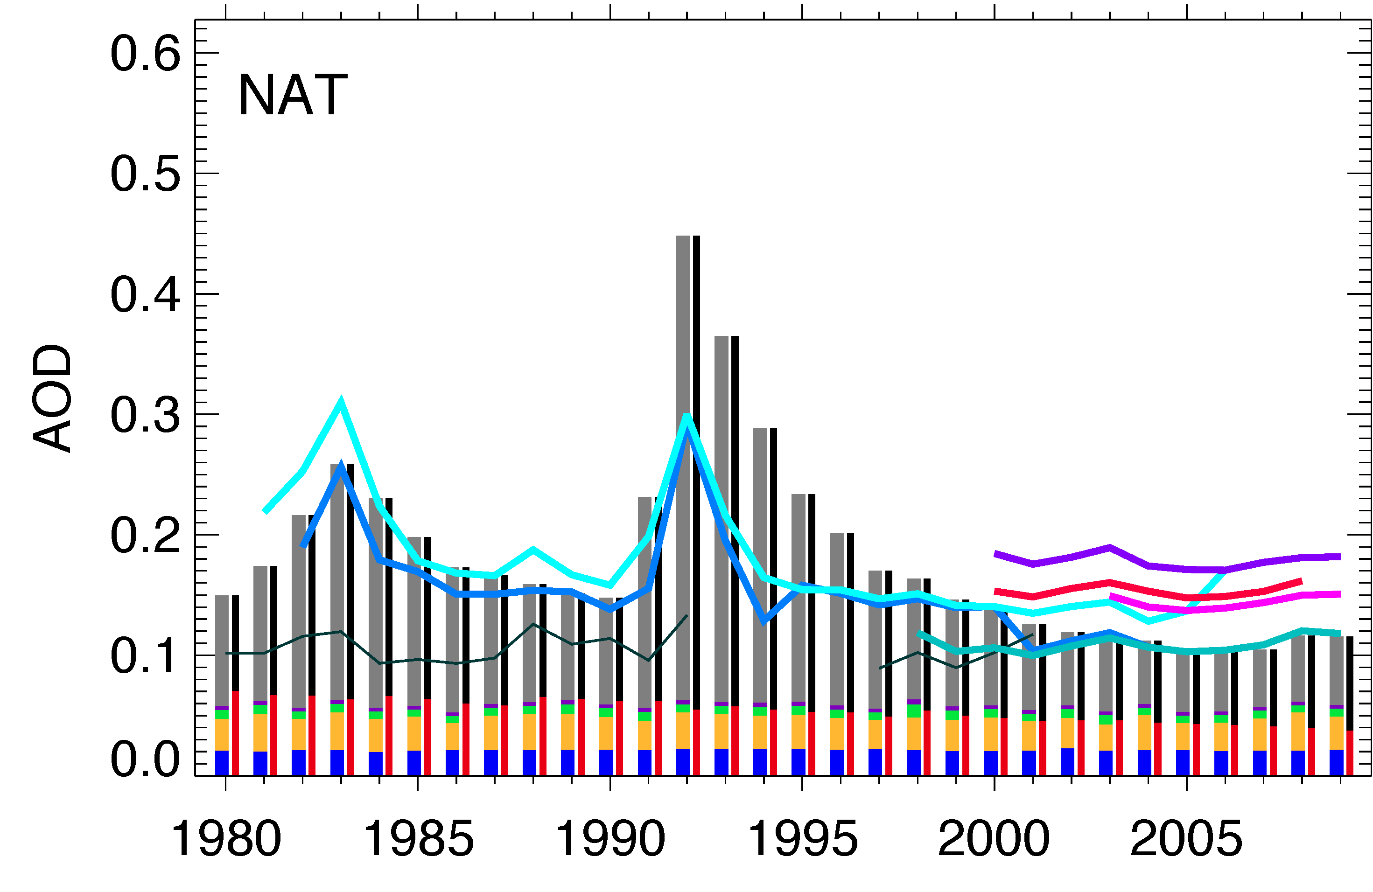
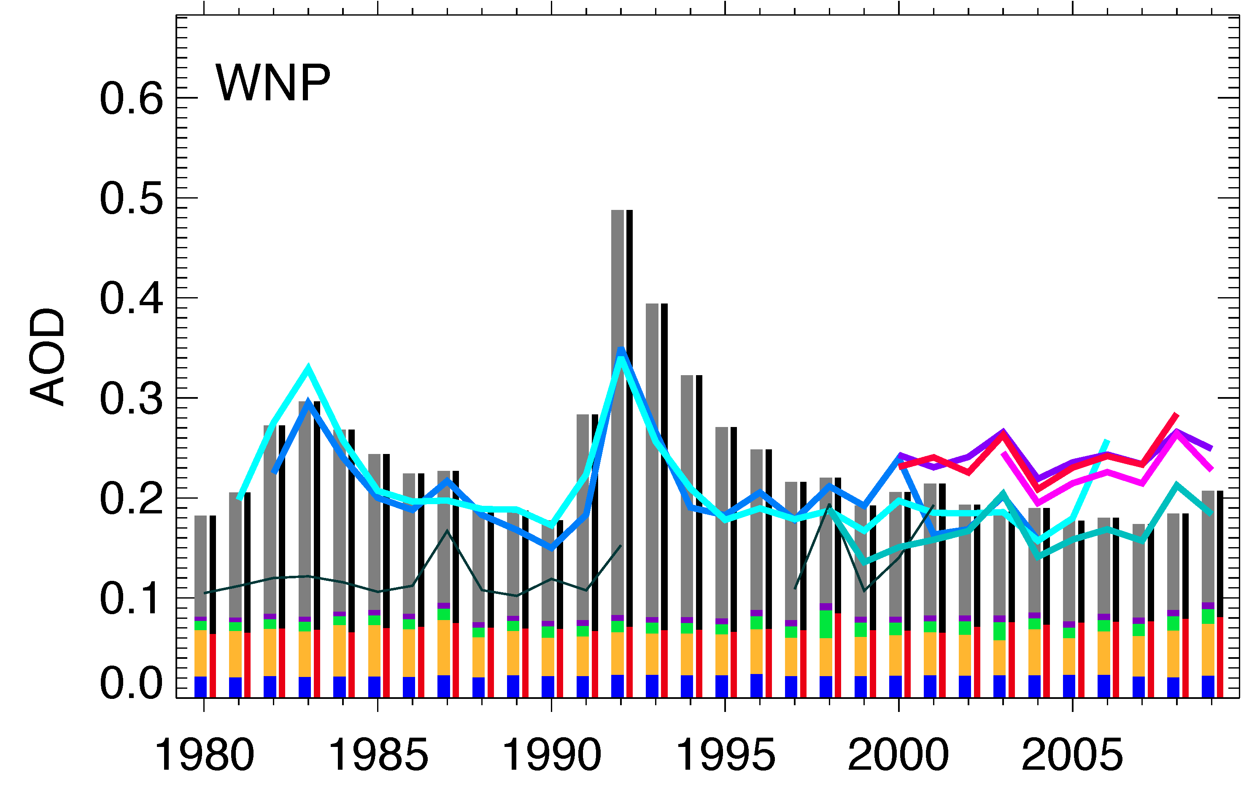
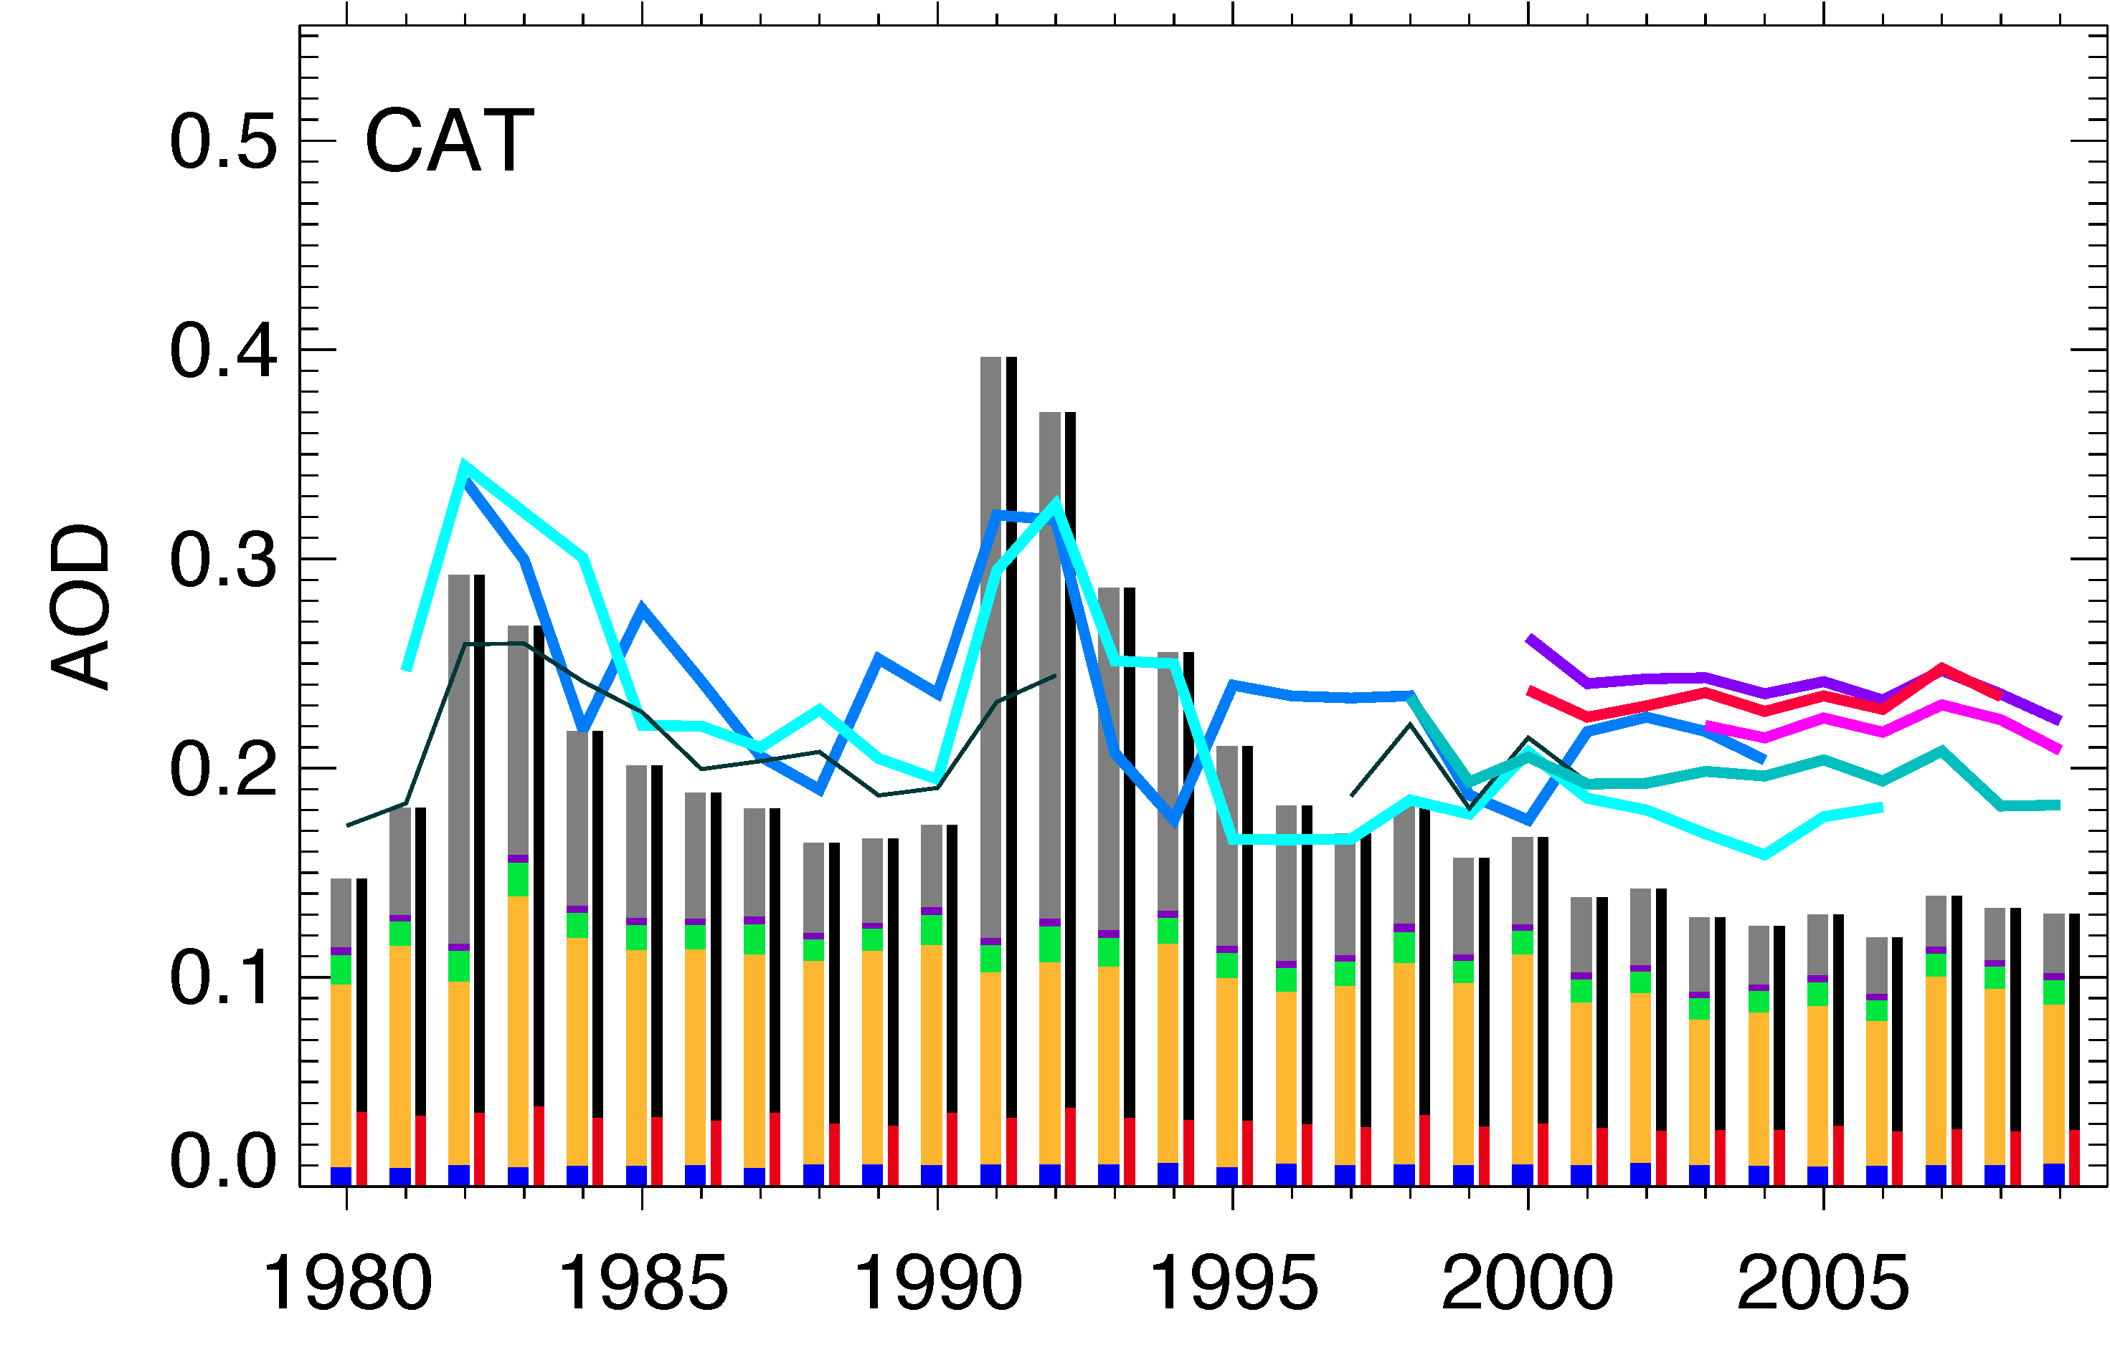
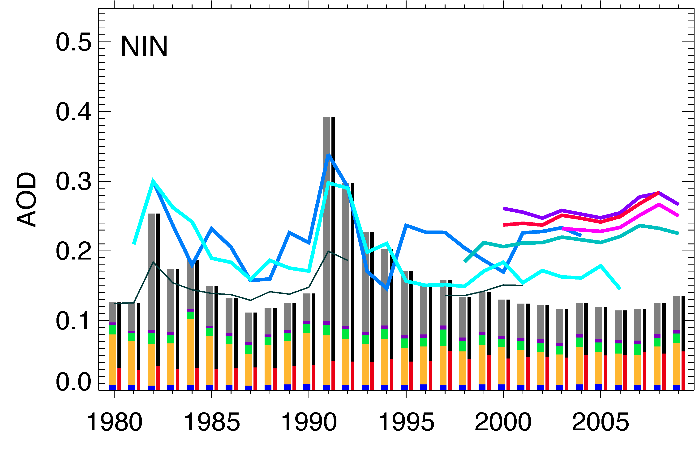
Regional AOD trends over ocean – N Atlantic, NW Pacific, C Atlantic, N Indian
Northern N Atlantic:
Overall decrease
Western N Pacific:
Anthro increase
Overall increase
Central N Atlantic:
Dust decrease
Overall increase
N Indian:
Anthro increase
Dust decrease
Overall increase
Model is much lower than satellites in CAT and NIN
TOMS
AVHRR-PATMOS
AVHRR-GACP
SeaWiFS
MODIS-Terra
MODIS-Aqua
MISR
GOCART
SS DU OM BC SU
AN+BB Natural

Slide 12
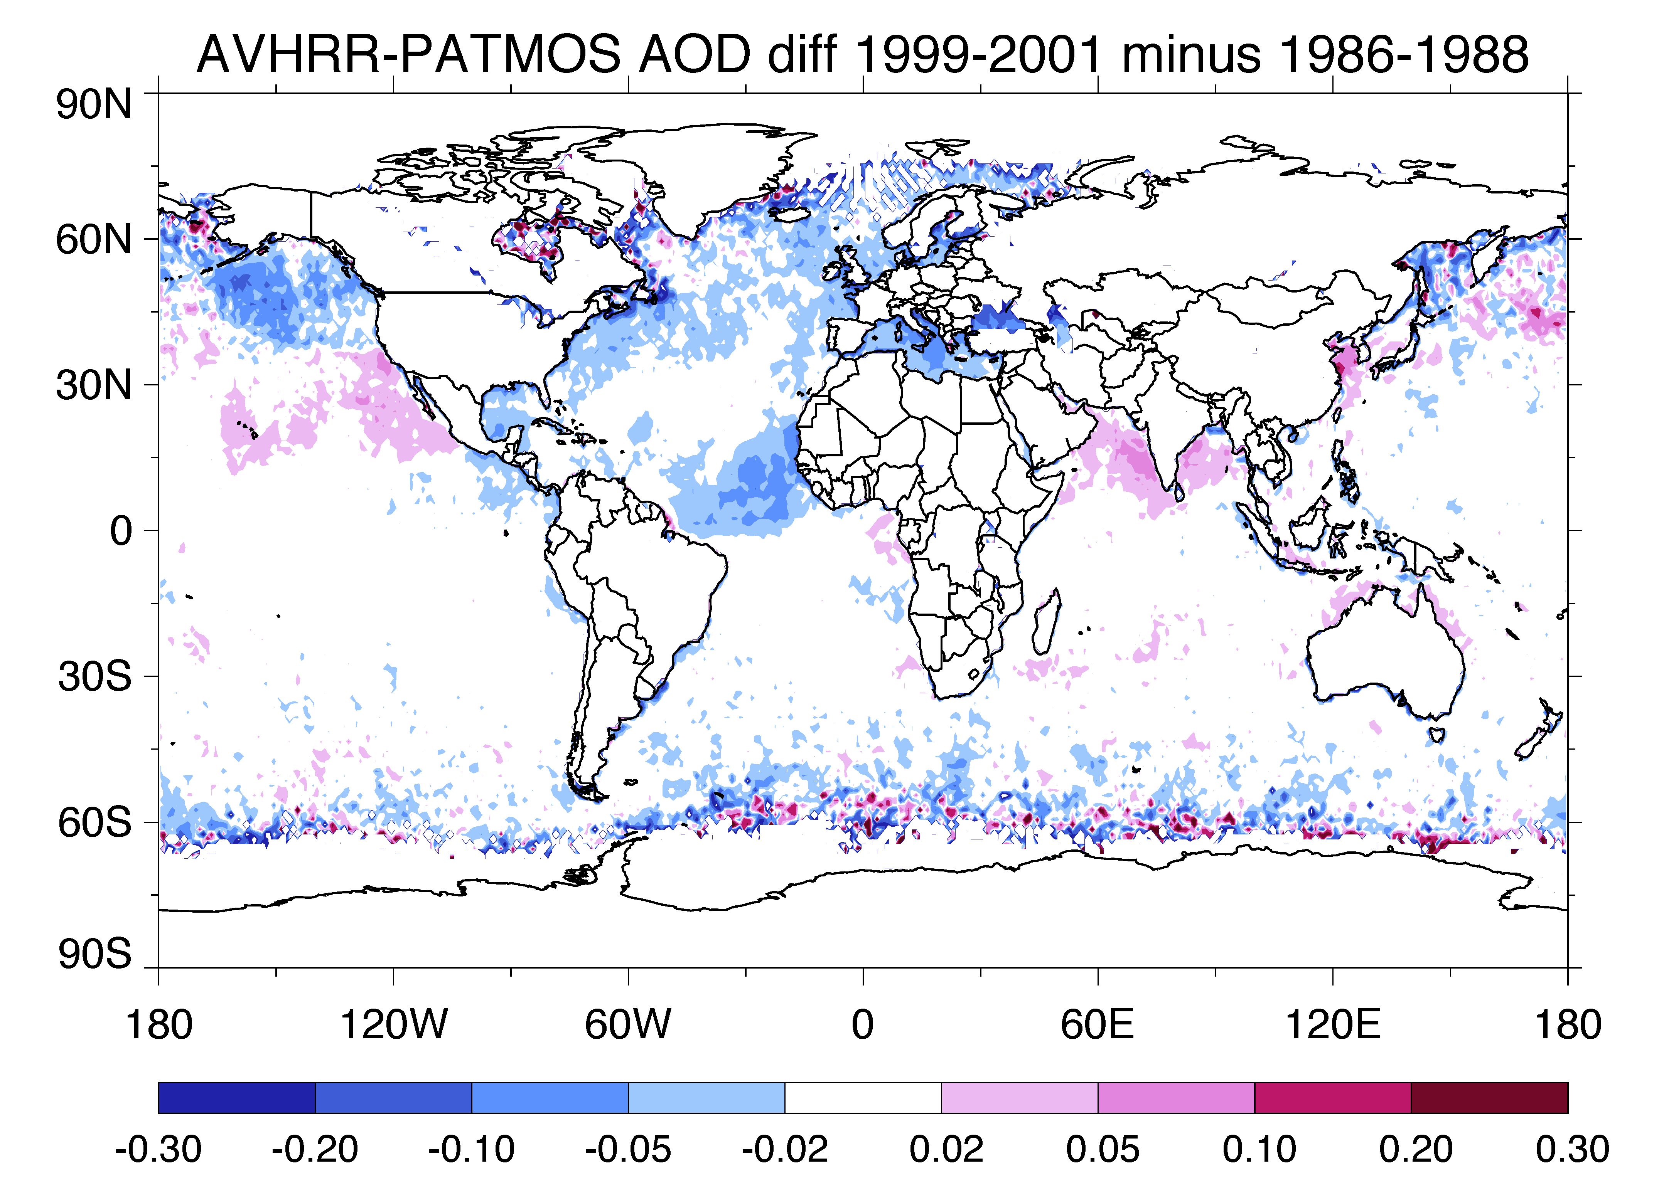
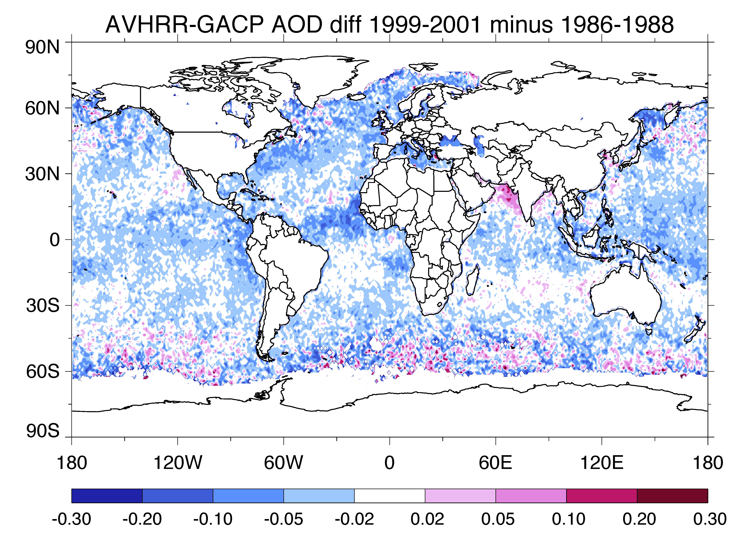
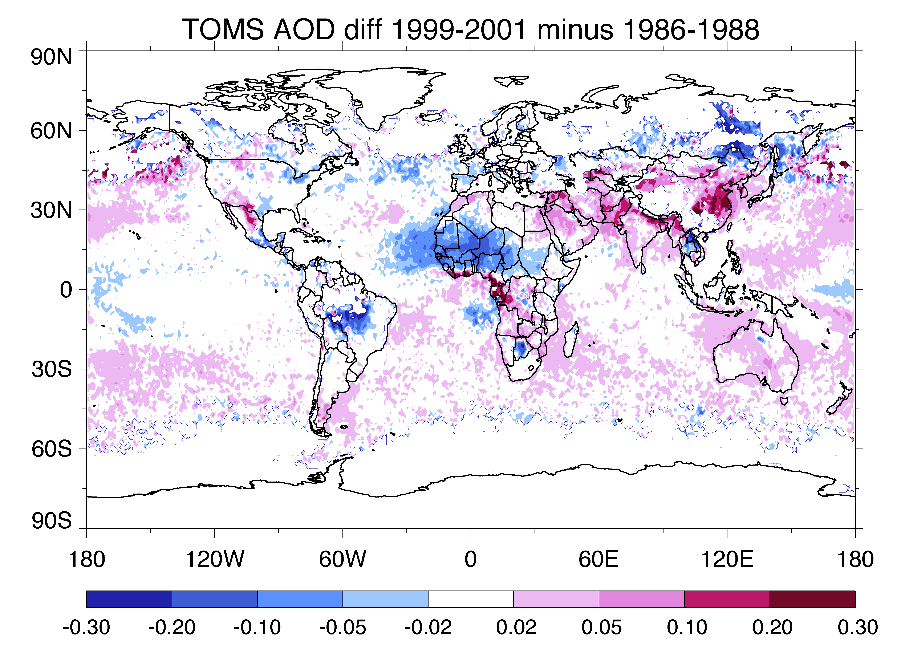
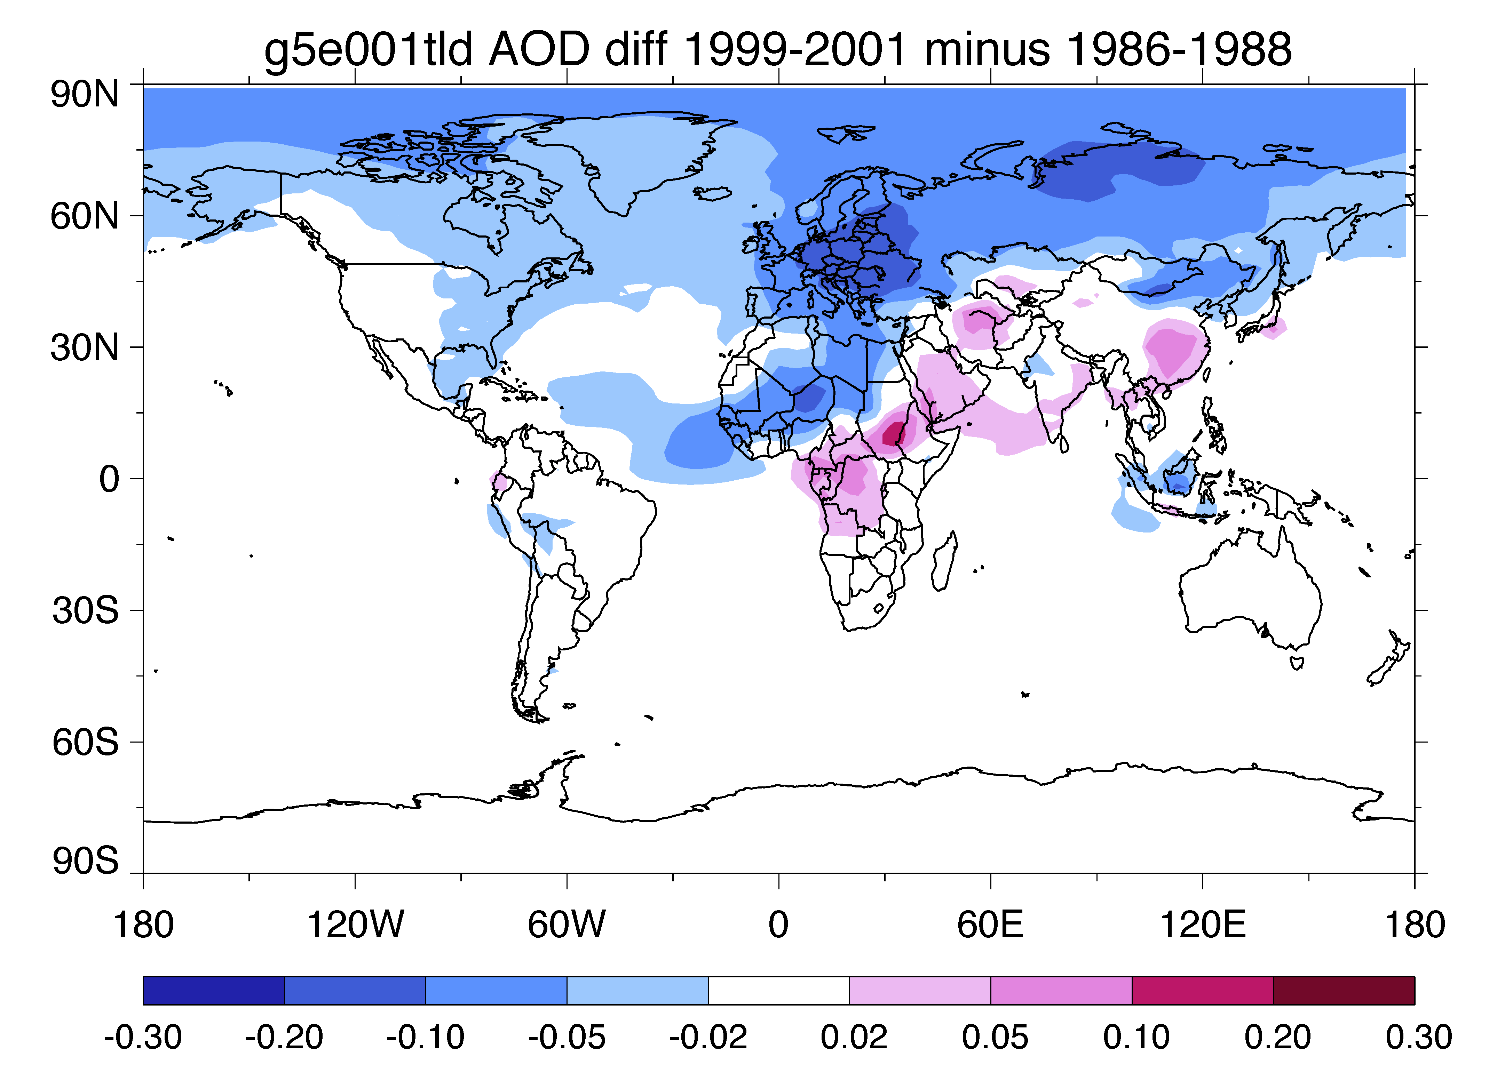
Where do the changes happen? - Diff. between 1999-2001 and 1986-1988
AVHRR-PATMOSx
AVHRR-GACP
TOMS
GOCART

Slide 13
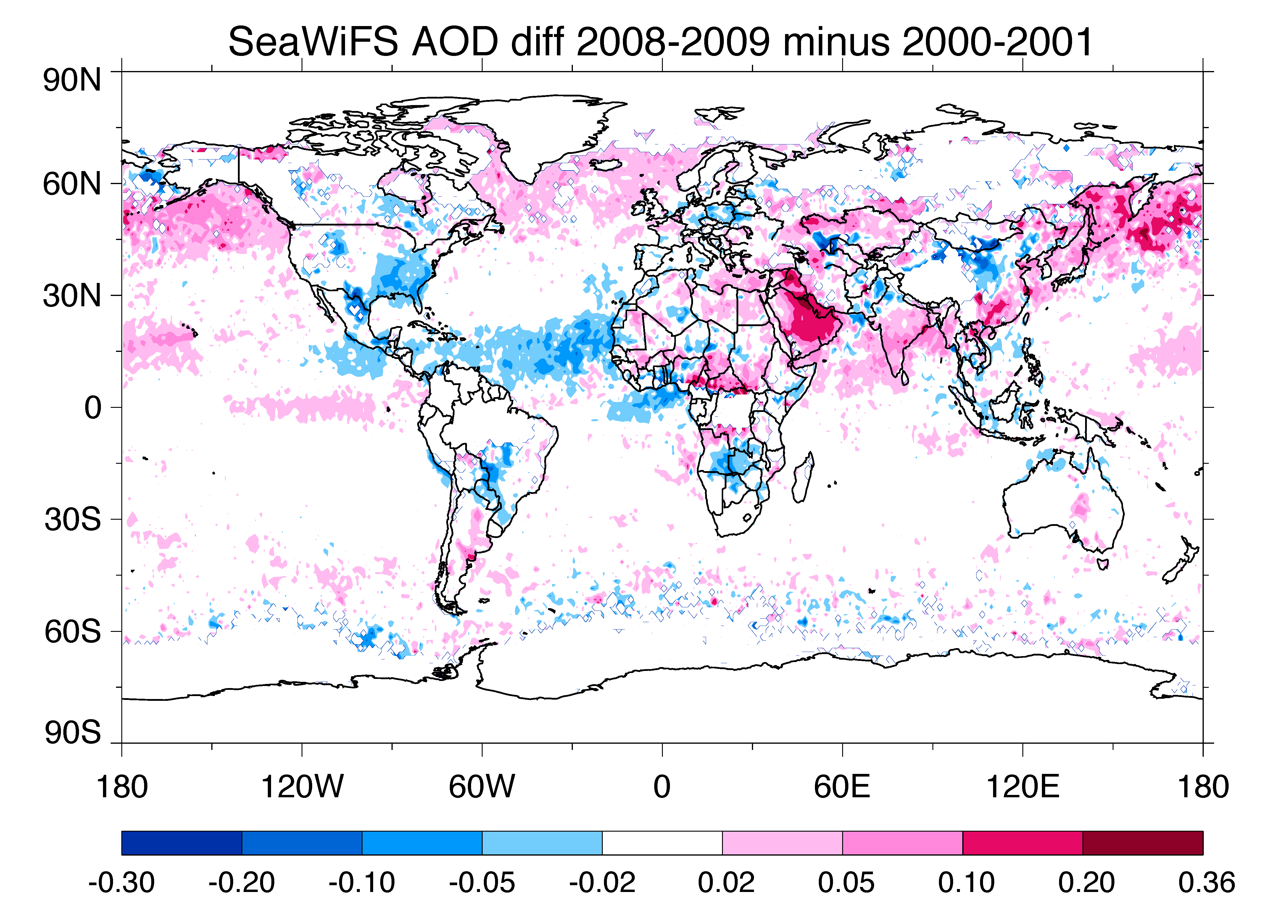
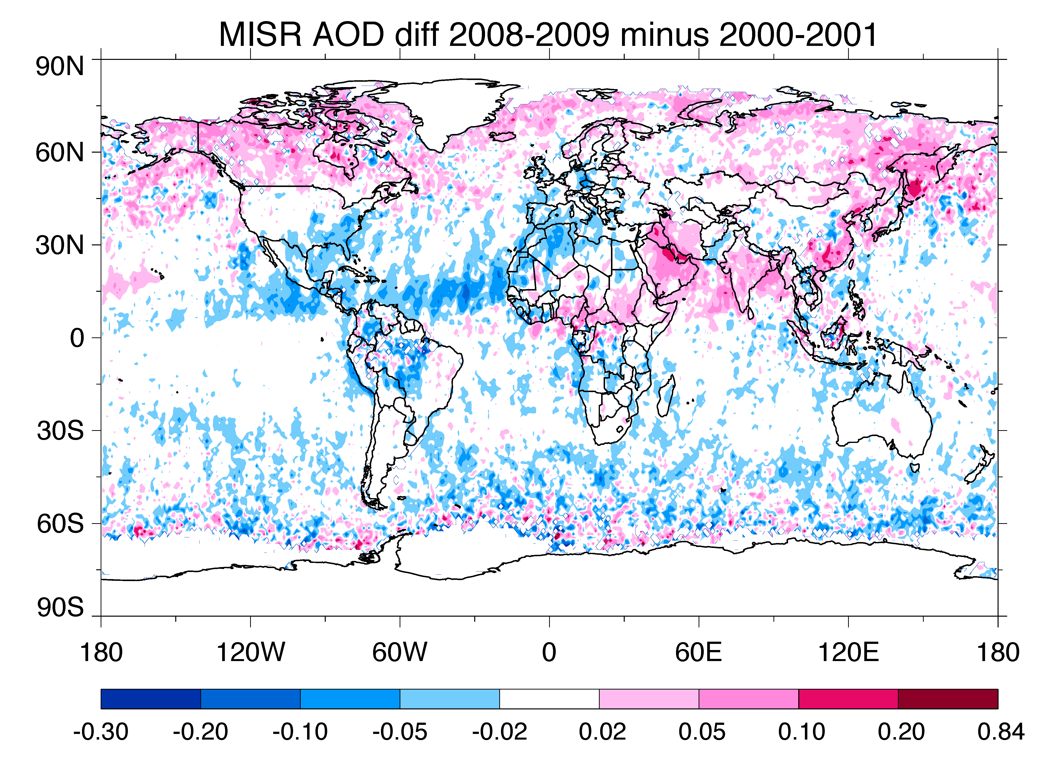
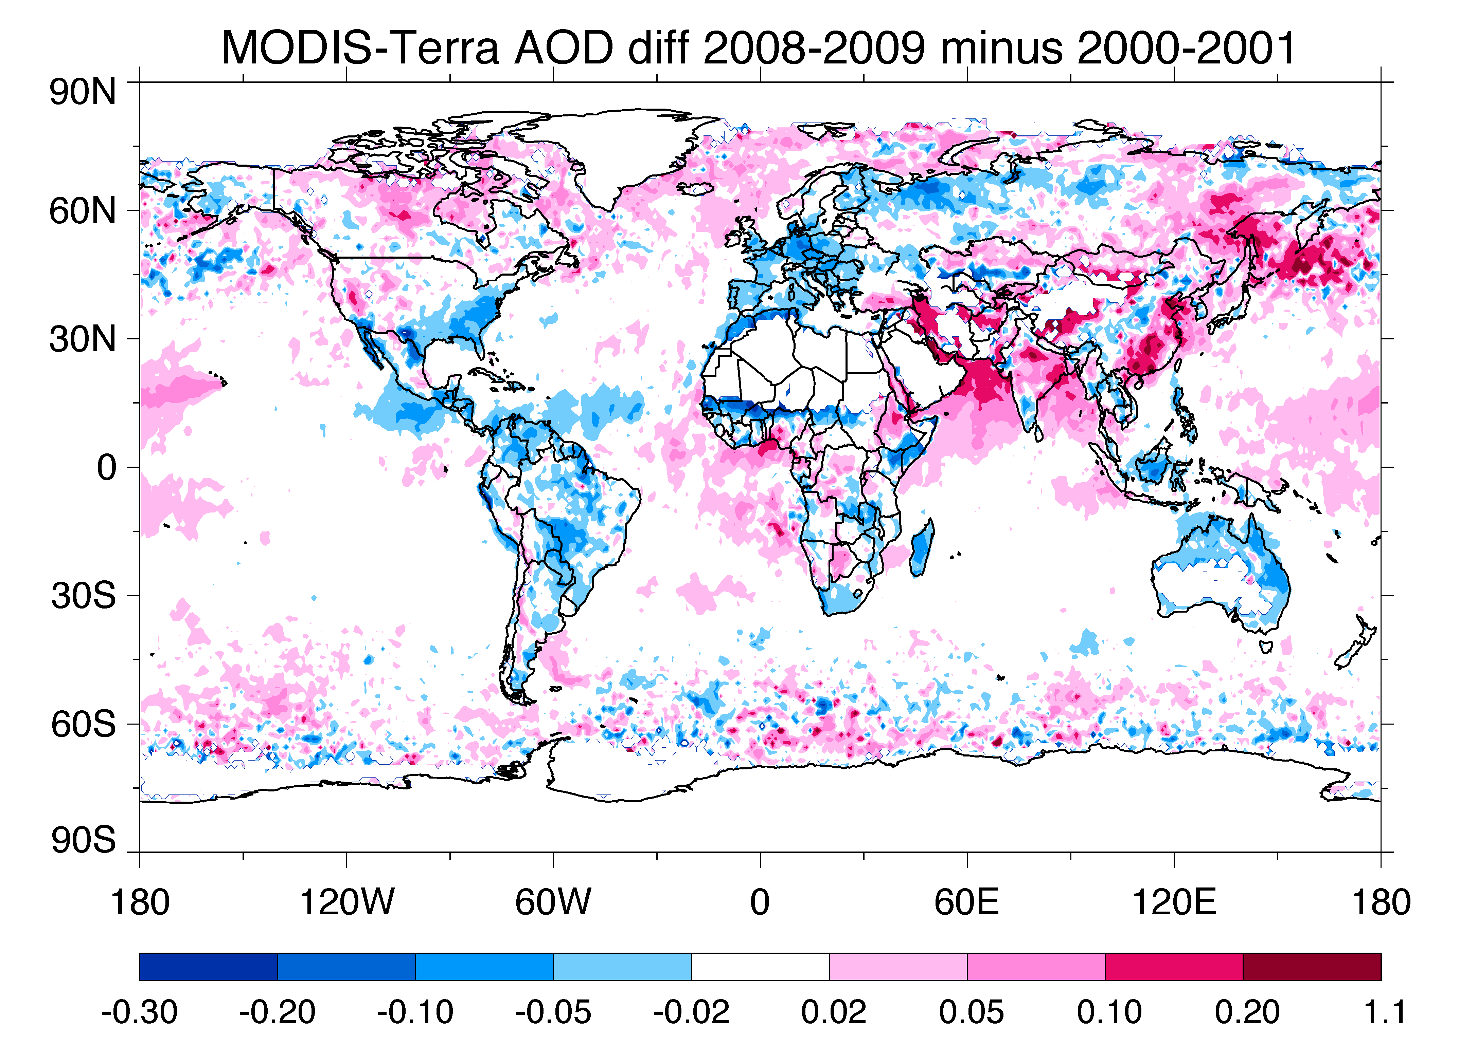
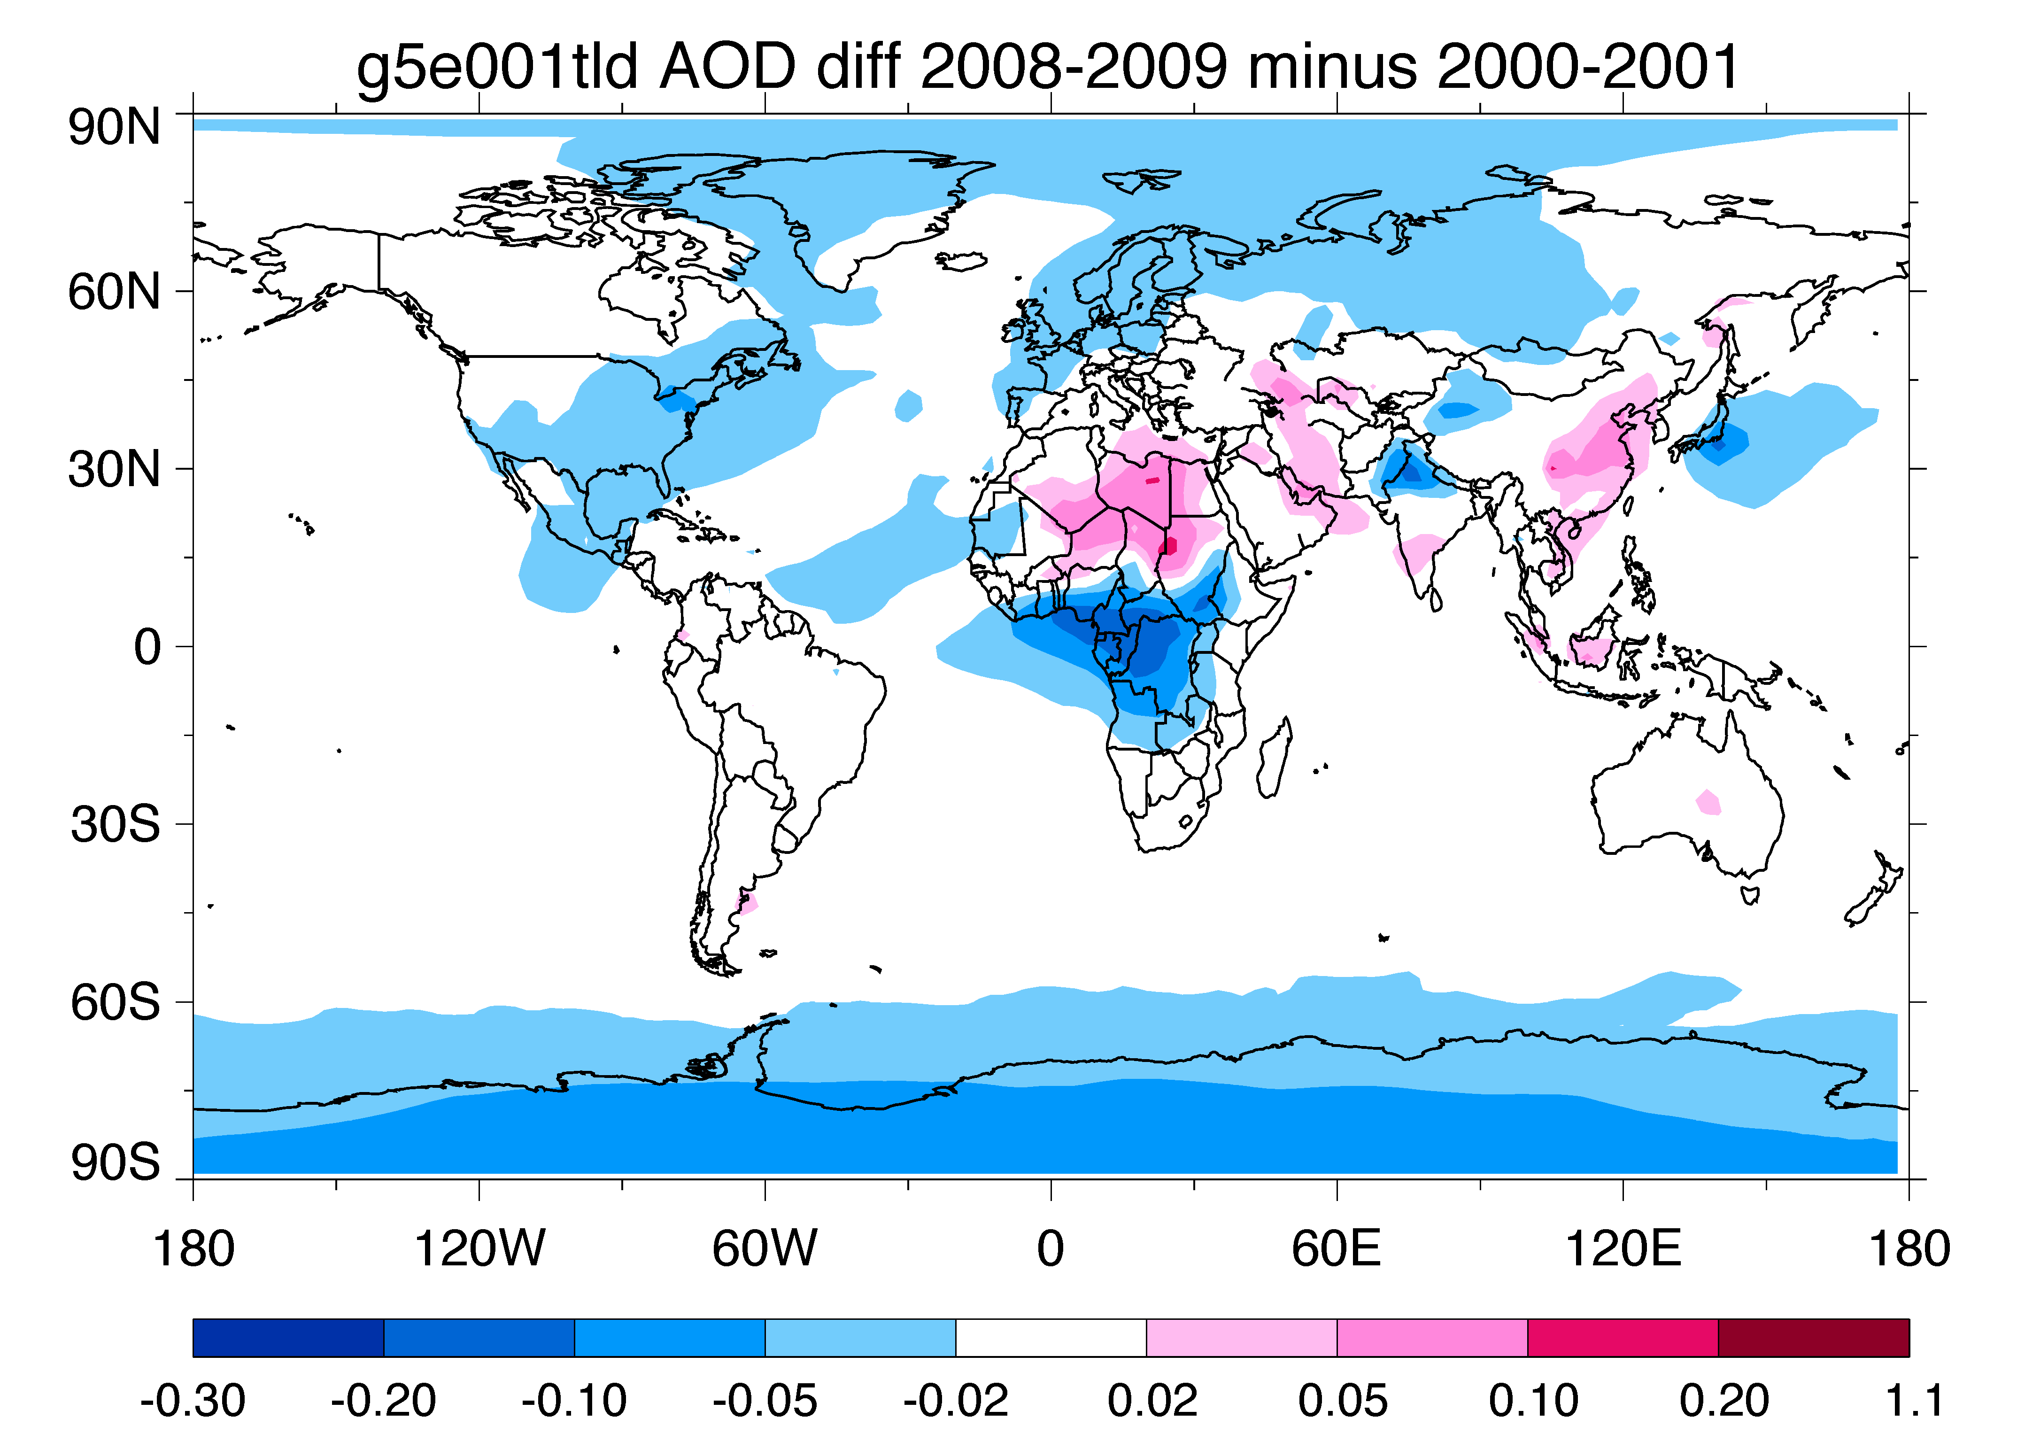
Where do the changes happen? - Diff. between 2008-2009 and 2000-2001
SeaWiFS
MISR
MODIS-Terra
GOCART

Slide 14
AOD variations at AERONET sites
276 sites, but only a handful started in the 1990s
Sites shown next have the longest data record in each region
Some regions do not have any AERONET sites (e.g., CAS)

Slide 15
Monthly AOD at 8 land sites
AERONET
SeaWiFS
MODIS-Terra
MODIS-Aqua
MISR
× TOMS
SS DU OM BC SU
GOCART

Slide 16
Monthly AOD at 8 island sites
AERONET
SeaWiFS
MODIS-Terra
MODIS-Aqua
MISR
× TOMS
SS DU OM BC SU
GOCART

Slide 17
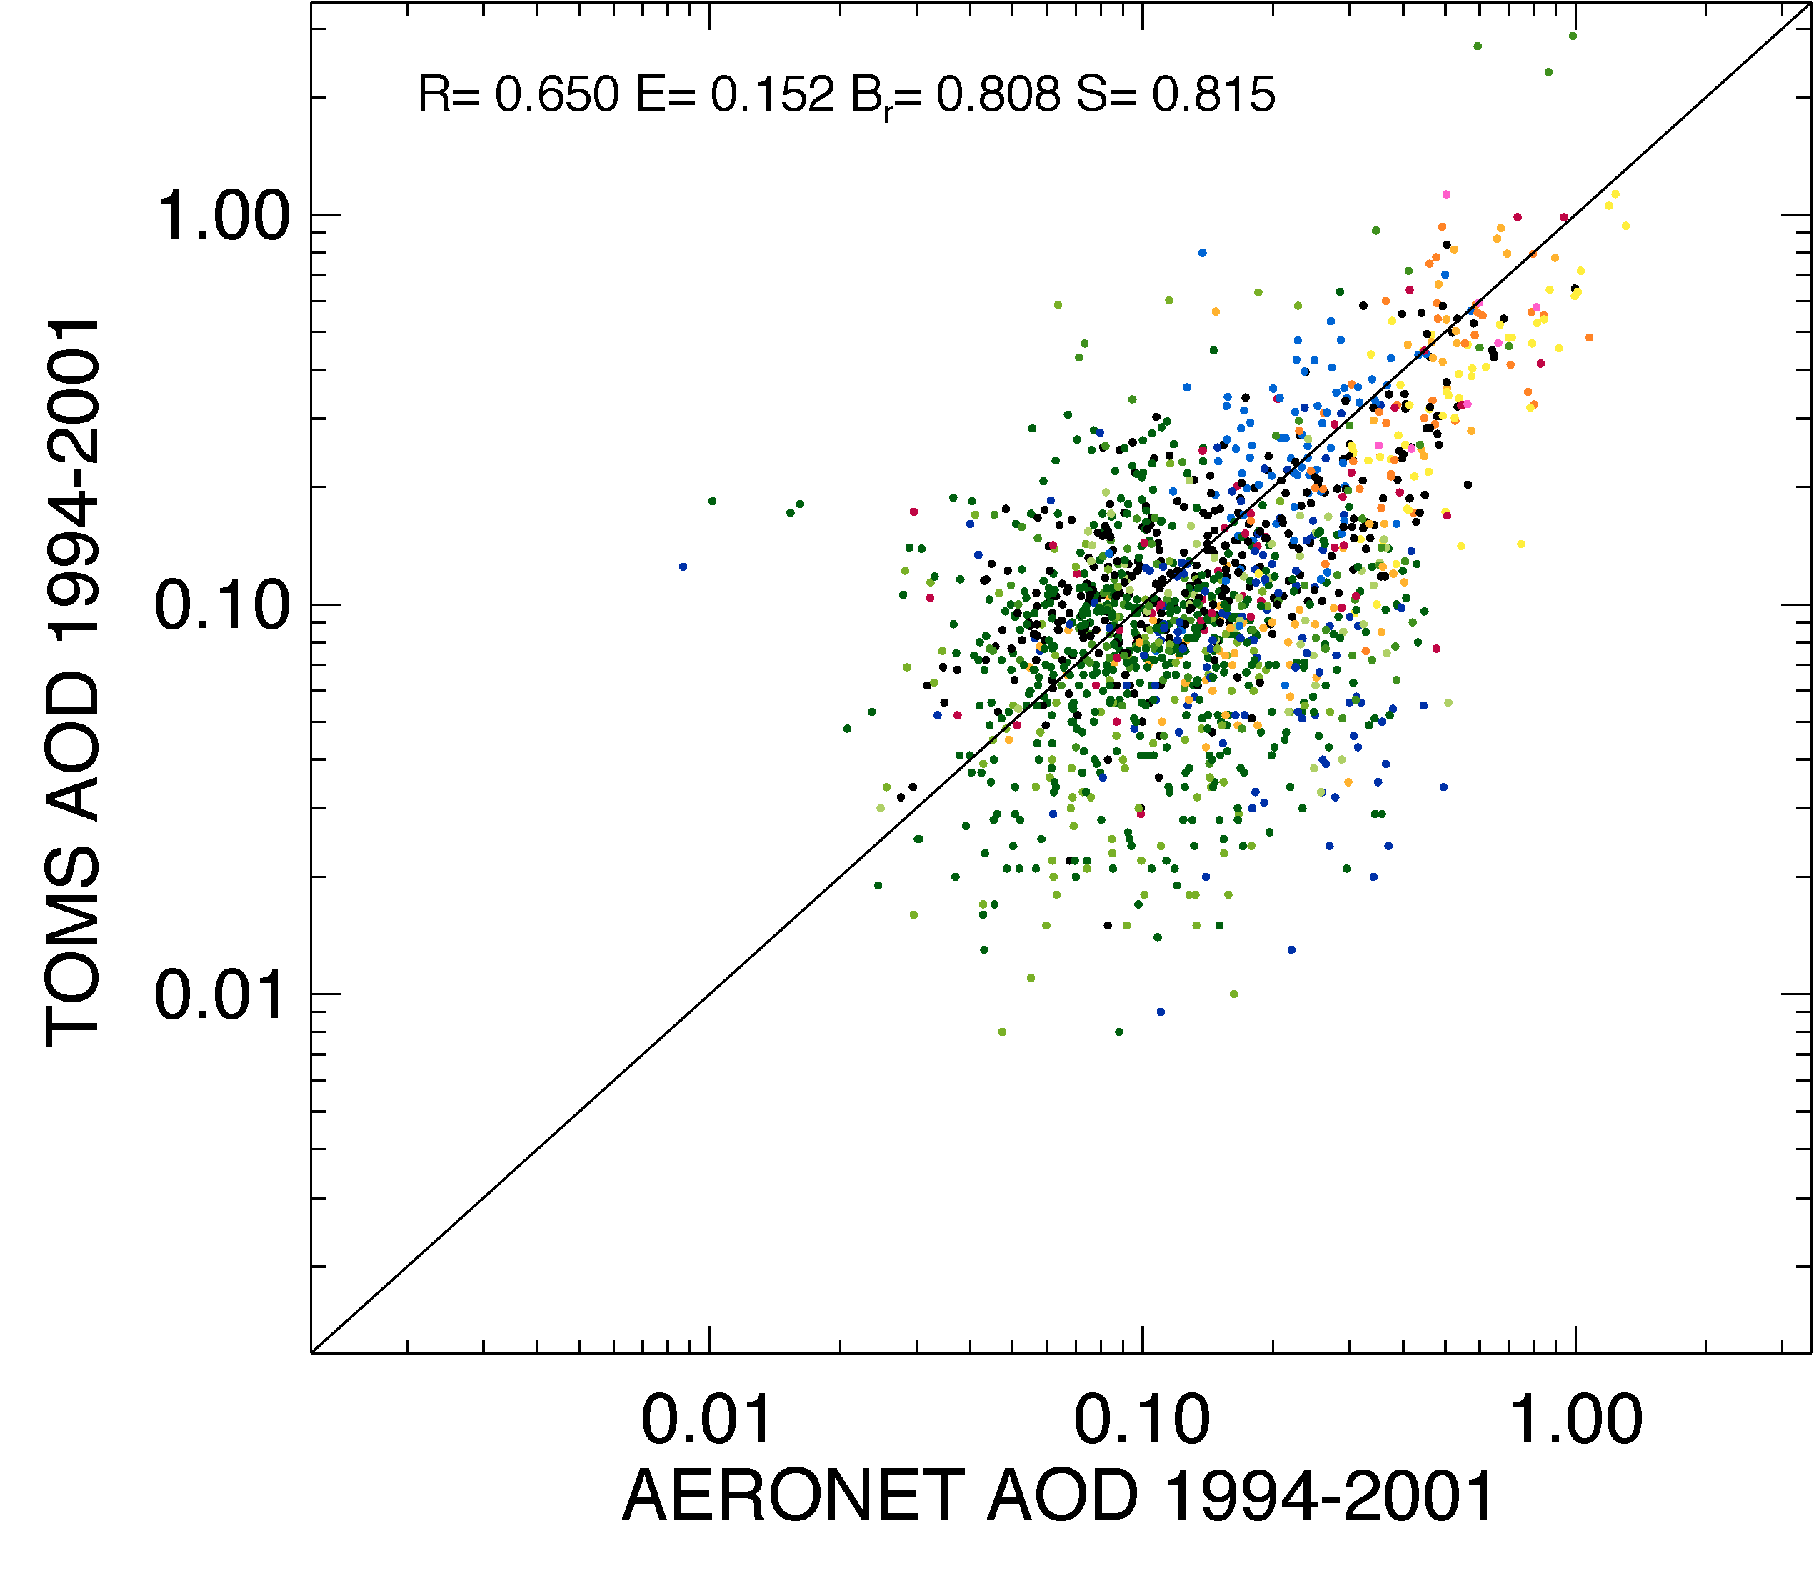
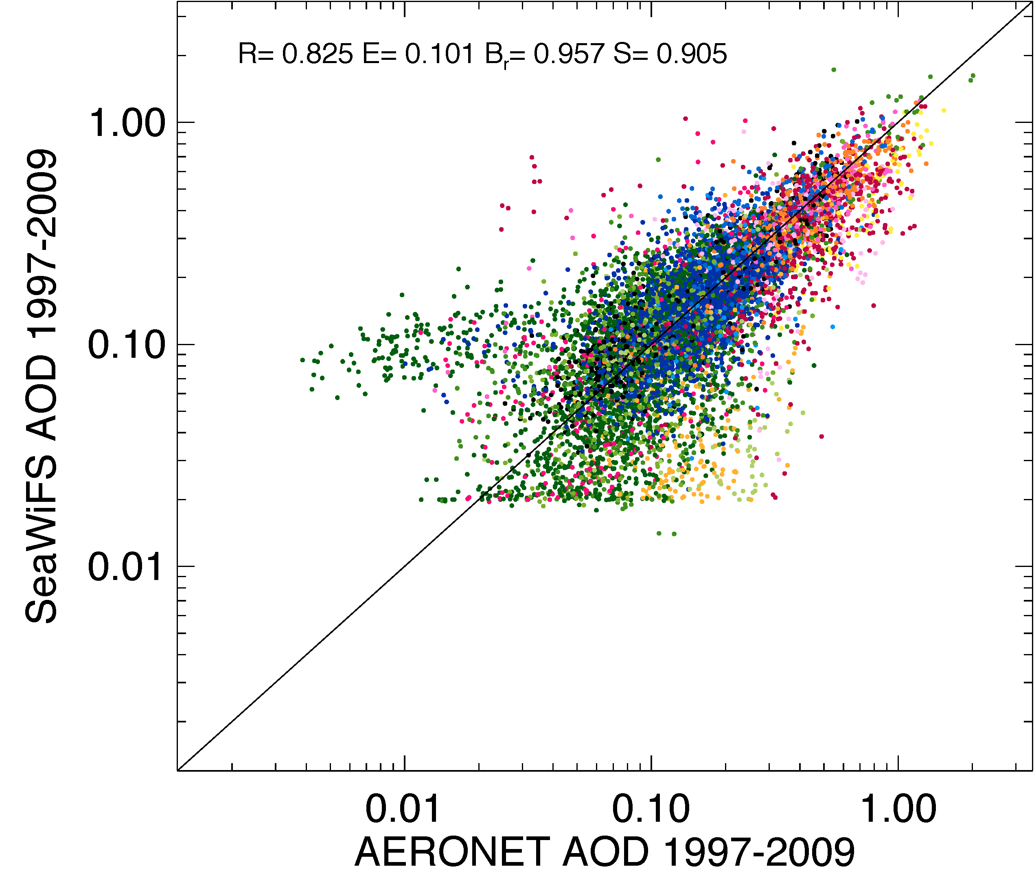
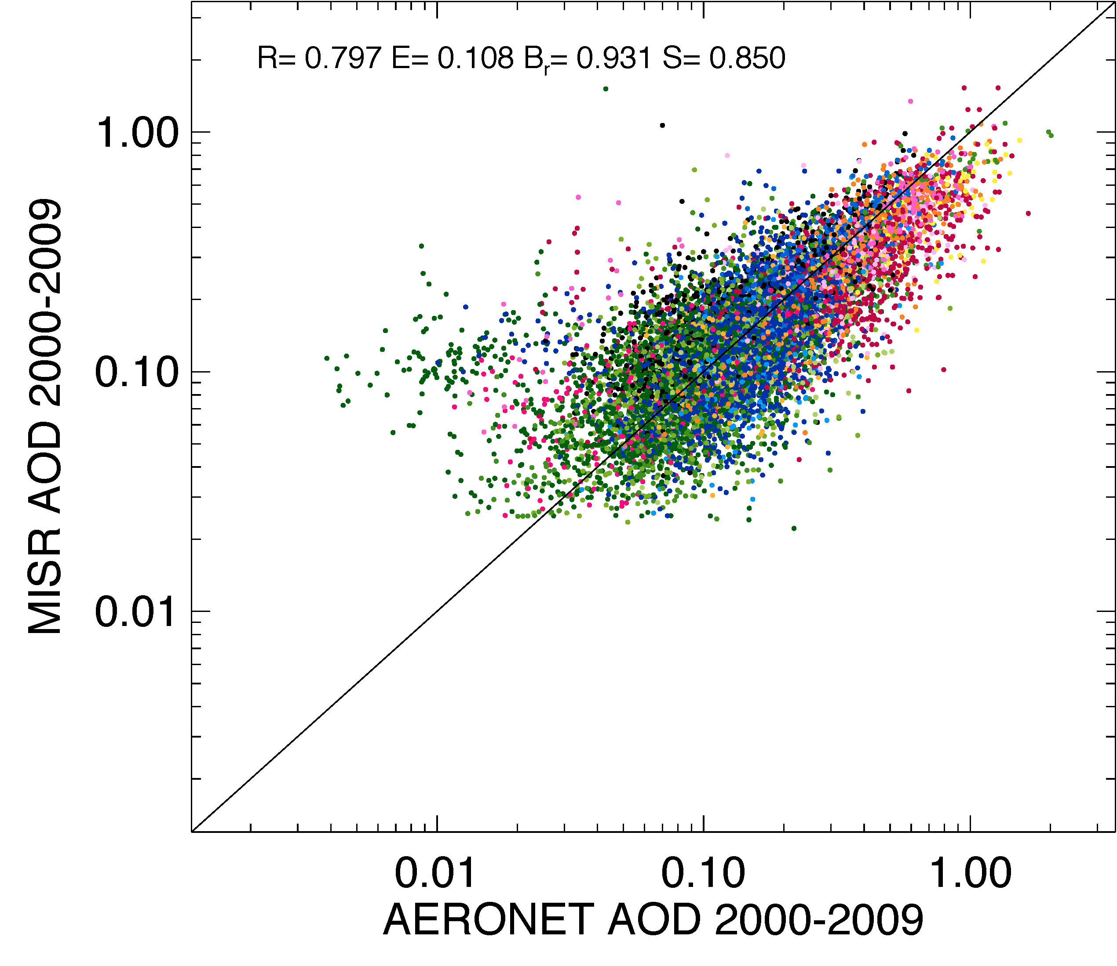
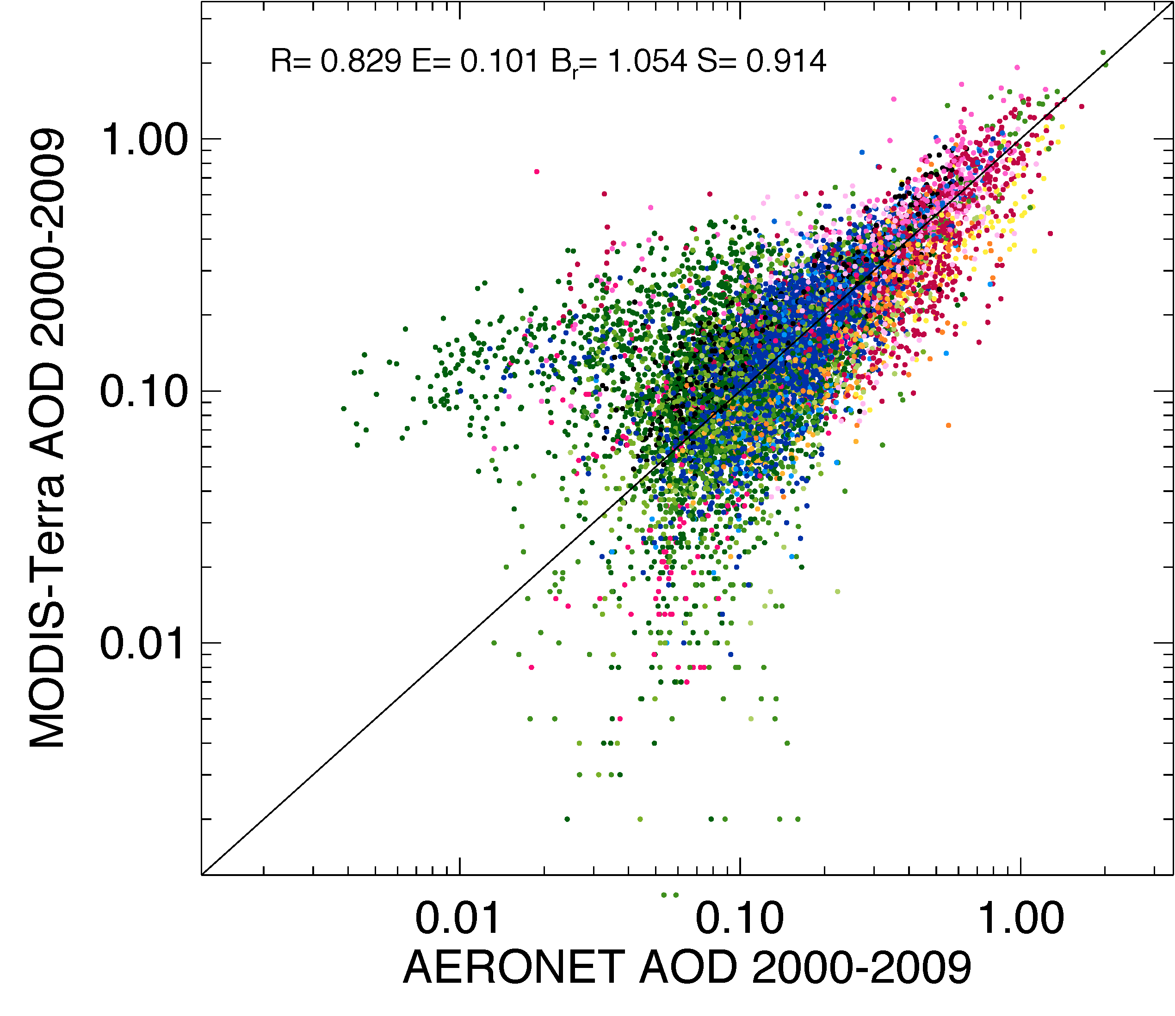
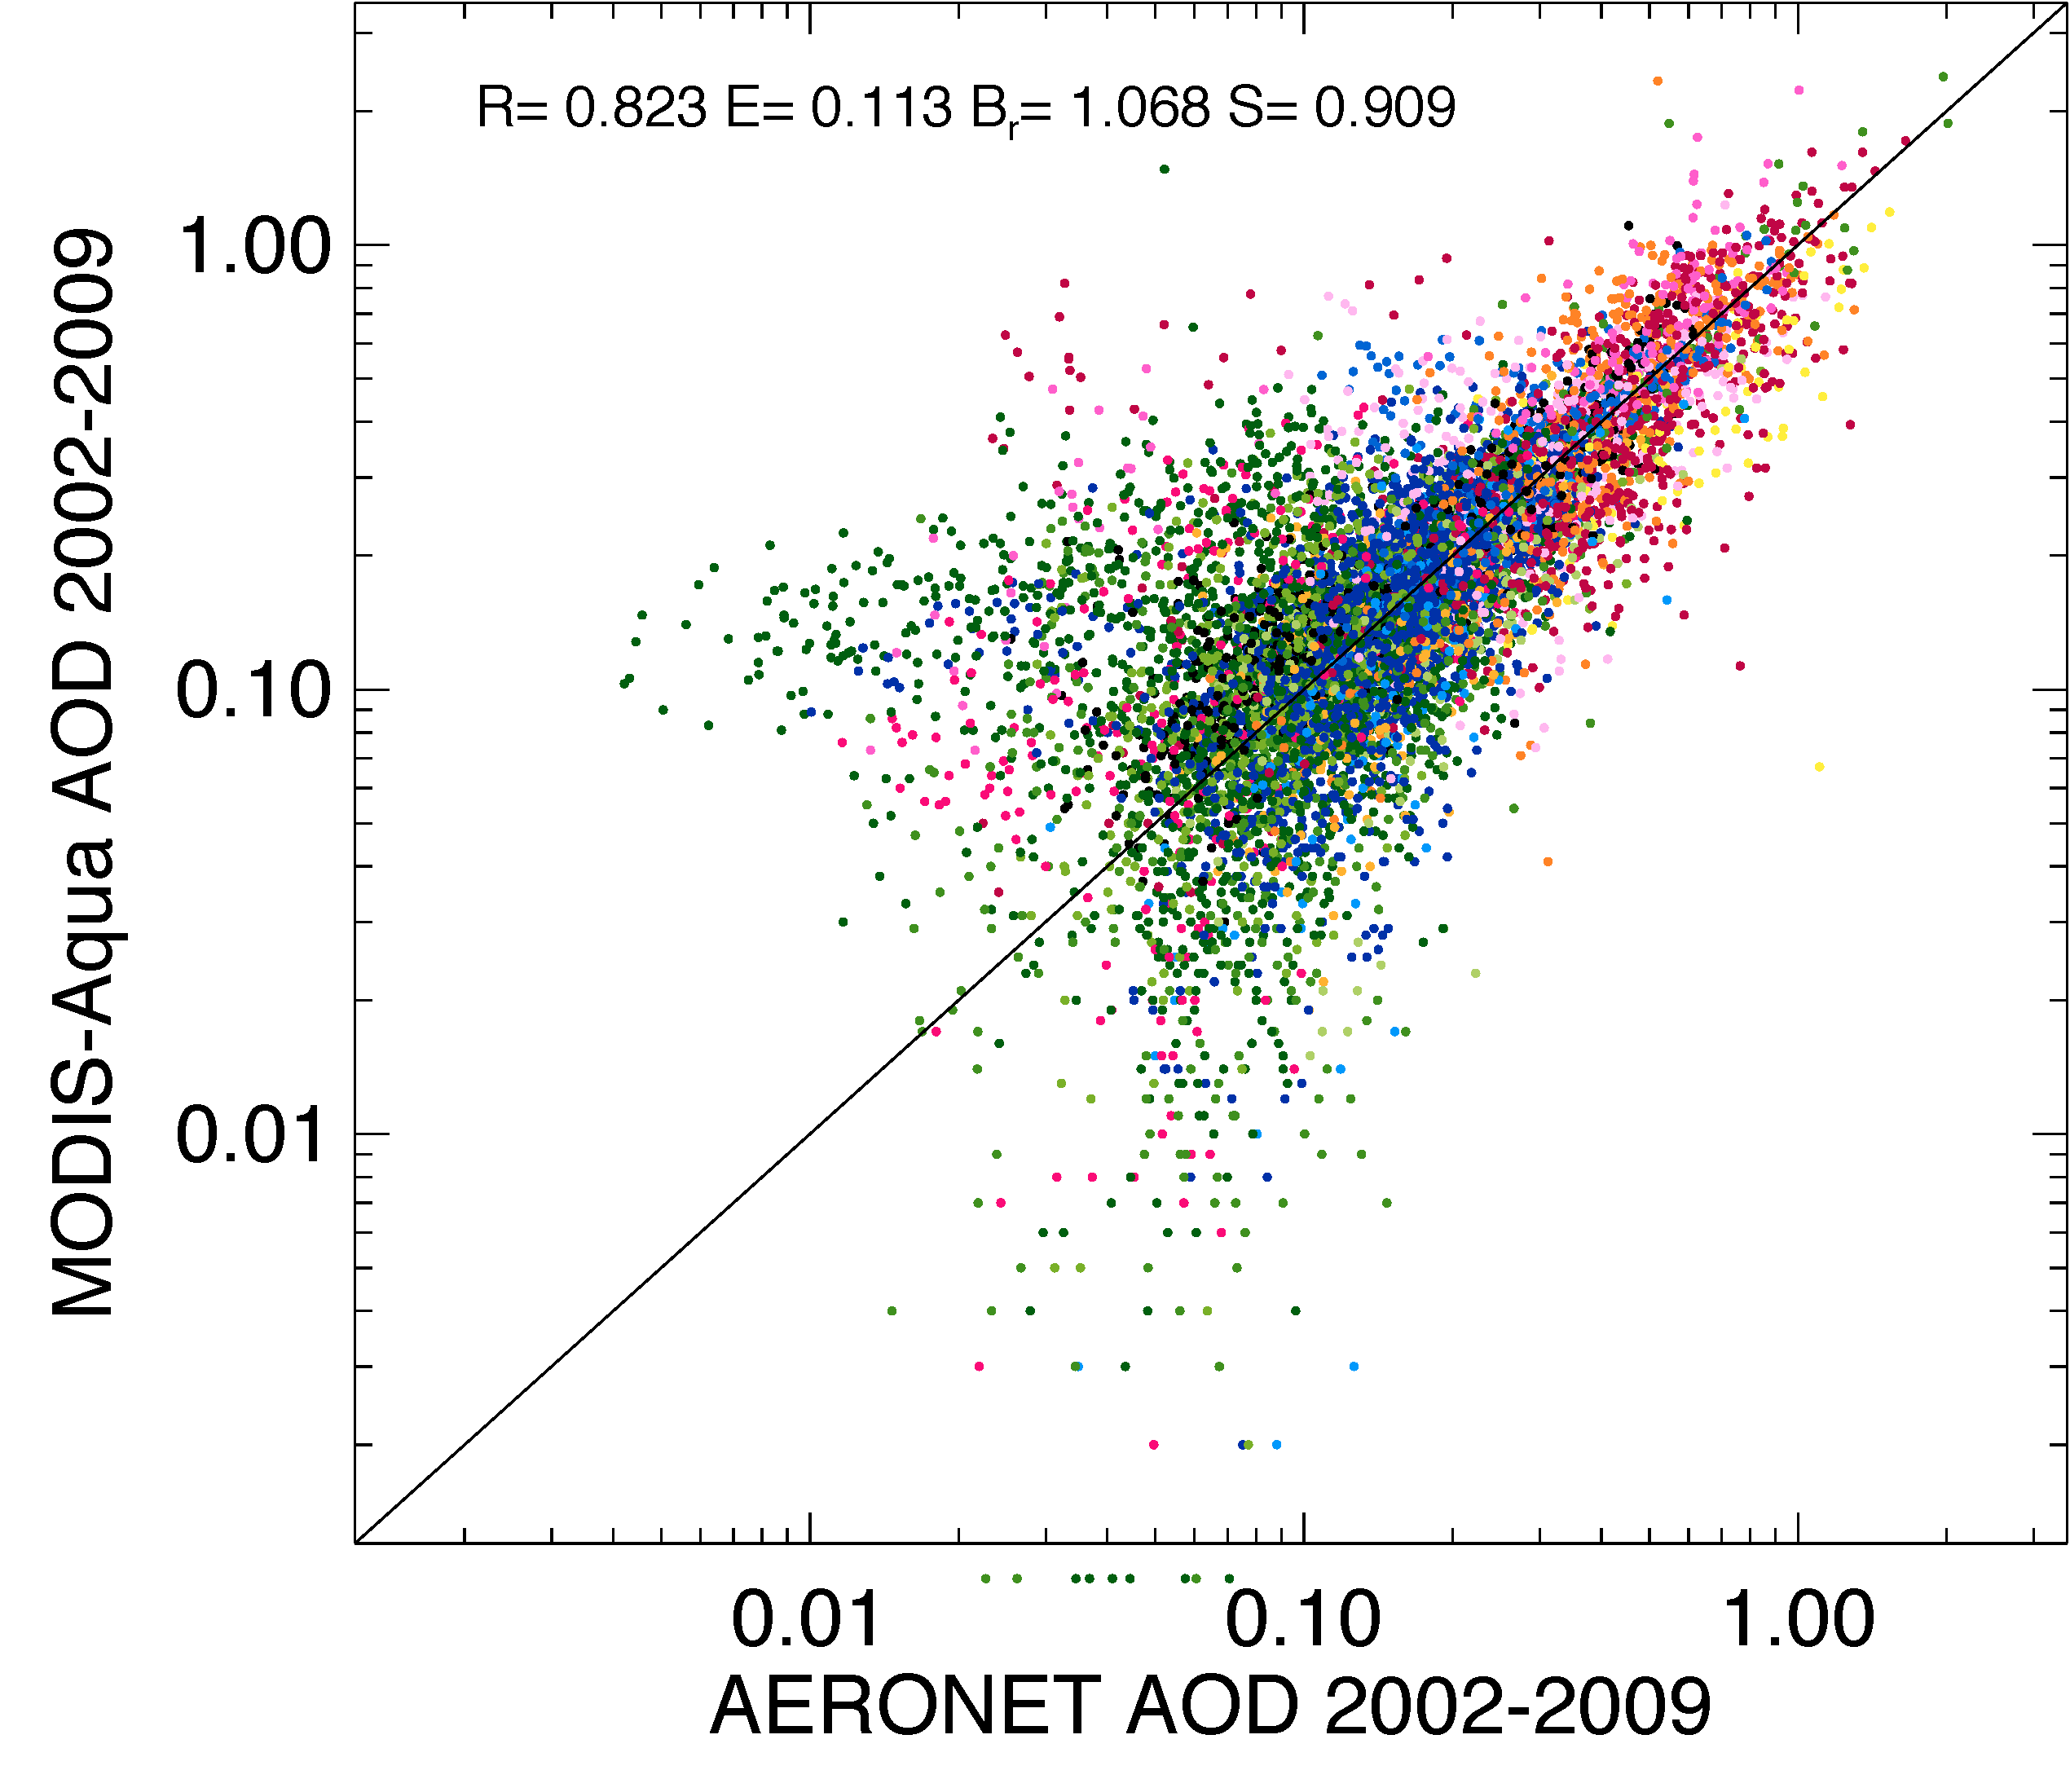
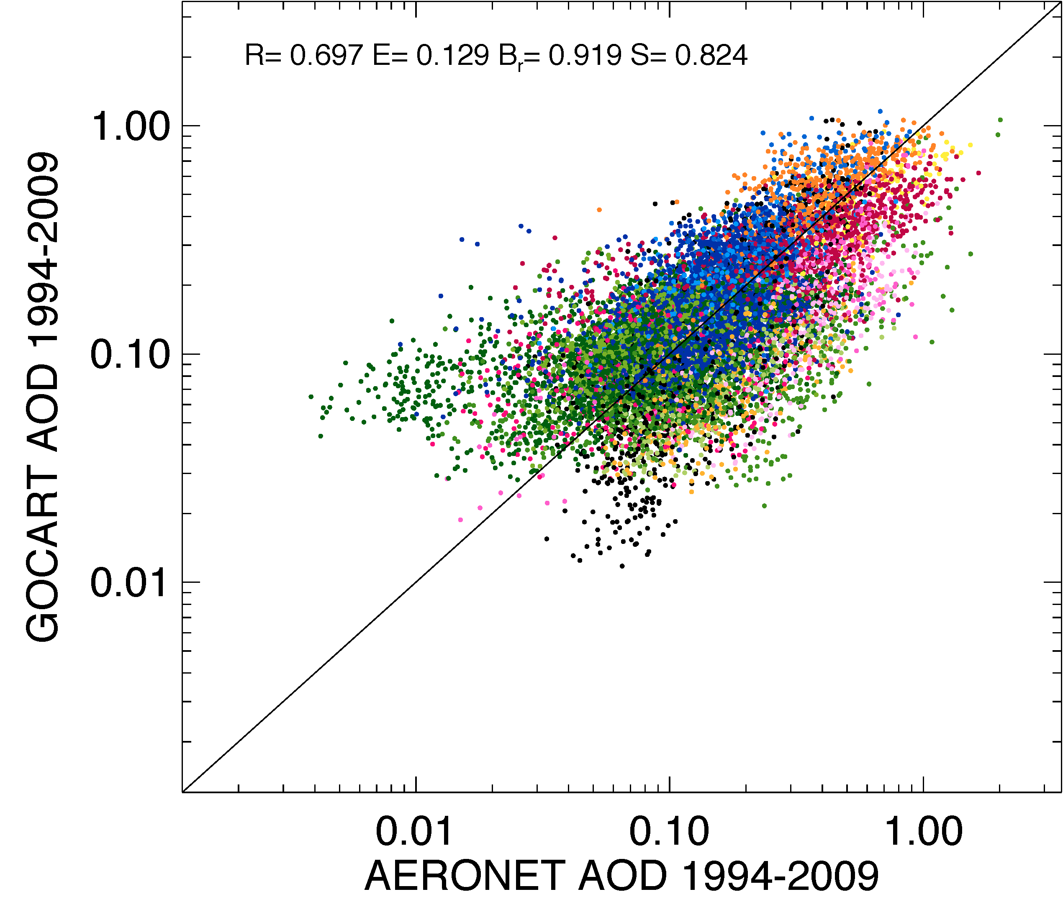
Scatter plots of satellite/modeled AOD vs. AERONET, monthly avg, all sites
Warning: The satellite data are aggregated to 1°×1° deg in this comparison. This is not showing satellite data validation – it is for fun.

Slide 18
Remarks regarding AOD trends
Over land:
The strongest declining AOD trends in the past 3 decades is over Europe, mainly because of the large decrease of anthropogenic emission
North America also show declining trends, in line with regional anthropogenic emission change
Trends over other “anthropogenic” regions are less connected to anthropogenic emission change, mostly because of variations of dust that could mask the effects of anthropogenic emission change
Over ocean:
North N Atlantic AOD have shown some decreasing trends
N Indian and NW Pacific have shown increasing trends
Satellite data have different trends over large ocean areas
AERONET data is generally not long enough for detecting clear trends

Slide 19
Surface concentrations from ground-based networks
Network | Location | Time Period | Species used
IMPROVE | USA | 1988-present | SO4, BC, OC, dust, fine mass
EMEP | Europe | 1980-present | SO2, SO4
U Miami | Atlantic, Pacific, Southern Ocean | 1980s to 1990s or early 2000s | SO4, dust, sea salt, MSA

Slide 20
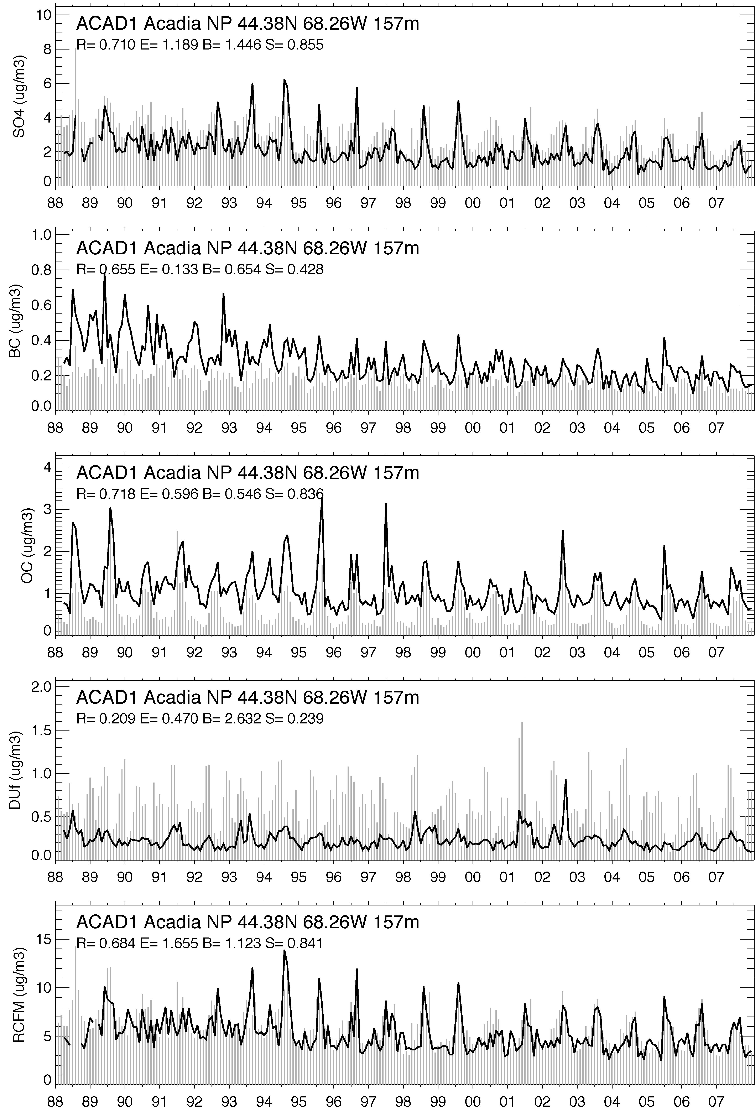
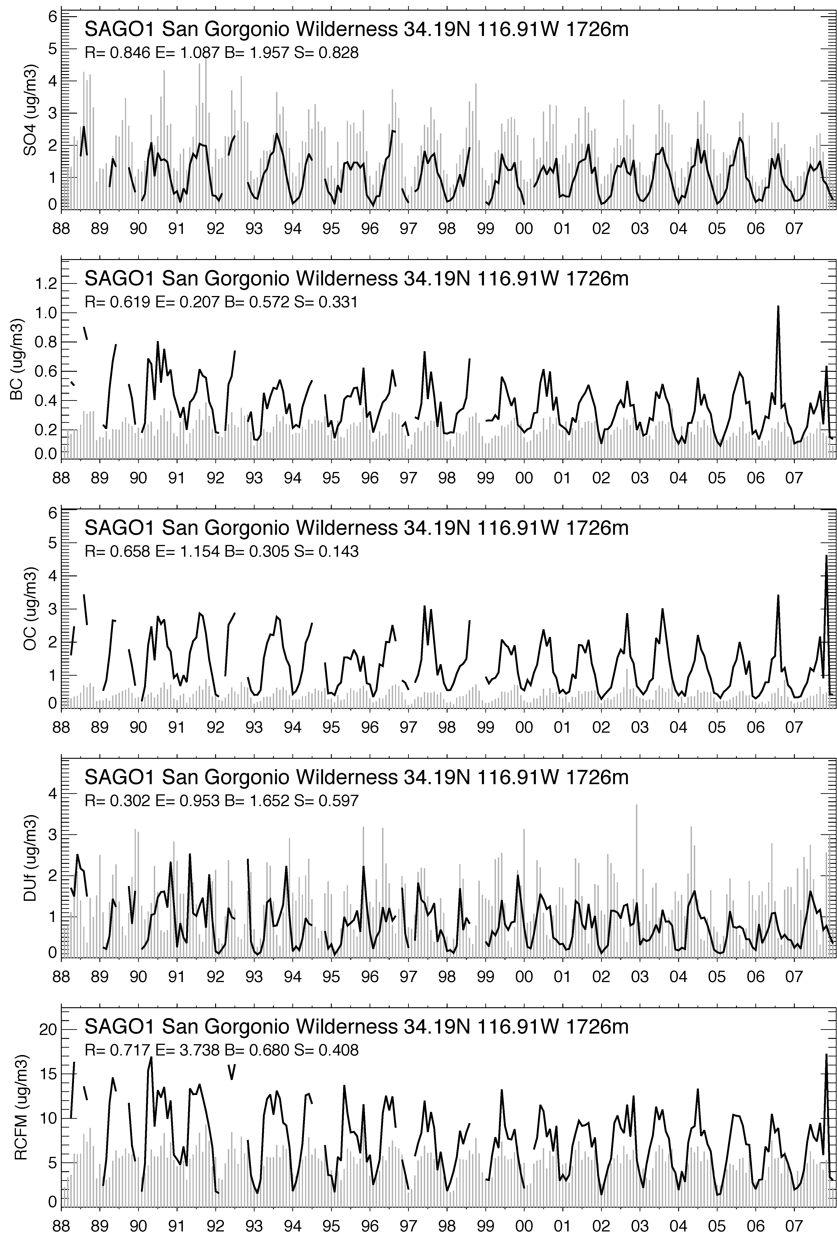
Monthly average aerosol species concentrations at 2 IMPROVE sites in USA
SO₄²⁻
BC
OC
Fine dust
Rec. fine mass
Black line: Observations Grey vertical bars: GOCART

Slide 21
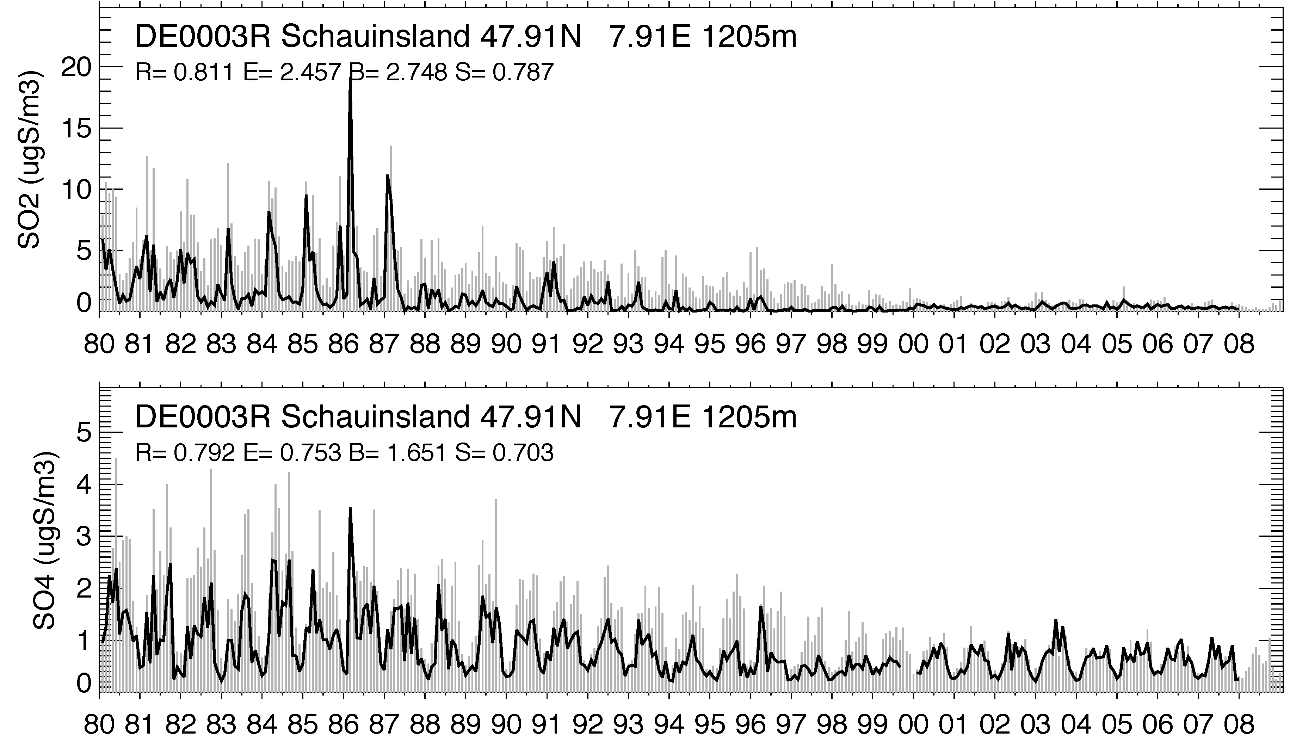
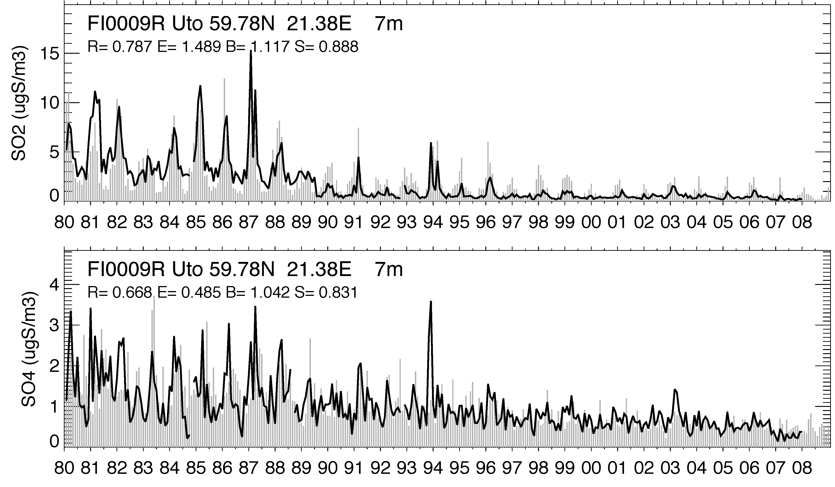
Monthly average aerosol species concentrations at 2 EMEP sites in Europe
SO₂
SO₄²⁻
Black line: Observations Grey vertical bars: GOCART

Slide 22
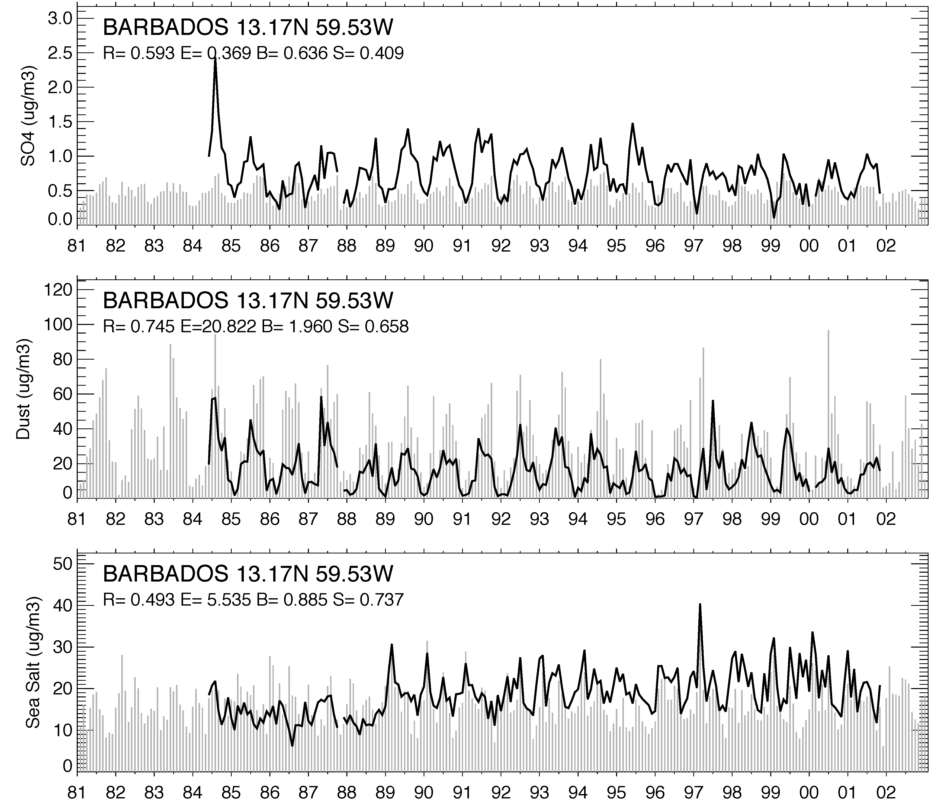
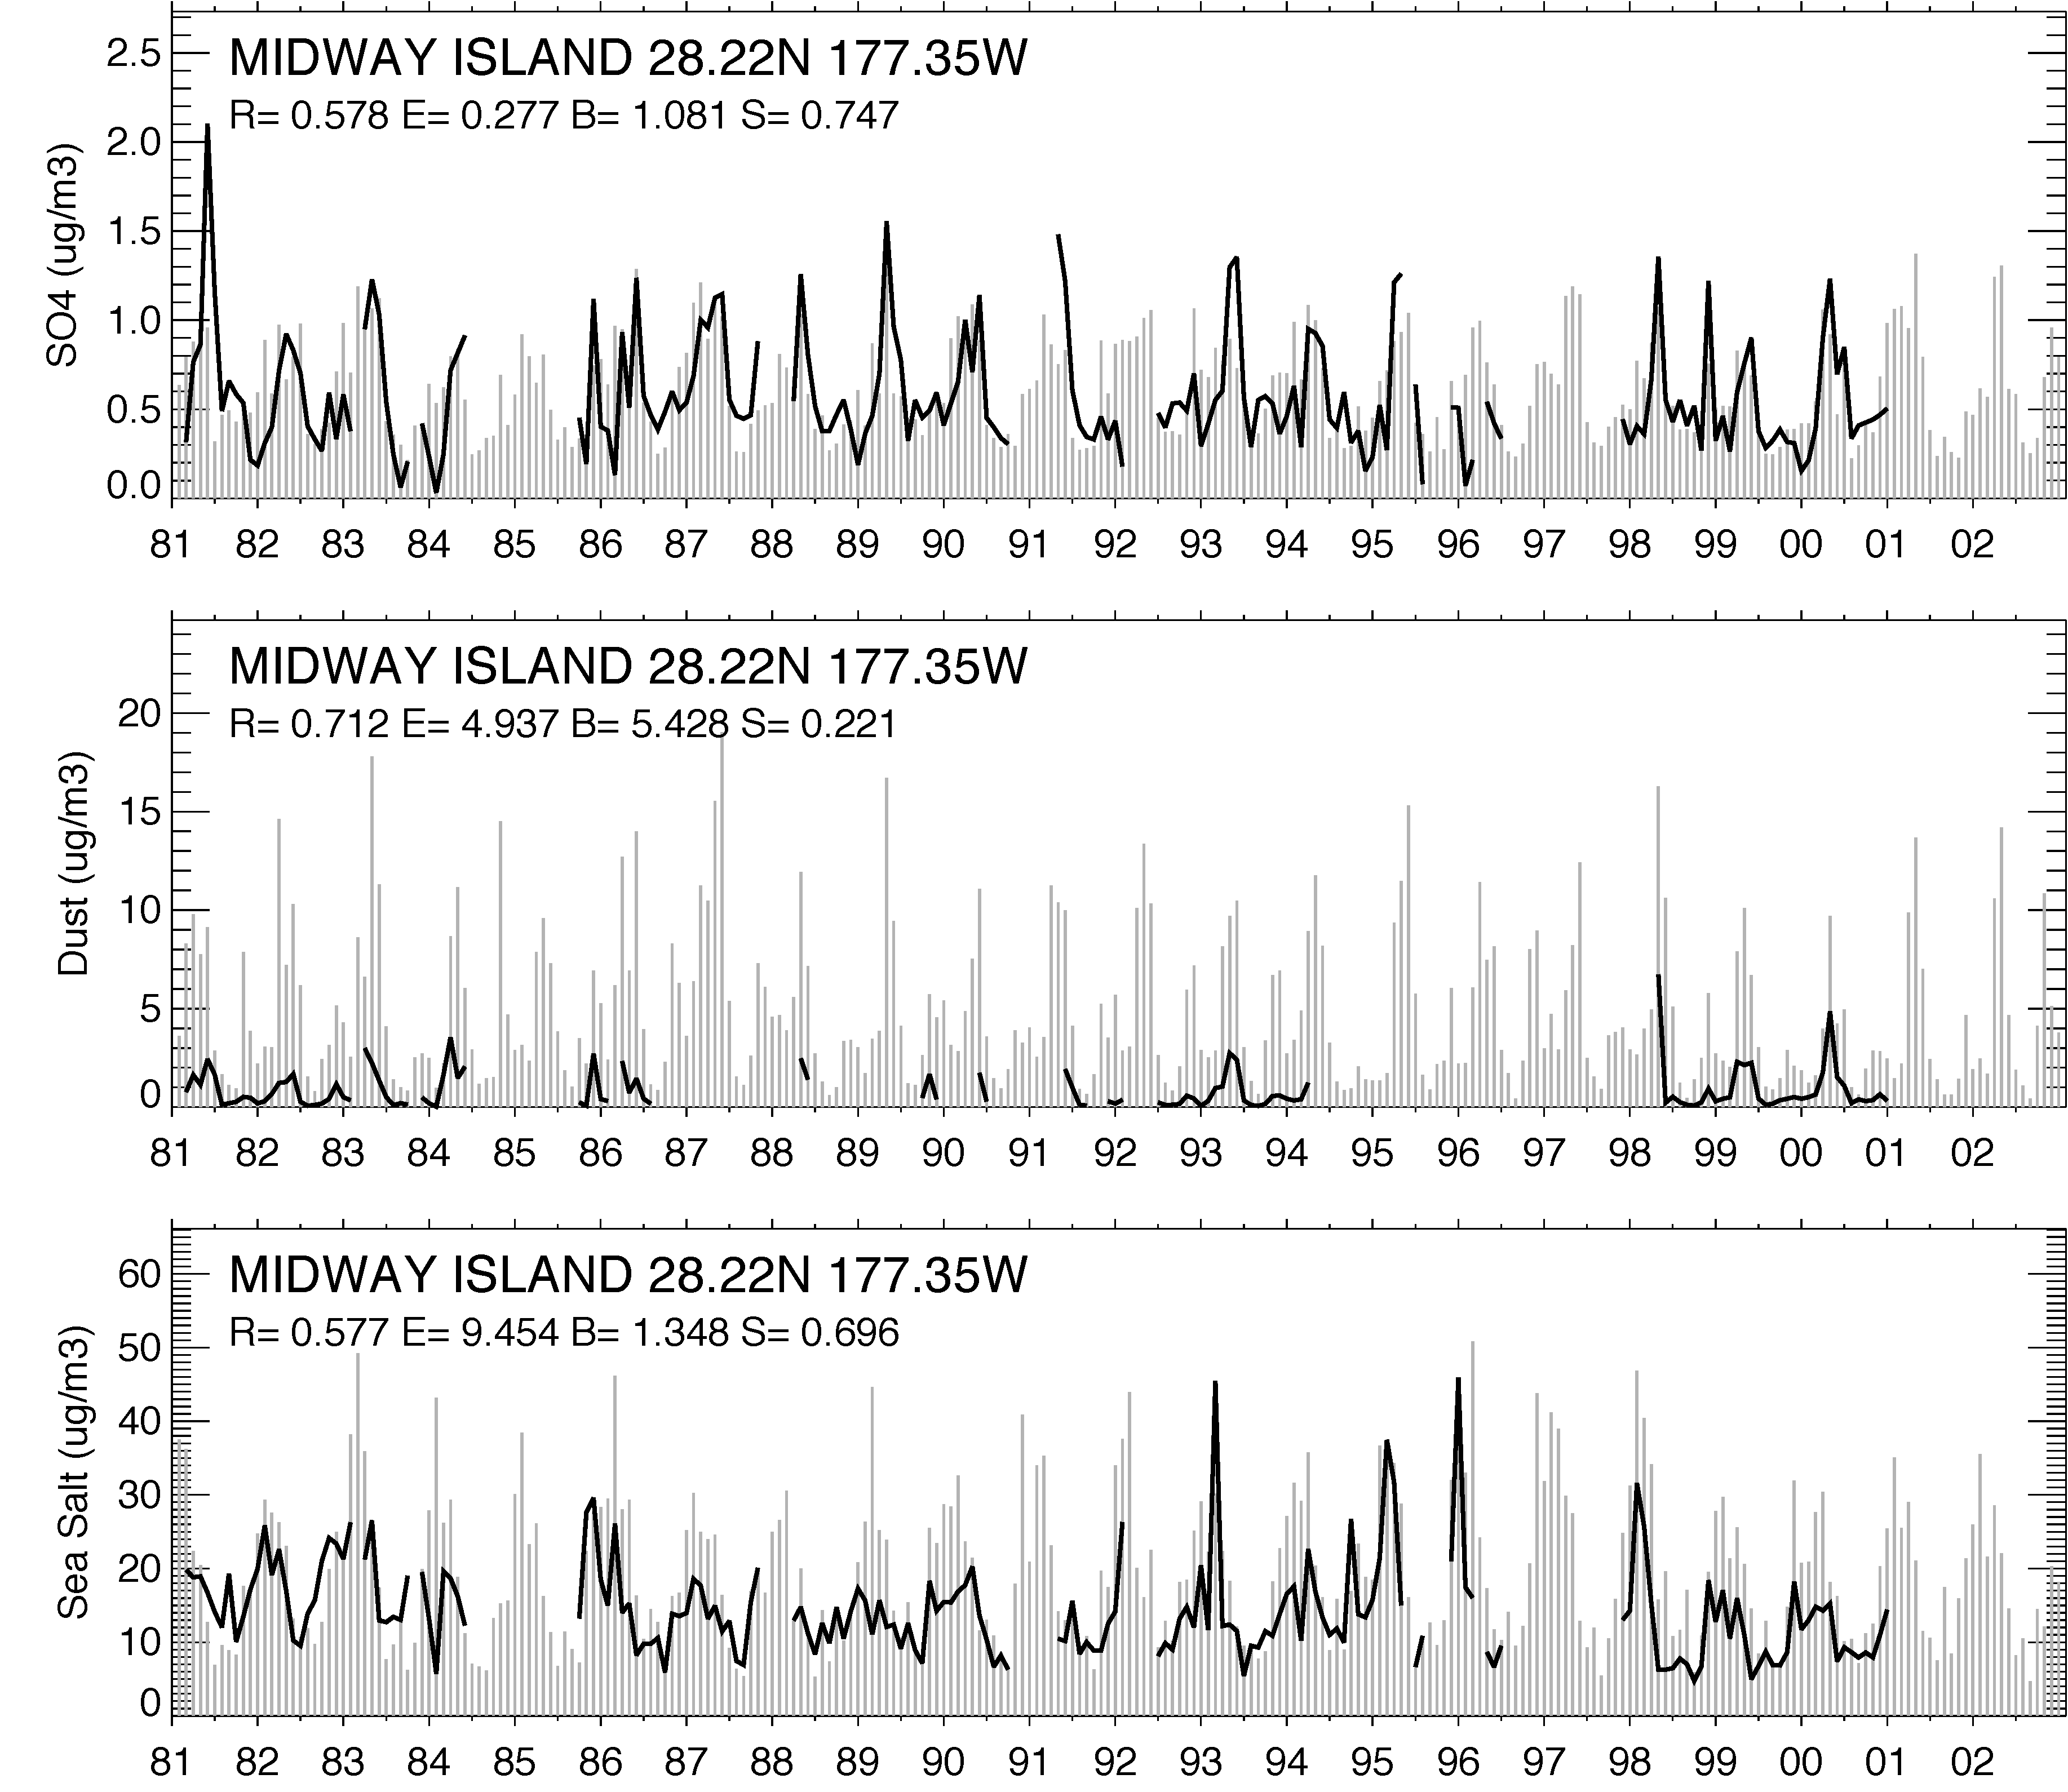
Monthly average aerosol species concentrations at 2 Atlantic and Pacific sites
SO₄²⁻
Dust
Sea Salt
Black line: Observations Grey vertical bars: GOCART

Slide 23
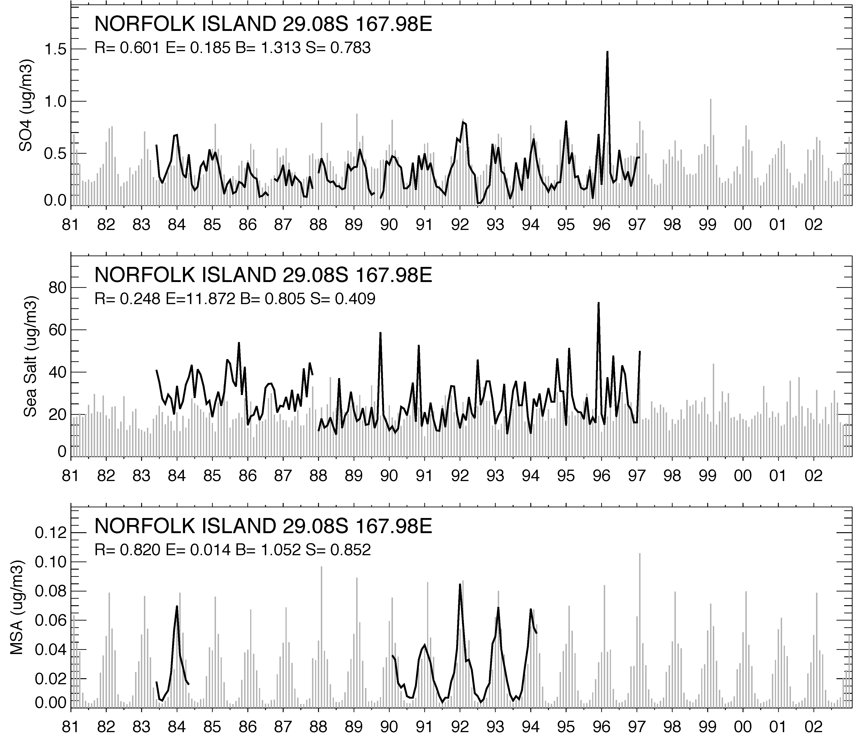
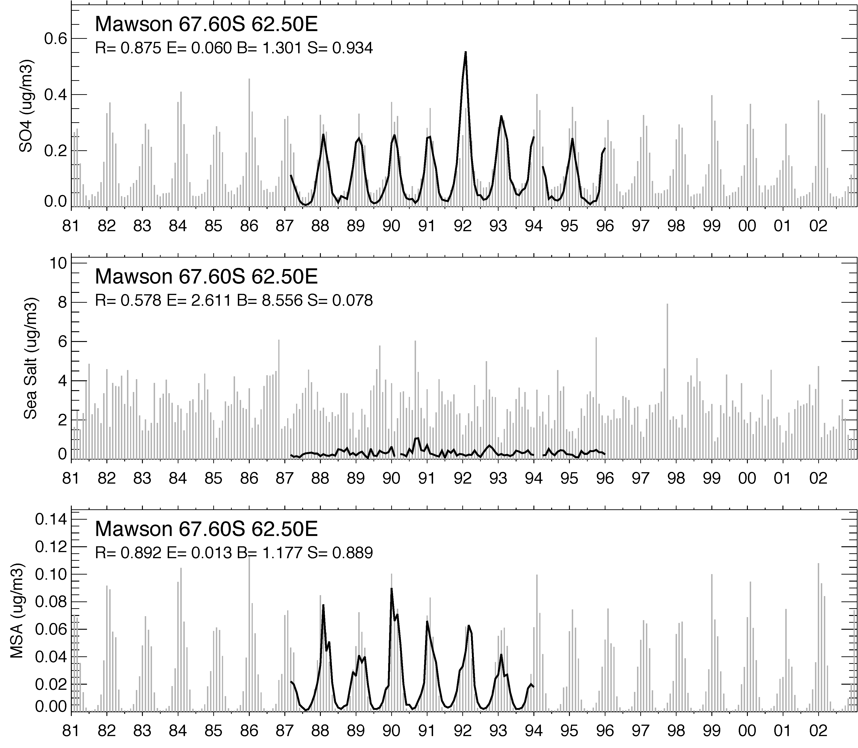
Monthly average aerosol species concentrations at 2 remote oceanic sites
SO₄²⁻
Sea Salt
MSA
Black line: Observations Grey vertical bars: GOCART

Slide 24
Remarks regarding concentration trends
Most remarkable decrease of sulfate surface concentrations in past 30 years is over Europe, because of the significant reduction of SO2 emission
Sulfate, BC, and fine aerosol mass over US also show a decrease trend from the late 1980s
Over ocean the trends are difficult to deduce
Over a vast area of the world there has little or no long term measurement data available

Slide 25
Aerosol effects on surface radiation
Working in progress……FYI only

Slide 26
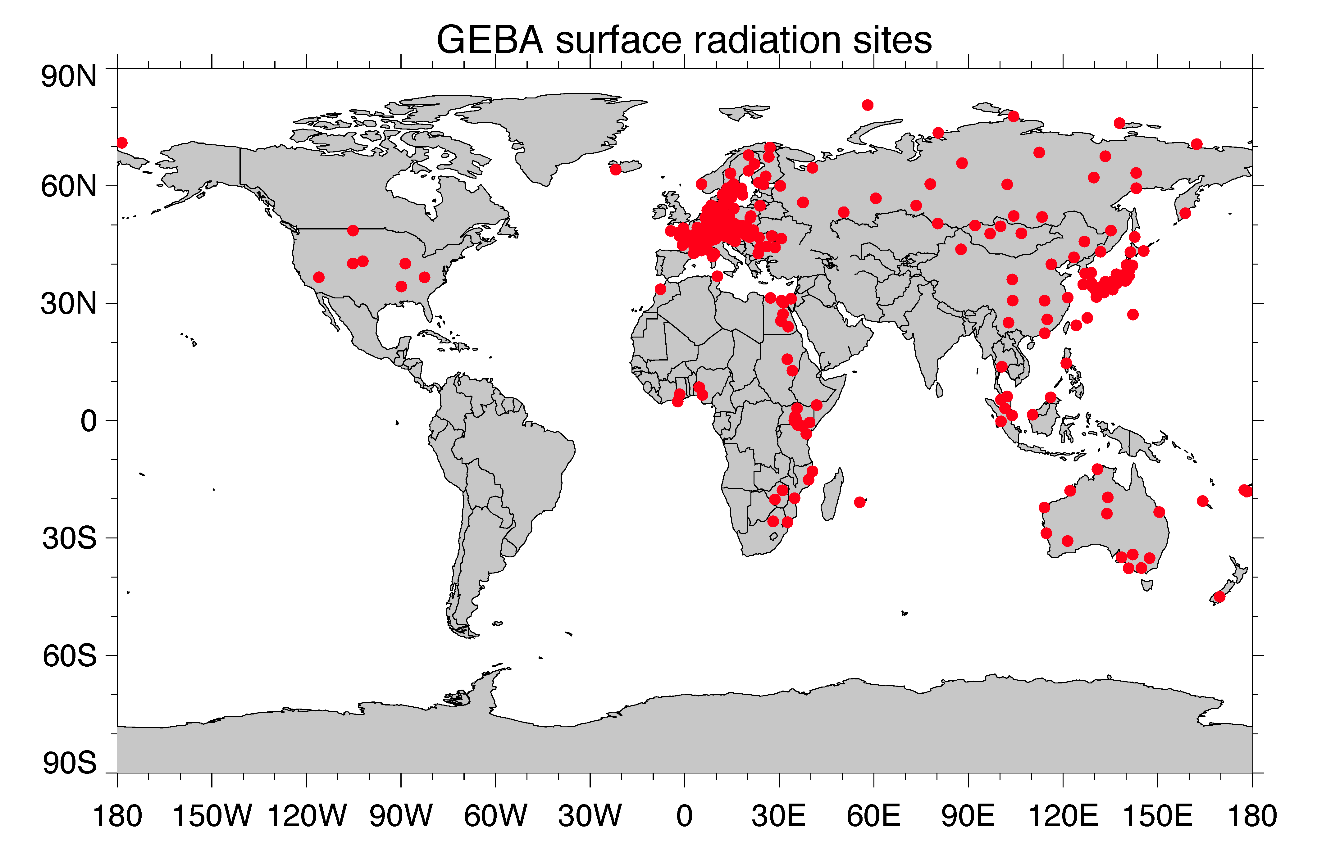
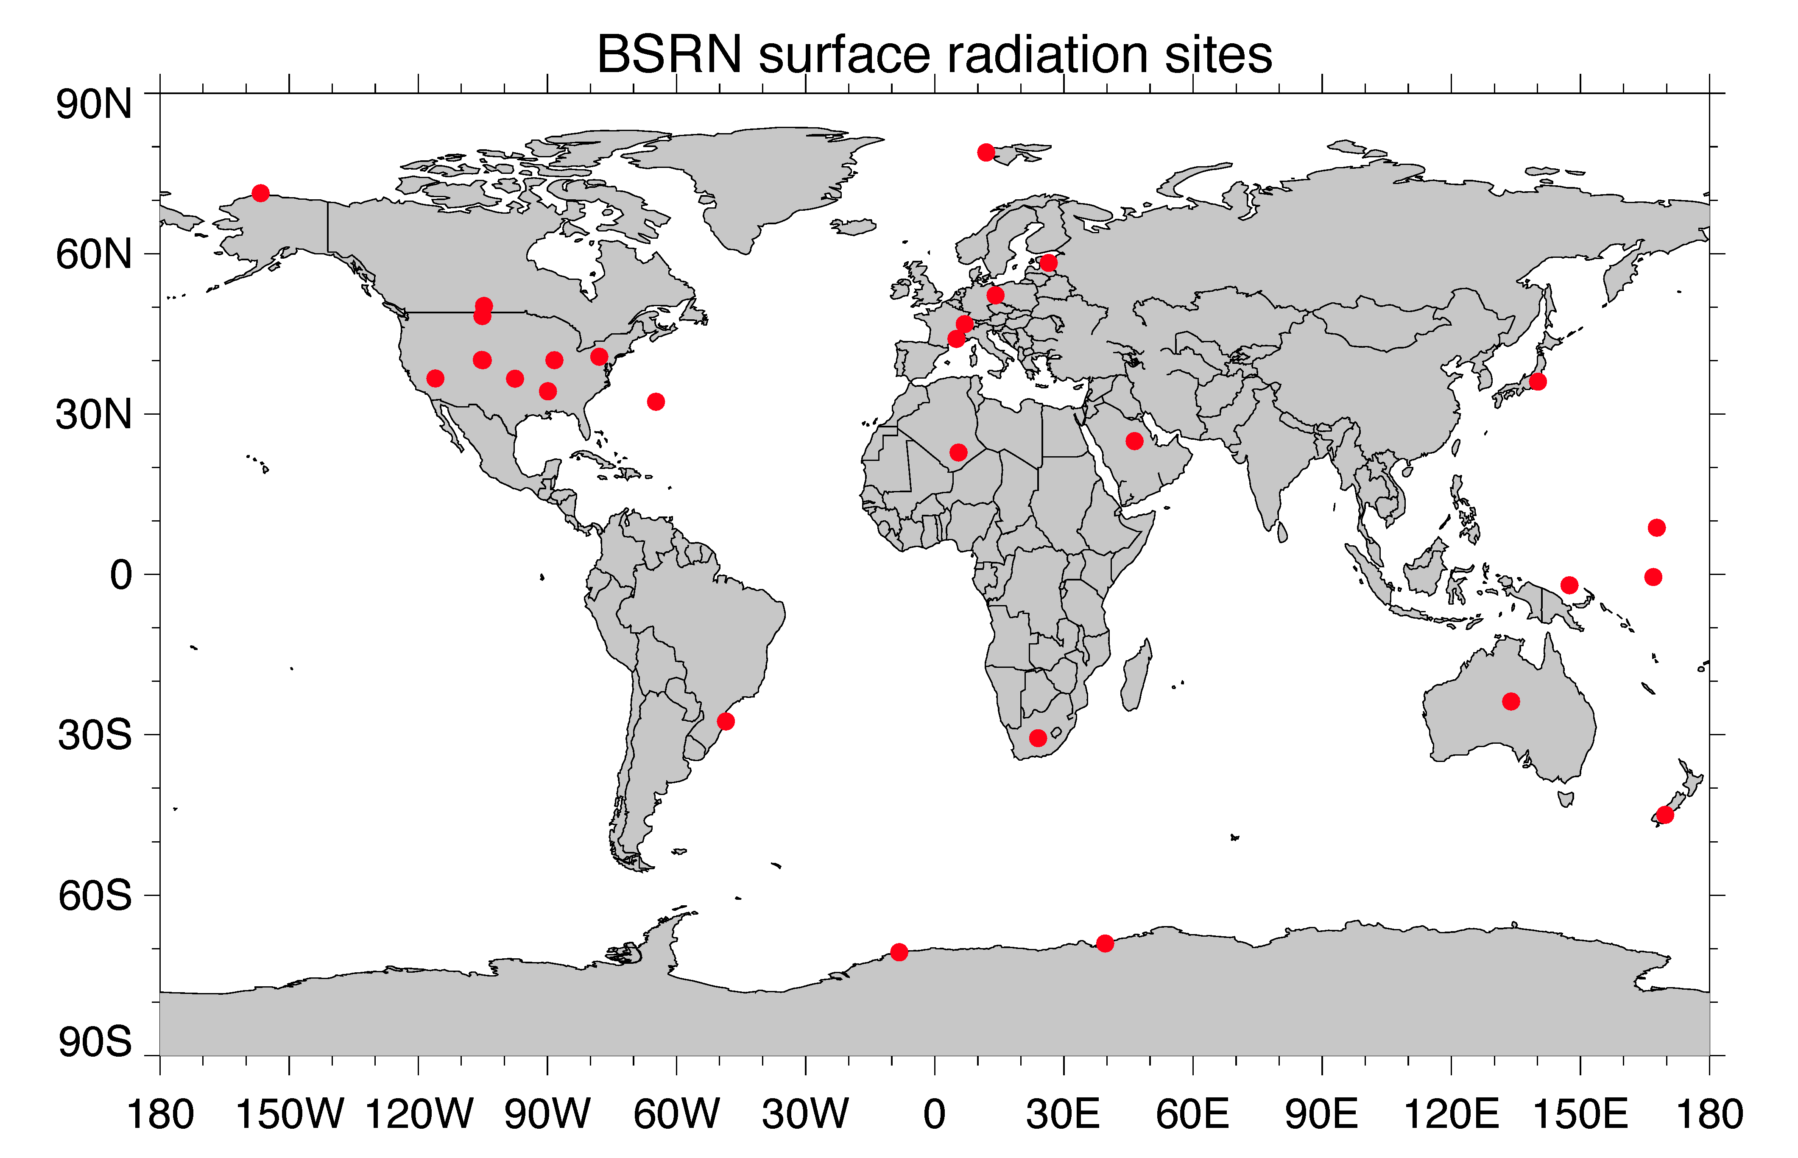
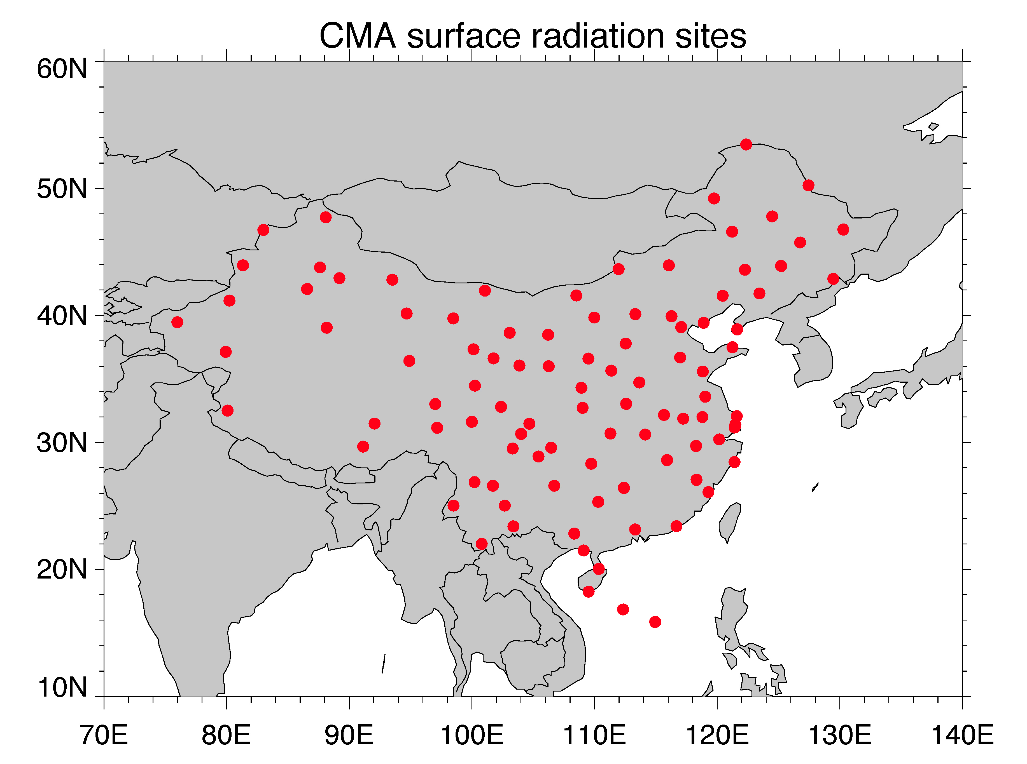
Aerosol effects on of SW radiation reaching the surface
Long-term measurements of sownward SW radiation at the surface:
GEBA network:
Long-term
Many sites, mostly in Europe
All-sky total radiation only
BSRN network:
Start 1992
Less than 3 dozen sites
All-sky and clear-sky total, direct, diffuse
CMA network:
Long-term
In China
All-sky and clear-sky total, direct, diffuse

Slide 27
Comparisons of normalized SW downward surface radiation anomaly with GEBA
0.10
Wuerzburg, Germany
Helsinki airport, Finland
Belsk, Poland
Oak Ridge, USA
All-sky total
However, it is difficult to assessing the aerosol effects under all-sky conditions because clouds effects on radiation would overwhelm the aerosol effects
-0.10
0.10
Guan Zhou, China
Seoul, South Korea
Fukuoka, Japan
Alice Springs, Australia
All-sky total
-0.10
0.10
Raizet, Guadeloupe
Valparaiso, Chile
Aswan Egypt
Bulawayo-Goetz, Zimbabwe
All-sky total
-0.10
GOCART
GEBA

Slide 28
Comparisons of normalized SW downward surface radiation anomaly with BSRN
0.10
Lindenberg, Germany
Payerne, Switzerland
Boulder, CO, USA
Syowa, Antarctica
All-sky total
-0.10
0.10
Lindenberg, Germany
Payerne, Switzerland
Boulder, CO, USA
Syowa, Antarctica
Clear-sky total
-0.10
0.10
Lindenberg, Germany
Payerne, Switzerland
Boulder, CO, USA
Syowa, Antarctica
Clear-sky diffuse
-0.10
GOCART
BSRN

Slide 29
Comparisons of normalized SW downward surface radiation anomaly with CMA (China)
0.10
Ulumuqi
乌鲁木齐
Shen Yang
沈阳
Beijing
北京
Kun Ming
昆明
All-sky total
-0.10
0.10
Ulumuqi
Shen Yang
Beijing
Kun Ming
Clear-sky total
-0.10
0.10
Ulumuqi
Shen Yang
Beijing
Kun Ming
Clear-sky diffuse
-0.10
GOCART
CMA

Slide 30
Aerosols attenuate direct radiation but amplify diffuse radiation
Clear sky total, W m⁻²
Clear sky diffuse, W m⁻²
Clear sky direct, W m⁻²
BSRN sites
With aerosol
Without aerosol
CMA sites
With aerosol
Without aerosol

Slide 31
Climatology (1984-2004) of SW downward radiative flux at surface – Clear sky
GOCART
ISCCP
SRB
Clear sky, 84-04 avg
Under clear sky condition, the model agrees with ISCCP and SRB in most location (Note: clear sky data from ISCCP and SRB are extracted with cloud fraction < 10%)

Slide 32
Clear sky trend of SW downward radiative flux at surface, [2000-2004] – [1984-1989]
GOCART
ISCCP
SRB
All sky, 84-04 avg
Decrease
Increase
Decrease
Increase
Decrease
Increase
Model shows brightening over eastern US, Europe, and Eurasia, dimming over Asia, Africa, and NW South America
SRB shows similar trends as model over land (except in S Africa), but the pattern is quite different over ocean
ISCCP shows dimming almost everywhere over land and brightening over SH ocean

Slide 33
Conclusions
Satellite observations and model simulations of the past three decades have shown a decreasing of AOD over North America and Europe but an increasing over East and South Asia, in general in line with the anthropogenic emission change, although the variation of dust makes the EAS and SAS trends less clear
It seems the dust has an increase trends in the most recent decades over Middle East and Central Asia
Over the ocean near the continental outflow regions, AOD trends are generally consistent with that in the upwind continents, although satellite data are not necessarily consistent on the direction of changes
Under the clear-sky conditions, the changes of SW downward radiation at the surface mirror the change of AOD, e.g., “brightening” is associated with the decrease of AOD and “dimming” with the increase of AOD

