Slide 1
Aerosol, Cumulus Congestus, MJO
Xiaowen Li
GEST/UMBC
Wei-Kuo Tao
NASA/GSFC
Aerocenter Annual Meeting April 2010

Slide 2
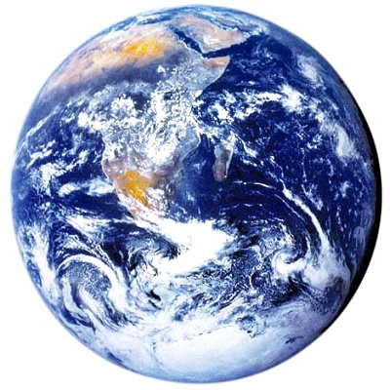
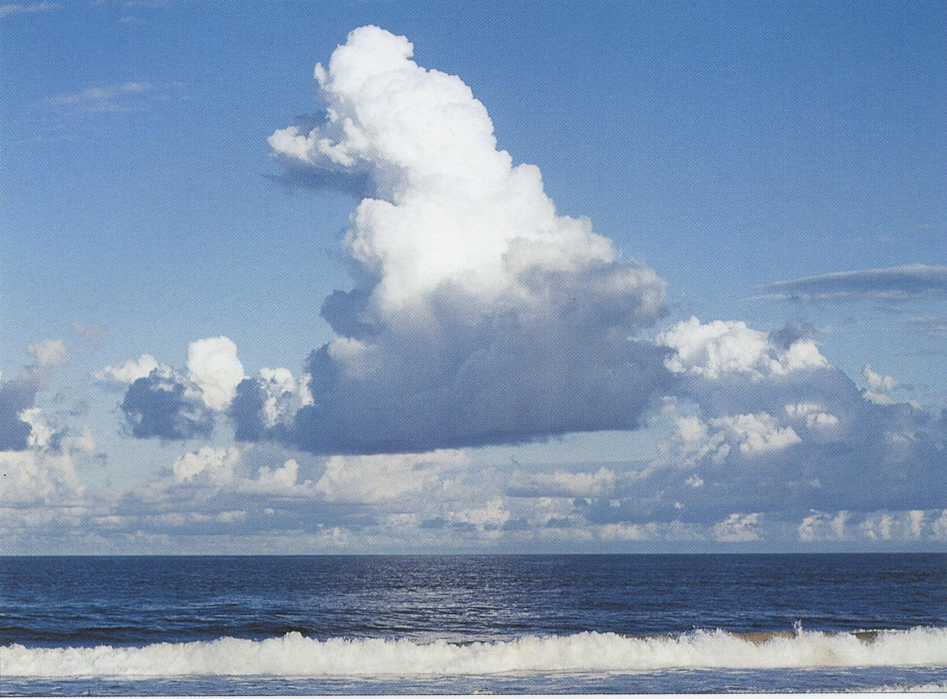
Making a connection….
aerosols
Cumulus Congestus
~10³ m
Madden-Julian Oscillation
~10⁷ m
~10⁻⁷ m

Slide 3
TOGA COARE control Experiment with typical
Maritime Aerosol concentrations (Jaenicke, 1988)

Slide 4
TOGA COARE 10x control aerosol number concentrations

Slide 5
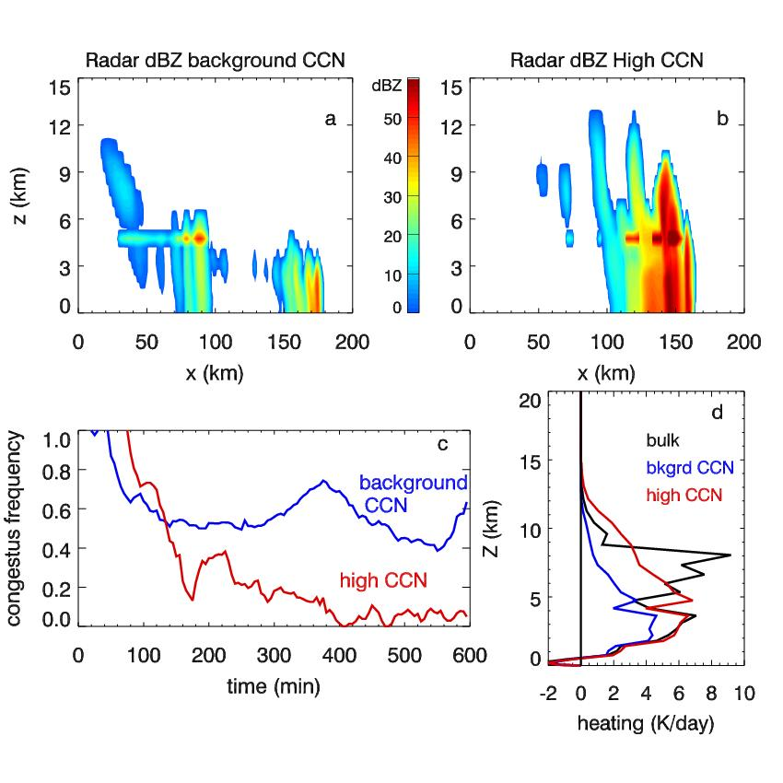
Summary of TOGA COARE Simulation

Slide 6
Other Cloud Modeling Studies
GATE
∆P (%)
LBA
∆N (cm⁻³)

Slide 7
Why?
TOGA COARE Thermodynamics;
Characteristics of Maritime aerosols;
Cloud microphysics and dynamics interactions;
Implications on large scale circulations.

Slide 8
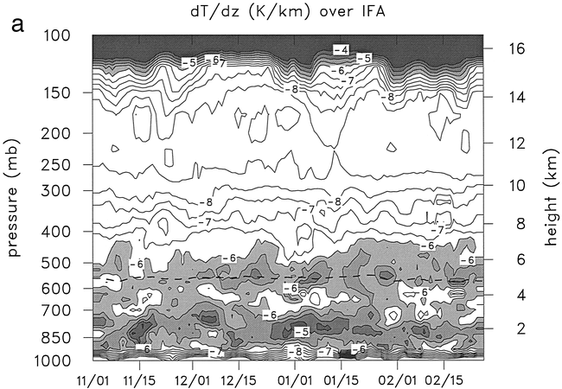
Thermodynamics
Tropical oceanic sounding is characterized by ample water vapor supply, weak instability, and two inversion layers: trade wind inversion and 0°C inversion.
Average temperature profile from COARE IFA
Johnson (1999)

Slide 9
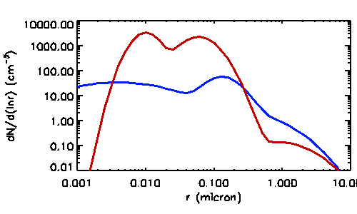
Maritime Aerosols
Higher concentrations at the large size tail but much lower concentration at smaller size
continenal
maritime

Slide 10
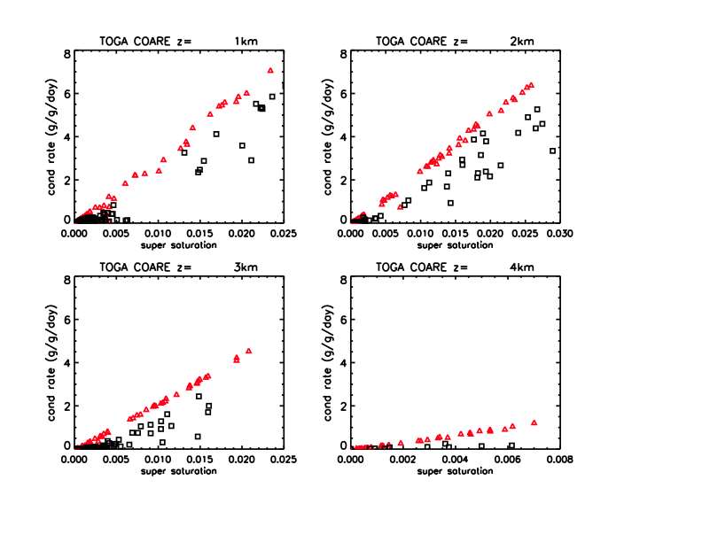
When there is large moisture supply, low CCN and less cloud drops resulted in less latent heat release.
As a result, most clouds cannot pass the 0°C inversion level.
High CCN
Low CCN

Slide 11
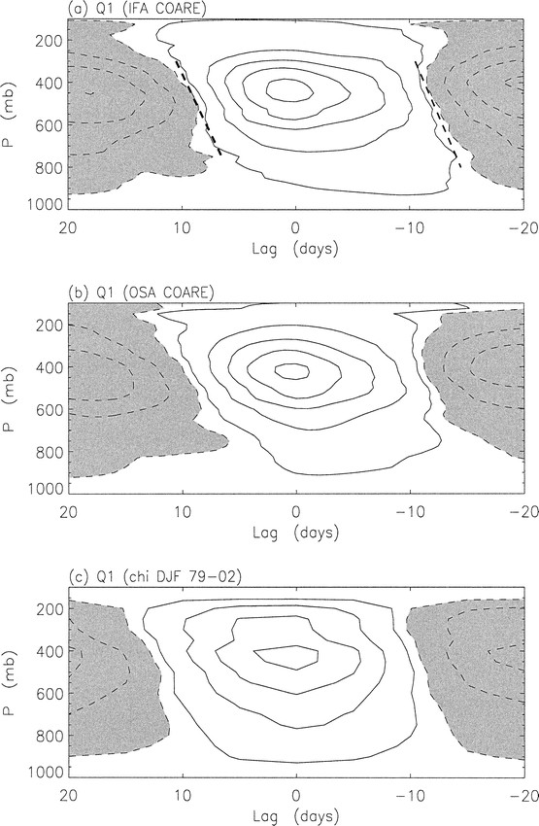
TOGA COARE IFA heating profiles during MJO events. The tilting at the MJO onset indicates cumulus congestus heating, which is poorly simulated in GCMs.
(Lin et al. 2004)

Slide 12
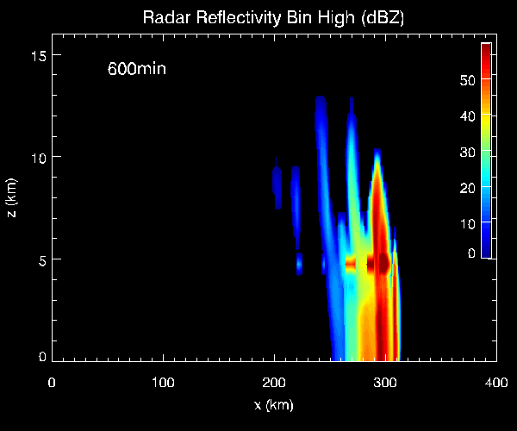
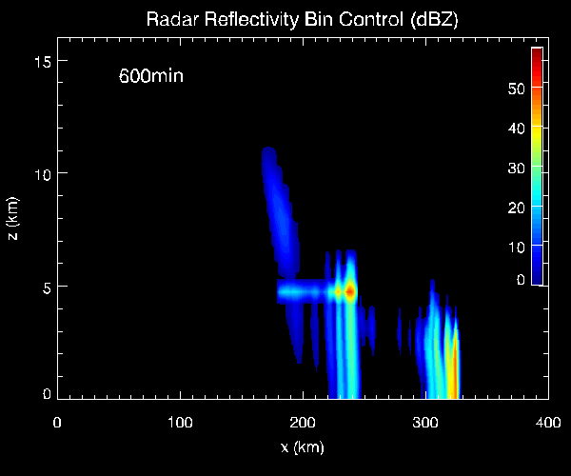
A Simplified Theory
Aerosol cycle over clean tropical ocean needs to be considered in order to properly simulate convection intensity and MJO events.
characteristics
of convection
atmos
heating
Tropical wave speed
aerosol conc
intraseasonal
variations and
general circulation

Slide 13
Multi-Scale Modeling System with Unified Physics
TRMM Jan/99
MMF
WRF- Hurricane Katrina
(1.67 km, 2 min)
GOCART
GCE - LBA (250 m, 30 sec)
Satellite Data
Field Campaigns
Re-analyses (MERRA)
MMF: Multi-Scale Modeling Framework
LIS: Land Information System
GCE: Goddard Cumulus Ensemble Model
WRF: Weather Research Forecast
Goddard Microphysical Package (5 options)
& Goddard Long/Shortwave Radiative Transfer
(including cloud-radiation interaction)
Tao, W.-K., D. Anderson, J. Chern, J. Estin, A. Hou, P. Houser, R. Kakar, S. Lang, W. Lau, C. Peters-Lidard, X. Li, T. Matsui, M. Rienecker, M. R. Schoeberl B.-W. Shen, J.-J. Shi, and X. Zeng, 2009: Goddard Multi-Scale Modeling Systems with Unified Physics, Annales Geophysics, 27, 3055-3064.

Slide 14
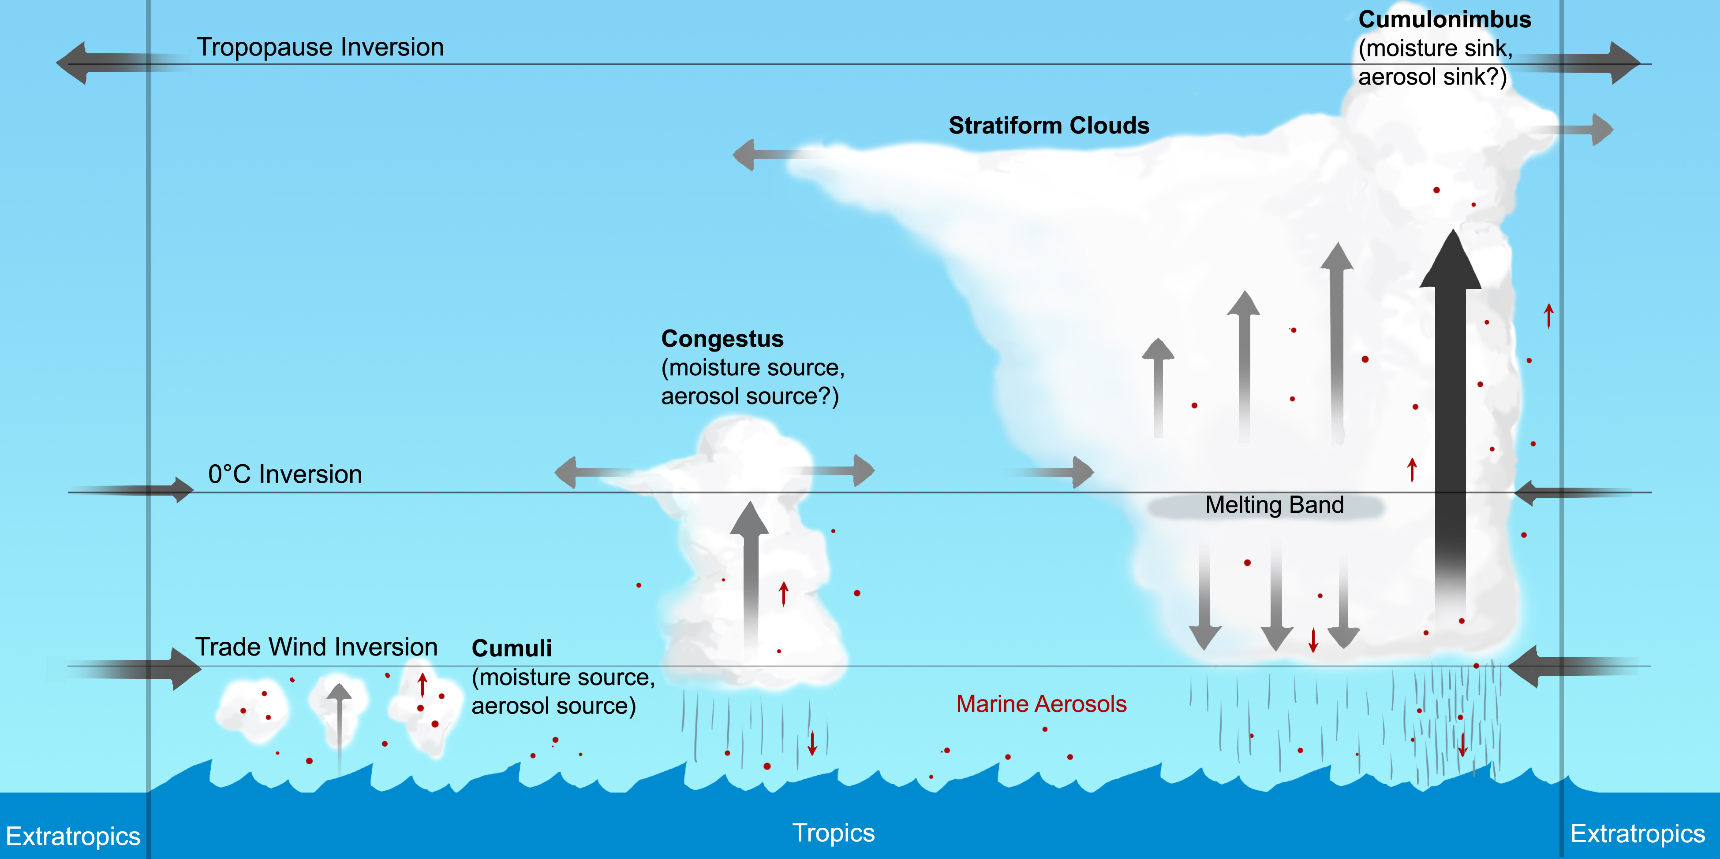
Thank You!

