Slide 1
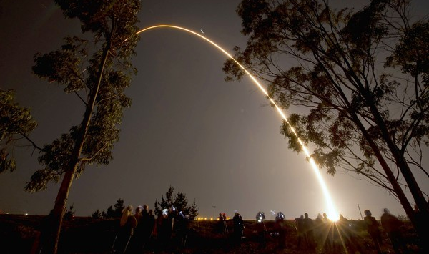
VIIRS aerosol algorithm and products.
Report to AeroCenter annual meeting.
Lorraine A. Remer
JCET UMBC

Slide 2
The future is now!
Suomi-NPP satellite launched 28 October 2011

Slide 3
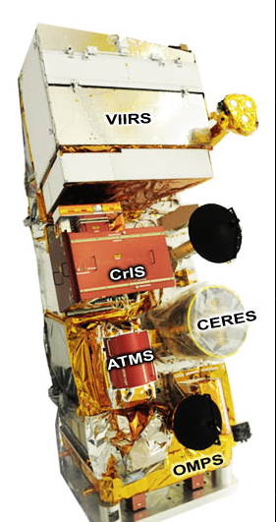
VIIRS: Visible-Infrared Imager/Radiometer Suite
CrIS: Cross-track Infrared Sounder
CERES: Cloud and Earth Radiant Energy System
ATMS: Advance Technology Microwave Sounder
OMPS: Ozone Mapping and Profiler Suite

Slide 4
VIIRS: Visible-Infrared Imager/Radiometer Suite
CrIS: Cross-track Infrared Sounder HIRS
CERES: Cloud and Earth Radiant Energy System CERES
ATMS: Advance Technology Microwave Sounder AMSU
OMPS: Ozone Mapping and Profiler Suite OMI

Slide 5
VIIRS: Visible-Infrared Imager/Radiometer Suite MODIS/AVHRR/ SeaWIFS
CrIS: Cross-track Infrared Sounder HIRS
CERES: Cloud and Earth Radiant Energy System CERES
ATMS: Advance Technology Microwave Sounder AMSU
OMPS: Ozone Mapping and Profiler Suite OMI

Slide 6
Name | Organization | Major Task
Kurt F. Brueske | IIS/Raytheon | Code testing support within IDPS
Ashley N. Griffin | PRAXIS, INC/NASA | JAM
Brent Holben | NASA/GSFC | AERONET observations for validation work
Robert Holz | UW/CIMSS | Product validation and science team support
Nai-Yung C. Hsu | NASA/GSFC | Deep-blue algorithm development
Ho-Chun Huang | UMD/CICS | SM algorithm development and validation
Jingfeng Huang | UMD/CICS | AOT Algorithm development and product validation
Edward J. Hyer | NRL | Product validation, assimilation activities
John M. Jackson | NGAS | VIIRS cal/val activities, liaison to SDR team
Shobha Kondragunta | NOAA/NESDIS | Co-lead
Istvan Laszlo | NOAA/NESDIS | Co-lead
Hongqing Liu | IMSG/NOAA | Visualization, algorithm development, validation
Min M. Oo | UW/CIMSS | Cal/Val with collocated MODIS data
Lorraine A. Remer | UMBC | Algorithm development, ATBD, liason to VCM team
Andrew M. Sayer | NASA/GESTAR | Deep-blue algorithm development
Hai Zhang | IMSG/NOAA | Algorithm coding, validation within IDEA

Slide 7

Heritage Capabilities
From Ed Hyer, NRL
VIIRS
DNB
MODIS
SeaWiFS
AVHRR
OLS
Low Light Imagery
0.4
0.5
0.6
0.7
0.8
0.9
1.2
1.8
2.4
4
6
8
10
12
14
Visible
Breaks in scale
Mid wave IR
Long wave IR
[micron]
Credit: Northrup Grumman & Raytheon

Slide 8
VIIRS is a multiwavelength imager, like MODIS
with similar wavelength bands in the aerosol range
 | MODIS | VIIRS
Orbit altitude | 690 km | 824 km
Equator crossing time | 13:30 LT | 13:30 LT
Granule size | 5 minutes | 86 seconds
swath | 2330 km | 3000 km
Pixel nadir | 0.5 km | 0.75 km
Pixel edge | 2 km | 1.5 km

Slide 9
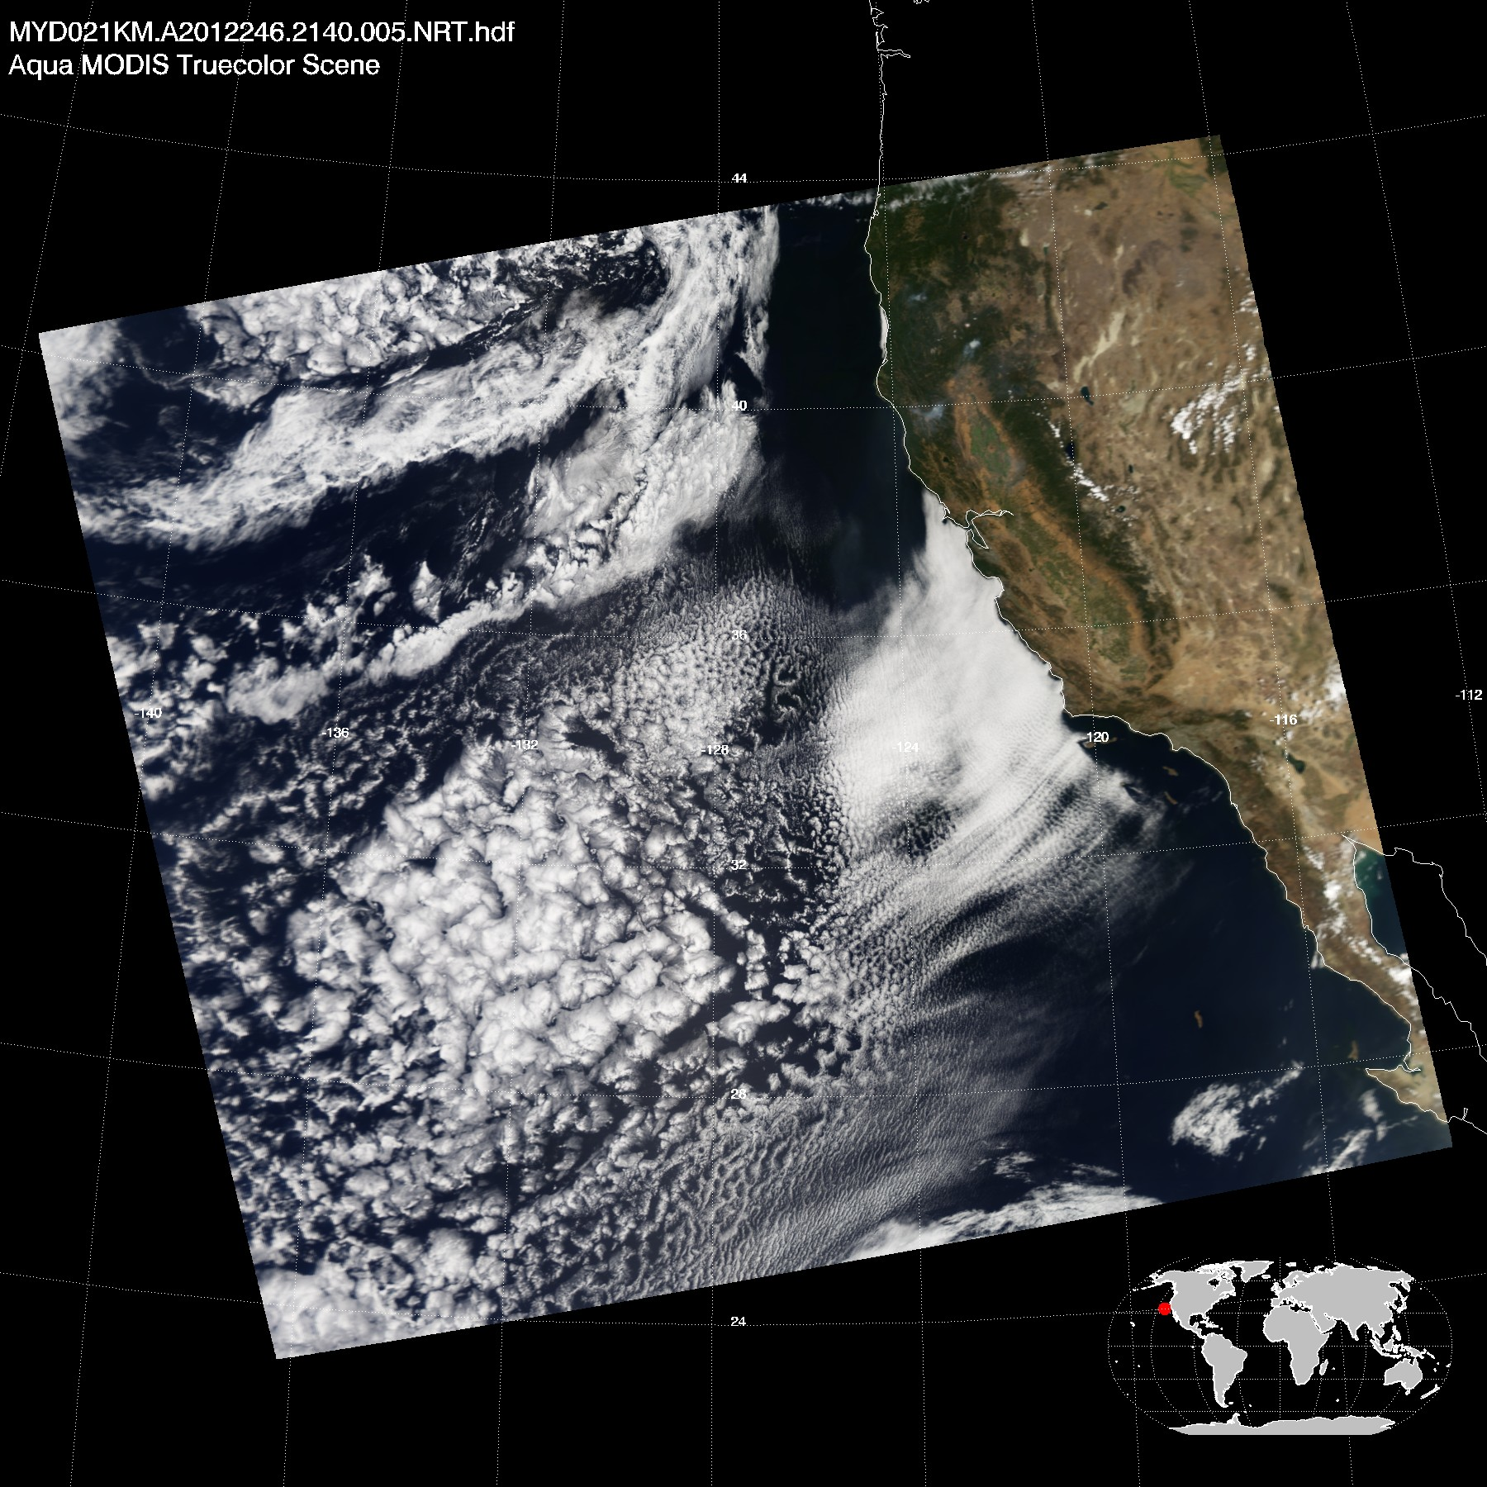
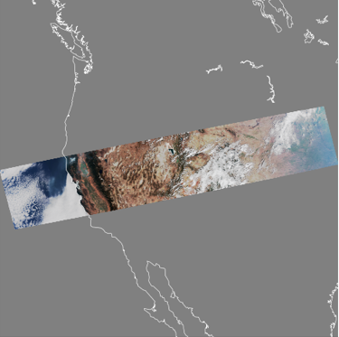
VIIRS granule
NASA MODIS Atmospheres
SSEC PEATE
MODIS
0.66 – 0.55 – 0.47 µm
2 Sep 2012
21:40 UTC
VIIRS
0.67 – 0.55 – 0.49 µm
2 Sep 2012
20:24:27.8 UTC

Slide 10
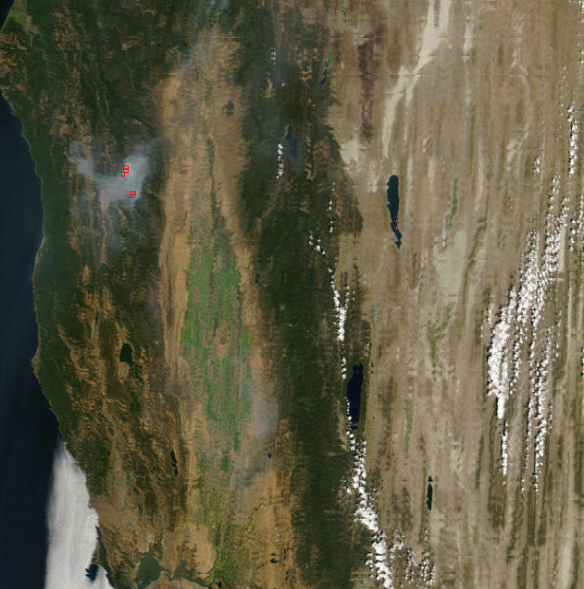
MODIS swath edge
‘bowtie’ effect
VIIRS doesn’t have this
From NASA LANCE

Slide 11
 | MODIS | VIIRS
Product resolution nadir | 10 km and 3 km | 6 km and 0.75 km
Product resolution edge | 40 km and 12 km | 12 km and 1.5 km
Products land | AOT | AOT, (suspended matter)
Products ocean | AOT, fine mode fraction | AOT, Angstrom exponent, (suspended matter)
Suspended matter is a qualitative index designating aerosol type.
It has no MODIS heritage, and is currently under development with no access to users.

Slide 12
Data (not SM) are available through CLASS:
http://www.class.noaa.gov
A “back door” for data via the IDEA site:
https://www.star.nesdis.noaa.gov/smcd/spb/aq/index_viirs.php?product_id=4
Users’ guide available at:
http://www.star.nesdis.noaa.gov/jpss/ATBD.php#S126472
README file under VIIRS aerosol (AOT) at:
http://www.nsof.class.noaa.gov/saa/products/welcome
Other documents are available at:
http://npp.gsfc.nasa.gov/science/documents.html

Slide 13
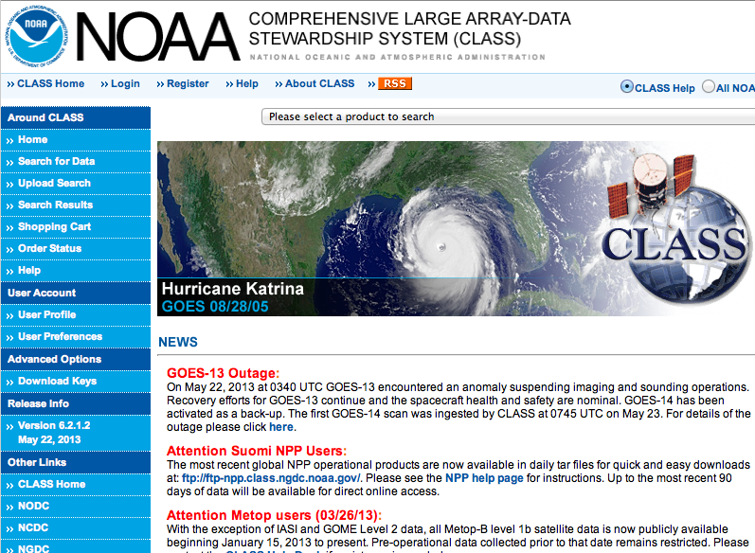

Slide 14
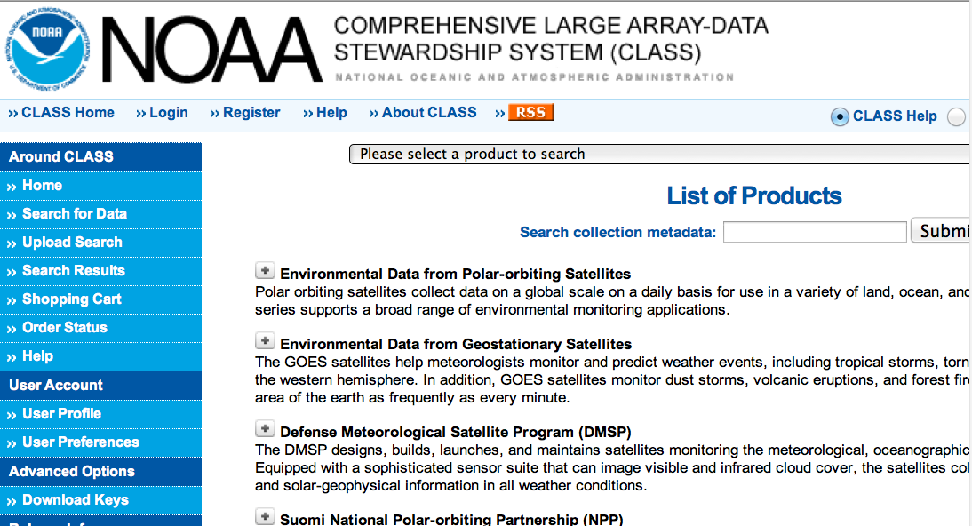

Slide 15
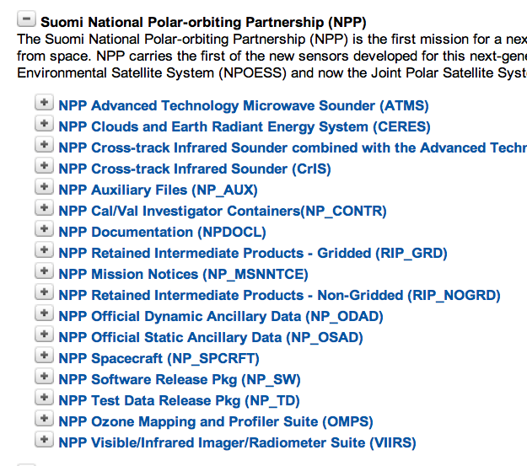

Slide 16
From the Users Guide
Data are available through CLASS:
http://www.class.noaa.gov
AEROSOL EDR Product File
VAOOO_npp_d20120626_t1958134_e1959376_b03440_c20120627024612139725_
noaa_ops.h5
HDF5 format
GAERO_npp_d20120626_t1958134_e1959376_b03440_c20120627021509002956_
noaa_ops.h5
AEROSOL geolocation file

Slide 17
EDR is Environmental Data Record
(Think Level 2 data product)
SDR is Sensor Data Record
(Think Level 1b)
IP is Intermediate Product
(No MODIS counterpart).
IP AOT is at 0.75 km nadir, no aggregation
EDR is the aggregation of 8x8 IP retrievals

Slide 18

IP product
EDR product
35 individual 0.75 km AOT retrievals
1 value of AOT to represent the entire box

Slide 19
IP product
EDR product
EDR product is aggregated from IP product,
using complex decision tree involving QA.
Not from original radiances

Slide 20
Ocean algorithm differences from MODIS
No 550 nm channel in the retrieval
Dynamic glint mask
Variable wind speed
But otherwise every inch a Tanré ocean retrieval,
just like MODIS

Slide 21
Land algorithm differences from MODIS
VIIRS retrieval is NOT a Kaufman retrieval, and NOT a Levy retrieval
VIIRS: 0.412 µm, 0.444 µm, 0.486 µm, 0.672µm, 2.257 µm
MODIS: 0.466 µm, 0.665 µm, 2.13 µm
VIIRS: Chooses from 5 discrete aerosol models
MODIS: mixes two assigned models
VIIRS: does atmospheric correction and solves for ρ_{surf}(λ)
MODIS: that’s crazy!
VIIRS: fits to expected spectral shape of ρ_{surf}
MODIS: assumes spectral shape and fits to ρ_{TOA}

Slide 22
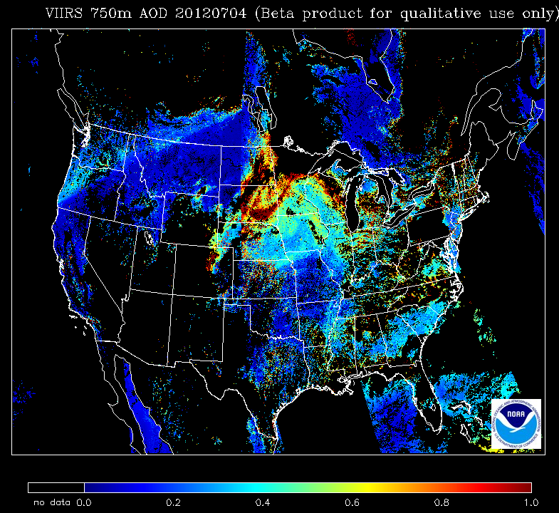
VIIRS AOT 550 nm 4 July 2012 IP 750 m
Kondragunta

Slide 23
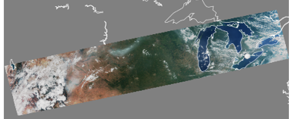
VIIRS AOT 550 nm 4 July 2012
VIIRS RGB
4 July 2012 19:07 UTC

Slide 24
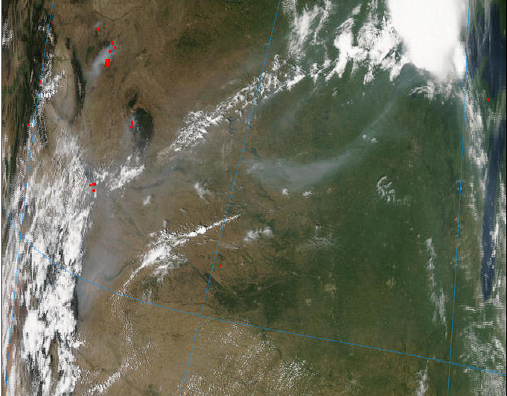
VIIRS RGB
4 July 2012 19:07 UTC
MODIS RGB 4 Jul 2012 19:40 UTC

Slide 25
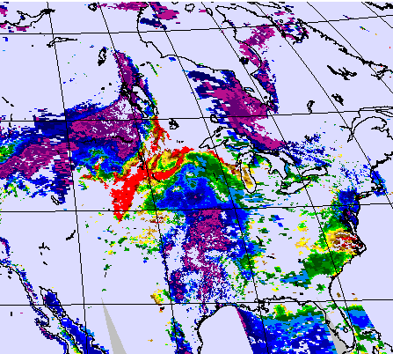

VIIRS AOT 550 nm 4 July 2012 IP 750 m
NASA MODIS Atmospheres
MODIS AOT 550 nm 4 July 2012
Aqua L2 Col51 10 km
Kondragunta

Slide 26
Important Dates:
Software production error
Aerosol product candidate provisional status
Initial instrument check out.
Tuning cloud mask parameters
Aerosol product at Beta status
Beta status
28 Oct
2011
2 May
2012
15 Oct
2012
22 Jan
2013
today
27 Nov
2012
Red periods: DO NOT USE the product.
Beta: Use with caution. Known biases. Frequent changes.
Provisional: Improved from Beta. Still under close scrutiny.

Slide 27
Daily global mean AOT550
And standard deviation
Important algorithm change
Processing error

Slide 28
NOT collocated: both algorithm and sampling differences
VIIRS AOT550 – MODIS AOT550
-0.20
0.00
0.20
VIIRS team is attacking this problem now
by linking surface assumptions to NDVI_SWIR

Slide 29
VIIRS AOT vs. AERONET
Ocean
VIIRS R=0.91 MODIS R=0.92
65% within expected error
(same as MODIS)
Land
VIIRS R=0.80 MODIS R=0.91
71% within expected error
MODIS only 65%

Slide 30
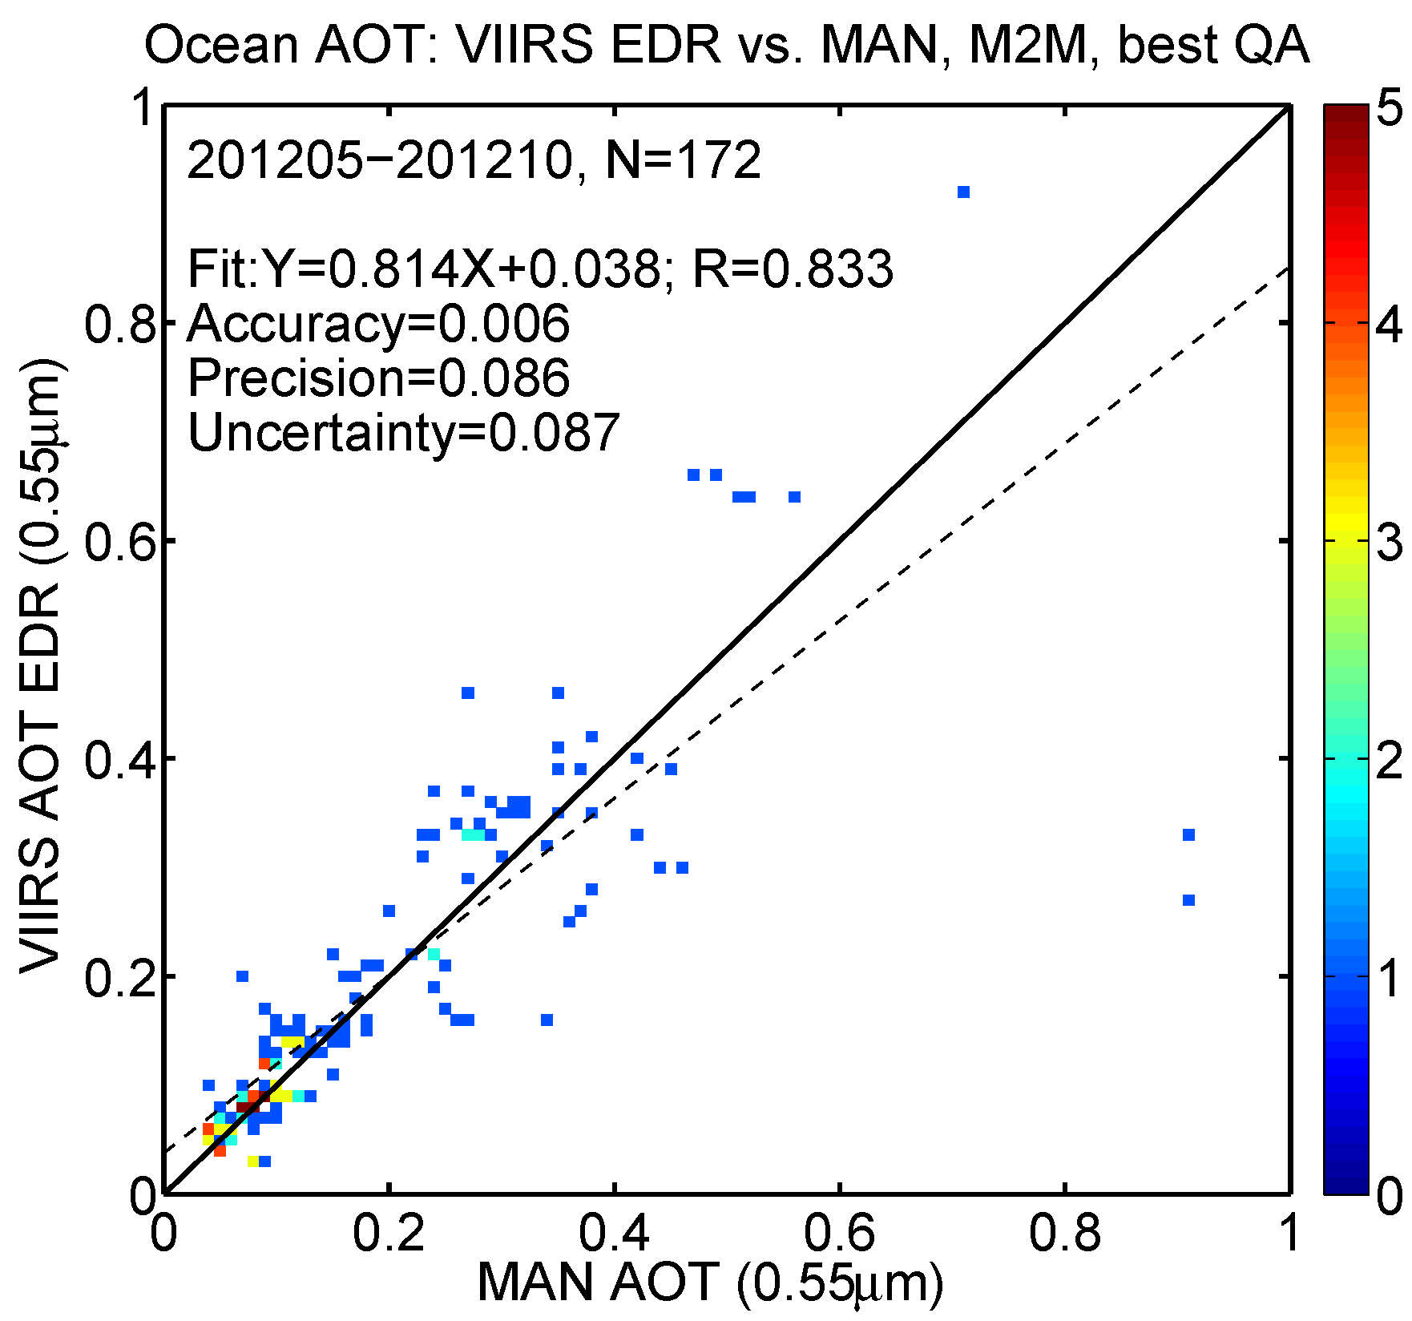
VIIRS vs. MAN

Slide 31
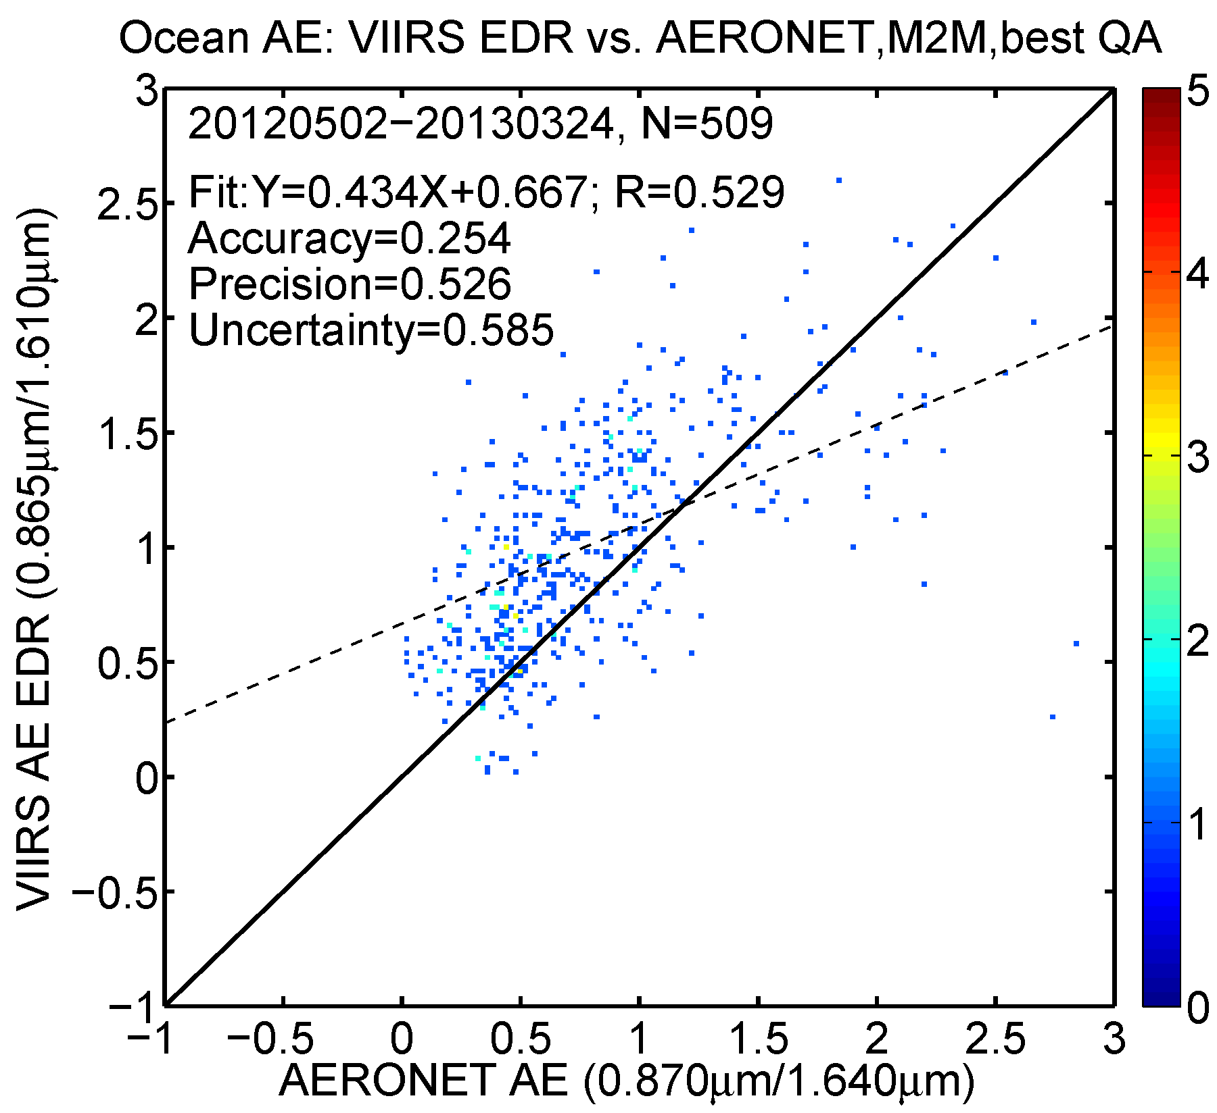
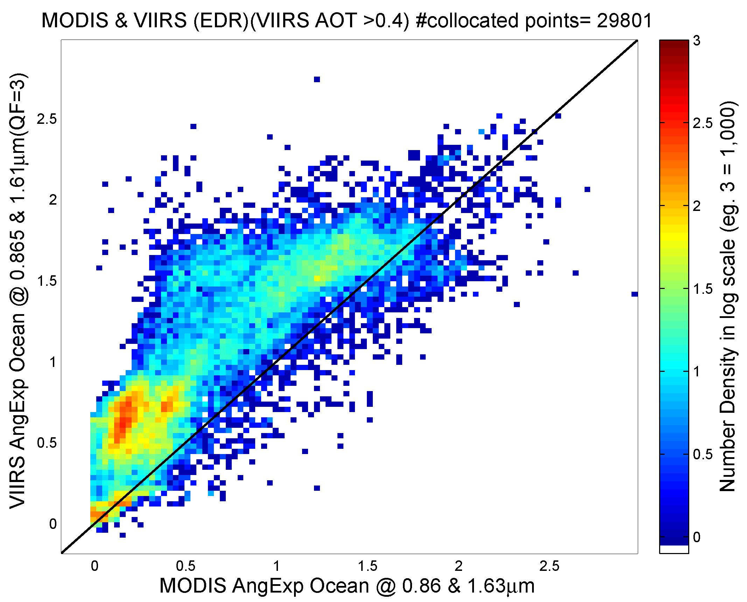
Angstrom Exponent Over Ocean
VIIRS vs. MODIS (AOT > 0.4)
VIIRS vs. AERONET

Slide 32
VIIRS aerosol product is quickly progressing to MODIS level of validity
Needs Level 3 and more “back doors” for access.
Needs Deep Blue.

Slide 33
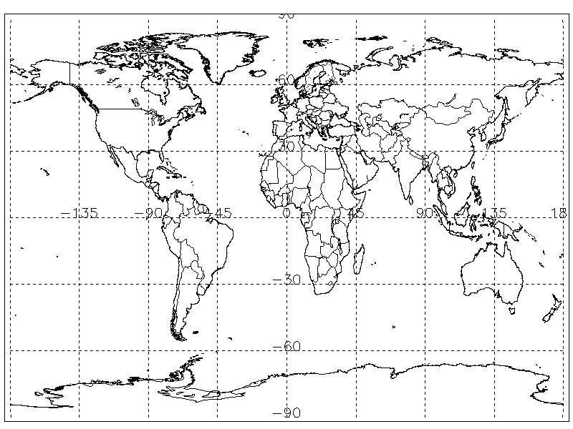
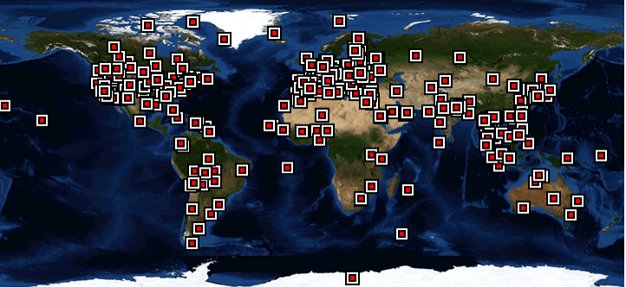
In perspective
VIIRS vs. MODIS algorithm evolution
3 years after Terra launch
1 year after Suomi-NPP launch
Global validation heavily weighted to Eastern U.S. and western Europe, with Amazon also well-represented.
ALL VEGETATED SURFACES
In time AERONET spread out to less desirable surfaces and MODIS retrieval “got worse”
VIIRS is facing a harder “audience”

Slide 34
In perspective
VIIRS vs. MODIS algorithm evolution
MODIS aerosol validation 2000-2002
(3 years after Terra launch)
AERONET sites
ocean
land
both
land
0.06 high bias over land,
against “favorable” AERONET stations.
2 years later this bias was closer to 0.10

Slide 35
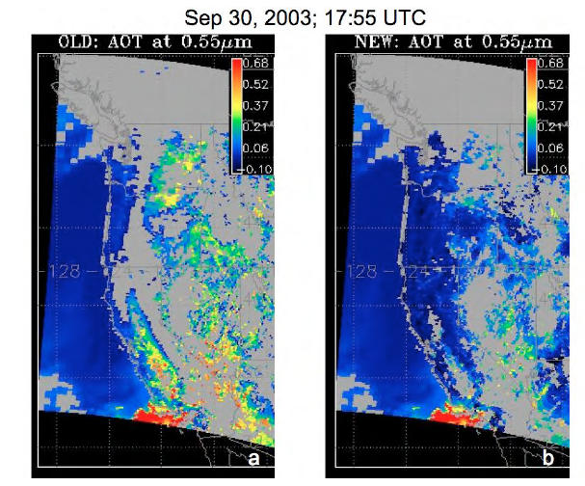
4 years after launch and still plagued by Spring thaw snow melt and artificial AOT of 0.2 to 0.3 over low NDVI areas and places with complex topography, which was finally eliminated in 2006 (6 years after launch)
Li et al. (2005)

Slide 36
In perspective
VIIRS vs. MODIS algorithm evolution
It’s only been 19 months since launch of VIIRS
Already VIIRS is producing AOT and AE with accuracy equal to MODIS that took MODIS 4 to 6 years to accomplish!
From the MODIS perspective, VIIRS is advancing at light speed, and people need to be patient with the expectations.
The main obstacle to VIIRS aerosol success will be
data dissemination,
not data quality.

Slide 37
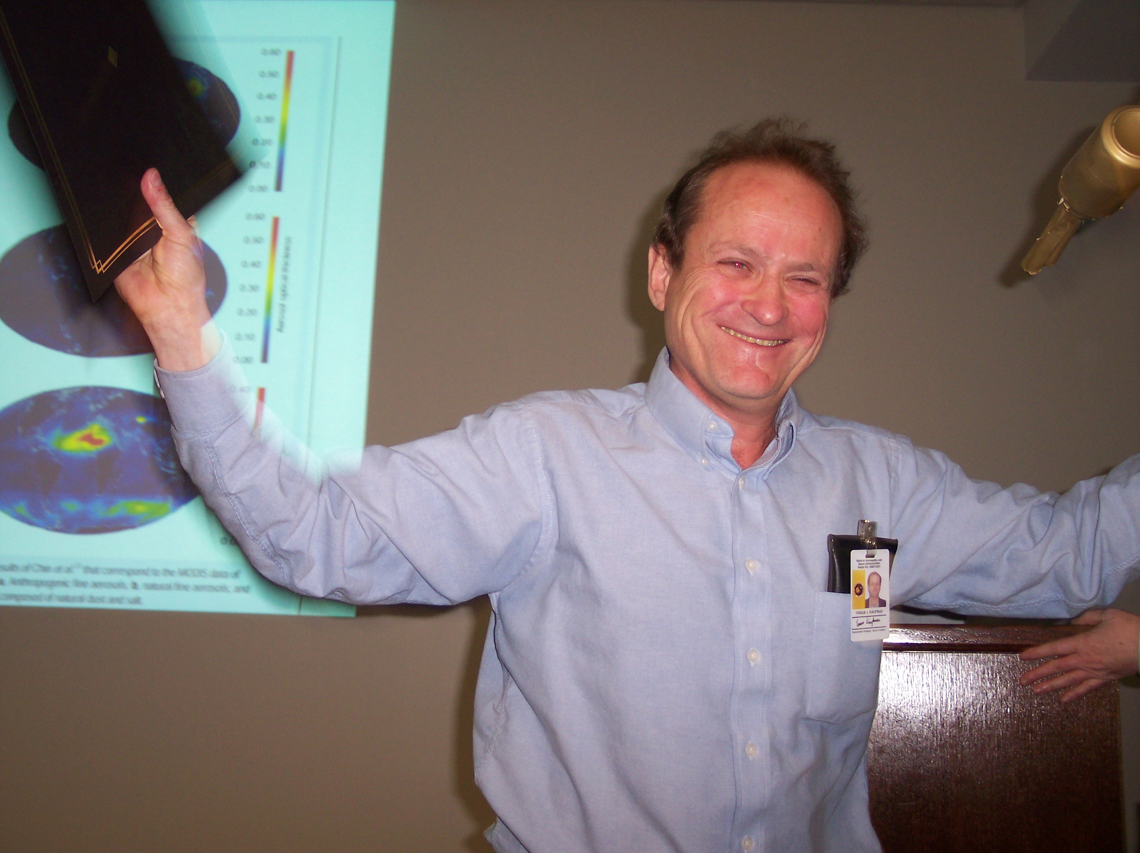
1 June 1948 – 31 May 2006
7 years gone
And I miss him so much. Still.

Slide 38
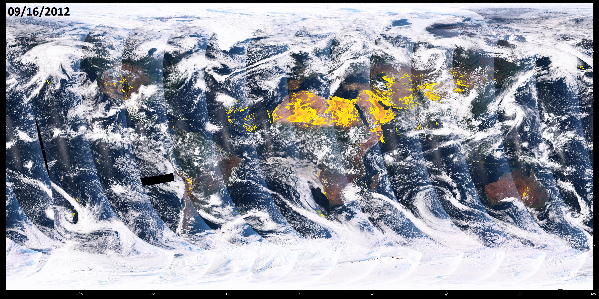
Suomi NPP VIIRS Global Dust Imagery
VIIRS experimental global dust index algorithm uses blue and mid-infrared bands (M1, M2, and M11) to generate a global dust index for National Weather Service air quality forecast applications. Movie loop shows dust outbreaks over the desert regions over a 3-day time period in September 2012. This algorithm will soon run at NESDIS STAR on VIIRS DB data covering the CONUS with a 30 minute latency.
Courtesy of Ciren (IMSG) and Kondragunta (NESDIS/STAR)

Slide 39
Ocean algorithm
reflectance
wavelength
0.10
0.20
1.0
2.0
Radius (µm)

