Slide 1
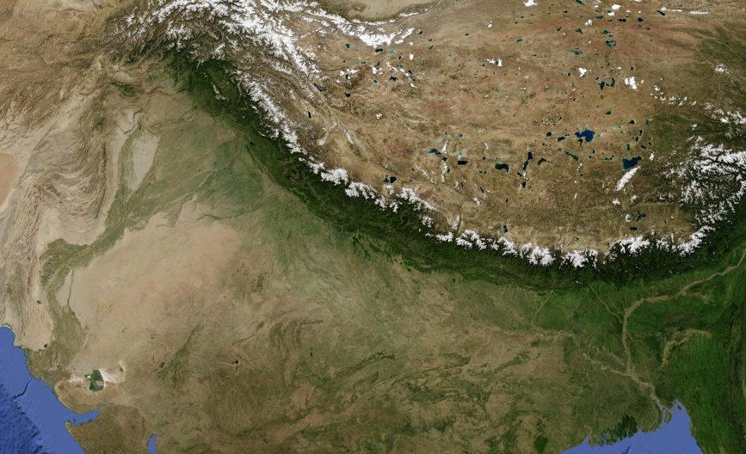
Satellite Observations of Enhanced Pre-Monsoon Aerosol Loading and Tropospheric Warming over the Gangetic-Himalayan Region
Ritesh Gautam¹, N. Christina Hsu², W. Lau²
¹GEST/University of Maryland Baltimore County
²NASA Goddard Space Flight Center
Tibetan Plateau
H i m a l a y a s
Biomass Burning
Dust
Anthropogenic Pollution
Gangetic Plains

Slide 2
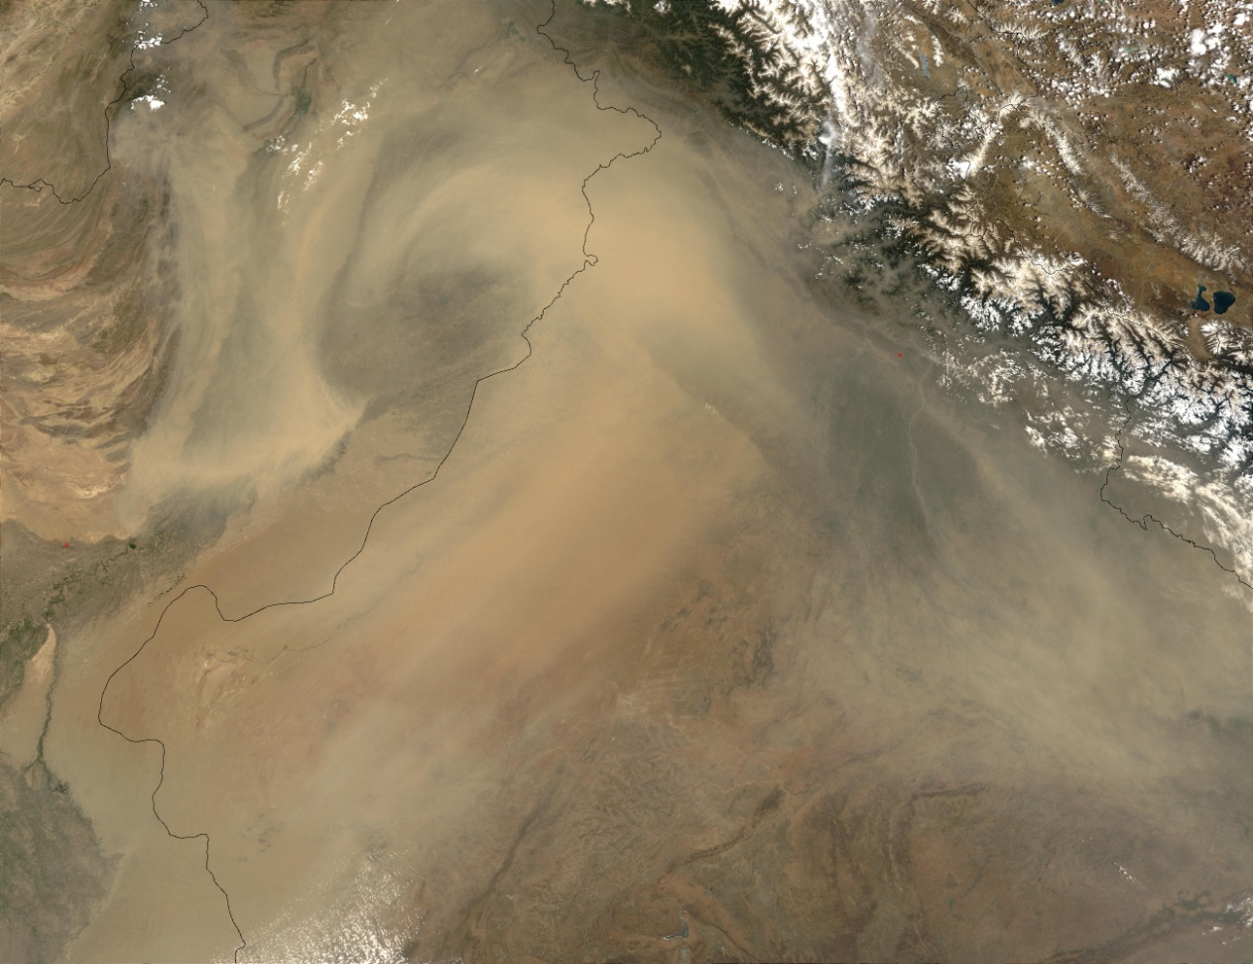
Motivation
In recent past years, model studies have suggested the importance of aerosol solar absorption in modulating the monsoon rainfall distribution (for e.g., Menon et al., 2002; Ramanathan et al., 2005; Lau et al., 2006; Meehl et al., 2008; Randles and Ramaswamy, 2008).
Pre-monsoon period marks the reversal of tropospheric temp. gradient and is crucial to the summer monsoon onset and rainfall.
Dust mixed with soot over northern India has been hypothesized in intensifying the early summer monsoon circulation and rainfall (Lau et al., 2006, Lau and Kim, 2006).
MODIS, 9 June 2003
→ Climate modeling can benefit from an indepth characterization of spatio-temporal-vertical characterization of the regional aerosol loading and associated radiative impacts.

Slide 3
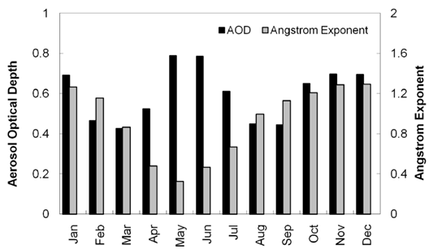
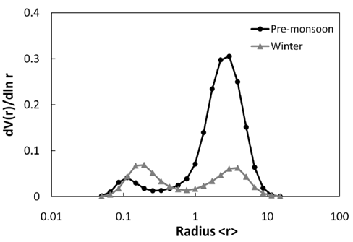
Strong seasonal variations of Aerosols over the IGP
Kanpur/AERONET
Pre-monsoon AOD Climatology 2003-2009 (Aqua MODIS Dark Target w/Deep Blue)

Slide 4
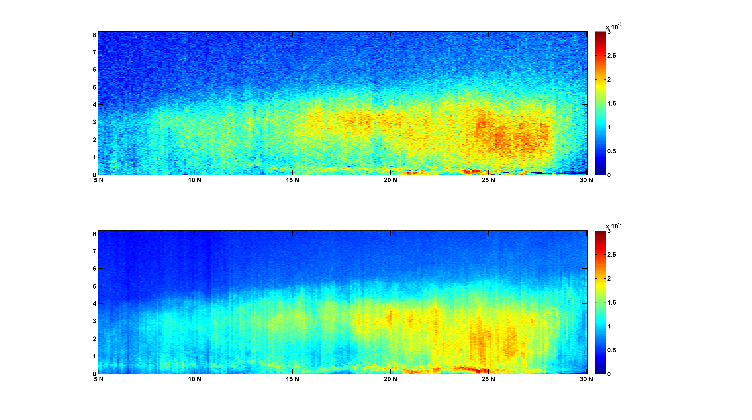
Pre-monsoon Aerosol Characterization from CALIPSO
CALIOP
Over 70% of mean AOD in northern India associated with higher depolarization ratio suggesting greater contribution of non-spherical particulates
Gautam, Liu, Singh, Hsu, GRL (2009)
CALIOP cloud-screened mean backscatter profile for April-May 2008
Vertically extended aerosols over northern India, aerosol layer top ~ 5 km
Altitude (km)

Slide 5
Aerosol Solar Absorption and Radiative Forcing
Model calculated column SSA (@550nm) in the IGP over Kanpur is 0.89±0.01 during pre-monsoon period.
Diurnally averaged surface forcing efficiency: -70Wm⁻² and mean forcing value (-44Wm⁻²) ranges from -11 to -79.8Wm⁻².

Slide 6
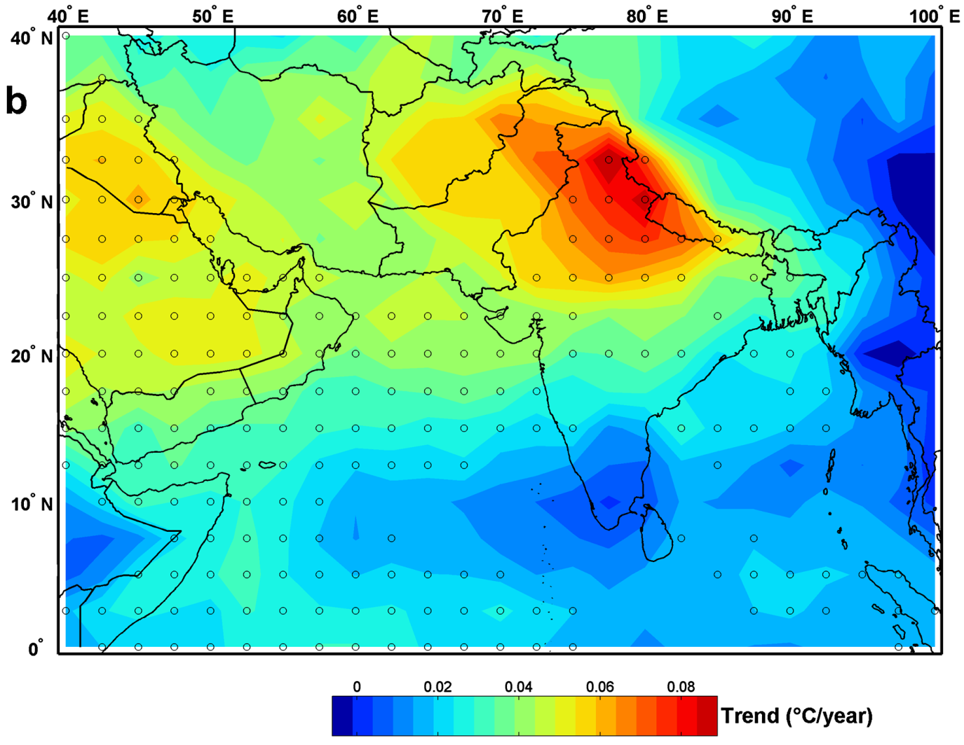
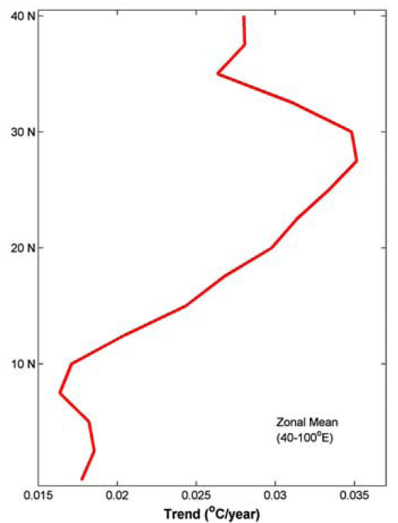
Enhanced Tropospheric Warming during Pre-Monsoon Season
1979-2007 May
March-April-May
Strengthened land-sea thermal gradient
Microwave Sounding Unit (MSU) data, corrected for stratospheric cooling influence - Fu et al., 2004 (Nature)
Gautam, Hsu, Lau, Tsay, Kafatos, Geophys. Res. Lett. (2009)

Slide 7
Annual Mean Trend (1979-2007)

Slide 8
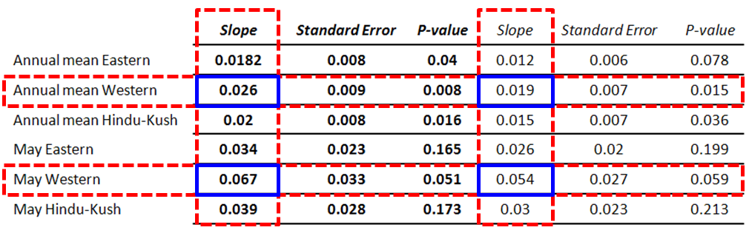
Trends for Annual Mean and May Tropospheric Temperature (1979-2007) over the Himalayas
After correcting for stratospheric cooling influence (Fu et al., 2004)
Directly from RSS data
*Trends in °C/year; RSS (Remote Sensing Systems) data portal
→ The western Himalayan warming significantly exceeds other surrounding elevated regions of the Himalayas and Tibetan Plateau.
→ Aerosol solar absorption effects/EHP mechanism, in addition to global warming, could potentially be amplifying the enhanced western Himalayan warming.
Gautam, Hsu, Lau, JGR (in press)

Slide 9
Summary
Progressive buildup of aerosol loading over the Gangetic region from April through June (pre-monsoon) observed from MODIS, with enhanced dust loading indicated by CALIOP-derived depolarization ratios and AERONET retrievals of optical properties.
Vertically extended aerosols upto 5km with enhanced aerosol solar absorption (SSA: 0.89) and large impact on regional radiation budget (surface forcing efficiency: -70Wm⁻² and mean forcing value ranges from -11 to -79.8Wm⁻²).
Tropospheric temperatures observed from MSU (1979-2007) indicate accelerated warming over western Himalayas (0.19-0.26°C/decade), most pronounced in the pre-monsoon period, suggesting the plausible role of absorbing aerosols in amplifying the observed warming trend.
Acknowledgements: satellite data production teams (MODIS, CALIPSO, MSU) and AERONET.

