Slide 1
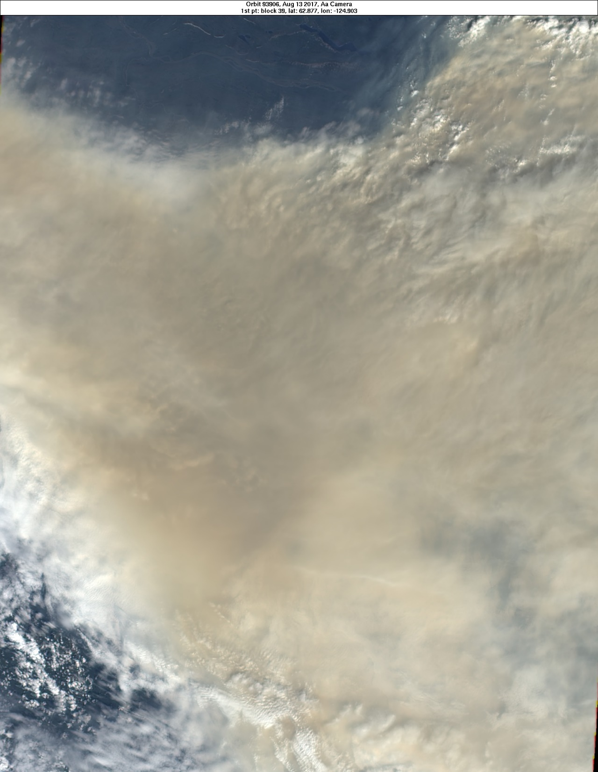

Stratospheric Smoke to Rival Volcanic Sulfate: the pyroCb Plume of 2017
Mike Fromm (mike.fromm@nrl.navy.mil)
Pat Kablick, Dave Peterson, James Campbell, Ed Hyer, Matt Deland
MISR True Color: 13 August 2017, Yukon
NASA AeroCenter, 6 Feb 2018
Notes:
Critical points:
We must characterize the source term correctly
Initial plume altitude, mass are essential…and possible with the data at hand
This is a well observed but confounding plume.

Slide 2
The Mother of all PyroCbs: British Columbia
12 August 2017
Off the charts:
* UVAI
* Stratospheric…
* plume AOD
* plume CO
* plume altitude
* Diabatic plume ascent from lowermost strat.
*like Chisholm and Black Saturday plumes.
! EGU Session AS3.4 !

Slide 3
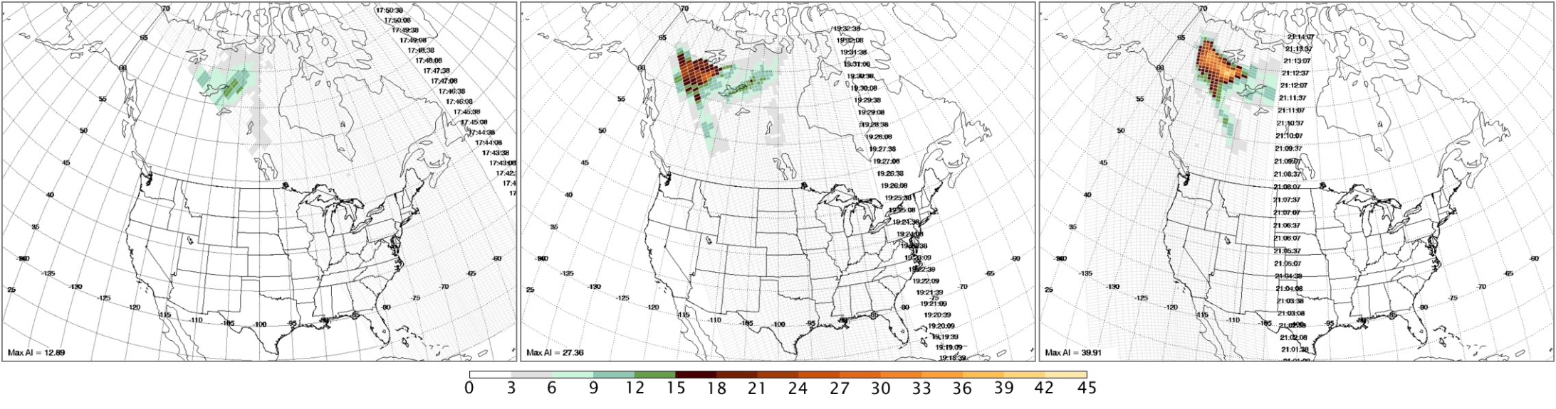
13 August 2017
Email to the pyroCb discussion group,
regarding OMPS UV Aerosol Index…
Colin Seftor (SSAI/NASA): “I can
safely say that I have never used the
AI scale that I have on the attached OMPS AI imagery before.”
…I think this maximum AI value (39.9) is the highest ever seen (including for volcanic ash). It's the highest I can remember.”
On 8/13 the max AI was 39.9. SInce 1979, TOMS-OMI-OMPS AI (OMTO3) had never exceeded 36.7.
On 8/14 the max AI surged to 49.4. Such an increase within a plume has never happened.
On 8/15 it increased to 49.7. This is just plain unprecedented. The plume is either higher, thicker, or
blacker than any smoke plume since 1979. NO VOLCANO has created anything like this.

Slide 4
UV Aerosol Index: GOME 2 & OMPS Together
- 12-17 August 2017
> Level 2 AAI
> One orbit per map
> Maps are time order
> Rainbow color scale, violet (just above noise) to red (large AAI)
> Red fixed AAI=25.
> OMPS AAI is divided by 2 (OMTO3 to OMAERUV scaling).

Slide 5
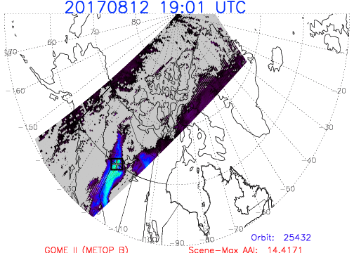

Slide 6
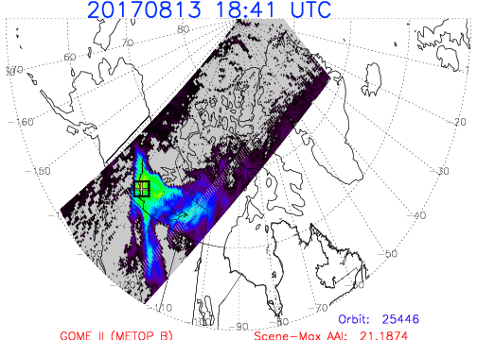

Slide 7
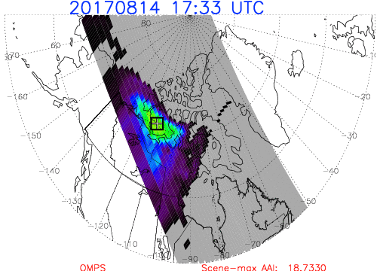

Slide 8
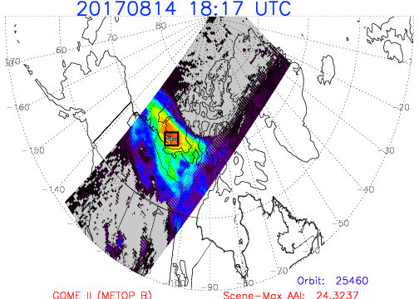

Slide 9
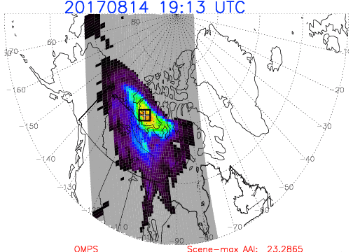

Slide 10
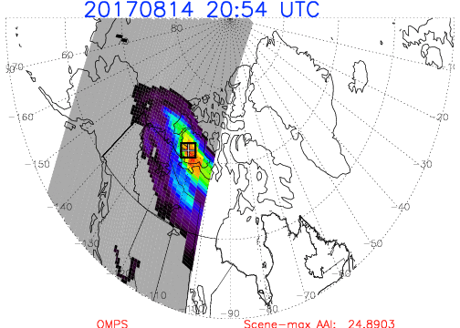

Slide 11
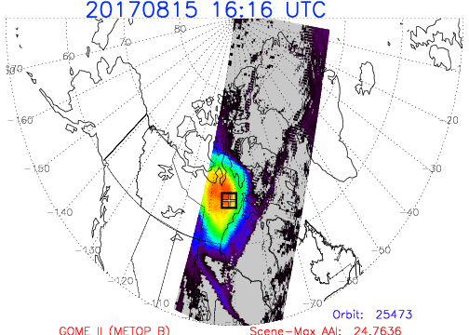

Slide 12
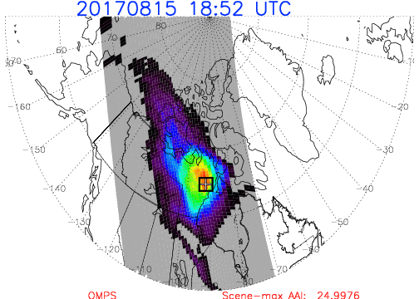

Slide 13
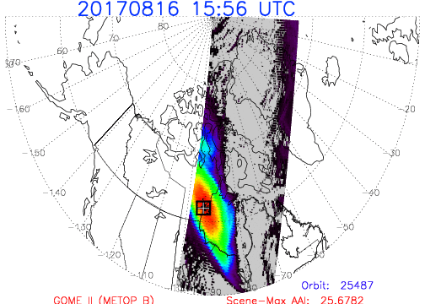

Slide 14
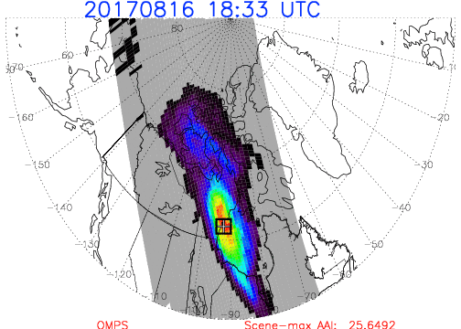

Slide 15
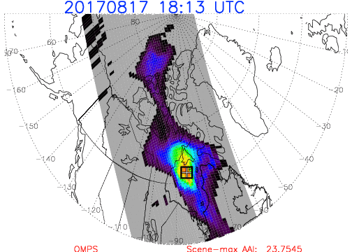

Slide 16
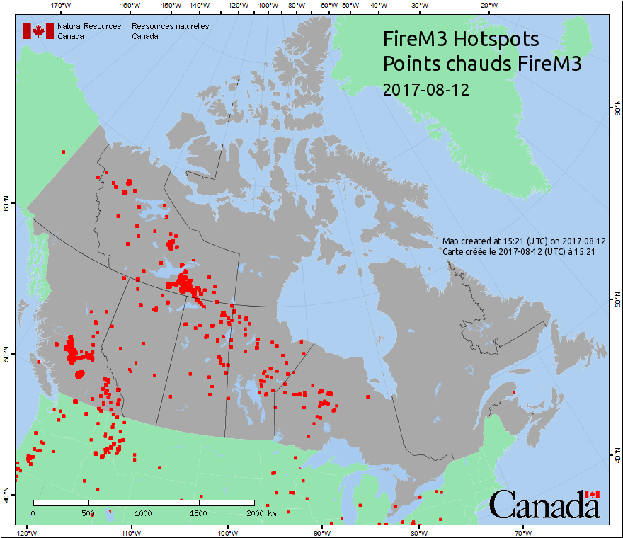
Sniffing out the source…
Ground Zero

Slide 17
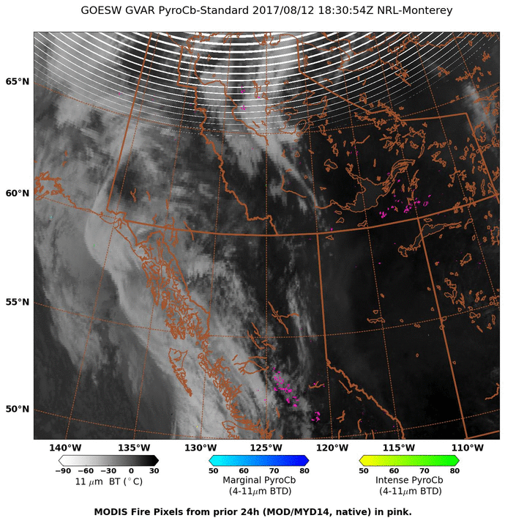
NRL automated, near-real-time pyroCb detection algorithm
PyroCbs in action: dinnertime on 12 August
GOES West Visible

Slide 18
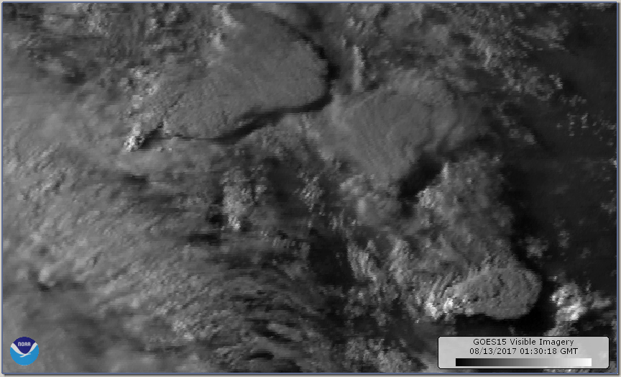
PyroCb cluster: dinnertime on 12 August
GOES West Visible

Slide 19
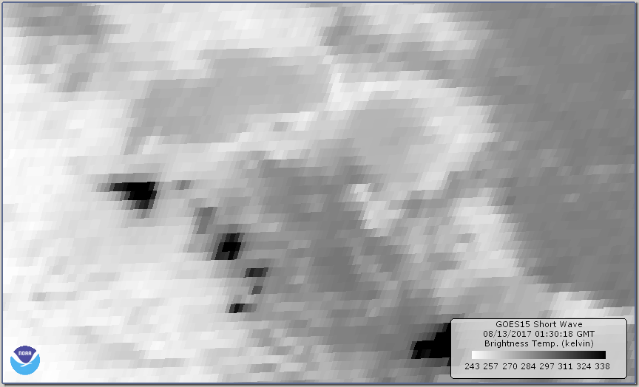
3.9μm Brightness Temperature
Warm!!!
Fires

Slide 20
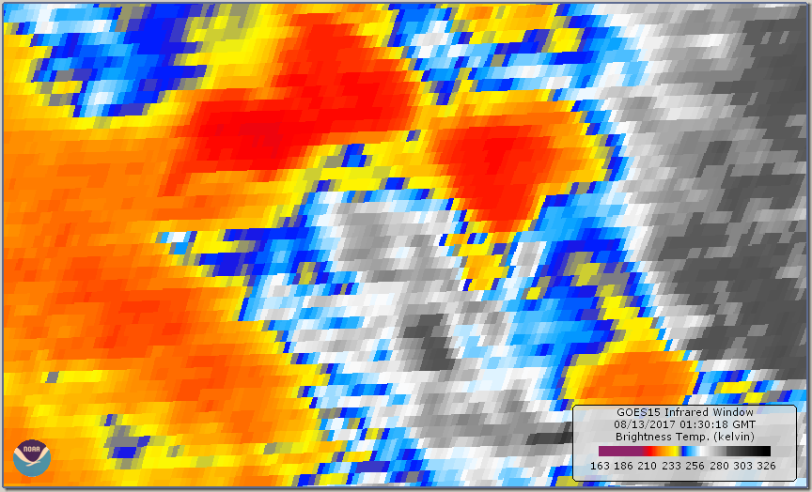
Window IR Brightness Temperature
COLD
Notes:
Btmin -63C

Slide 21
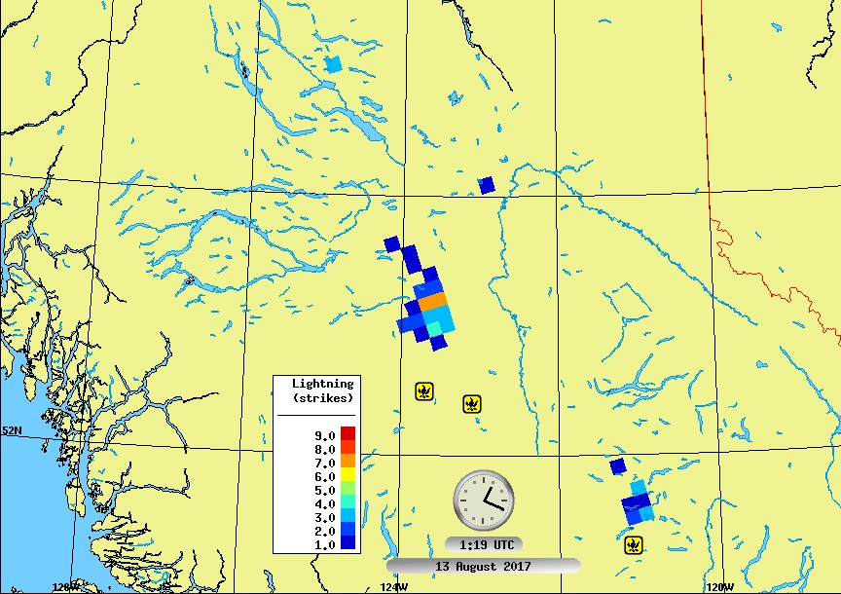
Lightning Strikes
British Columbia
13 Aug 2017 01:19 UTC
Fires

Slide 22
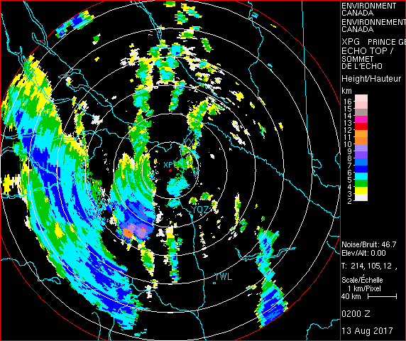
Prince George Radar Echotop
13 Aug 2017 02:00 UTC
Turret to 12-13 km
Notes:
PG RAOB Tmin: 195.0 12268 -60.7
Radar 100 km away from nearest pyroCb.

Slide 23
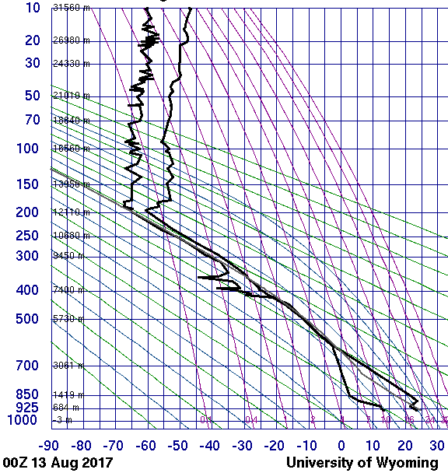
Prince George RAOB
00 UTC
13 Aug 2017
Conclusion:
* Injection z: 12-13 km
* Perhaps conservative
* Multiple pyroCbs
* 4 to 6
* Duration: ~5 hours
14.0 km
12.1 km
Peak Echo Top
GOES Bt_{min}=-63°C
- 3°C colder than coldpoint
Notes:
Btmin=-63C

Slide 24
Now to post-pyroCb: What do we know?
Notes:
Critical points:
We must characterize the source term correctly
Initial plume altitude, mass are essential…and possible with the data at hand
This is a well observed but confounding plume.

Slide 25
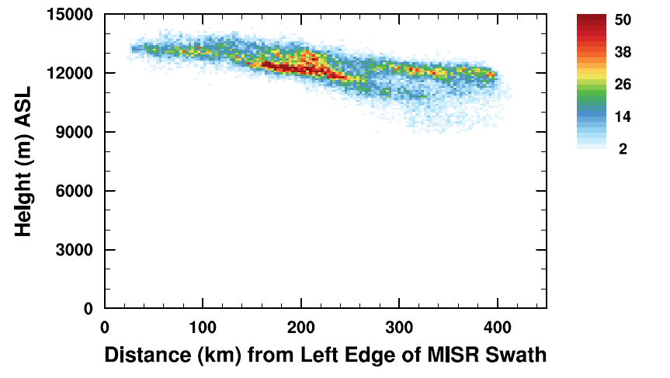
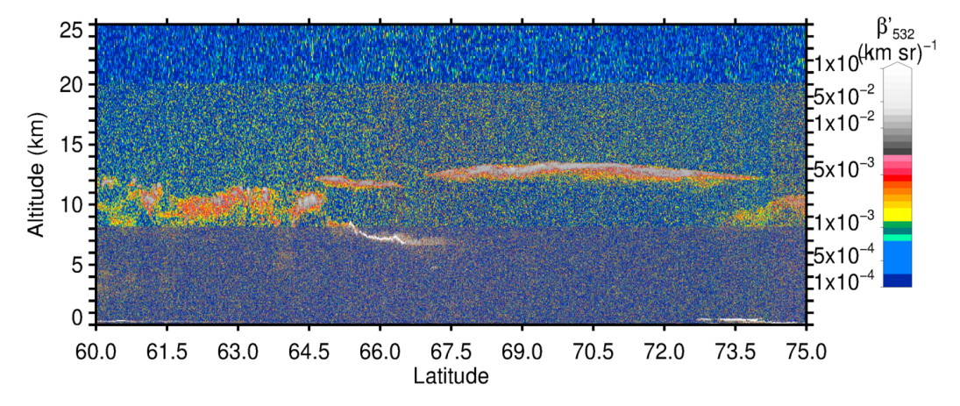
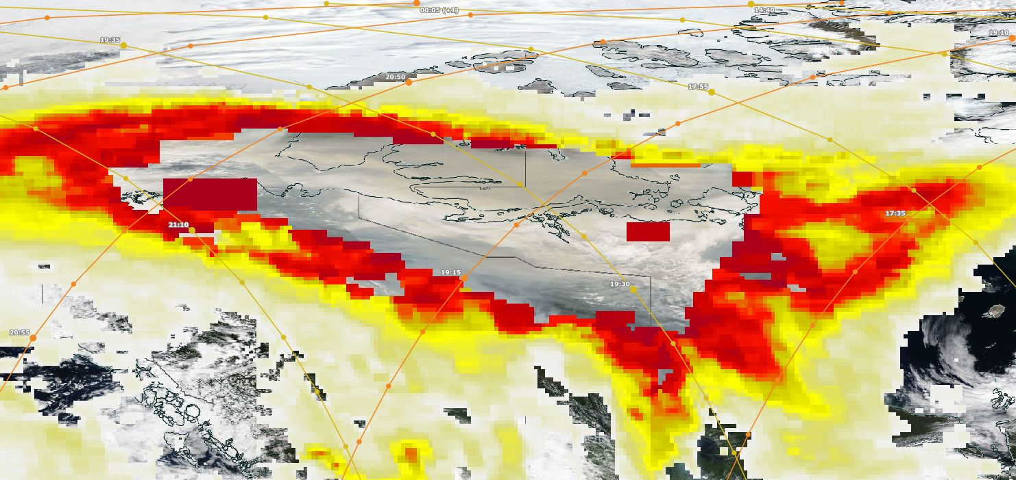
Plume Top: pyroCb + 2 days (14 Aug)
MISR Stereo Hgt.
Credit: Mika Tosca
CALIPSO 532 nm backscatter
Plume z:
12-14 km
CALIPSO
MISR
AI Max
49.4
Aqua MODIS True Color
OMPS AI
Credit: Worldview
Notes:
Tropopause ~12 km
MISR, CALIPSO give consitent info over large real estate.

Slide 26
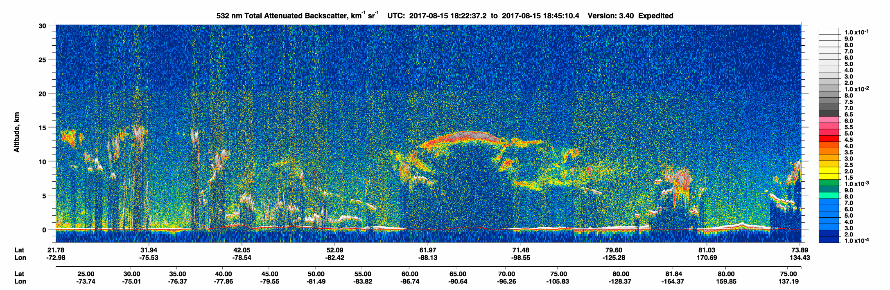
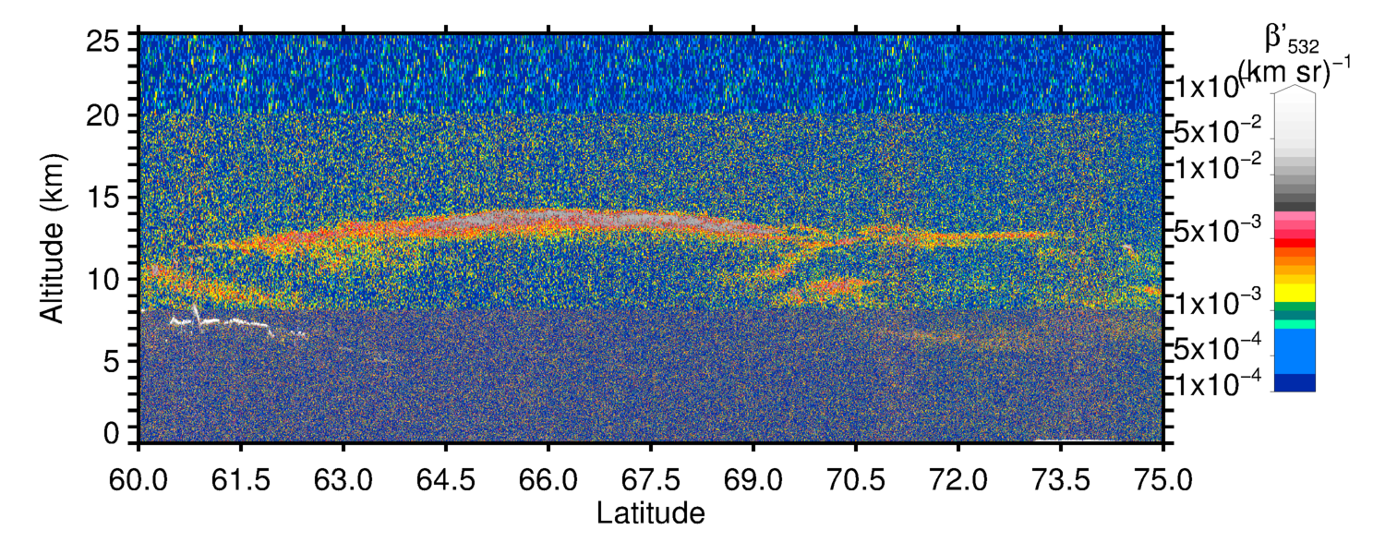
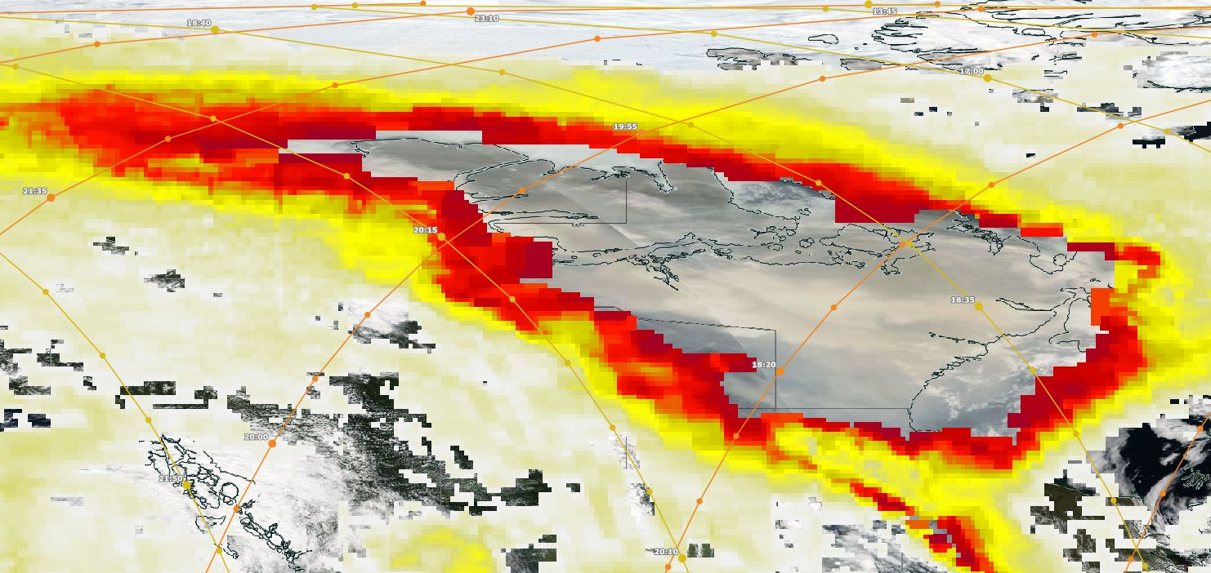
Plume Top: pyroCb + 3 days (15 Aug)
Total
Attenuation
- AOD >3?!
Plume z:
12-14 km
CALIPSO
MISR
AI Max
49.7

Slide 27
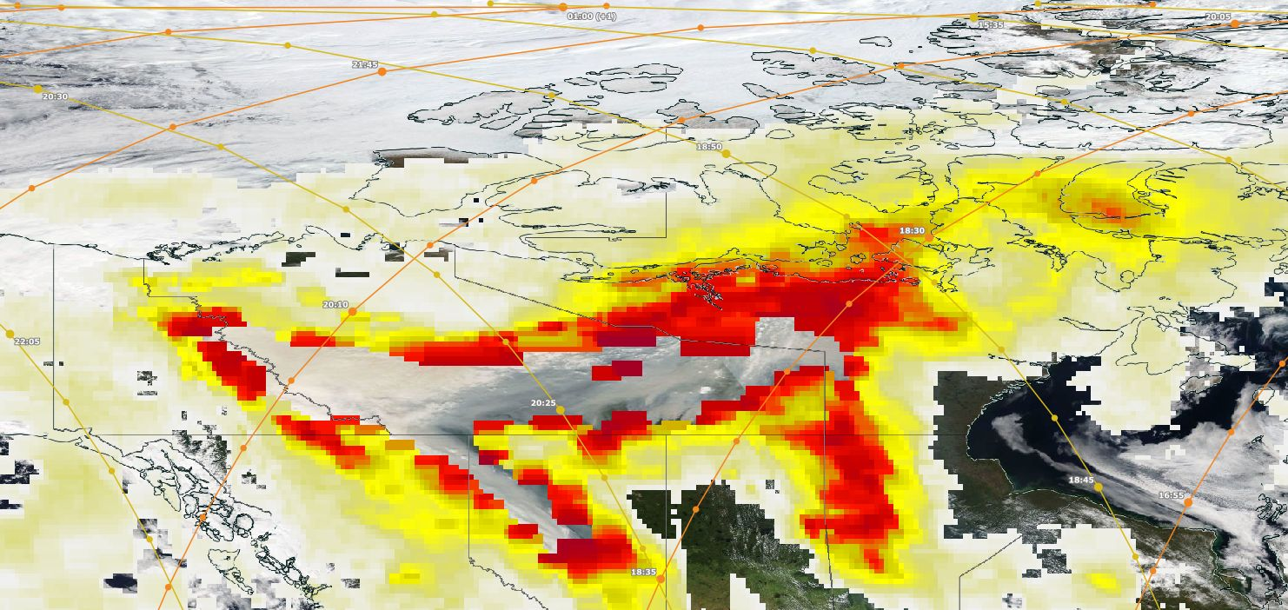
? What about the day after the pyroCbs (13 August)?
* CALIPSO is too far east. OMPS/LP misses too.
* MISR has an ideal vantage point.
* But at present, stereo hgt retrievals have not succeeded.
CALIPSO
MISR
AI Max
39.9

Slide 28
Hot off the press (GRL)…
Stratospheric smoke with unprecedentedly high backscatter observed by lidars above southern France
S.M. Khaykin, S. Godin-Beekmann, A. Hauchecorne , J. Pelon, F. Ravetta, and P. Keckhut
From Key Points:
Hemisphere-scale impact of wildfires on stratospheric aerosol load similar to that of moderate volcanic eruption…
Plume source(s):
* pyroconvection
* Athabasca-area fires
* Fires in NW USA
* Initial plume: 16 August
! Nice paper; lots of useful
information.
No “Athabasca”
pyroCbs
BC
pyroCbs
The “volcano-like”
plume came from BC
on 12 August.
Models need accurate
initial conditions.
pyroCbs, but between
29 Aug & 5 Sep

Slide 29
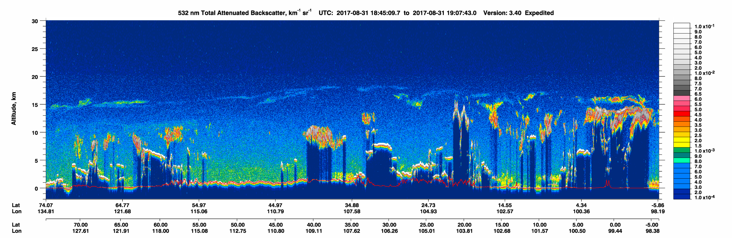
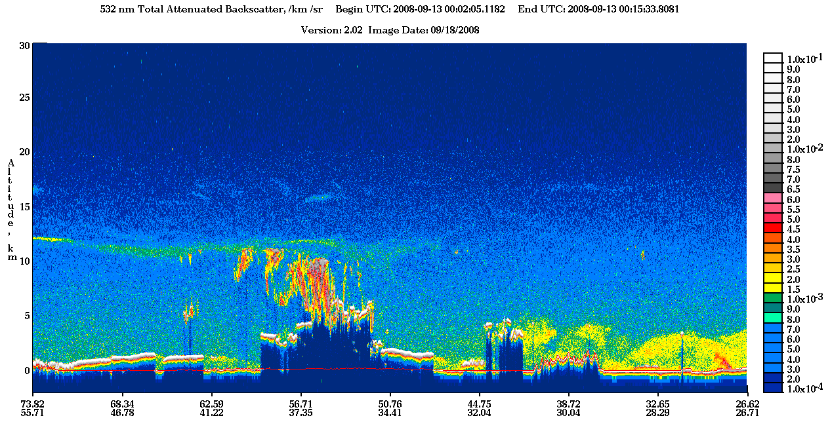
pyroCb Smoke 31 Aug 2017 ~19 Days Old
Kasatochi Sulfate 13 Sep 2008 ~37 Days Old

Slide 30
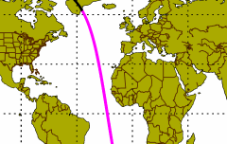
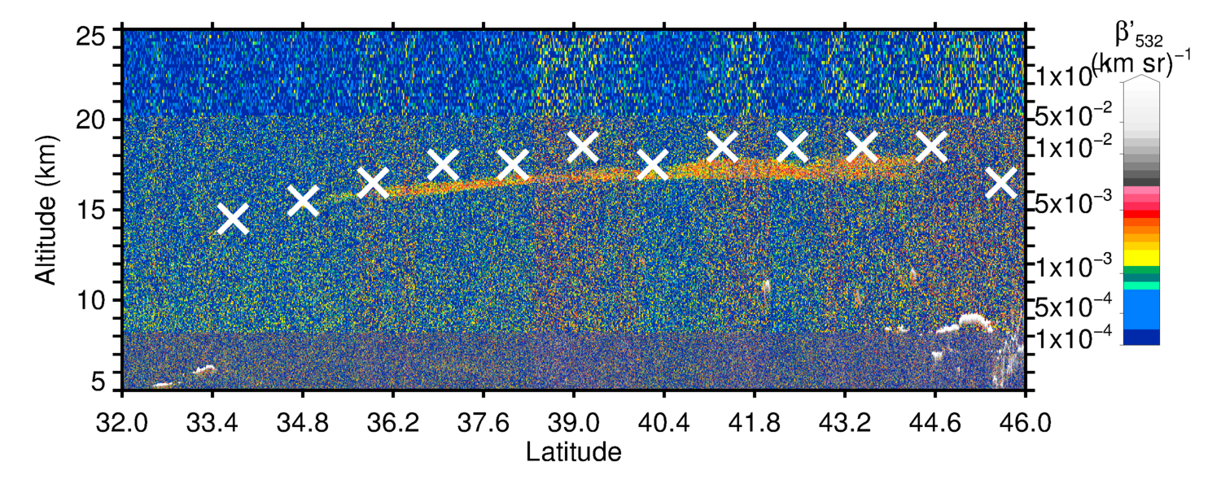
9-day old strat. smoke
22 August 2017
CALIPSO 532 nm
Backscatter
17 km
X OMPS LP Cloud Z

Slide 31
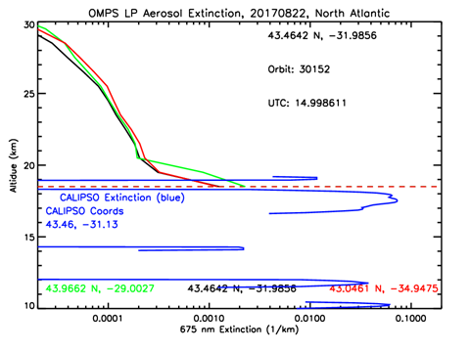

Slide 32
CALIPSO aerosol and Aura MLS Carbon Monoxide together
* 31 August (pyroCb + 19 days)
* Plume height above 20 km!!
* That’s Θ > 500 K
* MLS CO > 330 ppbv!!
Michael Schwartz: “Also, I'd just like to note how
unprecedented these values are in the MLS record at
215 hPa and 147 hPa. At 100 hPa they are rivaled only by
Black Saturday.

Slide 33
31 August 2017
20 km

Slide 34
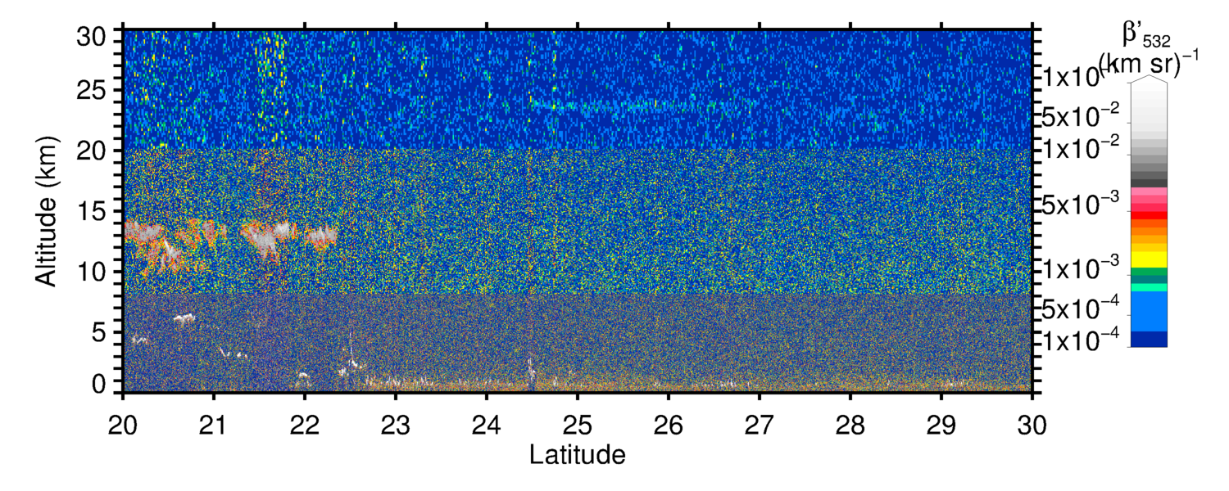
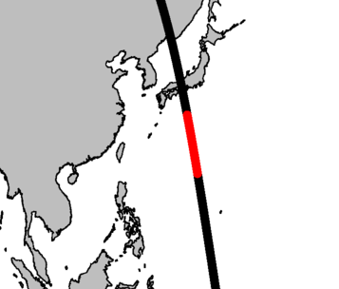
Mother Smoke Plume @ 24 km, 19 October 2017
CALIPSO 532 nm Backscatter
P=30 mb
Θ=590K

Slide 35
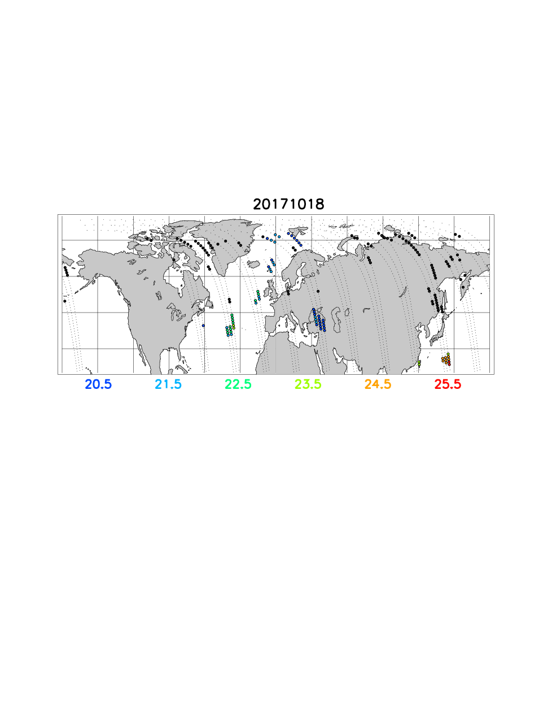
OMPS/LP Cloud Hgt., 18 October 2017
- Cloud Hgt. flag is indicator of strong gradient
in aerosol scattering index
- Big, colored dots: Cloud Hgt Flag set at Z>= 20.5 km
- High “cloud” where CALIPSO shows aerosol layer, south of Japan
- OMPS/LP cloud Z close to CALIPSO plume height
- 2 months post-pyroCb, smoke ~24 km and optically dense
enough to trigger cloud flag

Slide 36
And all that came from inside that, which came from that. ☺
13 Aug 2017

Slide 37
Apples to Apples*: Comparison of 3 Top PyroCb Events
? Where does BC2017 fit in ?
* All confirmed as pyroCb based on radar echo-top and lightning observations
pyroCb Event Injection z¹ Post-injection z^{2,3} Top z³ Duration ³ (months)
Chisholm 14 km 12 km 18 km 3
Black Saturday 15 km 17 km 23 km 4
BC2017 13 km 13-14 km 24 km 2+ (TBD)
1 - Based on radar echo tops
2 - One or two days post-pyroCb
3 - Based on published works (Chisholm and Black Saturday)
Chisholm (Alberta, Canada, 28 May 2001):
Rosenfeld et al. (ACP, 2007)
Fromm et al. (JGR, 2008)
Black Saturday (Victoria, Australia, 7 February 2009):
Siddaway and Petelina, (JGR, 2011)
Pumphrey et al. (ACP, 2011)
Dowdy et al. (JGR, 2017)
Notes:
Chisholm theta = 458K

Slide 38
The Mother of all PyroCbs: British Columbia
12 August 2017
Off the charts:
* UVAI
* Stratospheric…
* plume AOD
* plume CO
* plume altitude
* Diabatic plume ascent from lowermost strat.
*like Chisholm and Black Saturday plumes.
! EGU Session AS3.4 !

Slide 39
Acknowledgements:
René Servranckx
Colin Seftor
Marloes Penning de Vries
P.K. Bhartia
Ghassan Taha
Omar Torres
Mika Tosca
NASA LANCE
NOAA Weather and Climate Toolkit
Environment Canada

