Slide 1
Maintaining continuity in the satellite aerosol record
Andrew Sayer GESTAR-USRA at NASA GSFC andrew.sayer@nasa.gov
with thanks to many others for discussions

Slide 2
Maintaining continuity in the satellite aerosol record
Andrew Sayer GESTAR-USRA at NASA GSFC andrew.sayer@nasa.gov
with thanks to many others for discussions

Slide 3
Maintaining continuity in the satellite aerosol record
^passive total column
not UV polar-orbiting
Andrew Sayer GESTAR-USRA at NASA GSFC andrew.sayer@nasa.gov
with thanks to many others for discussions

Slide 4
Maintaining continuity in the satellite aerosol record
^passive total column
not UV polar-orbiting
Andrew Sayer GESTAR-USRA at NASA GSFC andrew.sayer@nasa.gov
with thanks to many others for discussions

Slide 5
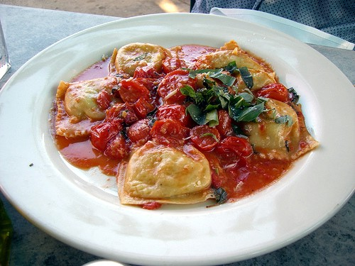
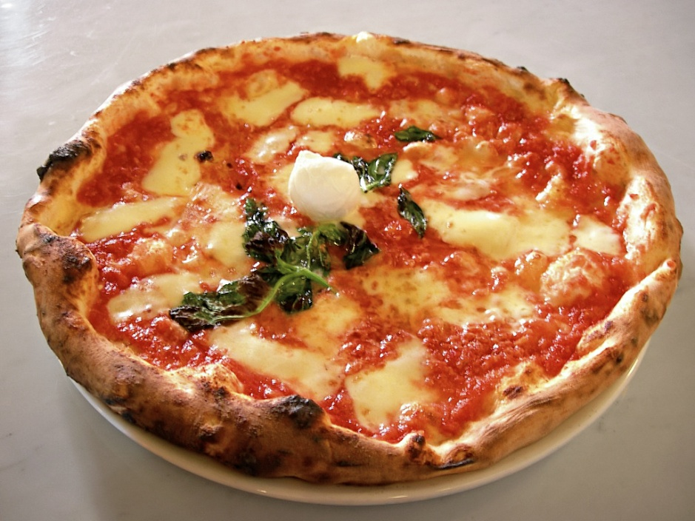
“Continuity” depends on your needs
Example: AOD at 550 nm vs. AOD at 870 nm
Images courtesy of Wikipedia

Slide 6
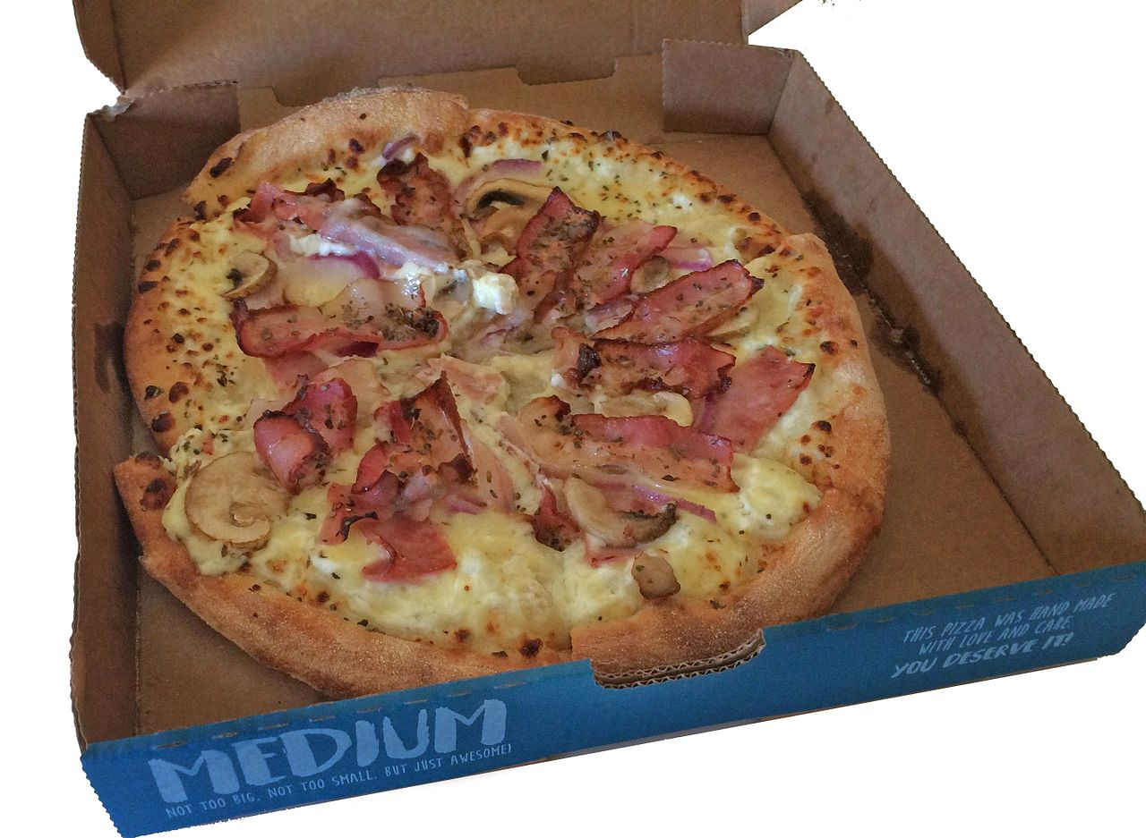
“Continuity” depends on your needs
Example: MODIS vs. VIIRS
… or Deep Blue vs. Dark Target
Images courtesy of Wikipedia

Slide 7
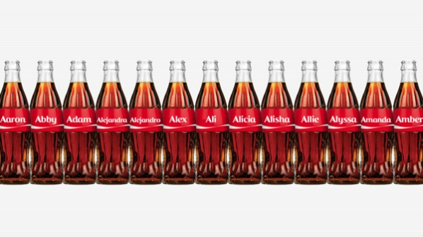
“Continuity” depends on your needs
Example: MODIS Terra vs. MODIS Aqua
Image courtesy of coca-colacompany.com

Slide 8
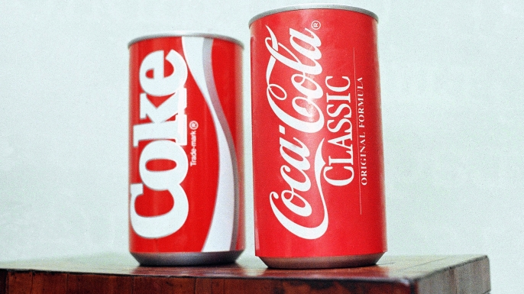
“Continuity” depends on your needs
Example: MODIS Terra in 2000 vs. MODIS Terra in 2015
Image courtesy of history.com

Slide 9
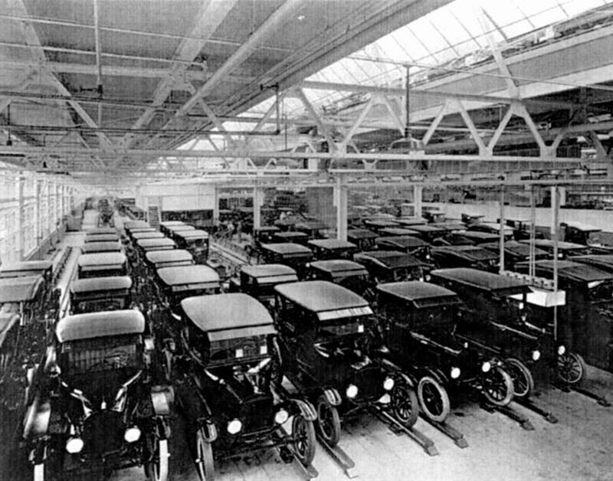
“Continuity” depends on your needs
Example: Well, we’ve not had any…
Images courtesy of Wikipedia

Slide 10
Ok. Then what?

Slide 11
There is a long time series of similar* spaceborne instruments
 |  |  | 80 |  |  |  |  | 85 |  |  |  |  | 90 |  |  |  |  | 95 |  |  |  |  | 00 |  |  |  |  | 05 |  |  |  |  | 10 |  |  |  |  | 15
AVHRR
SeaWiFS
VIRS (TRMM)
MODIS (Terra)
MODIS (Aqua)
MERIS
(S)GLI
CAI
VIIRS (S-NPP)
OLCI
Daytime overpass: MORNING AFTERNOON BOTH
* single-view, broad-swath, passive, moderate resolution, visible/IR imaging radiometers on polar-orbiting platforms

Slide 12
There is a long time series of similar* spaceborne instruments
 |  |  | 80 |  |  |  |  | 85 |  |  |  |  | 90 |  |  |  |  | 95 |  |  |  |  | 00 |  |  |  |  | 05 |  |  |  |  | 10 |  |  |  |  | 15
(A)ATSR
POLDER
MISR
SLSTR
Daytime overpass: MORNING AFTERNOON BOTH
* multi-view, passive, visible/IR imaging radiometers/polarimeters on polar-orbiting platforms

Slide 13
There is a long time series of similar* spaceborne instruments
 |  |  | 80 |  |  |  |  | 85 |  |  |  |  | 90 |  |  |  |  | 95 |  |  |  |  | 00 |  |  |  |  | 05 |  |  |  |  | 10 |  |  |  |  | 15
HIRS
AIRS
IASI
CrIS
Daytime overpass: MORNING AFTERNOON BOTH
* IR sounders on polar-orbiting platforms

Slide 14
There is a long time series of similar* spaceborne instruments
 |  |  | 80 |  |  |  |  | 85 |  |  |  |  | 90 |  |  |  |  | 95 |  |  |  |  | 00 |  |  |  |  | 05 |  |  |  |  | 10 |  |  |  |  | 15
GLAS
CALIOP
CATS
Daytime overpass: MORNING AFTERNOON BOTH
* lidar

Slide 15
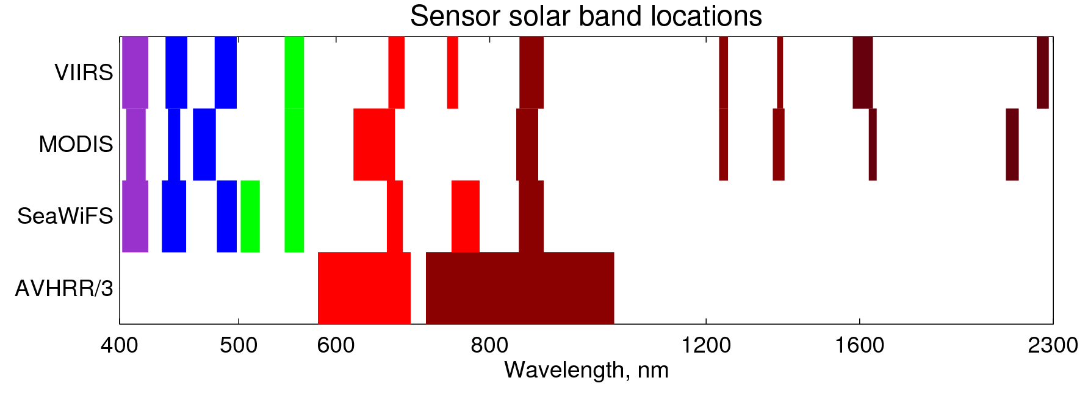
Wavelengths are slightly different
Note: VIIRS, MODIS and AVHRR have additional bands not shown
Adapted from Sayer et al., JGR 2016

Slide 16
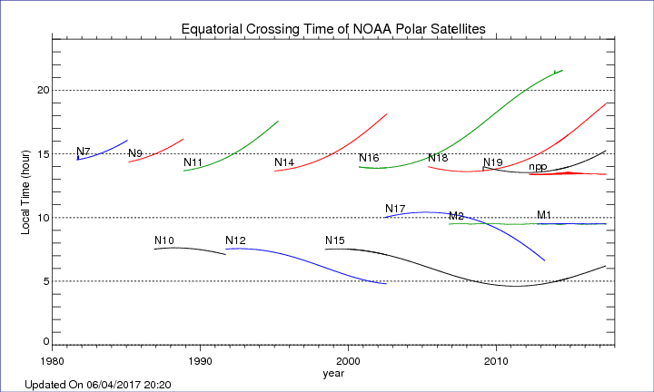
Orbital parameters are slightly different
Image courtesy of NOAA NESDIS

Slide 17
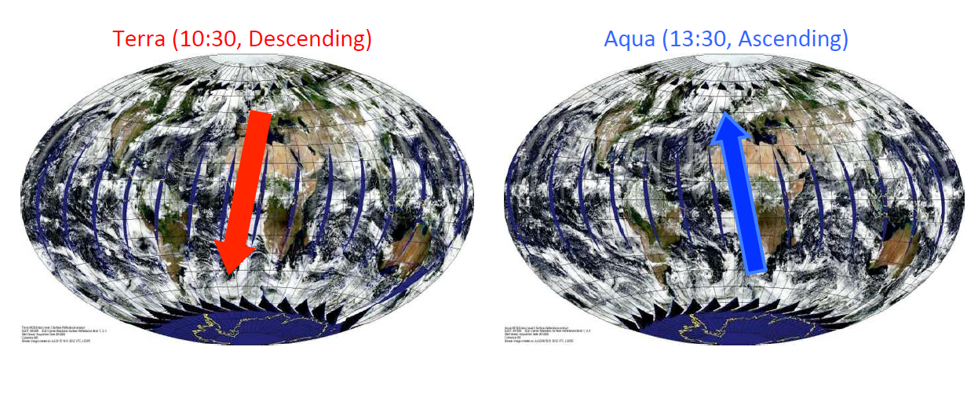
Orbital parameters are slightly different
Image courtesy of Rob Levy

Slide 18
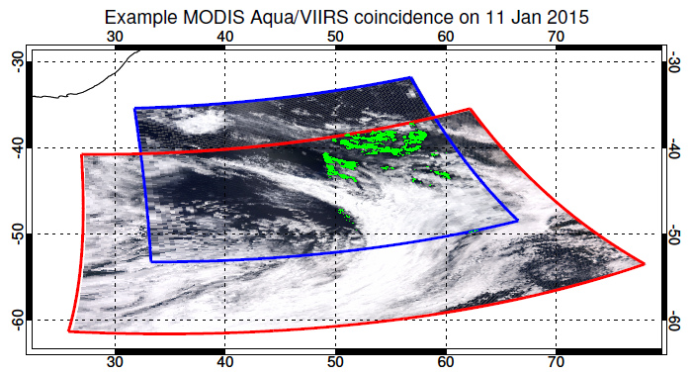
Orbital parameters are slightly different
Sayer et al., AMT 2017

Slide 19
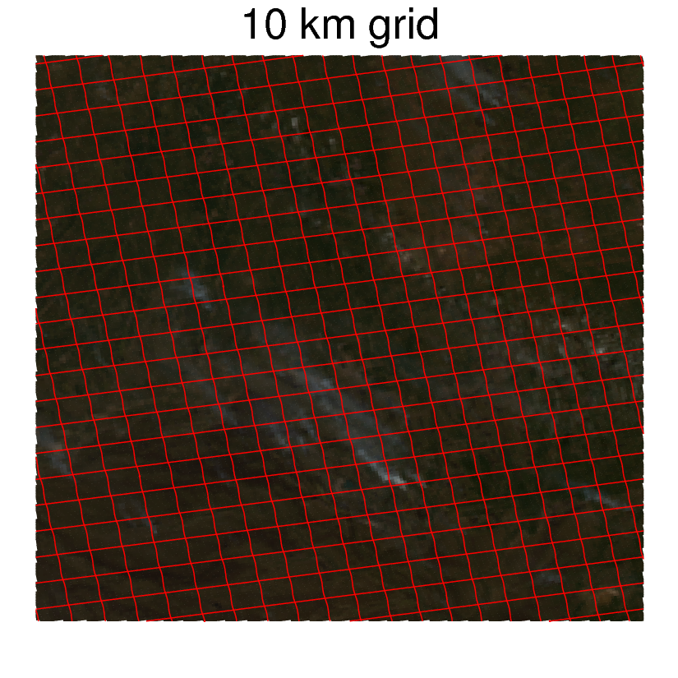
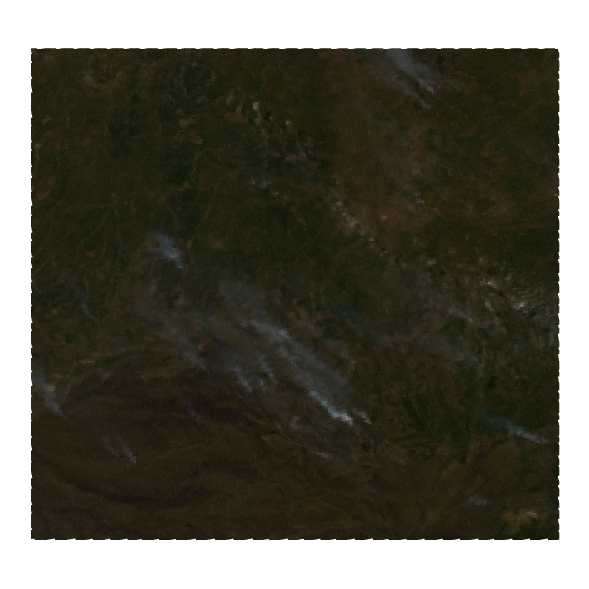
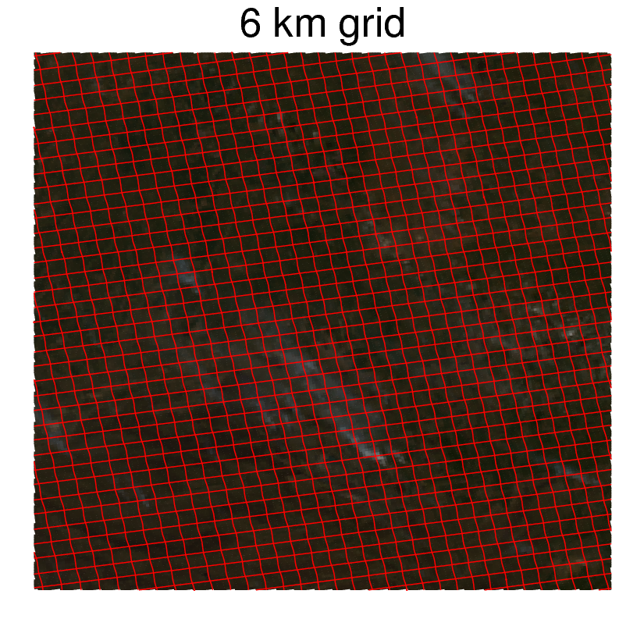
Pixel sizes are different

Slide 20
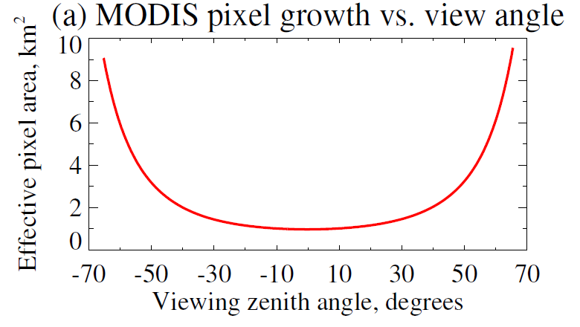
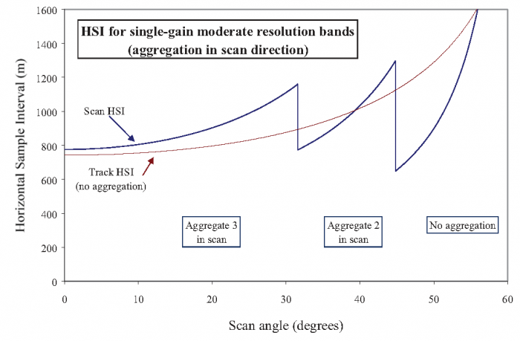
Pixel sizes are different
(even within an individual sensor)
MODIS
VIIRS
Left: Sayer et al., AMT 2015
Right image courtesy of UMD

Slide 21
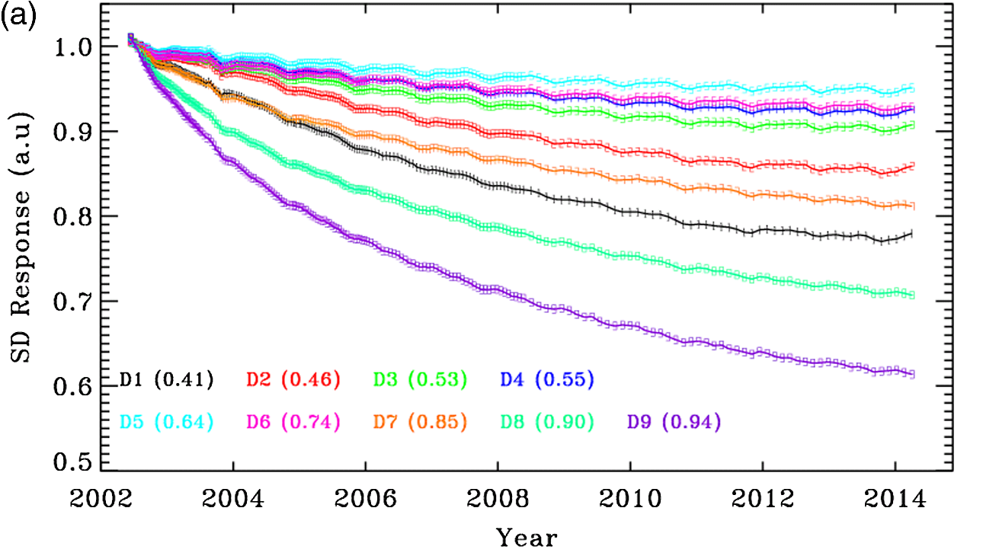
Calibration degrades
MODIS Aqua solar diffuser-based degradation through time
Xiong et al., SPIE 2014

Slide 22
… So. Ok. Then what?
for passive total column
not UV polar-orbiting data

Slide 23
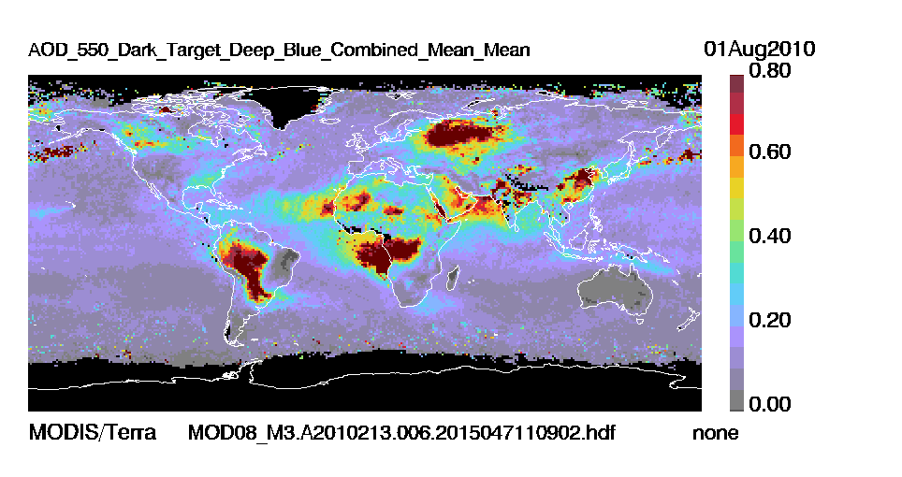
We can apply identical algorithms to the two MODIS sensors
Image courtesy MODIS Atmos website team

Slide 24
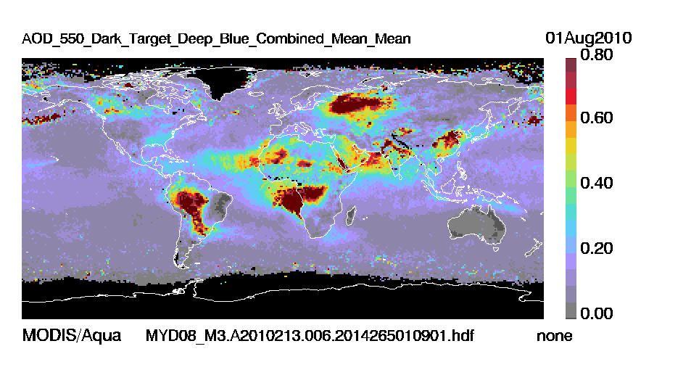
We can apply identical algorithms to the two MODIS sensors
Image courtesy MODIS Atmos website team

Slide 25
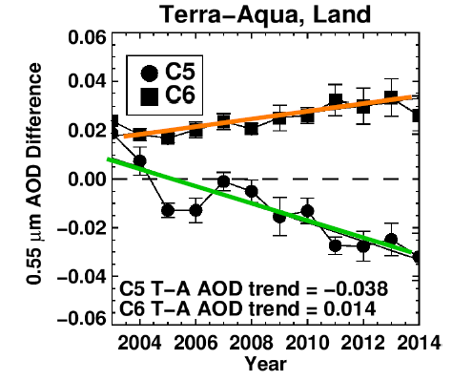
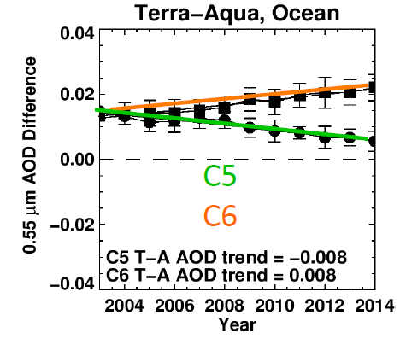
Even that does not guarantee consistency in retrieved quantities
Images courtesy of Rob Levy

Slide 26
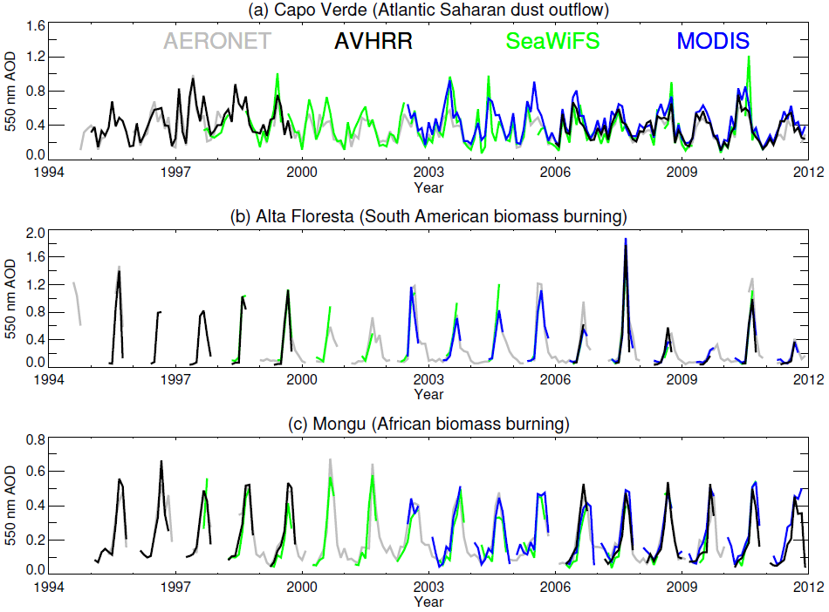
We can apply similar algorithms to these similar sensors
Adapted from Sayer et al., JGR, in review

Slide 27
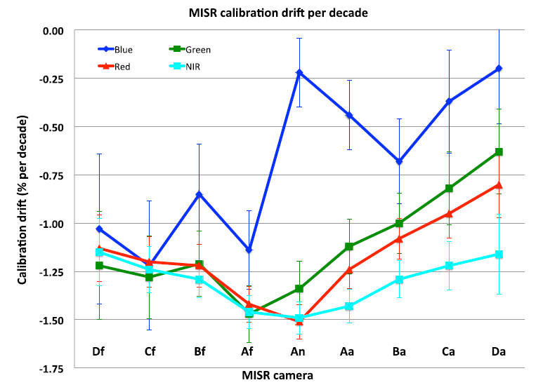
We can assess and maintain stability with on-board mechanisms and/or (presumably) invariant surface targets
Limbacher & Kahn, AMT, 2017

Slide 28
We can assess offsets and stability with ground-truth validation data
Image courtesy Alexei Lyapustin

Slide 29
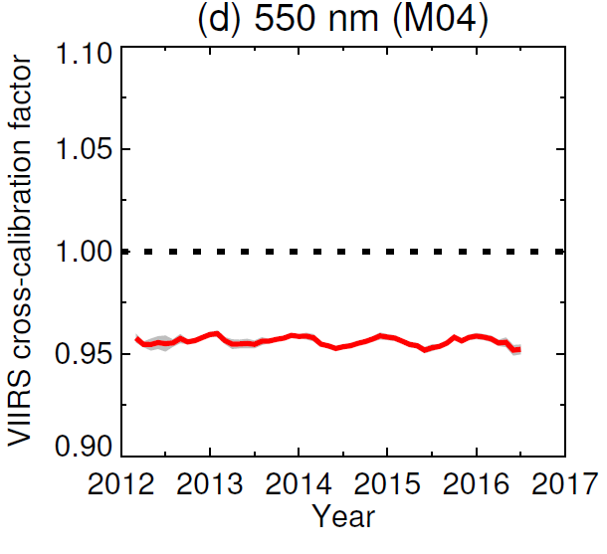
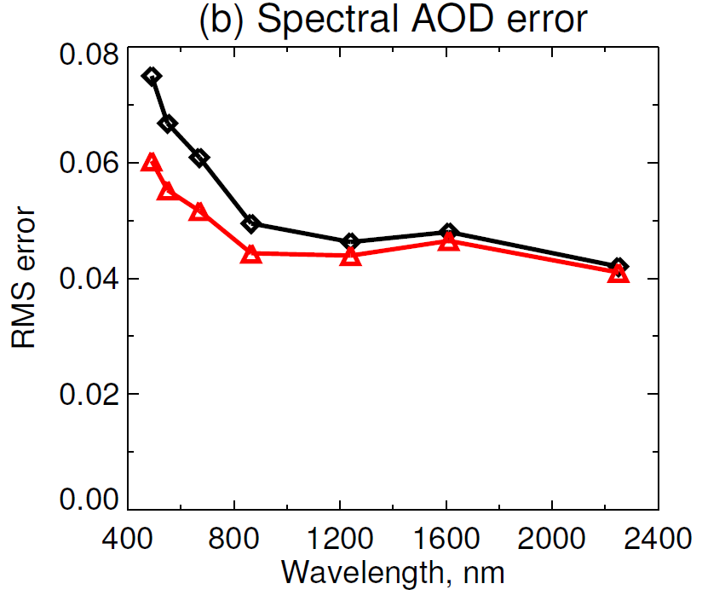
We can cross-calibrate to obtain radiometric consistency
550 nm cross-calibration
RMSE vs. AERONET
CLARREO would be really helpful for this type of analysis
Adapted from Sayer et al., AMT 2017

Slide 30
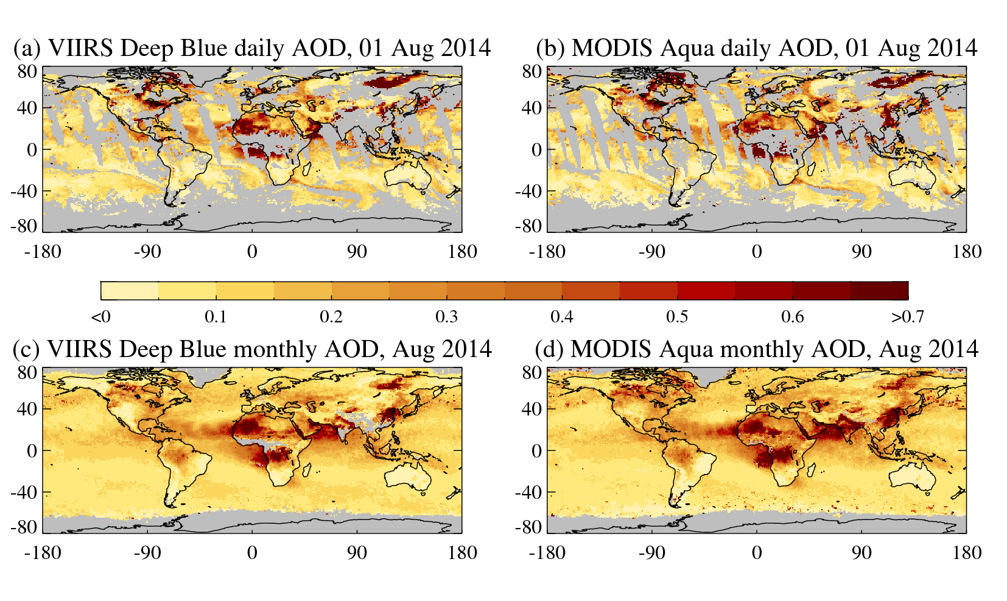
We can regrid to common (level 3) scales

Slide 31
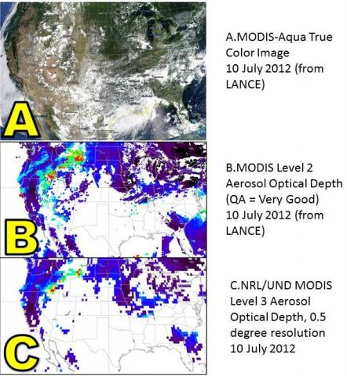
We can bias-correct against reference data
Image courtesy NASA LANCE/Earthdata/UND/NRL

Slide 32
But, fundamentally,

Slide 33
with current and planned US missions, it is not possible to obtain truly consistent, continuous data sets.

Slide 34
The best we can do up to now is (hopefully) close enough for most purposes, so long as we have, and continue to have:

Slide 35
Similar sensor types
Each of spectral, spatial, temporal, angular, radiometric characteristics
Sensor-to-sensor overlap in time
Continued availability of calibration resources
Continued availability of validation resources
Continued ability to update algorithms and reprocess

