Slide 1
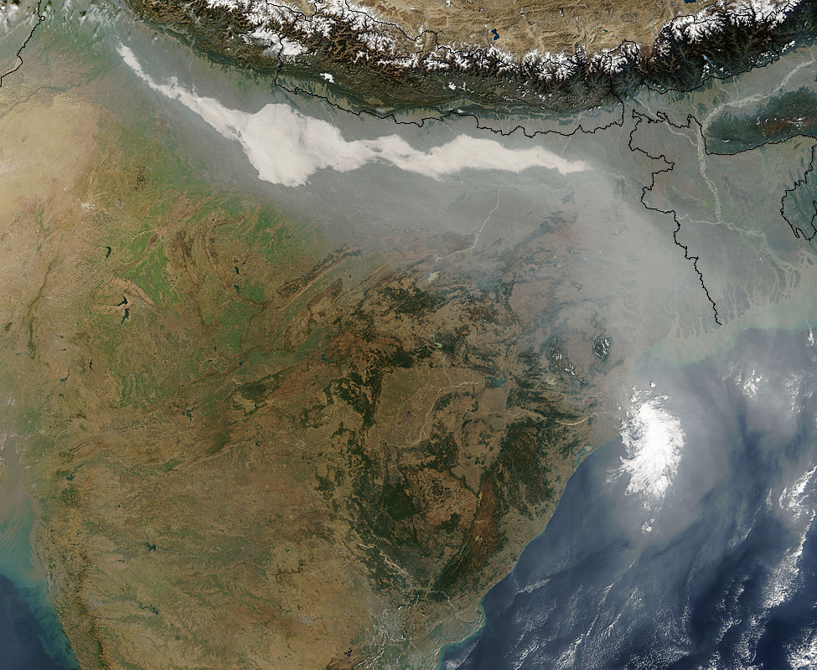

Aerosol and Water Cycle Interaction:
Past, Present and Future
William K. M. Lau
Earth Science Division
NASA/GSFC
With contributions from: K. M. Kim, D. Rosenfeld, Zhanqing Li, M. Chin, T. J. Yasunari, S. C. Tsay, C. Hsu, R. Gautam, P. Colarco, D. Lee, L. Oreopoulos, A. DaSilva, K. Vadrevu, R. Shi, W. K. Tao

Slide 2
Aerosol-Water Cycles Study: my perspective
Past ( 2005 – 2008):
Aerosol-monsoon water cycle interaction, direct effects and feedback processes; proposed EHP hypothesis; preliminary validations; planning of major international initiatives
Present ( 2009- 2012):
- Joint-Aerosol Monsoon Experiment (JAMEX)/Asian Monsoon Year (AMY) field campaign and modeling;
accelerated melting of snowpack and glaciers over Himalayan/Tibetan Plateau due to EHP, and snow-darkening;
Developed, implemented and tested a snow darkening impurity module in GEOS-5 GCM
Saharan dust and hurricanes, EHP impacts on West African monsoon and Atlantic water cycle
- IGBP/IGAC/GEWEX Aerosol-Clouds-Precipitation-Climate (ACPC) Science Steering Group formed to promote aerosol-water cycle studies and use of remote sensing observations (ACPC-SAT)
Future ( 2013 and beyond): …….

Slide 3
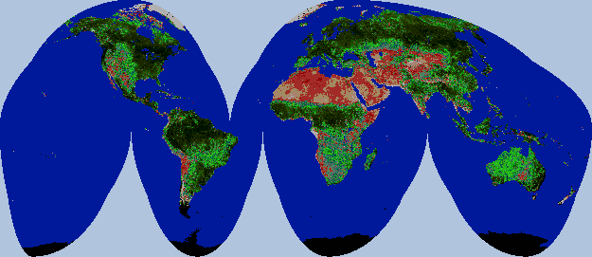
The Global Monsoon System
ASM
NAM
WAfM
SAM
EAfM
AUM
NDVI image for 21-31 August 2000, from Pathfinder AVHRR

Slide 4
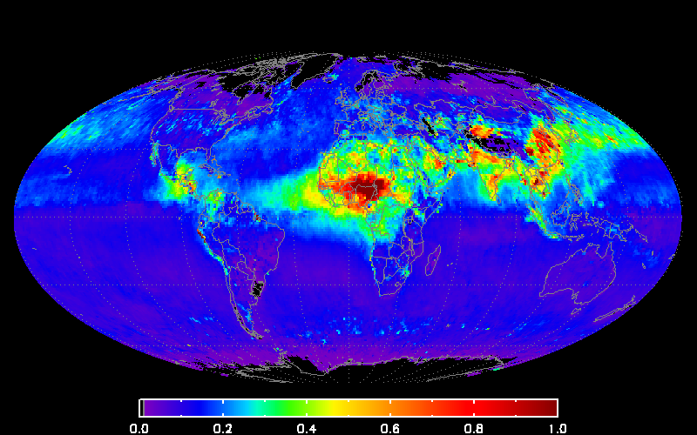
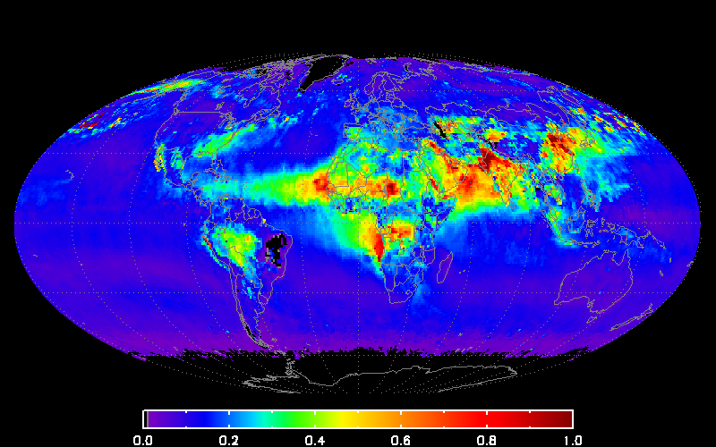
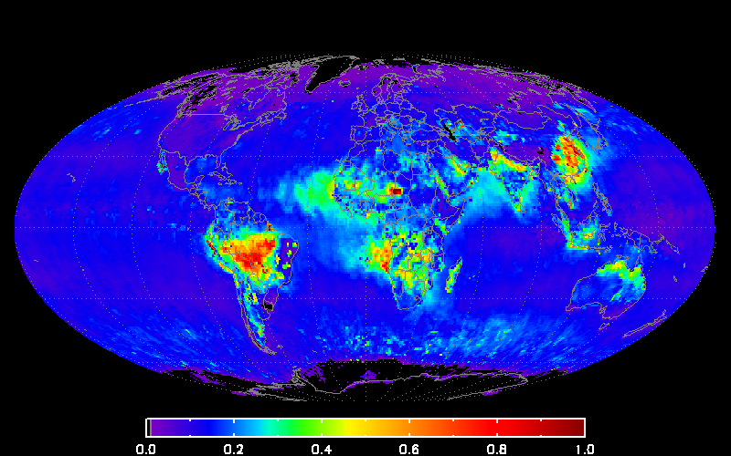
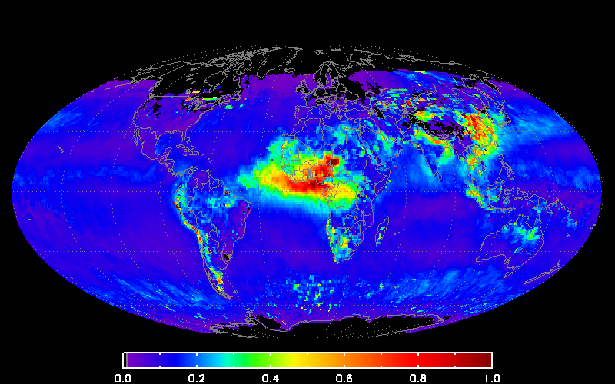
Aerosol (natural and anthropogenic) is an integral part of the Earth’s climate system
Year-round aerosols
  East-Southeast China, mega-city/smoke
  Indo-Gangetic Plain, mega-city/dust
  Africa, Saharan dust (less in SON)
Seasonal aerosols
  East Asia, dust (MAM)
  Southwest Asia, dust (JJA)
  Southeast Asia, smoke (DJF-MAM)
  S. America, smoke (JJA-SON)
  Africa, smoke (SON-DJF)
  Southwest Asia, haze (MAM)
March-April-May
June-July-August
2005
September-October-November
December-January-February
Courtesy C. Hsu
τ_{λ}(0.55µm)

Slide 5
Aerosol- atmospheric water cycle interaction:
Water vapor, clouds precipitation and dynamical feedback
Direct effect
Blocks sunlight,
cools surface -
“dimming effect”
Semi-direct
effect
Increased stability
less convection
Atmospheric
Water Cycle
Aerosols
alters
heating
gradients,
convection
and circulation
Indirect effect
1st kind
Brightens
clouds; increases
life time of clouds
Indirect effect
2nd kind
Suppresses or
Increases rainfall
Aerosol chemistry, transport, deposition and A-A interaction
Lau et al, 2008 BAMS

Slide 6
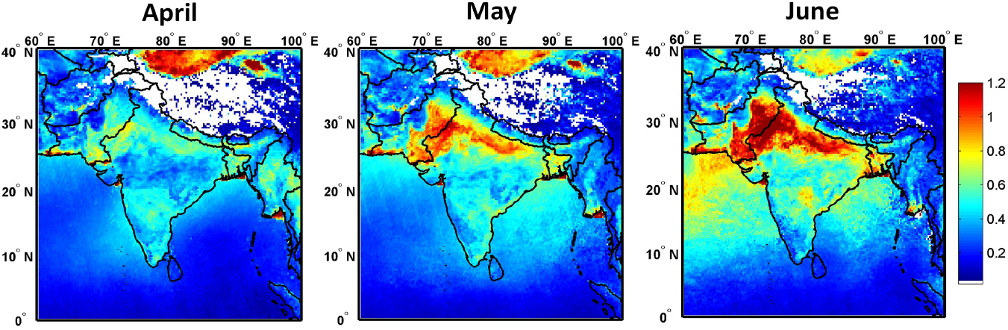
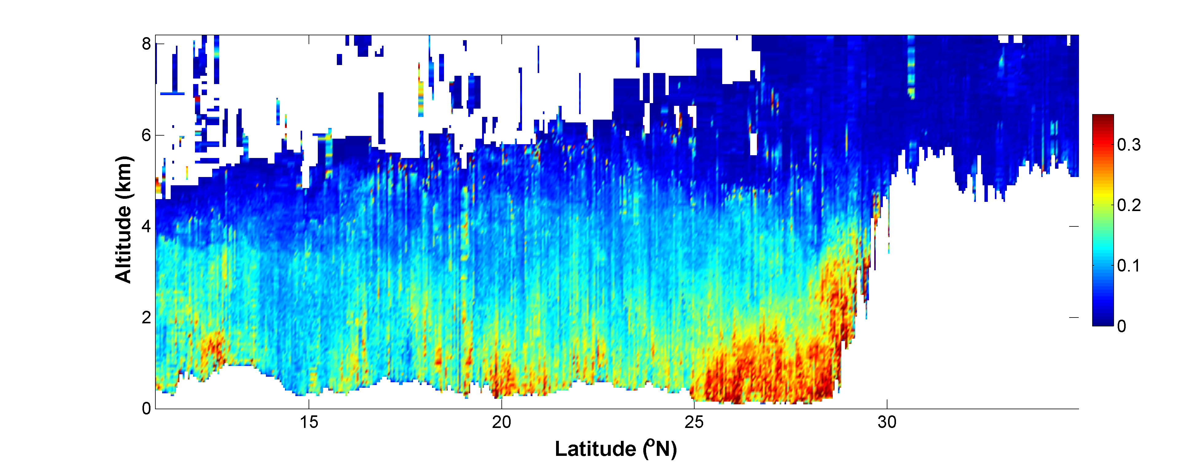
Aerosol Optical Depth from Aqua MODIS (2003-09)
Gautam, Hsu, Lau (2010)
CALIOP Extinction Coefficient indicate aerosols piling up against the southern slopes of the Himalayas.
CALIOP data March 15-June 15 2007-10
Himalayas
Tibetan Plateau
EHP hypothesis
Lau et al 2006,
2008, Lau and Kim
2010
km⁻¹
Notes:
This slide shows A progressive buildup and increase in aerosol loading is clearly visible over northern India, associated with enhanced westerly-wind-blown dust transport from the Thar Desert into the IGP and Himalayan foothill region during the pre-monsoon season.
And the dust loading is also observed to pile up against the southern slopes of the Himalayas, reaching elevated altitudes near the Himalayan snow cover, as indicated by CALIPSO lidar measurements.

Slide 7
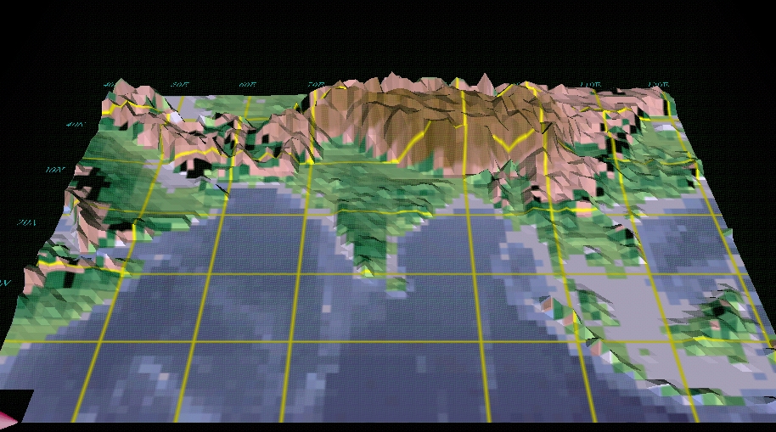

The Elevated Heat Pump (EHP) Hypothesis
(Lau et al. 2006, Lau and Kim 2006, Lau et al. 2008 > 450 citations)
“Clean”
Monsoon
Somali Jet
May -June
Polluted (dust and BC) monsoon
Somali Jet
May-June

Slide 8
Possible signatures of the EHP effect (initiated by absorption of solar radiation by dust and BC) for the South Asian monsoon (seasonal-interannual, decadal and climate change time scales) :
Warming and moistening of the mid- and upper troposphere over the Himalayan foothills and Tibetan Plateau late spring and early summer
Advance of the rainy season in northern India/Nepal, Himalayas foothills in May-June
The increased convection spreads from the foothills of the Himalayas to central India, resulting in an intensification of the South Asia monsoon in early season (June-July)
Subsequent reduction of monsoon rain in central India in peak monsoon (July-Aug)
Enhanced melting of Himalayan snowpack, possibly contributing to the rapid retreat of Himalayan glacier
(Lau et al 2006, Lau et al 2008 ,Lau and Kim 2006, 2010, 2011)

Slide 9
Joint Aerosol Monsoon Experiment (JAMEX)/Asian Monsoon Year(AMY)-2008-2012

Slide 10
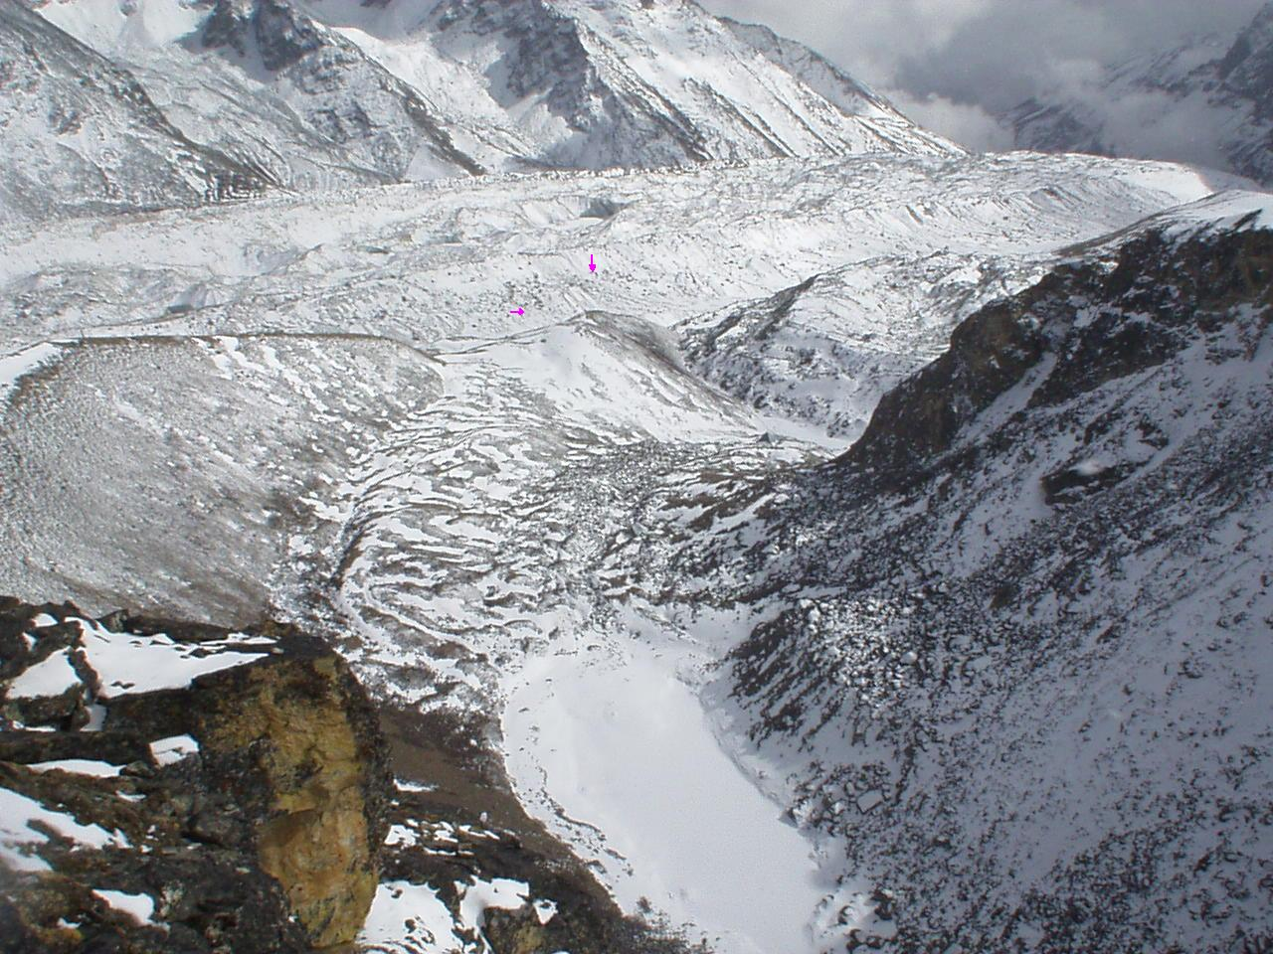
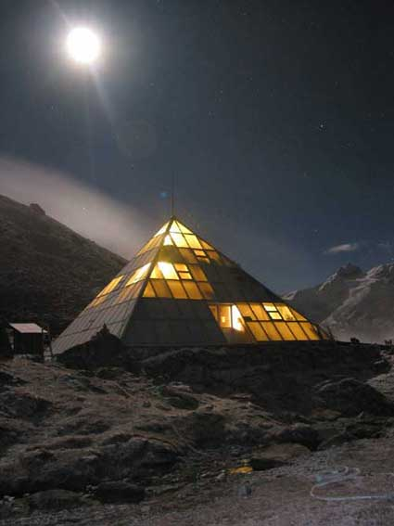
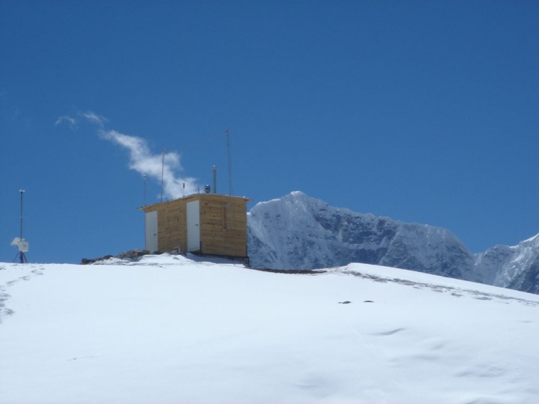
The Pyramid Observatory
Tibet
Nepal
KHUMBU GLACIER

Slide 11
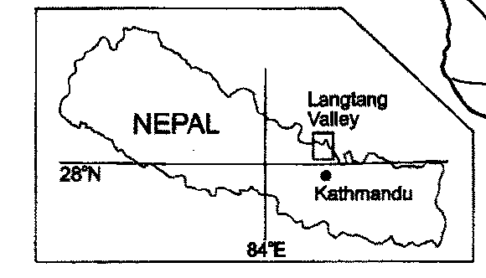
Estimated “lower limit” of effect of BC deposition in darkening Himalayan glaciers
BC deposition of 209 µg/m² by dry fallout
during March-May in 2006 (2.27 µg m⁻² day⁻¹)
Surface snow density
at Yala glacier:195 to 512 kg/m³
(Fujita et al., 1998)
2cm surface snow
Now, imagine that we take snow samples from 2cm surface snow layer. At this time, we assume slight BC layer on the pure ice with no contamination.

Slide 12
Increased total annual runoffs of 54-149 mm w.e. from Dongkemadi glacier corresponding to
9.0-24.8% of total annual runoff of the glacier.
Estimation of albedo reduction and anomalous annual runoff from snow-darkening effect
Using observations from Ev-K2 (Pyramid) and a glacier mass balance model (Fujita, 2007, Fujita et al., 2007), we estimated 2-5% reduction in SW snow albedo
Over a typical Tibetan glacier
(Dongkemadi glacier), this albedo snow-darkening effect may increase by 10-30% the annual run off from discharge of additional melted snow
Yasunari et al. 2010
A case of a tyipical Tibetan glacier

Slide 13
A new snow-darkening model implemented in the GEOS-5 GCM
- Multiple reflections
(two-stream approximation) by
Kondo et al. (1988).
- Snow is assumed to be constructed
by ice plates and air layers.
- Snow albedos mainly depends on
snow density changes, and snow-darkening
by BC and dust
- Spectral shortwave and long wave albedos
for direct and diffuse condition, following
Wiscombe and Warren, 1980).
Yasunari et al. 2011
Notes:
This albedo model is based on Kondo et al. (1988) & Yamazaki et al. (1991; 1993)

Slide 14
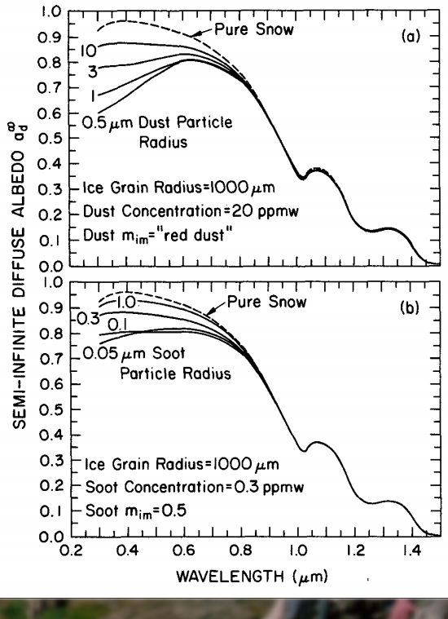
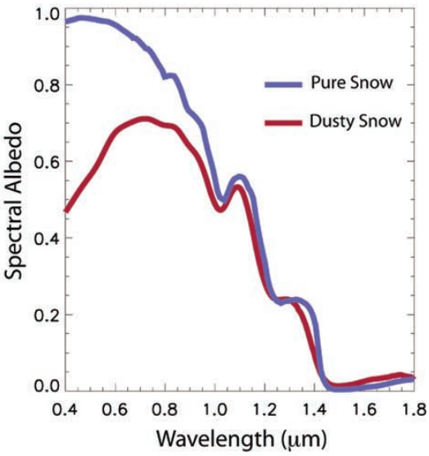
Satellite Detection of Snow Darkening effect
Warren and Wiscombe, 1980
Dust and black carbon effectively reduce snow albedo in the visible wavelengths
Painter et al., 2009
Field Spectral Measurements

Slide 15
Seasonal variation of spectral Reflectance over western Himalaya
R_{0.47μm} - R_{0.86μm}
(a) Seasonal variations of surface reflectance (February-June, MOD09), shown as 15 day averages, (b) Absolute difference of surface reflectance between 0.47 and 0.86 µm, averaged for 6–15 June 2003. Positive difference is generally found over the Karakoram, while dust-laden western Himalaya and southern Hindu-Kush region are characterized by negative differences.
Gautam et al. 2013

Slide 16
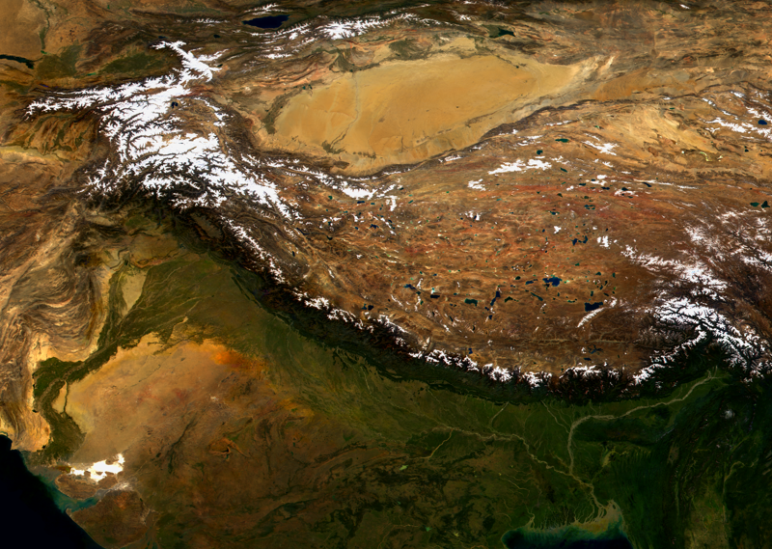
More Westerly dominated precipitation
Less monsoon-influenced precipitation
Glaciers grow by winter accumulation
Less glacier disintegration & lake growth
EHP net influence small?*
Less intense melting, more intense sublimation
More cold-based ice
Less debris cover
Spatial variability of Elevated Heat-Pump effect
Less soot-affected exposed ice surfaces
But more exposed ice to be affected
More sensitive to precipitation changes and wind
1
2
3
More intense melting
More warm-based ice
More debris cover
Strong Elevated Heat Pump effect
More soot effect on exposed ice surfaces
But less exposed ice to be affected
Glaciers are more sensitive to warming
4
Less Westerly dominated precipitation
More monsoon dominated precipitation
Grow mainly by summer snow accumulation
More lake growth and glacier disintegration
Strong EHP reduces glacier stability*
Contact: Jeff Kargel
MODIS base image courtesy of GSFC/NASA
Glacier behavior varies across the region, with faster retreat in the east. Possibly glaciers in northwest pick up more snow precipitation due to Elevated Heat Pump (EHP) and other climate mechanisms thus partly offsetting heating/melting. Glaciers in the eastern Himalaya may be more sensitive to EHP heating and are melting more quickly.

Slide 17
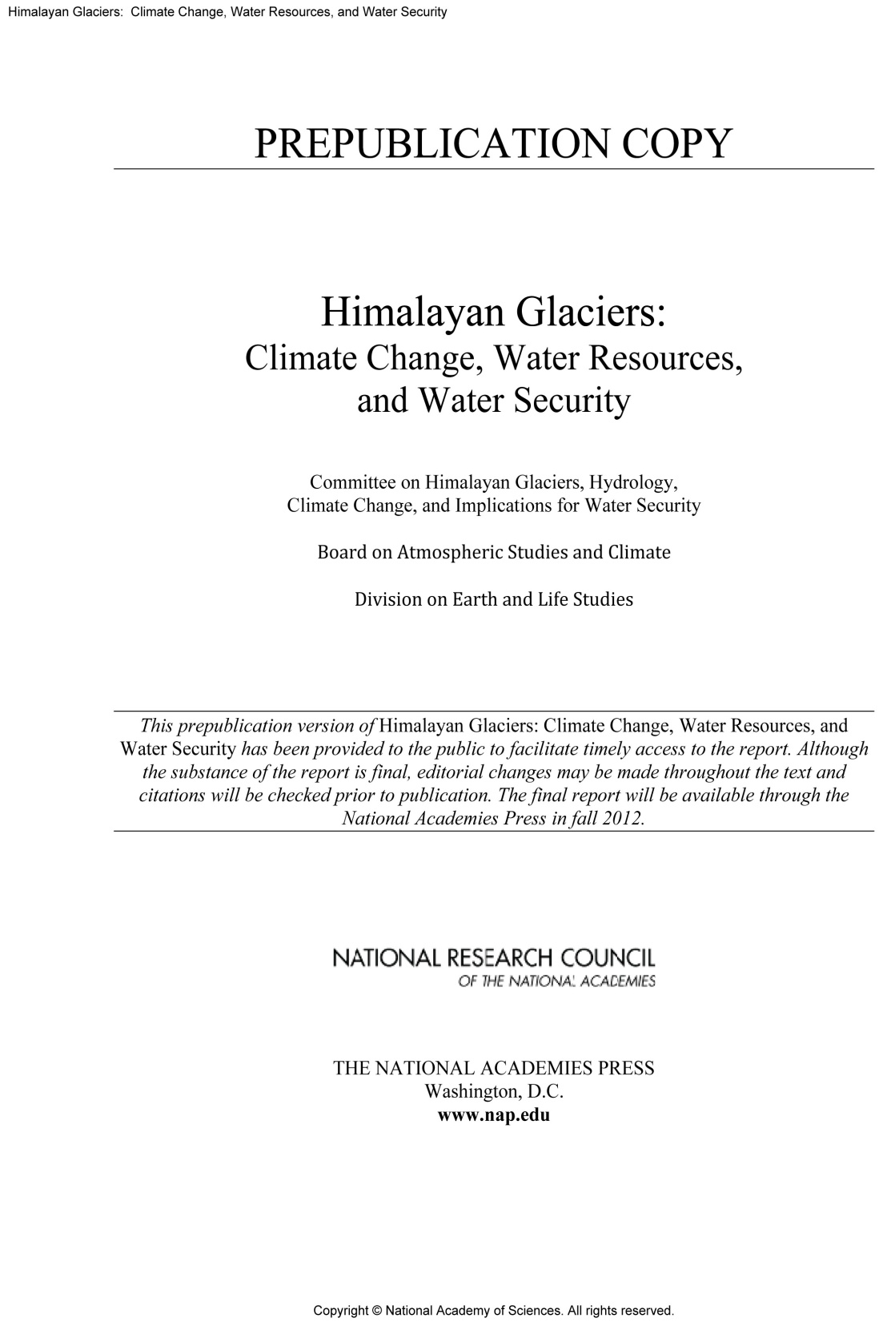

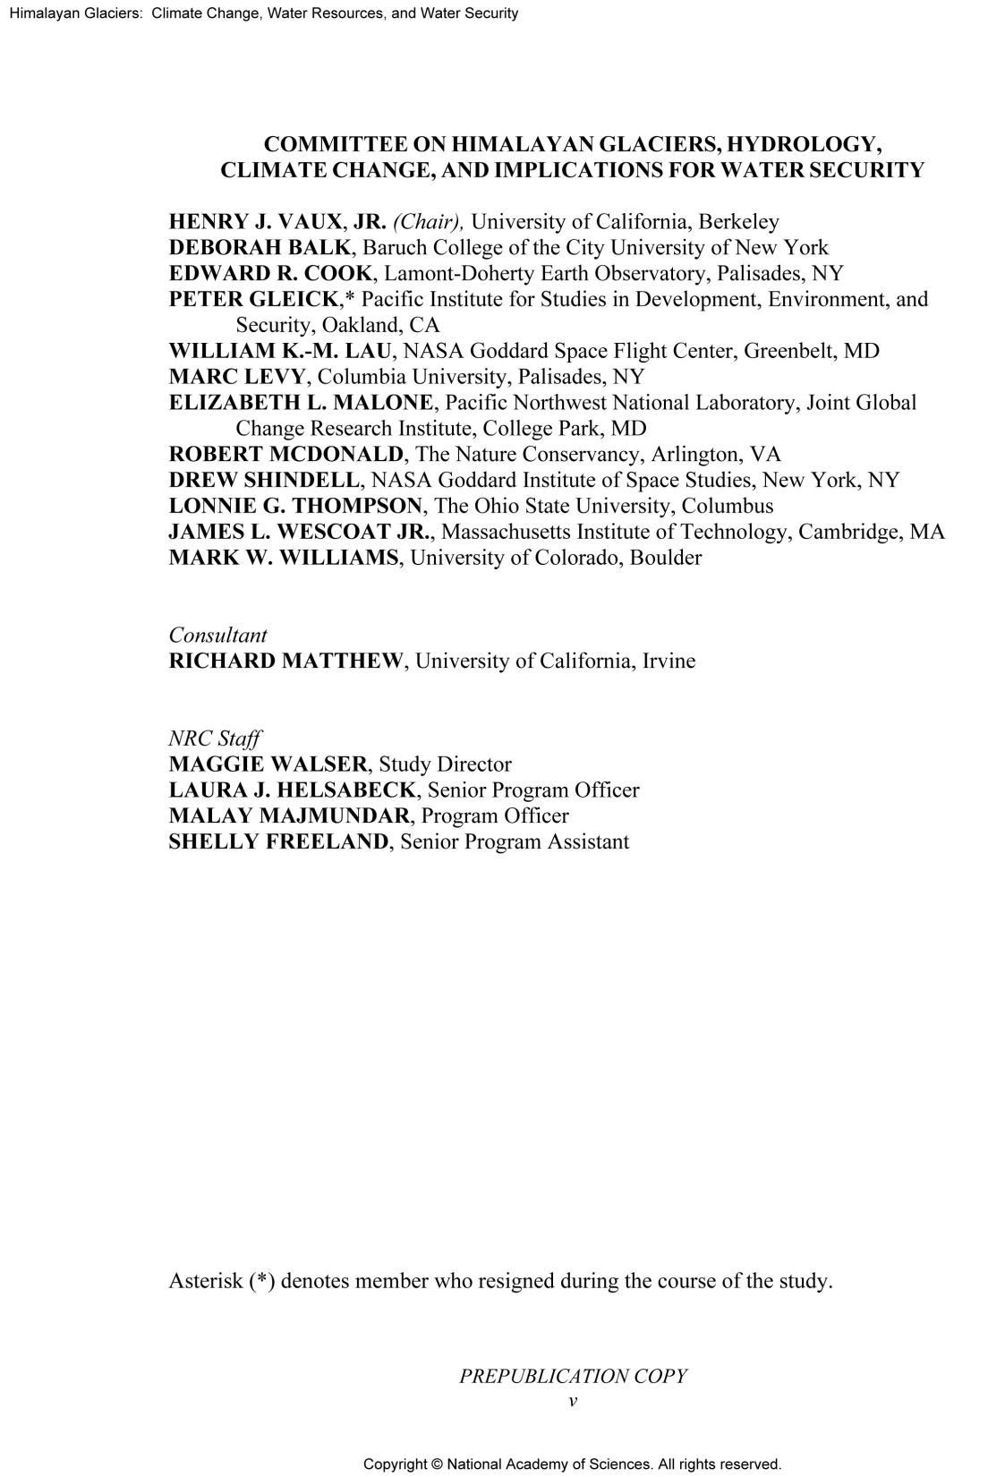

Slide 18
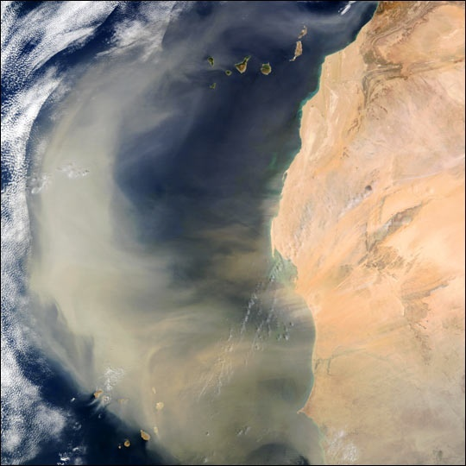
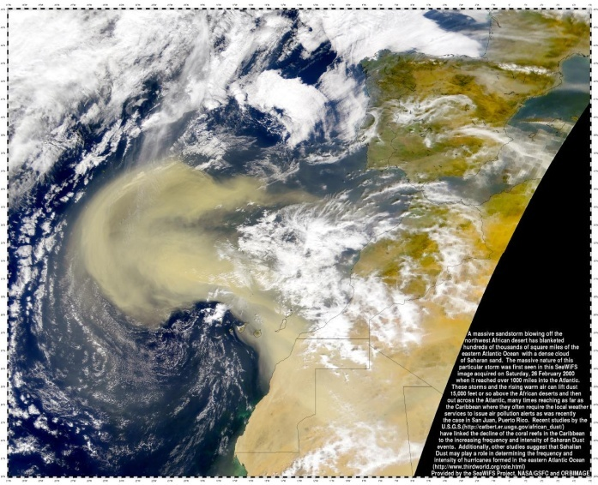
Atmospheric loading of Saharan dust
Annual emission of Saharan dust is estimated to be 3-4 billion tons with
large uncertainties
Increased Saharan dust outbreak since the 1970’s, associated with the prolonged drought in Sahel ; decreasing loading over Atlantic, since 1990’s associated with Sahel rainfall recovery
Possible weather and climate impacts
SAL dry air may suppress tropical cyclogenesis, and/or hurricane formation
Microphysics effects: suppress warm rain; increase ice-nucleation and deep convection
Solar Dimming Effect
“ Elevated Heat Pump” (EHP) Effect
(Lau et al 2006, 2009)
MODIS Images

Slide 19
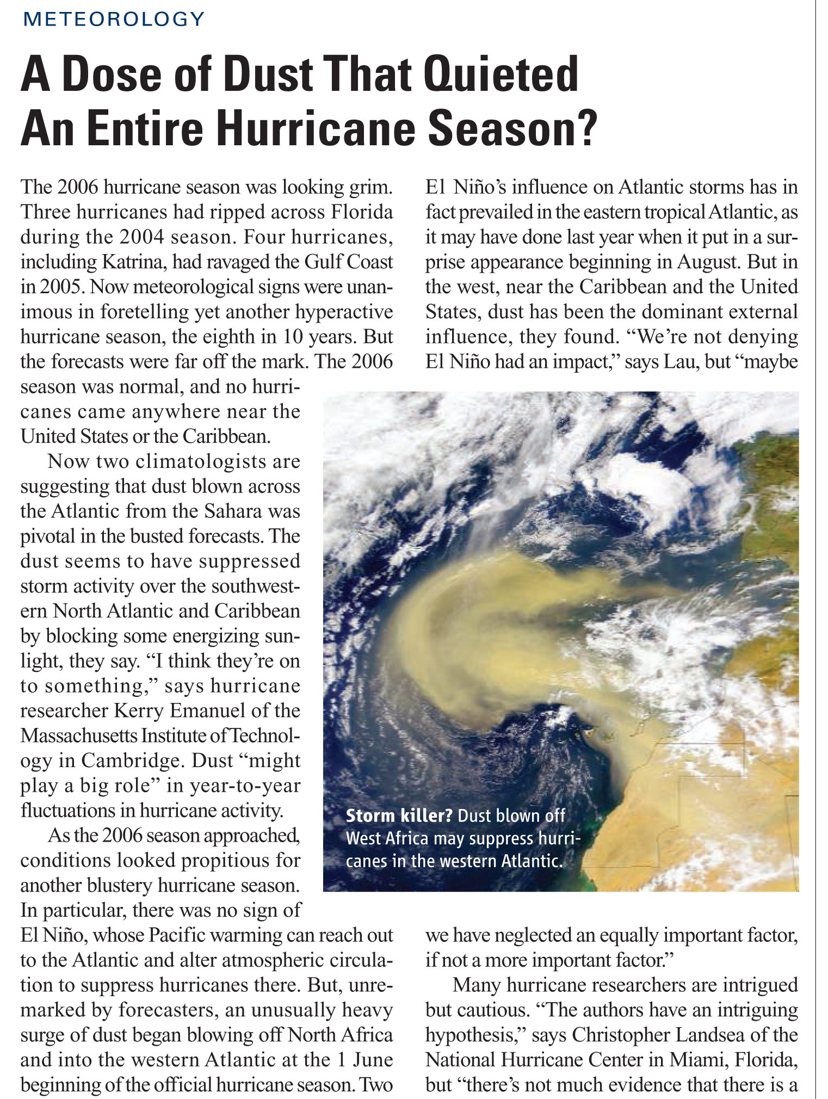
“How Nature Foiled the 2006 Hurricane Forecast “ Lau and Kim 2007, EOS

Slide 20
2005 | 15H, 12TS, 2TD, 1STS, 1STD
2006 | 5H, 4TS
How did nature foil the
2006 hurricane forecasts?
Notes:
Hurricane tracks and statistics in 2005 and in 2006.

Slide 21
Abrupt shift in the atmospheric water cycle over the Atlantic during the hurricane seasons
(JAS 2006 minus 2005)
Notes:
(a) Extensive cooling of the Atlantic in 2006 of 0.5 – 1C in blue; b) increased dust aerosol over the Atlantic and north Africa ; c) increased rainfall just south of the dust layer and large reduction in rainfall over the western Atlantic and Caribbean d) overall increased in deep clouds over the eastern Atlantic (blue indicated colder cloud top), and reduced deep clouds over the western Atlantic and Caribbean → large-scale sinking motion over the W. Atlantic and Caribbean region, which will also kill hurricane, in addition to the cooler SST there.

Slide 22
Saharan dust induced changes in radiative surface fluxes,
and surface temperature anomalies in GEOS5 model

Slide 24
Aerosol Effects (IAA-NOA)
Simulated by GEOS-5 with interactive Aerosol
(a) Dust aerosol optical depth distribution simulated by GEOS5 GCM coupled with fully interactive GOCART model (IAA) for August and September. (b) Aerosol induced anomalies of rainfall (% change) and winds at 850hPa. Anomalies are obtained as a difference between GEOS5 coupled with interactive aerosols (IAA) and no aerosol radiative forcing (NOA).

Slide 25
The Elevated-Heat-Pump (EHP) effect: Water Cycle and climate feedback induced by Saharan dust radiative forcing over W. Africa and the tropical Atlantic
increased upper level clouds
reduced upper level clouds
induced subsidence
suppresses convection
increased
moisture transport, AEW
reduced SW
cools land
Increased
rainfall
increased low level clouds
dust
source
reduced SW
cooler land
cooler ocean
W. Africa
Caribbean
Gulf of Guinea
Lau et al. 2009, Geophys. Annales

Slide 26
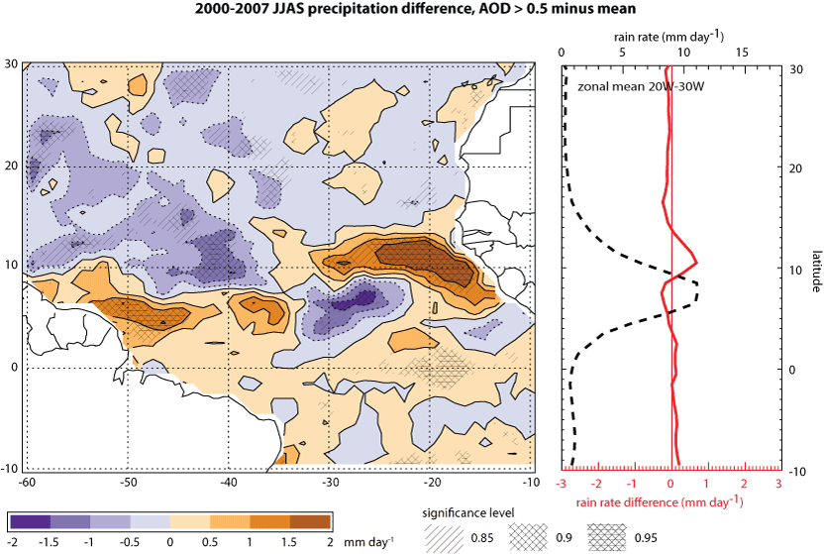
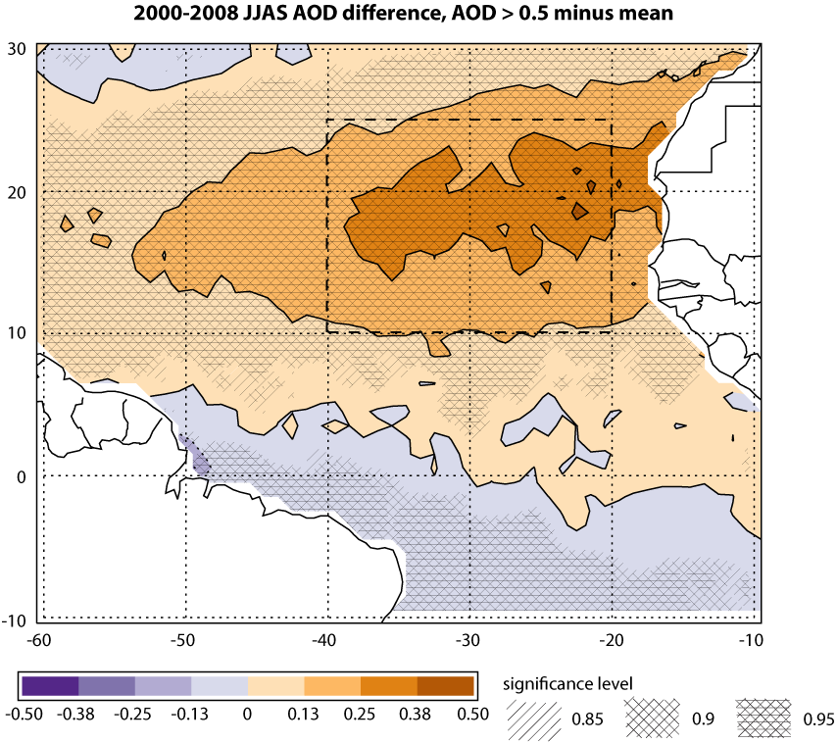
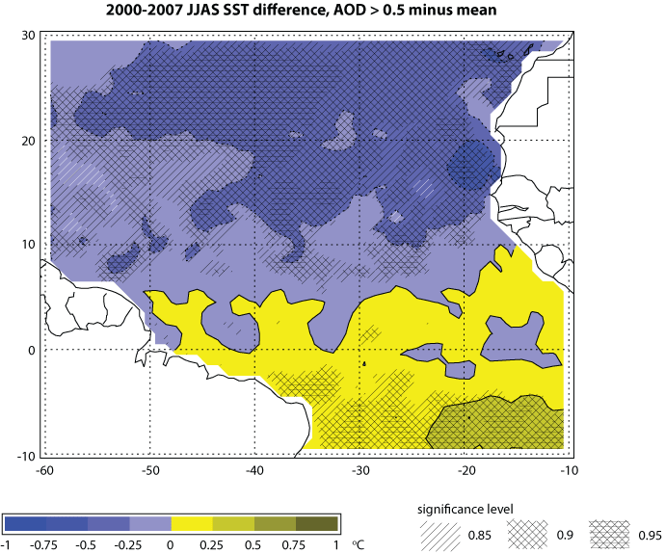
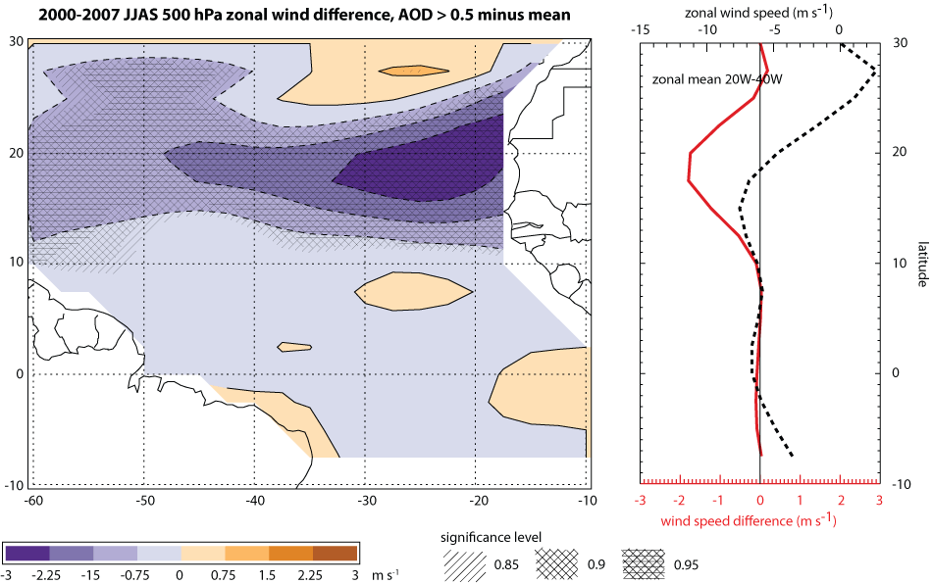
Wilcox et al 2010

Slide 27
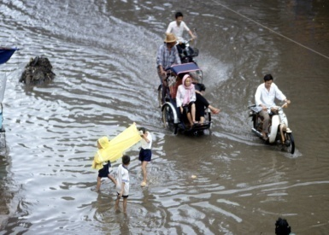
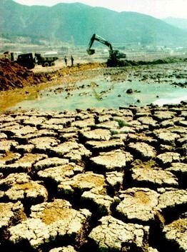
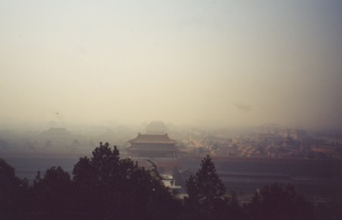
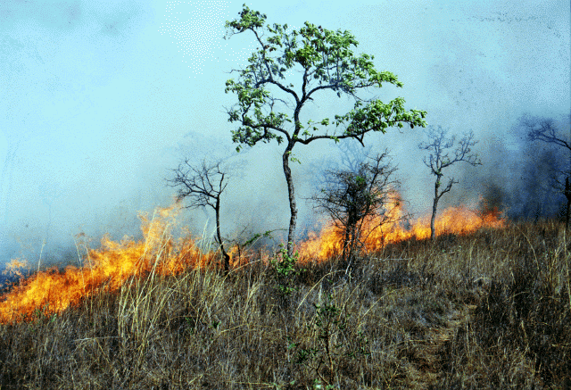
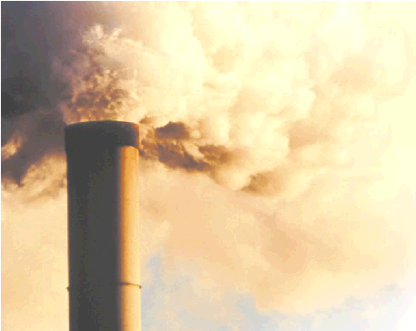
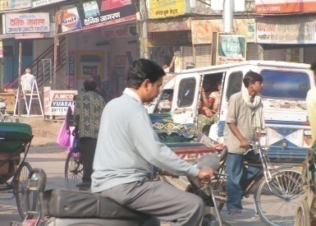
The Future (2013 and beyond) :
The Global Aerosol-Monsoon Climate System – A new paradigm
Hourly-daily-to-intraseasonal: individual clouds and cloud
clusters (< 100s km)
Seasonal-to-interannual: regional to continental (100s -
1000s km)
Interdecadal and beyond: intercontinental to global
(>10,000s km)

Slide 28
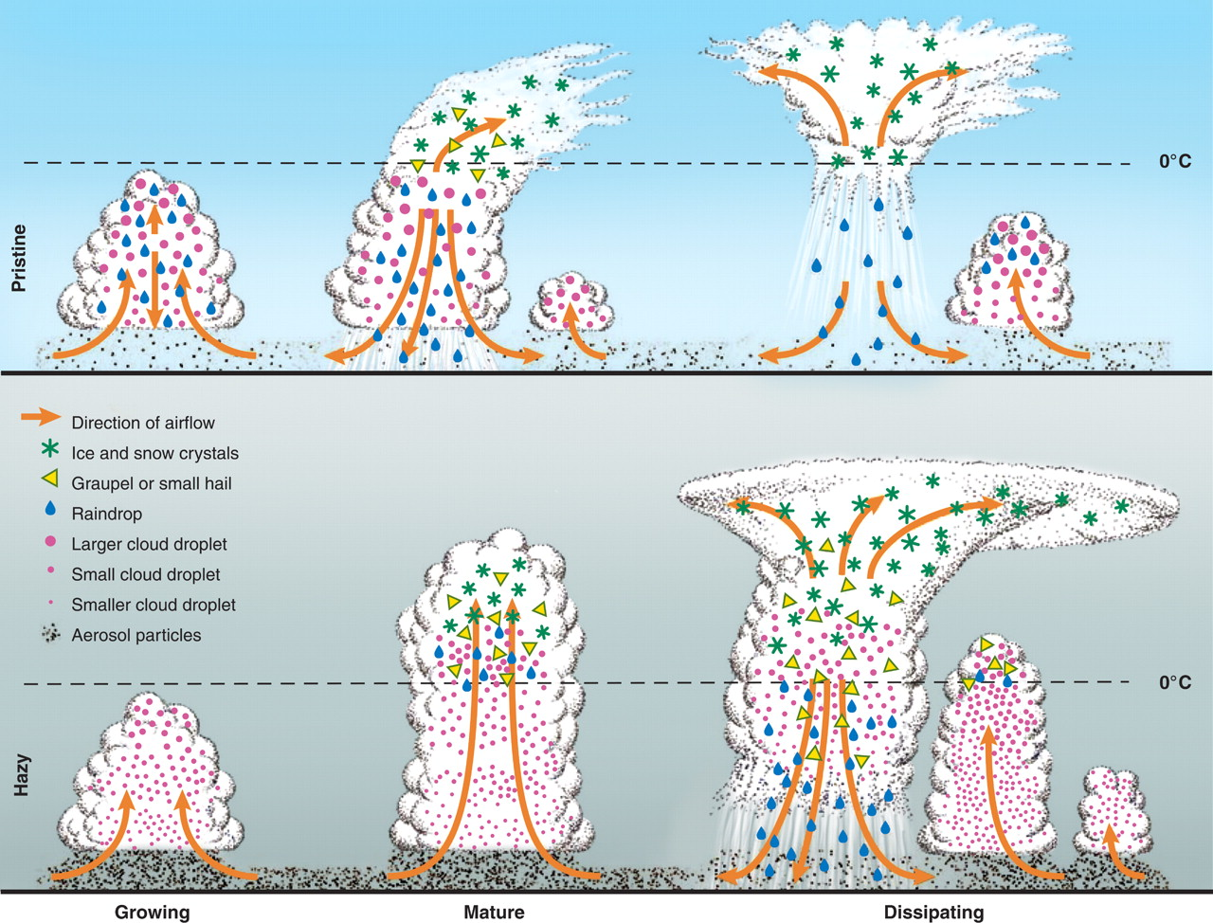

Hourly-daily-intraseasonal time scales :
Delayed warm rain, and prolonged cloud life time by aerosols in
a monsoon (moisture-rich) environment may invigorate deep convection
Rosenfeld et al 2008, Science

Slide 29
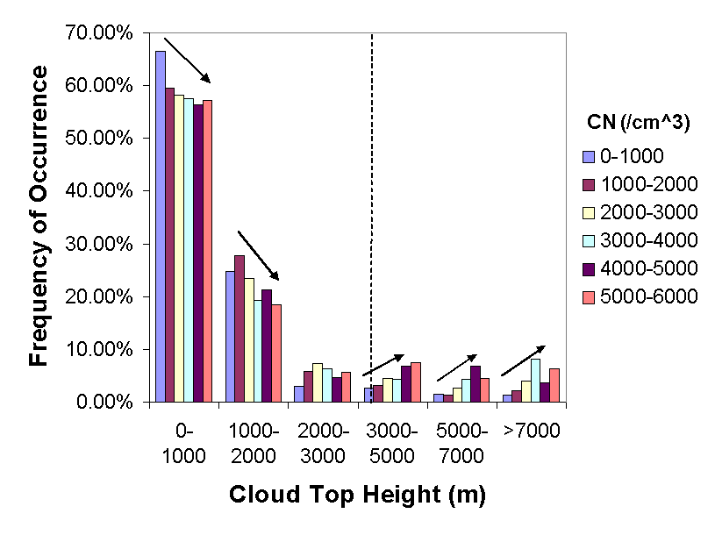


Effects of Aerosols on the
Frequency of Cloud Occurrence
Freezing level
Suppress low water clouds
Enhance
high, ice clouds
Li et al.
(Nature-Geo, 2011)
As CN increases, deep (ice-phase) clouds occurred more frequently but low (liquid-phase) clouds occurred less frequently
Notes:
The freezing-induced invigoration is confirmed by the analyses of the frequency of cloud occurrence and LWP with respect to six aerosol number concentration (CN) bins for six different cloud top height (CTH) ranges. As CN increases, high clouds occurred more frequently but low clouds occurred less frequently (Left). The right figure reveals that cloud water content increases drastically with the CN after it exceeds 0.8mm, the threshold used in slide 2, which thus explains the dependence on LWP for the relationship between rainfall frequency and CN

Slide 30
Pending future activities ( 2013 and beyond):
Expanded work on aerosol-monsoon climate system – A New Paradigm (current IDS)
IPCC CMIP5 model projections; detecting aerosol v. GHG warming impacts on monsoon water cycle
Biomass burning and drought feedback over Southeast Asia and Maritime continent (Pending IDS proposal, PI: W. Lau)
International DOE/ ARM field campaign over Nepal/Tibet to study aerosol (snow- darkening, EHP and other theories) on accelerated glacier melt over Himalayas and Tibetan Plateau (Pending DOE proposal, PI. Y. Qian)
Aerosol microphysics effect in enhancement of deep convection in Atlantic ITCZ and West African monsoon
Saharan dust interaction with African Easterly Jet, African Easterly waves, tropical cyclogenesis, and hurricane intensification (Pending CC proposal, PI. K. M. Kim)
Snow-darkening effects on accelerated springtime snowmelt over Eurasia, and impacts on extreme heat wave and prolonged drought (Funded MAP proposal: PI: W. Lau)

Slide 31
Back Up

Slide 32
Saharan dust cools the Atlantic
Notes:
Top left: difference of MODIS AOD showing large increase in Saharan dust ; Bottom left: Extensive cooling of SST indicated by TMI
top

Slide 33
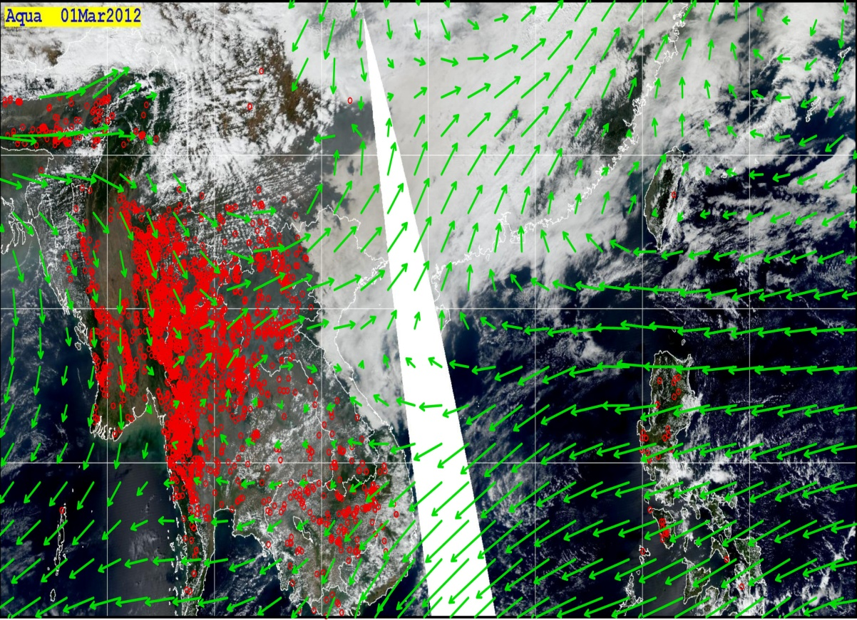
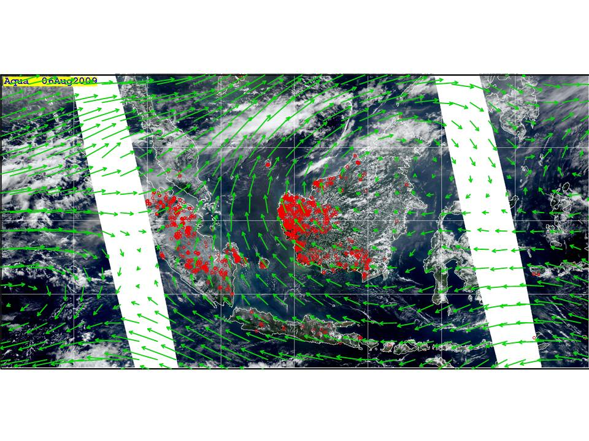
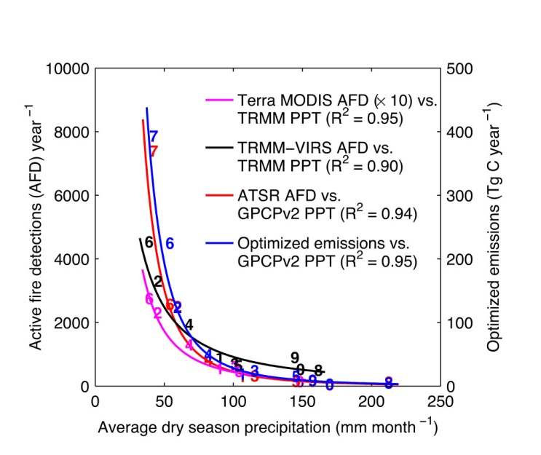

Slide 34
Weak subsidence from Asian continent
BB aerosol transport
from IndoChina Peninsula
W
Increased rainfall from EHP and/or
delayed invigoration of deep convection.
Semi-direct effects increases atmospheric stability,
Burn-off clouds, suppresses warm rain
Gulf of Tonkin/
northern South China Sea
Vietnam/southern China

Slide 36
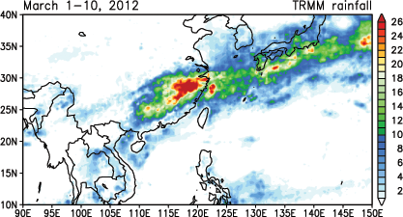
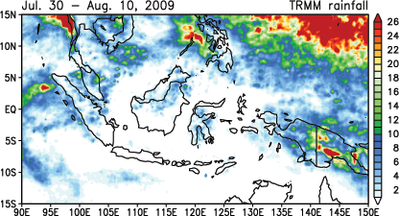
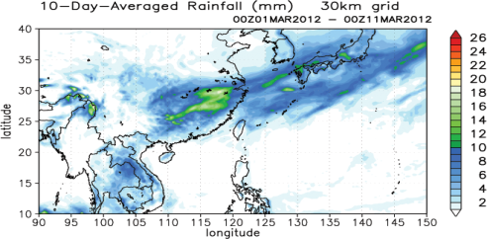
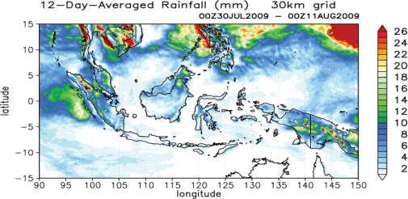
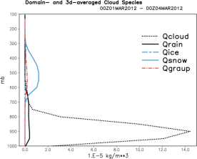
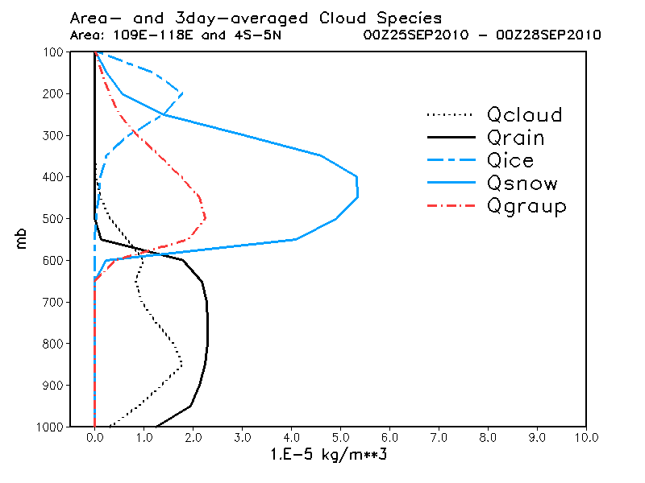

Slide 37
Increased upper tropospheric
water vapor through cirrus anvil
interactions
Subsidence, adiabatic warming driven by
ENSO and/or dry phase of MJO
Aerosol heating/cooling
enhances atmos.stability
increases adiabactic
warming and drying
Deep convection/precip
enhancement
Prevailing wind
BB aerosol transport
by pyro-convection
Warm rain suppression
Indian Ocean
Indonesia/Maritime Continent
Western Pacific

Slide 38
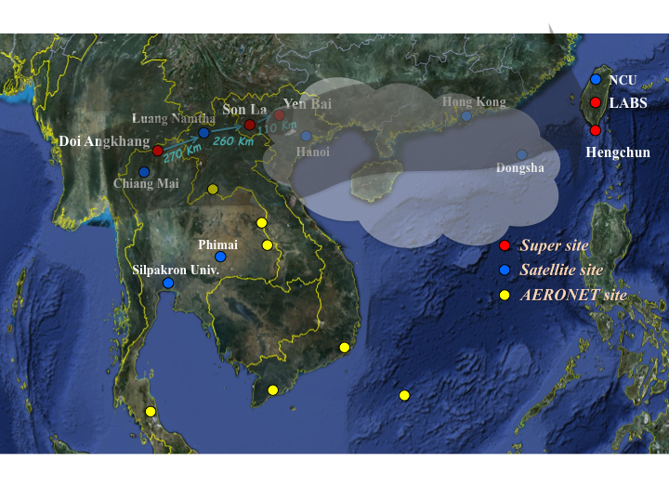

Slide 39
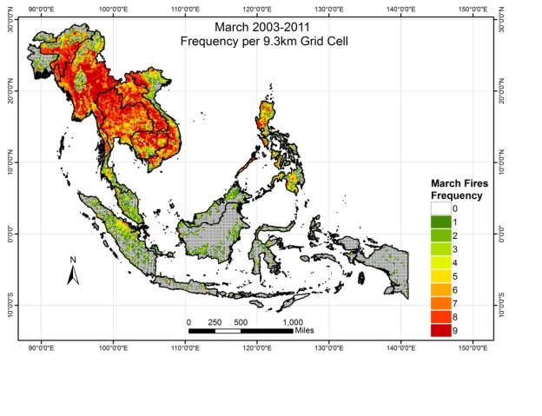
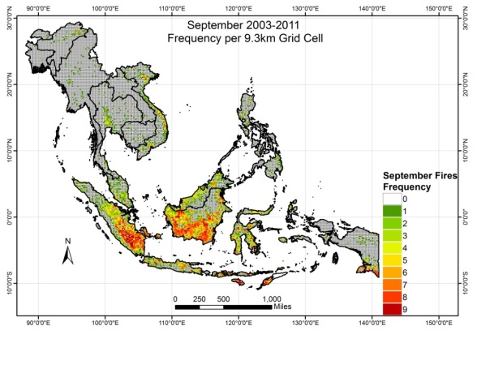

Slide 40
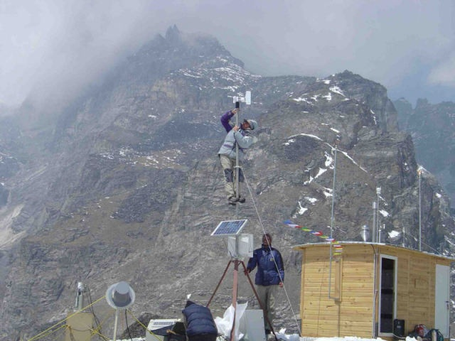
The observatory is operational since February 2006, with full-time technical assistence;
Every three months, an expedition provides extraordinary maintenance, renewal of the consumables, and recovery of the filter and flask samples.

Slide 41
Aerosols - Monsoon Interaction
Over 60% of world population live in the Asian monsoon regions
Monsoon related droughts and floods, and aerosols are the two most severe environmental hazards in Asian monsoon regions,
The monsoon water cycle is driven by atmospheric heating, through the dynamical interaction of wind, moisture, clouds and rainfall.
Sea surface temperature, and land surface processes alter monsoon water cycle, through generation of surface heating gradients and atmospheric heat sources and sinks.
Suspended particles (aerosol, clouds, precipitation) in the atmosphere regulate and interact with heat sources and sinks, and alter the monsoon water cycle

Slide 42
The Elevated Heat Pump Hypothesis
(Lau et al. 2006, Lau and Kim 2006, Lau et al. 2008)
“Clean”
Monsoon
Somali Jet
May -June
Polluted (dust and BC) monsoon
Somali Jet
May-June

