Slide 1
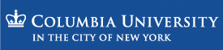


Influences of the primary organic marine component on sea-spray composition and climate
Kostas Tsigaridis, Dorothy Koch and Surabi Menon
kt2347@columbia.edu
ktsigaridis@giss.nasa.gov

Slide 2
Sea-spray
Solubility (hygroscopicity)
  Aerosol composition ➔ cloud formation
  Clouds ➔ aerosol formation
  Clouds ➔ aerosol removal
  Dissolved aerosols into clouds ➔ cloud properties & lifetime

Slide 3
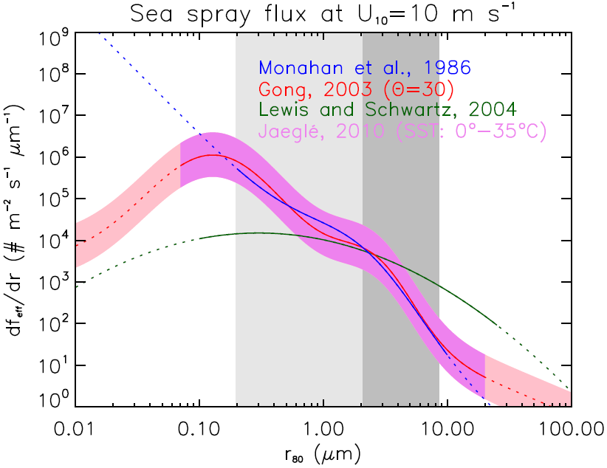
Sea-spray source

Slide 4
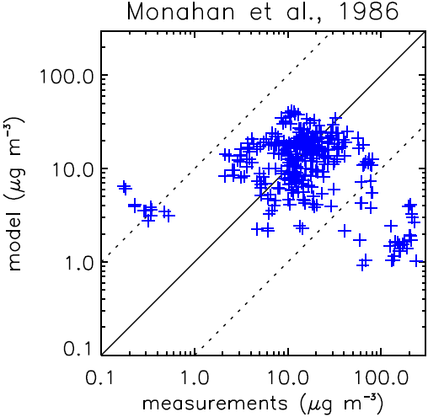
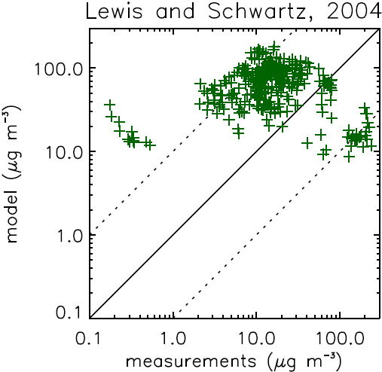
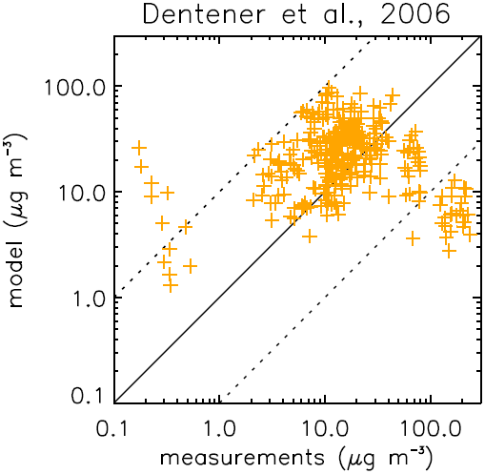
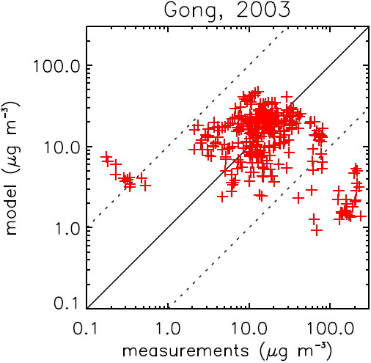
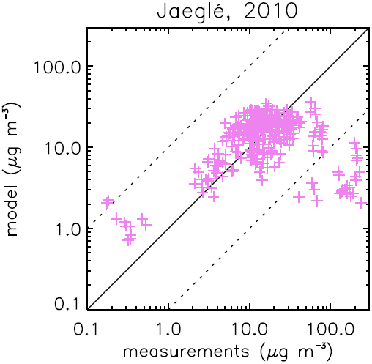
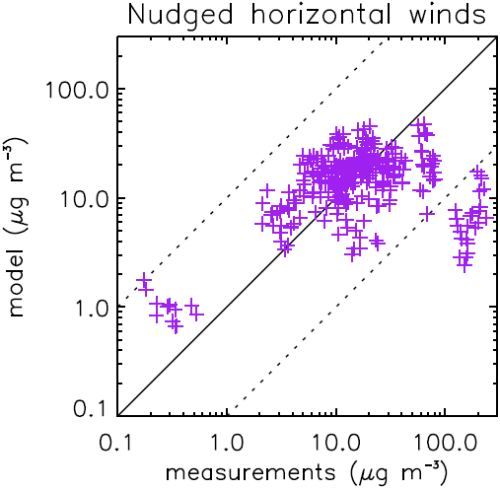
Sea-salt comparison with measurements
Prospero and Savoie dataset, University of Miami

Slide 5
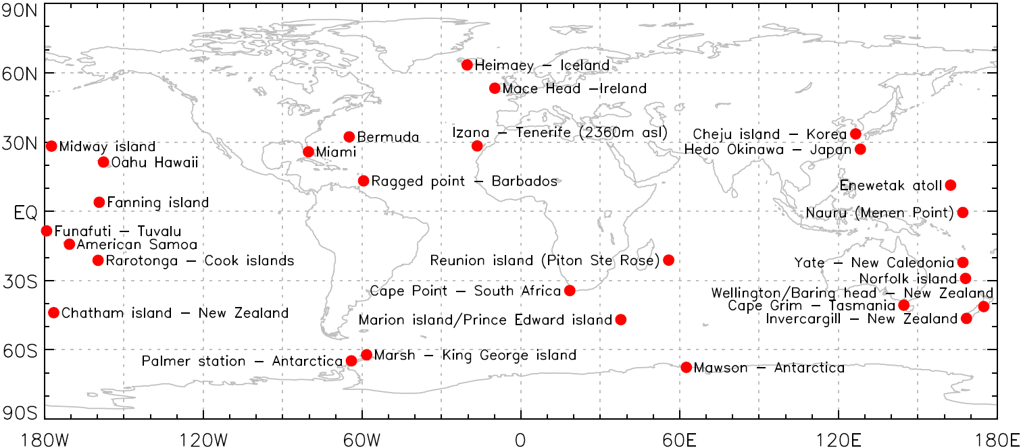
Sea-salt comparison with measurements
“BAD”
Prospero and Savoie dataset, University of Miami

Slide 6
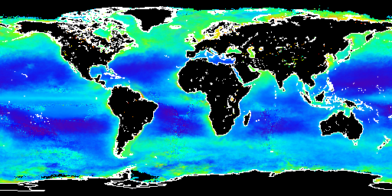
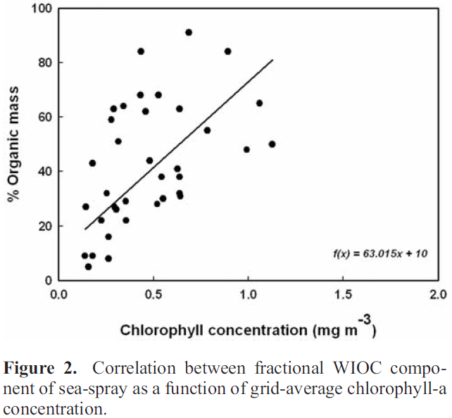

Sea-spray organic enrichment
SeaWiFS, 2000
O’Dowd et al., 2008
Vignati et al., 2010

Slide 7
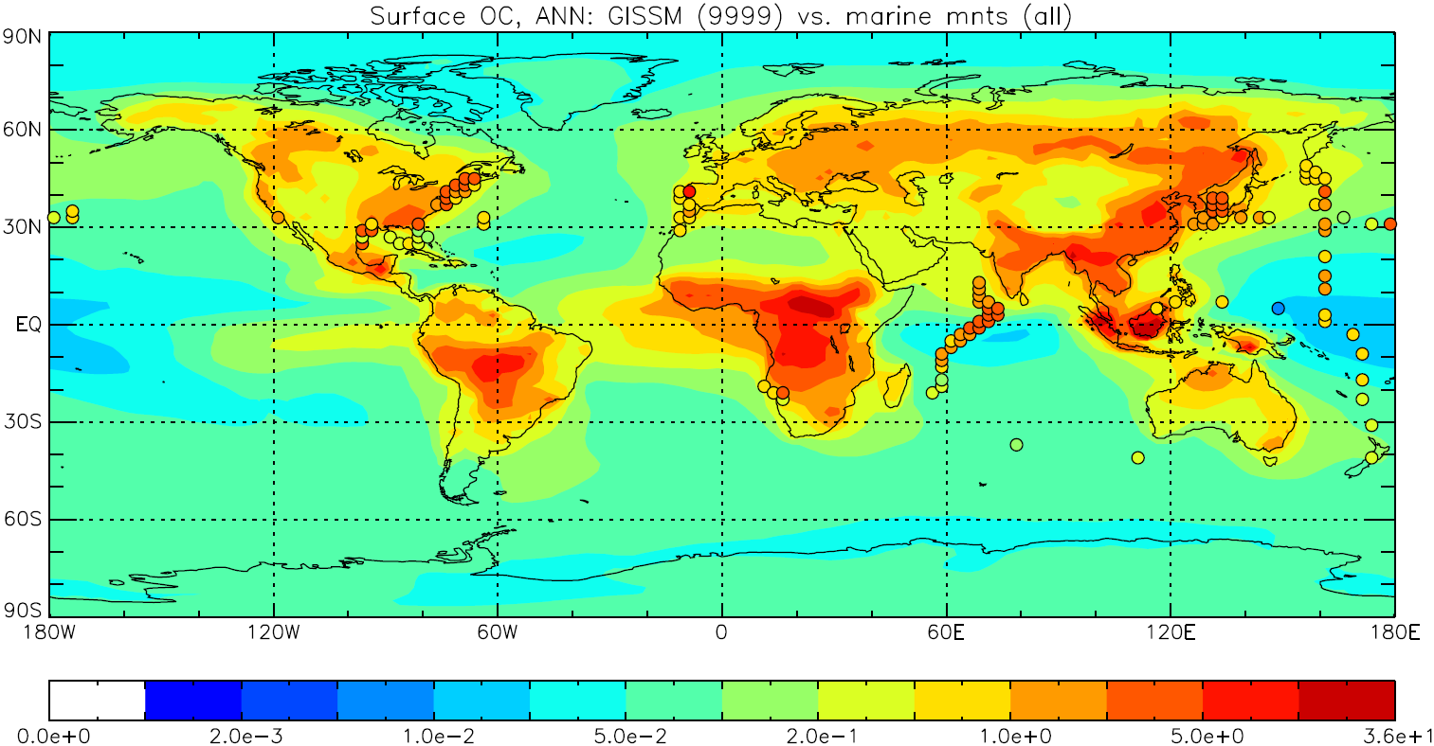
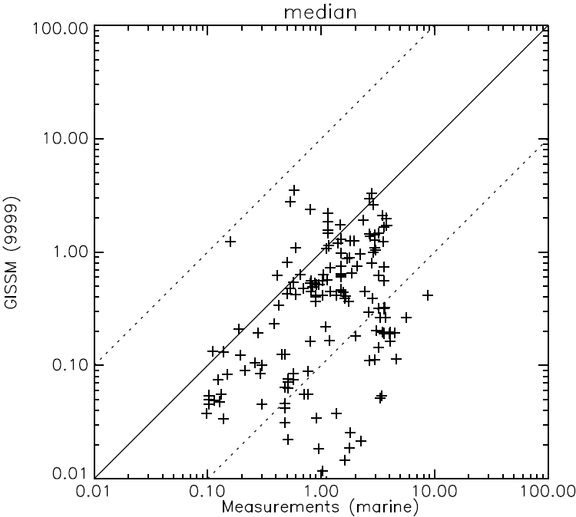
Organics comparison with measurements
Without oceanic organics

Slide 8
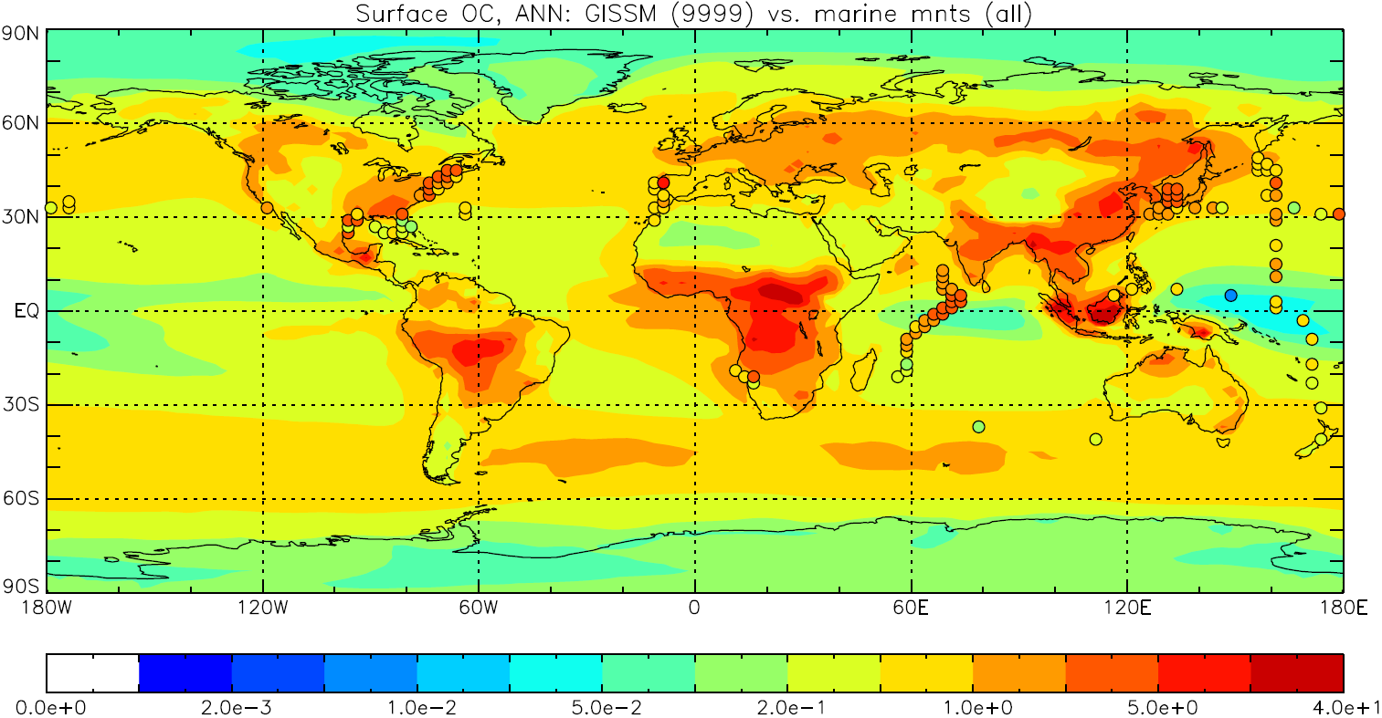
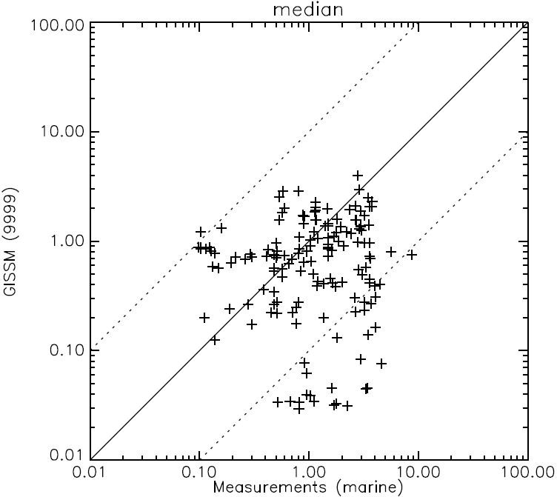
Organics comparison with measurements
With oceanic organics

Slide 9
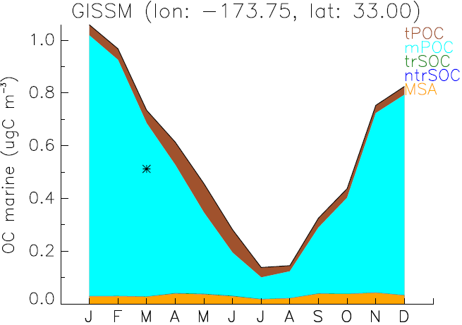

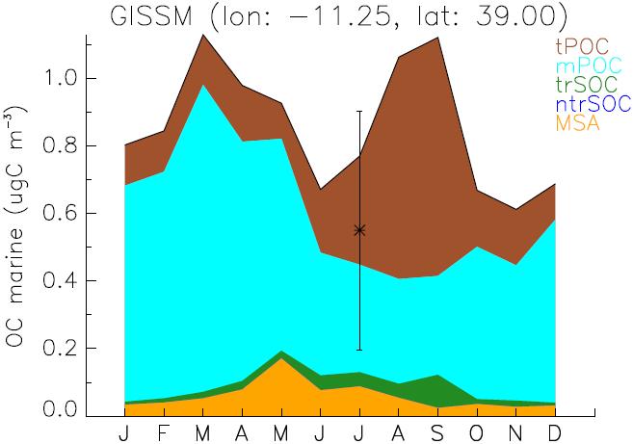
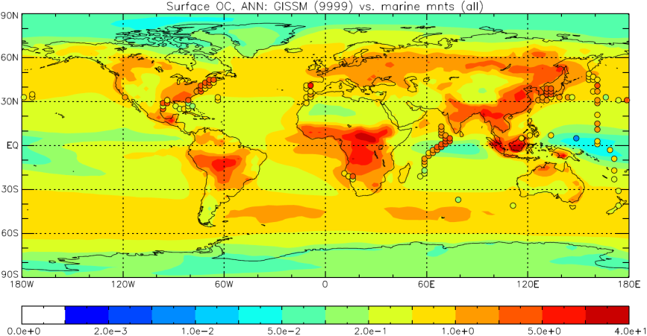
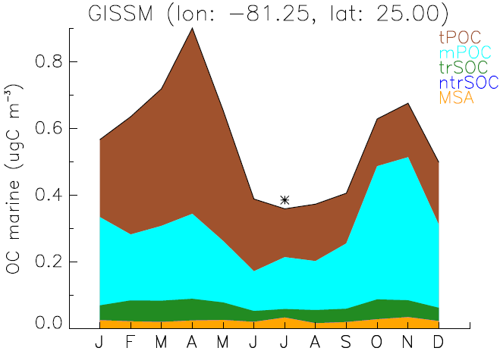
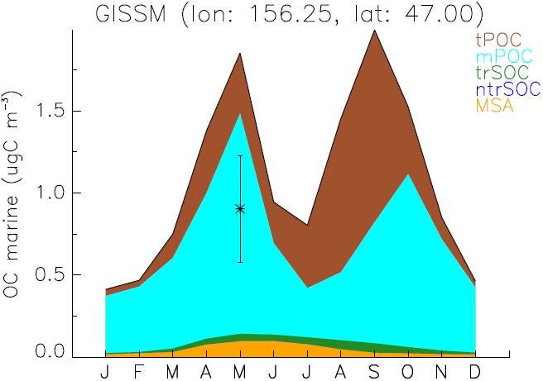
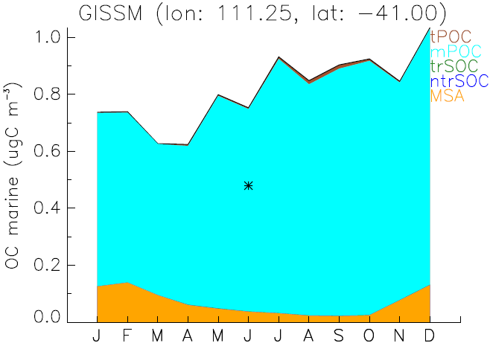
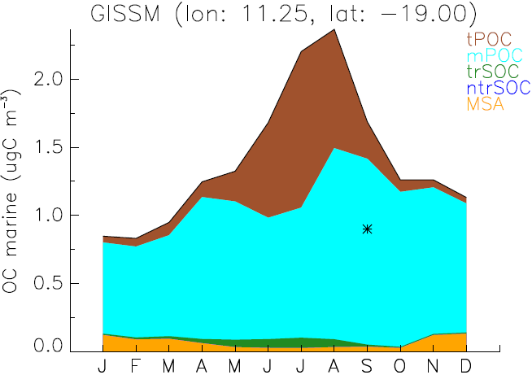
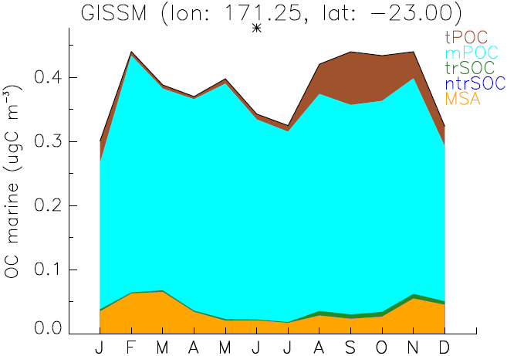
Organics comparison with measurements

Slide 10
Oceanic aerosol budget
Tracer | Source (Tg a⁻¹) | Burden (Tg) | Lifetime (days)
Oceanic OA | 63-73 | 0.25-0.30 | 1.5
Sea-salt | 240-279+ 1970-2286 | 0.91-1.10+ 5.9-6.9 | 1.4-1.5, 1.1
Fine ss* | 308-348 | 1.10-1.27 | 1.3-1.4
*Without
sea-spray
organic
enrichment
Tracer | Source (Tg a⁻¹) | Burden (Tg) | Lifetime (days) | Reference
Sea-salt | 6297 |  |  | Vignati et al., 2010
Sea-salt | 6290 | 2.4 |  | Myriokefalitakis et al., 2010
Sea-salt | 59+2229 | 0.3+5.9 | 1.03, 0.5 | Jaeglé et al., 2010
Oceanic OA | 8.2 | 0.05 | 2.2 | Vignati et al., 2010
Oceanic OA | 7-8 | 0.12 | 4.5 | Myriokefalitakis et al., 2010
Oceanic OA | 8 (TgC a⁻¹) |  |  | Spracklen et al., 2008
Oceanic OA | 75 (TgC a⁻¹) |  |  | Roelofs, 2008
Oceanic OA | 22.3 (TgC a⁻¹) |  |  | Gantt et al., 2009

Slide 11
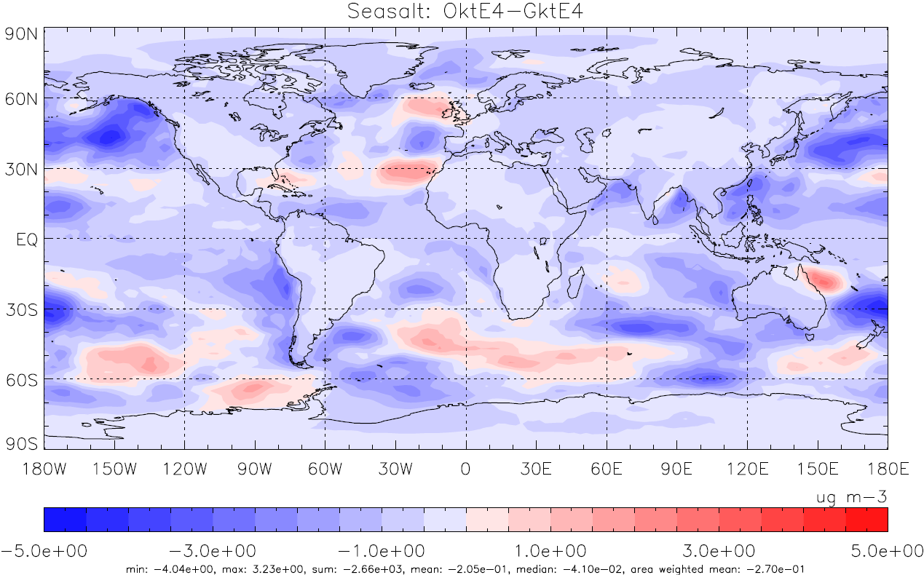
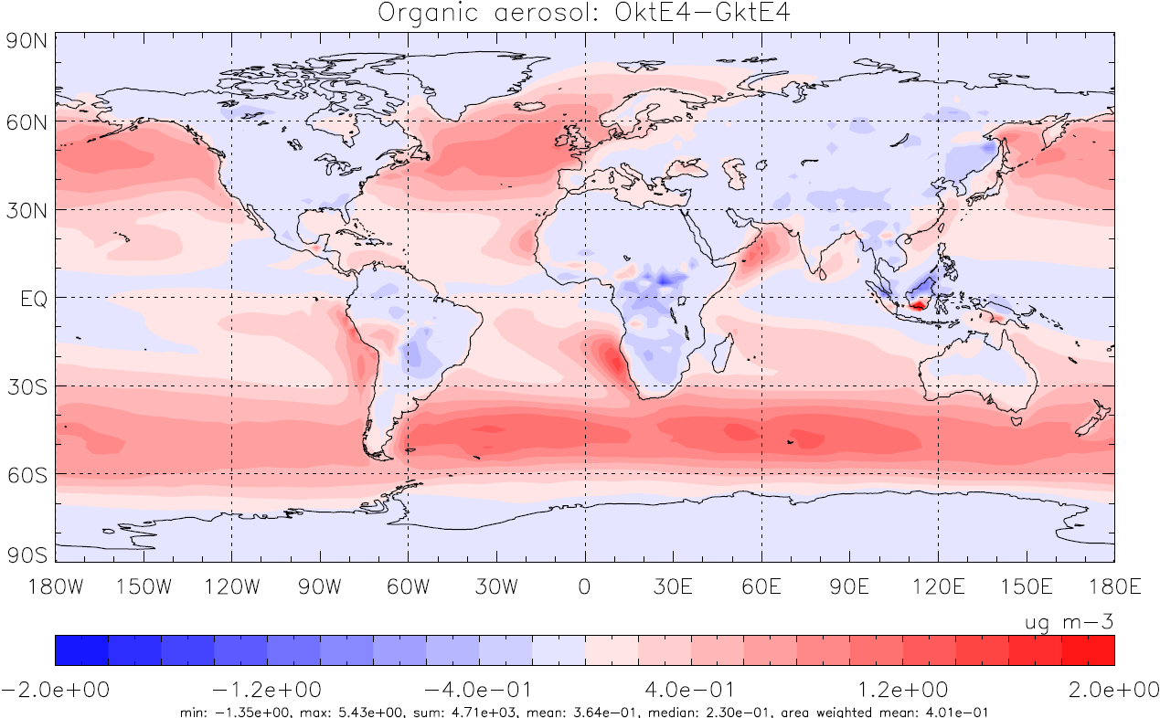
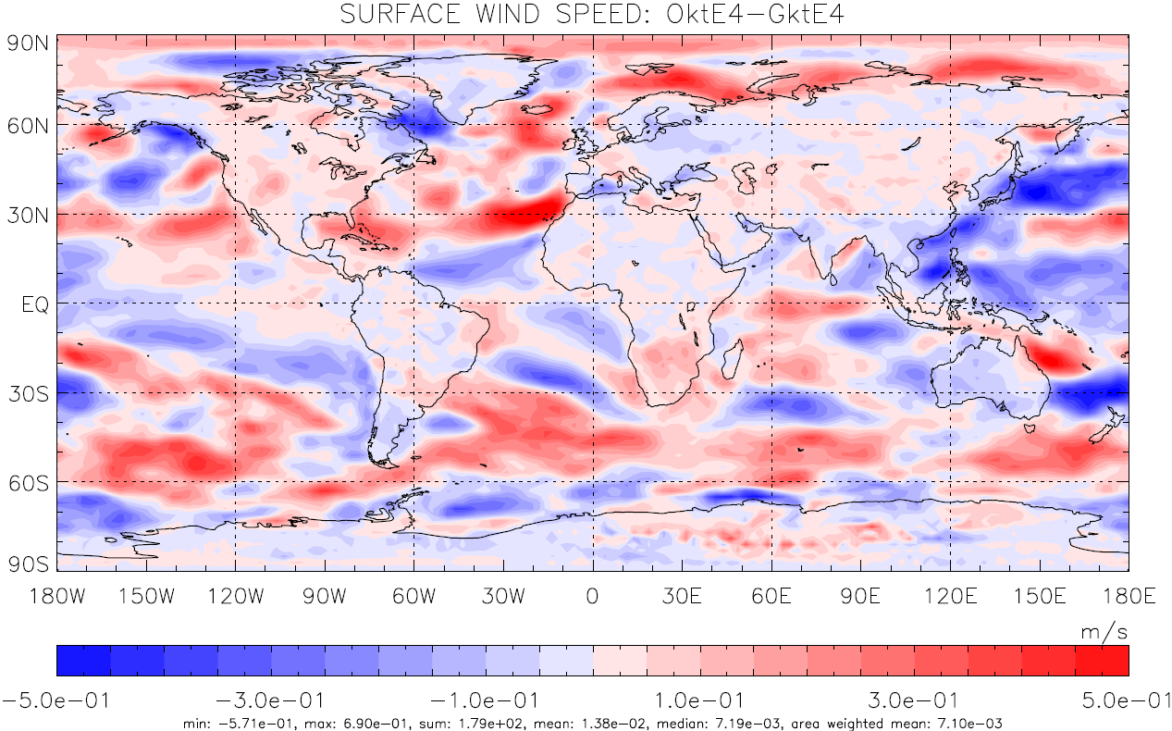
Aerosol concentration changes
Sea salt
Organic aerosol
Wind speed

Slide 12
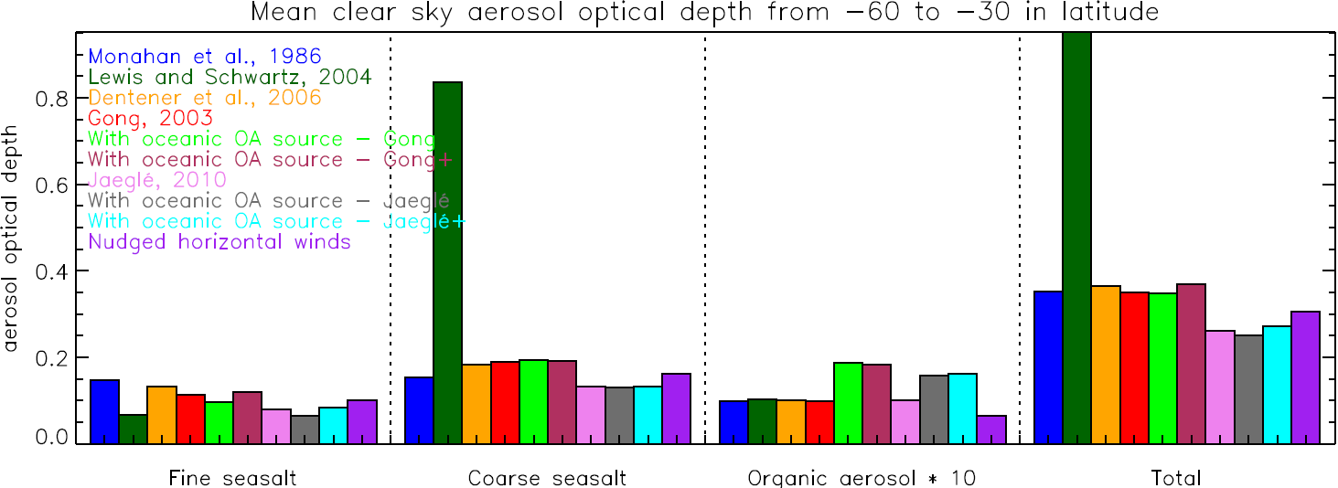
Southern ocean optical depth

Slide 13
Concluding remarks
Oceanic sources
  Sea-spray source very important on oceanic OA flux
  Oceanic OA source is very uncertain and differs by an order of magnitude between models; sea-salt source is among the ones to blame
Effects on climate
  Oceanic OA affect winds, affecting sea spray source, affecting oceanic OA
  Sea spray changes and OA presence affect CDNC, affecting clouds, affecting sea salt and oceanic OA removal

Slide 15
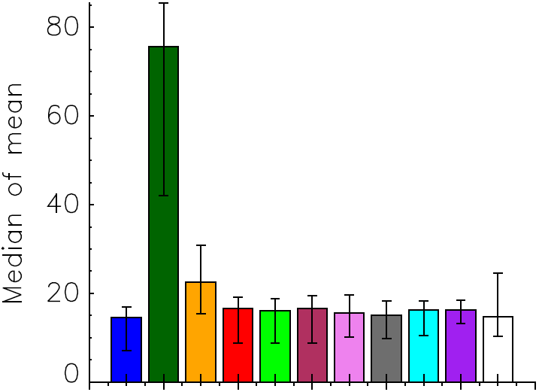
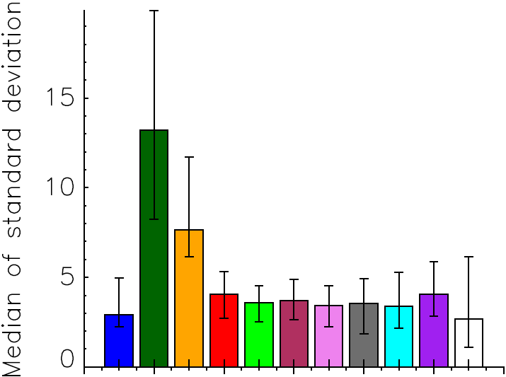
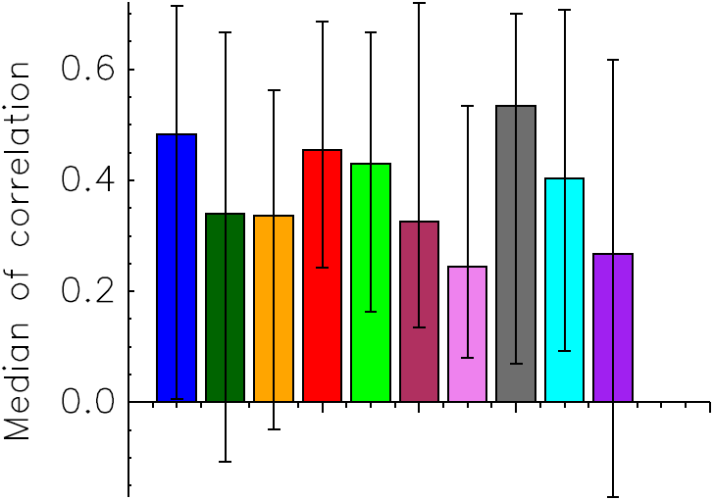
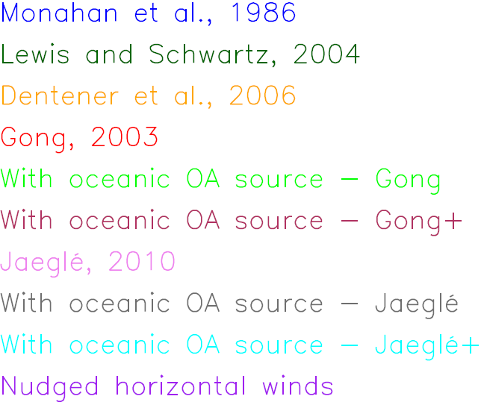

Slide 16
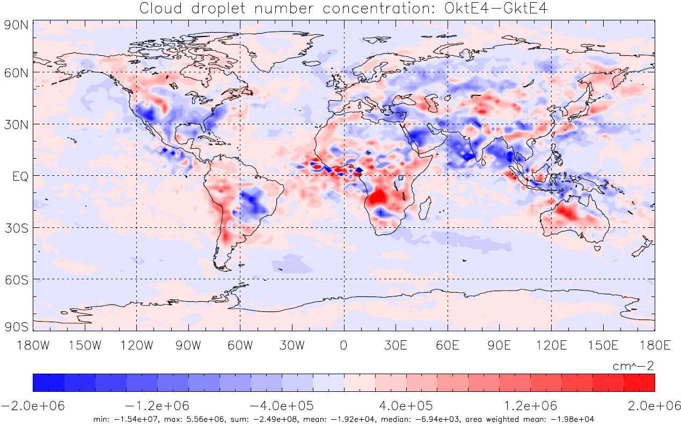
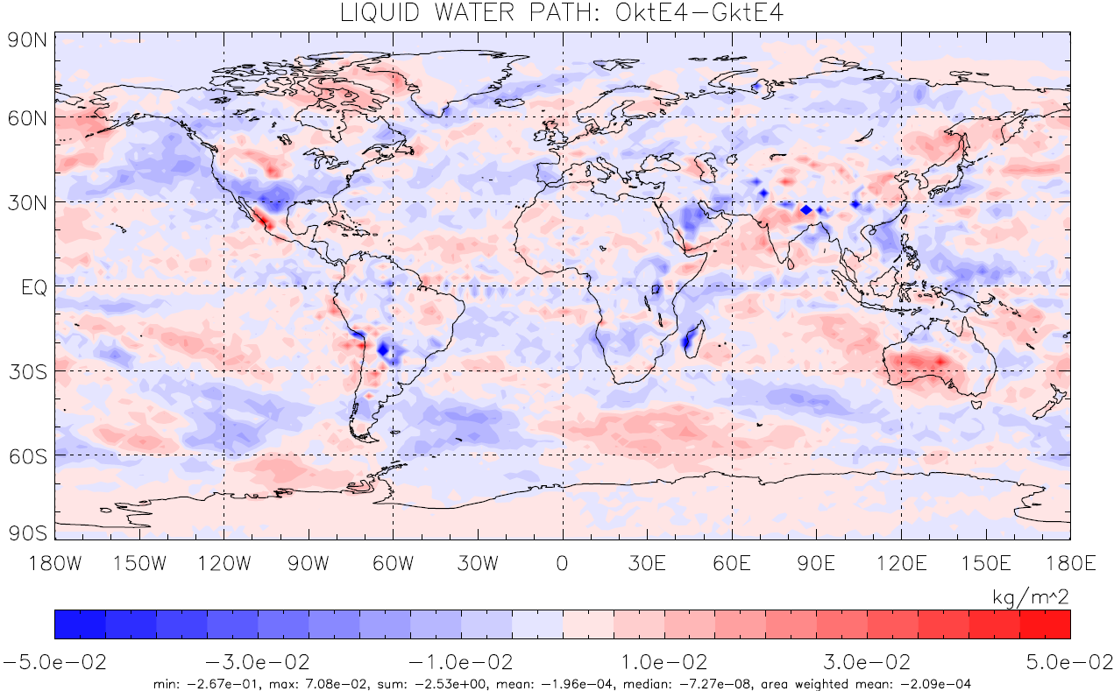
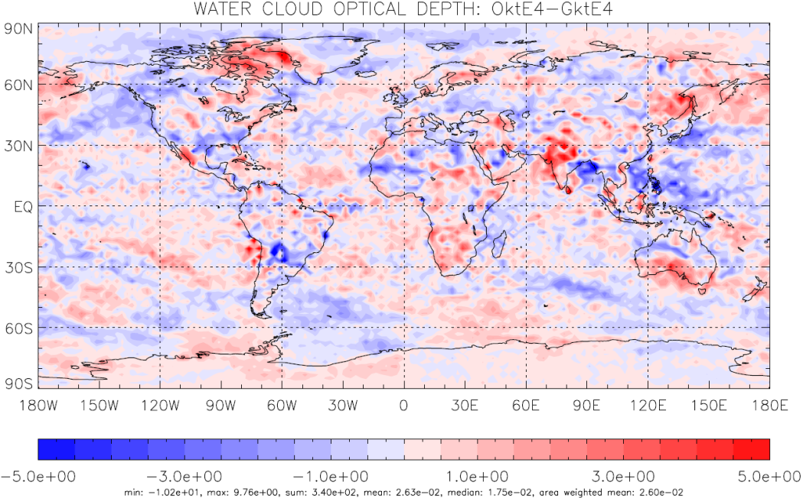
Effect on clouds
CDNC
Liquid water path
Water cloud
optical depth

