Slide 1
Near UV Aerosol Group Report
Omar Torres
NASA GSFC 614
GSFC Aerocenter Update
May 31, 2013

Slide 2
People
Research Group:
-Omar Torres (NASA – 614)
-Changwoo Ahn (SSAI)
-Hiren Jethva (GESTAR-USRA)
-Pawan Gupta (GESTAR-USRA)
-Santiago Gasso (GESTAR- Morgan State University)
-Peter Leonard (ADNET)
Collaborations:
-PK Bhartia
-Nick Krotkov
-Mian Chin
-Rich McPeters
-Peter Colarco, Valentina Aquila (JHU)
-E.S. Yang (SSAI)
-Sasha Marshak, Jay Herman (UMBC)
-Kelly Chance (SAO)
-Lorraine Remer (UMBC)
-Robert Loughman (HU)

Slide 3
Projects
OMI near UV aerosol algorithm and products
Algorithm Upgrades (Ahn, Jethva, Gupta, Torres)
Product Assessment (Ahn, Jethva, Gasso, Torres)
-OMI-MODIS Synergy (Gasso, Torres)
-Near UV High Spatial resolution (CAI, GLI) Analysis (Gasso, Torres)
Detecting Aerosol Above Clouds ( Jethva, Ahn, Torres, Bhartia, Remer)
OMI
MODIS Application
Inter-comparison to other techniques (POLDER, CALIOP)
Ground based observations of aerosols (Krotkov, Mok, Jethva, Loughman, Torres, Labow)
-Combined use of Cimel and UV and VIS MFRS sensors to measure aerosol absorption
Real and spurious effects of stratospheric aerosols on Satellite-measured total ozone
(Aquila, Yang, Torres, Bhartia, McPeters, Colarco)
MEASURES Near UV Aerosol Project (Torres, Bhartia)

Slide 4
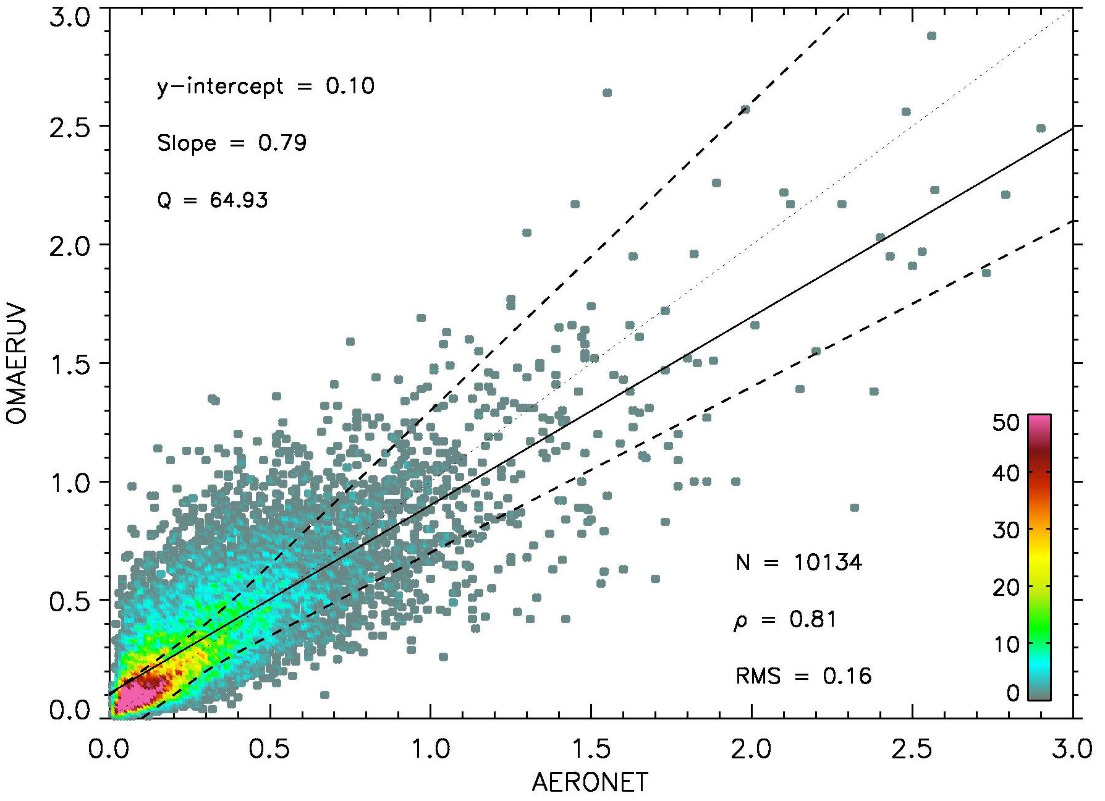
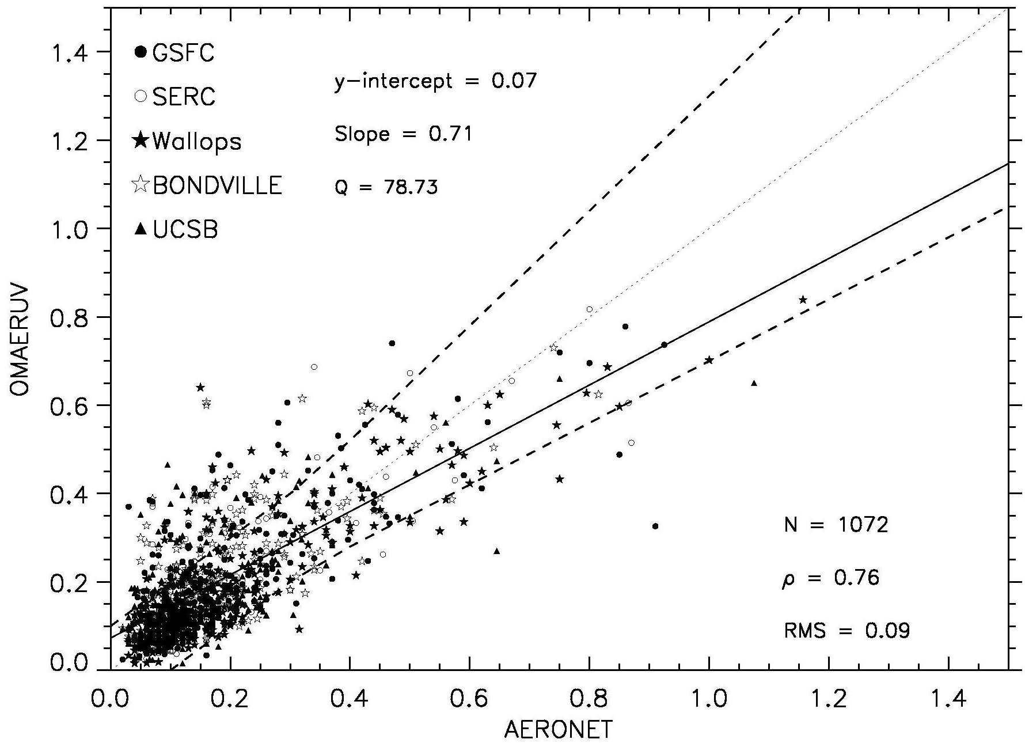
OMAERUV AOD Validation
Comparisons at 44 AERONET sites over for years (2005-2008)
All sites
Non-absorbing aerosol sites
Ahn et al., JGR 2013 (submitted); Torres et al., AMT 2013, (submitted)

Slide 5
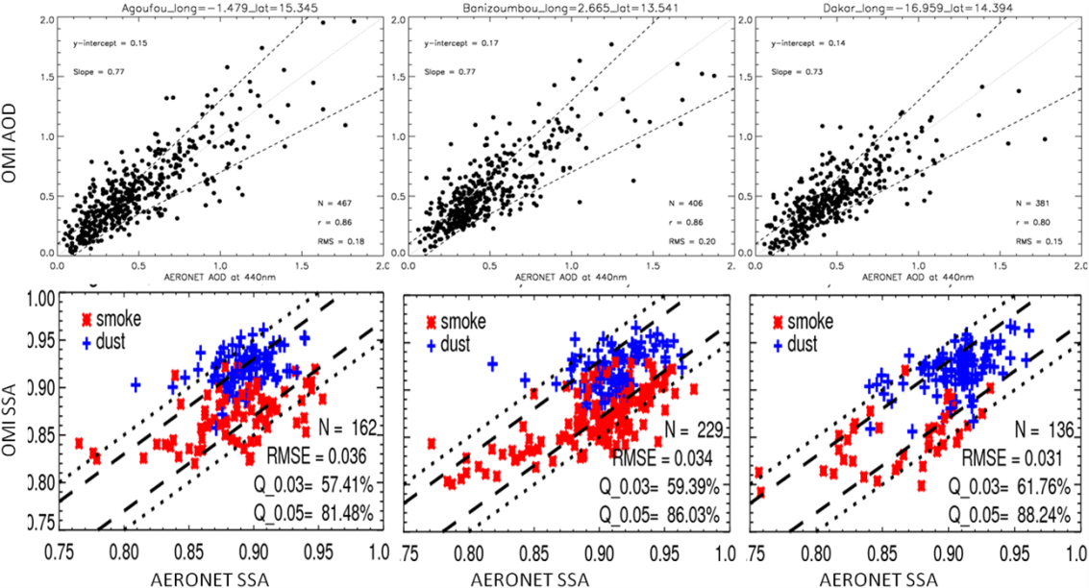
Single Scattering Albedo Evaluation
Comparison to AERONET SSA (440 nm) retrievals
Most OMAERUV SSA retrievals agree with AERONET’s within 0.03 in South America,
Northern India, NE China, Eastern Saharan Desert, and the Sahel region.
Larger differences are observed in Central Saharan, Southern Africa and Southeast Asia.
Jethva et al., JGR, 2013 submitted

Slide 6
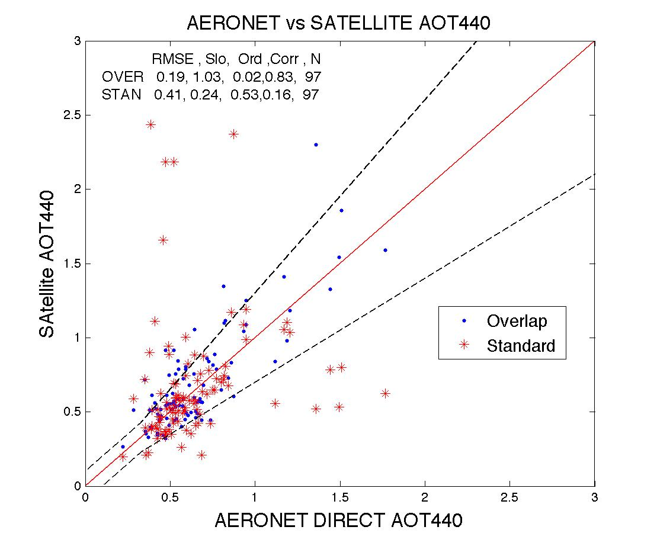
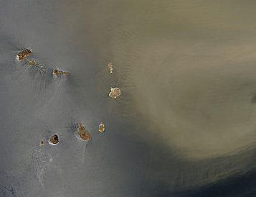
OMI-MODIS AOD analysis
Identification of OMI algorithm and scene specific issues
(Santiago Gassó)
Cloud Contamination
Algorithm Related issues
Overestimation of AOD in partly cloud conditions
Underestimation of AOD in very dense dust storms (assumed size distribution, aerosol height)
About the graphs:
Collocated OMI+MODIS+Aeronet pixel (years 04-11)
Overlap : OMI AOD corrected by the MODIS AOD
Standard : OMAERUV AOD
Gasso and Torres (in preparation)

Slide 7
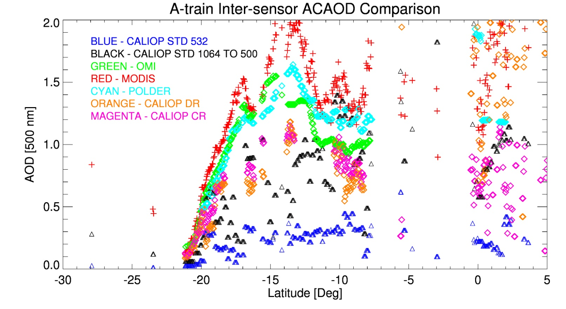
Aerosols Above Clouds: Sensor Inter-comparison
(Jethva, Torres, Waquet, Chand)
Aqua-MODIS
OMI
POLDER
Aug 13, 2006

Slide 8
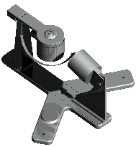
Combined use of CIMEL and Modified UV and VIS MFSR Measurements
(Krotkov, Torres, Mok, Labow, Jethva, Loughman)
UV
VIS
Inter-calibration:
Replace three original UV filters with CIMEL’s 340, 380 and 440 nm filters.
Add a 440 nm CIMEL filter to VIS MFSR sensor
Measure 1 min F_{diff} and F_{tot} (3% error)
Calculate F_{dir}
Derive
Direct Sun measurements: AOD
Sky-radiance measurements
Particle Size Distribution
Real Refractive Index
Mie plus RT Calculations
K _{uv-vis’} SSA _{uv-vis} that explains measured
F_{diff}/F_{tot} ratios

Slide 9
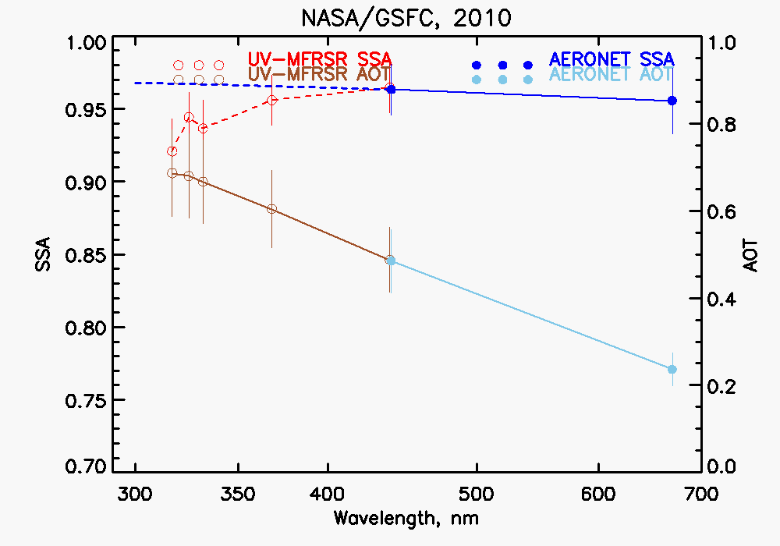
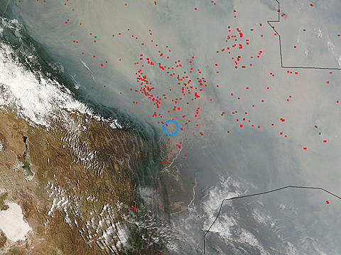
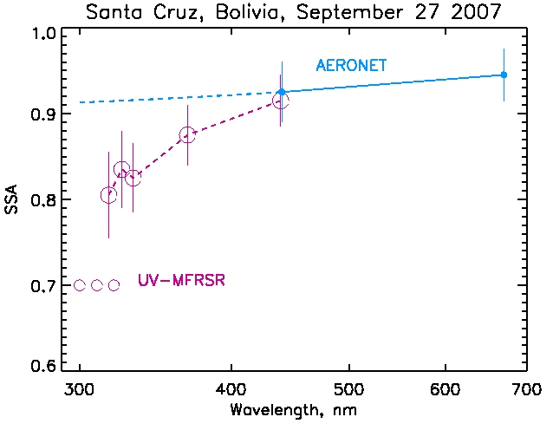
CIMEL and Modified UV and VIS MFSR observations: Results
Plan to return to Bolivia in 2013 using three-instrument suite

Slide 10
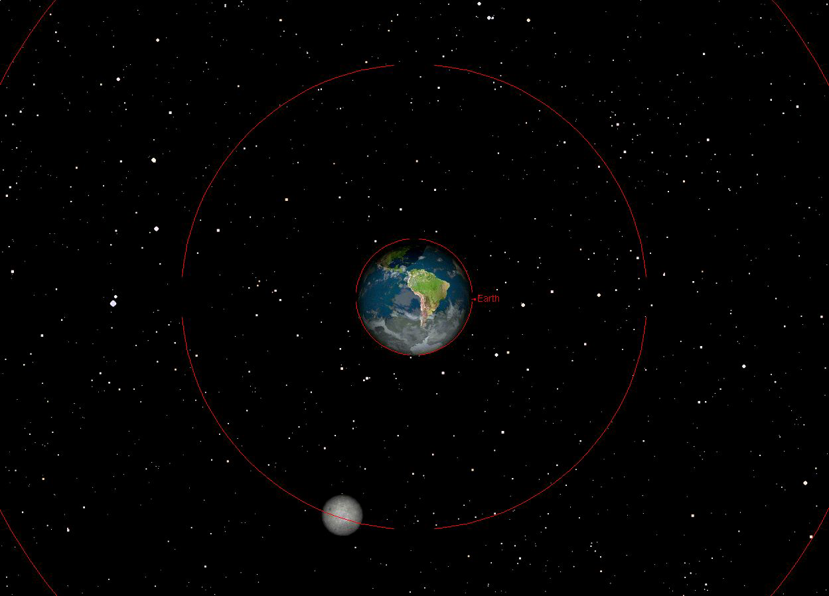
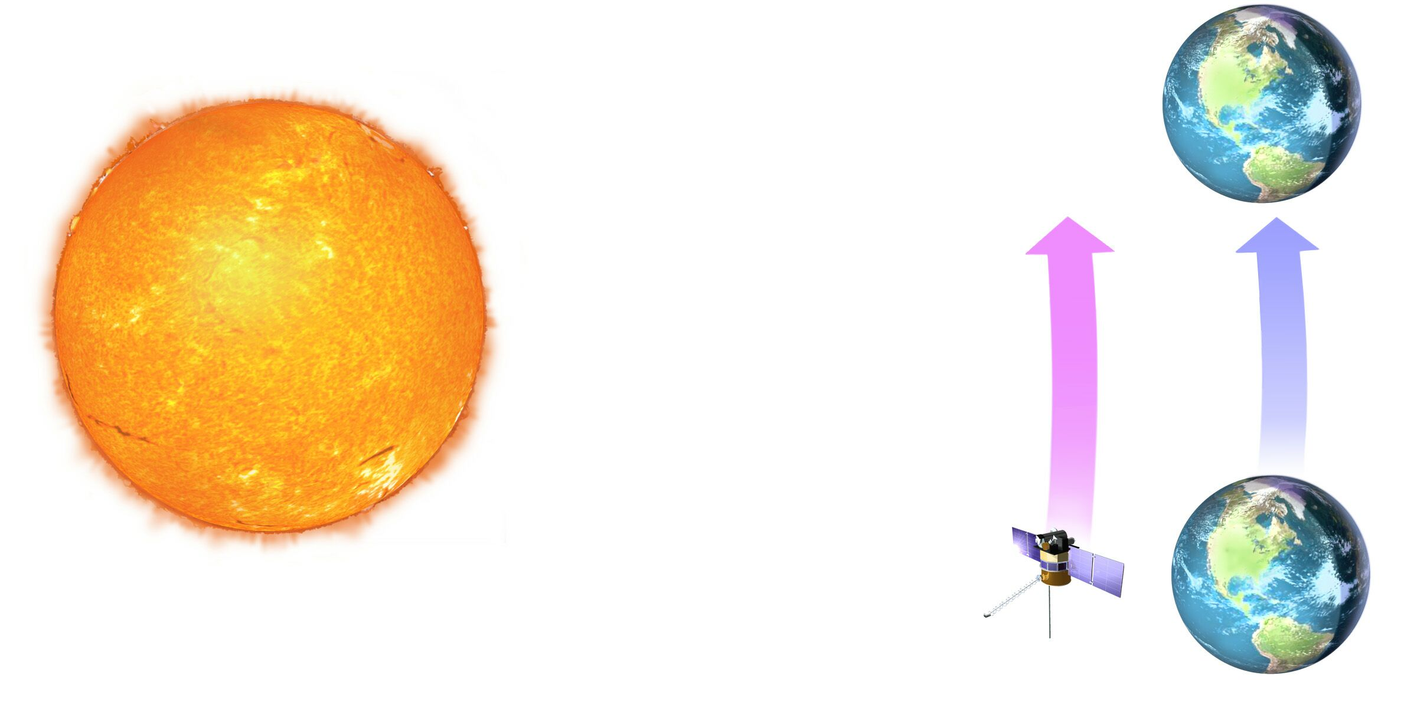
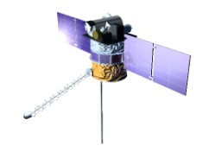
Future Perspective:
DSCOVR At Lagrange-1
Deep Space Climate Observatory
Earth Seen from L-1 on 12/25/2015 with Lunar Shadow in Northern Hemisphere
Jay Herman and Alexander Marshak
At L1, the neutral gravity point between the Sun and the Earth, DSCOVR will remain near the same position relative to the Earth and Sun

Slide 11
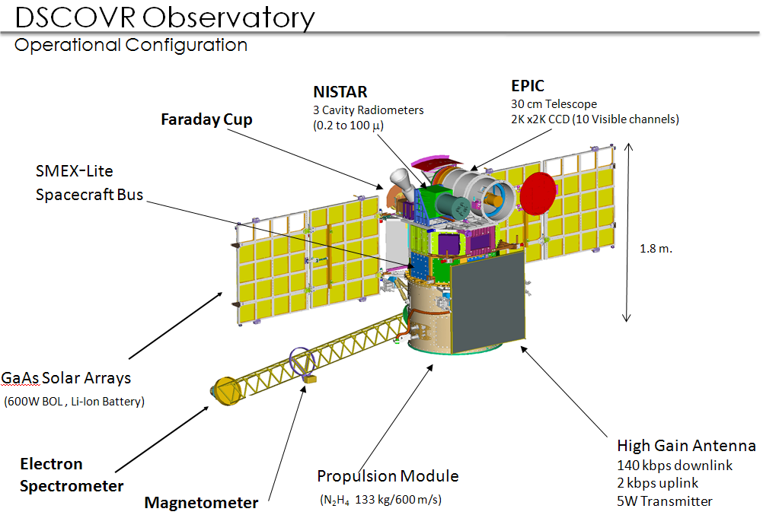
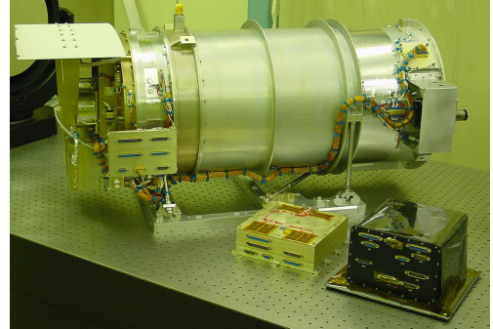
Earth Polychromatic Imaging Camera
Channels and Applications
Channel (nm) | FWHM (nm) | Purpose | Spatial Resolution (km) | SNR | Exp. Time (seconds)
317.5± 0.1 | 1±0.2 | Ozone, SO₂ , UV | 10* | 265 | 1.3
325± 0.1 | 1±0.2 | Ozone, UV | 10 | 265 | 0.84
340± 0.3 | 3± 0.6 | Ozone, Aerosols, UV, and Volcanic Ash | 10 | 265 | 0.13
388± 0.3 | 3± 0.6 | Aerosols, Clouds, UV and Volcanic Ash | 10 | 266 | 0.087
443± 1 | 3± 0.6 | Blue, Aerosols, Vegetation | 10 | 265 | 0.052
551± 1 | 3± 0.6 | Green, Aerosols, Vegetation | 10 | 265 | 0.030
680± 0.2 | 2± 0.4 | Red, Aerosol, Veg., O₂ B-Band, Clouds | 10 | 266 | 0.037
687.75± 0.2 | 0.8± 0.2 | O₂ B-Band Cloud Height | 10 | 266 | 0.060
764.0± 0.2 | 1 ± 0.2 | A-Band Cloud Height | 10 | 265 | 0.061
779.5± 0.3 | 2 ± 0.4 | A-Band Reference, Vegetation | 10 | 265 | 0.036
Official launch date: November 2014
Science Team to be selected via ROSES call

Slide 12
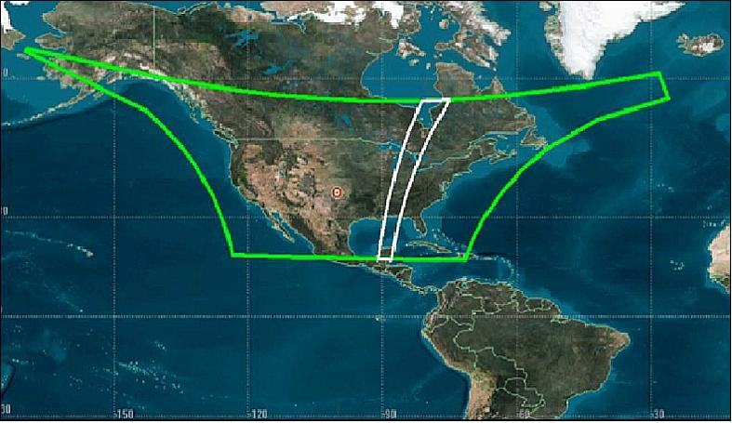
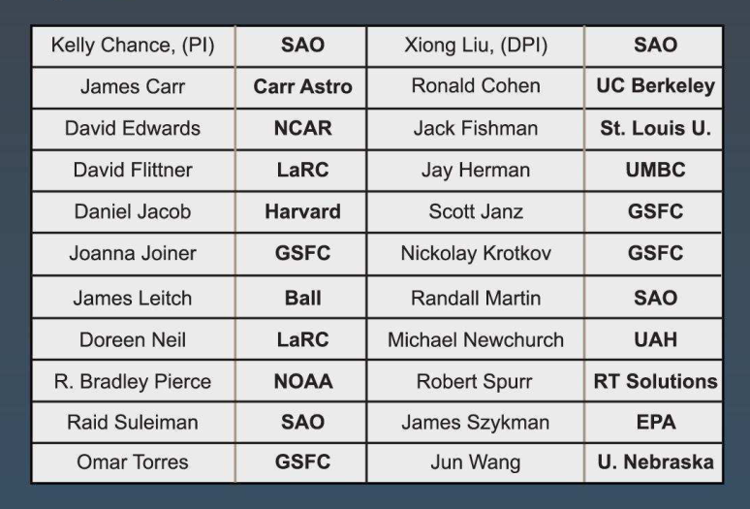
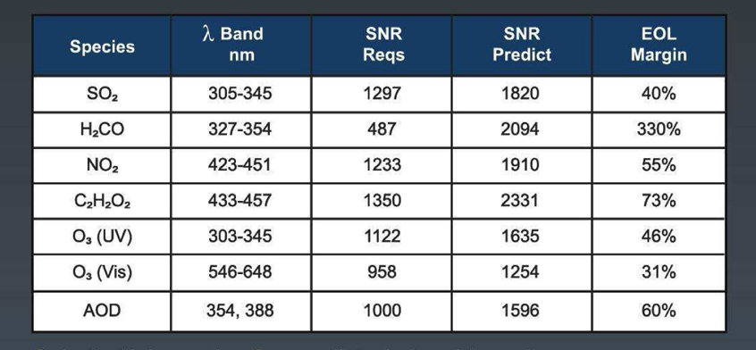
Future Perspective (2):
Tropospheric Emissions: Monitoring of Pollution (TEMPO)
PI: Kelly Chance (Smithsonian Astrophysical Observatory)
First GEO NASA Science Mission
Commercial Satellite Hosted Payload
GEOCAPE Precursor
To be launched in 2019
GEOGRAPHICAL COVERAGE
SCIENCE TEAM
PLANED PRODUCTS

