Slide 1

The NASA-Unified WRF:
Observation-Driven Regional Earth-System Model
Toshi Matsui
Code 612 NASA GSFC & ESSIC UMD
NU-WRF Team: C. Peters-Lidard (PI), W.-K. Tao, Mian. Chin, A. Hou, E. Kemp, R. Shi, Di. Wu, J. Santanello, Q. Tan, Z. Tao, D. Starr, S. Zhang, , J. Geiger, Y. Liu, B. Zaitchik, J. Case, B. Zavodsky, M. Zupanski

Slide 2
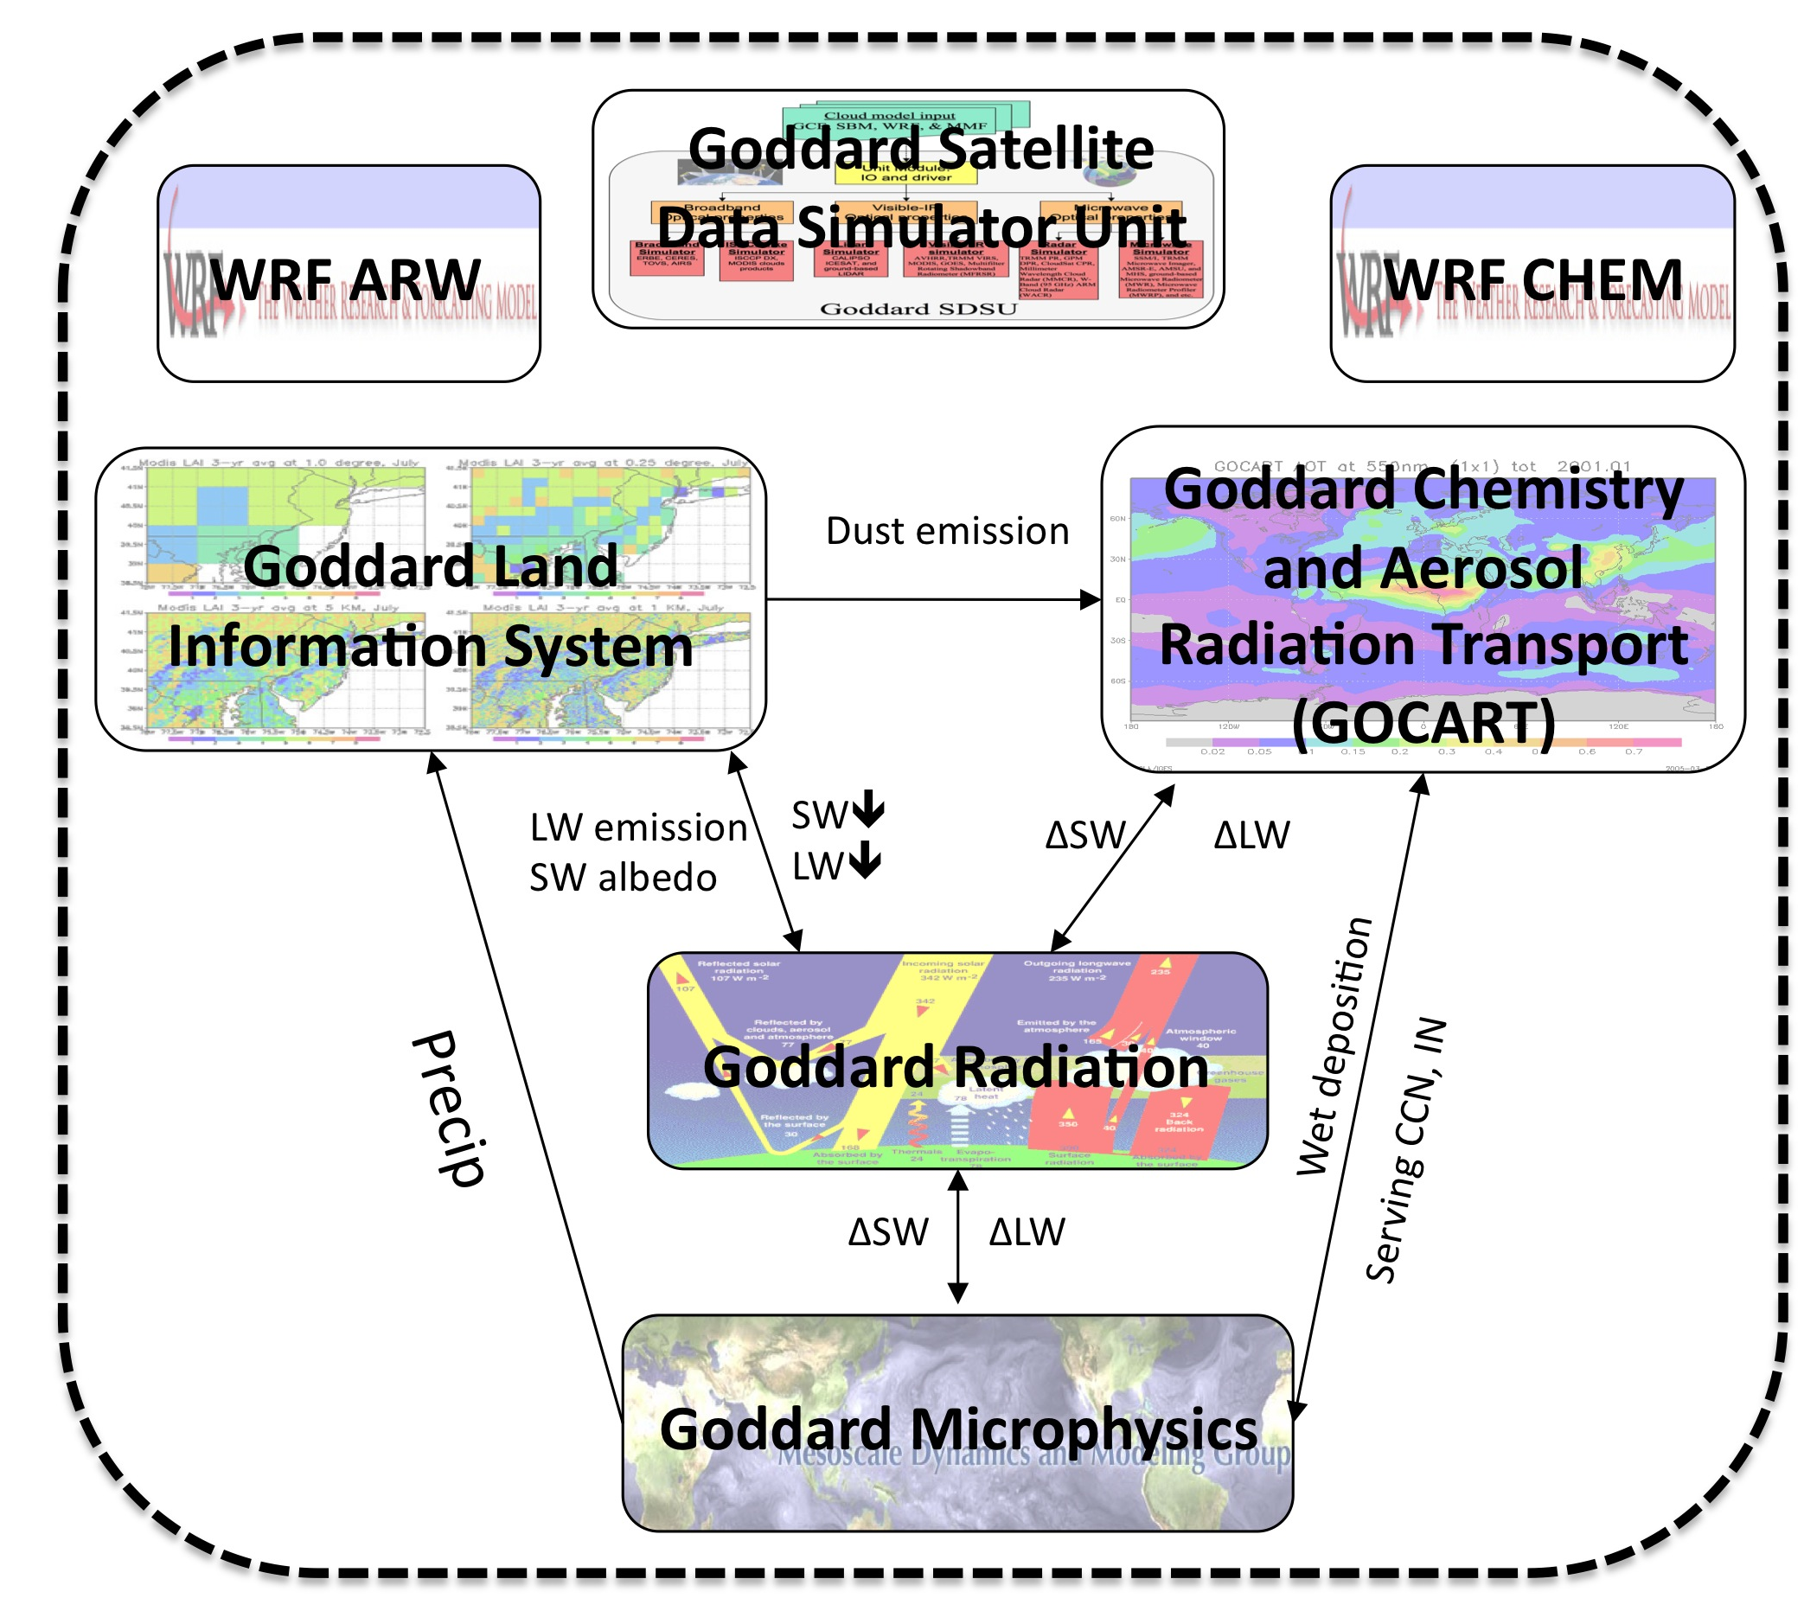
NASA-Unified WRF
NU-WRF
NU-WRF is regional earth system model, developed upon WRF-ARW, by integrating the
  Goddard Bulk Microphysics (cloud)
  Goddard SW/LW radiation (atmospheric heating rate)
  WRFChem GOCART model (aerosols)
  GSFC Land Information System (land),
  G-SDSU (satellite simulator)
NU-WRF can be driven by GEOS5 forecast and/or MERRA global analysis.
GEOS5, MERRA
Satellite Obs

Slide 3
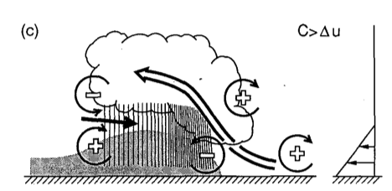
Define the NU-WRF Scale
Satellite-Resolvable Scale: 1~6km of horizontal grid spacing (Meso-gamma scale). = Storm-resolving scale.
  Explicit cloud-precipitation processes via aerosol-interactive full microphysics without sug-grid convective parameterization.
  High-resolution land-surface model: agricultural-urban-resolving scale.
200km
From Weisman [1992]

Slide 4
Effect of Land Cover on Atmospheric Processes and Air Quality over the Continental United States – A NASA Unified WRF (NU-WRF) Model Study
USGS
UMD
MODIS
1 = barren land; 2 = cropland;
3 = cropland/natural land mosaic;
4 = grassland; 5 = open shrubland;
6 = closed shrubland; 7 = woodland; 8 = mixed forest; 9 = deciduous BL forest; 10 = evergreen NL forest;
11 = evergreen BL forest; 12 = urban
Soil Moisture (%)
Surface Temp (K)
Surface O₃(ppbv)
Surface NO₂(ppbv)
[USGS]
[UMD-USGS]
[MODIS-USGS]
Z. Tao et al., ACP (2013)
Notes:
great care should be taken to ensure accuracy and consistency of land cover data in all coupled components of an Earth System model. It also highlights the need for more frequent and detailed update of such satellite-derived land cover products in the future.

Slide 5
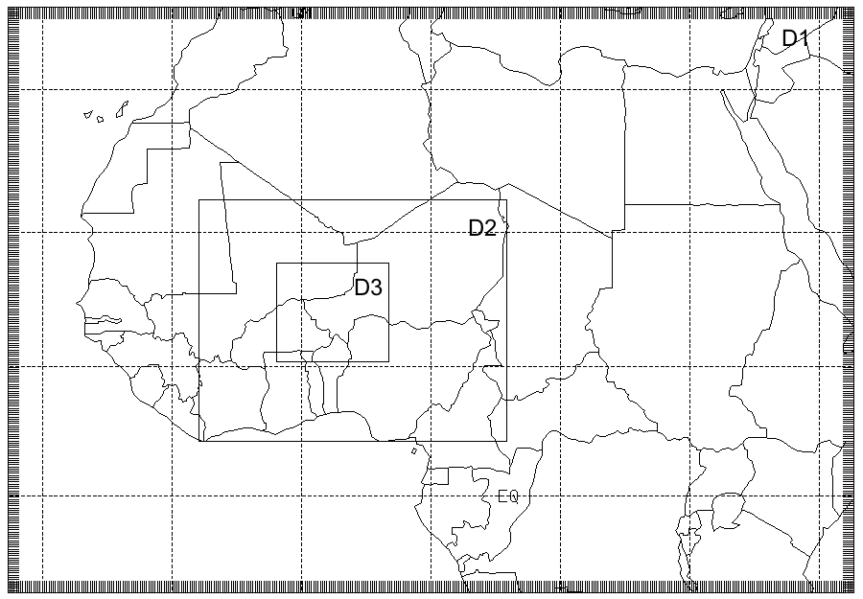
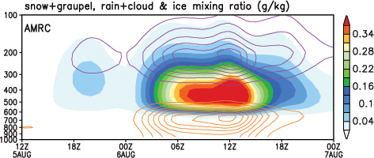
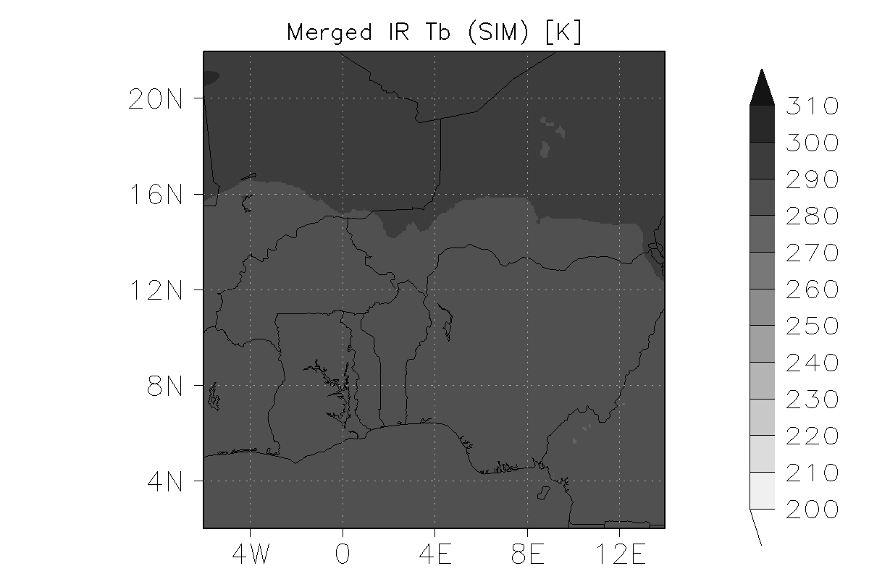
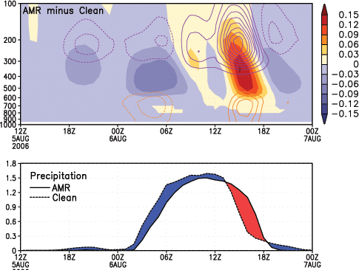
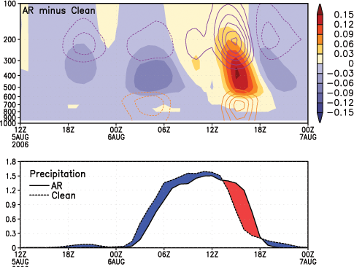
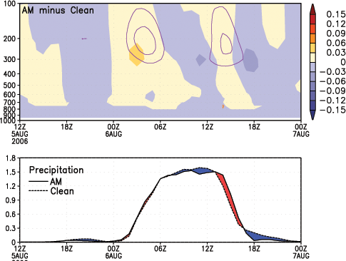
Dust-Cloud-Precipitation-Radiation Interaction over West Africa
2km
6km
Contour (q_{i}), shade (q_{s}+q_{g}), Contour (q_{c}+q_{r})
18km
AMR – Clean
AR – Clean
Mesoscale Convective System (MCS) formed and propagated over West Africa (Niger) region.
Dust-Microphysics effect appears to be small probably continental thermodynamic environment.
Dust-Radiation effect delayed onset, which overwhelmed impact of dust-microphysics effect.
AM – Clean
Shi et al. 2013, QJRMS
Notes:
Fig. 15 Time series of the difference in area-mean cloud hydrometeors (upper panels) and precipitation (lower panels) between (a) Exp. AM, (b) Exp. AR, (c) Exp. AMR and Exp. Clean. In the upper panels, orange contours are for cloud plus rain, purple contours ice, and shading snow plus graupel; solid and dashed lines indicate positive and negative respectively. In the lower panels, blue areas mean less precipitation than in Exp. Clean and red greater. (d) Time series of area-mean cloud hydrometeor profiles from Exp. Clean. The averaging area is the same as for Fig. 9.

Slide 6
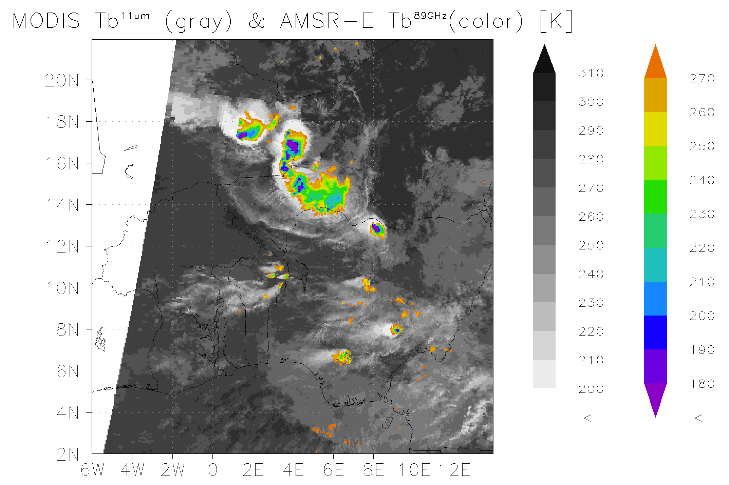
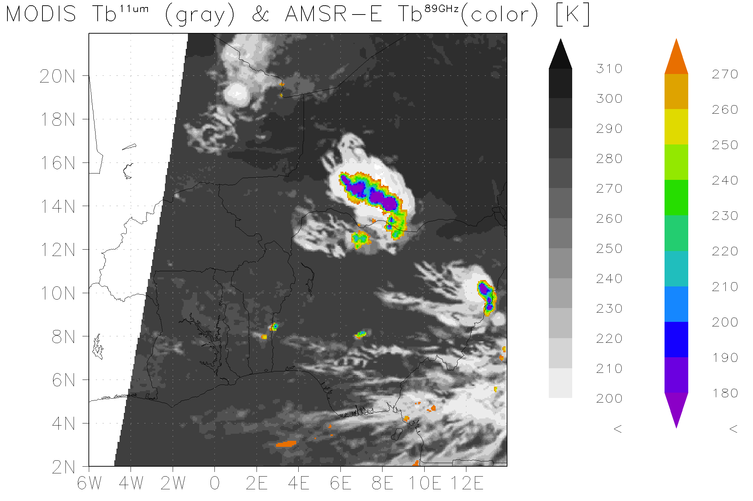
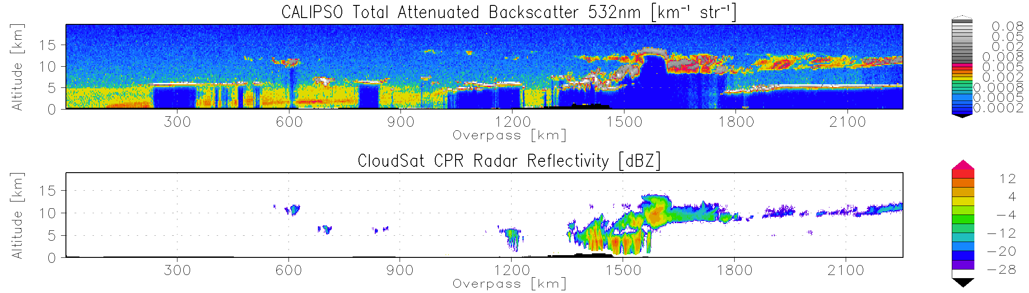
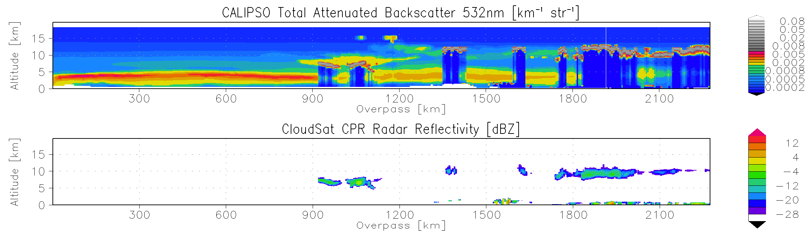
Multi-Sensor Satellite Radiance-based Evaluation Methods for a Regional Earth System Model
Observations
NUWRF+GSDSU
Objective
This paper introduces step-by-step methods of radiance-based model evaluation through the result of NUWRF-GSDSU simulations and existing satellite observations.
Results
Fully coupled NU-WRF simulation result over the West Africa at 01Z at Aug 5, 2006 were compared with various satellite L1B observation through the G-SDSU.
MODIS IR + AMSR-E 89GHz
a1) NUWRF en reproduced spatial patterns of MODIS IR Tb linking to the organized convective cluster.
a2) NUWRF overestimate depression of AMSR-E Tb due to presence of excessive solid precipitation.
CALIPSO + CLoudSat
b1) NUWRF overestimated CALIPSO backscattering due to overestimated dust amount, but plume heights (related to PBL) are accurate (~5km).
b2) NUWRF reproduced realistic CALIPSO and CloudSat signals related to high clouds, but it misses signals from convective clouds and some of cumuli.
a1)
a2)
Observations
b1)
b2)
NUWRF+GSDSU
Matsui et al. 2013, JAMES

Slide 7
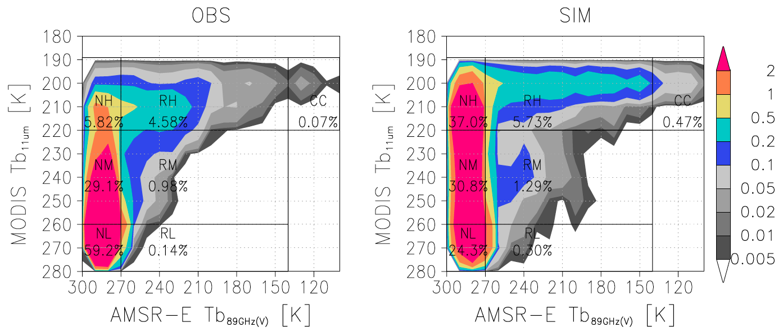
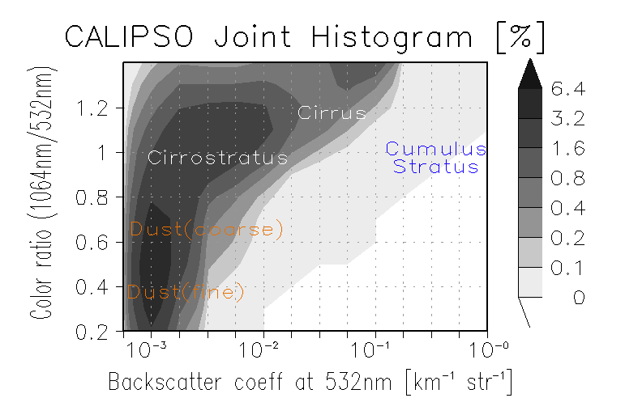
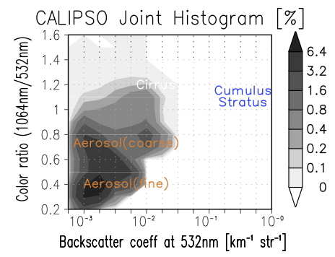
Cloud-Precip Classification
Cloud-Aerosol Microphysics
OBS
SIM

Slide 8
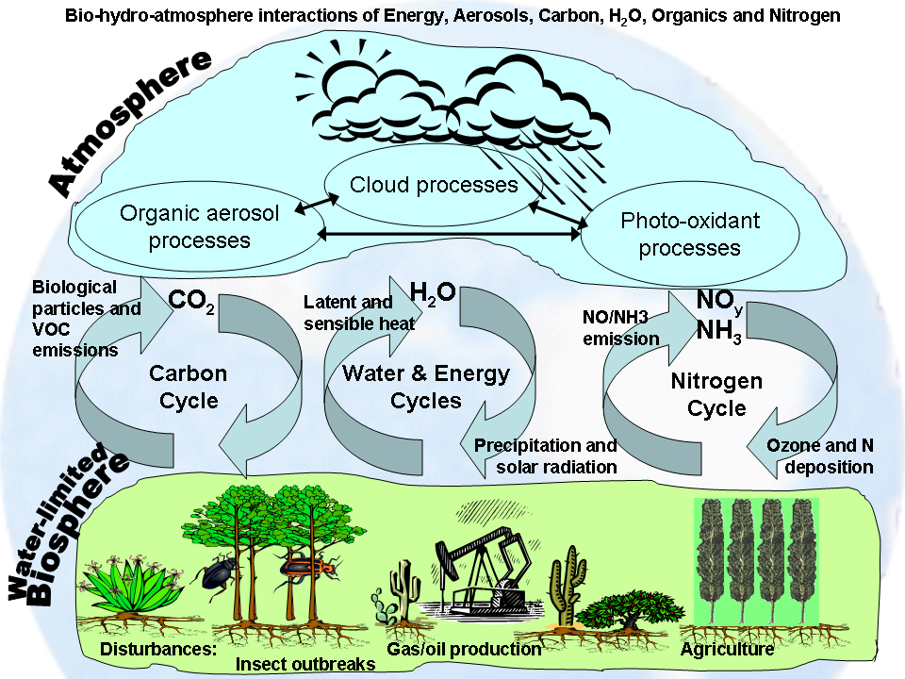
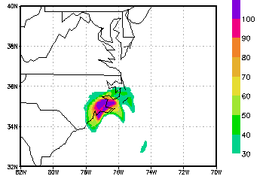
NU-WRF integrated development framework using Satellite Observation
NU-WRF Physics
GOCART
Microphysics
Feedback
G-SDSU
Physics error
PBL
Radiation
Science Questions
Severe Weather Prediction
Land-Atmosphere interaction
Aerosol and AQM
Drought/Flood
Satellite Missions
Current: TRMM, A-Train, Tera, GOES,…
Future: GPM, SMAP,…
LIS, LIS-OPT
Bias Correction
Forecast error
NU-WRF DAS
LIS-DAS, LIS-RTM (land)
WRF-EDA (Precipitation)
Forecast
Correction
G-SDSU

Slide 9
Ensemble Data Assimilation
Maximum Likelihood Ensemble Filter
Observing precipitation process: a storm in southeast US, 1800 UTC September 2009.
BC-Global Analysis
WRF high-resolution forecast
Ensemble + Control
x_{f} ; P_{f}
Observation data
observation operators
Ensemble + Control
GSDSU for precipitation sensitive radiance
Improving precipitation forecast: surface rainfall accumulation during a flooding in southeast US, 15-22 September, 2009.
MINIMIZATION
Obs
WRF
WRF-EDAS
CONTROL VARIABLE UPDATE
FINAL ANALYSIS SOLUTIOM
flooding
flooding
High resolution Precipitation analysis
X_{a} ; P_{a}
GPM era
3hr assimilation cycle
GMI High-frequency Tb
To next assimilation cycle
Zupanski, D, 2011: J. Hydrometeor, 12, 118–134.
Zhang, S. Q., et al., 2013: Mon. Wea. Rev., 141(2), 754-772.

Slide 10
Summary
Update
The initial version of fully coupled regional earth system model: the NASA-Unified WRF has been developed.
NU-WRF can be applied for regional study of chemistry-aerosol-cloud-precipitation-land surface processes and interactions.
NU-WRF is the observation-driven modeling system: Multi-platform satellite and simulator allows to identify forecast errors and physics biases.
Future
For next 4 years, we will improve physics performance (esp. aerosol and chemistry) on the storm-resolving scale.
Ensemble data assimilation of precipitation and land-surface will be incorporated and test the sensitivity of coupled simulations.

