Slide 1

Pushing the limits of dark-target aerosol remote sensing from MODIS
Robert C. Levy (SSAI and 613.2)
Contributors: S. Mattoo (SSAI), L. Remer (NASA), R. Kleidman (SSAI), K. Wells (CSU),
L. Zhu (UMBC), J.V. Martins (UMBC), A. von Donkalar (Dalhousie), M. Martins (SSAI)

Slide 2
Outline (a mishmash of many things)
Critical reflectance and ω₀ (New science)
3-km product (New applications)
Balancing cloud masking and contamination
Trends and MODIS calibration
Transitioning to a VIRS world

Slide 3
New science:
Critical reflectance and ω₀
K. Wells, L. Zhu, J.V. Martins, L. Remer, S. Kreidenweis

Slide 4
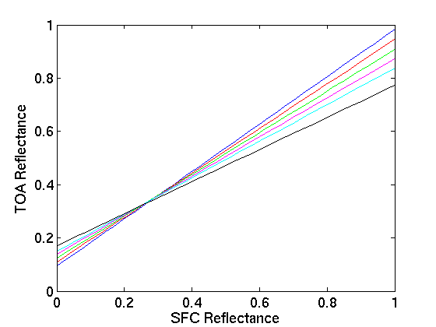
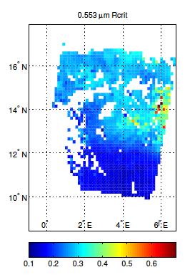
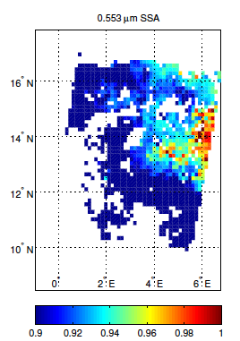
Critical reflectance and ω₀ : Theory
R_{crit} at 0.55 μm
R_{crit} = where adding aerosol mass does not change TOA refl
Δτ>0
Rcrit_{TOA}
F_{TOA}<0
F_{TOA}>0
Use multiple images 16 days apart
(“clean” vs “dirty”)
Plus Radiative transfer, etc ->
Retrieves SSA, Forcing, etc.
SSA at 0.55 μm
Δτ>0
Subject of Two Dissertations:
K. Wells @ CSU: Dust
L. Zhu @ UMBC: Smoke

Slide 5
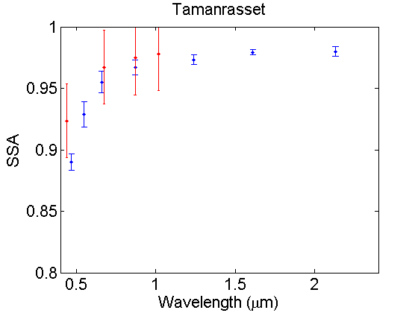
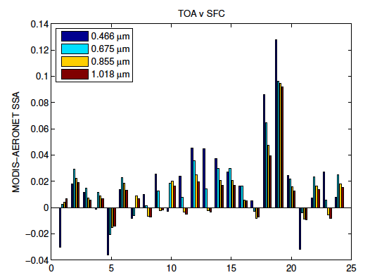
Critical reflectance and ω₀ : Results 1
DUST
MODIS R_{crit} SSA 30km mean ± σ
24 cases at the Tamanrasset
AERONET site
AERONET SSA ± 0.03
Retrieval across
7 MODIS wavelengths
TOA vs AERONET (SSA difference)
0.12
0.09
0.06
0.03
0.00
-0.03
Agrees with AERONET within ±0.03 at 4 λ.
Retrieves spectral ω₀ (including 2.1 μm!)
0 5 10 15 20 25
Case #
K. Wells dissertation

Slide 6
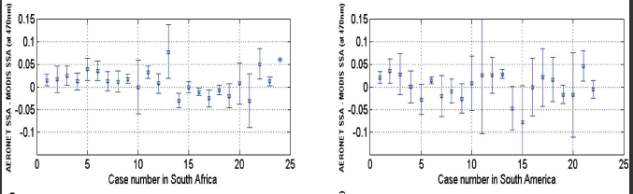
Critical reflectance and ω₀ : Results 2
SMOKE
Africa and
South America
470 nm
Differences between MODIS and AERONET
Smoke SSA retrieval is only in visible λs, because smoke is transparent in mid-IR
Agrees with AERONET ±0.05
470 nm
Zhu, Martins, Remer (2011)

Slide 7
New applications:
MODIS 3 km product (operational for C006)
S. Mattoo, M. Martins, L. Remer, B. Holben, et al

Slide 8
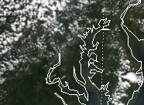
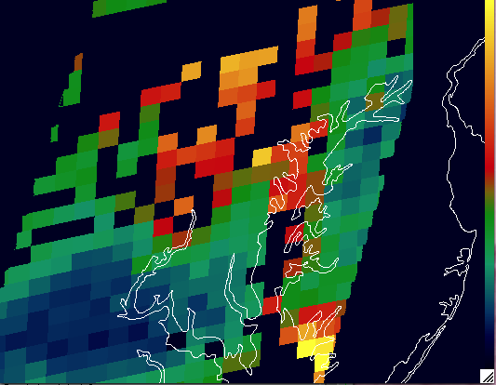
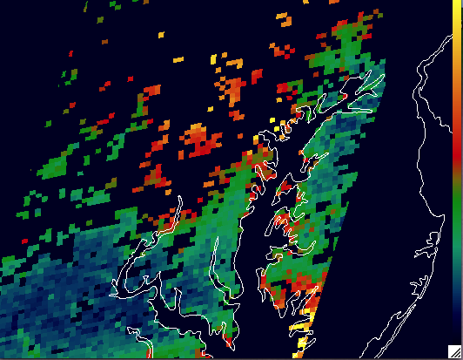
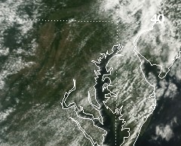
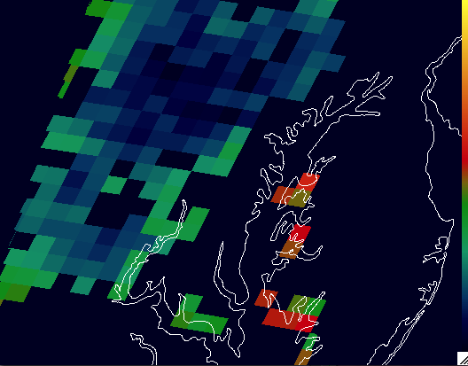
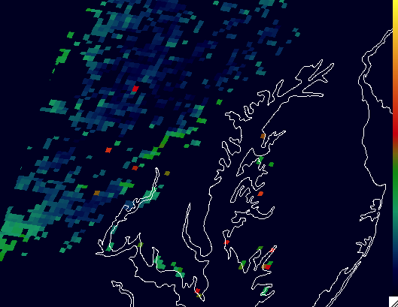
MODIS 3 km product over suburban (MD) landscape (DRAGON, summer 2010)
Aqua: Day 209 2010
10 km
3 km
Terra: Day 219 2010
10 km
3 km
3 km mirrors 10 km product (pattern and magnitude)
3 km introduces noise, but also can reduce spatial impact of outliers

Slide 9
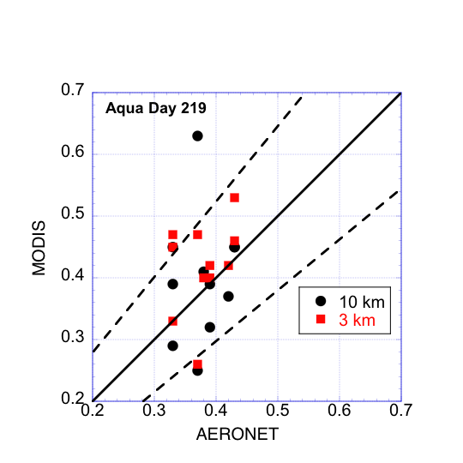
MODIS 3 km product over Maryland, Summer 2010
Compare with AERONET (DRAGON)
11 AERONET stations from Baltimore to College Park; Olney to Bowie.
station | AERONET | MODIS 3 km | MODIS 10km
BLTIM | 0.29 | 0.28 | 0.17
LAUMD | 0.26 | 0.24 | 0.20
OLNES | 0.23 | 0.22 | 0.09
RCKMD | 0.25 | 0.33 | 0.19
Overall, 3 km mirrors 10 km “validation”.
3 km validation sometimes improves with higher resolution matching

Slide 10
Issues of cloud mask and cloud contamination

Slide 11
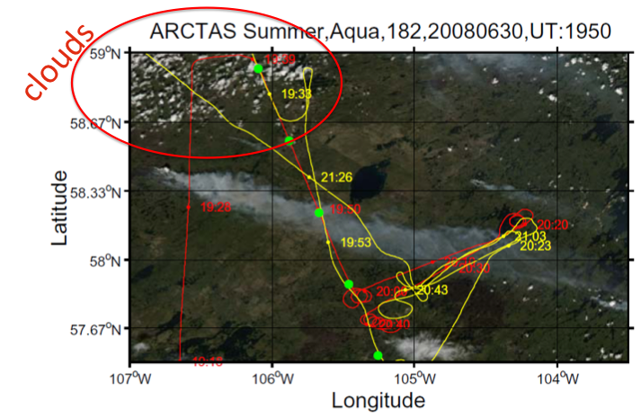
Aqua image of smoke plume: ARCTAS
NASA P3 Flight Tracks
10 km
3 km
(no spatial cloud mask)
3 km
10 km resolves plume, avoids clouds and heaviest part of plume
3 km gives more details, while still avoiding clouds and heavy plume
3 km with no cloud mask retrieves heaviest part of plume, but is cloud contaminated
Livingston, Zhang, Redemann

Slide 12
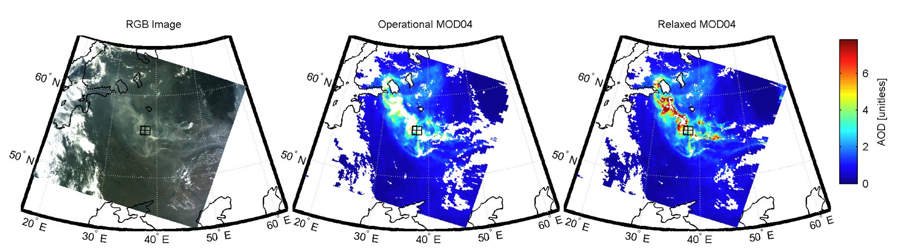
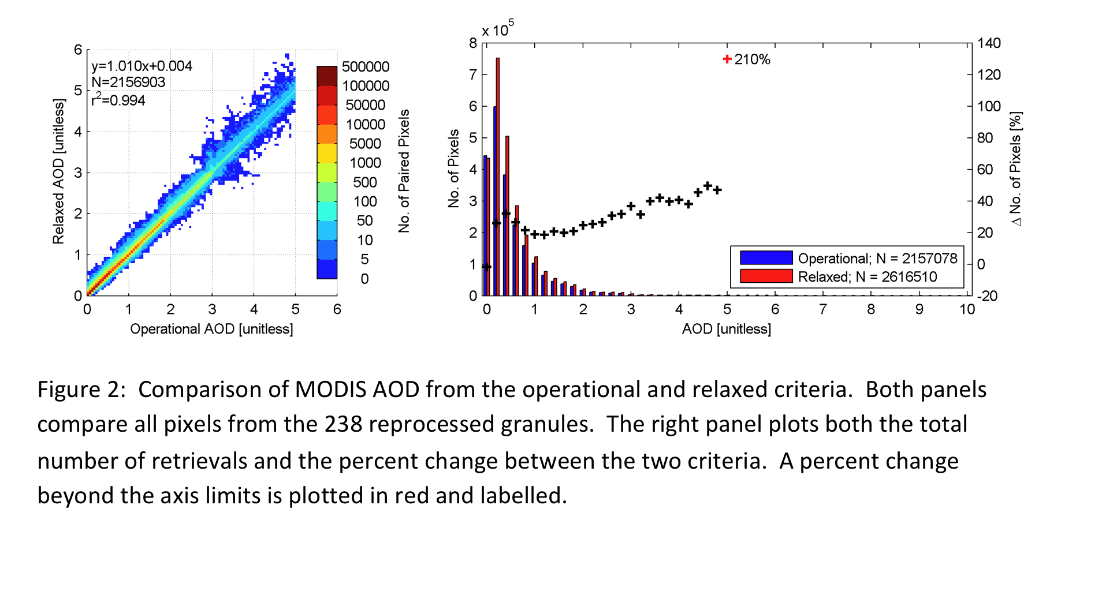
Resolving 2010 Moscow Fire smoke plumes
for health risks and chemistry models
Aug 8 @ 08:50 UTC
Operational 10 km
“Relaxed” cloud mask
AOD
6
4
2
0
Using 2.1 μm spatial variability to “undo” 0.47 μm mask
2 months of Moscow Fires (238 granules)
20% Increased coverage with relaxed cloud mask
Identify regions of exposure to high concentrations
Van Donkelaar et al.

Slide 13
AOD Trends and MODIS calibration
R. Levy, L. Remer, X. Xiong, W. Ridgway, et al.,

Slide 14
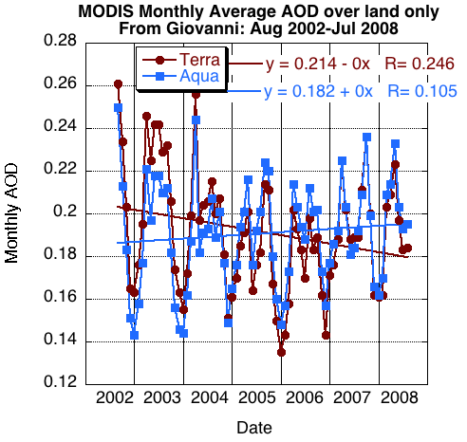
Trends over land are in question
Land
Terra decreases (-0.004/yr), and is significant at 95% level
Aqua increases (+0.0007/yr), and is not significant at 95% level

Slide 15
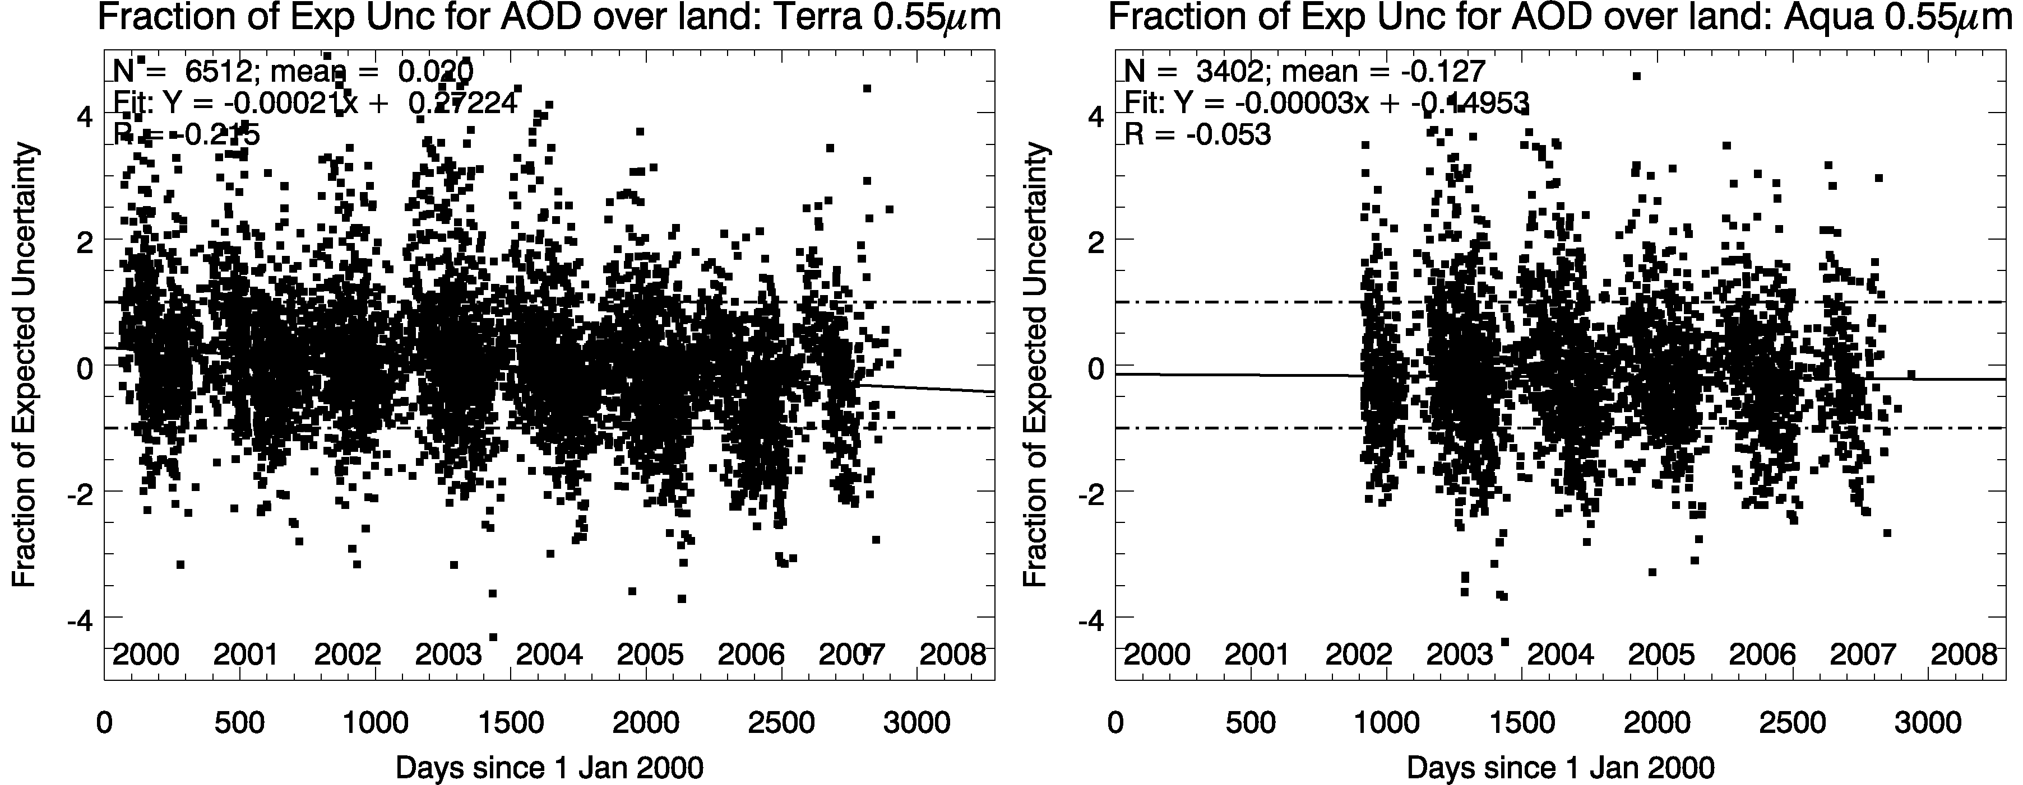
Performance of MODIS instruments may be changing…
Trends of MODIS-AERONET “agreement” over time (land)
4
2
0
-2
-4
N = 6516; R = -0.275
Terra
4
2
0
-2
-4
N = 3402; R = -0.053
Aqua
Difference Metric
Over land: 14 AERONET sites with >7 years of data (plotted)
Metric decreases for Terra (R = -0.275, significant), which means that in <2004, MODIS overestimates AOD, but >2004 MODIS underestimates! No trend for Aqua.
AOD Trends over land are likely changes of instrument “bias”.
We are working with MCST to isolate problems, and “learn each other’s language!”

Slide 16

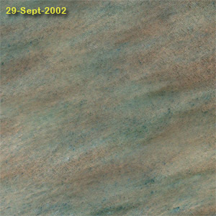
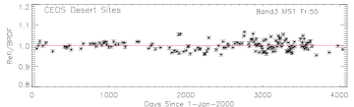
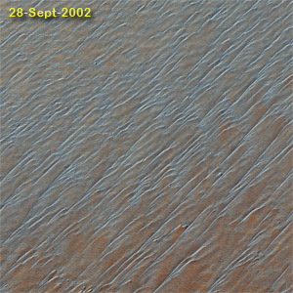
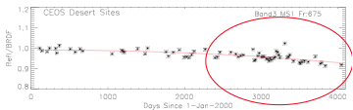
Tracking MODIS RSB radiometric stability from reflectance trends over CEOS desert sites
Collect clear-sky MODIS data over desert sites
Develop site-specific BRDF from first 3 years of mission
Over time, compare “observed” reflectance with BRDF modeled reflectance, for different view angles
Trends in Band #3 (0.47 μm) are consistent with Terra’s AOD trends over land!
Far from nadir angles are stable
CEOS desert test sites
Near nadir angles have trends
MCST (Sun, Xiong et al)
Notes:
16

Slide 17
Looking ahead to Collection 6

Slide 18

Looking ahead to Collection 6
C006 development:
We know that C006 Radiance product will be different than C005. We may need to introduce de-trending ourselves.
We are testing versions of C006 radiances over many days, months, and seasons throughout both Terra and Aqua lifetimes, and test with C006 retrieval algorithms
Our goal is to characterize C006
product before becoming operational
Which means that we have held back start date!

Slide 19
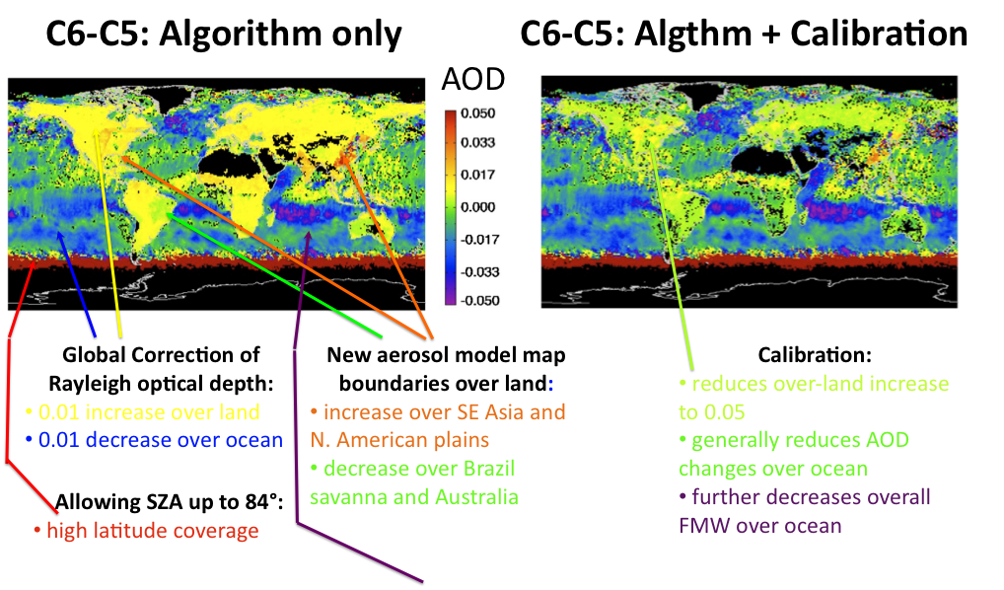
“Characterizing” the expected C006
C006 – C005 (Monthly average)
Calibration:
Cuts over land-increase in half
0.01 increase over land
MONTHLY
MEANS
Multiple wind speed LUT
Over ocean
>0.02 decrease near glint and where large wind speed (e.g. roaring 40s in SH
In collaboration with LAADS, via B. Ridgway

Slide 20
Transitioning to VIIRS world

Slide 21
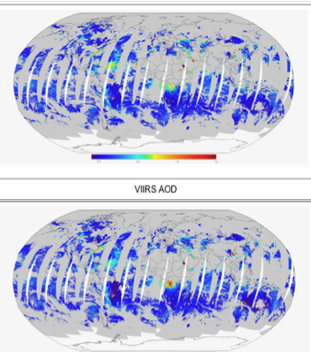
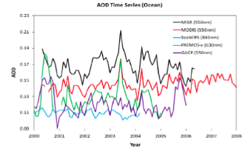
Transitioning to VIIRS world
MODIS will not be here forever
VIIRS will be flying soon.
Can we “smooth” the data records?
Simulate VIIRS-like algorithm with MODIS data
Identify differences in instruments, algorithms, data products, etc.
VIIRS algorithm, with MODIS radiances
0.0 0.5 1.0 1.5
AOD
AOD Ocean : (Different λs)
0.23
0.21
0.19
0.17
0.15
0.13
0.11
MISR
MODIS
SeaWIFS
PaTMOS
GACP
MODIS
Z. Li
2000 ’01 ’02 ‘03 ‘04 ’05 ‘06 ‘07 ‘08
L. Remer, I. Lazslo, R. Levy, S. Mattoo

Slide 22
Thank you
Notes:
We process one scan at a time? We could look at mirror side issues

