Slide 1
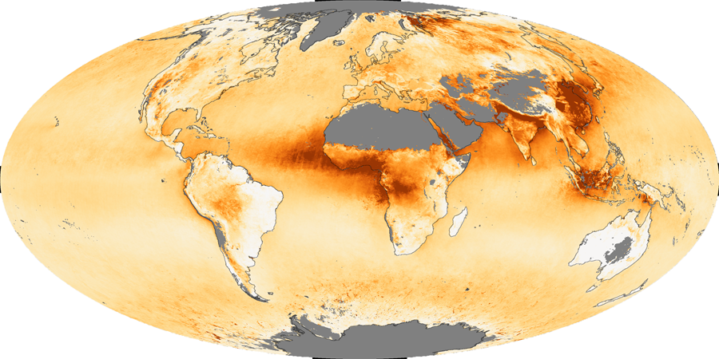
2011 Aerosol Update NASA-GSFC Visitor Center March 29, 2011
Rob Levy (SSAI/GSFC 613.2)
Huisheng Bian (UMBC/GSFC 613.3)
Toshi Matsui (GEST/GSFC 613.1)
Alexander Sinyuk (Sigma/GSFC 614.4)
Cathy Newman (SSAI / GSFC 613.2)

Slide 2
Agenda
What is AeroCenter?
Highlights from 2010-2011
This year’s update
12 talks
18 posters
The near future

Slide 3
What is AeroCenter?
Aerosols are a cross-cutting theme of research at NASA-GSFC
Yoram Kaufman proposed the idea for AeroCenter in 2000
Data center for aerosols
Organize people here
Seminar series
Visitor program**

Slide 4
Who is AeroCenter?
We are an interdisciplinary union of researchers, including GSFC, UMBC, NOAA and other institutions in DC area and beyond
Our interests include “anything” aerosols
We are theorists, observationalists and modelers, chemists and physicists
We have 240 current members (listserv) AND a web page (http://aerocenter.gsfc.nasa.gov)

Slide 5
Highlights from 2010-2011
27 Seminars on AeroCenter calendar
Most are at the usual time (Tuesday @ 11 AM)
We have moved homes, from Room F225 (2010) to G133 (2011)
We have provided WebEx for most of them.
Co-sponsored seminars with branches

Slide 6
Some seminar statistics
Almost “weekly” seminars from our surprise
Visitor program**
Each seminar averages:
35 “Physical” attendees
7 “Virtual” attendees

Slide 7
Highlights from 2010-2011
2011 Annual “Poster Bash” held in Bldg #33 Lobby in January (after AGU)
This Aerosol Update: Held for the 2nd time in the Visitor Center!

Slide 8
2011 Visitor overload!
In Dec 2010, we learned that there was $20K in GEST budget for AeroCenter visitors:
“Use it or Lose it” by April 2011.
We asked for GSFC “hosts” to suggest “visitors”, and complete 1 page “application”
We are funding travel costs for fifteen visitors, mostly between Feb 2011 and Apr 2011.
They include senior, junior and student scientists
They represent the diverse interests of AeroCenter members
We are sharing our visitors with CRB and other branch’s seminar series.
We thank C. Newman (SSAI), V. Casasanto (UMBC), and B. Lewis (UMBC) for travel/badge organization.

Slide 9
Today’s Agenda
Oral Presentations
13 min (10 min + 2 min for questions)
Toshi will be your time-keeper
A break in the middle (approx 2:30)
Poster Presentations
12 posters
Set up will be during 2nd break
Refreshments
During Poster session
Thanks to AeroCenter member donations
Please help (setup/cleanup)

Slide 10
Oral Presentations

Slide 11
Poster Presentations

