Slide 1
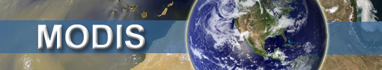
“Introducing the Collection 6 MODIS Aerosol products”
Season III
AeroCenter Update May 31, 2013

Slide 2
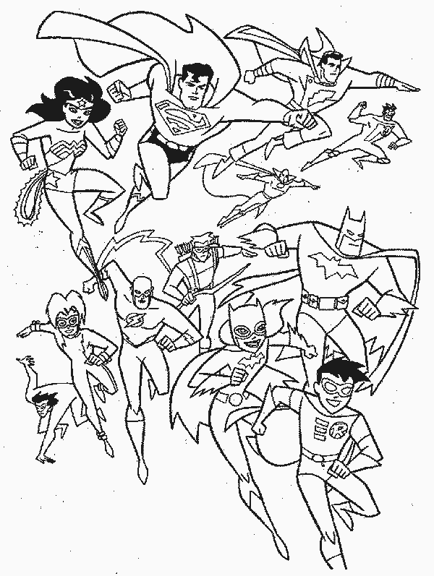







Starring: The “Dark Target” Aerosol Team
Rich Kleidman
(SSAI)
Disclaimer: Lorraine is an renegade superhero. She receives no financial contribution from the MODIS aerosol group, and does not in any way "influence the government on this particular matter on behalf of UMBC".
Telling Rob what to do, on a personal level, is perfectly legal. That's just female-male communication.
Lorraine Remer
(UMBC)
Shana Mattoo
(SSAI)
Pawan Gupta
(USRA)
Leigh Munchak
(SSAI)
Rob Levy
(GSFC)
Falguni Patadia
(USRA)

Slide 3
When we last saw our motley gang of heroes…
(Scenes from Season II)
AeroCenter update: May 2012

Slide 4


… They were promising “final” delivery of Collection 6 algorithms
(imagine camera pans into each office)
Rob was fussing with gas correction
Leigh was fixing the cloud mask
Shana was ordering that Version V6.0.11 was the final version
Rich was evaluating DeepBlue/DarkTarget merge
Lorraine was at UMBC, starting AirPhoton
Falguni and Pawan had not yet joined the gang.

Slide 5
Now one year later…
(Scenes from Season III)

Slide 6
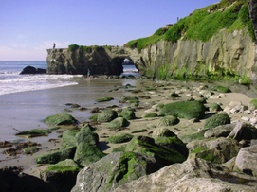
… They are still promising “final” delivery of Collection 6 algorithms
(imagine camera pans into each office)
Rob is answering 40 pages of AMTD comments
Leigh is fixing the coastline mask
Shana is insisting that Version V6.0.27 is the final version
Rich is re-evaluating DeepBlue/DarkTarget merge
Lorraine comes to GSFC because she misses the rest of the gang.
Falguni is fussing with gas correction.
Pawan is improving urban aerosol retrieval

Slide 7
Introducing the Collection 6 MODIS aerosol products
Subtitle: The art of the MODIS aerosol retrieval
Sub-subtitle: Getting a cat into a carrier

Slide 8
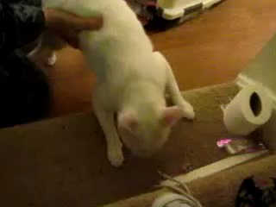
Trying to get C6 into product is like…
Video found on You-Tube
Note: no harm to cat

Slide 9
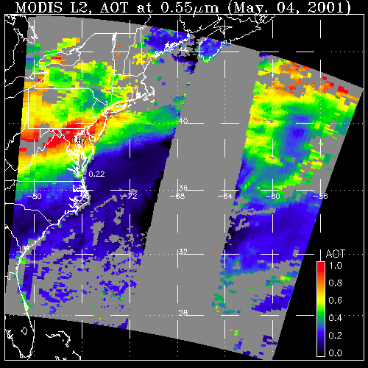
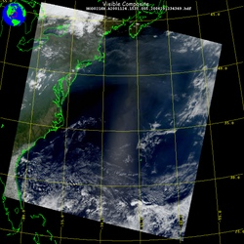
Aerosol retrieval from MODIS
What MODIS observes
Attributed to aerosol (AOD)
May 4, 2001; 13:25 UTC
Level 1 “reflectance”
May 4, 2001; 13:25 UTC
Level 2 “product”
LAND
OCEAN
GLINT
AOD
1.0
0.0
There are many different “algorithms” to retrieve aerosol from MODIS
Dark Target (“DT” ocean and land; Levy, Mattoo, Munchak, Remer, Tanré, Kaufman)
Deep Blue (“DB” desert and beyond; Hsu, Bettenhousen, Sayer,.. )
MAIAC (coupled with land surface everywhere; Lyapustin, Wang, Korkin,…)
Ocean color/atmospheric correction (McClain, Ahmad, …)
Etc (neural net, model assimilation, statistical, … )
Your own algorithm (many groups around the world)

Slide 10
Generic MODIS-DT retrieval algorithm
INPUTS / UPSTREAM PRODUCTS
MOD02 = MODIS spectral reflectance pixels (at 500 m resolution)
MOD03 = geo-location: geometry and surface type ( 1 km resolution)
MOD35 = cloud mask, including IR tests. Also has surface type
Ancillary data: GDAS 1° ozone, water vapor, surface wind speed
Aggregate into N x N boxes
= 20x20 for 10 km
What surface are we?
100% water?
At least 1% land?
Try Ocean retrieval
Coastal? lakeshore?
Try land retrieval
No retrieval
“Massaging” input data
Cloud masking (MOD35 IR tests + our tests)
Perform spectral gas absorption correction
Other masking (glint, deserts, sediments, etc)
Sort and select valid pixels → one value per N x N
We expected to change these for C6
The retrieval itself
Compare with pre-computed Lookup tables (LUTs)
Decisions about what is a “successful” retrieval
Decisions about what to report, and under what conditions

Slide 11
Last November we submitted Collection 6 overview paper to AMTD
Levy, R., S. Mattoo, L.A. Munchak, L.A. Remer, A.M. Sayer, and N. Hsu (2013). The Collection 6 MODIS Aerosol Products over Land and Ocean Atmos. Meas. Tech. Disc. (6), 159-259
We thought it would be a service to our users to have paper out when C6 processing began.
It was a really long paper (100 AMTD pages) describing major updates and effects on the “products”
It received 40 pages of online criticism and comments
Then the rug was pulled out from under us.
What happened?

Slide 12
The world changed
(or at least the MODIS-observed view of the world)
INPUTS / UPSTREAM PRODUCTS
MOD02 = MODIS spectral reflectance pixels (at 500 m resolution)
MOD03 = geo-location: geometry and surface type ( 1 km resolution)
MOD35 = cloud mask, including IR tests. Also has surface type
Ancillary data: GDAS 1° ozone, water vapor, surface wind speed
What surface are we?
100% water?
At least 20% land?
Try Ocean retrieval
Coastal? lakeshore?
Try land retrieval
No retrieval
For MOD02: Different decisions about bad/missing pixels, plus calibration
For MOD03: Definitions of land/water/coastal were changed
For MOD35: IR test finding high cirrus clouds was changed
For ozone: Input stream changed from TOAST to GDAS
“Our” changes for C6 needed to be revised
Note: that “our” also refers to ALL MODIS products (clouds, land surface, etc)

Slide 13
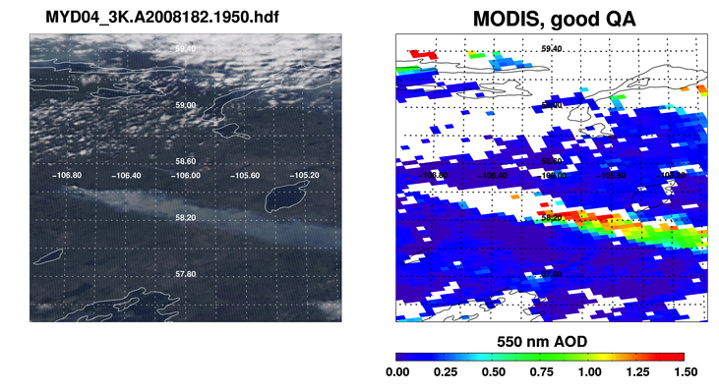
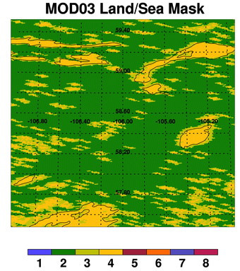
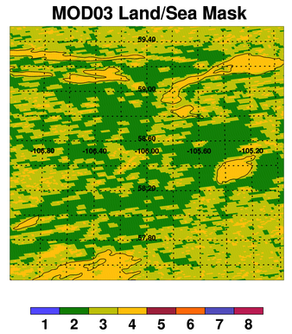
“Definitions” of land/coastal/water:
C5: Used MOD35; C6: Use MOD03 (It’s a long story)
MODIS AOD, with no coastline pixels
MODIS AOD, with coastline pixels
This is ARCTAS region in northern Canada.
Land ‘o lakes
improved
coverage near
water
C5 MOD03 Land/Sea Mask
C6 MOD03 Land/Sea Mask
Note much more “coastal” in C6.
Lots of shorelines (lime colored) pixels that would be thrown out.
Note very little “coastal” in C5.
Clean divide between Green (land) and Yellow (Lakes)
Notes:
If you only want one slide, use this one

Slide 14

… Now they are promising “final” delivery of Collection 6 algorithms
(Shana will allow NO MORE CHANGES!!!!)
OUTLINE of REST of TALK
Compensated for upstream changes!!!!!
Better RT (gas corrections, LUTs)
Cloud mask and pixel decision-making
“Science” upgrades
“Quality assurance” upgrades
DT products (expected C6 versus C5)
Other stuff: 3 km, DT/DB merge, etc

Slide 15
Better RT: Gas Corrections
Gases (H₂O, O₃, CO₂, NO₂, etc… ) absorb radiation, T_{gas} < 1.0
T_{gas} varies spectrally and function of gas optical depth:
T_{gas} ≈ 1-τ_{gas}:
The C5 assumptions were undocumented (circa 1995)
Used modern RT code and found changes
Changes for C6 have impacts.

Slide 16
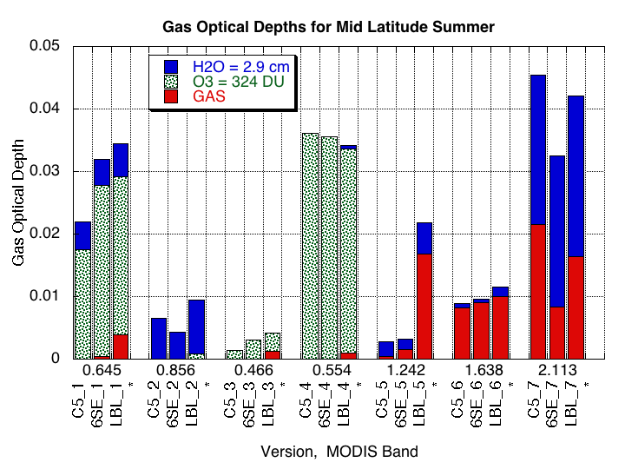
Gas Corrections (cont.)
For Z=0°: T’_{gas} ≈ 1 + τ_{gas}
ΔT’_{gas} ≈ 0.01 → Δρ∗ ≈ 0.001
Consistent “bias” of Δρ∗ ≈ 0.001 → “bias” of AOD of 0.01.
Bias is double for Z=60°. Quadruple for two-way transmission!
Something really weird is happening at 1.24 μm channel (big impact on land retrieval)
ACE: We want to know global AOD to ±0.01? Not when we don’t know gas!!!

Slide 17
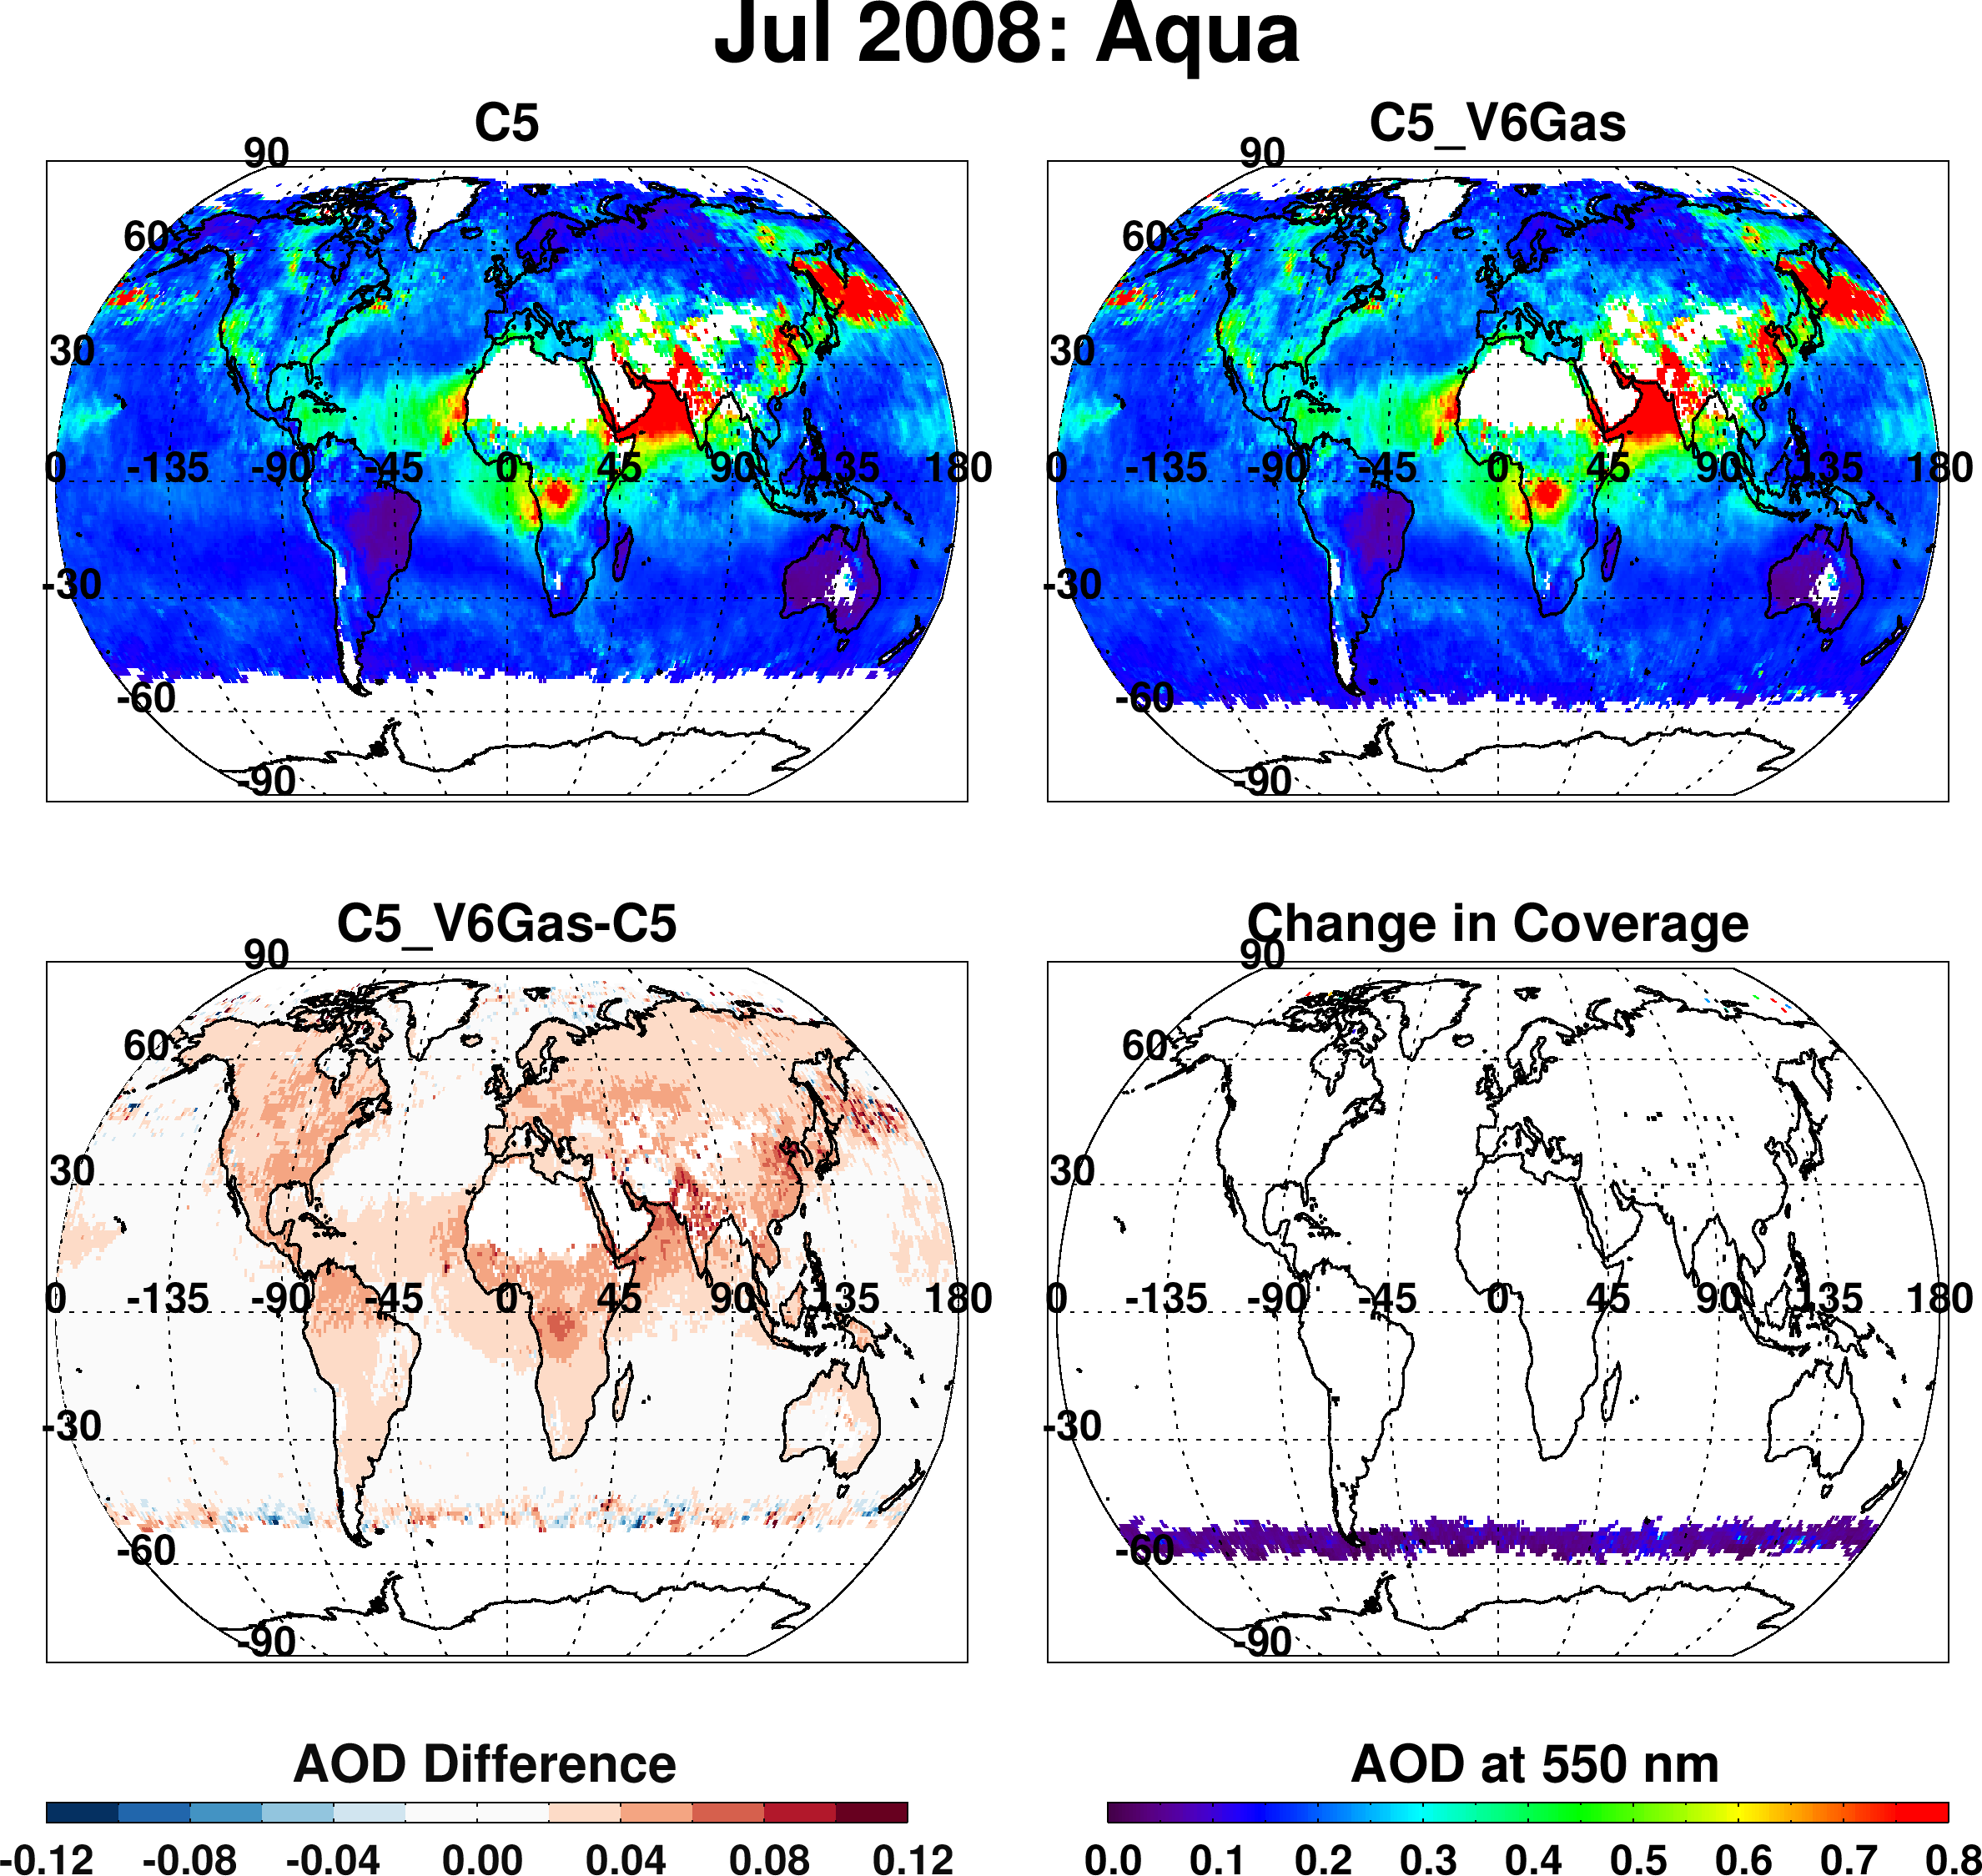
Radiative Transfer updates (applied to C5)
Recalculate “center wavelengths” from MODIS filter functions, and spectral Rayleigh optical depths
Recalculate gas absorption coefficients and optical depths for H₂O, O₃, CO₂, CH₄, O₂, etc
Extend valid solar zenith angle from 72° to 84°.
Pretty big changes, but they are justified.

Slide 18
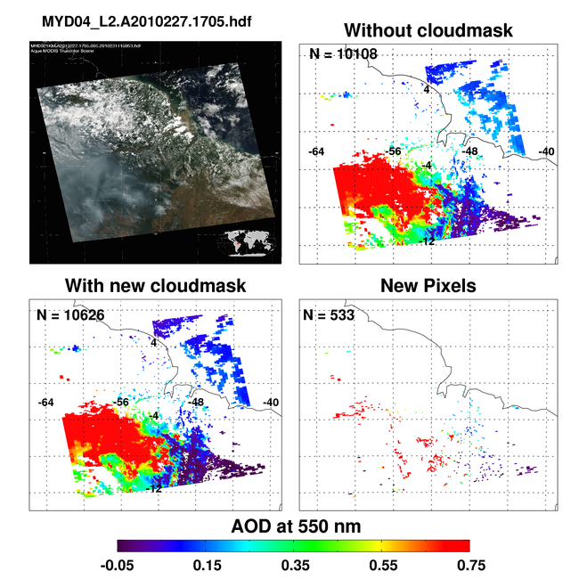
Update cloud masking (ocean & land)
Retrieve more “heavy smoke” cases
Retrieve fewer “thin cirrus” cases
Correct assignment of QAC due to clouds

Slide 19
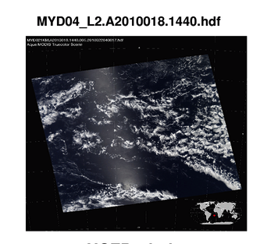
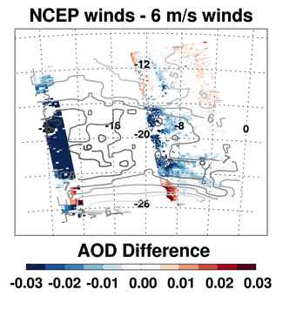
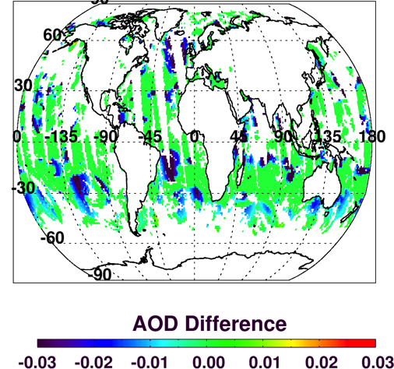
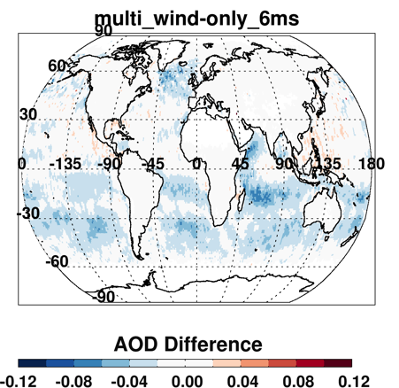
Science: wind speed dependence (ocean)
Higher wind speeds → more ocean foam and diffused glitter pattern
Aerosol LUT now calculated for 4 wind speeds
(v=2, 6*, 10, 14 m/s)
Retrieved AOD reduced when v≥6
Reduces AOD near 40° glint mask edges and in “Roaring 40s” of southern Oceans.
One granule
One day
One month

Slide 20
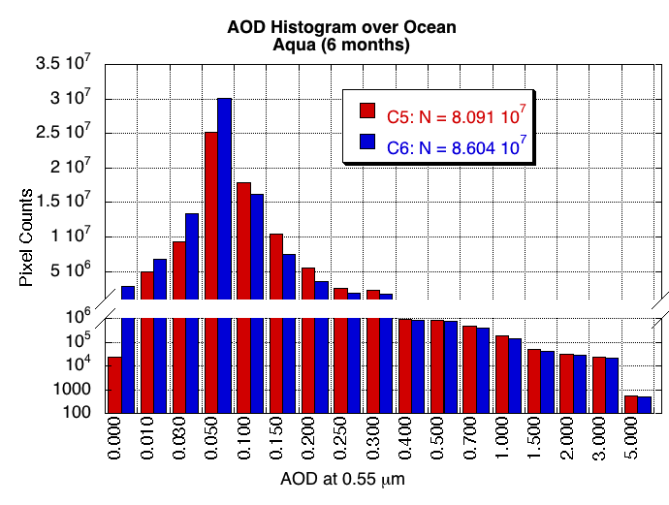
Quality Confidence “definitions”
Old (C5): Quality assurance depends on success of a retrieval solution. If aerosol signal is too small, then do not include in daily/monthly statistics.
New (C6) : Sometimes signal is small, but we are confident that it is small. Include in daily/monthly statistics.
- But “major” influence on estimating regional and global mean AOD
Notes:
Highlight additional retrieval coverage in higher solar zenith angles

Slide 21
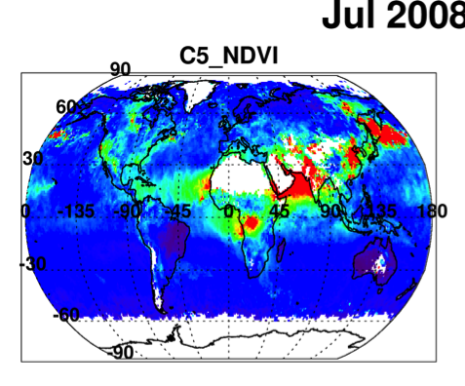
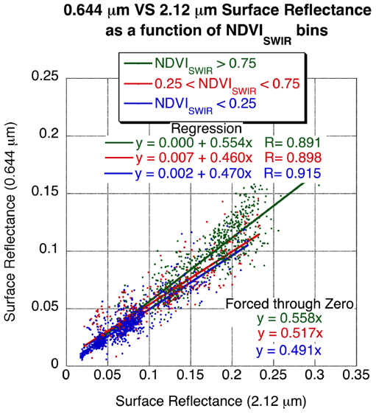
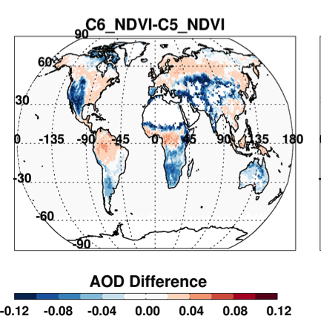
Major bug fix: surface reflectance relationship to NDVI_swir
Coding error from C5 continued to C6
Surface reflectance dependence on NDVI_swir was reversed
New: Reduces super-high bias for semi-arid regions.
These labels were reversed
Resulting in coding error

Slide 22
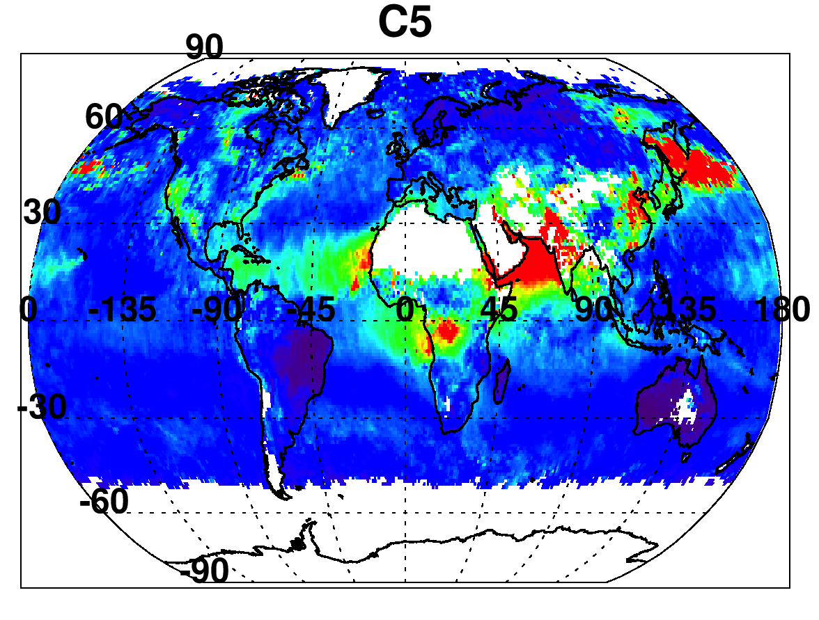
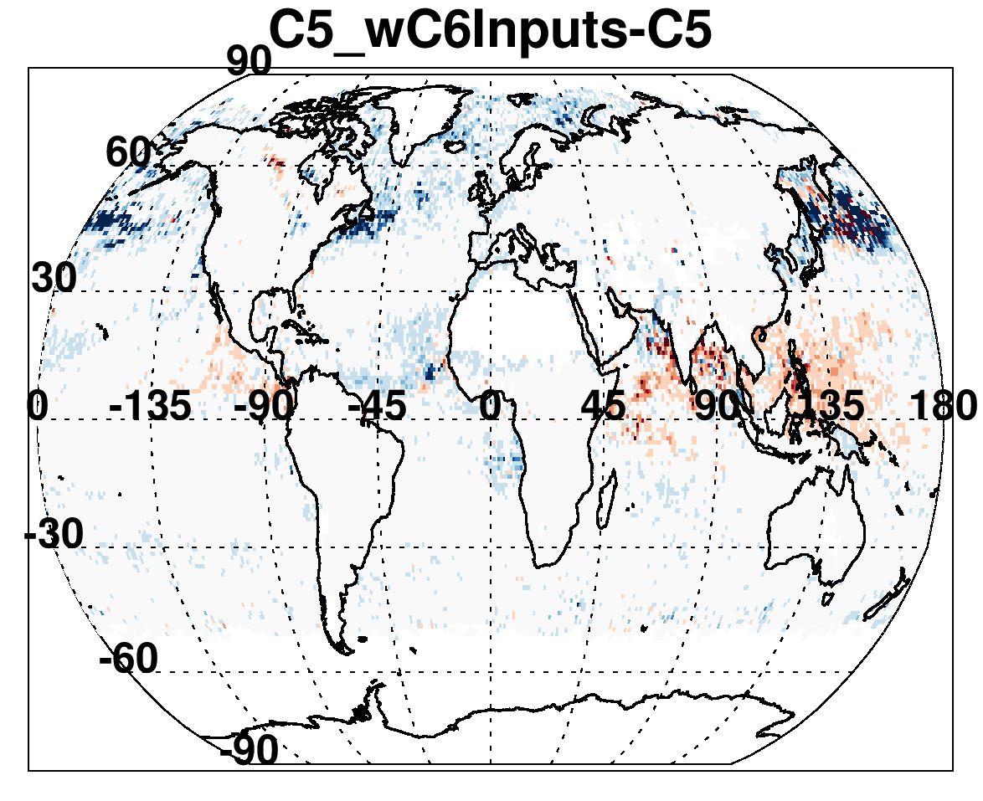
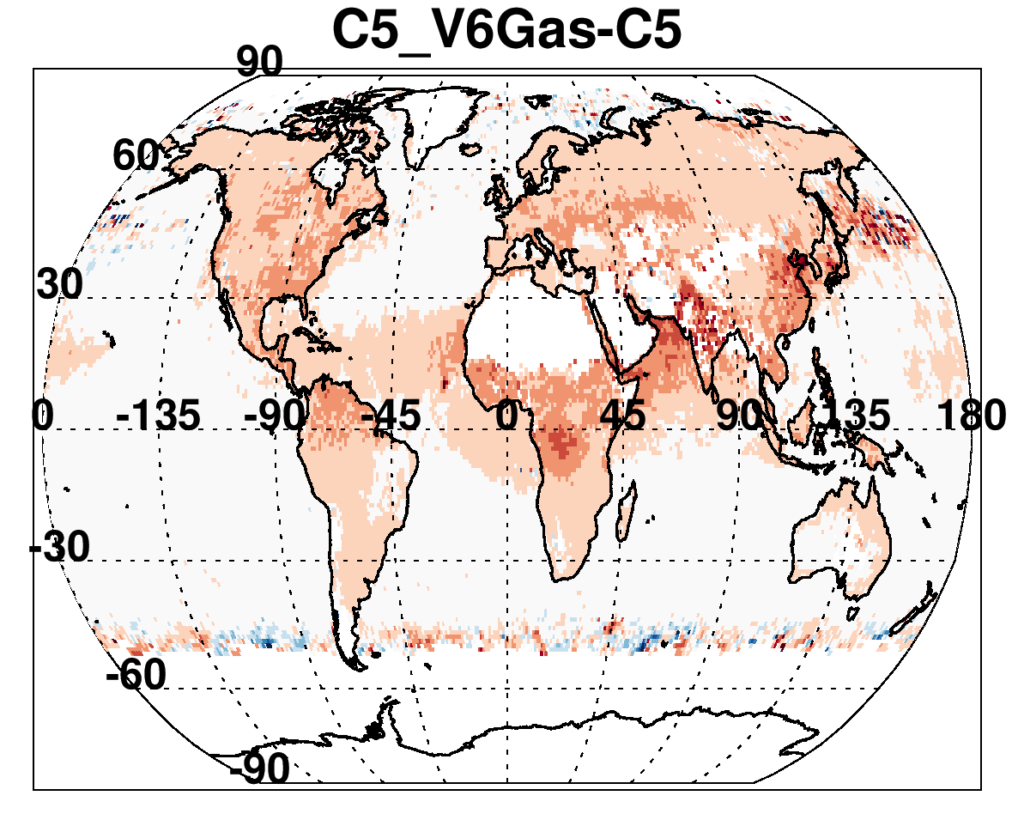
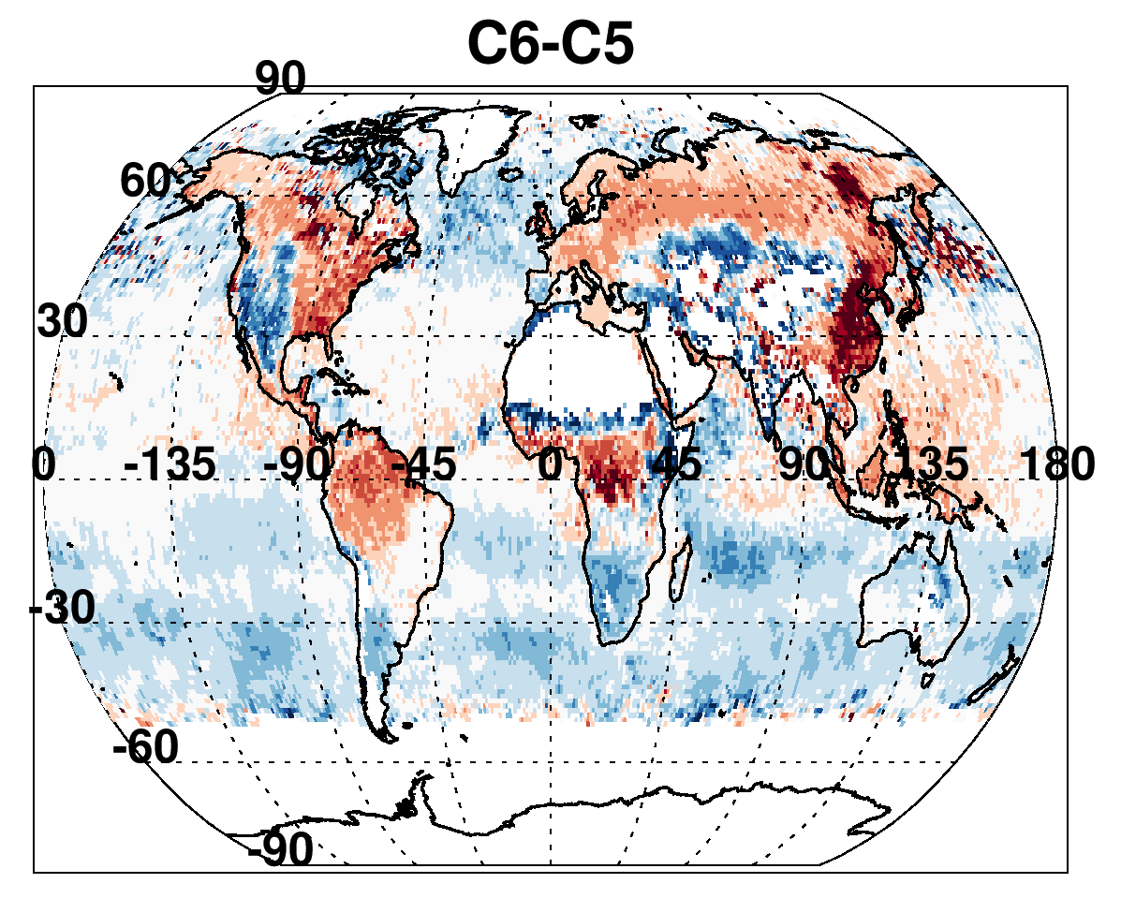
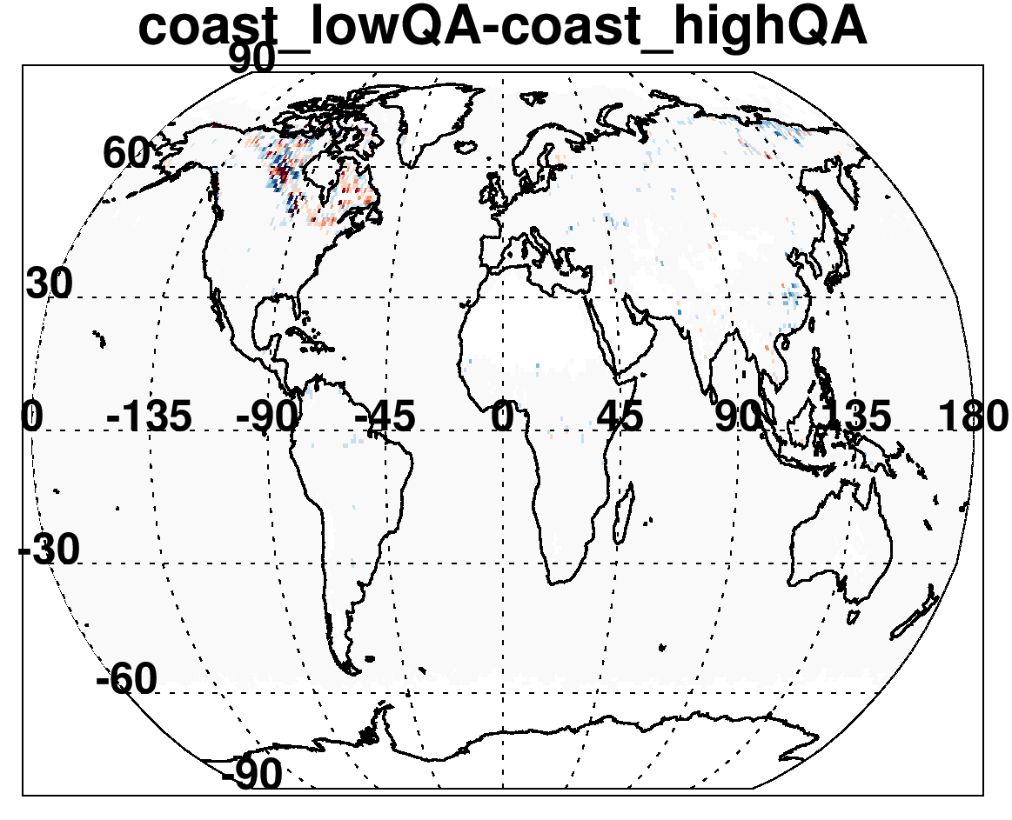
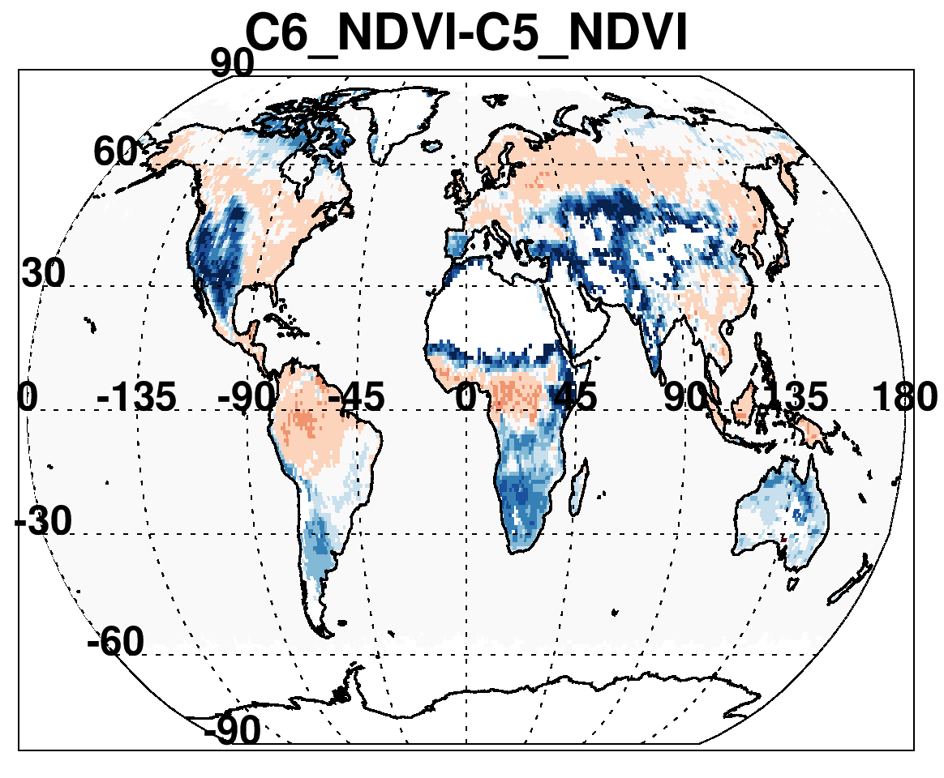
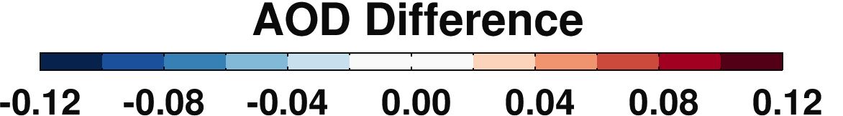
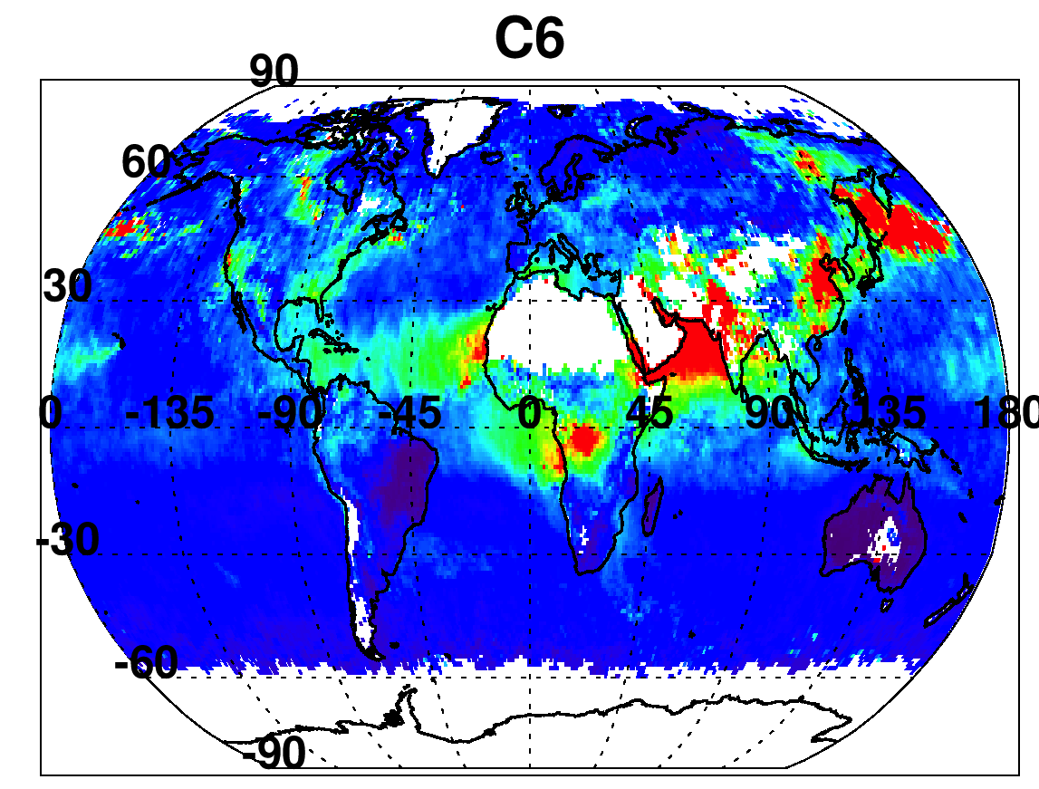
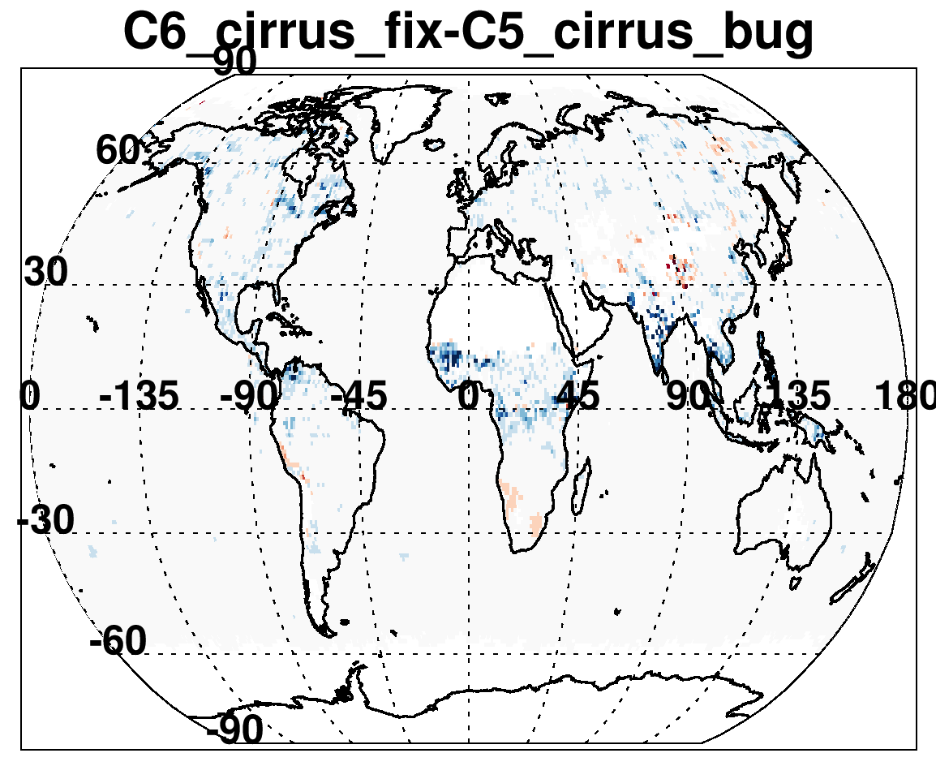
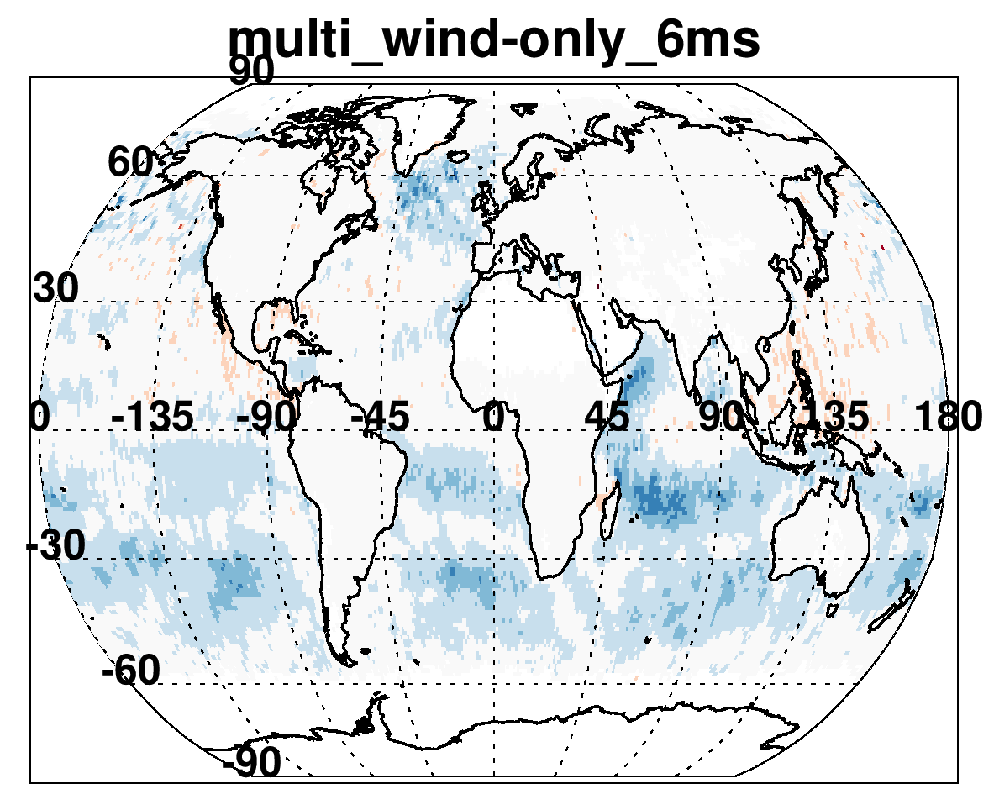
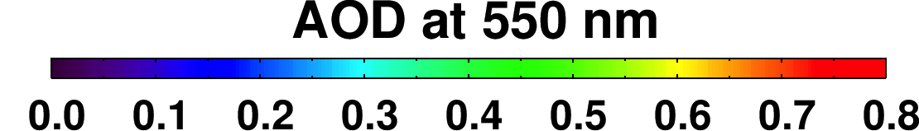
New INPUTS
New GAS and LUT
Degrade coastal QA
Switch NDVI_swir
Fix cirrus bug over land
Add wind speed dep.

Slide 23
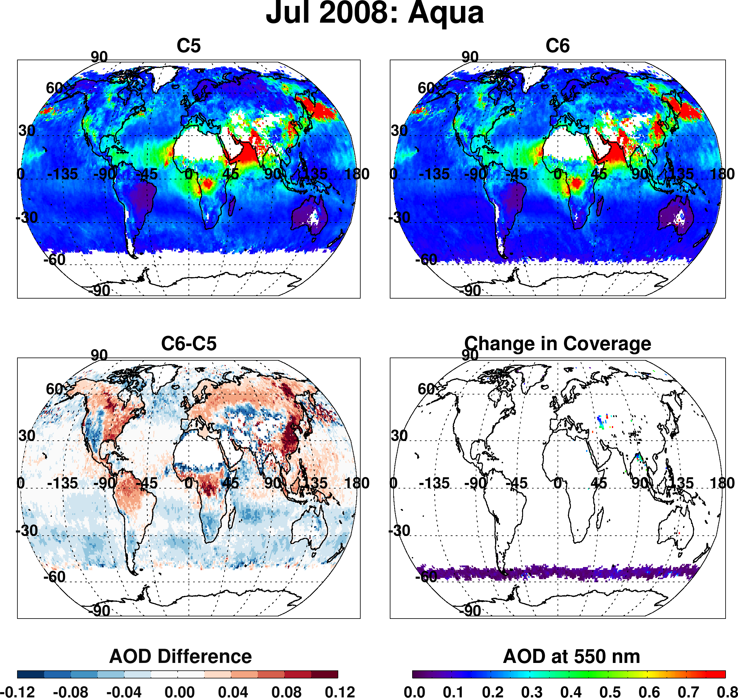
Results from ALL changes
Version 6.0.27
NDVI switch
Decisions about land/sea/coastal
Mostly wind speed upgrades
Higher zenith angle valid
  lower AOD over ocean, but significantly lower over southern oceans
  Higher AOD over most land, but lower in semi-arid regions.
  Changes in decisions to retrieve (see Aral sea).
Notes:
Highlight additional retrieval coverage in higher solar zenith angles

Slide 24
Preliminary “validation” of C6
6 months testing (on Aqua)
QAC = 3
QAC ≥ 1
No dramatic changes, but 10-20% more valid collocations with AERONET
C6 algorithm has slightly better (68% vs 64%) retrieved over ocean
C6 will have more of a high bias over land, but slightly better correlation.

Slide 25
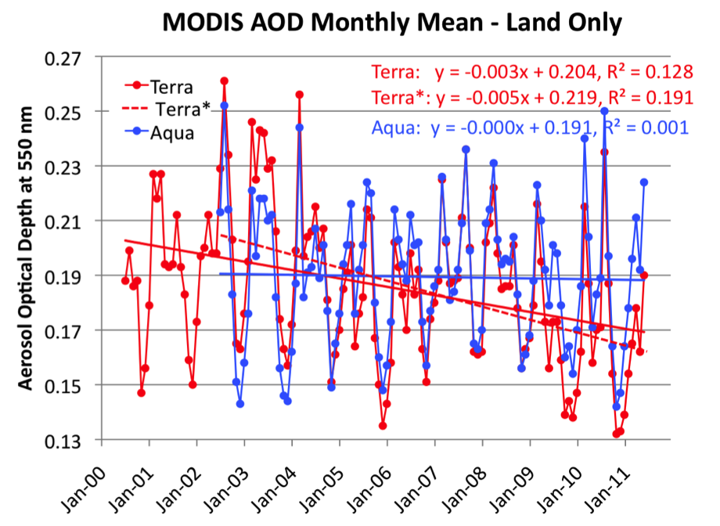
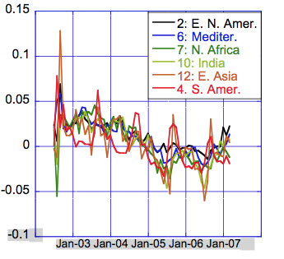
C5: Trends Terra ≠ Aqua
Over land, Terra decreases (-0.04/decade), Aqua constant
Terra / Aqua divergence is the same everywhere on the globe!
Artificial Terra trend traced to degrading of Terra’s calibration

Slide 26
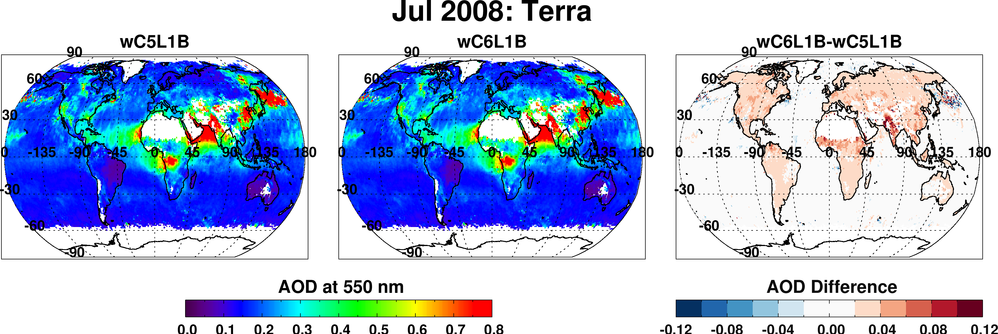
C6: Impact of New Terra calibration
Main impacts over land
  Global increase by 0.02 (for this particular month)
Impact over ocean is small
  Global increase by 0.004 (for this particular month)
Jack Xiong, Junqing Sun and MCST

Slide 27
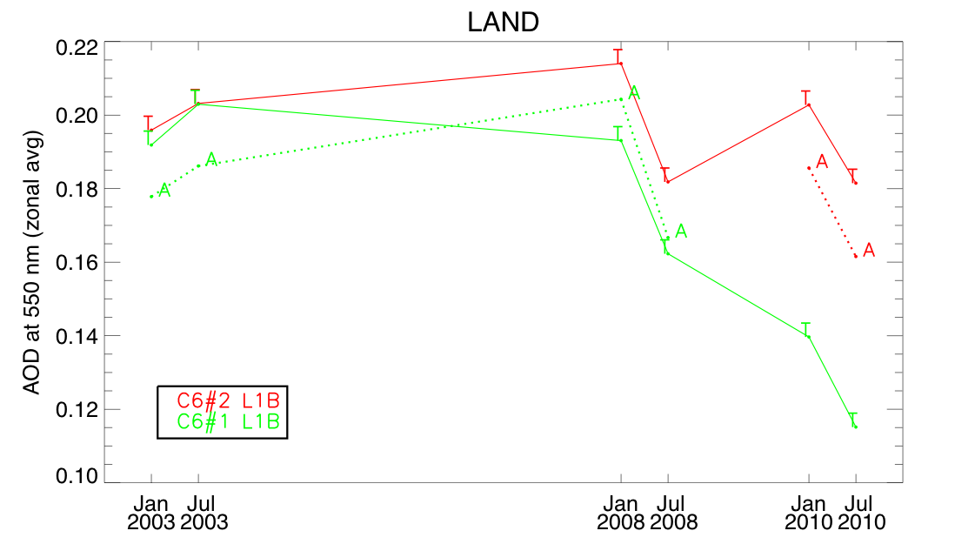
C6: Impact of new calibration on trend?
T
T
A
T
T
T
T
T
A
A
T
T
A
A
A
T
T
Old Calibration
New calibration
T
6 months processed with same dark-target aerosol algorithms
Terra (T) now “in sync” with Aqua (A) time series
(Terra-Aqua) offset remains 0.01 (ocean) and 0.015 (land)
New calibration → Terra/Aqua divergence removed for C006!

Slide 28
What else for C6 Level 2?

Slide 29
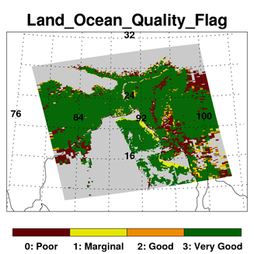
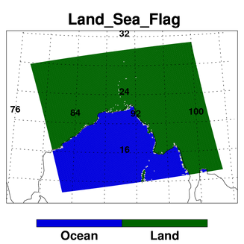
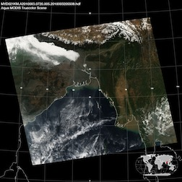
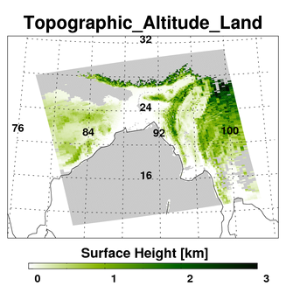
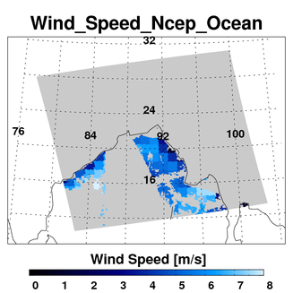
New Diagnostic SDSs

Slide 30
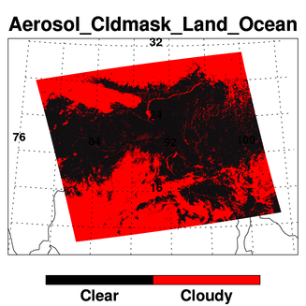
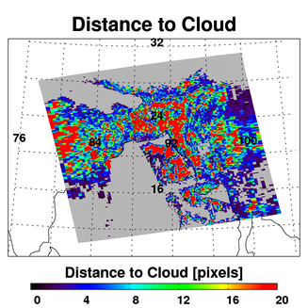
Cloud and Aerosol SDSs
500 meter resolution cloud mask used in aerosol retrieval. Can be (at times, significantly) different than MOD35
Number of pixels between an aerosol retrieval and the closest cloud. Not thoroughly validated yet.

Slide 31
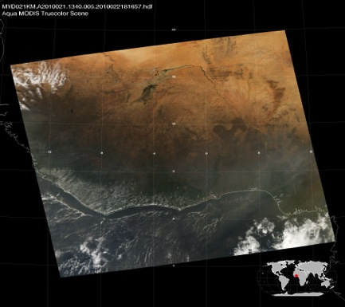
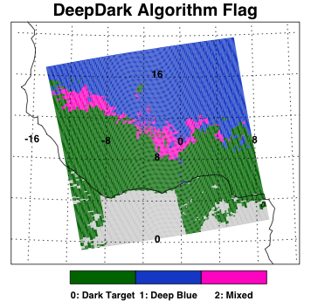
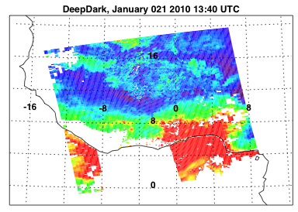

The Deep/Dark merge
Jan 21 2010 at 13:40 UTC
Dark, bright, and transitional regions are identified by monthly mean NDVI
In Dark regions, value from dark-target retrieval is used
In bright regions, deep-blue is used
In transition regions, AOD is merged, dependent on QA of retrievals
DeepDark Algorithm Flag
DeepDark 550 nm AOD
C. Hsu, A. Sayer, C. Bettenhousen, S. Mattoo, L. Munchak, R. Kleidman, et al.,

Slide 32
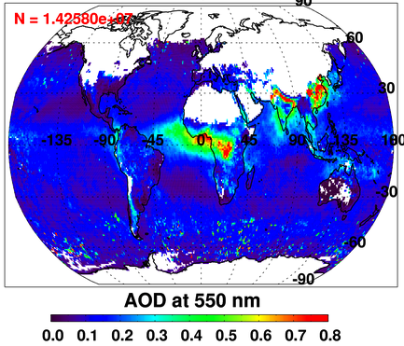
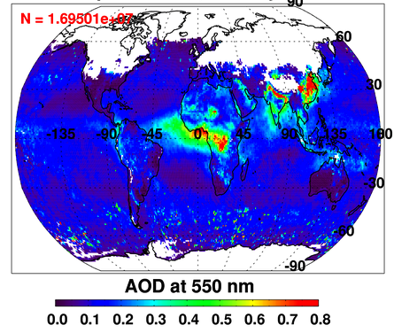
Monthly mean AOD for Aqua, January 2010
Dark Target AOD
DeepDark AOD
Merging deep blue & dark target produces best global coverage
Deep blue is land-only; need dark target for oceans
Deep blue introduces coverage over Australian outback, Sahara desert
  and Arabian peninsula
Still no coverage over snow (see: most of Northern Hemisphere).
MERGE LOOKS REASONABLE, BUT NOT VALIDATED YET!!!! (Kleidman et al)

Slide 33
What about C6 Level 3?

Slide 34
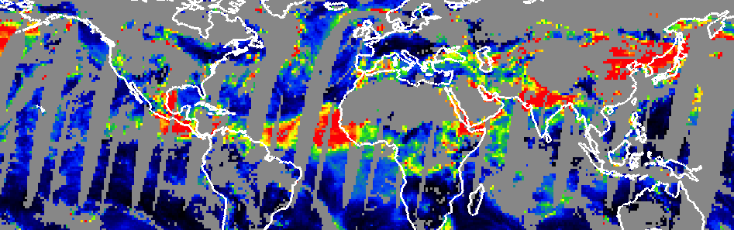
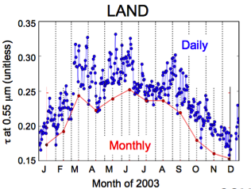

Calculating mean AOD
Daily data?
Monthly data?
Levy et al., TRGS, 2009
It depends on the post-processing path
Many choices for aggregation and weighting
Accentuate different limitations of original (L2) sampling
Levy et al., submitted 2008

Slide 35

Changes to Level 3: monthly
C5
C6
C6-C5
Pixel weighting for monthly data is removed
Replaced by “equal day” weighting (assuming at least 5 observations per day).
→ Increase monthly mean AOD over land, and ocean

Slide 36
Global → Local
Nominal resolution (e.g. 10 km) cannot resolve higher scale (e.g. urban, neighborhood) variability
Air Quality community has been asking (no, pleading!) for higher resolution data
We have been afraid to lose the advantage (pixel statistics) of the 10 km.

Slide 37
3 km algorithm
In two AMT-Discussion Papers (in revision for AMT)
Munchak, L., R.C. Levy, S. Mattoo, L.A. Remer, B.N. Holben, J.S. Schafer, C.A. Hostetler, and R.A. Ferrare (2013). MODIS 3km Aerosol Product: applications over land in an urban/suburban region, Atmos. Chem. Phys. Dis, 6, 1683-1716
doi:10.5194/amtd-6-1683-2013
Remer, L., S. Mattoo, R.C. Levy, and L. Munchak (2013). MODIS 3km Aerosol Product: Algorithm and Global Perspective, Atmos. Meas. Tech. Disc., (6), 69-112
doi:10.5194/amtd-6-69-2013
J. M. Livingston, J. Redemann, Y. Shinozuka, R. Johnson, P. B. Russell, Q. Zhang, S. Mattoo, L. Remer, R. Levy, L. Munchak, and S. Ramachandran, (2013). Comparison of MODIS 3-km and 10-km resolution aerosol optical depth retrievals over land with airborne Sunphotometer measurements during ARCTAS summer 2008, Atmos. Chem. Phys. Dis, (submitted last week).

Slide 38






MODIS 3 km product over suburban (MD) landscape (summer 2010)
Aqua: Day 209 2010
10 km
3 km
Terra: Day 219 2010
10 km
3 km
3 km mirrors 10 km product (pattern and magnitude)
3 km introduces noise, but also can reduce spatial impact of outliers

Slide 39

MODIS vs DRAGON
July 21, 2011
AOD (AERONET: DRAGON)
0.0
0.20
0.40
0.60
0.80
>1
BALT
DC
DRAGON = Many AERONET over Maryland during DISCOVER-AQ experiment, July 2011
For MODIS plots, QA=3 only
  Circle Center = AERONET ±2 hours
  Circle Outer = MODIS 5 x 5 box
3km (bottom) resolves Baltimore maxima
Gray is MODIS-Aerosol cloud mask
3km also resolves aerosol over Ches. Bay

Slide 40
MODIS 3 km product (operational for C006)
Algorithm structurally identical to standard “10 km” retrieval
Results will be in new files, ‘MOD04_3K’
Over land and ocean, (but no Deep Blue yet).
Both MOD04_L2 and MOD04_3K will be available
S. Mattoo, L. Munchak, M. Martins, L. Remer, B. Holben, et al

Slide 41




Summary (1)
Dark-target algorithm/products are updated for C6, but only “modest” changes (no major science updates).
“Modest” is relative… Many difficult decisions about seemingly small things that actually were significant. (e.g. Gas Correction, Cloud Mask, Quality Assurance etc).
Upstream changes (L1B and MOD35) meant we had to re-analyze, over and over.
Not superhero like, but there were mistakes (bugs carried over from C5) that needed re-analysis.
Dark-target and Deep-blue products are merged, leading to more global coverage
MODIS RGB
MODIS Aerosol (06:35 UT)
MODIS RGB
MODIS Aerosol (06:35 UT)
The MODIS aerosol
cloud mask is more
conservative than
the VIIRS VCM.
The MODIS aerosol
cloud mask is more
conservative than
the VIIRS VCM.
VIIRS RGB
VIIRS Aerosol EDR
MODIS Algorithm, VIIRS Input
VIIRS RGB
VIIRS Aerosol EDR
MODIS Algorithm, VIIRS Input

Slide 42
Summary (2)
MODIS aerosol retrieval was intended for global climate applications
  Air quality events are sometimes on urban and local scales
  Aerosol properties change near clouds
  → The MODIS dark-target team is offering 3 km operational aerosol data.
  Issues in land/sea/coastal are ACCENTUATED!
MODIS RGB
MODIS Aerosol (06:35 UT)
MODIS RGB
MODIS Aerosol (06:35 UT)
The MODIS aerosol
cloud mask is more
conservative than
the VIIRS VCM.
The MODIS aerosol
cloud mask is more
conservative than
the VIIRS VCM.
VIIRS RGB
VIIRS Aerosol EDR
MODIS Algorithm, VIIRS Input
VIIRS RGB
VIIRS Aerosol EDR
MODIS Algorithm, VIIRS Input

Slide 43

Trying to get C6 into product is like…
… Being Sisyphus
Hopefully, there will be no season IV for “Introducing Collection 6 products”

Slide 44

On towards Collection 7!
Proper per-pixel error products
Better urban retrievals
Use IR information for dust detection
Etc: It’s proposal season!
At the Yoram memorial tree outside of Bldg #33
THANK YOU FOR YOUR ATTENTION !!!

