Slide 1
Aerosol effects on 20th century climate in the GISS Model
Dorothy Koch
Coauthors: Surabi Menon, Drew Shindell, Susanne Bauer,
Greg Faluvegi, Gavin Schmidt, Anthony Del Genio, David Rind,
Ron Miller, Reto Ruedy, Joe McConnell
Columbia University
NASA Goddard Institute for Space Studies
GSFC AEROCENTER Update April 29, 2010

Slide 2
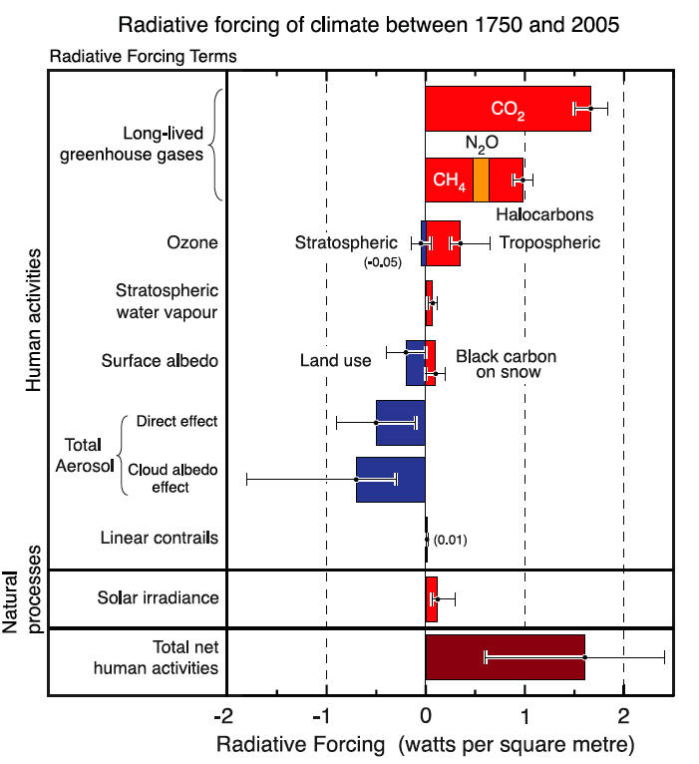
Global mean, 200-year perspective
However short-lived pollutants vary strongly in time and region
Sulfate BC
IPCC AR4 Ch2

Slide 3
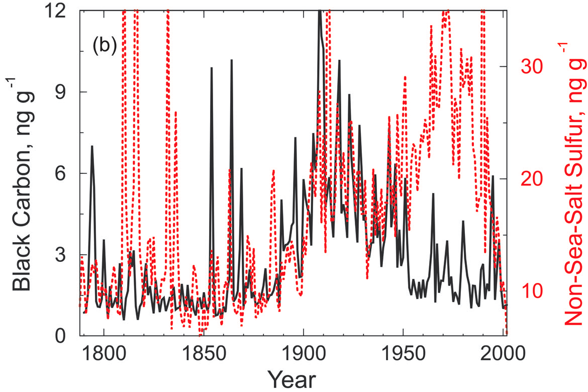
Greenland ice core records McConnell et al., 2007 Indicator of North American pollution changes
Oil, Gas
Coal

Slide 4
Our “On-line”: Aerosol-Climate Simulations
Previous study: Koch et al., J. Clim., 2009:
Aerosol-climate coupling in equilibrium simulations for 1890, 2000 with Q-flux slab ocean.
Current: Koch et al., (J. Clim., in revision)
Aerosols-ozone-chemistry
Coupled to climate including dynamic ocean
Transient simulation from 1890 to 2000
Other forcings included (e.g. GHG, solar, volcanic aerosols, etc)
Three sets of ensembles allow isolation of aerosol effects:
Direct
Indirect
BC-snow-albedo

Slide 5
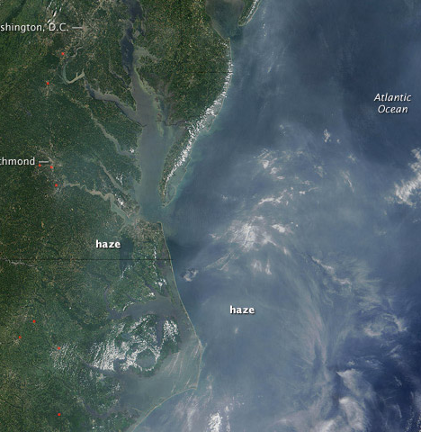
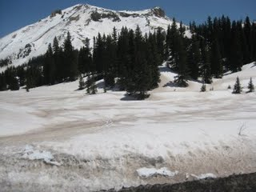
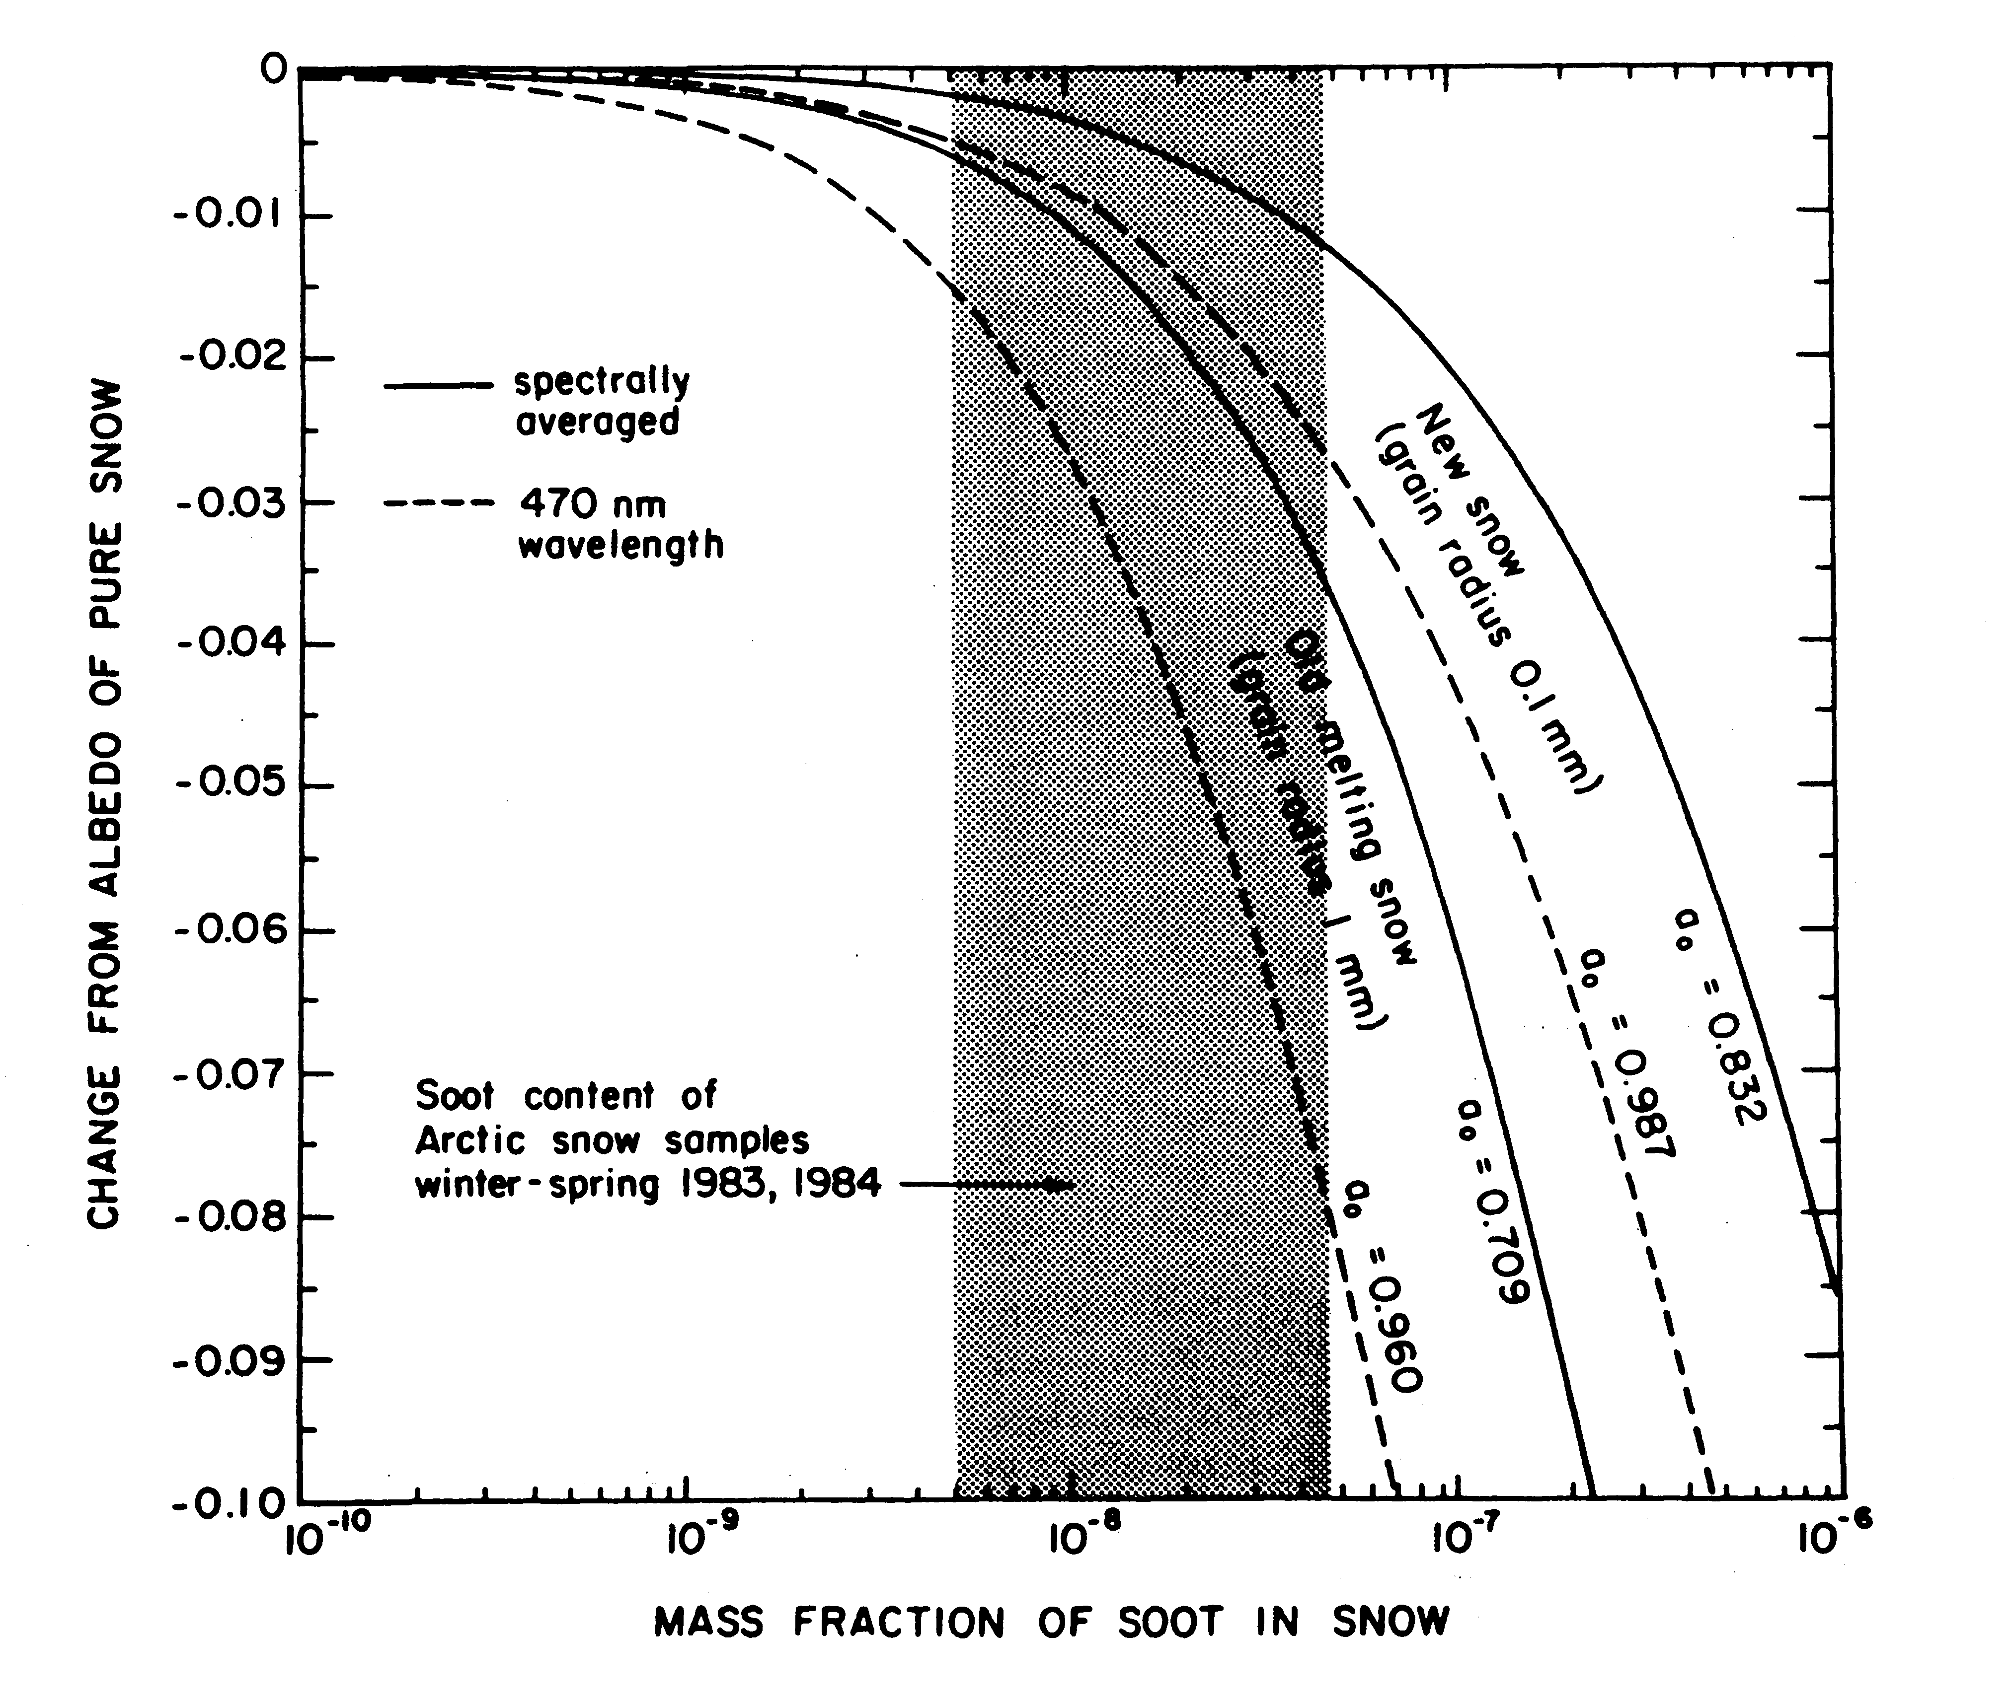
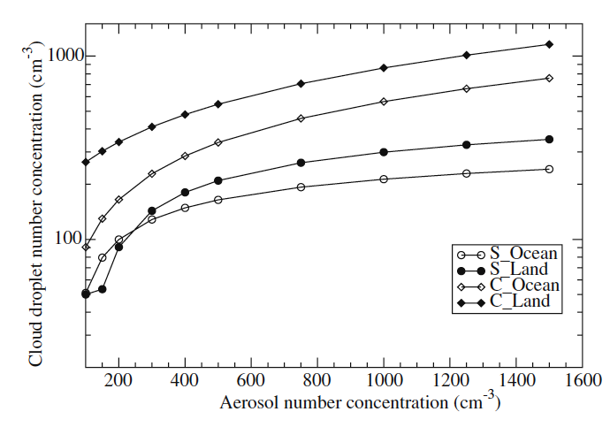
(Interactive) Aerosol Effects
Warren and Clarke, 1986
1. Direct effect: scattering, absorption of radiation.
Menon and Rotstayn, 2006
3. BC-albedo effect: BC deposited on snow reduces snow albedo and promotes melting
2. Indirect cloud effect
3. BC snow-albedo effect

Slide 6
Emissions Trends
Normalized to 1890
Emissions:
SO₂, NO_{x}, CO etc: EDGAR (van Aardenne et al., 2001; EDGAR32_FT)
BC, OC: Bond et al. (2007)
Biomass burning: GFED (scaled to 1/2 in tropics for 1880, increasing linearly to 2000)
Natural sources

Slide 7
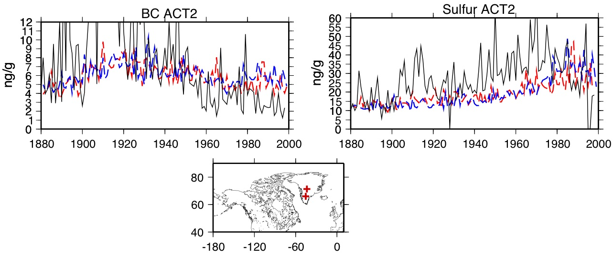
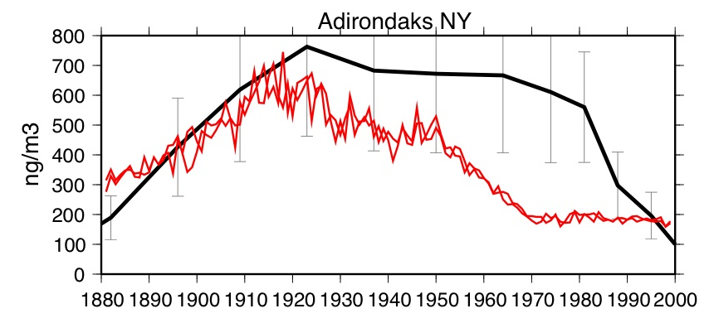
Model vs observations, North America
BC, sulfate trends compared to Greenland ice core data
core
STD
IE
ACT2
McConnell et al., 2007
BC air concentration history derived from NY lakecore BC
Core
model
Husain et al., 2008

Slide 8
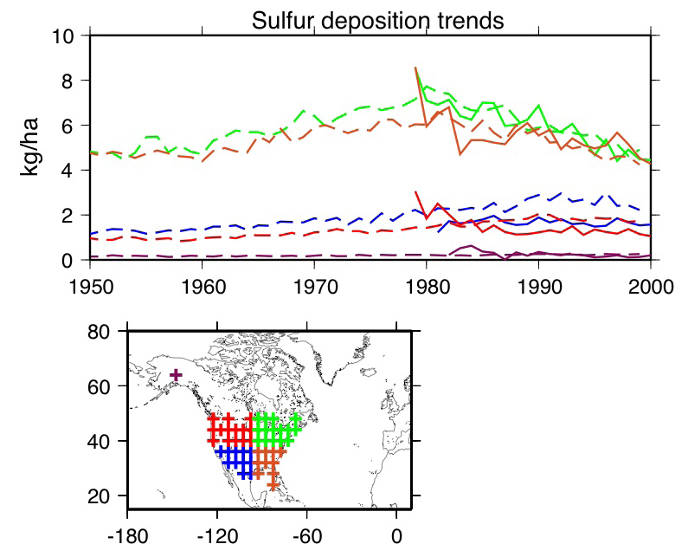
Model sulfur is nearly perfect in the US, in magnitude and trend
Model (dashed)
NADP data (solid)

Slide 9
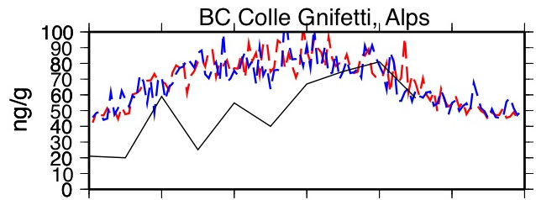
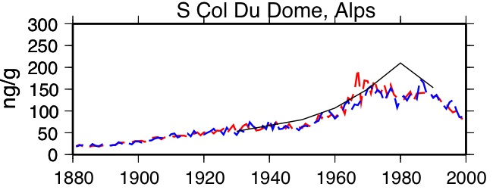
Europe and China
Black Carbon ice core
(Lavanchy et al., 1999)
model
Sulfur ice core
(Preunkert et al., 2001)
Black Carbon, Lake core concentrations, Yongming Han, personal comm.
(data scaled arbitrarily)
obs
model
Yangtzee Delta
Inner Mongolia
NE Tibetan Plateau
South coast

Slide 10
TOA forcing changes
Global [Arctic]
Sulfate

Slide 11
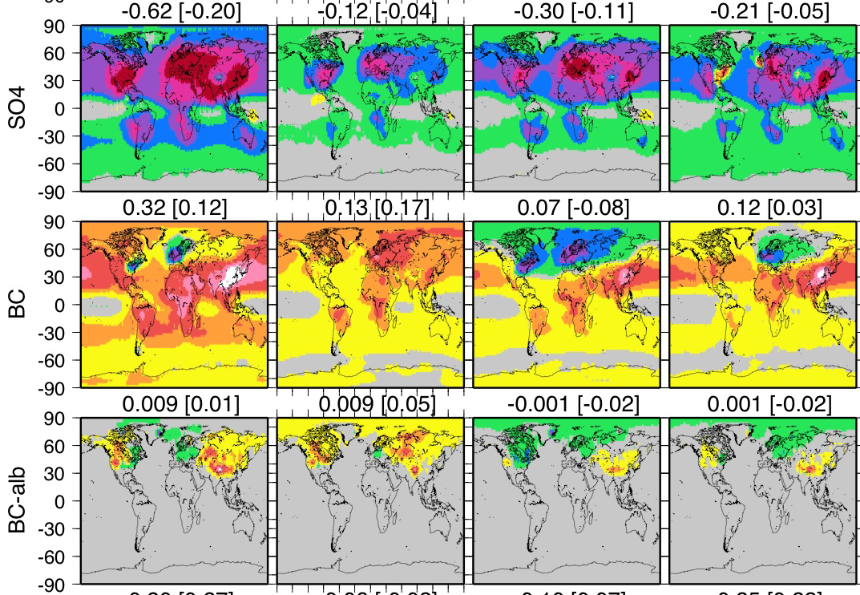
TOA forcing changes
Global [Arctic]
Sulfate
Black Carbon in the Atmosphere
Black Carbon on snow

Slide 12
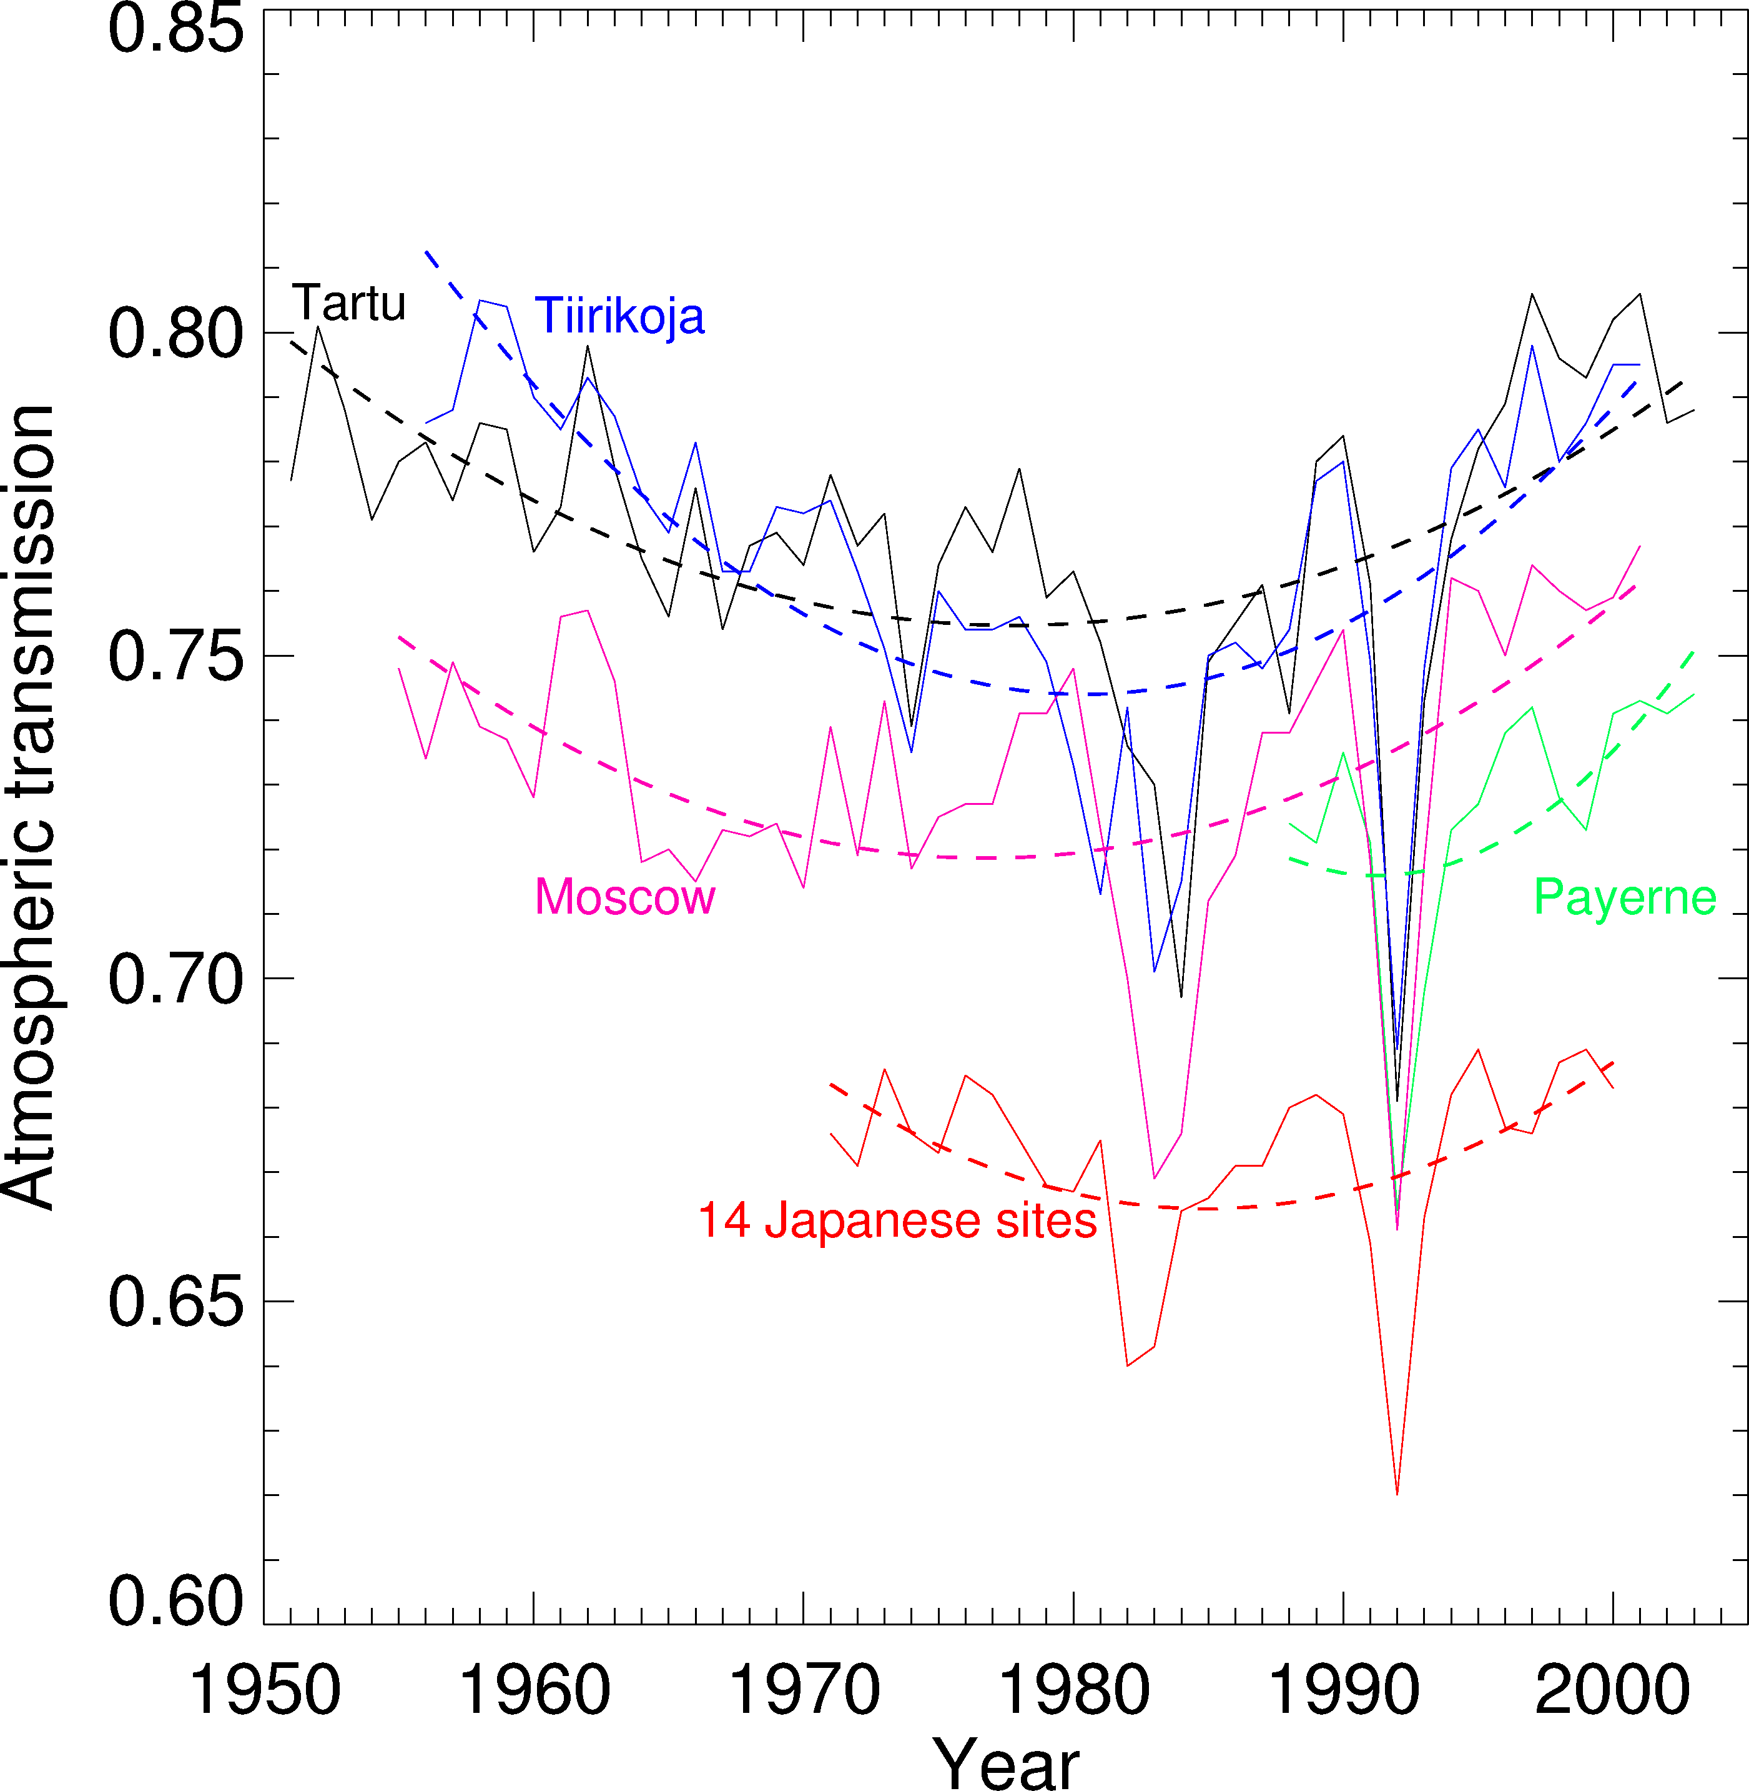
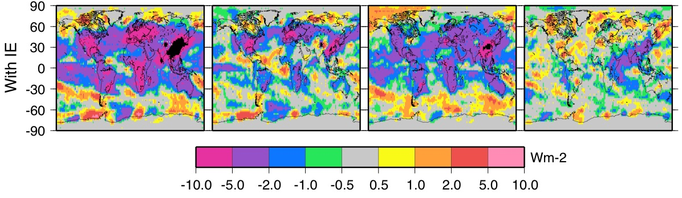
Dimming/brightening changes Observed
Wild et al., 2005, Science 308
Surface radiation changes
Century 1890s to 1940s 1940s to 1980s 1980s to 1990s
Dimming brightening

Slide 13
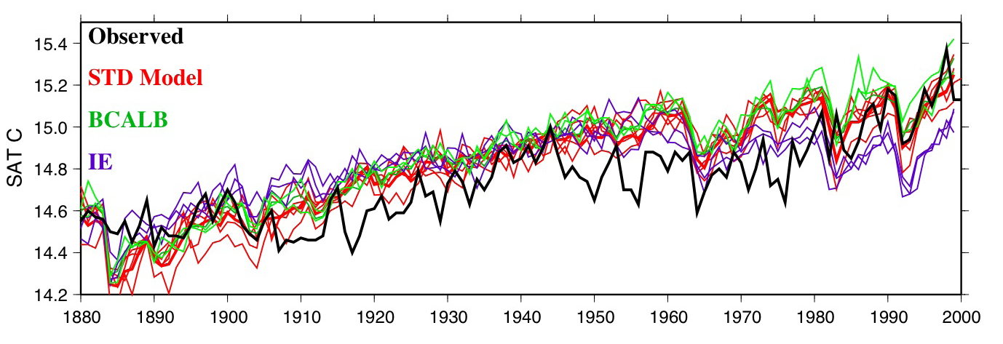
Surface Air Temperature
warming
stable
warming
Aerosol effects contribute to temperature, snow/ice changes during these periods

Slide 14
Observed Surface Air Temperature changes
GISS observed temperature analysis
Δcentury warmer neutral warmer

Slide 15
Observed Surface Air Temperature changes
Global [Arctic]
Modeled SAT changes
IE: better
Model OK until the end, then too cool.

Slide 16
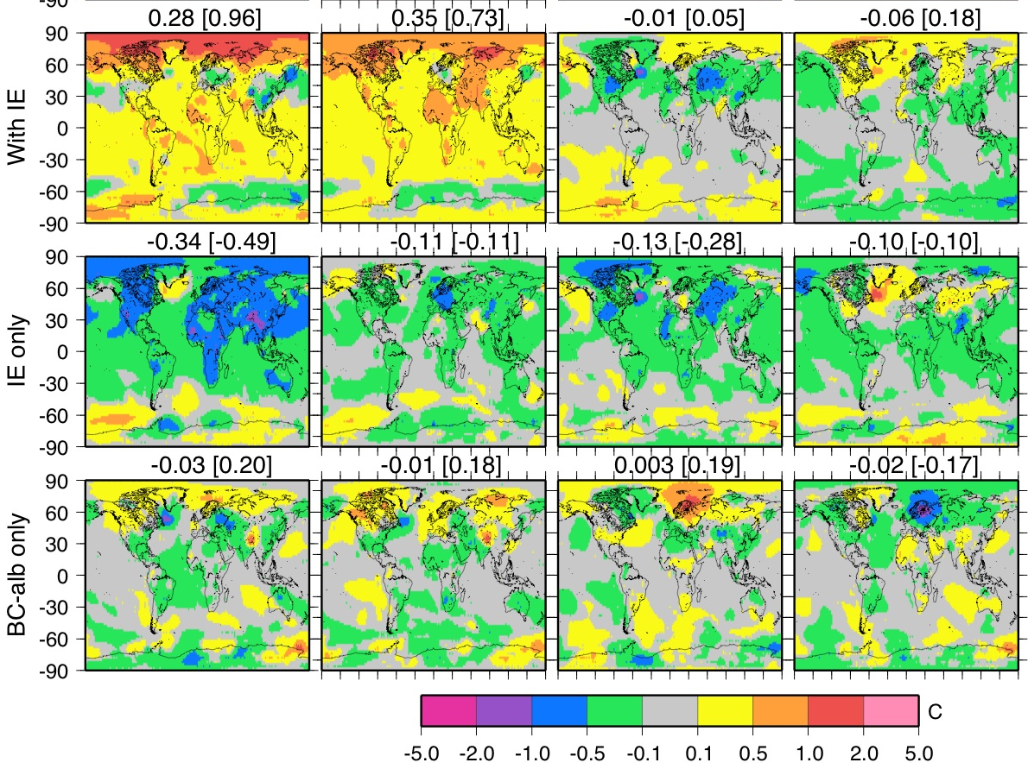
Aerosol effects on Surface Air Temperature (SAT) changes
All effects
Indirect effect
cools
Local warming
(Not enough?)
BC-albedo effect
warms
Cools
Global [Arctic]

Slide 17
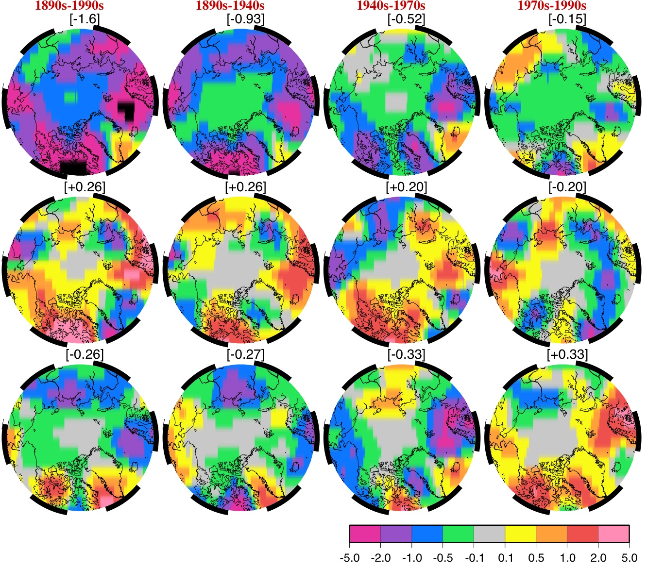
Model snow/ice cover changes
All effects
Arctic melting!
More snow
Indirect effect
More snow/ice!!
Arctic melting
BC-albedo effect
Global [Arctic]

Slide 18
“Mitigation” Sensitivity studies 1970-2000
Starting in 1970, branch 3 experiments, run to 2000 (no indirect effect)
Cooling experiments:
Pollution BC = 0 (-0.3 W/m2)
2. Long-lived GHG at 1970 levels (-1 W/m2)
Warming Experiment:
3. Pollution sulfur = 0 (+0.4 W/m2)

Slide 19
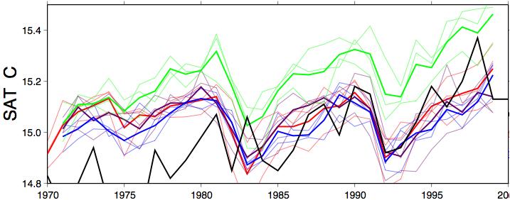
Global Surface Air Temperature Trend
Sulfur ⬇
Standard
GHG=1970
BC ⬇
Observed
Sulfur reduction, “unmasking”: much warmer
BC, GHG reductions, only small cooling
Due to thermal inertia, warming in “pipeline”

Slide 20
Δ(Mitigation – STD)
BC ⬇
GHG=1970
Sulfur ⬇

Slide 21
Δ(Mitigation – STD)
BC ⬇
Less clouds
(warming)
GHG=1970
More clouds
(cooling)
Sulfur ⬇
Less clouds (warming)

Slide 22
Koch and Del Genio, ACPD, review paper: “Black carbon absorption effects on cloud cover”

Slide 23
Conclusions
BC, BC-snow-albedo are important warming agents early in century. Over century BC-snow-albedo effect caused 20% of Arctic snow/ice loss.
Sulfate and the indirect effect caused strong dimming and cooling from 1940s to 1980s. Some decline in sulfur from Europe contributes to warming (“unmasking”) in final decades.
Why does model fail to warm enough from 1970 to 2000? Maybe sulfur emissions do not decline enough? Smith et al. (2004) has ‘better’ trend-shape (AR5 emissions).

Slide 24
Conclusions
4. Transient climate is a new challenge for the indirect effect! The IE cloud response is stronger in the transient deep-ocean simulations than Qflux equilibrium simulations. We will repeat these experiments using our new aerosol (MATRIX, Bauer et al., 2008) and cloud (Menon et al.) microphysical schemes.
5. “Mitigation”: Reduction of sulfur causes strong warming; reduction of BC does not cool very much. Arctic benefits more from reduced GHG than BC due to the cloud response (in our model).
6. The “semi-direct” effects of BC on clouds: net cloud-cover increases due to BC in many global models, requires further study (Koch and Del Genio, ACPD, 2010).

Slide 25
Thanks!
Funded by:
NASA MAP, Clean Air Task Force

Slide 26
Model without indirect effect (STD) warms the right amount.
Modeled SAT
Observed SAT
But too warm mid-century. Use IE from our Q-flux model experiments…

Slide 27
Surface Air Temperature trend
Model with indirect effect (IE1)

Slide 28
First IE try: Surface Air Temperature trend
Indirect effect (IE1) experiment Failed!
The cloud response is stronger in the transient deep-ocean compared to equilibrium slab-ocean run…

Slide 29
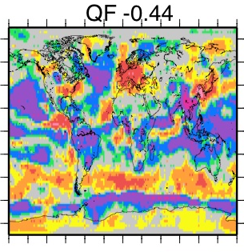
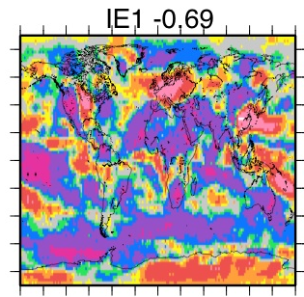
Cloud forcing change (1990-1890) for Q-flux, IE1
Qflux ocean IE1 deep ocean
Qflux equilibrium: shallow ocean warms faster, fewer low clouds
IE1 transient deep ocean: ocean not as warm, more low clouds, more negative cloud forcing (colder)

Slide 30
IE2: weaker indirect effect
IE2: weaker sulfate dependence.
This model does not include aerosol microphysics (mixing). Mixing might reduce number of CCN.
(Menon and Rotstayn, 2006)
Our model
Real world

Slide 31
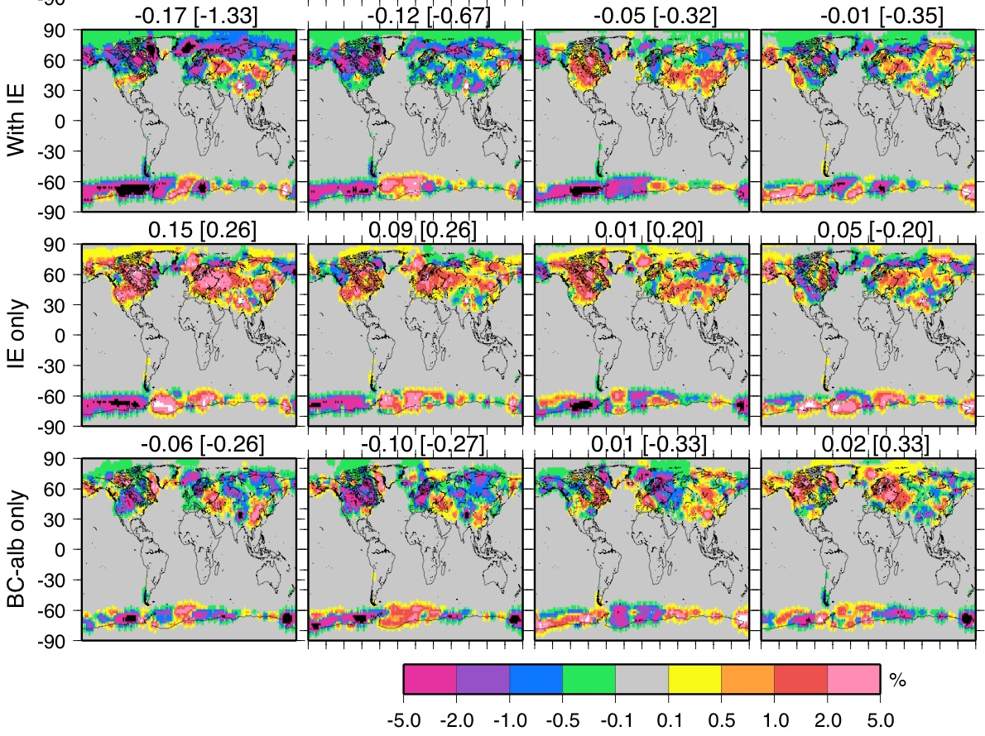
Model snow/ice cover changes
All effects
Indirect effect
Arctic melting!
More snow
BC-albedo effect
Arctic melting
More snow/ice!!
Global [Arctic]

Slide 32
Unmasking!
BC ⬇
GHG=1970
Sulfur ⬇

