Slide 1
Enhanced surface warming and accelerated snow melt in the Himalayas and Tibetan Plateau
induced by absorbing aerosols
William K-M Lau (NASA/GSFC)
Kyu-Myong Kim (UMBC/GEST)
Maeng-Ki Kim (KNU, Korea)
Woo-Seop Lee (KNU, Korea)
Yogesh C. Sud (NASA/GSFC)
Gregory K. Walker (SAIC)

Slide 2
Annual cycle of monsoon rainfall, aerosol, snow, and land-sea contrast

Slide 3
Seasonal to interannual variation of snowpack
The spatial, temporal variation of snowpack varies with altitude and is also closely linked to the atmospheric circulation and moisture availability (Pu and Xu 2009)
The atmospheric teleconnection pattern initiated by ENSO increases the upper tropospheric vorticity and increase snowfall over TP during winter. The increased snowfall produces a larger snowpack which lasts through the spring and summer, and subsequently weaken the Indian monsoon (Shaman and Tziperman 2005).

Slide 4
Possible major causes of accelerated snowmelt and glacier retreat
Sixty-seven percent of glaciers are retreating at a startling rate in the Himalayas, and the major causes have been identified as global warming . Ageta and Kadota 1992, Yamada et al. 1996, Fushinmi 2000). Overall, Himalaya glaciers are losing mass rapidly at a rates about 500 -1000 kg m⁻²/year, but rates are highly variable in space and time.
Aerosols may accelerated snowmelt and glacier retreat.
- Atmospheric heating due to aerosols
- Snow darkening effect

Slide 5
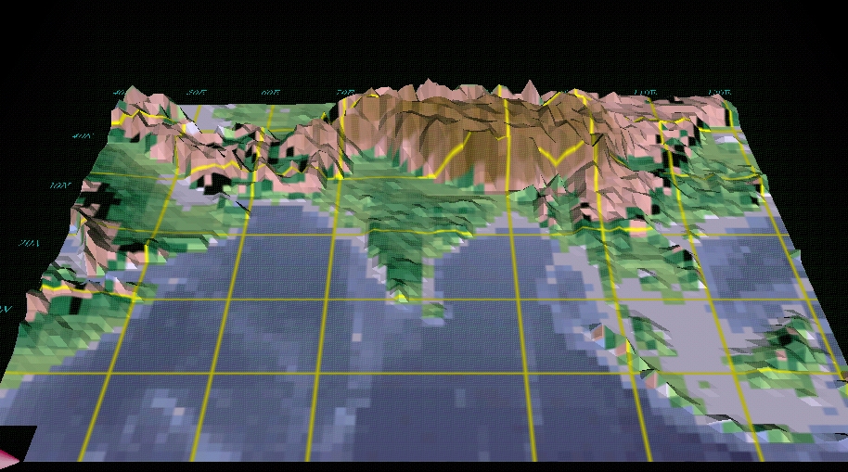
The Elevated Heat Pump Hypothesis
(Lau et al. 2006, Lau and Kim 2006)
Dust transport from Middle East and Thar desert into
IG plains
Somali Jet
May -June
Absorbing dust and BC
accumulated on foothills of
Himalayas accentuate
atmospheric heating by
sensible heat flux over Tibetan Plateau
Increase dust and moisture transport from low level
monsoon westerlies
Increased convection over
Bay of Bengal, eastern TP,
NE and central India
May-June

Slide 6
April-May mean aerosol optical depth(AOD) from 2000 to 2009
The dusts in IGP are coated with black carbon produced from local emissions and become a strong absorber of solar radiation and an efficient source of atmosphere heating( Lau and Kim, 2006).
Area mean monthly AOD anomaly over IGP
[70~90E, 20~30N]
April to May
High AOD : 2004
Low AOD : 2005
Nino3 Index
DJF 2004: 0.29
DJF 2005: 0.27

Slide 7
Snow Water Equivalent(mm) change (2004 minus 2005)

Slide 9
NASA fvGCM Experimental Set-up
Four sets of 8 year simulations (2000-2007), coupled to mixed layer ocean, and interactive land surface model, with same CO2 forcing, for:
Control (dirty) with prescribed seasonally varying aerosol loading (dust, BC, OC, sulfate, and sea salt), and computed radiative forcing, i.e., all aerosol (AA)
Anomaly (clean world): with aerosol radiative forcing disabled, i.e., no aerosol (NA).

Slide 10
AOT of total GOCART aerosols
May
Area-averaged composition of aerosols in May
Region Aerosol Type | IGP [ 75~90°E, 17.5~30°N] | TP [ 80~95°E, 30~35°N] | Central China [105~120°E, 25~35°N]
All aerosols | 0.24 | 0.15 | 0.73
Black Carbon | (11.7%) | (10.7%) | ( 8.0%)
Dust | (41.9%) | (43.3%) | (15.8%)
Sulfate | (15.8%) | (22.3%) | (62.5%)
Organic Carbon | (26.5%) | (20.4%) | (12.4%)
Sea salt | ( 3.8%) | ( 3.0%) | ( 1.1%)
Surface skin temperature(℃)
Dirty-minus-Clean
Lau et al. 2010 ERL

Slide 11
EHP induced heating and moistening along 80ºE
Temperature (shading, K) & SW Heating Rate (K/day)
May
Specific Humidity (shading, g/Kg) & SW Heating Rate (K/day)
May

Slide 12
Relative percentage change of surface albedo (due to changes in snow-cover, and exposure of underlying land surface )
Slow melting fast melting quasi-equilibrium partial recovery

Slide 13
Mean temperature change in upper troposphere from 700 to 300hP,
(b) Surface skin temperature change,
(c) specific humidity (g/kg) change in upper troposphere from 700 to 300hPa,
(d) precipitation(mm/day) change,
(e) total cloud fraction change(%)

Slide 14
net radiative flux
(negative=sfc cooling )
latent heat flux
(negative = sfc warming)
sensible heat flux (negative=sfc warming)
net surface flux
(positive= warming)
WTP
ETP

Slide 15
Summary
Heating by absorption of solar radiation by soot and dust in the IGP region initiates an atmospheric feedback via the EHP effect leading to:
Increased mid-tropospheric radiative heating along Himalayas foothills enhances convection in northern India, leading to warming and moistening of the middle and upper troposphere over the HKHT region
The atmosphere transfers sensible heat to the land surface, enhancing early spring snow melt
The snowmelt is further accelerated by transfer of latent heat from atmosphere to land, resulting in up to 10% additional melting in May

