Slide 1

Update on GOCART Model Development and Applications
Aerocenter Annual Update
May 31, 2013
Dongchul Kim, GOCART group, and many collaborators

Slide 2
Contents
Emission
  Update of emission inventories for hindcast runs (A2-MAP) (T. Diehl et al.)
  Development of the dynamic dust source function for GOCART (D. Kim et al.)
  Constrain BB emission in GOCART using satellite AOD (M. M. Petrenko et al.)
Development
  Modeling nitrate in GMI and GOCART (H. Bian et al.)
Scientific Applications
  Multi-decadal variations of aerosol (M. Chin., T. Diehl et al.)
  Volcanic and anthropo. contributions to stratospheric aerosol (M. Chin, T. Diehl et al.)
  GOCART and GMI models participated in HTAP source-receptor experiments to assess the role of intercontinental transport (H. Yu et al.)
  Comparisons between models and observations for transatlantic dust (D. Kim et al.)
  Evaluation of multi-model aerosol over South Asia (X. Pan et al.)

Slide 3
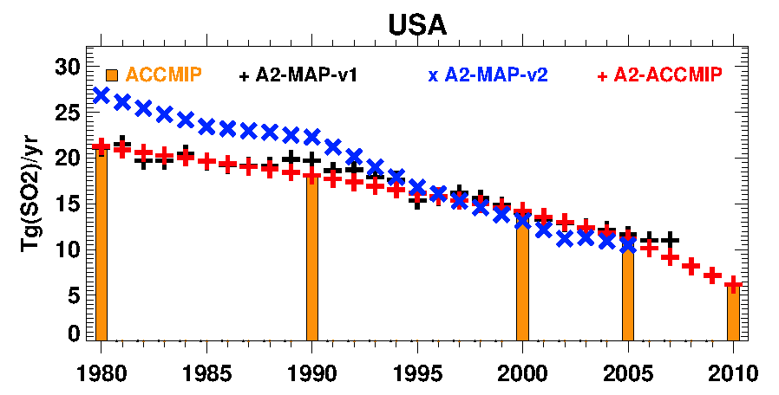
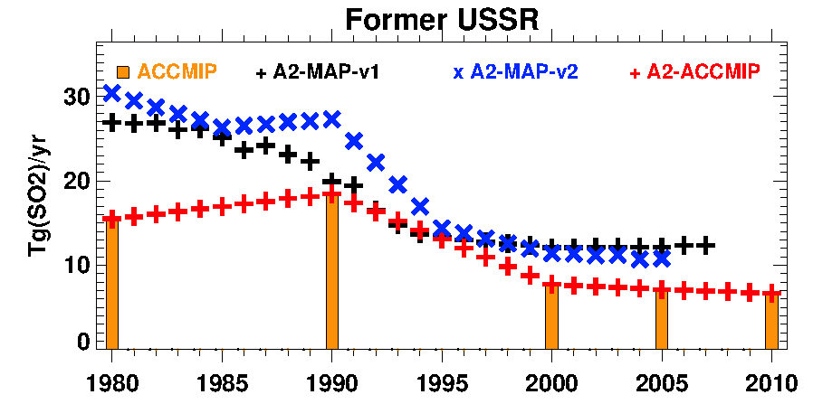
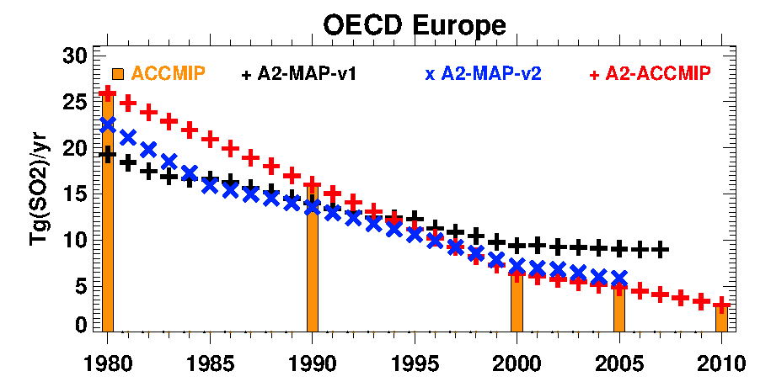
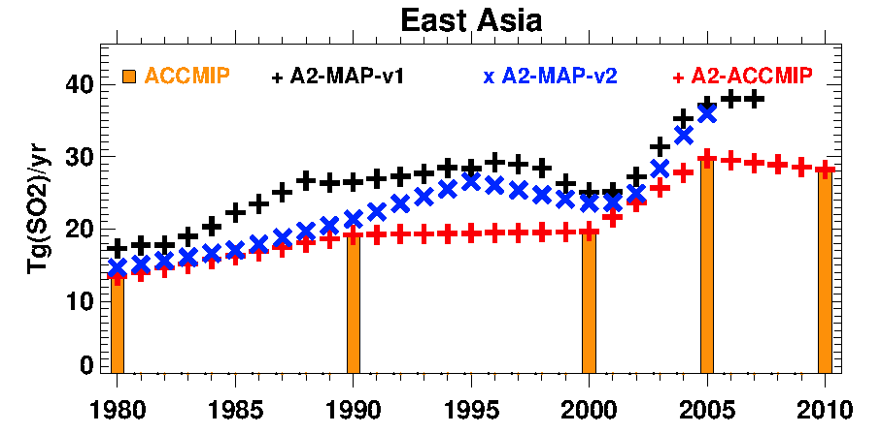
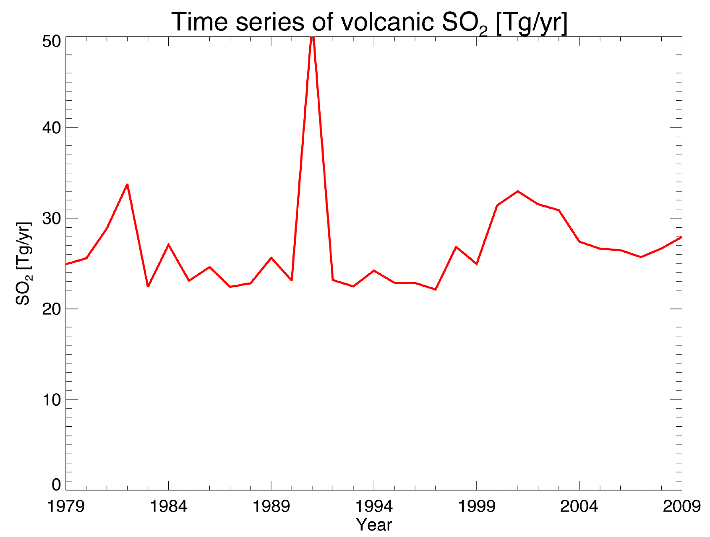
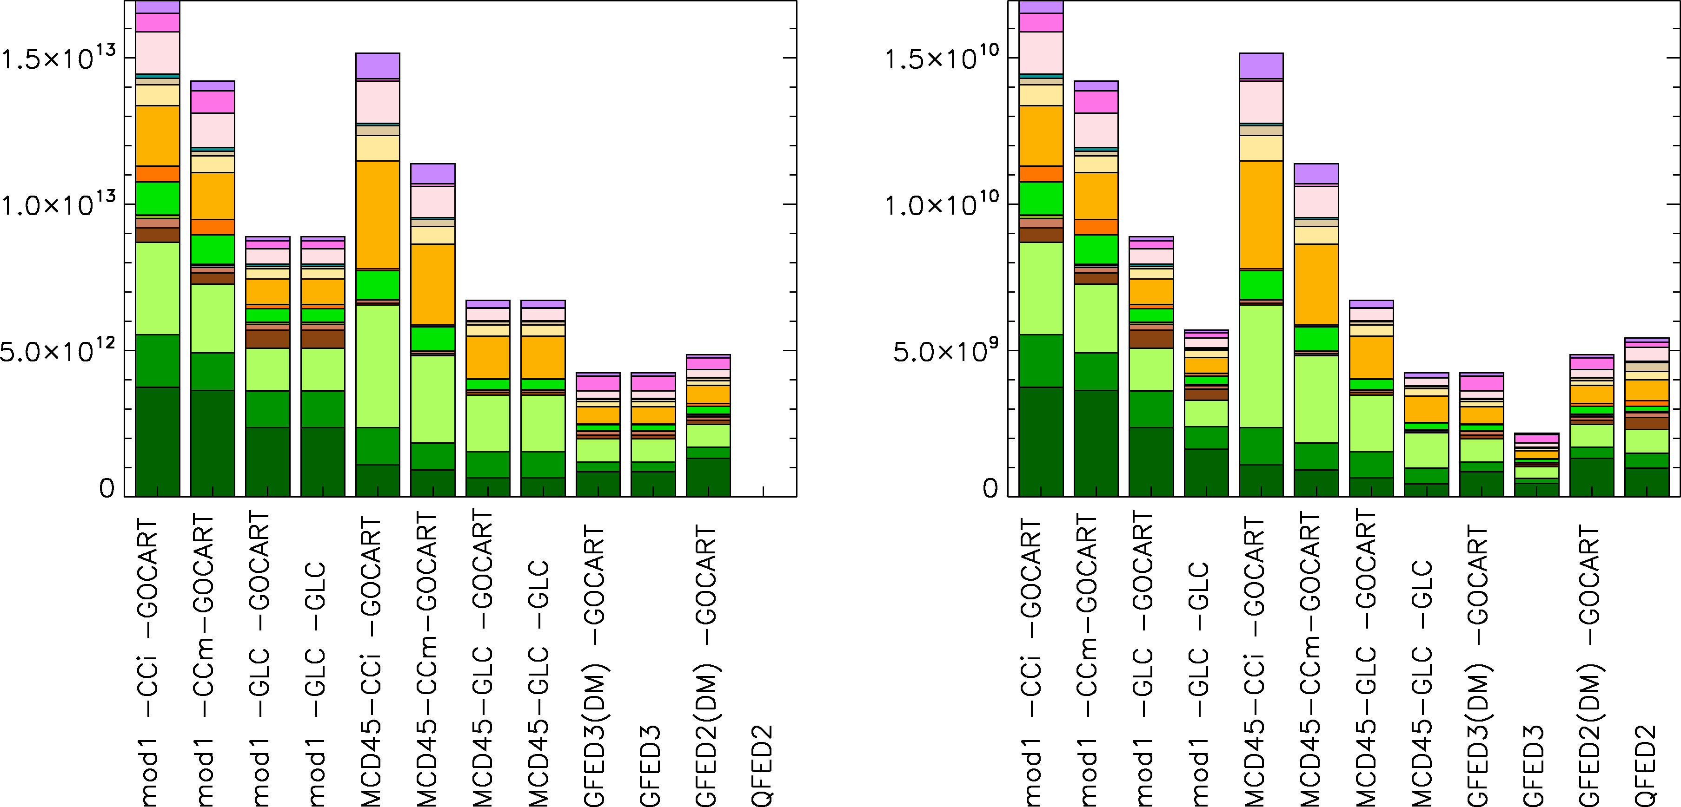
Updated emission inventories for hindcast runs (A2-ACCMIP)
A2-ACCMIP emissions derived from decadal ACCMIP emissions for latest hindcast ; A2-MAP emissions based on Streets et al. (BC, OC) and EDGAR 4.1 (SO2)
Volcanic emissions compiled from Smithsonian database, TOMS, OMI, and other sources
Anthropogenic inventories agree on general trends, but large differences for some years in some regions
Diehl et al. (2012)
Notes:
GOCART model was used as a testbed to test the performance of several biomass burning emission inventories. The method was also developed to use snapshots of satellite-measured aerosol optical depth to constrain bimoass burning emissions in the GOCART model. Ralph Kahn will provide additional insight into the method in his update later today. In a few words, if smoke emissions, aerosol processes and transport in the model resemble those happening in reality, a snapshot of AOD taken from the satellite should resemble total column AOD simulated by the model at the same time. This work discovered consistent regional performance of different biomass burning emission inventories in over- or underestimating MODIS AOD, and quantified the relationships between emission amounts and simulated AOD.

Slide 4
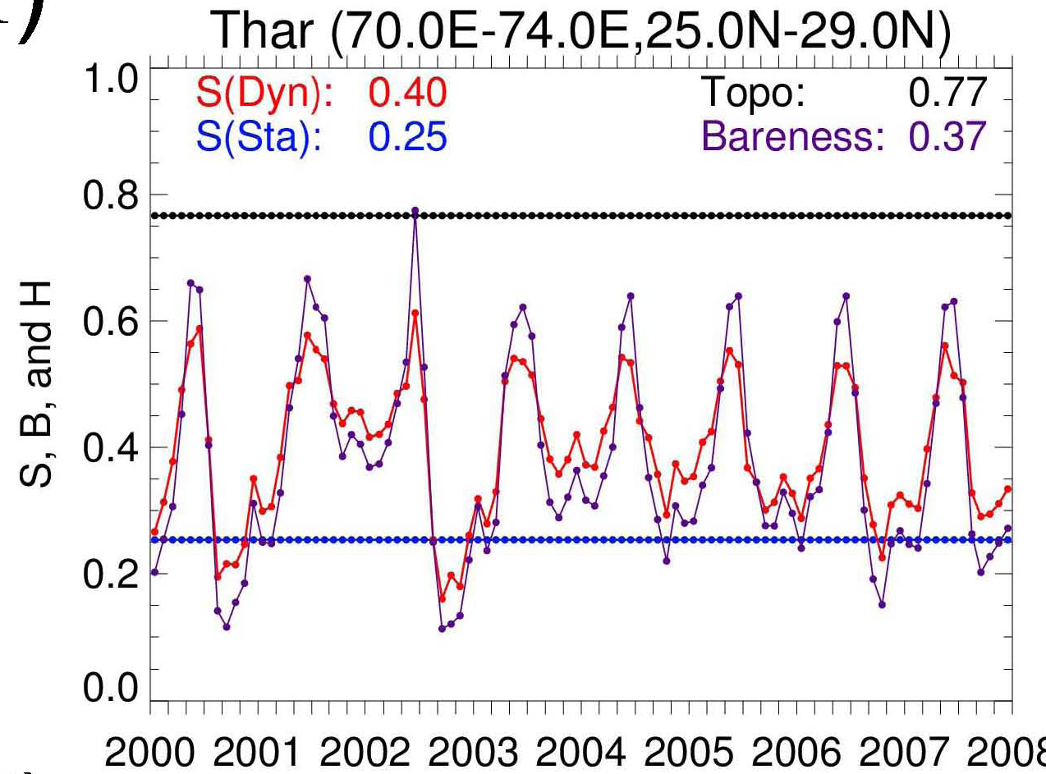
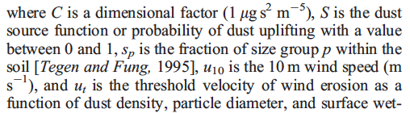
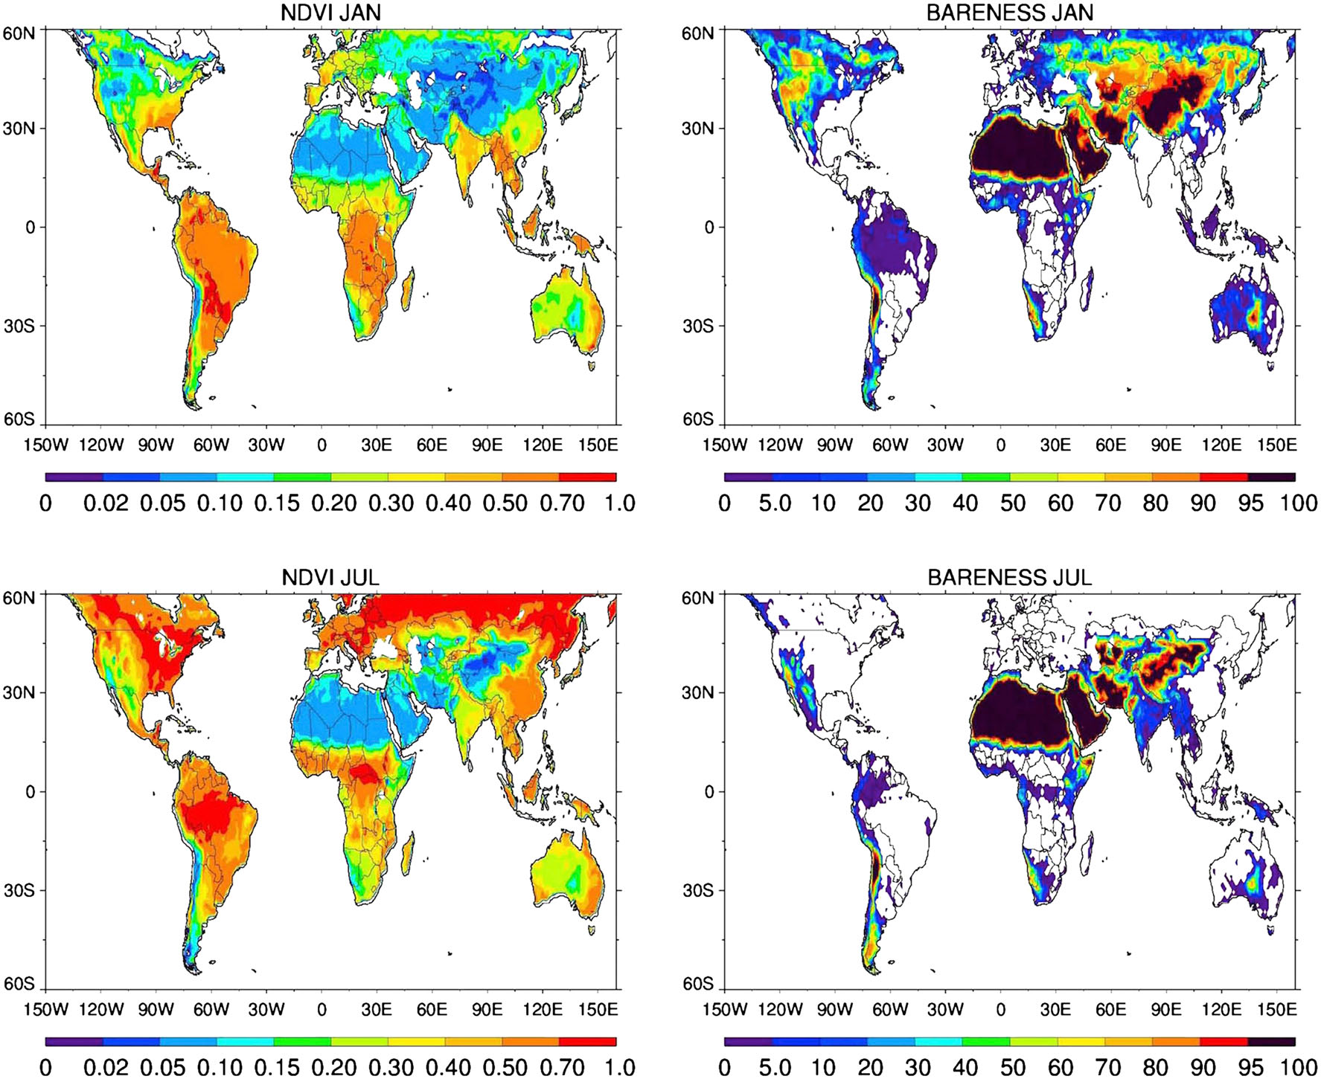
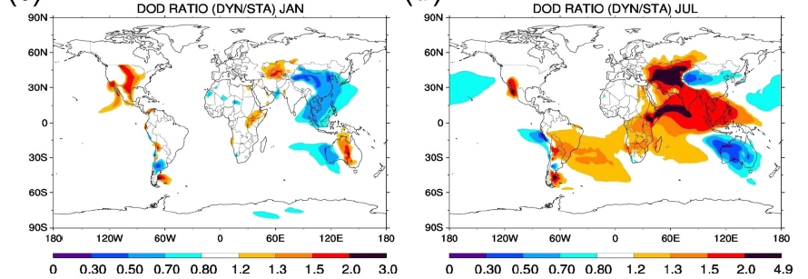
Development of the Dynamic Dust Source Function for GOCART
NDVI
A global dynamic source function has been developed for GOCART using the AVHRR-NDVI 8km.
One half of 22 analyzed deserts are seasonality in their bareness.
We found a clear and significant effect of the new dynamic dust source on seasonal variation of dust emission and dust optical depth near the source regions.
DOD Ratio (DYN/STA)
Kim et al. (2013)

Slide 5
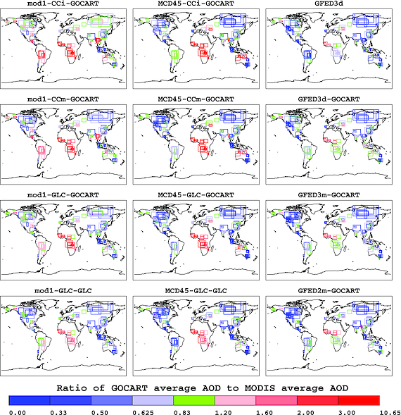
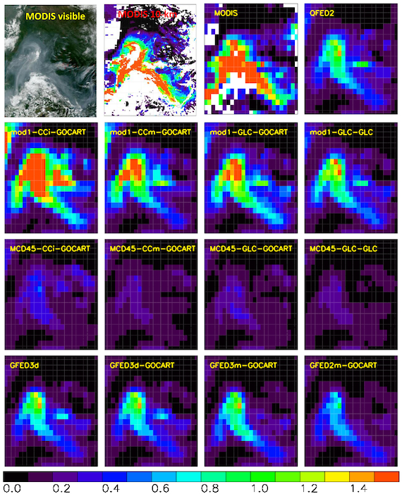
Using satellite AOD to constrain BB emissions in the GOCART model
1. Currently 13 biomass burning (BB) emission options are available
3. Regional dependency in AOD for different options against MODIS AOD using 124 fires
E(BB) = F x C x A
F=Emission factor
C=Fuel consumption
A= Area burned
: Different data sources (MODIS, GFED2, GFED3, CCi, GLC, etc..) result 13 different options!
2. A fire case study shows large diversity in AODs with MODIS AOD and GOCART simulations
This work shows consistent regional bias compared to MODIS AOD, depending on biomass burning emission options.
Future goal is to improve the agreement between modeled and observed biomass burning aerosol.
Petrenko et al. (2012)
Notes:
GOCART model was used as a testbed to test the performance of several biomass burning emission inventories. The method was also developed to use snapshots of satellite-measured aerosol optical depth to constrain bimoass burning emissions in the GOCART model. Ralph Kahn will provide additional insight into the method in his update later today. In a few words, if smoke emissions, aerosol processes and transport in the model resemble those happening in reality, a snapshot of AOD taken from the satellite should resemble total column AOD simulated by the model at the same time. This work discovered consistent regional performance of different biomass burning emission inventories in over- or underestimating MODIS AOD, and quantified the relationships between emission amounts and simulated AOD.

Slide 6
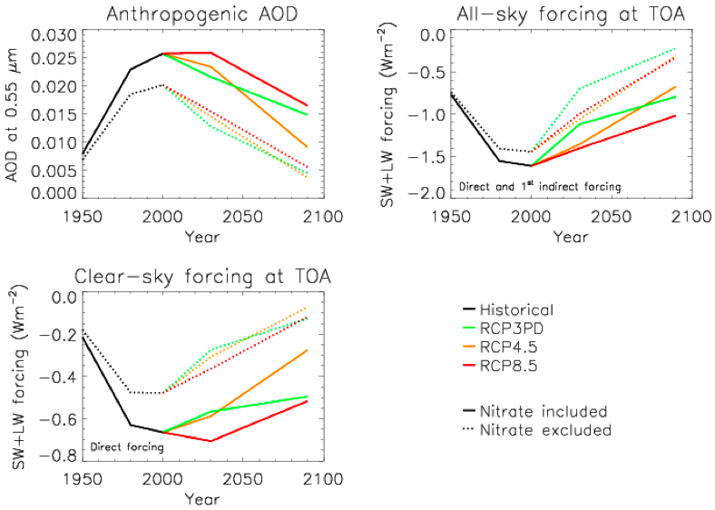
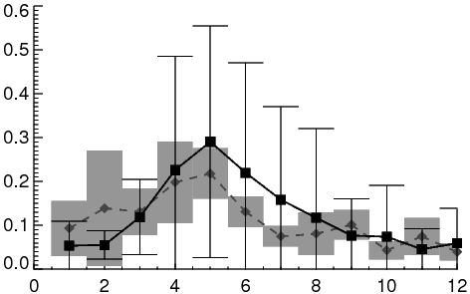
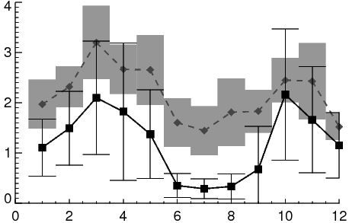
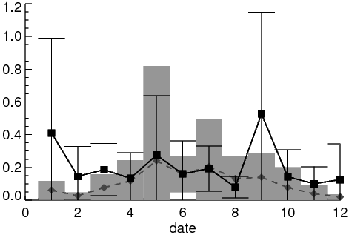
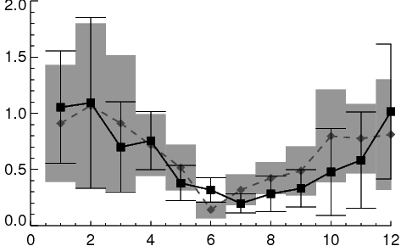
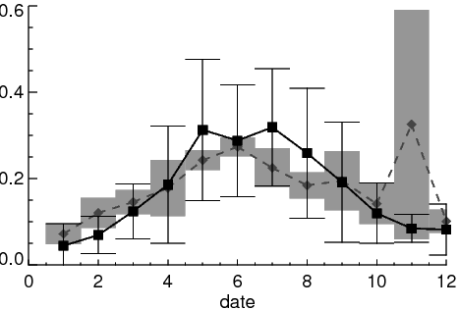
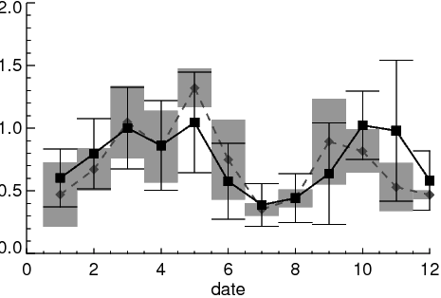
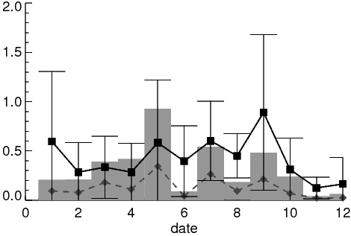
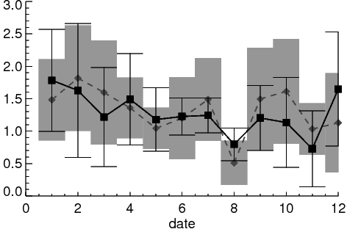
Modeling Nitrate in GMI and it will to be implemented to GEOS5-GOCART (1)
Clear – sky forcing at TOA
The nitrate contribution is substantial, about 1/4 to 1/3 to that of sulfate.
As other air pollutants are decreased nitrate will be more important in next century.
Model suggests stronger negative forcing in the next century due to the nitrate (Belluin et al., 2010).
NO3 and NH4 simulation: compare with surface measurement in US and Europe
39.0N, 107.0W
27.8N, 80.5W
62.5N, 8.5E
42.6N, 12.3E
NO3a [μgN/m³]
NH4a [μgN/m³]
Bian et al. (2013)
Notes:
According to recent multi-model studies organized by Aerocom phase II activity, the nitrate contribution is about ¼ to 1/3 to that of sulfate and its contribution is comparible or even larger than some other major aerosol components for the present day aerosol loading, AOD, and RF. Most of all, nitrate study becomes more important for climate study. According to the CMIP future emission projection shown in the upper panel, future SO2 emission will drop dramatically, while NOx, precursors of nitrate, doesn’t drop as deep as that of SO2. In the meanwhile, NH3 will even increase due to future population growth. So in relative to sulfate, nitrate will become more important in the future.
An example using the CMIP emissions for aerosol radiative forcing changed over 1950 to 2090 was performed by Nicolas et all using Hadley model shown in the bottom panel. To highlight the impact of nitrate, the simulation was performed by with and without nitrate. The clear sky direct + 1st indirect forcing peak in the early 21st century before decreasing. The addition of nitrate slows down the rate of decrease: the forcing is 2 to 4 times stronger in 2090 with nitrate included, depending on scenario. So for climate study, we do care about nitrate.

Slide 7
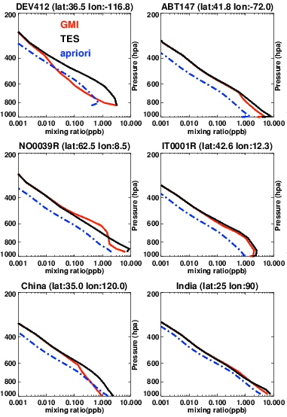
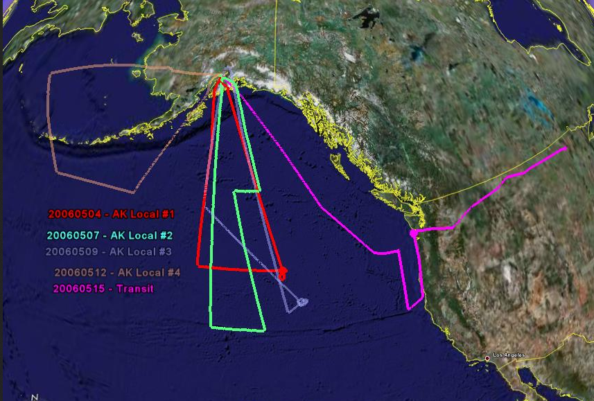
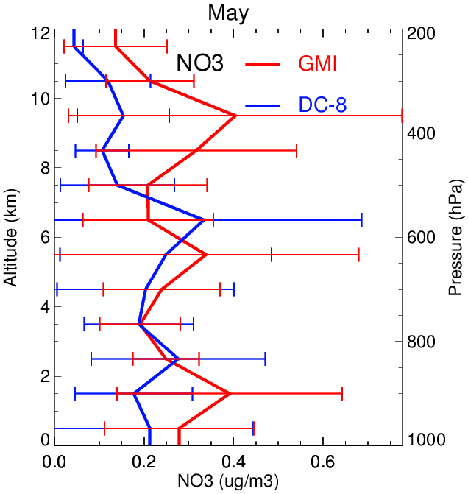
Modeling Nitrate in GMI and it will to be implemented to GEOS5-GOCART (2)
Compare with aircraft measurements
(INTEX-B Anchorage, Alaska campaign during May, 2006)
Vertical profile of NH3 from TES & GMI (annual mean in 2006)
Bian et al. (2013)
Notes:
We also compare our model simulation with aircraft measurements. Here we show model-aircraft comparison for INTEX-B Anchorage, Alaska campaign during May, 2006. The left top panel shows the aircraft flight tracks for this campaign for totally 5 flights. The left bottom two plots show the comparison for so4 and no3. The model results are comparable with measurements but the model seems overestimate both so4 and no3 at high altitudes.
The NH3 vertical profiles compared between the model simulation and TES retrieval is shown in the right column over two NA stations, 2 EU stations and 1 over China and 1 over India. The dot-dash blue line is the used a priori data provided by GEOS-CHEM model. The TES data is shown in black line and GMI profile is in red line. The model vertical profiles are reprocessed using the a priori and TES averaging kernel. The a priori provided by GEOS-CHEM are for three regimes: polluted, moderated polluted, and unpolluted. The largest NH3 concentration occurs near surface and the concentration decrease rapidly as altitude increases. GMI results are more close to TES estimates than to a priori in most cases but generally and GMI results are lower than TES estimates.

Slide 8
Contents
Emission
  Update of emission inventories for hindcast runs (A2-MAP) (T. Diehl et al.)
  Development of the dynamic dust source function for GOCART (D. Kim et al.)
  Constrain BB emission in GOCART using satellite AOD (M. M. Petrenko et al.)
Development
  Modeling nitrate in GMI and GOCART (H. Bian et al.)
Scientific Applications
  Multi-decadal variations of aerosol (M. Chin., T. Diehl et al.)
  Volcanic and anthropo. contributions to stratospheric aerosol (M. Chin, T. Diehl et al.)
  GOCART and GMI models participated in HTAP source-receptor experiments to assess the role of intercontinental transport (H. Yu et al.)
  Comparisons between models and observations for transatlantic dust (D. Kim et al.)
  Evaluation of multi-model aerosol over South Asia (X. Pan et al.)

Slide 9
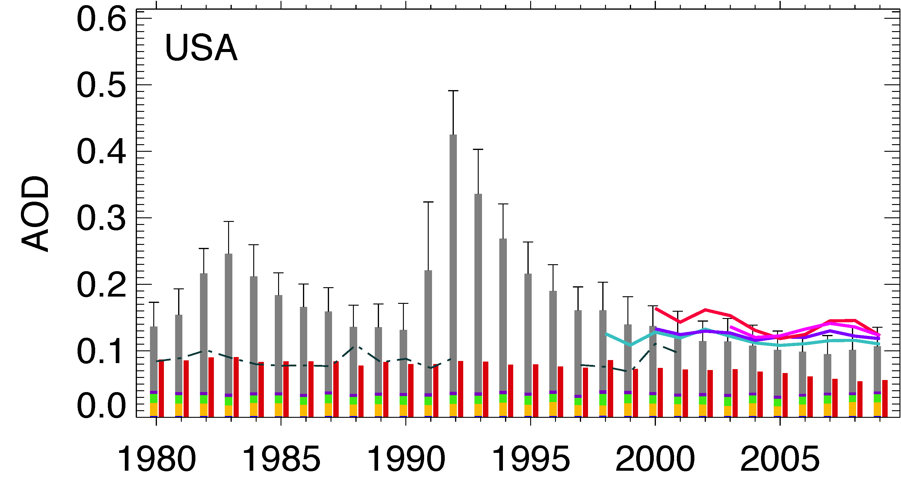
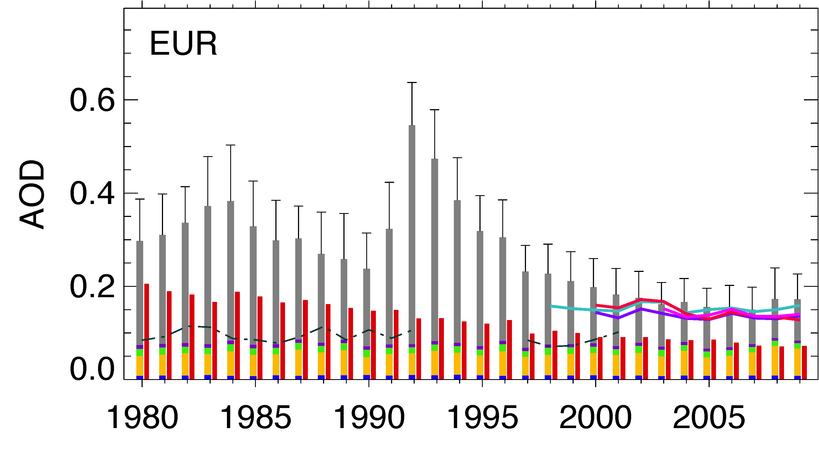
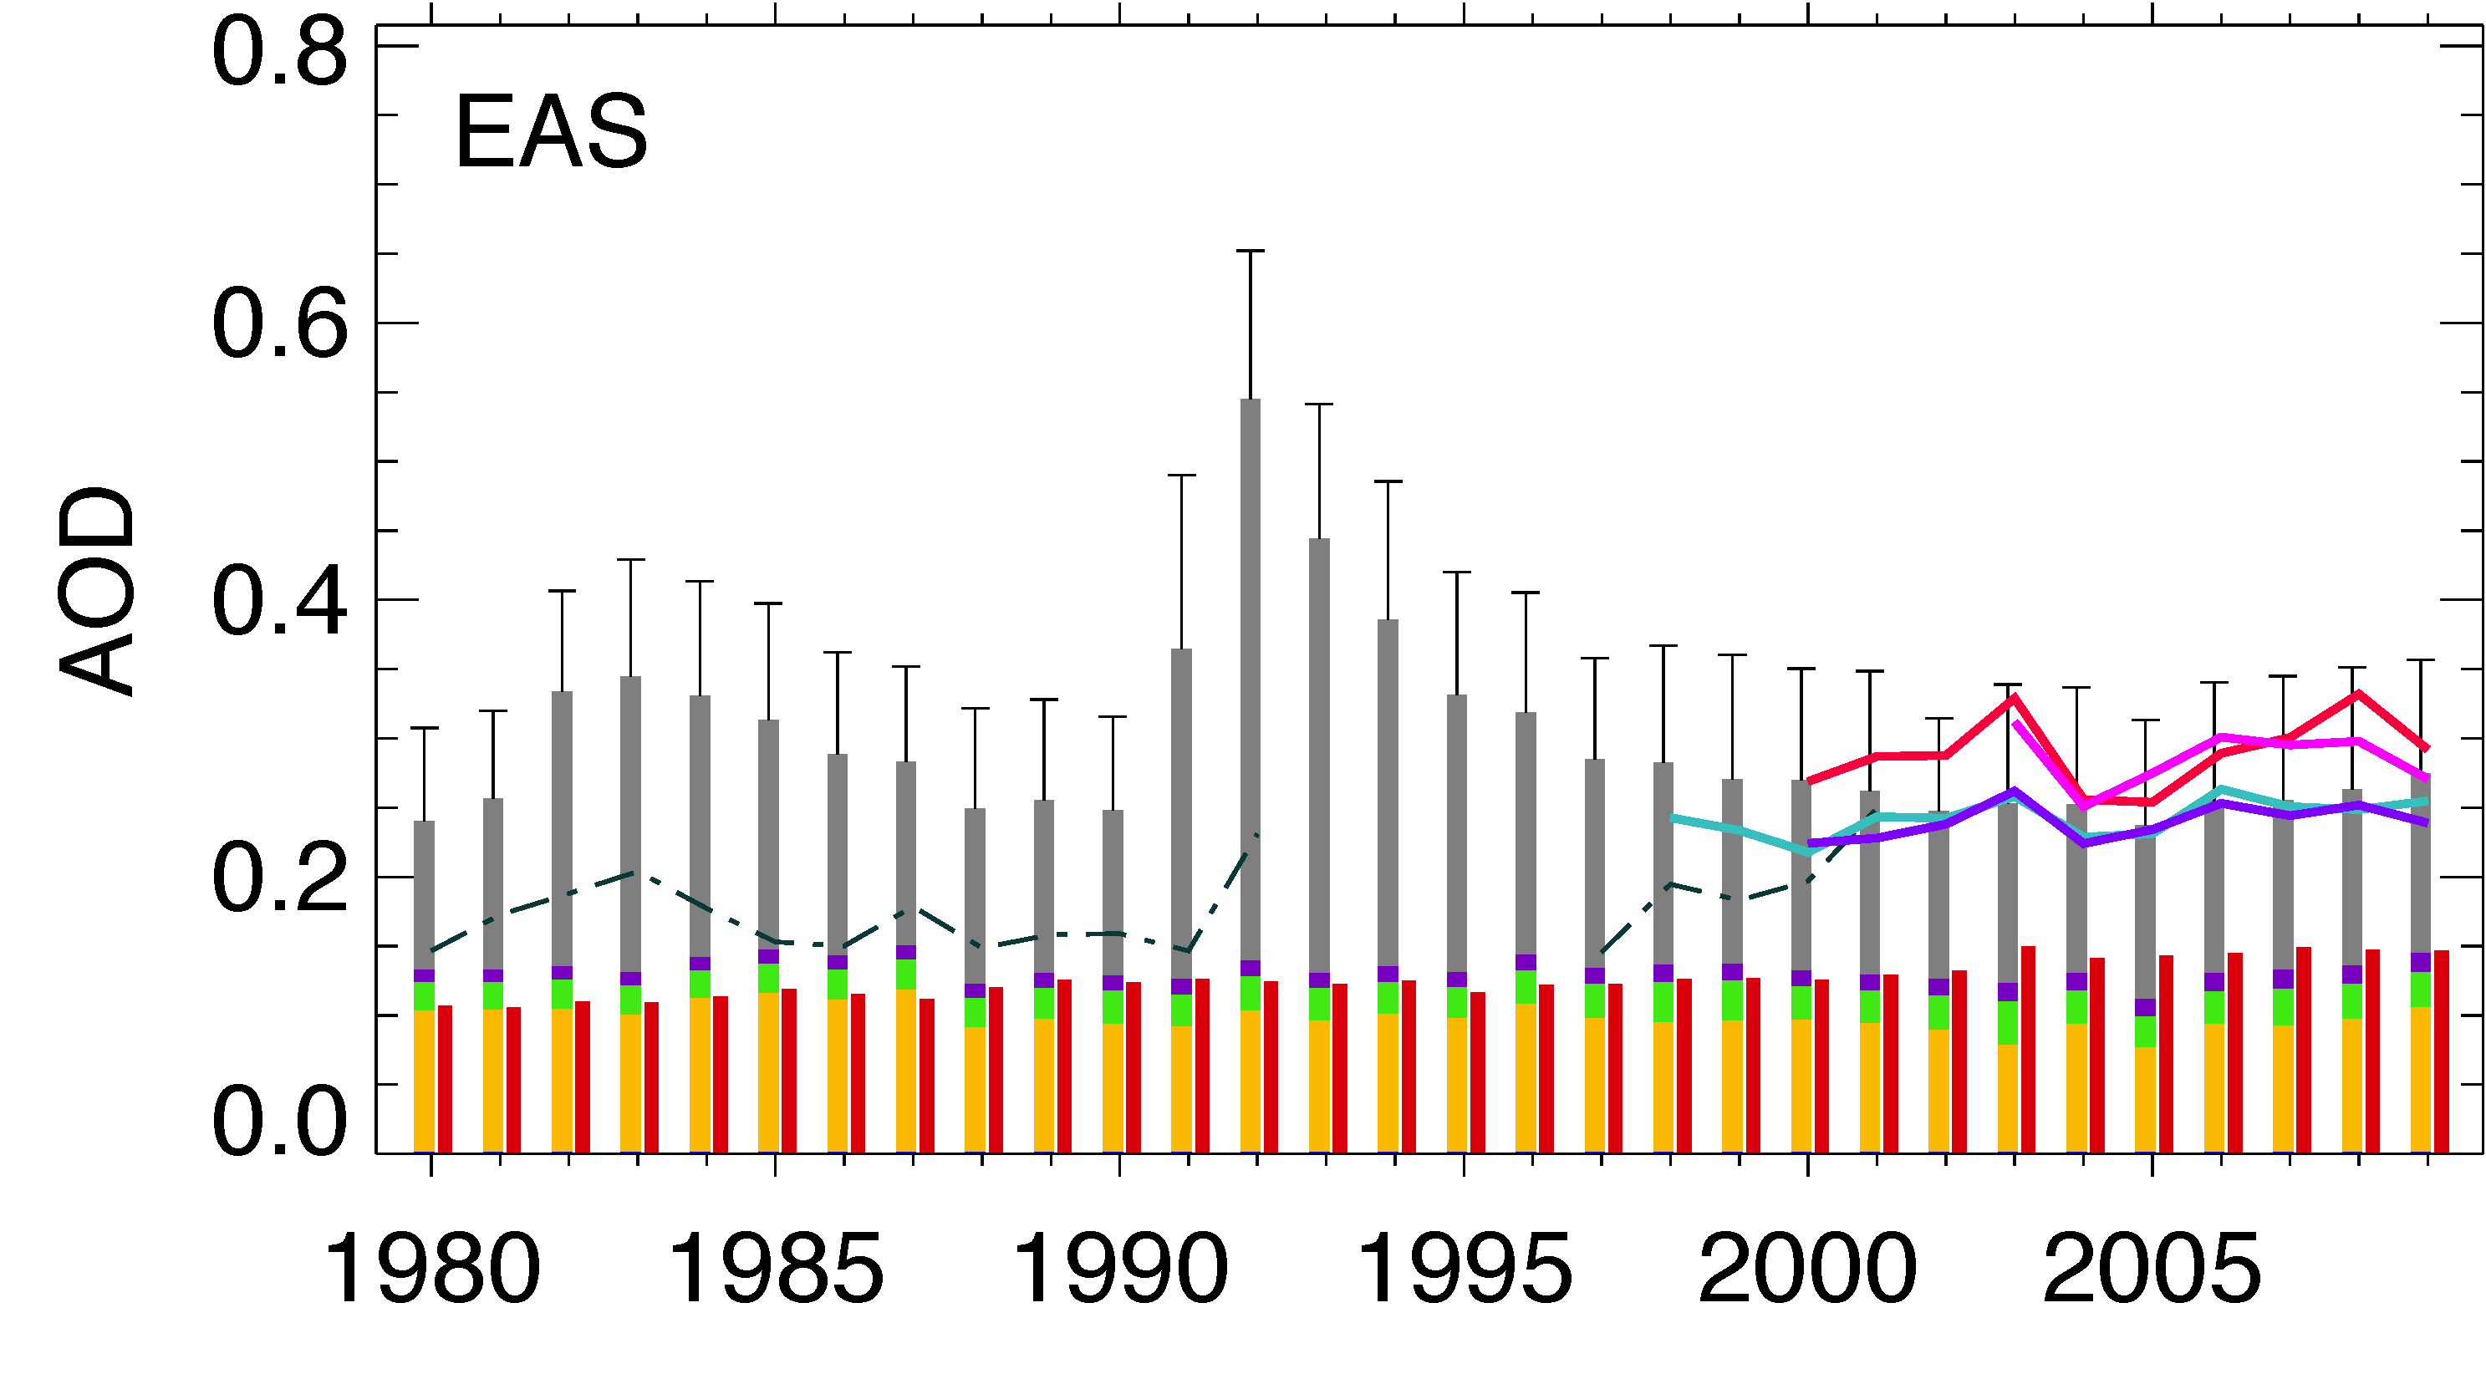
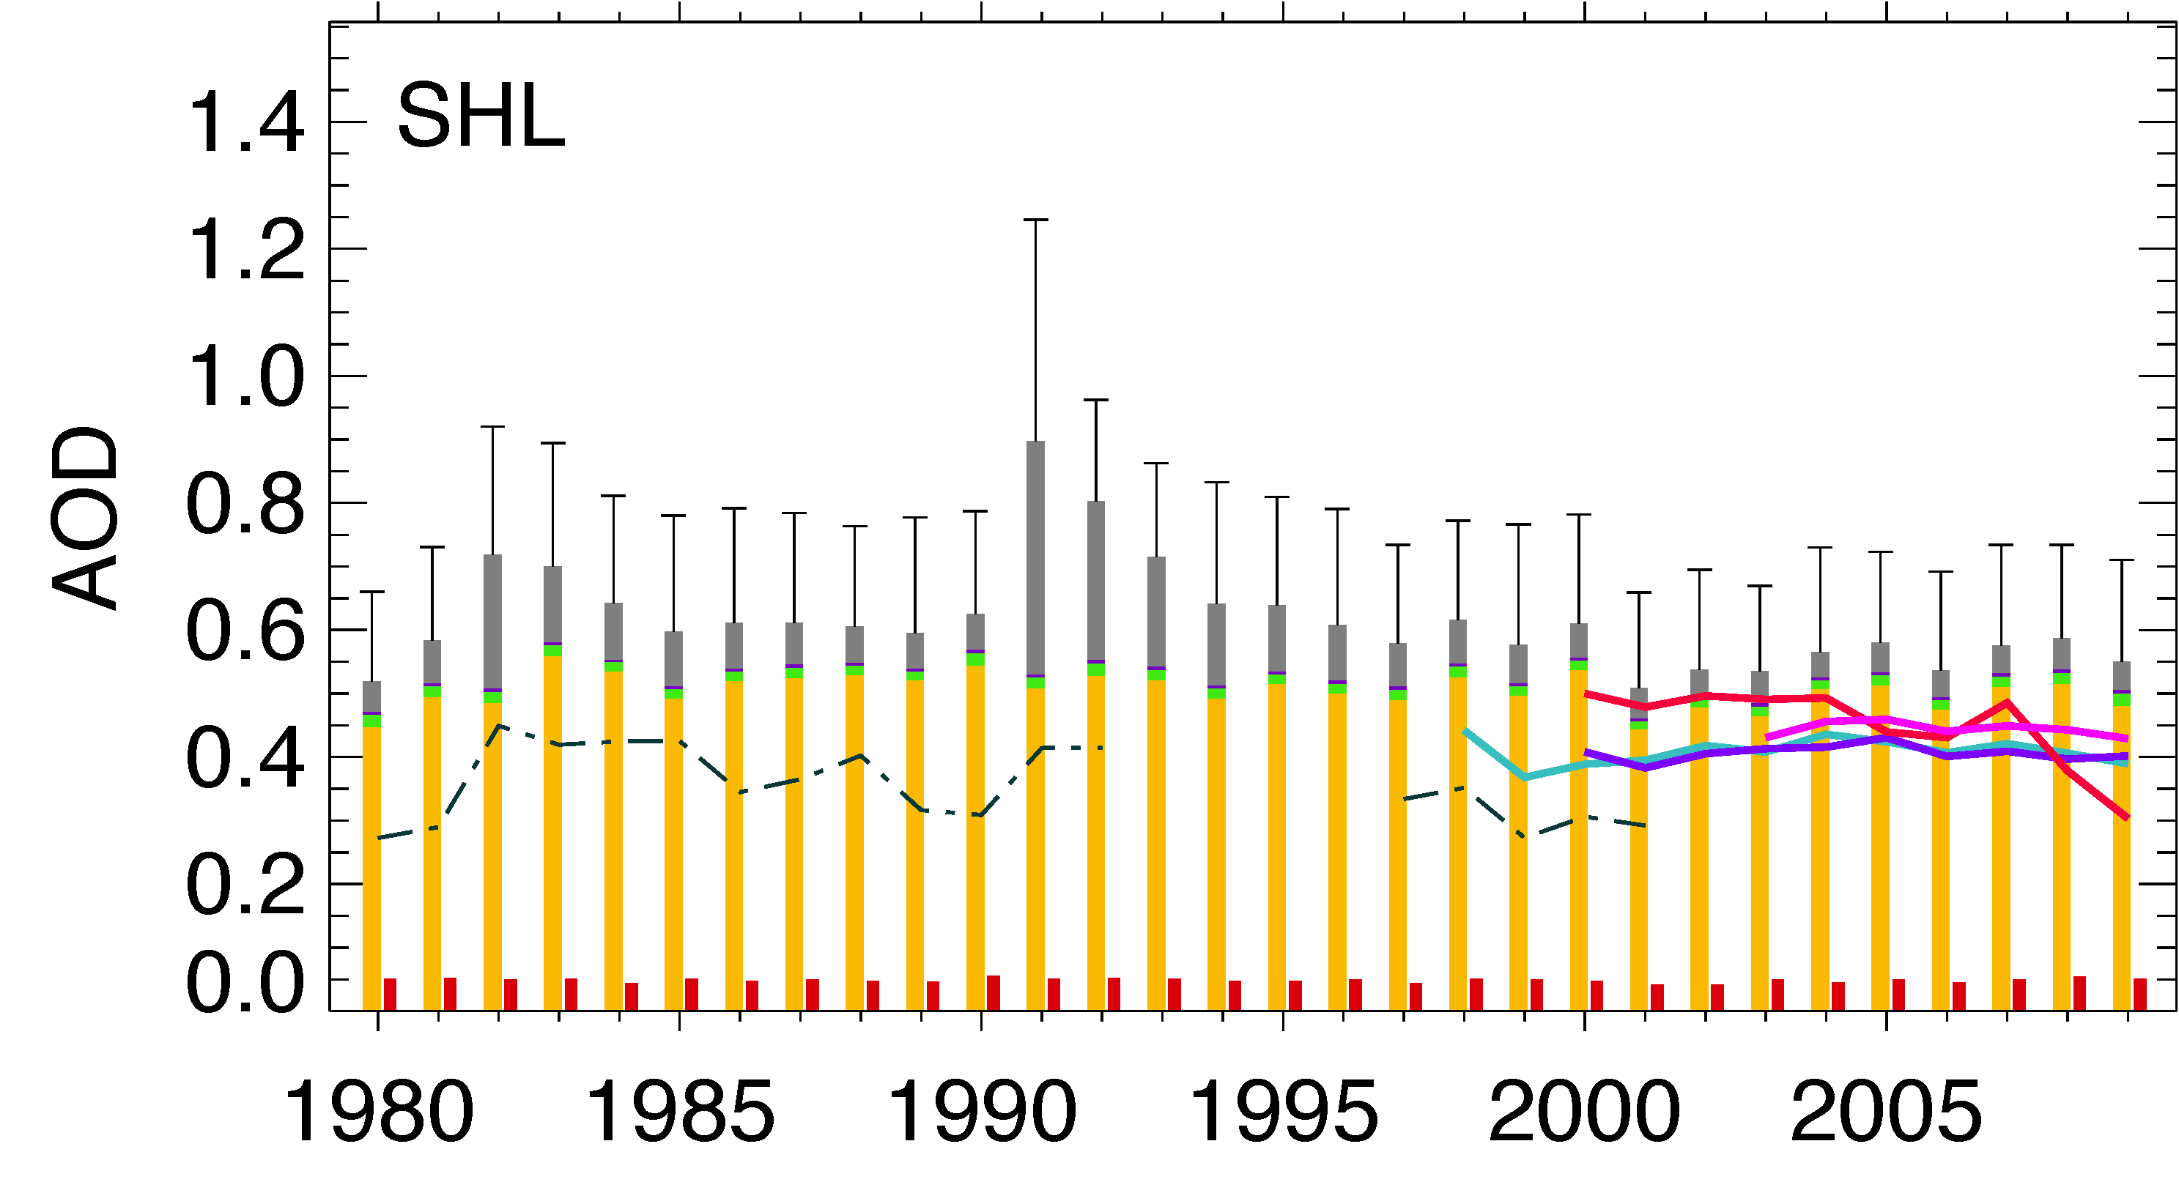
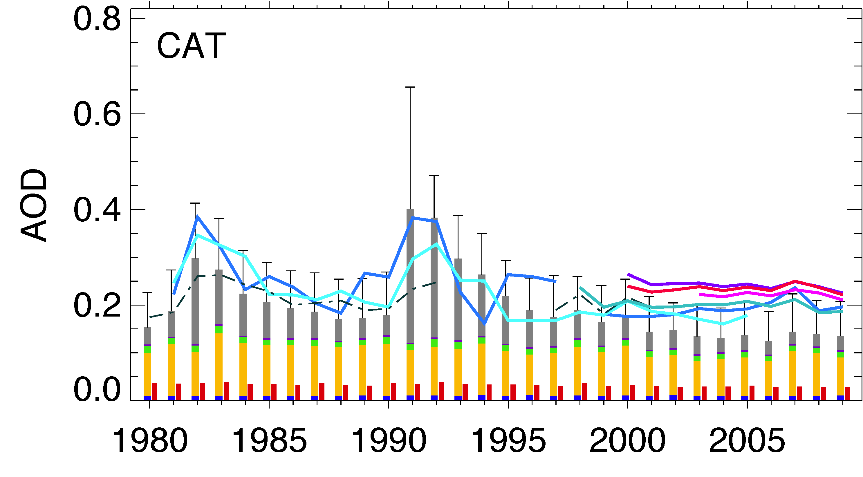
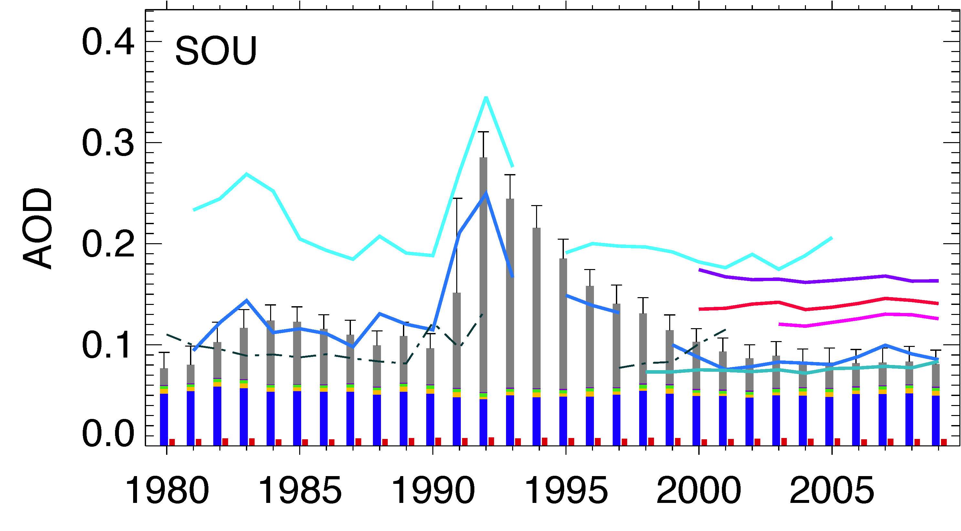
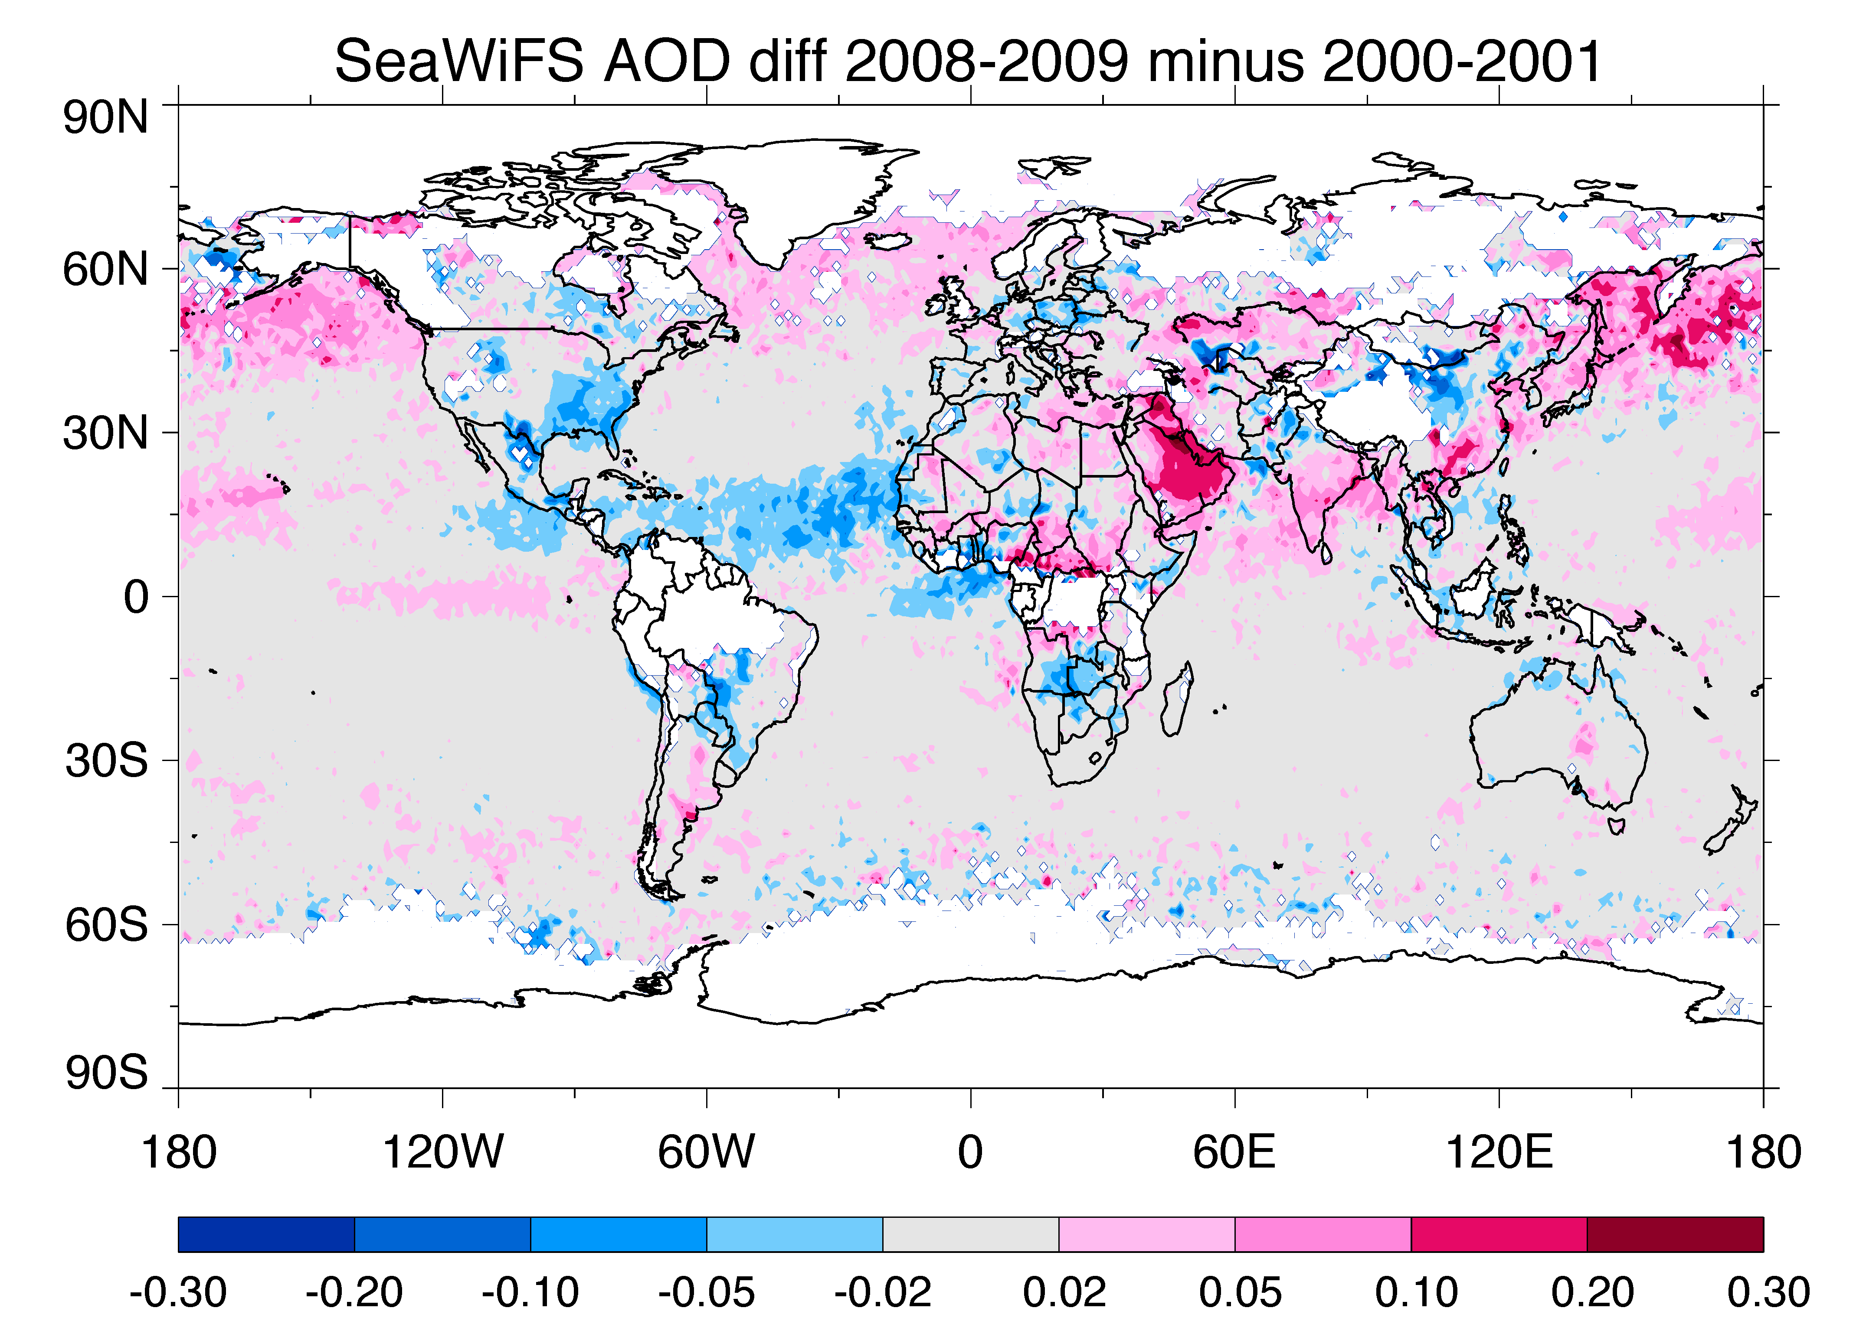
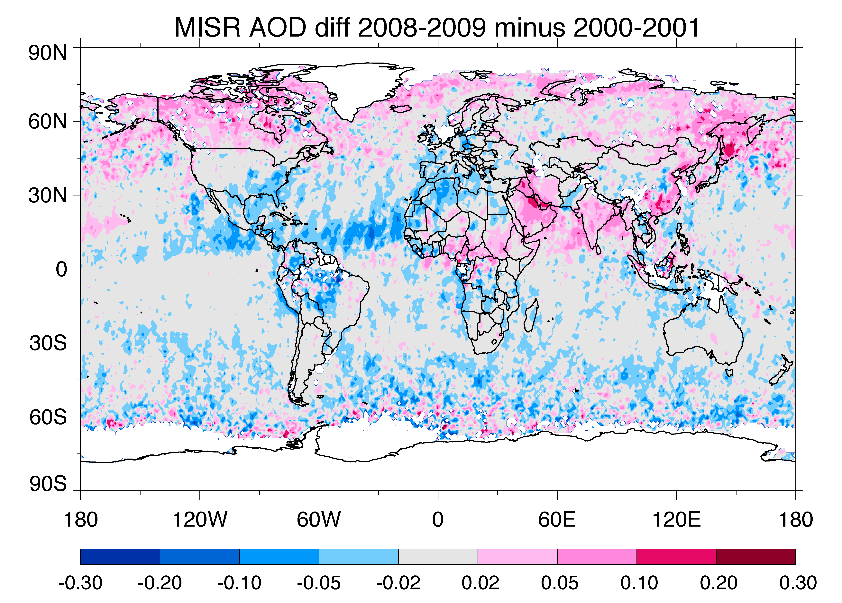
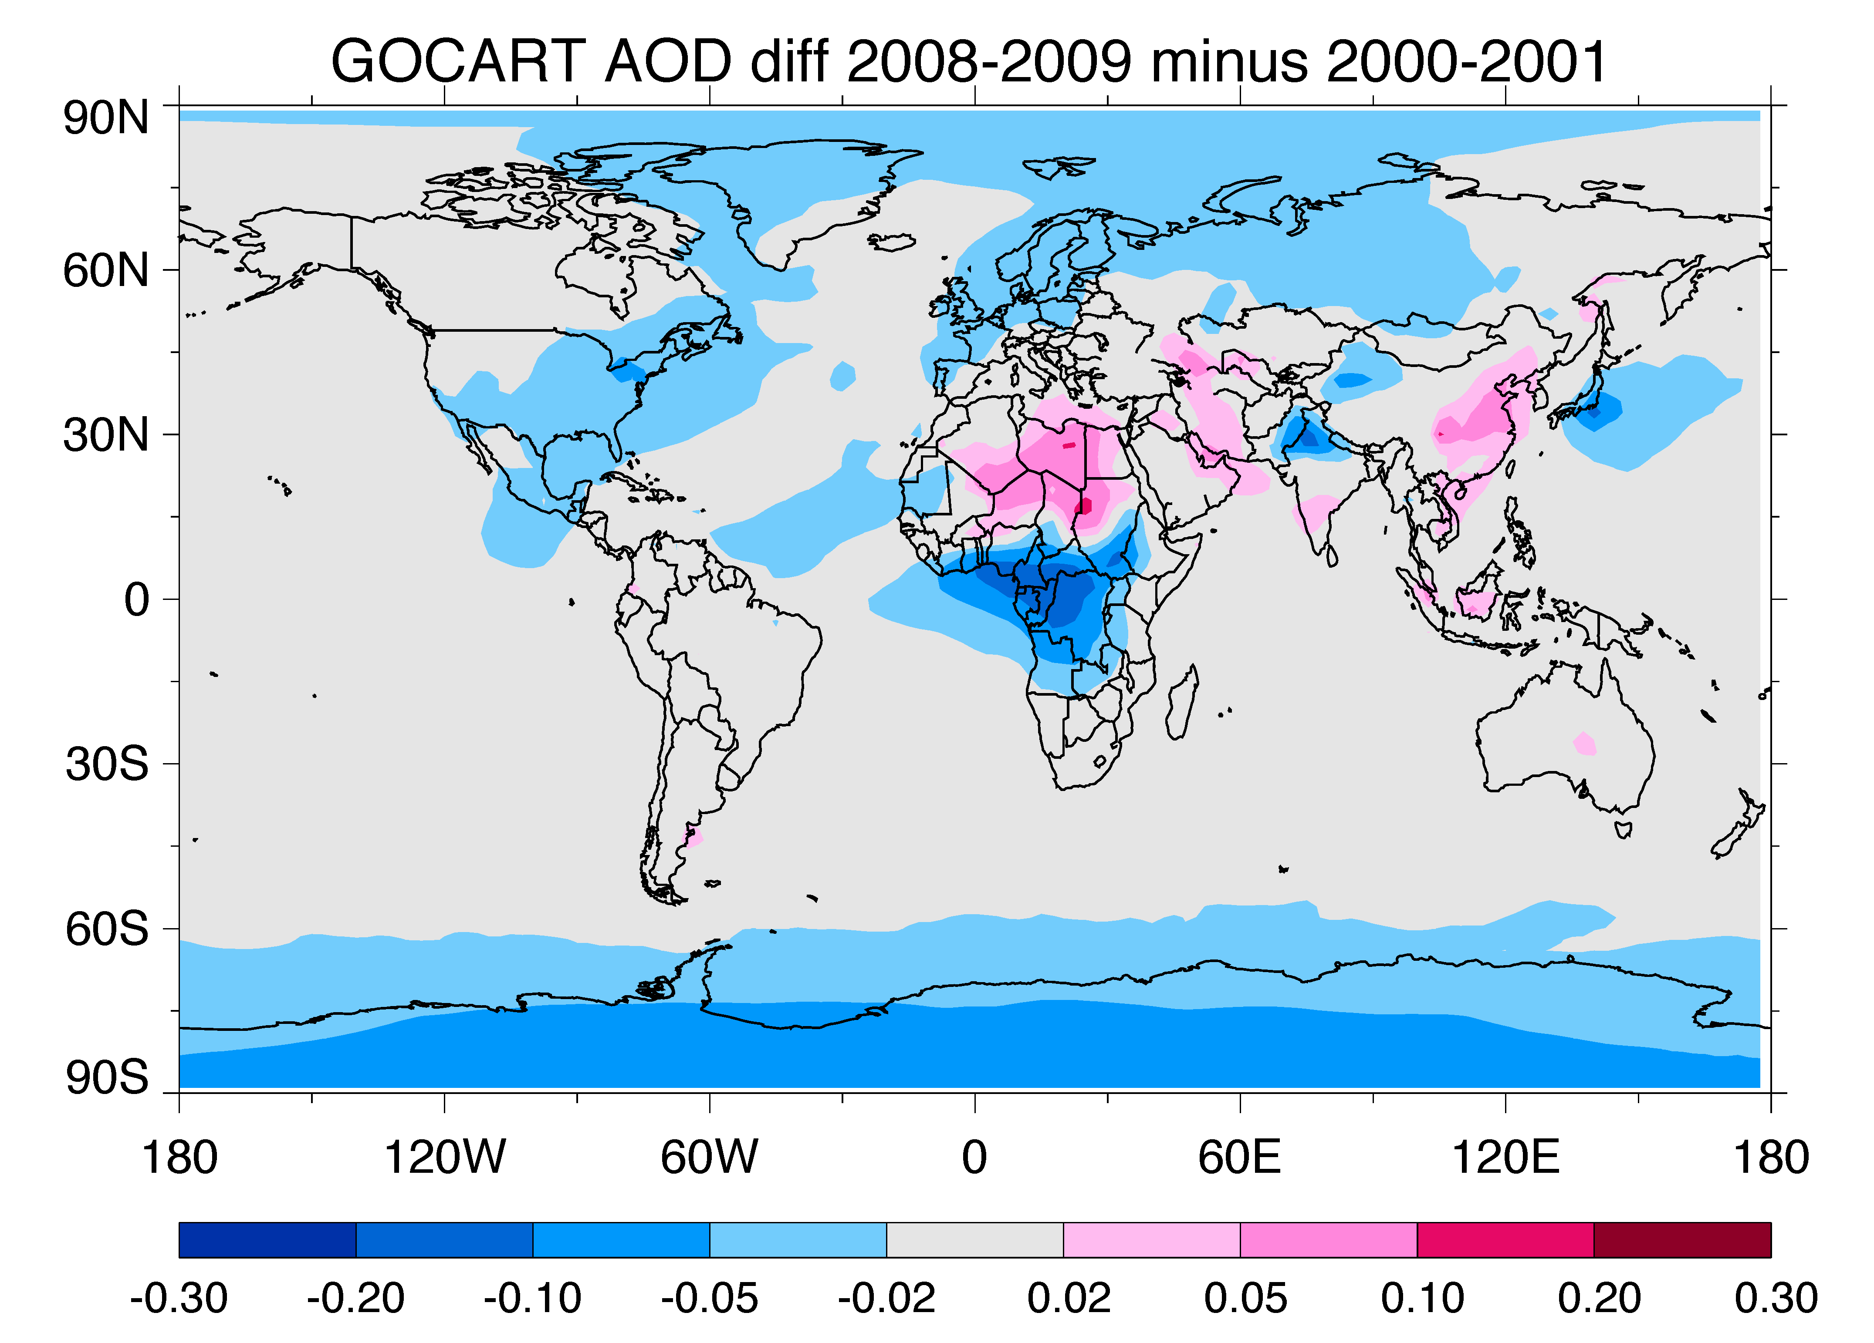
Multi-decadal variations of aerosols from 1980 to 2009: Global and regional trends
Annual AOD variations from 1980 to 2009 – Model and Satellites
Polluted Region
- Anthrop.
USA
(1)
Europe
(2)
E. Asia
(3)
Remote
Region
- Natural
Sahel
(4)
Cent. Atlantic
(5)
S. Ocean
(6)
TOMS
AVHRR-CDR
AVHRR-GACP
SeaWiFS
MISR
MODIS-Terra
MODIS-Aqua
SS DU OM BC SU
FF+BB
GOCART
Aerosol emission & AOD have been greatly changed over different regions in period.
Differences in AOD: (2008-2009) minus (2000-2001)
SeaWiFS
MISR
GOCART
(a)
(b)
(c)
The aerosol trends over polluted regions are controlled by emissions, but over remote regions they are also controlled by climate variability.
Chin et al. (2013)
Notes:
Motivation:
It is important to know where aerosols are and how they change over time to assess their effects in the present time and in the future.
Emission:
It has changed a lot. For example, fossil fuel SO₂ emissions in USA and Europe have decreased by a factor of more than 2 and 4, respectively, in the last three decades, but have increased by the same magnitude in East Asia and South Asia respectively. In addition, aerosols are generated from natural sources, such as deserts, volcanic eruptions, and wild fires.
AOD:
Having incorporated those emission changes and utilizing GOCART with the reanalysis meteorological fields from MERRA, this work concludes that the aerosol trends over polluted regions are controlled by emissions, but over remote regions they are also controlled by climate variabilities.

Slide 10
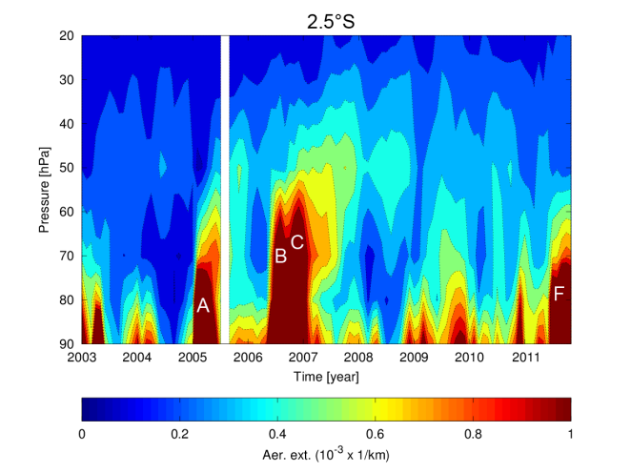
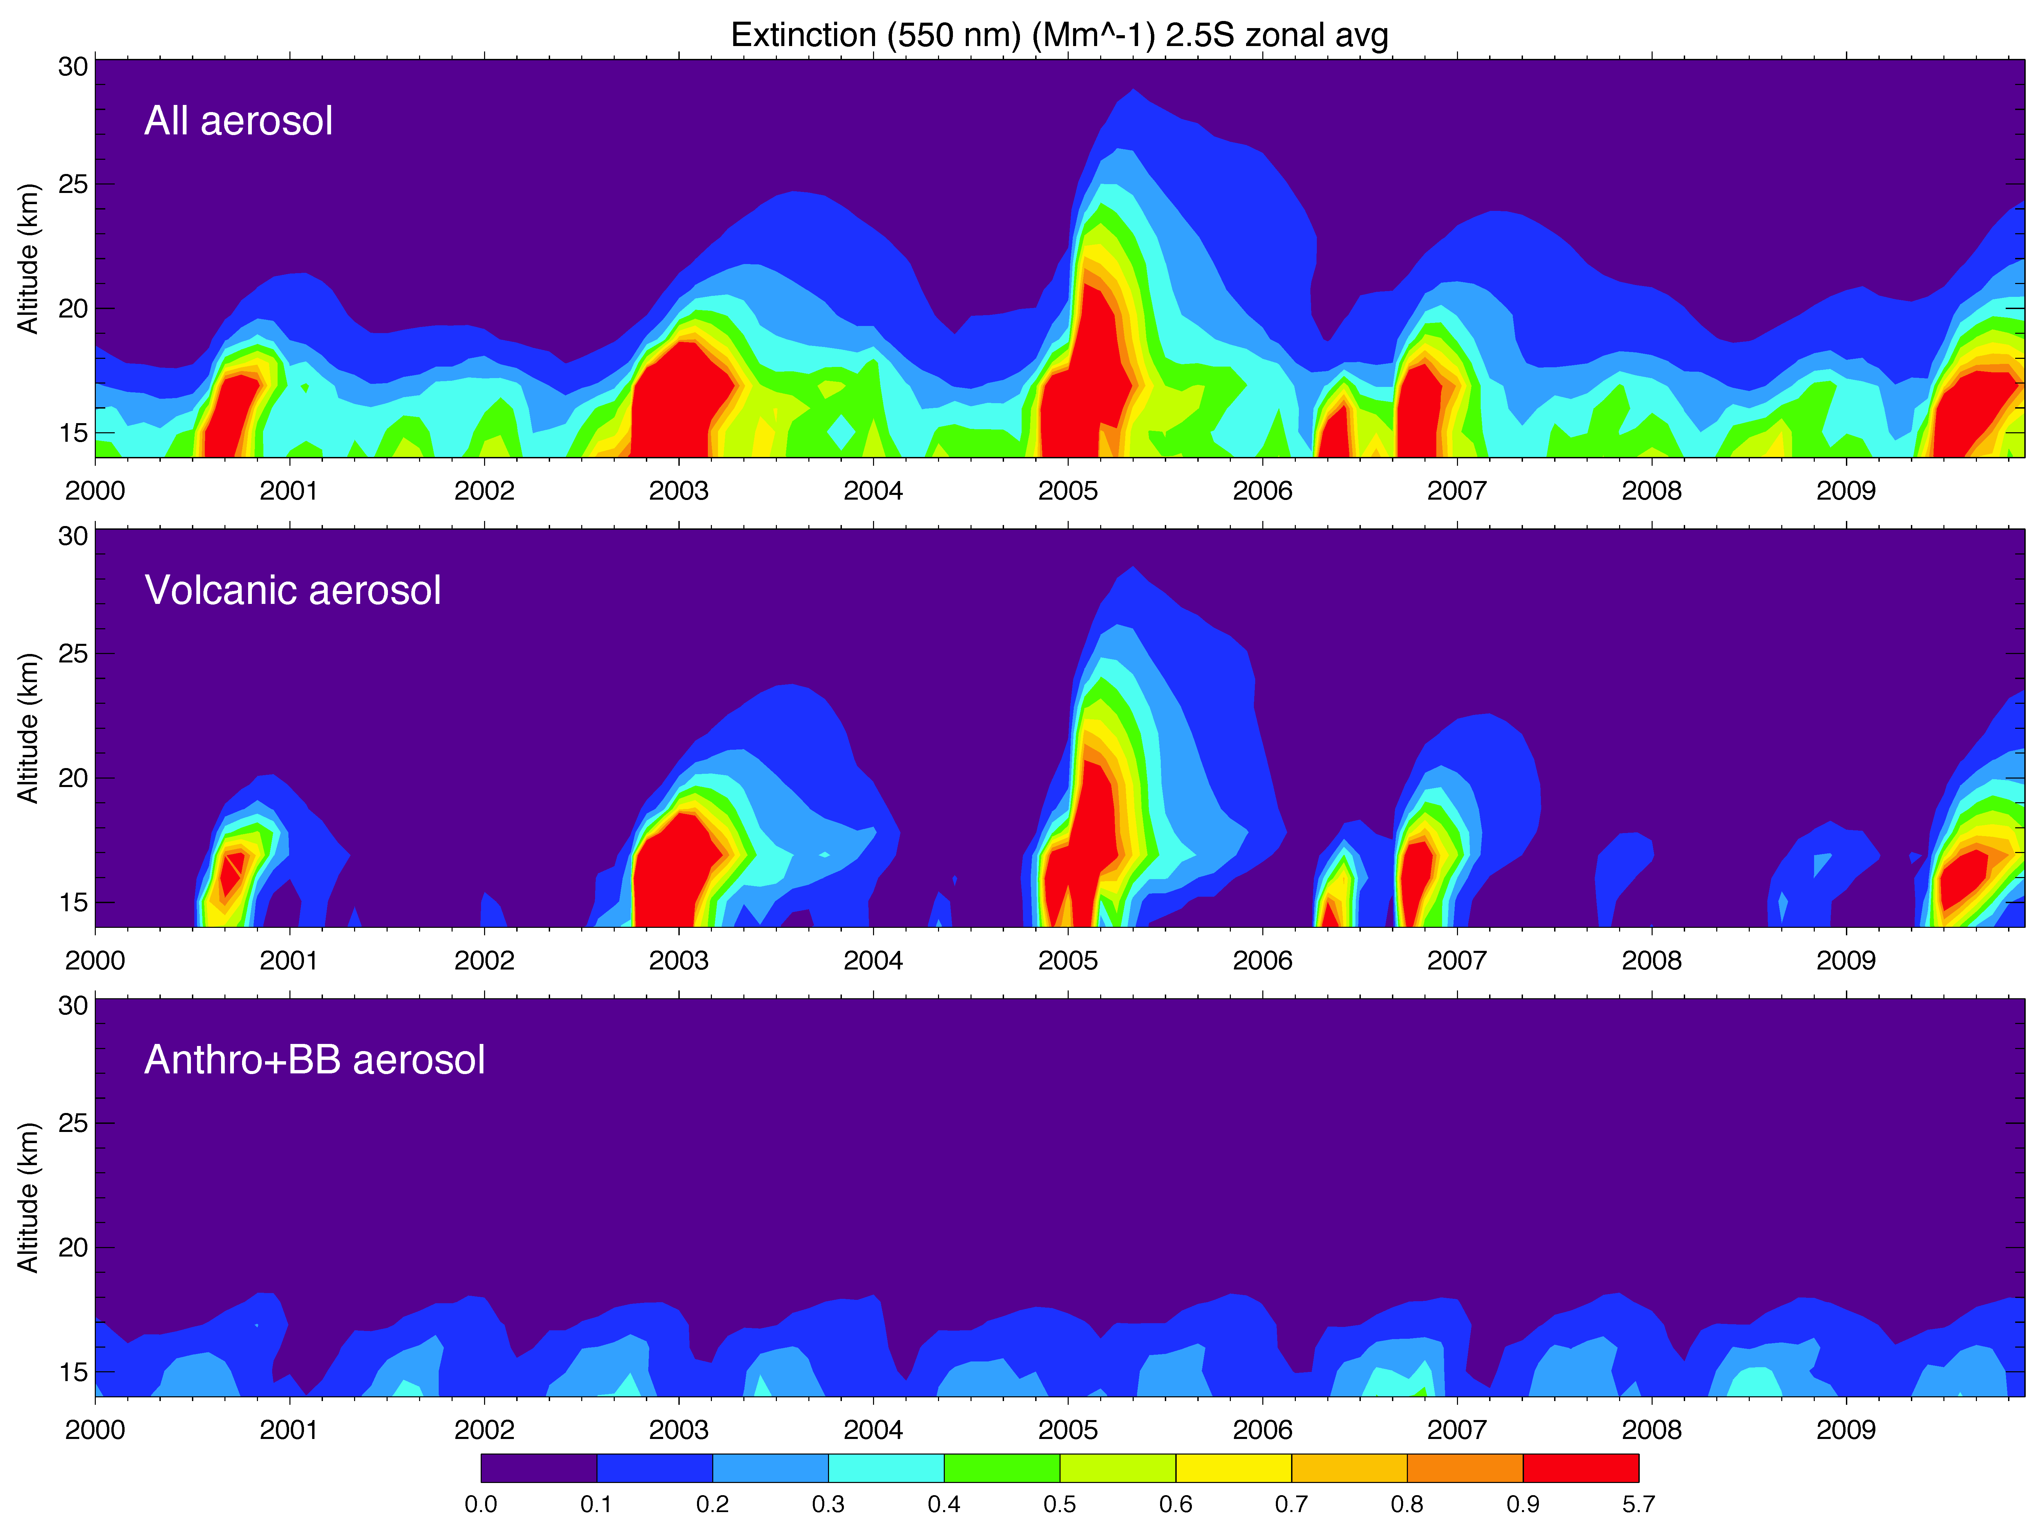
Volcanic and anthropogenic contributions to stratospheric aerosol trends
Stratospheric aerosol extinction vertical profiles (2.5S)
25 km
SCIAMACHY
SCIAMACHY
20 km
C
A
B
D
16 km
Time series of zonal and monthly averaged extinction
Major volcanic eruptions:
A. Manam (Jan 2005, 4°S)
B. Soufriere Hills (May 2006, 16°N)
C. Tavurvur (Oct 2006, 4°S)
D. Sarychev Peak (July 2009, 48°N)
GOCART - all
GOCART total
GOCART - volcano
GOCART Volcanic
GOCART - FF+BB
GOCART FF+BB
2000
2009
Without major explosive volcanic eruptions (i.e., at the magnitude of El Chichon or Pinatubo), numerous volcanic eruptions frequently perturb the stratospheric “background” aerosols.
The model suggests that the increase of Asia pollution contribute to the stratospheric aerosol, but they are mostly confined in the lower stratosphere with organized seasonal cycles and is much less than volcanic aerosols.
Chin et al. (AMS meeting)
Notes:
The model suggests that the increase of Asia pollution does contribute to the stratospheric aerosol, but they are mostly confined in the lower stratosphere with organized seasonal cycles and is much less than volcanic aerosols.

Slide 11
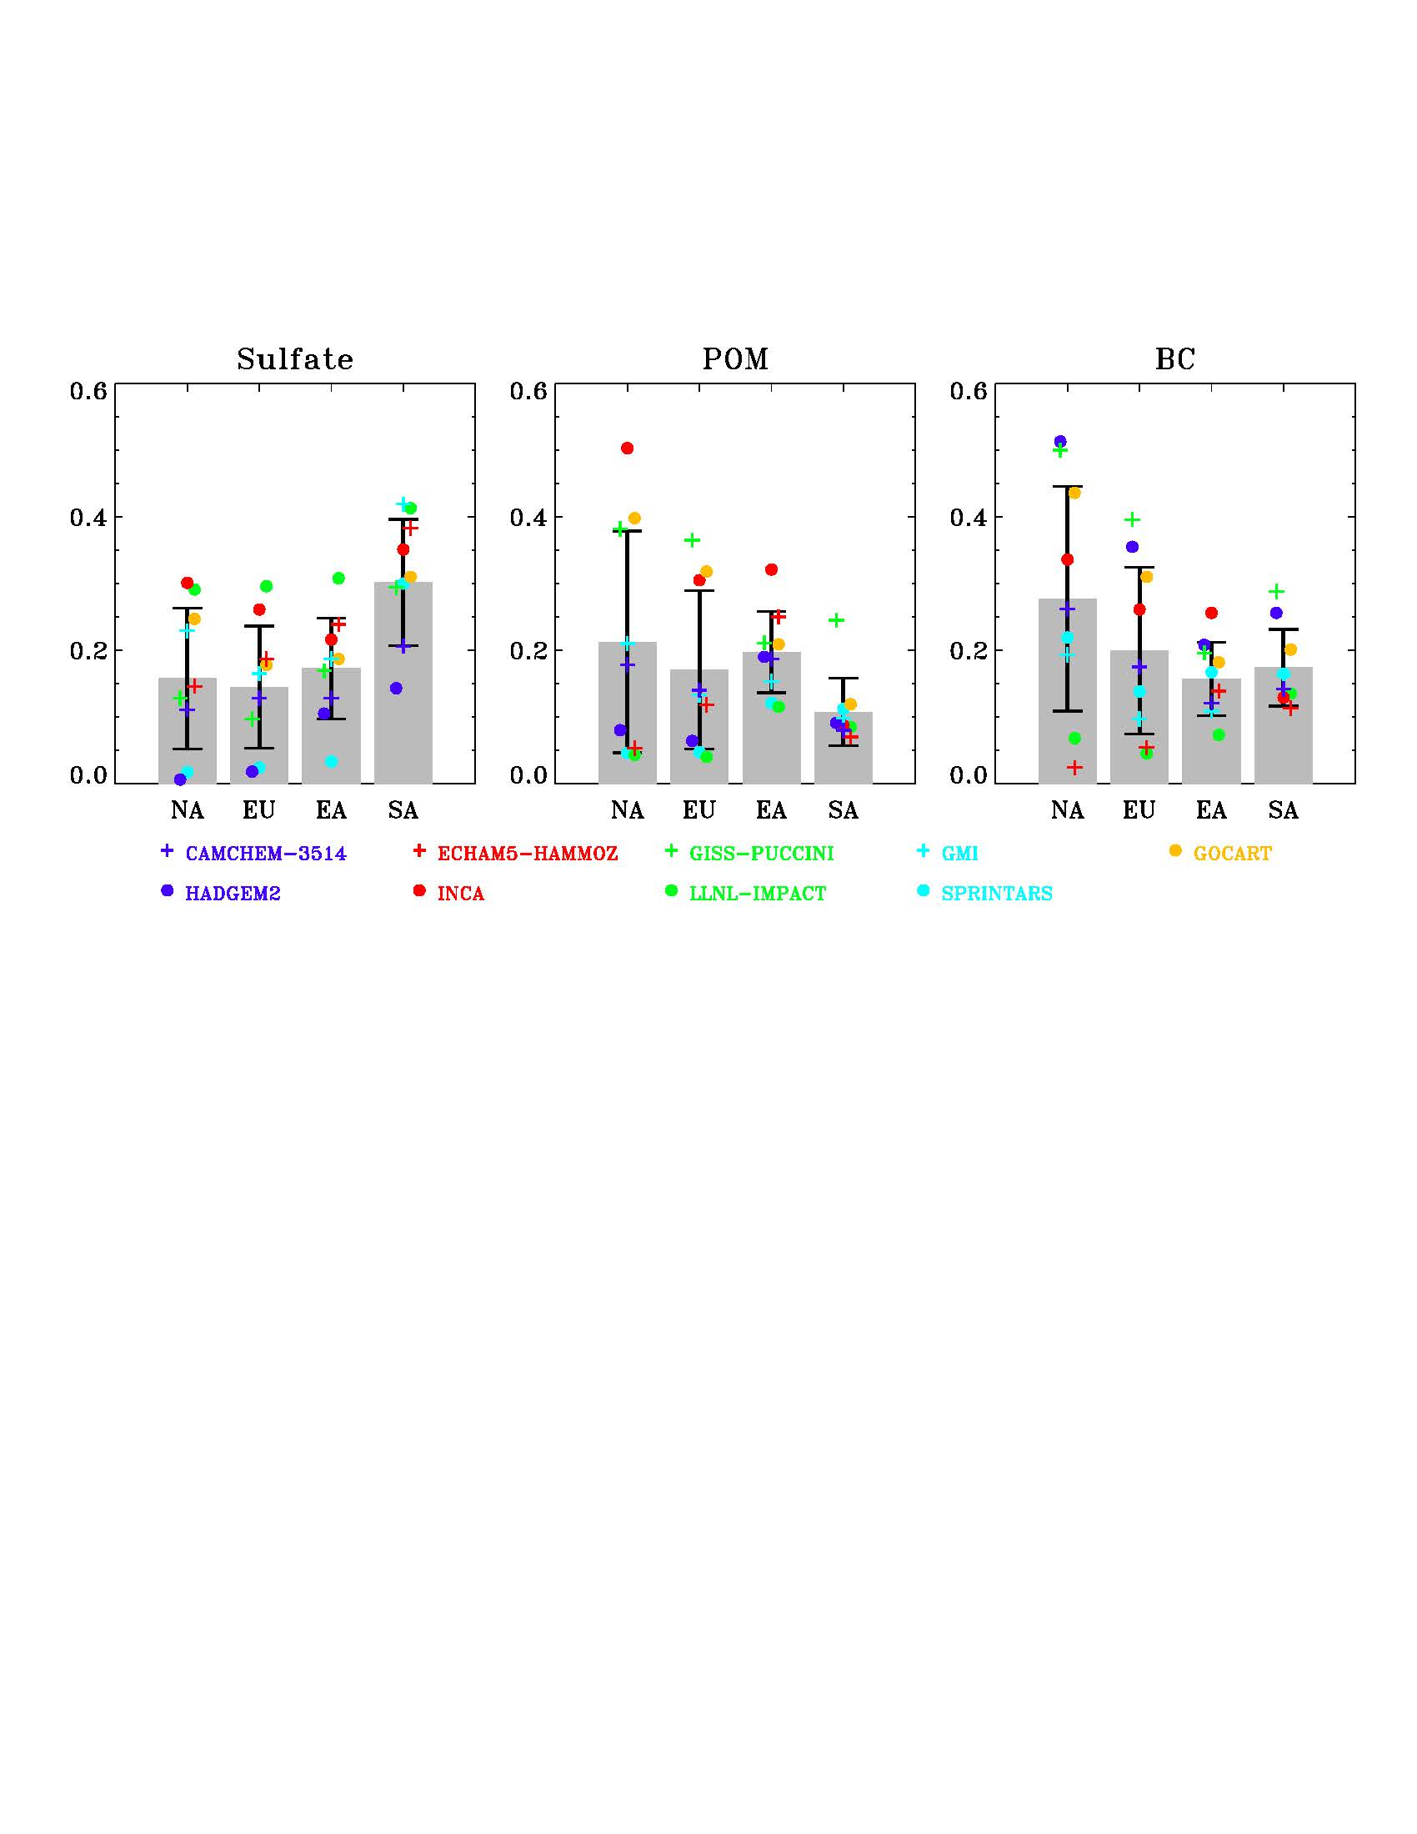
GOCART and GMI models participated in HTAP source-receptor experiments to assess the role of intercontinental transport
AOD fractional contribution of foreign aerosol import via intercontinental transport (for man-made aerosols)
NA – North America ; EU – Europe ; EA – East Asia ; SA – South Asia
The 9-model median fraction ranges from 10% to 30%, depending on region and species. But model spread is large.
Yu et al., JGR 2013

Slide 12
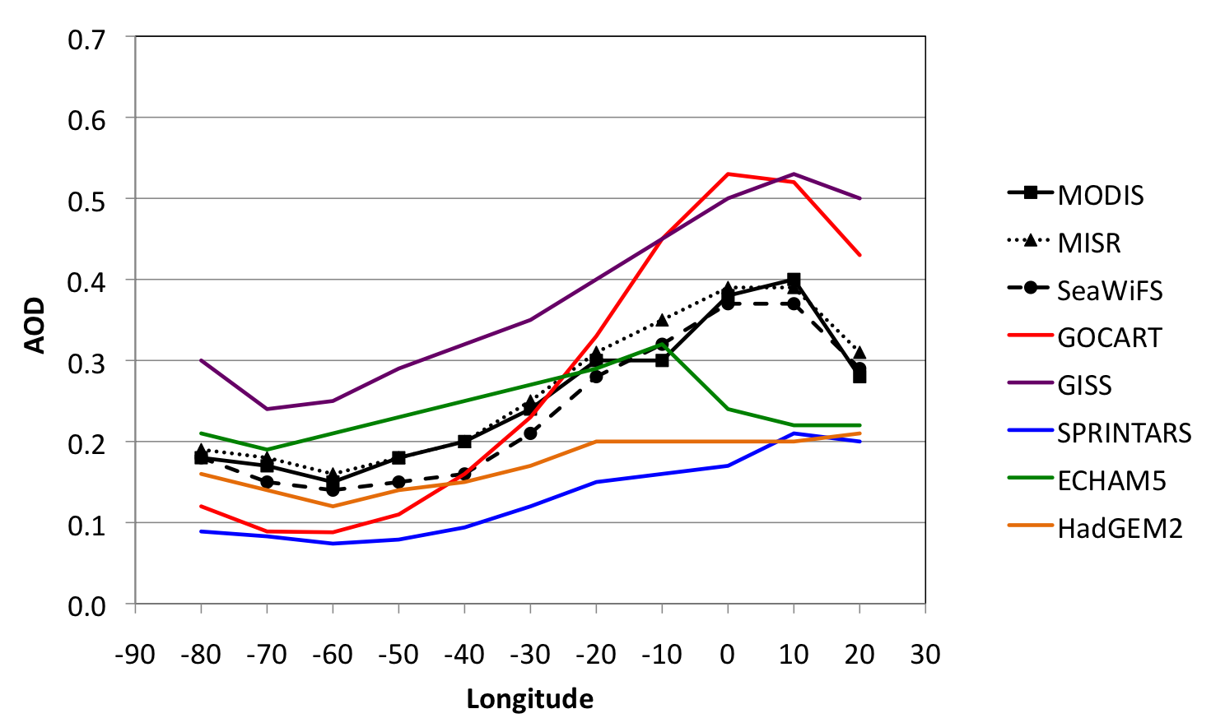
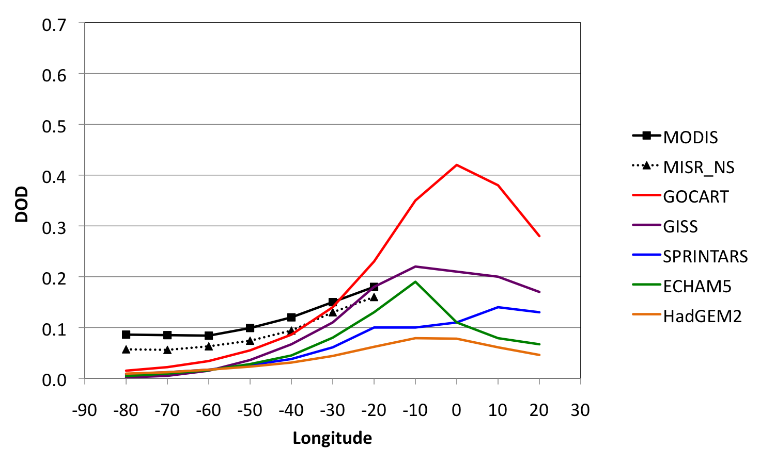
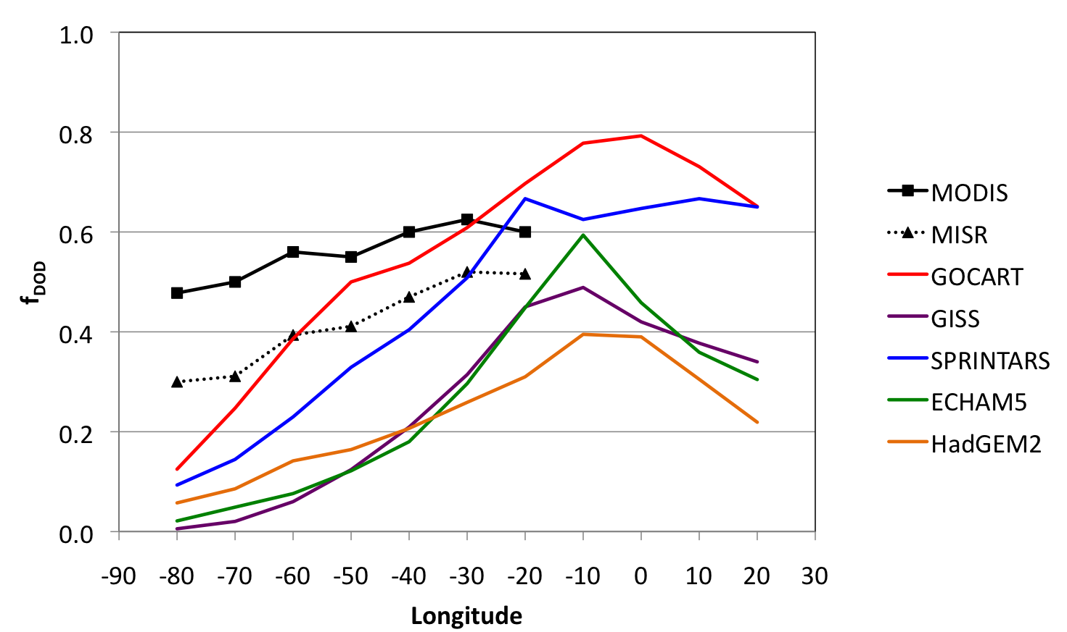
Comparisons of models and satellite observations for transatlantic dust
Satellite DOD
Longitudinal gradient (0-35N)
AOD
OBS
Model DOD
DOD
f_{DOD}
Unlike to AOD, model DODs are too lower than OBS.
Also the longitudinal gradient of f_{DOD} in most models including GOCART are too strong than OBS.
Longitude
Kim et al. (2012)

Slide 13
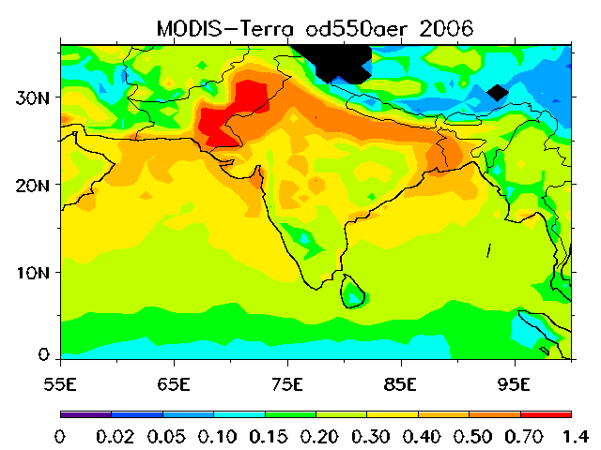
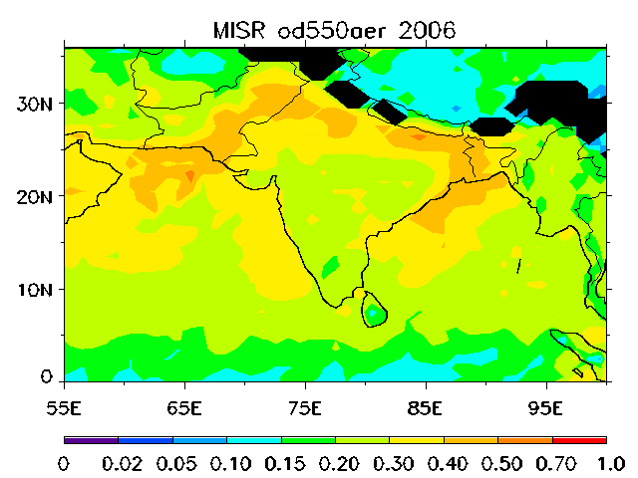
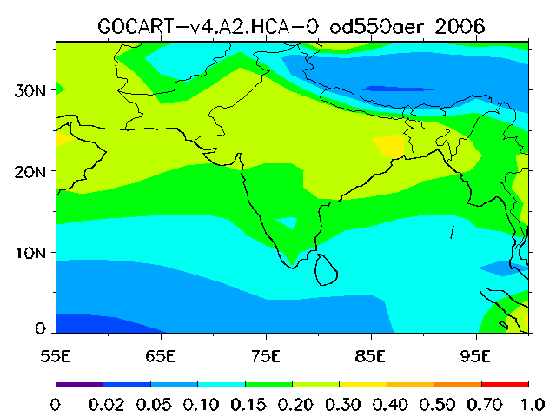
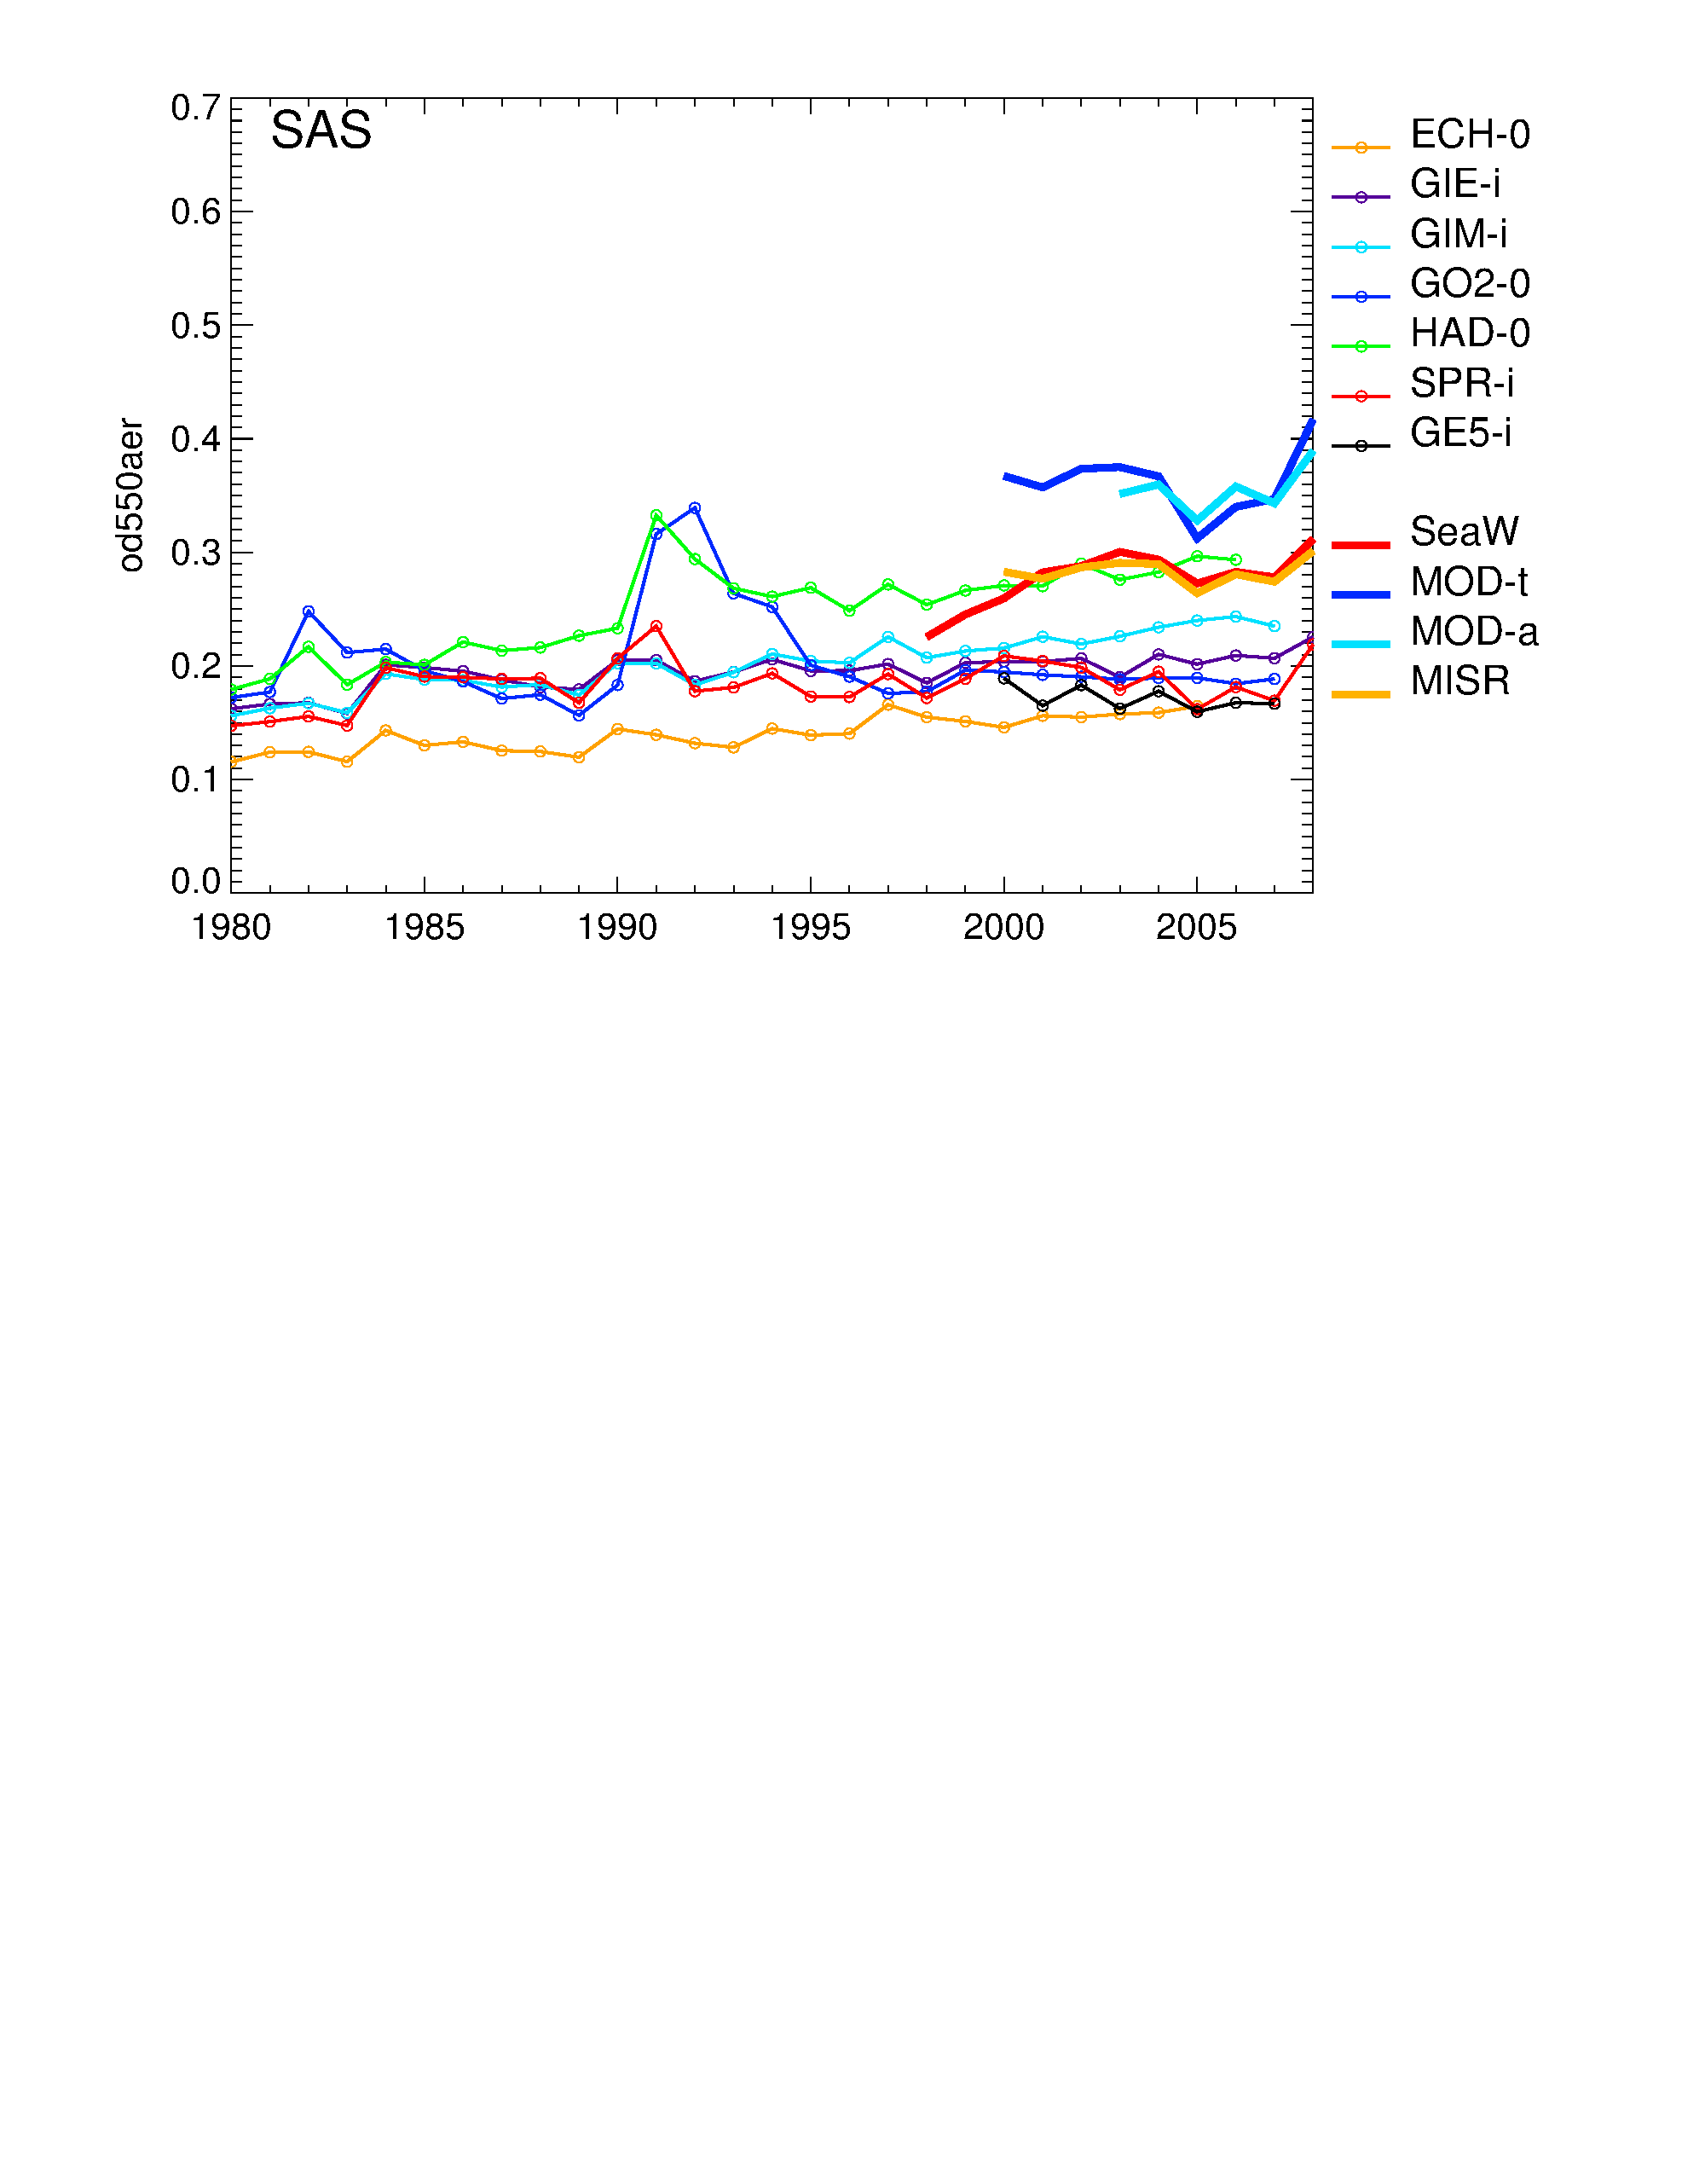
Evaluation of multi-model aerosol simulations over South Asia
MODIS-Terra
MISR
GOCART
Annual Mean AOD
For 2006
Representing the high AOD belt over the northern India is challenging for many current global chemical transport models, including NASA GOCART and GISS models.
Averaged over entire South Asia, 6 out of 7 models underestimated the annual mean AOD about 30% compared to MISR, indicating an incorrect regional contribution towards the global mean radiation forcing estimation.
Annual mean AOD for 1980-2008
Pan et al. (2013)

Slide 14
End

