Slide 1
Current and Future Applications of the GEOS-5 Aerosol Modeling System
Peter Colarco
Arlindo da Silva, Virginie Buchard-Marchant
Anton Darmenov, Ravi Govindaraju
Cynthia Randles, Valentina Aquila
Ed Nowottnick, Huisheng Bian

Slide 2
Forecasting Support and Event Simulation
Observation Simulation
Aerosols-Chemistry-Climate
Future Applications

Slide 3
Forecasting Support and Event Simulation
Observation Simulation
Aerosols-Chemistry-Climate
Future Applications

Slide 4
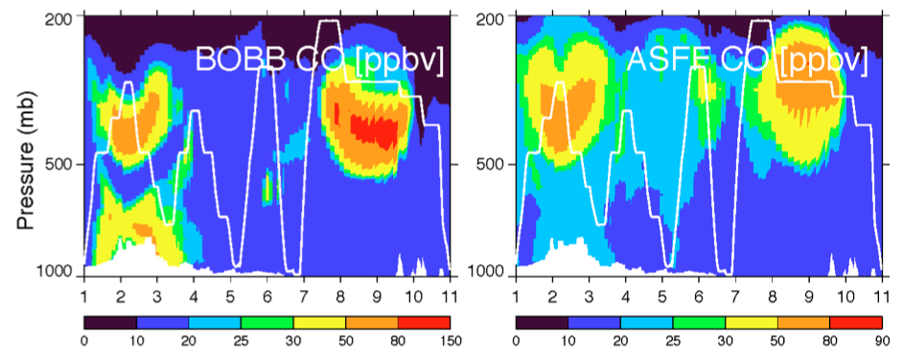
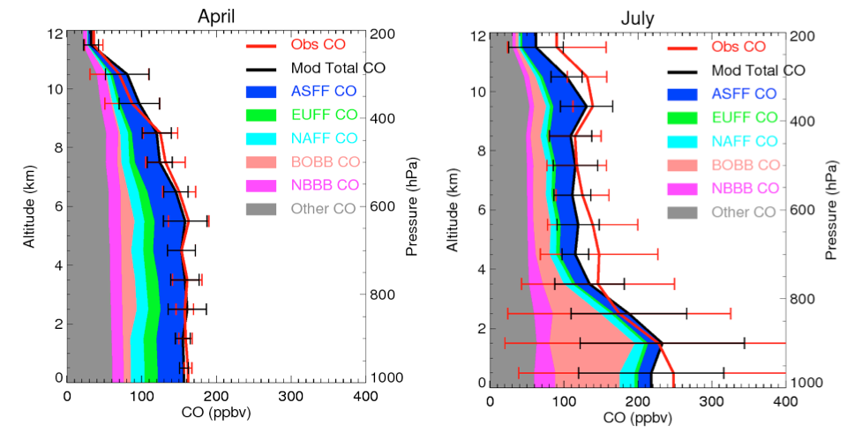
Forecasting for NASA Airborne Field Missions
For ARCTAS GEOS-5 forecasting system deployed with online aerosol and CO tracers
CO tracers tagged by region of origin or emission source to show air mass history
Interpretation of observations
Important: People deploy with the model to assist in interpretation, forecasting, and flight planning
Contributions to numerous campaigns: TC4, ARCTAS, GloPac, SEAC4RS, HS3, DISCOVER-AQ, ...
Simulated CO profiles along July 21, 2008, flight from Cold Lake, Alberta, to Thule, Greenland
Boreal Biomass Burning
Asian Fossil Fuel
Campaign Averaged CO Distribution by Component Along Flight Tracks
Bian et al., Source Attributions of Pollution to the Western Arctic During the NASA ARCTAS Field Campaign , Atmos. Chem. Phys., 13, 4707-4721 (2013)

Slide 5
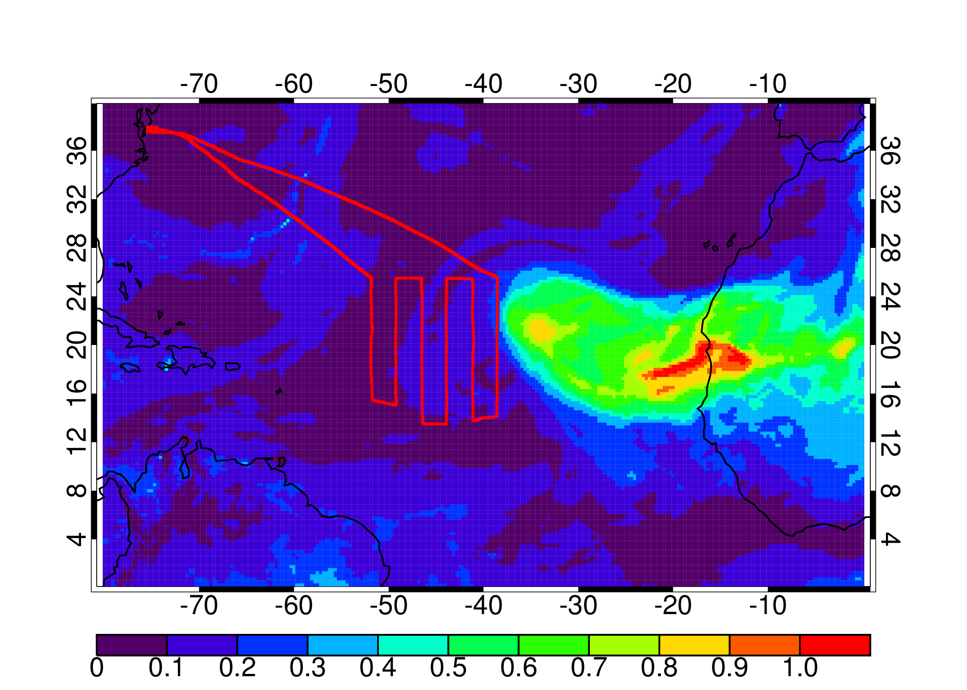
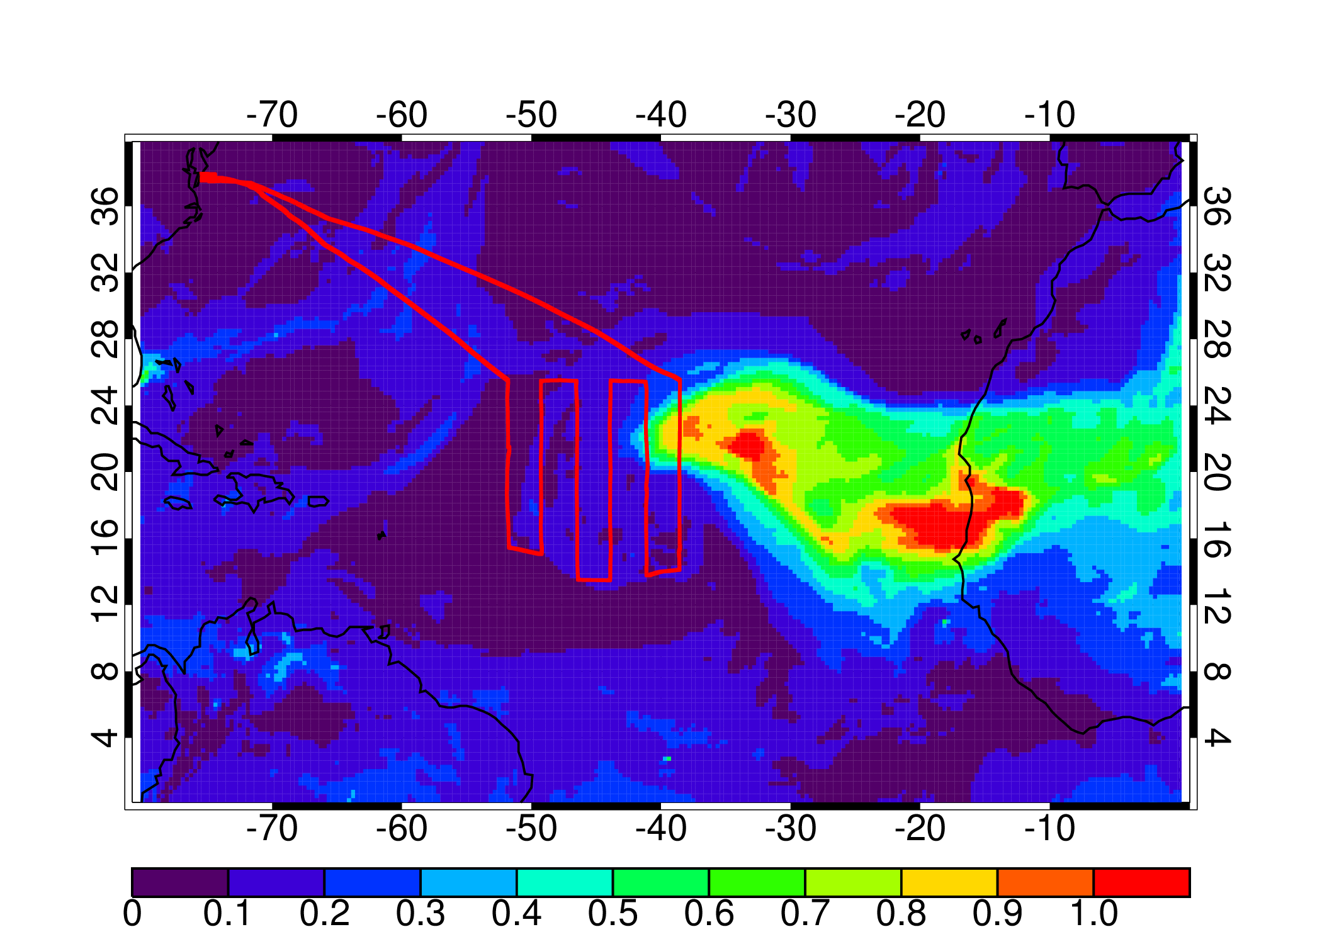
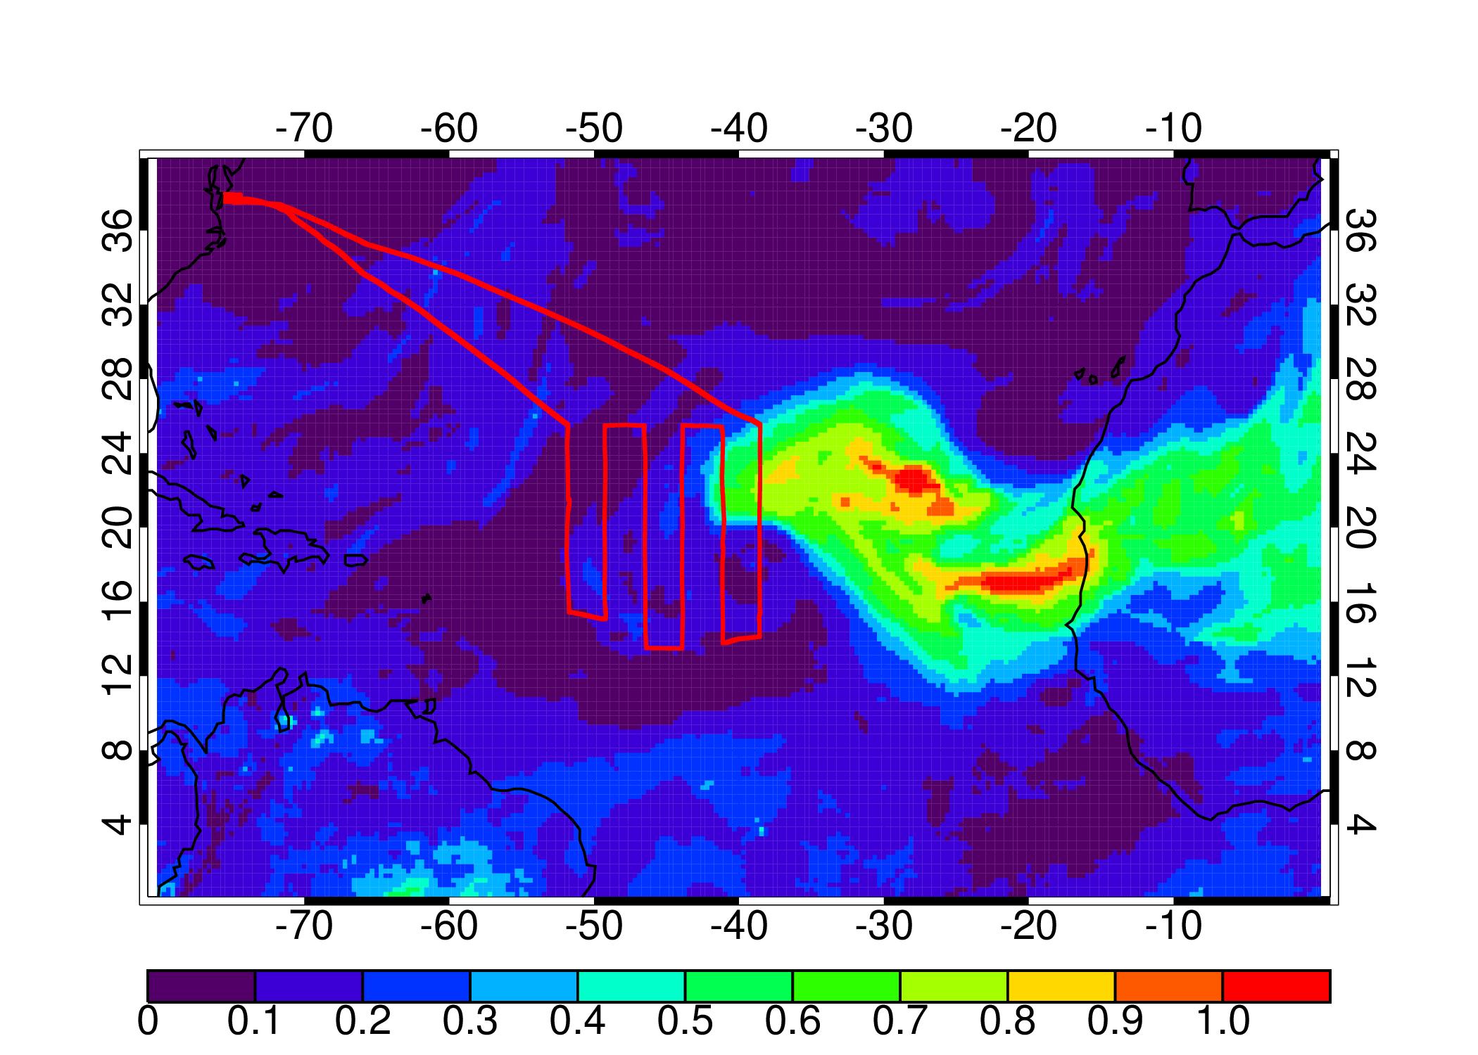
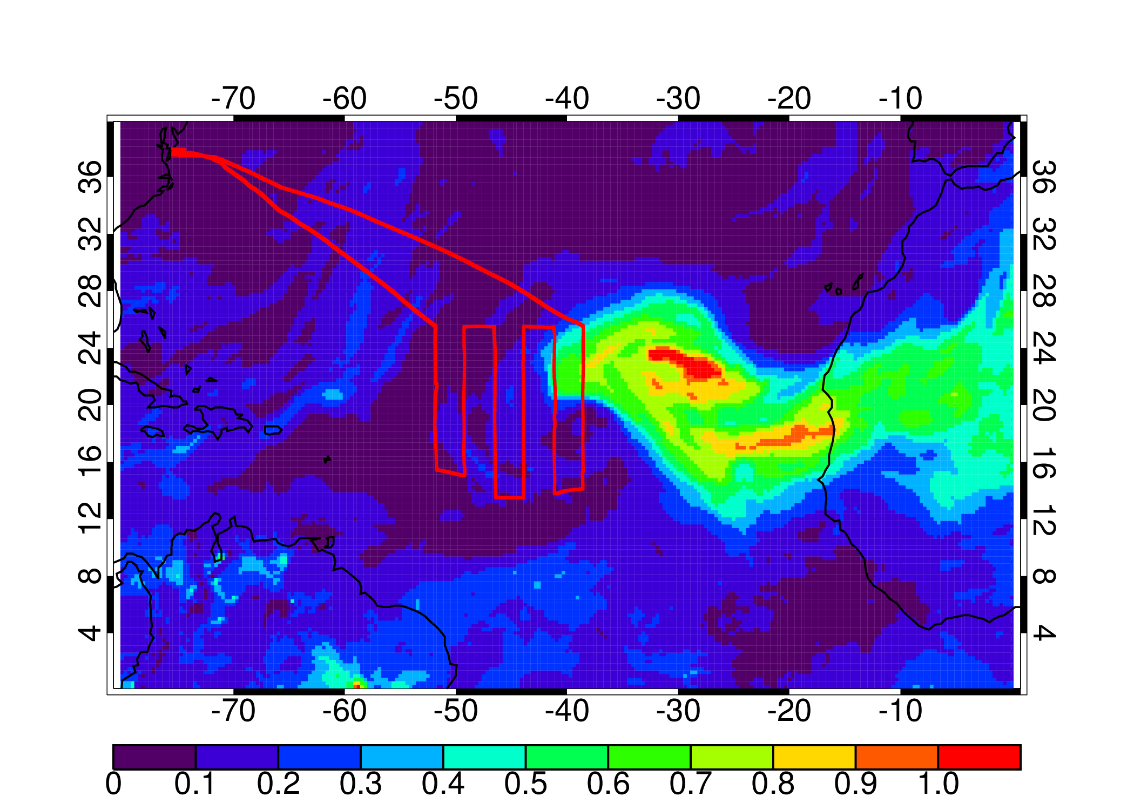
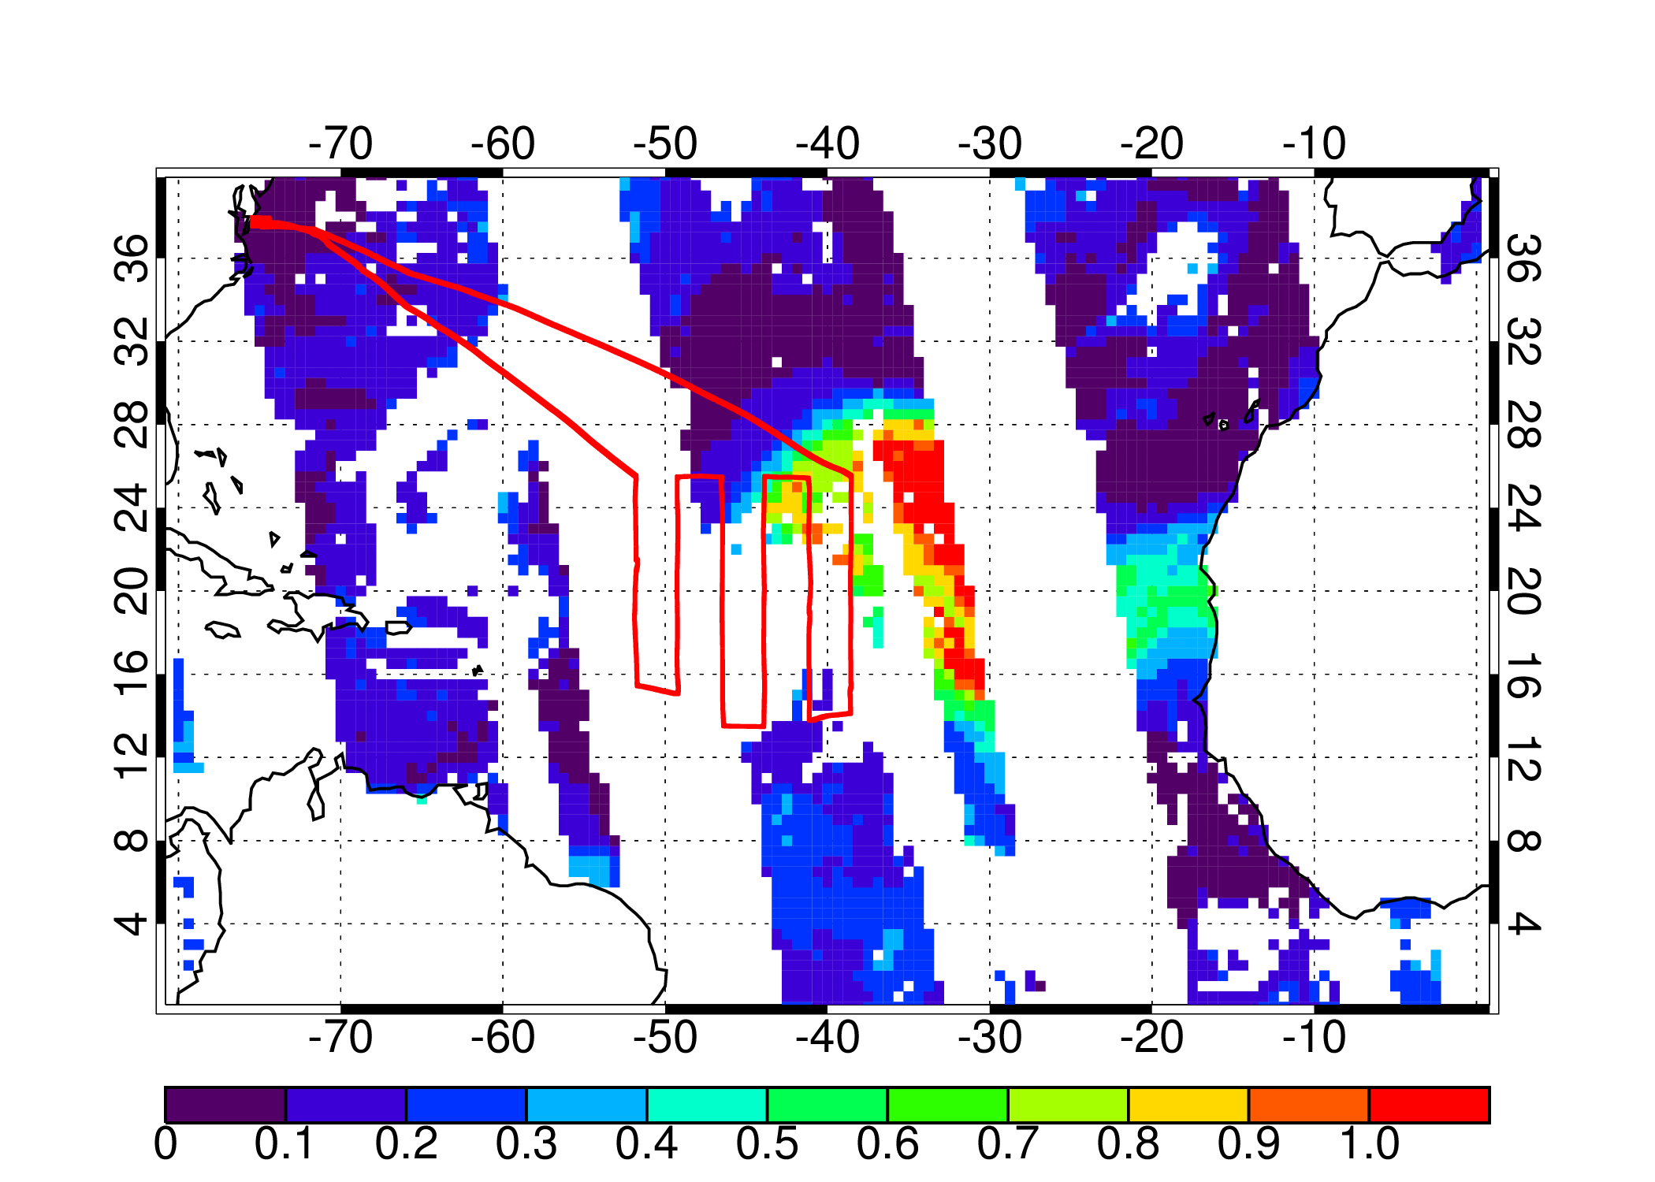
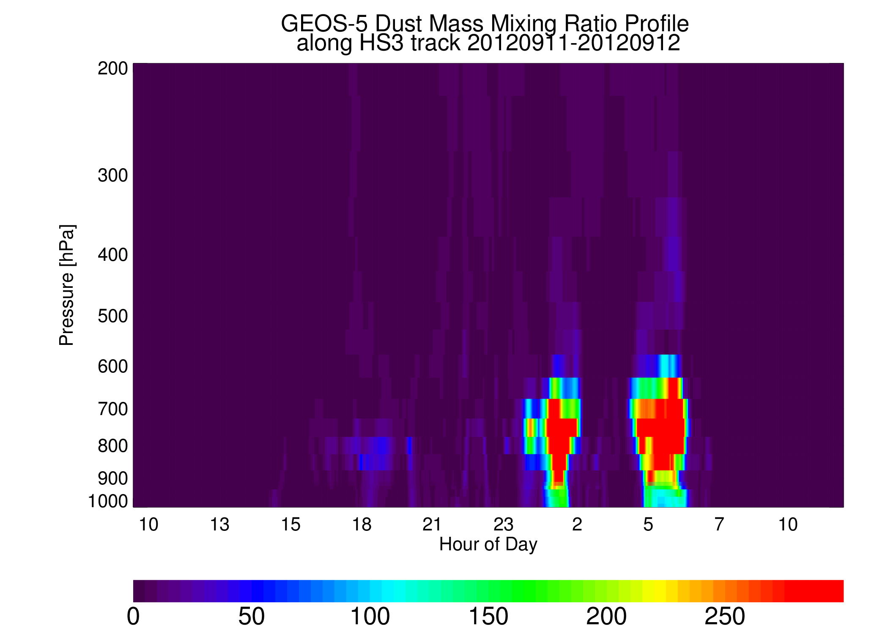
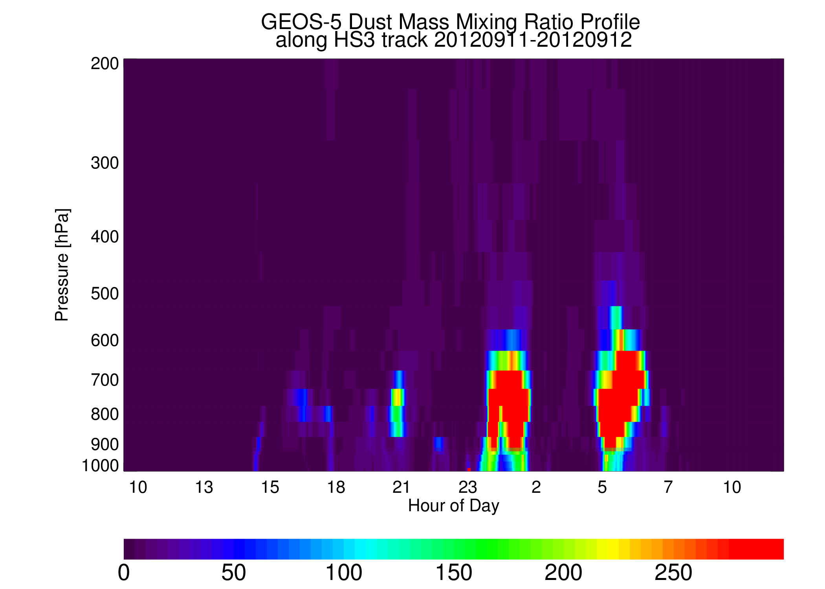
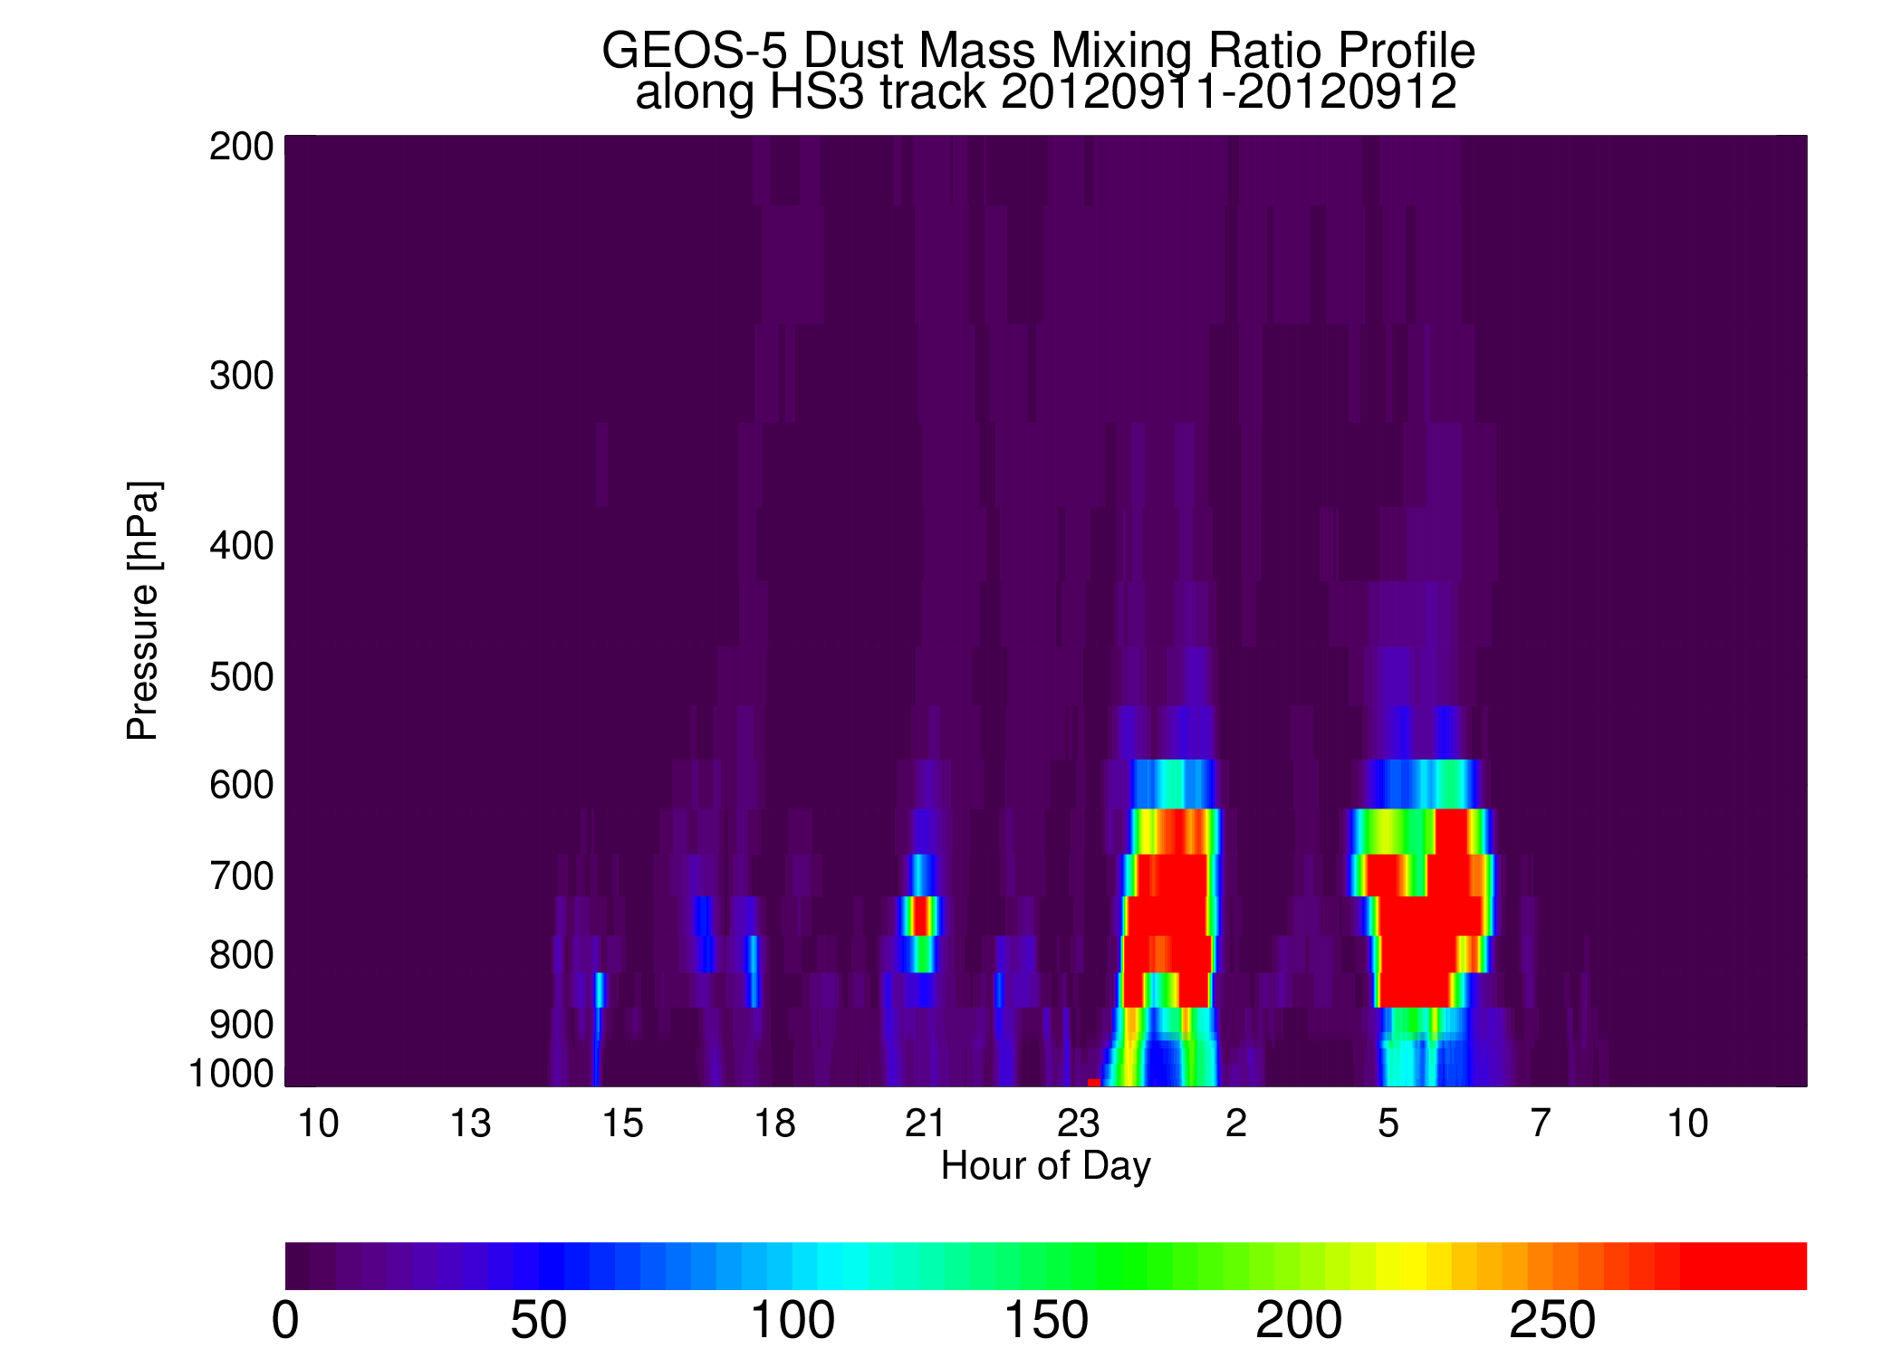
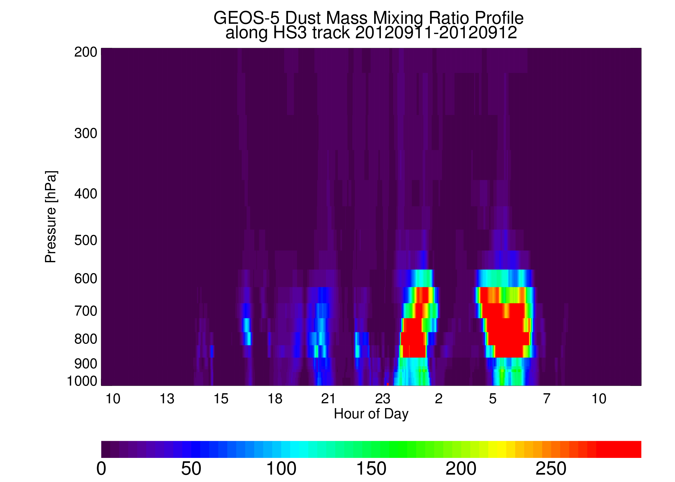
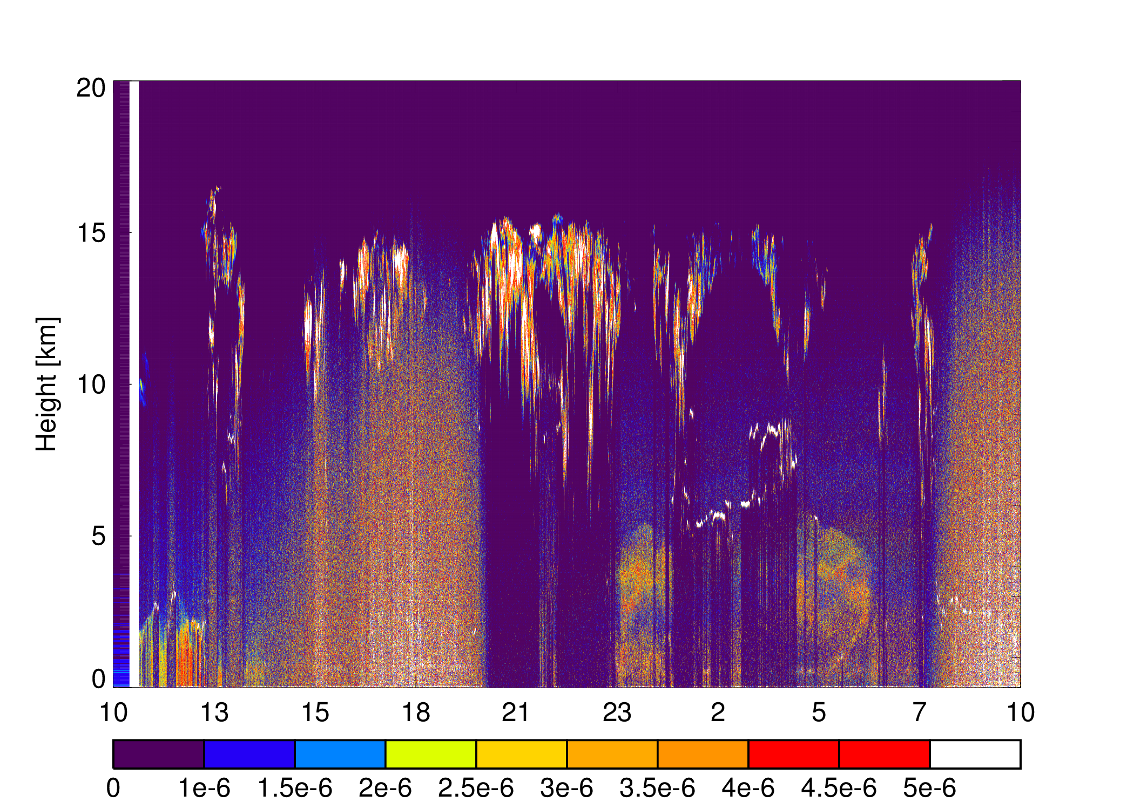
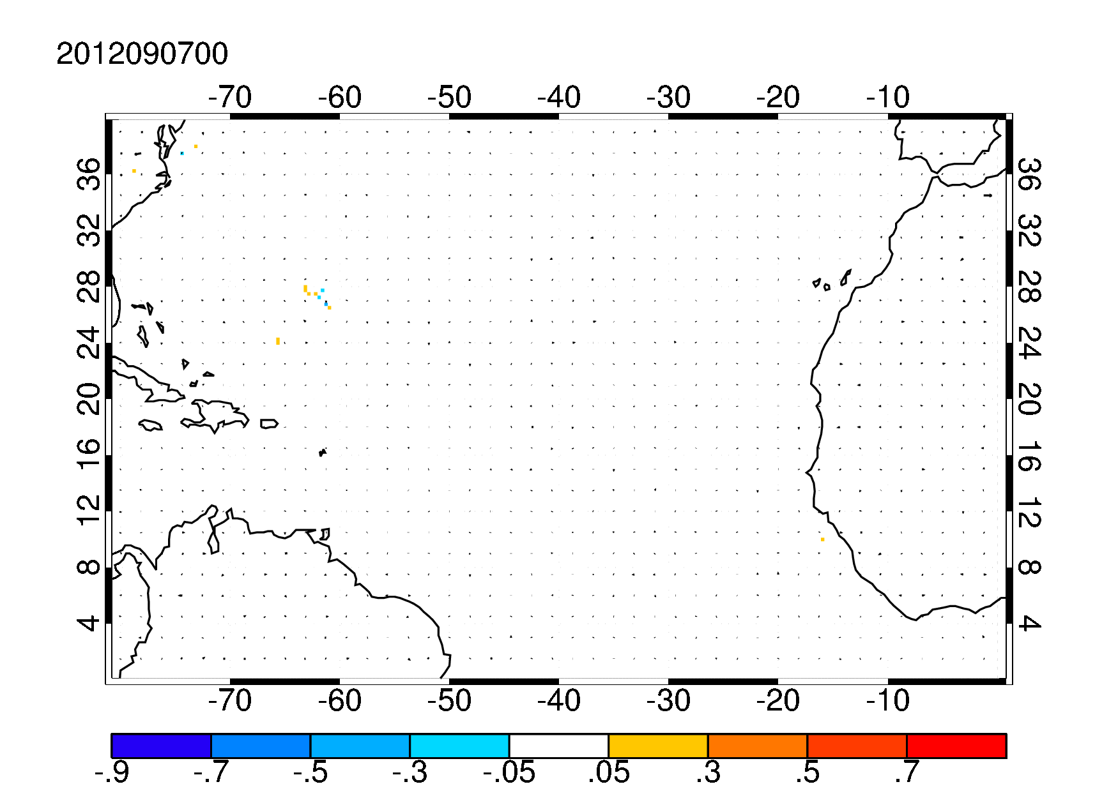
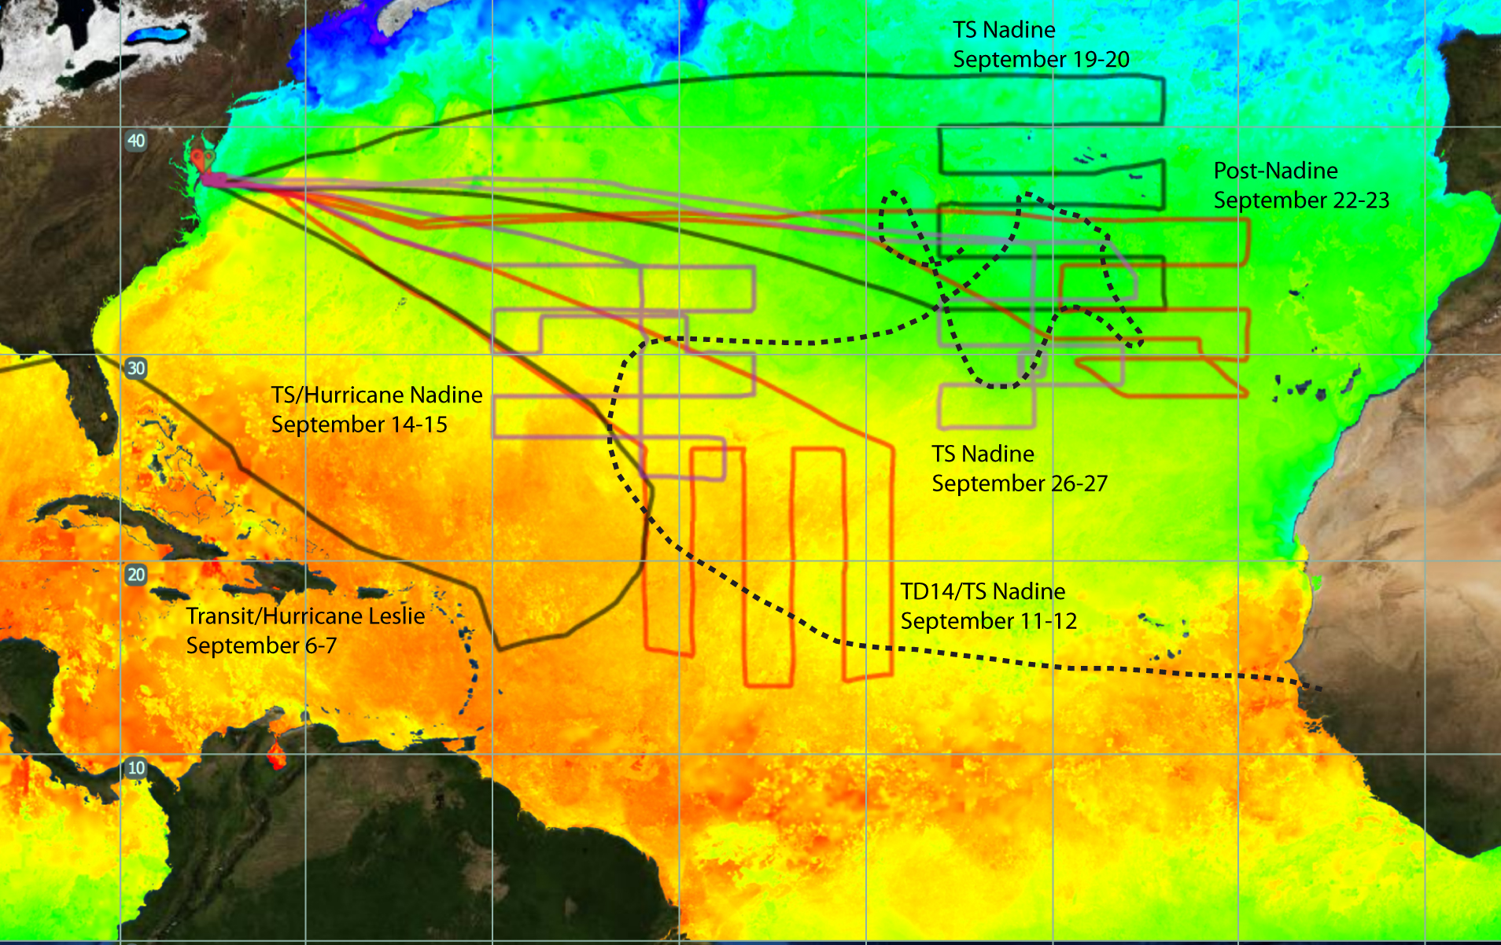
Aerosol Impacts on Cyclogenesis During HS3
For NASA HS3 aircraft campaign GEOS-5 aerosol forecasts used to guide and interpret Global Hawk flights over hurricane Nadine (September 2012)
One objective is to evaluate the skill of forecast as a function of lead time
Another objective is to understand aerosol impact on storm development
Forecasts valid 12z September 11, 2012
MODIS Aqua AOT on 9/11 & CPL backscatter from flight
72hr
48hr
24hr
0hr
AOT
Extinction Profile
DUST
2012 HS3
Flight
Tracks
Forecast development of Hurricane Nadine shown as the difference in mid-troposphere winds (arrows) and aerosol optical thickness between simulations with and without aerosol radiative forcing

Slide 6
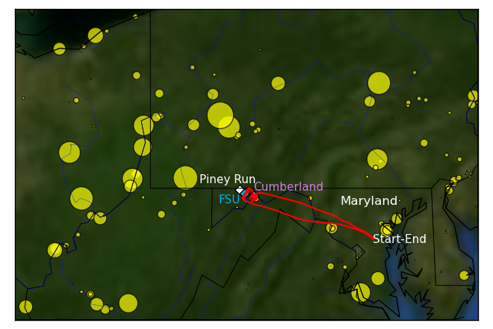
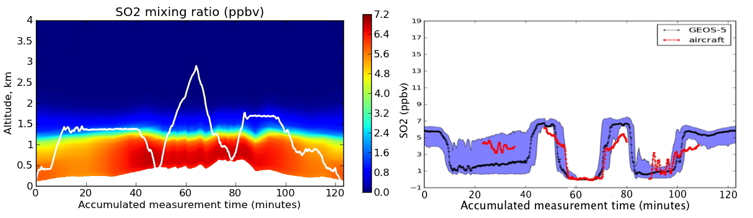
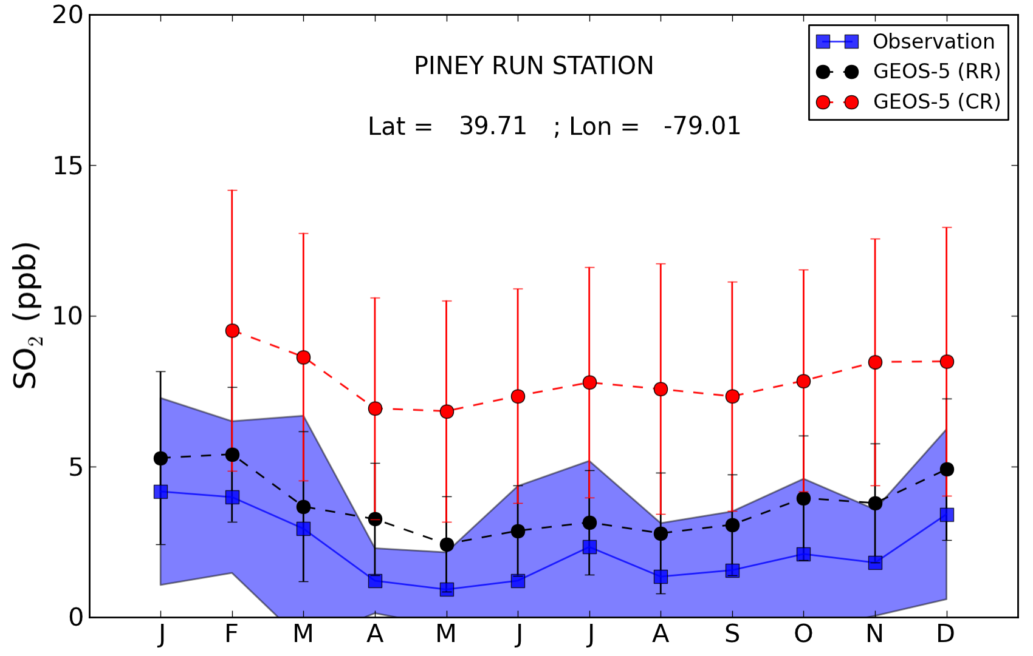
SO₂ simulations : Frostburg, MD Field Campaign
GEOS-5/GOCART SO₂ simulations (revised run) along flight track.
Coal fired power plants
Flight track
Monthly averaged concentrations of SO₂ at the surface in 2010 at the Piney Run station in Maryland.
Opportunity to evaluate the GEOS-5 model simulations of SO2 against in-situ and aircraft measurements and guide model improvements :
Evaluation of the GEOS-5 vertical distribution of SO2 : GEOS-5 captures most of the major features of the aircraft observations
Evaluation of the GEOS-5 SO₂ surface concentrations :
New SO₂ anthropogenic emission dataset (EDGAR v4.1)
Adjustment of the vertical placement of the emissions in the model
Buchard et al., Manuscript to be submitted

Slide 7

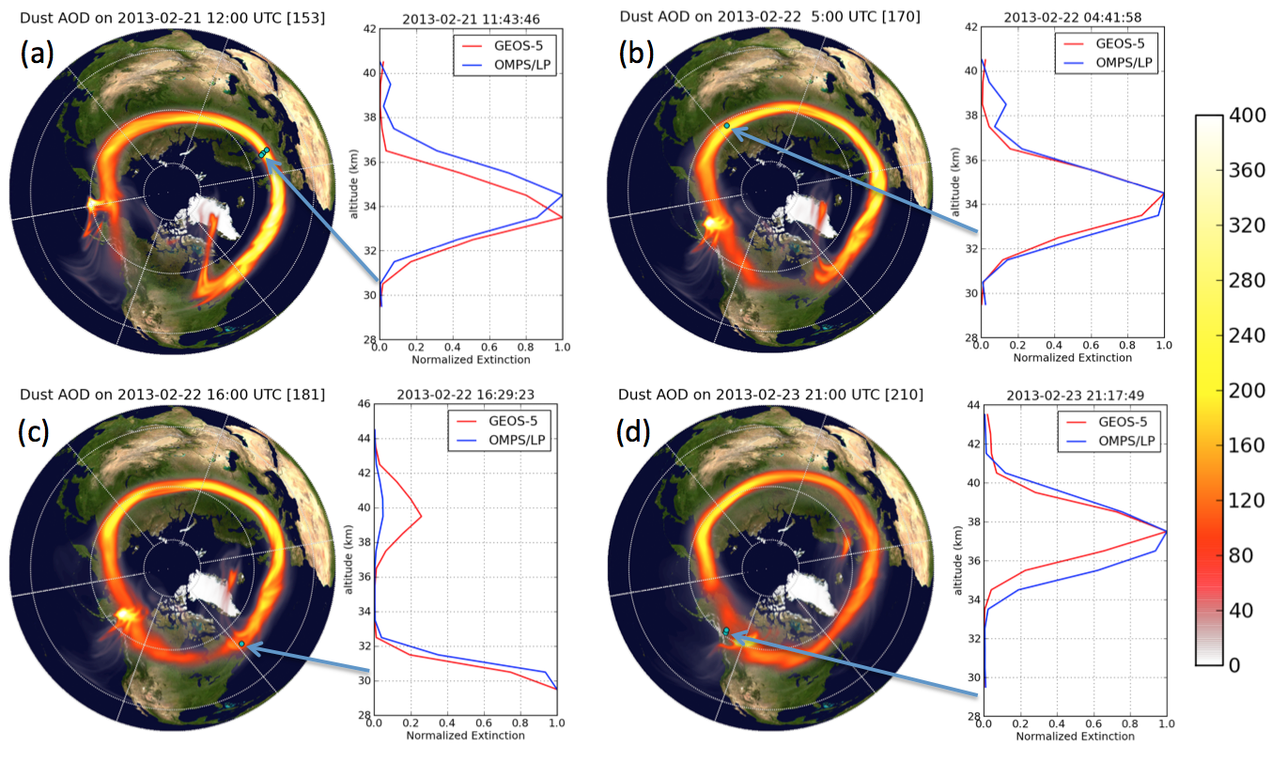
Event Simulations: February 2013 Russian Meteorite
Debris from meteorite explosion over Chelyabinsk observed for weeks in Suomi NPP OMPS/LP
da Silva et al., Manuscript in preparation

Slide 8
Forecasting Support and Event Simulation
Observation Simulation
Aerosols-Chemistry-Climate
Future Applications

Slide 9
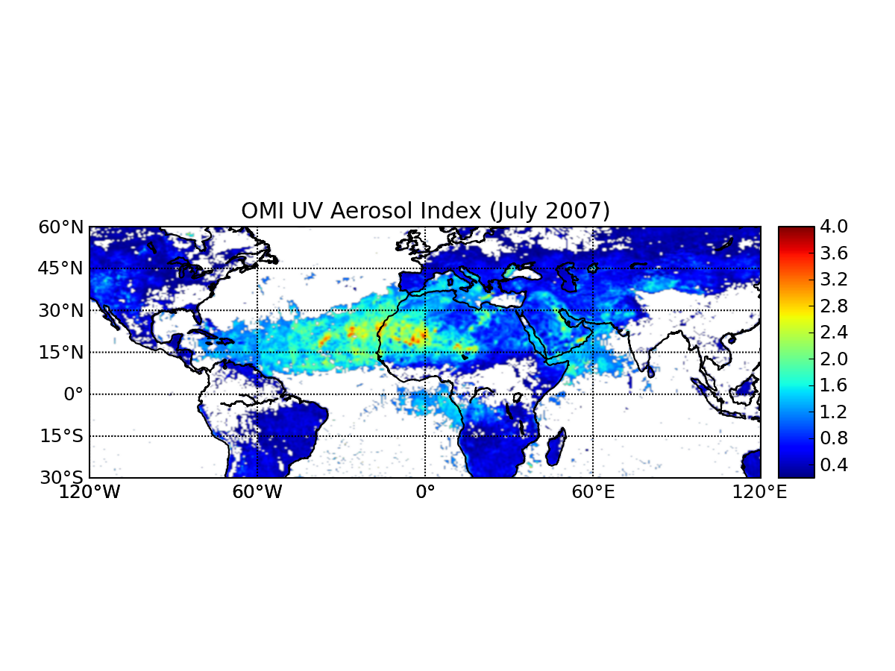
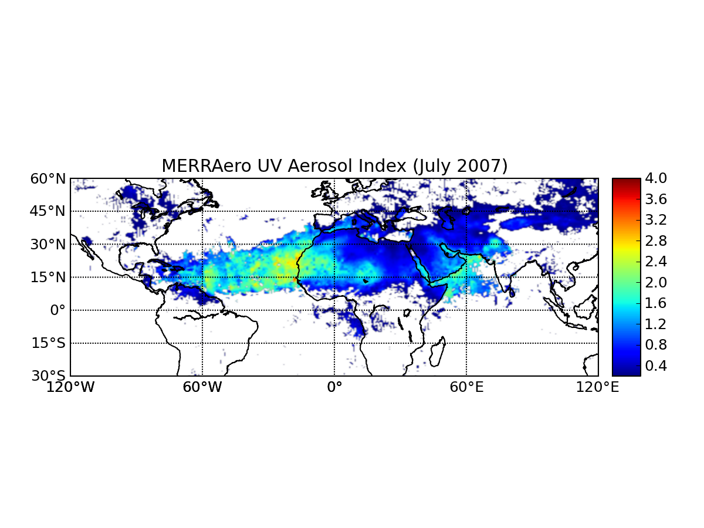
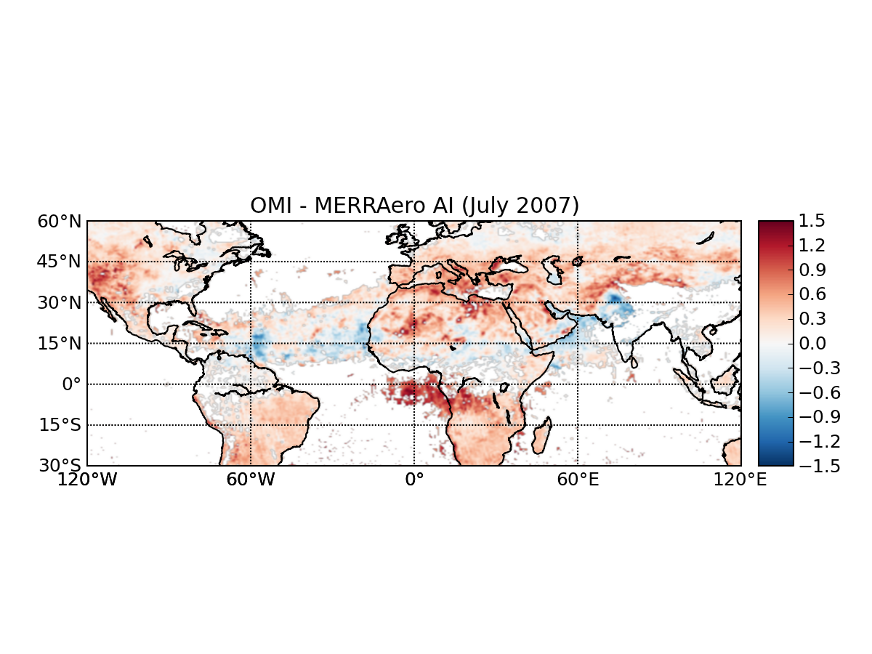
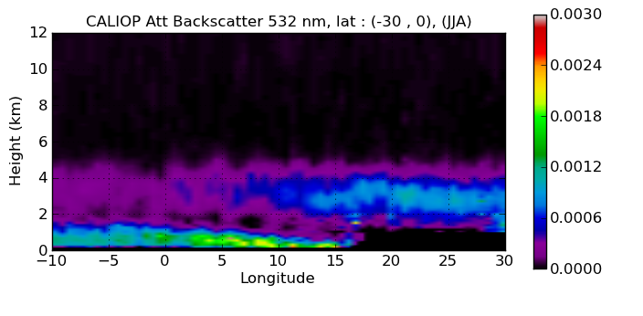
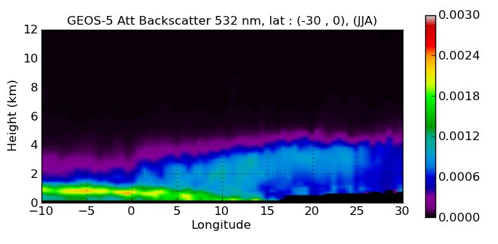
Observation Simulation from MERRAero
Comparison of Simulated GEOS-5 Aerosol Index to OMI observations (July 2007)
MERRAero uses MODIS aerosol observations to constrain total aerosol loading (AOT), but vertical distribution and composition remain unconstrained
Simulation of the UV Aerosol Index at OMI locations:
Developed interface between GEOS-5 and VLIDORT radiation code
Simulated aerosol index sensitive to both absorption and aerosol plume height. Dust is well captured, but not African biomass burning
Simulation of aerosol backscatter at CALIOP locations
CALIOP measurements : ascertain the misplacement of plume height by the model: the GEOS-5 biomass burning plume does not remain elevated in the simulation as it does in the observations.
OMI
MERRAero
OMI - MERRAero
Comparison of GEOS-5 derived Attenuated Backscatter Coefficient to CALIOP measurements (Southern Africa, JJA 2011)
CALIOP
MERRAero
Buchard et al., Manuscript in preparation

Slide 10
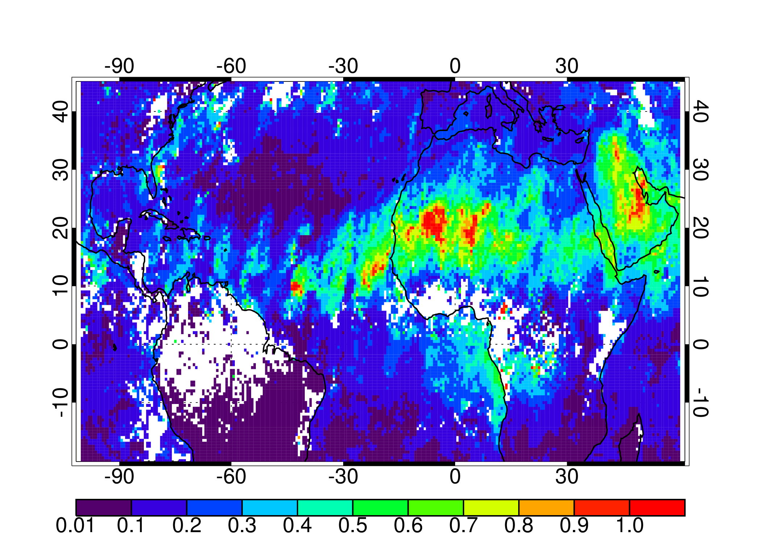
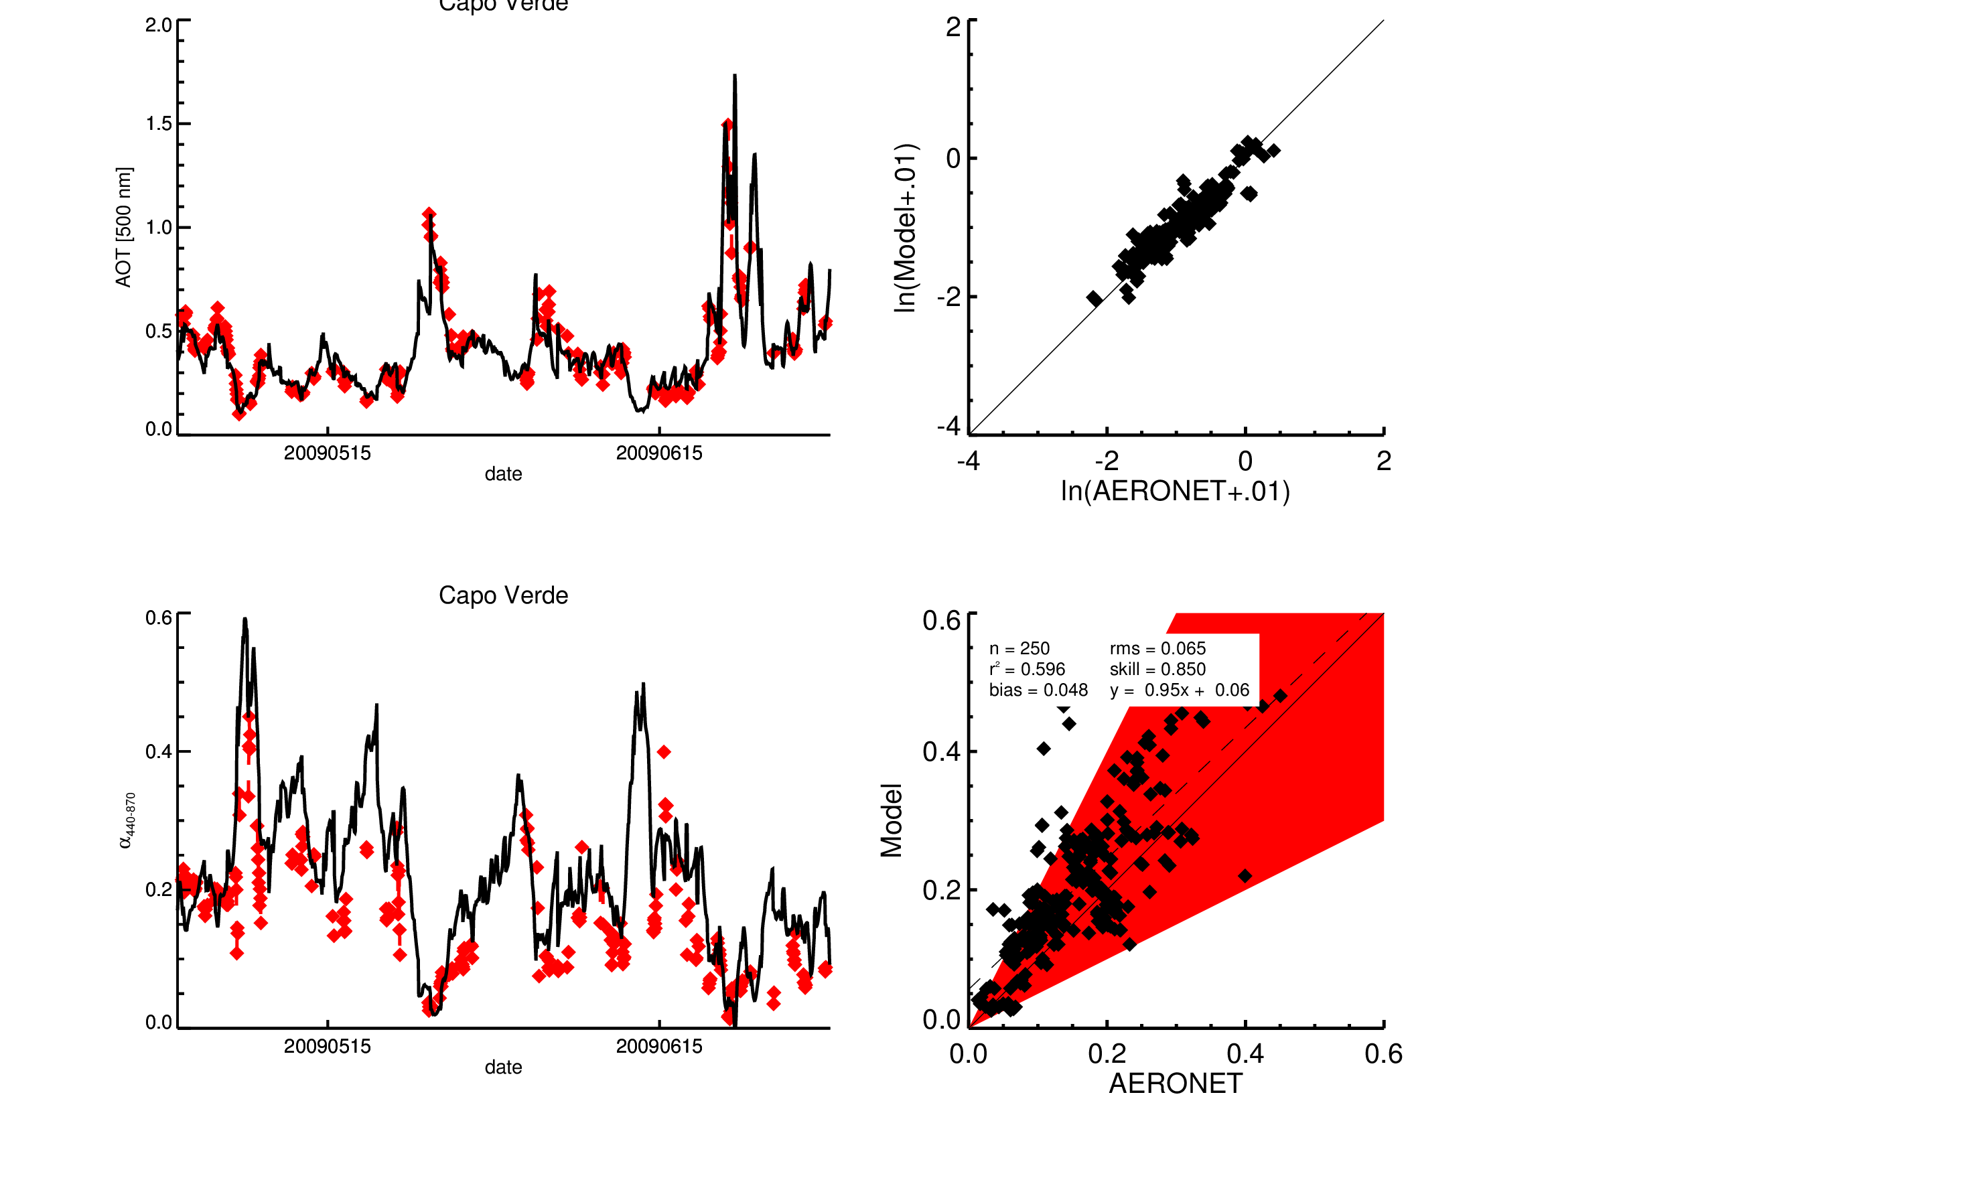
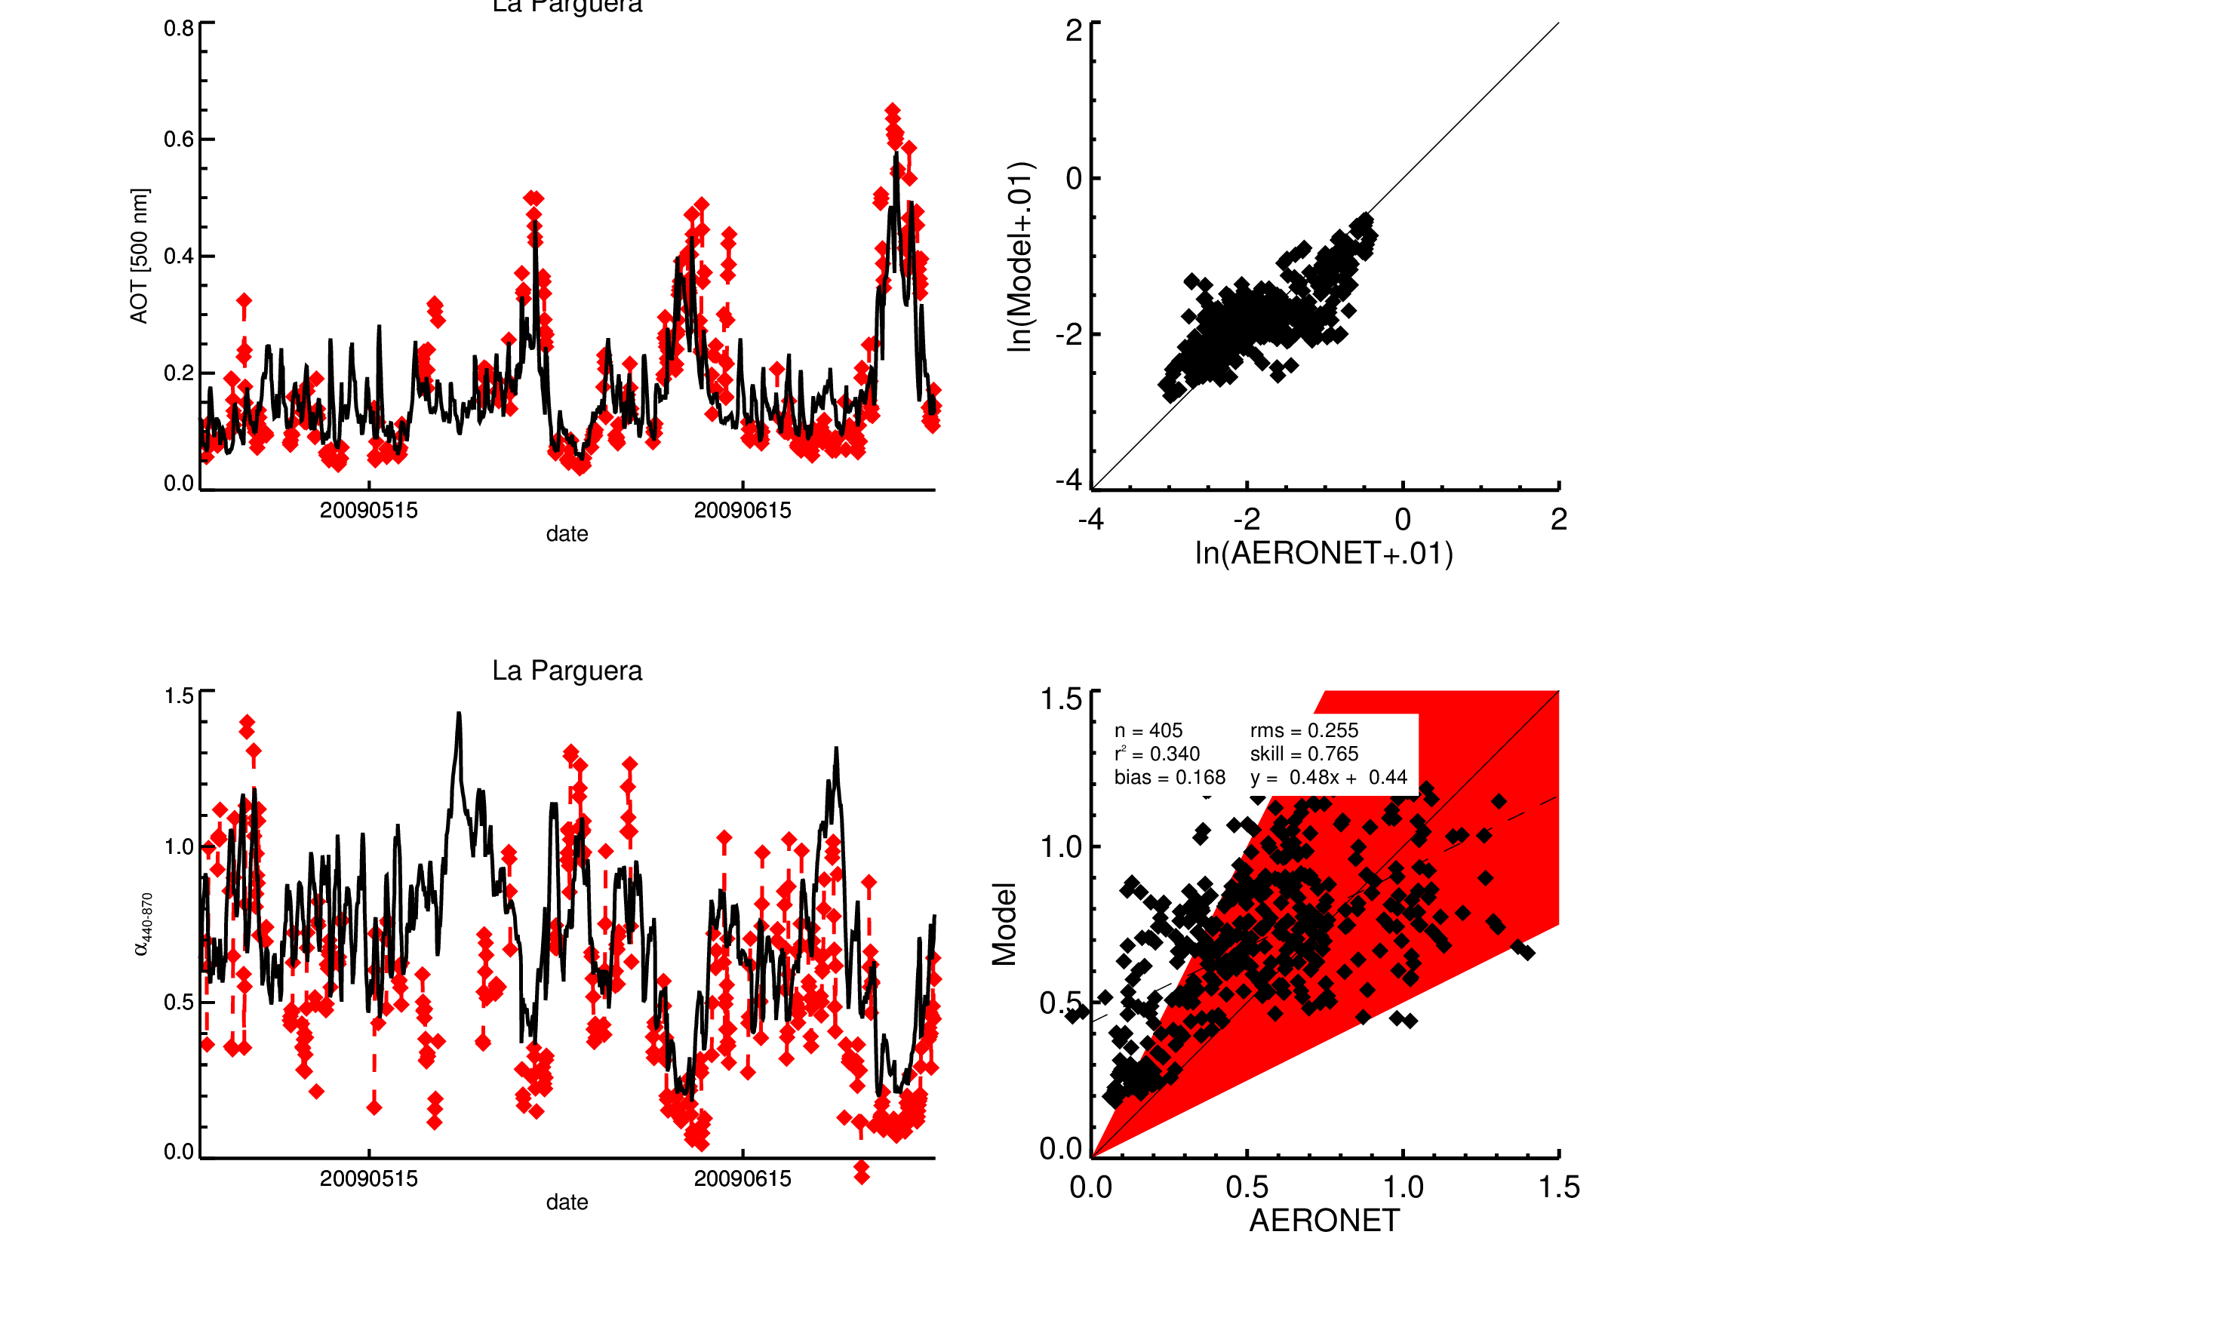
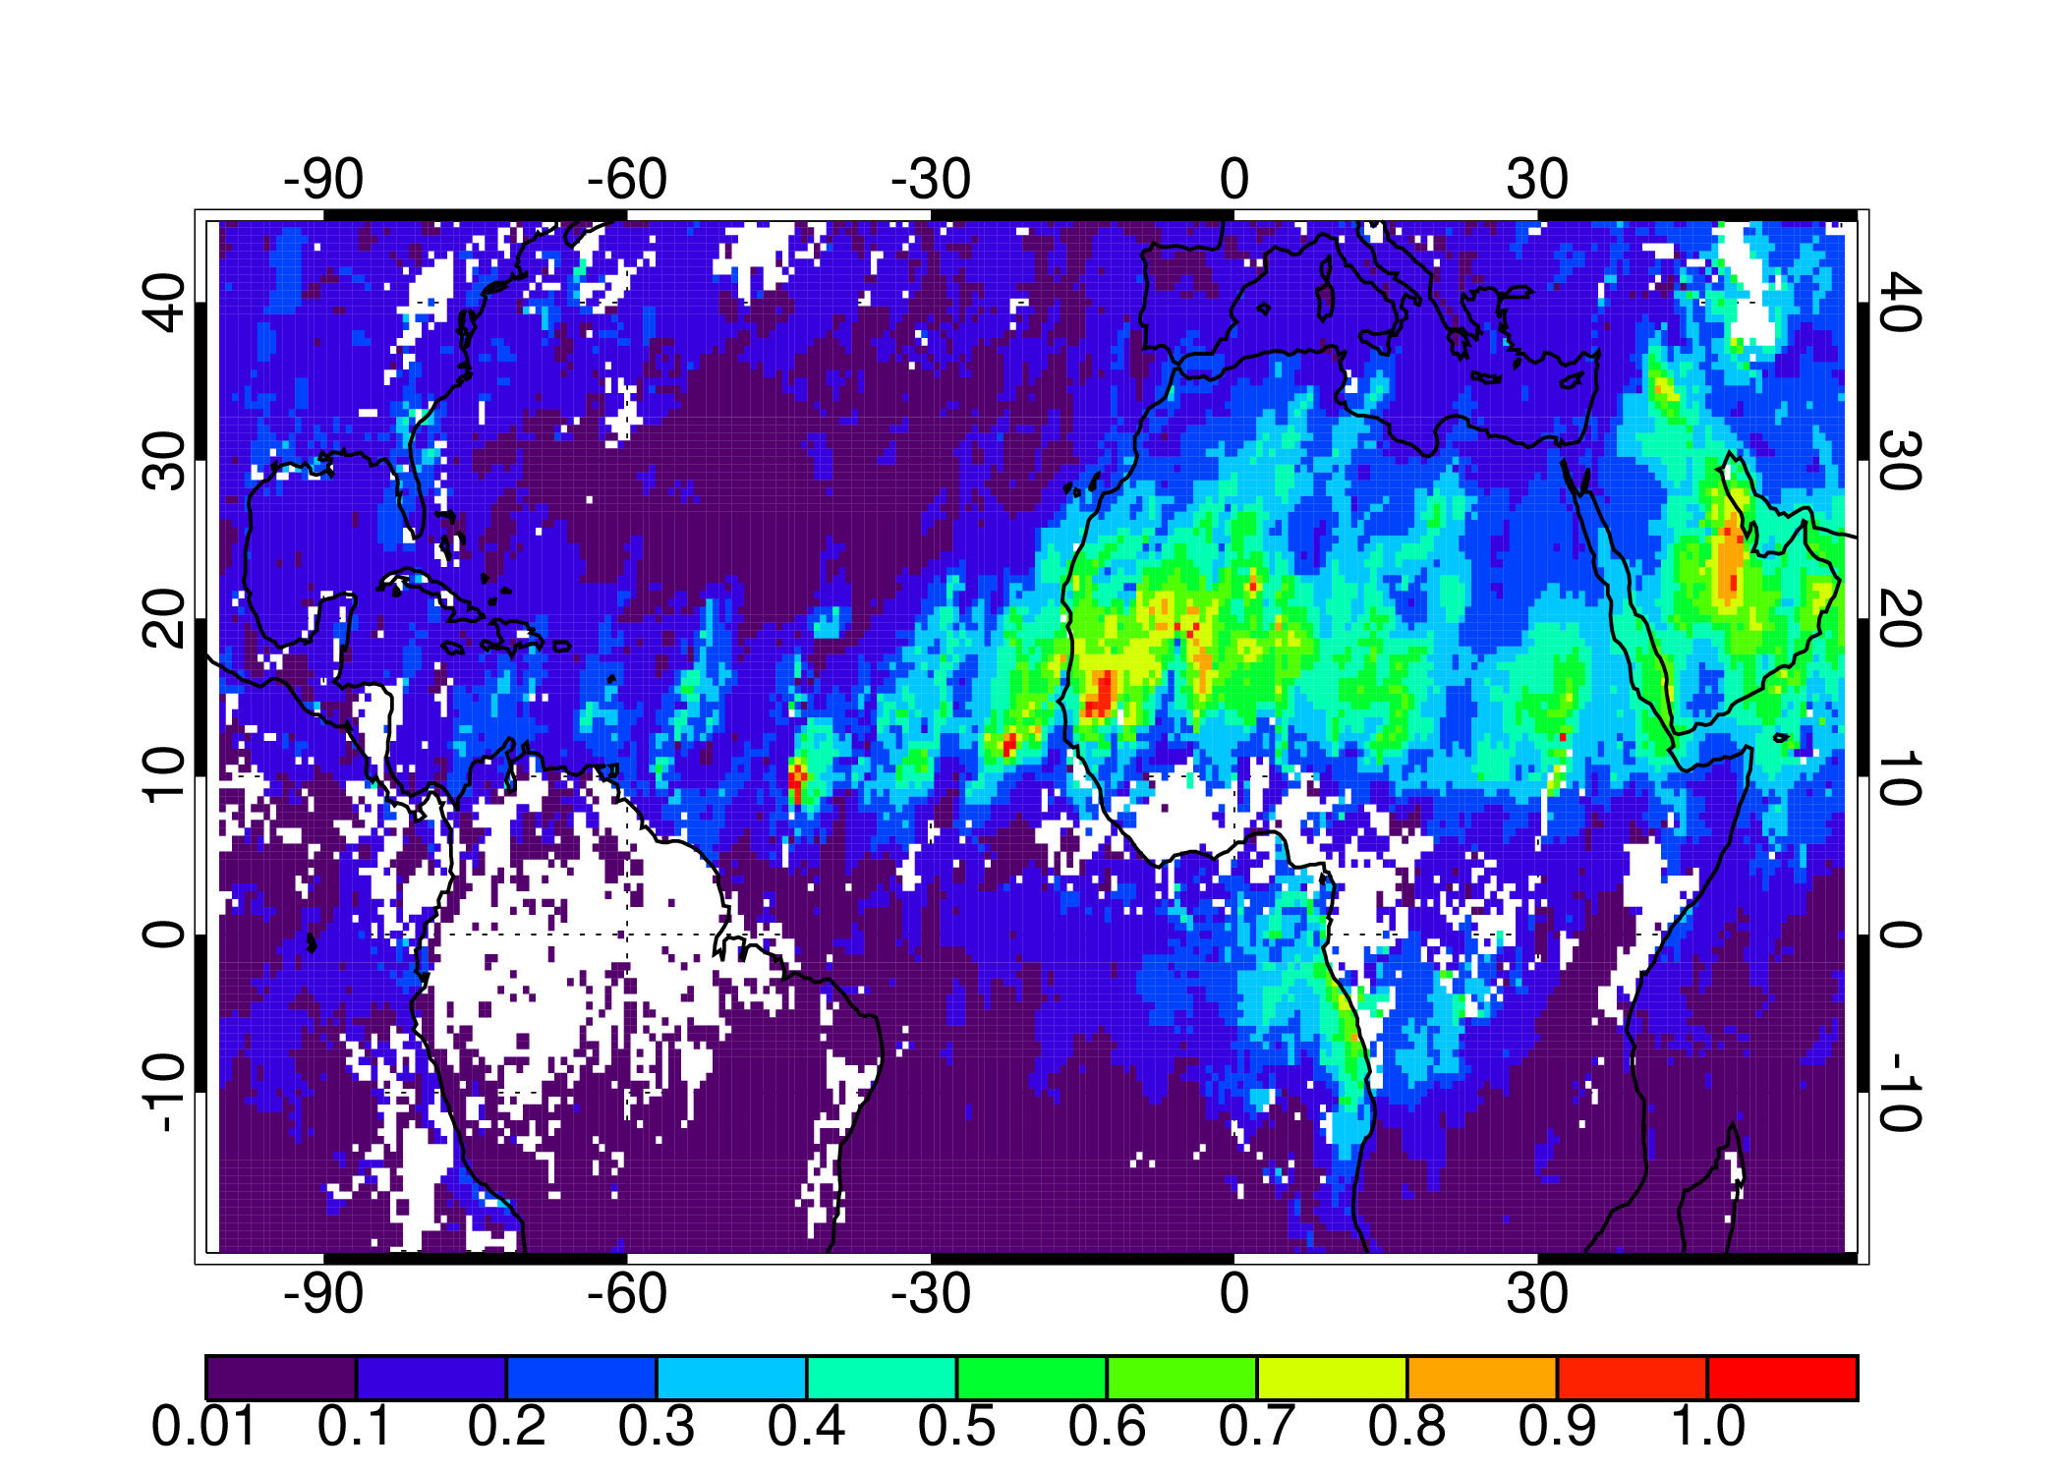
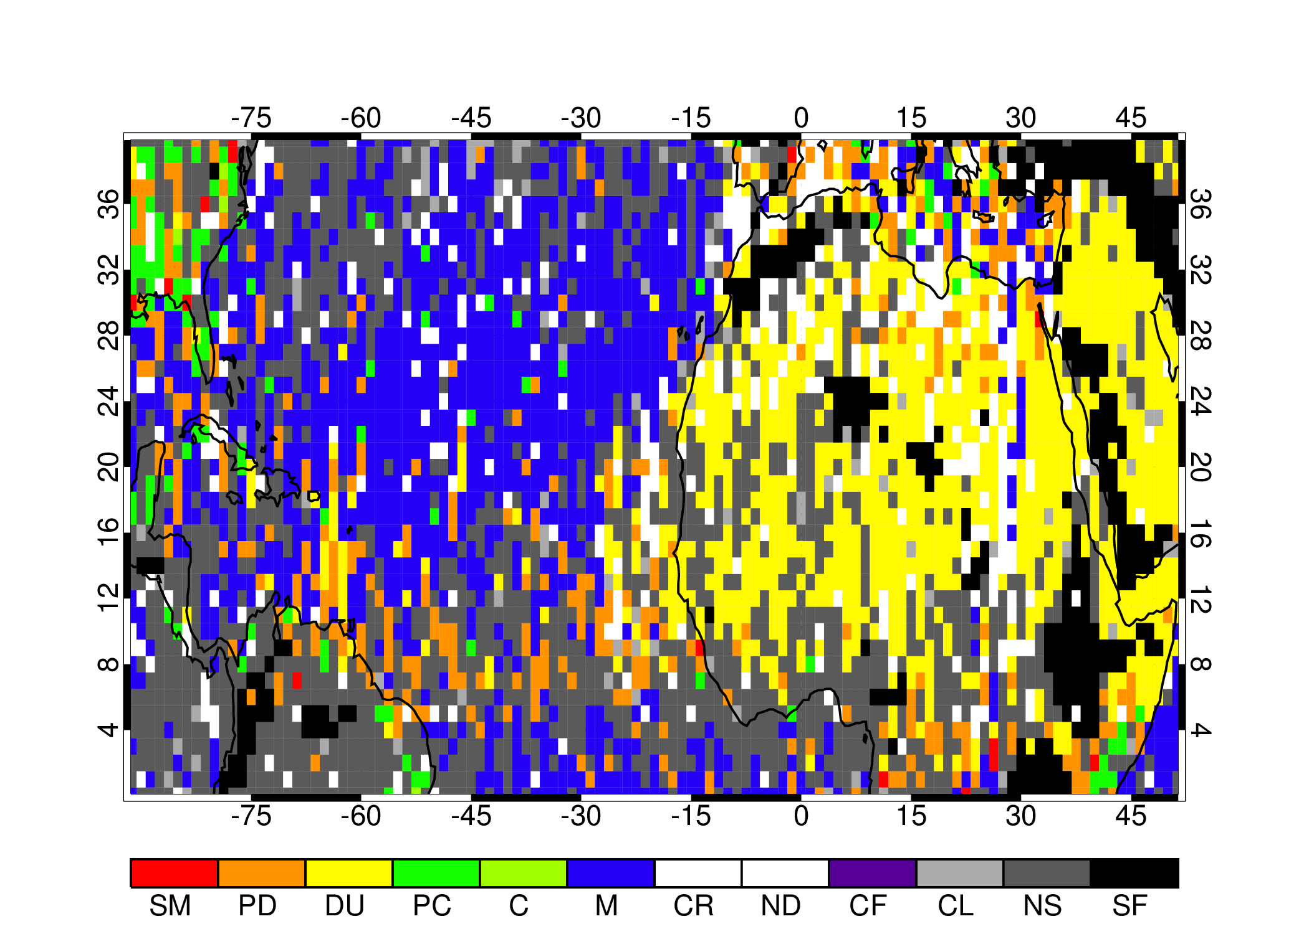
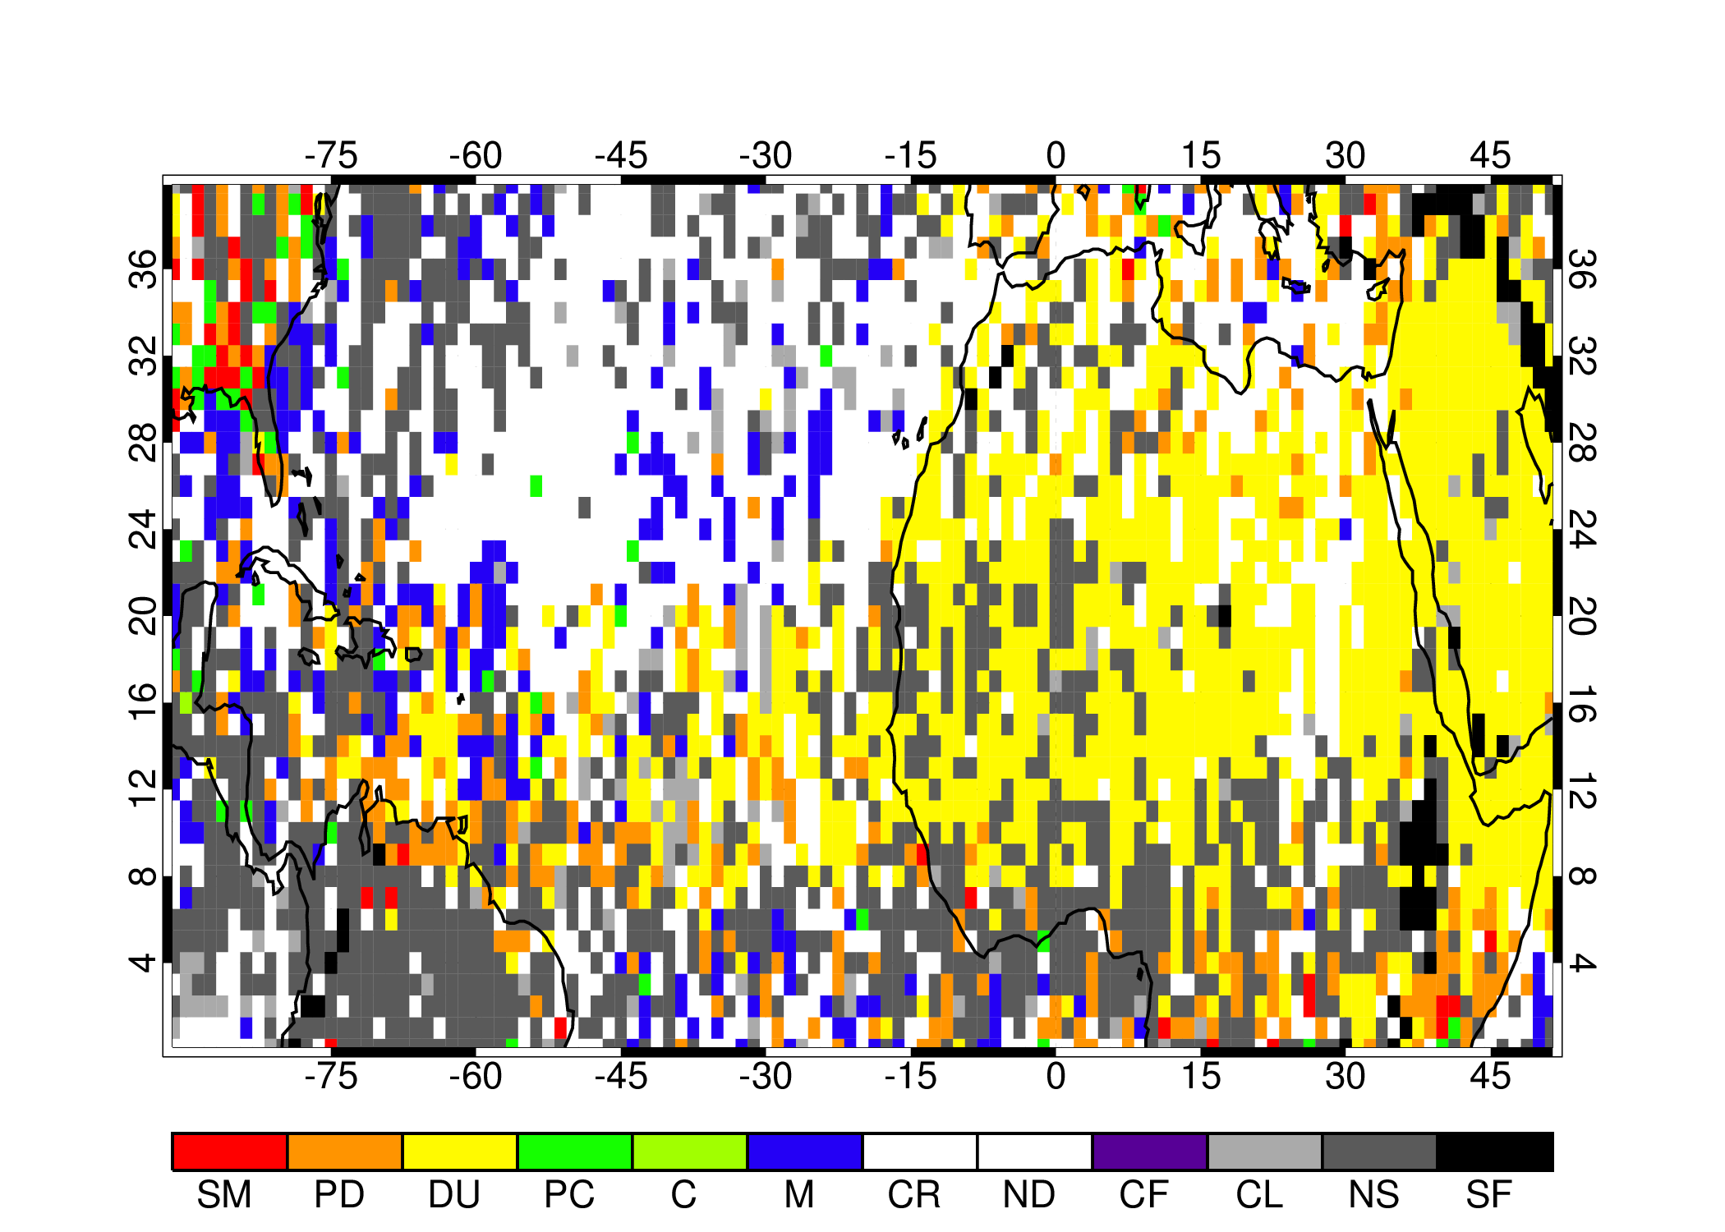
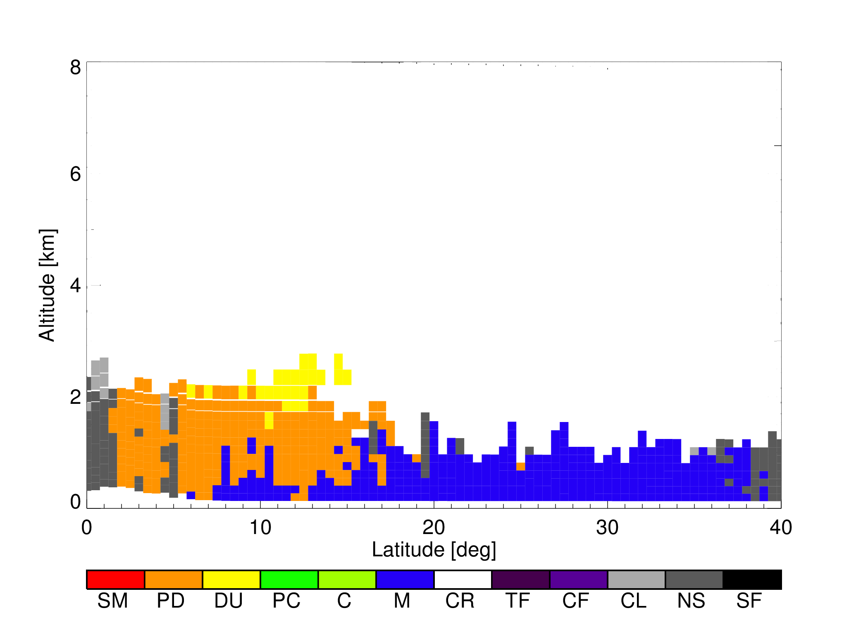
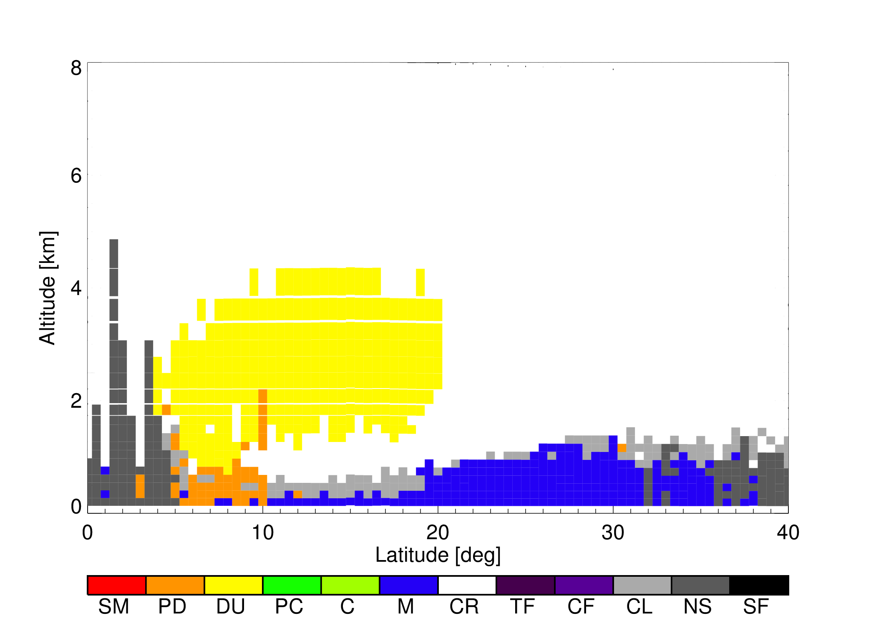
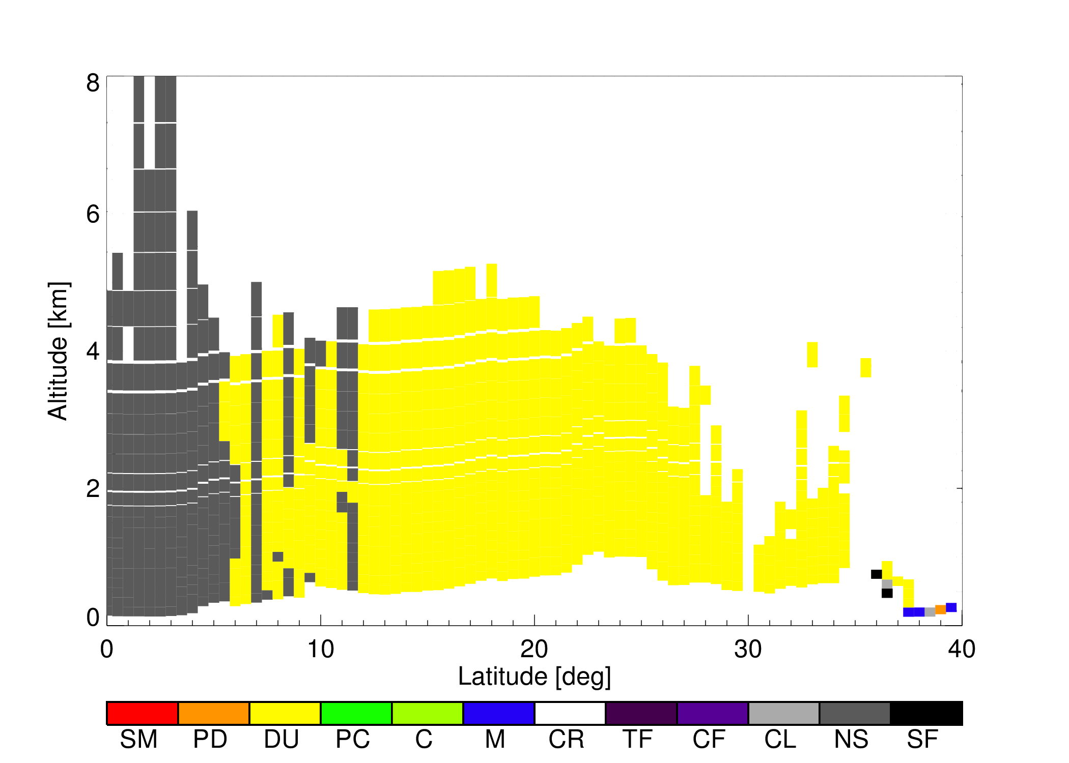
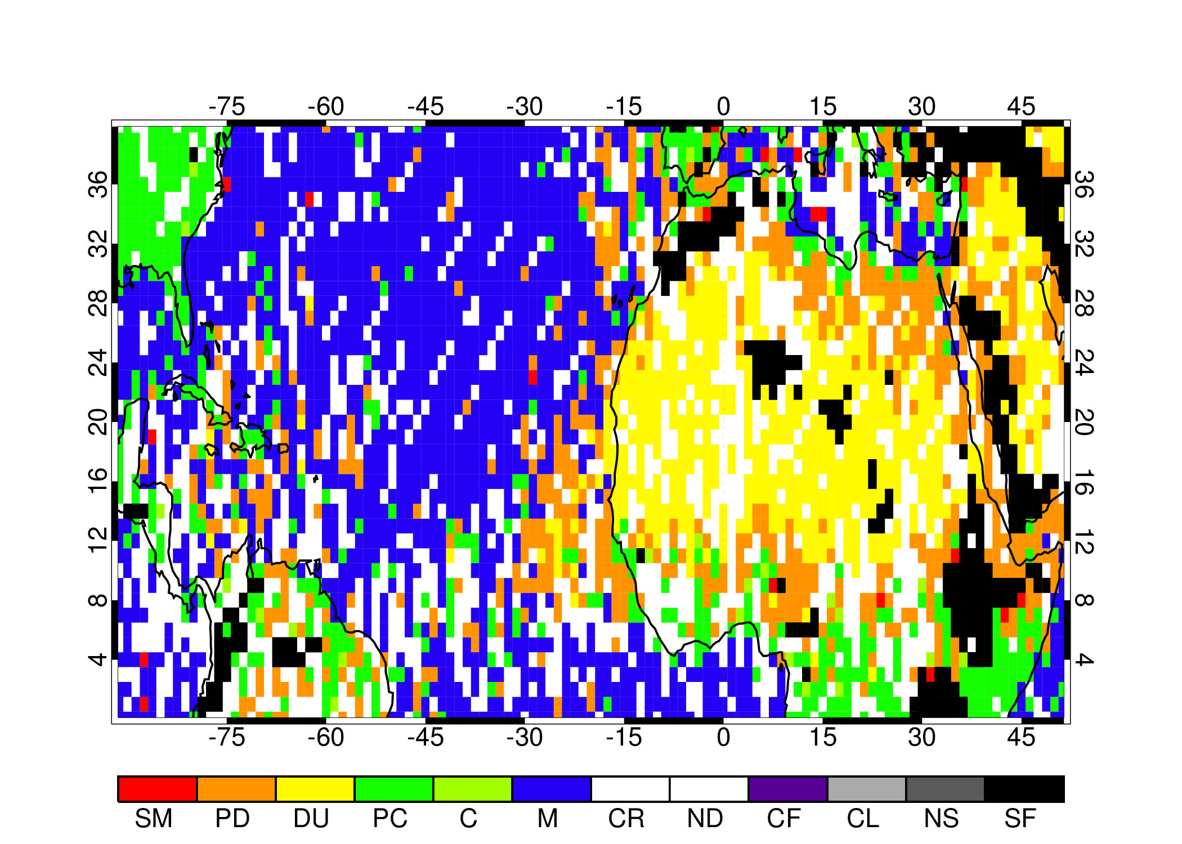
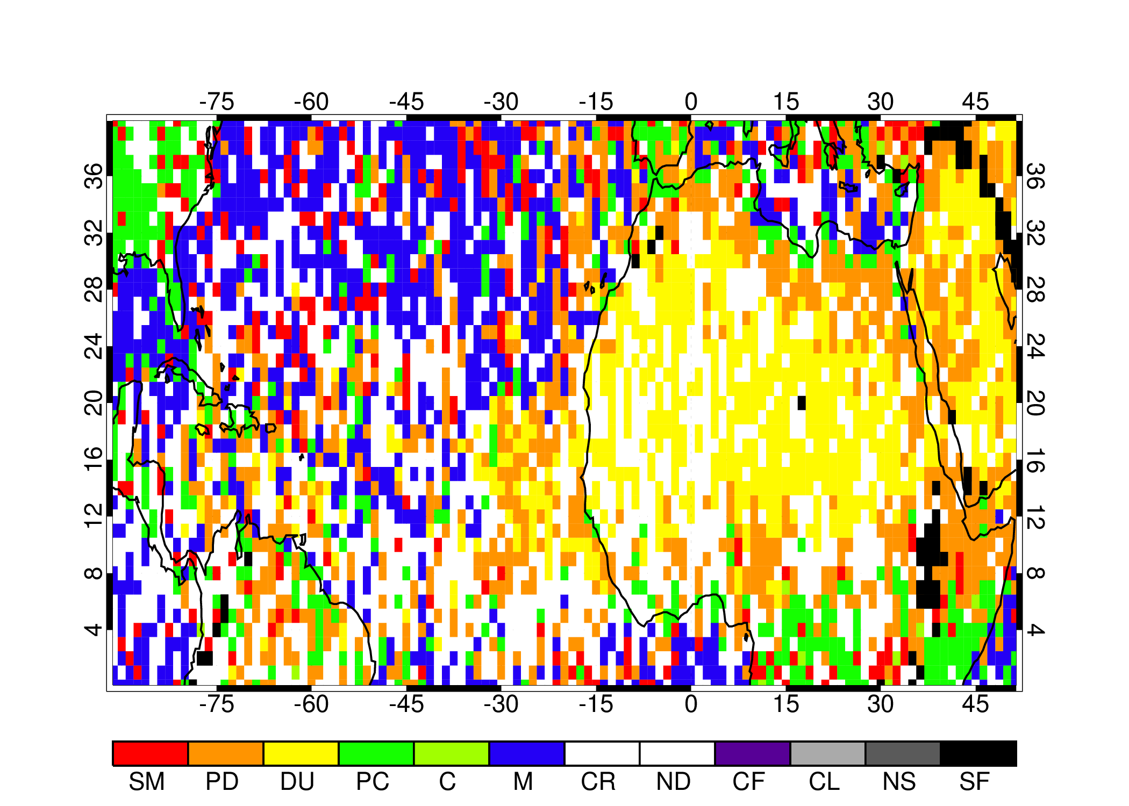
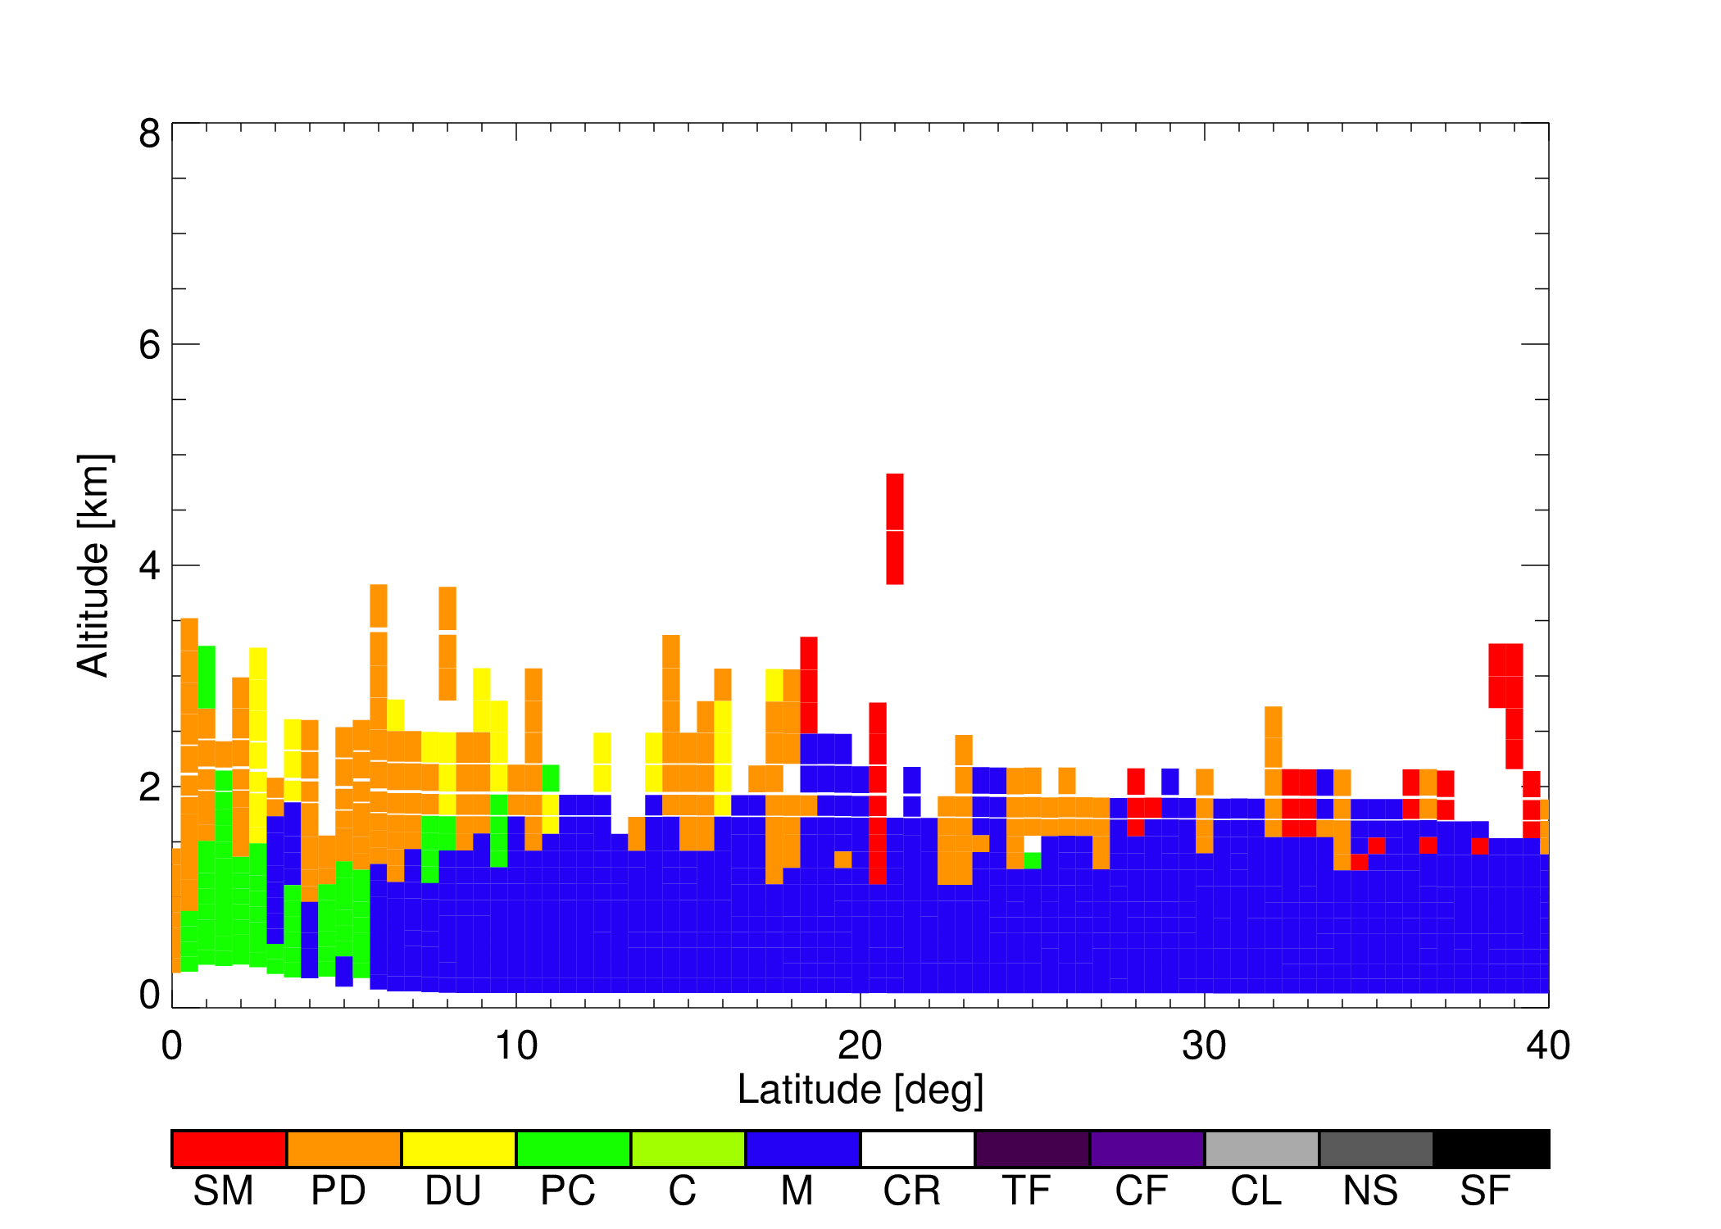
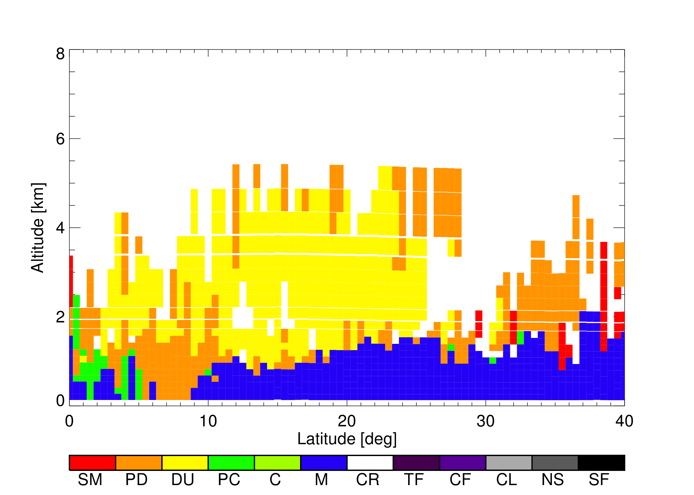
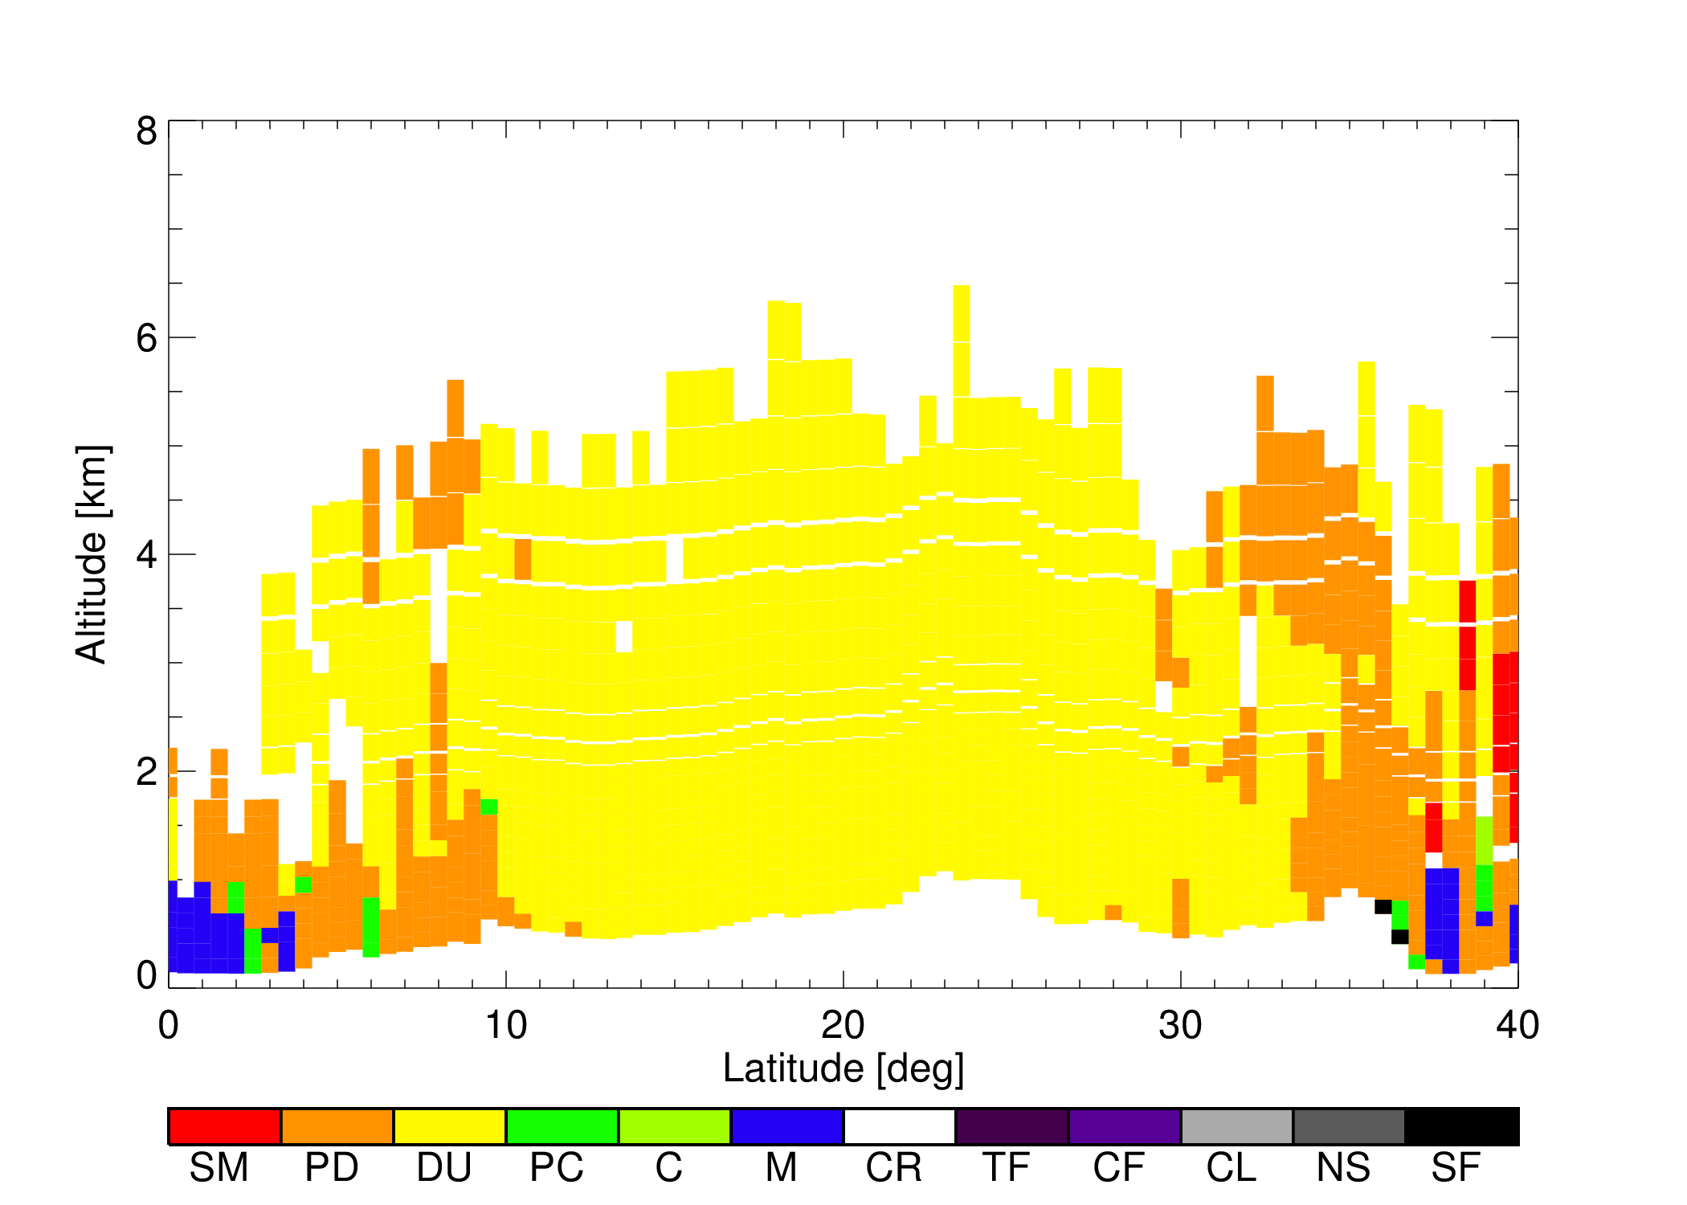
Using the CALIOP Vertical Feature Mask to Evaluate Aerosol Composition
MISR
AERONET
A complementary approach to investigate aerosol vertical distribution is to simulate the CALIOP lidar signal from MERRAero fields and then run CALIOP vertical feature mask algorithm (vertical composition mapping). This is possible because of detailed optical models (e.g., depolarizing dust)
Cape Verde
La Parguera
GEOS-5 (Sampled)
CALIOP VFM
1 – 2 km
0 – 1 km
60° W
30° W
0°
SM
PD
DU
PC
C
M
CR
CL
NS
SF
MERRAero VFM
1 – 2 km
0 – 1 km
Nowottnick et al., Manuscript in preparation

Slide 11
Forecasting Support and Event Simulation
Observation Simulation
Aerosols-Chemistry-Climate
Future Applications

Slide 12
Response to Aerosol Direct and Semi-Direct Effects
Climate simulations forced with either all or natural (dust + sea salt) aerosols
Aerosols radiatively coupled: direct and semi-direct effects included
Total aerosol effect
Cooler land surface and warmer troposphere in tropics and midlatitudes reduces cloud amount (positive semi-direct effect)
Strengthened Hadley circulation, strengthening and poleward migration of midlatitude jets and storm tracks (expansion of the tropics)
Increased water vapor
Natural aerosol effect
Generally opposite of total aerosol effect (weakened Hadley circulation, decreased atmospheric water vapor)
Response in SH strongly influenced by sea salt aerosol (e.g., strengthening of zonal wind)
Randles et al., Direct and semi-direct aerosol effects in the NASA GEOS-5 AGCM: aerosol-climate interactions due to prognostic versus prescribed aerosols, J. Geophys. Res., doi:10.1029/2012JD018388 (2013)

Slide 13
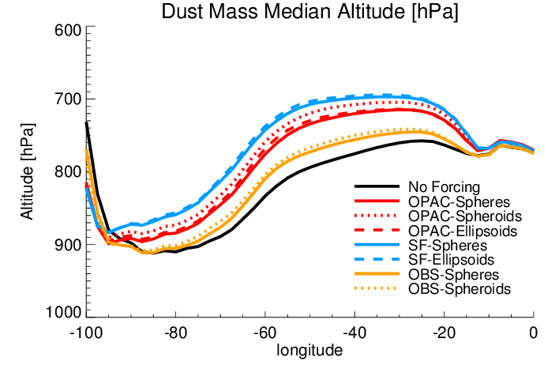
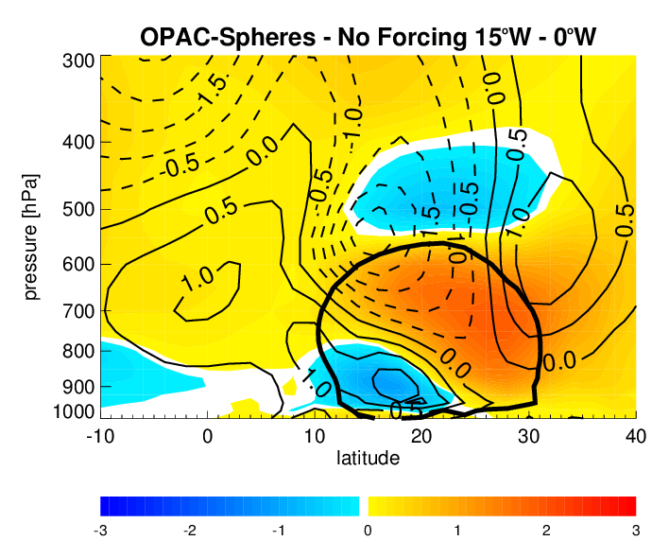
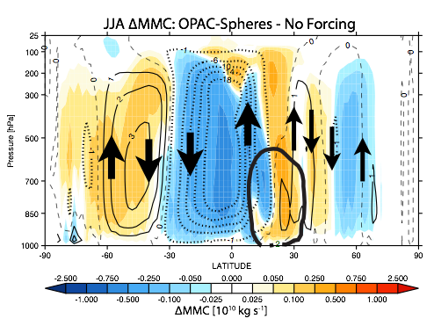
Impact of Dust Forcing on Dust Altitude
Dust Mass Median Height 10° - 30° N
Dust Radiative Impact on Transport and Lifecycle
Multi-decadal climate simulations with interactive dust aerosols
Sensitivity to dust optical properties, including refractive index and particle shape
Strengthening of African Easterly jet and elevation of Saharan dust plume associated with enhanced dust absorption leads to longer range transport
JJA West Africa Temperature Profile and Zonal Mean Wind (Absorbing - No Dust)
JJA Impact of Dust Forcing on Mean Meridional Circulation
ΔT [K]
Colarco et al., Impact of Radiatively Interactive Dust Aerosols in the NASA GEOS-5 Climate Model: Sensitivity to Dust Particle Shape and Refractive Index, submitted J. Geophys. Res. (2013)

Slide 14

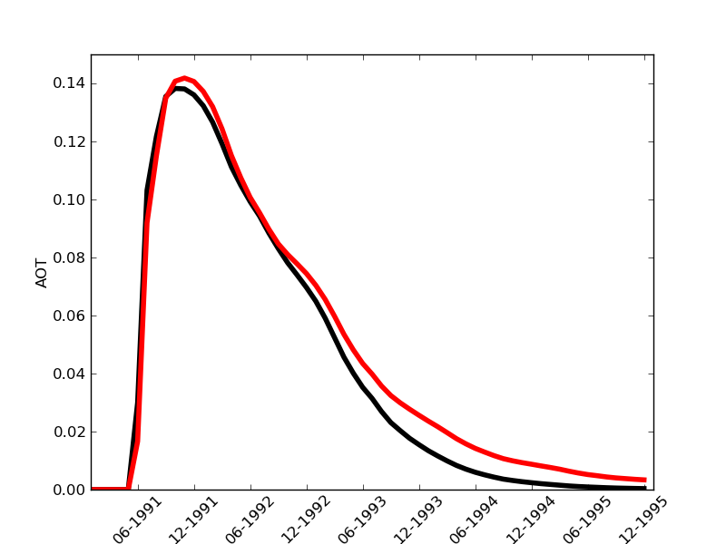
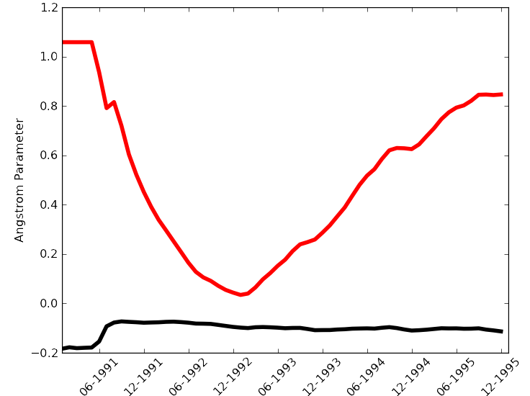
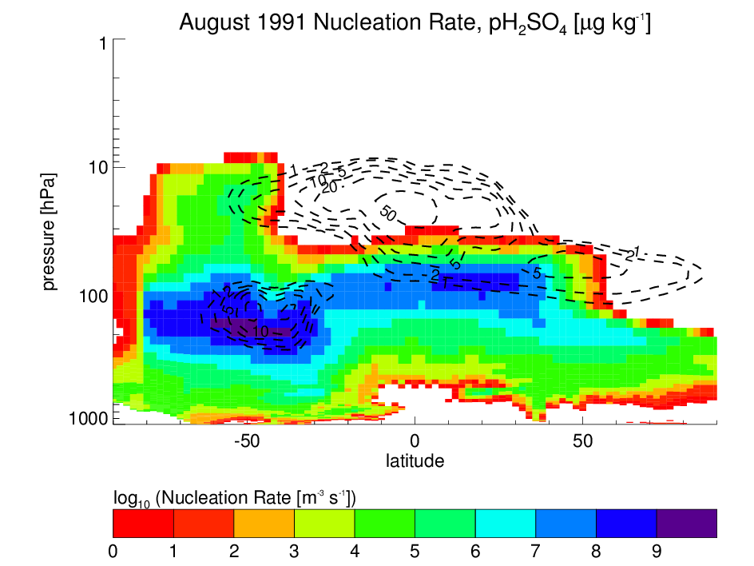
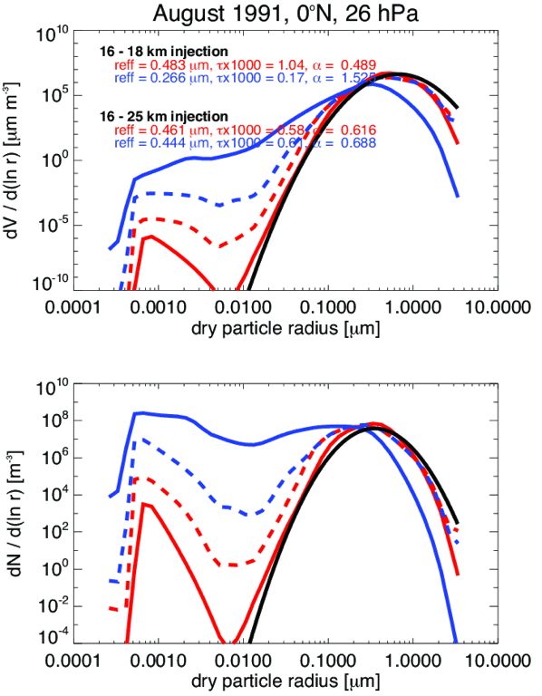
Simulation of Stratospheric Aerosols
Modification of GOCART mechanism to treat a separate stratospheric sulfate with its own optical properties
Coupling of stratospheric sulfate tracer with stratospheric chemistry module to investigate ozone impacts
Additionally, development of a new sectional aerosol microphysical module (CARMA) that explicitly resolves evolution of aerosol particle size distribution
Application to studies of 1991 Mt. Pinatubo eruption
AOT
Angstrom Parameter
GOCART
CARMA
GOCART
Sectional aerosol scheme permits study of particle formation and evolution of size distribution.
Aquila et al., Dispersion of the Volcanic Sulfate Cloud from a Mount Pinatubo-like Eruption, J. Geophys. Res., 117, D06216, doi:10.1029/2011JD016968 (2012)
Aquila et al., The Response of Ozone and Nitrogen Dioxide to the Eruption of Mt. Pinatubo at Southern and Northern Midlatitudes, J. Atm. Sci., 70 DOI: 10.1175/JAS-D-12-0143.1 (2013)

Slide 15
Aerosol-Chemistry-Climate Interaction
GEOSCCM with coupled aerosol (GOCART) and stratospheric chemistry.
Pinatubo: 20 Tg SO2 injection between 15 km and 18 km on 15 June 1991
Geoengineering: 5 Tg/year SO2 between 16 km and 25 km for 50 years
Zonal mean AOT
Zonal mean AOT
Global Stratospheric Column NOx
Global Column O3
Aquila et al., The Response of Ozone and Nitrogen Dioxide to the Eruption of Mt. Pinatubo at Southern and Northern Midlatitudes, J. Atm. Sci., 70 DOI: 10.1175/JAS-D-12-0143.1 (2013)
Pitari et al., Stratospheric Ozone Response in Experiments G3 and G4 of the Geoengineering Model Intercomparison Project (GeoMIP), in preparation for J. Geophys. Res. (2013)

Slide 16
Forecasting Support and Event Simulation
Observation Simulation
Aerosols-Chemistry-Climate
Future Applications

Slide 17
Biomass Burning Aerosol Direct and Semi-Direct Effects
Replaying from MERRA, the GEOS-5 Analysis Update (AU) constrains the model state (u, v, t, p, q) every 6-hours, preventing aerosol heating from inducing regional-scale circulation changes that could impact clouds → isolates thermodynamic semi-direct effect only.
AU can also be used, along with observations of aerosol properties, as an additional tuning parameter in a series of sensitivity studies:
Biomass burning aerosols heat atmosphere (positive SW temperature tendency, below).
BUT, AU shows that additional heating is needed!
Could be not enough aerosol, aerosol not absorbing enough, etc.
Randles et al., Improving estimates of biomass burning aerosol direct and semi-direct effects using the GEOS-5 Incremental Analysis Update (IAU), (NNH10ZDA001N-ACMAP)

Slide 18
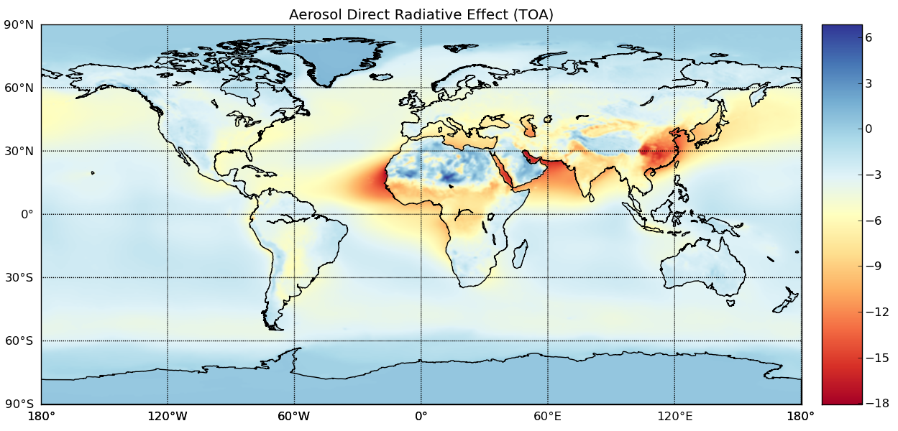
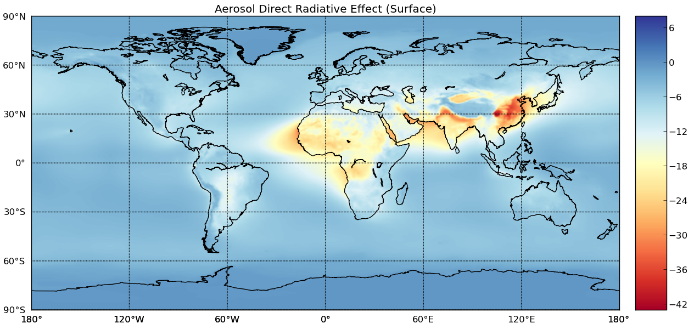
Diagnosing Model Dependent Uncertainty in Estimates of Aerosol Direct Effect
MERRAero Estimated Clear-Sky Aerosol Radiative Effect
Sampling of Aerosol Composition Diversity in AeroCom
Source | TOA SW DRE Ocean (Land) | Atmos. Ocean (Land) | Surface SW DRE Ocean (Land)
MERRAero | -3.8 (-4.3) | 2.8 (6.8) | -6.6 (-11.1)
Other Observational Yu et al. (2006) | -5.5 ± 0.2 (-4.9 ± 0.7) | 3.3 (6.8) | -8.8 ± 0.7 (-11.8±1.9)
Multi-model Ensemble Yu et al. (2006) | -3.4 ± 0.6 (-2.8 ± 0.6) | 1.4 (4.4) | -4.8 ± 0.8 (-7.2 ± 0.9)
GEOS-5 (Free) | -3.4 (-2.7) | 0.5 (2.8) | -3.9 (-5.5)
From Kinne et al. 2006
Diversity in AeroCom Anthropogenic Direct Forcing
MERRAero constrains the total AOT (550 nm)
Aerosol composition, vertical distribution, etc., remain very model dependent → corresponding uncertainties in forcing
Indeed, AeroCom and other studies make clear that there are large model dependencies in estimates of aerosol direct effect
Biomass burning aerosols heat atmosphere (positive SW temperature tendency, below).
BUT, AU shows that additional heating is needed!
Could be not enough aerosol, aerosol not absorbing enough, etc.
From Schulz et al. 2006
Colarco et al., Diagnosing uncertainty in the aerosol direct radiative effect with the NASA GEOS-5 model and NASA satellite observations, (NNH12ZDA001N-ACMAP)

Slide 19
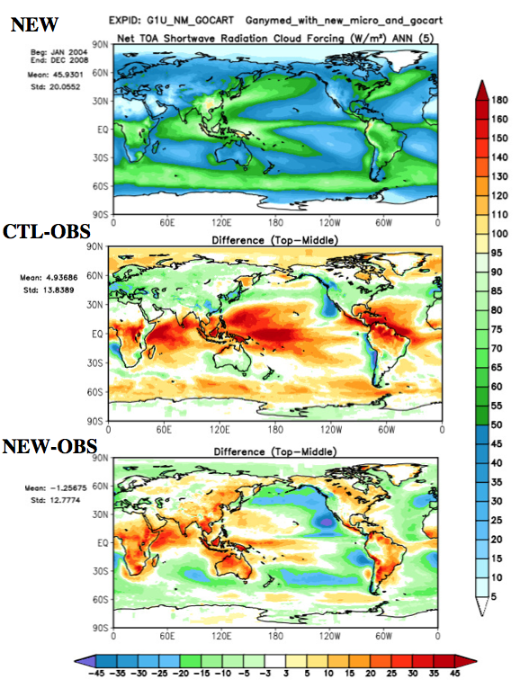
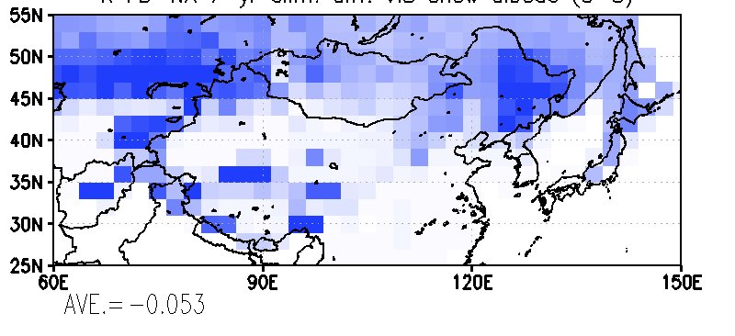
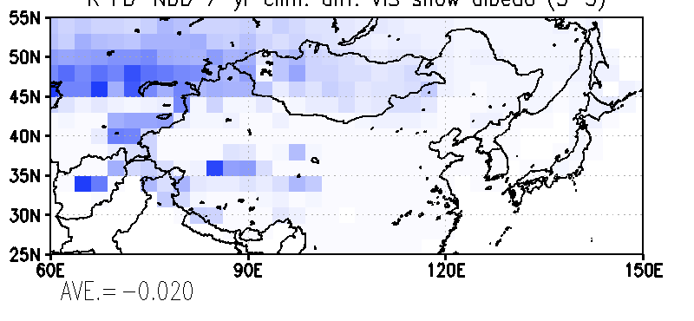
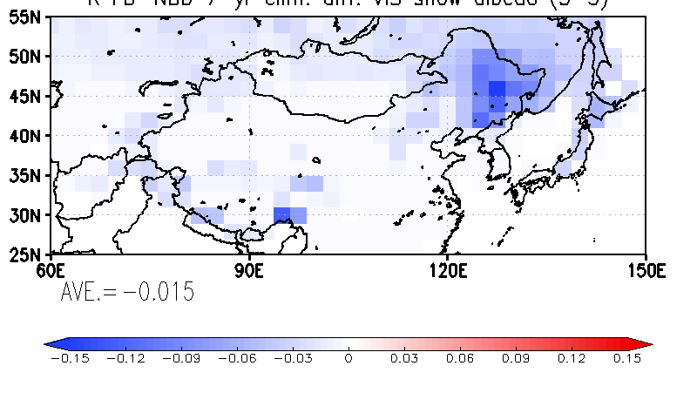
Future Applications
Enhanced Composition and Size Modeling for Aerosol Direct and Indirect Effects
Change in Surface Reflectance Due to Aerosol Deposition over Snow
All Aerosols - No Aerosols
Black Carbon Impact
Dust Impact
Courtesy Donifan Barahona
Courtesy Teppei Yasunari

Slide 20


Future Applications
Aerosols Composition and Chemistry
→ Air quality (TEMPO, Geo-CAPE, GEMS, Sentinel-4)
→ Aerosol-Clouds (CATS, PACE/ACE, EarthCare)
Forecasting and Event Simulation
→ NRT volcanic emission forecasting
→ Continued involvement with field missions
Observation Simulation
→ Observation interpretation (PODEX)
→ OSSEs for mission design (ACE, CATS)
→ Data assimilation activities (…)
Aerosols-Chemistry-Climate
→ Stratospheric aerosols, ozone recovery
→ CCMI
→ Coupled ocean → climate impacts

