Slide 1
MAIAC Update Alexei Lyapustin, GSFC, code 613 Yujie Wang (UMBC), Sergei Korkin (USRA) AEROCENTER Annual Meeting
May 31, 2013

Slide 2
MAIAC = Time Series + Spatial Analysis
MODIS, TOA RGB
NBRF
AOT
BRF

Slide 3
Multi-Angle Implementation of
Atmospheric Correction (MAIAC)
QB:Is Snow Detected?
4a. Retrieve Snow sub-pixel Fraction and Snow Grain Size
Queue of K days
New Granule
1. Grid L1B Data and Split in Tiles
2. LTP: Retrieve
Water Vapor
(NIR Algorithm)
3. QB, LTP: Cloud Mask (Covariance-Based Algorithm)
Is B7 BRF known?
No
Use MODIS Dark Target Algorithm
Yes
7. QP: Retrieve BRF and albedo in reflective bands.
Backup: Lambertian retrieval
6. LTP: Retrieve Fine Mode Fraction
5. LTP: Retrieve B3 AOT using known surface BRF, ρ_{B}=ρ₇b_{B}
4. QB: Retrieve Spectral Regression Coefficients in Blue band B3 (b_{B}).
MAIAC Products (1 km, gridded)
Atmosphere: Surface:
Cloud Mask; Parameters of RTLS BRF model;
Water Vapor; Surface Reflectance (BRF)/ Albedo;
AOT & aerosol type; Dynamic Land-Water-Snow Mask.

Slide 4
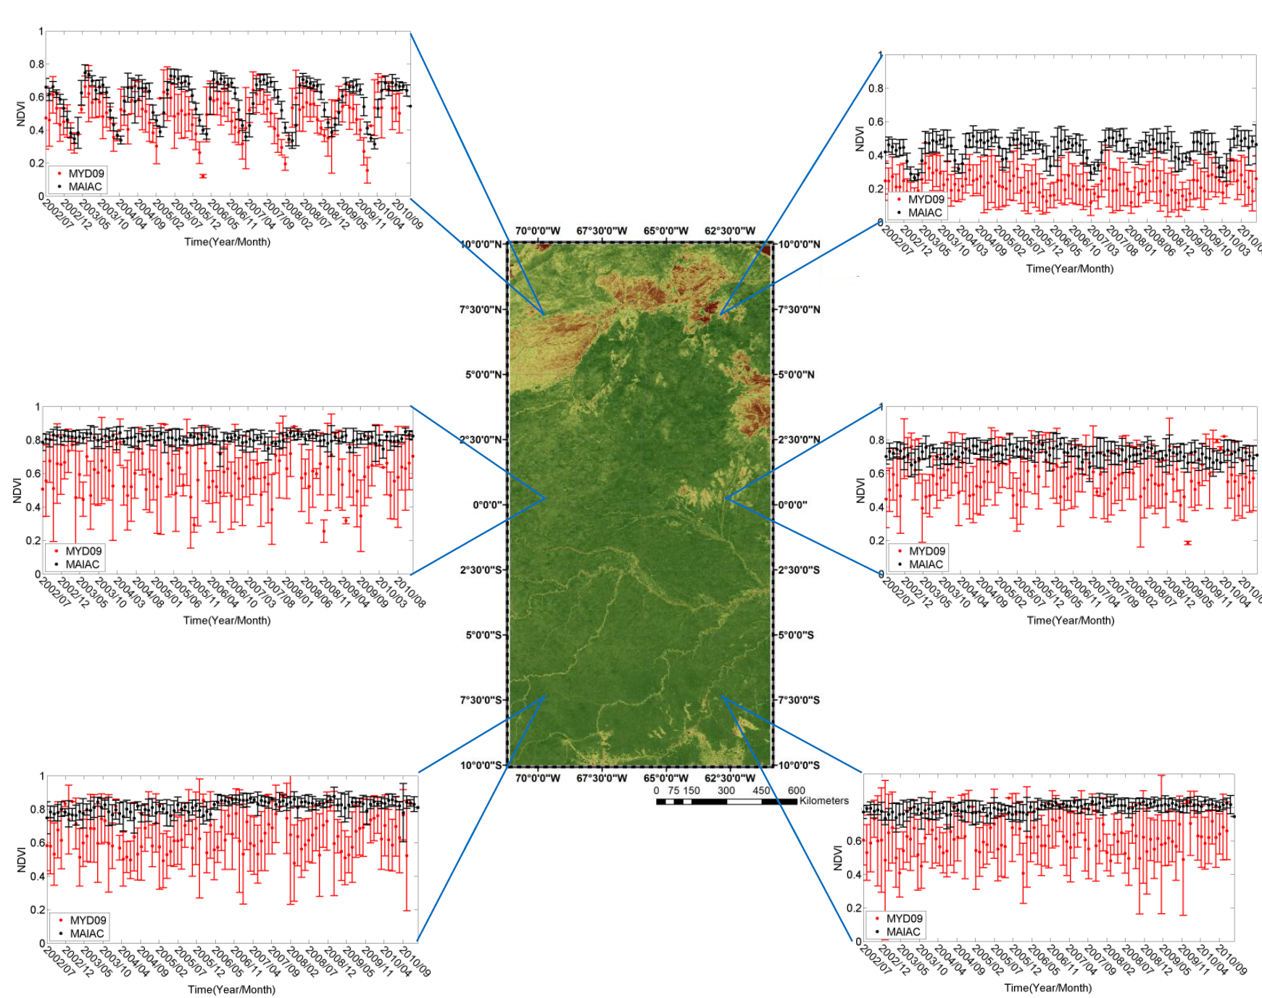
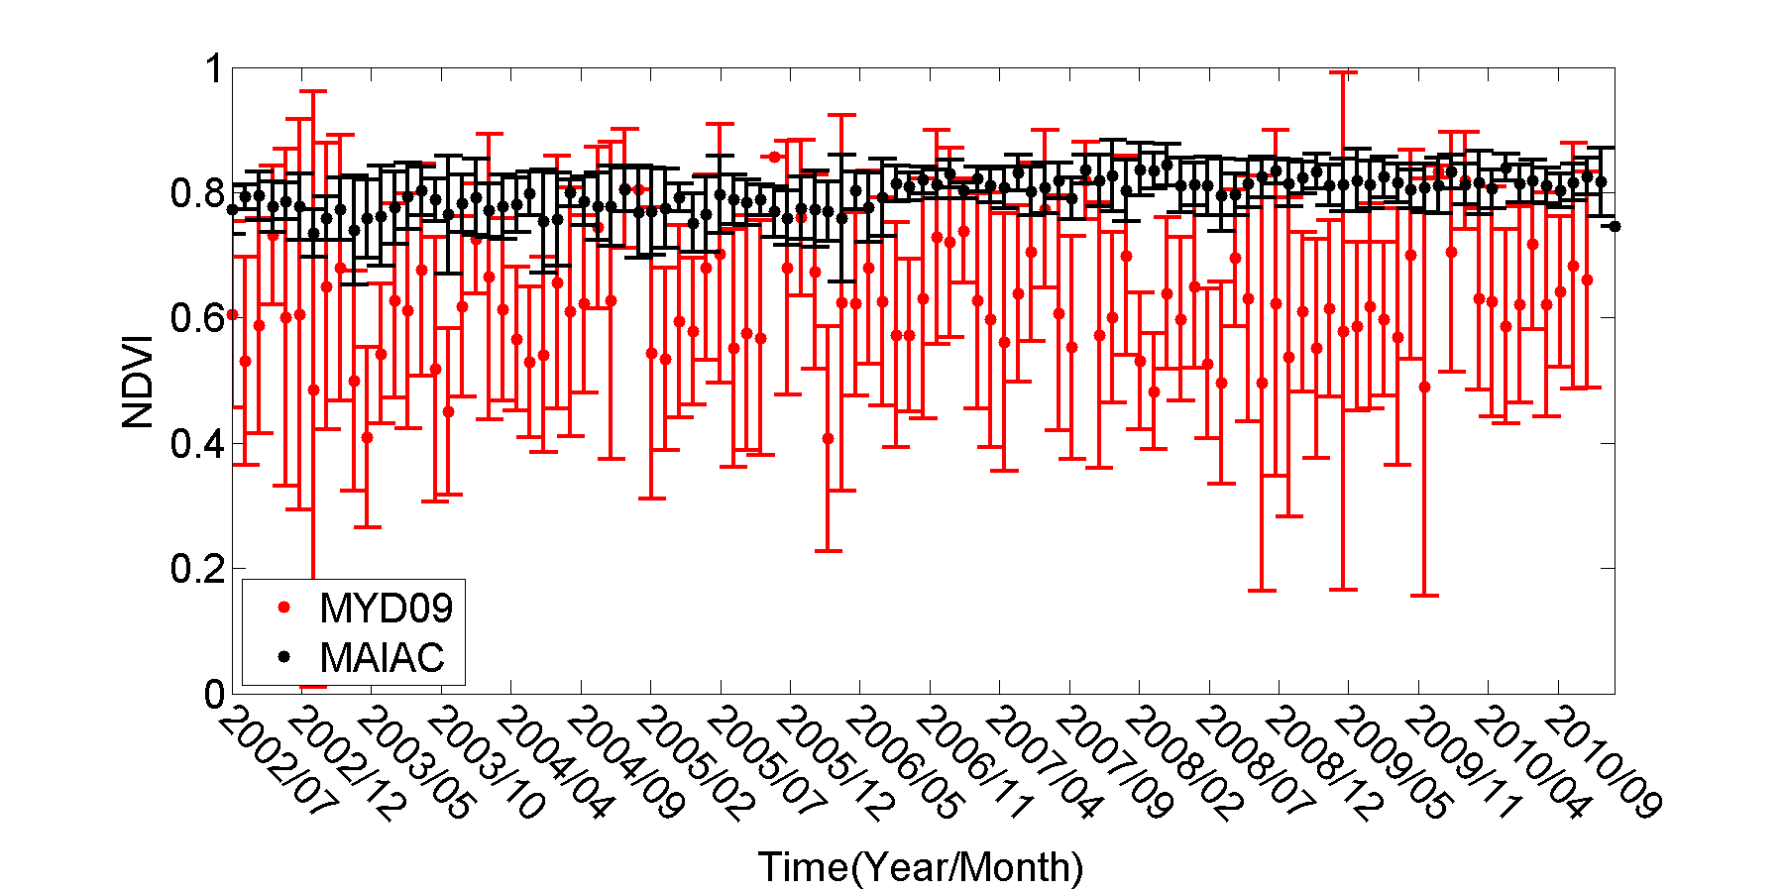
Amazonia: Comparison with MOD09

Slide 5
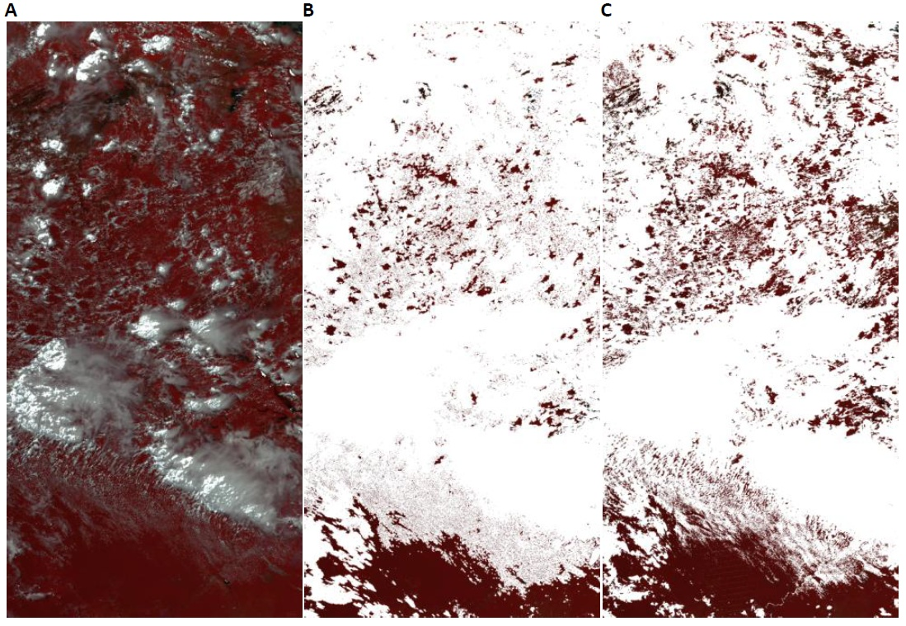
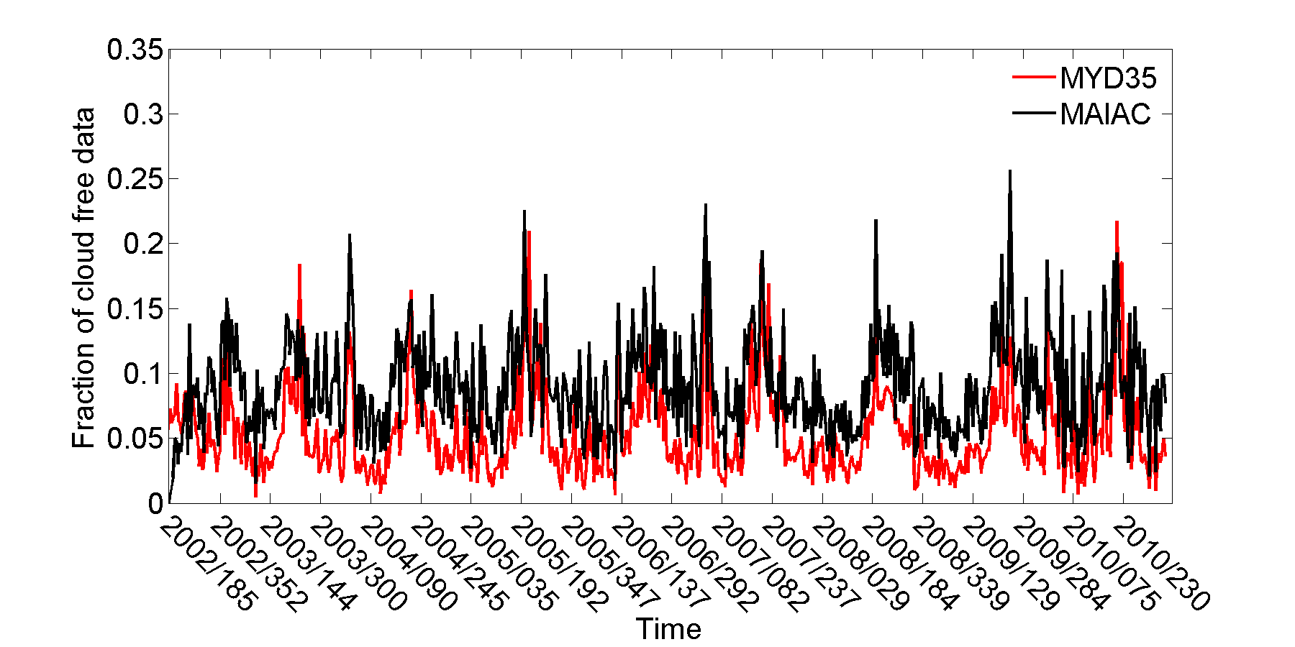
Cloud mask
MODIS TOA
MOD35 CM
MAIAC CM
Hilker, T., A. I. Lyapustin, C. J. Tucker, P. J. Sellers, F. G. Hall, Y. Wang, 2012: Remote Sensing of Tropical Ecosystems: Atmospheric Correction and Cloud Masking Matter. RSE, http://dx.doi.org/10.1016/j.rse.2012.08.035.
MAIAC Terra&Aqua Amazon dataset is available on the LAADS FTP site ftp://ladsweb.nascom.nasa.gov/MAIAC/

Slide 6
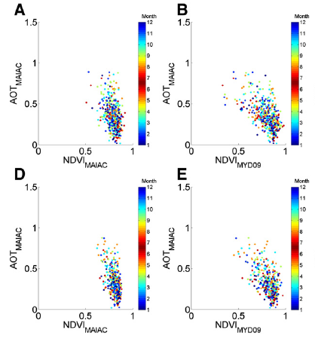
Aerosol Effect on NDVI
Northern area
(7°30′ N, 70° W)
Southern area
(7°30′ S, 70° W)

Slide 7
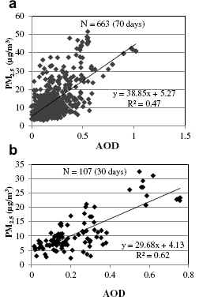
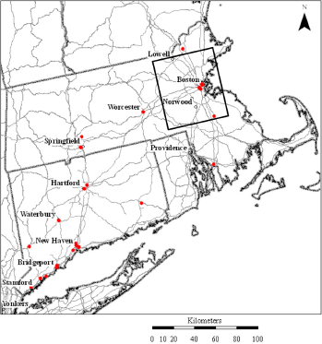
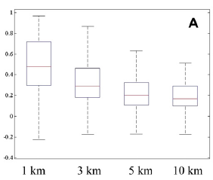
Air Quality Applications
Harvard School of Public Health
A. Chudnovsky, P. Koutrakis, J. Schwartz, I. Kloog
Effect of Spatial Resolution
Regional
Intra-Urban, 5 EPA sites, 10km box
26 EPA Sites
Range
AOD- PM_{2.5} R²
25, 75%
Median
A. Chudnovsky, A. Kostinski, A. Lyapustin and P. Koutrakis, 2012: Spatial scales of pollution from variable resolution satellite imaging, Environmental Pollution, 172, 131-138.

Slide 8
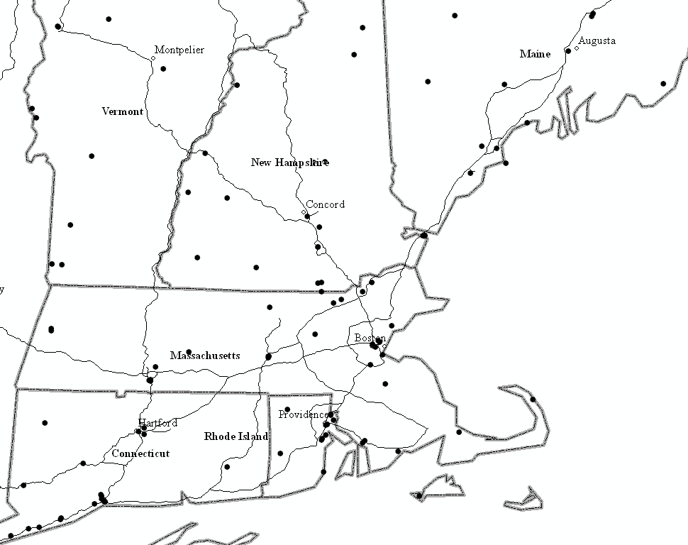
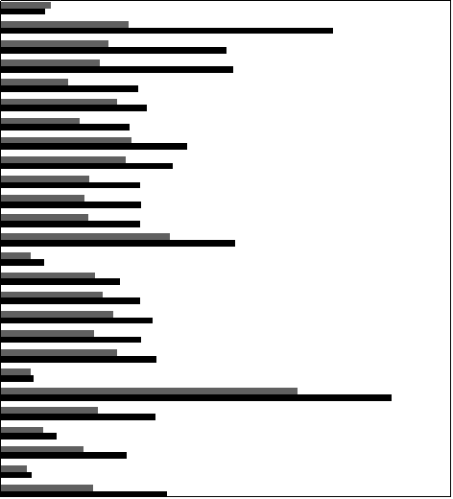
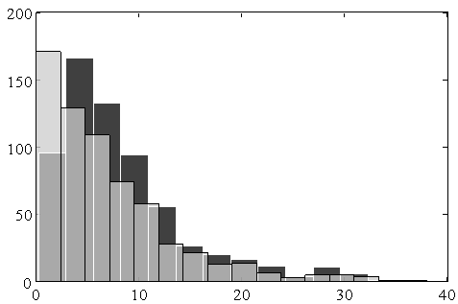
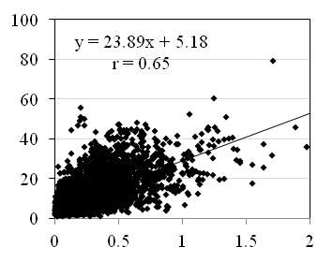
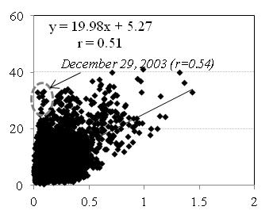
Predicting Spatial Pattern of PM_{2.5}
1. More Data Availability (1.5-1.8)
Region 1
MAIAC
MYD04
R
MYD04/MAIAC
1: 0.62 0.62
2: 0.56 0.62
3: 0.66 0.69
Site
Average Increase in N_{obs}: Collocated-1.52;
Non-coll. – 1.77
Region 2
Region 3
85 EPA Sites
N_{obs} (2002-2008)
2. Larger Observed PM-contrast
3. Providing Data in PCloudy Conditions
MAIAC
MYD04
Frequency
PM_{2.5} (μg/m³)
PM _{max} – PM _{min}
MAIAC AOD
Days with MYD04
Days without MYD04 (344)

Slide 9
Aerosol Algorithm: Smoke Test
Lyapustin, A. et al., 2012: Discrimination of biomass burning smoke and clouds in MAIAC algorithm, ACP, 12, 9679–9686.
Phys. principles (~OMI): 1) n_{i} increases R→DB; 2) Multiple scattering, and absorption, increase R→DB, for absorbing aerosols.
TOA RGB CM AOT_{0.47} Angstrom SP (b) AP (0.7-0.91) Smoke Mask NBRF
DOY 253-254
500m
199, 500m

Slide 10
Georgia/Florida Fires of 2007
Removal of polluted air by weather system [Lyapustin et al., 2012, ACP].

Slide 11
Aerosol Type Discrimination
TOA
CM
AOT
δ_{0.412}
δ_{0.47}
δ_{0.66}
δ_{2.13}
BW
Aerosol
Reflectance:
Rockies
S. Israel
Model | Abs. | Size
Backgr. | No | Small
Smoke | Yes | Small
Dust | Yes | Large
Backgr./Smoke/Dust

