Slide 1
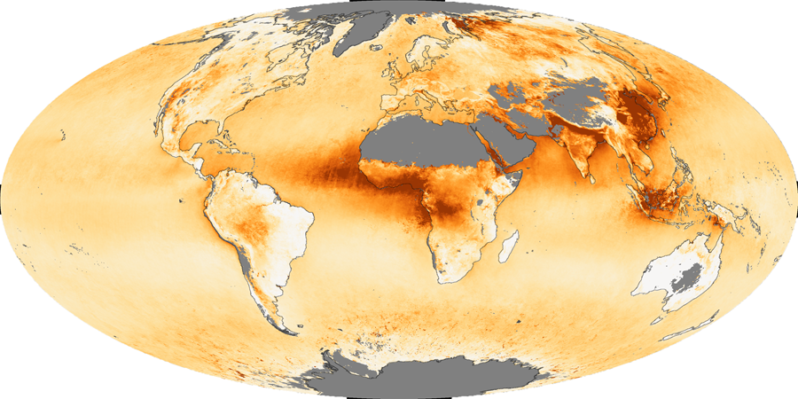
2010 Aerosol Update NASA-GSFC Visitor Center April 29, 2010
Rob Levy (SSAI/GSFC 613.2)
Huisheng Bian (UMBC/GSFC 613.3)
Toshi Matsui (GEST/GSFC 613.1)
Sasha Sinyuk (Sigma/GSFC 614.4)
Cathy Newman (SSAI / GSFC 613.2)

Slide 2
Agenda
What is AeroCenter?
Highlights from 2009-2010
This year’s update
12 talks
18 posters
The near future

Slide 3
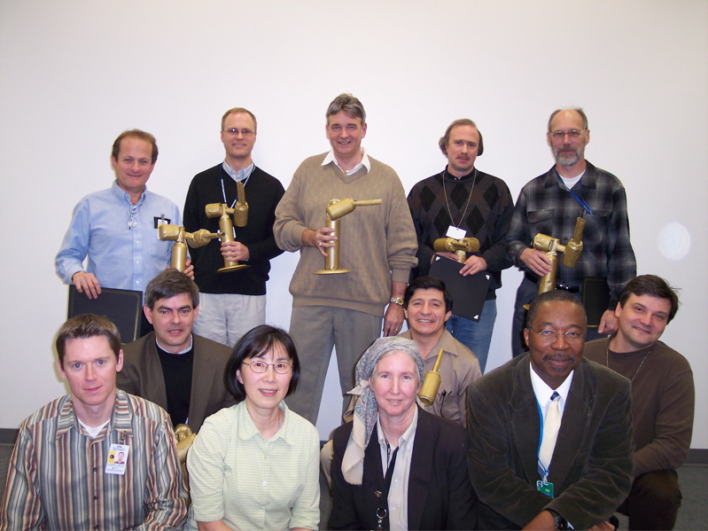
What is AeroCenter? (1)
Aerosols are a cross-cutting theme of research at NASA-GSFC
Yoram Kaufman proposed the idea for Aerocenter in 2000
Data center for aerosols
Organize people here
Visitor program
Seminar series
Began in 2001
2003 Cimmy awards

Slide 4
Who is AeroCenter? (2)
We are an interdisciplinary union of researchers, including GSFC, UMBC, NOAA and other institutions in DC area and beyond
Our interests include “anything” aerosols
We are theorists, observationalists and modelers, chemists and physicists
We have 210 members (listserv) AND a web page (http://aerocenter.gsfc.nasa.gov)

Slide 5
Highlights from 2009-2010 (1)
25 Seminars on AeroCenter calendar
20 as “AeroCenter” sponsored: the usual time and place (Tuesday @ 11 AM, in Bldg #33 Room F225)
Coordinated or co-sponsored 5 “special” seminars from visitors or potential job hires

Slide 6
Highlights from 2009-2010 (2)
WebEx/Teleconference for sharing seminars outside of GSFC
8 seminars “broadcasted”
Up to 32 on-line participants per seminar
Some kinks with “secure WebEx” but have been resolved

Slide 7
Highlights from 2009-2010 (3)
2010 Annual “Poster Bash” held in Bldg #33 Lobby in January (after AGU)
This Aerosol Update: Held for the first time in the Visitor Center!

Slide 8
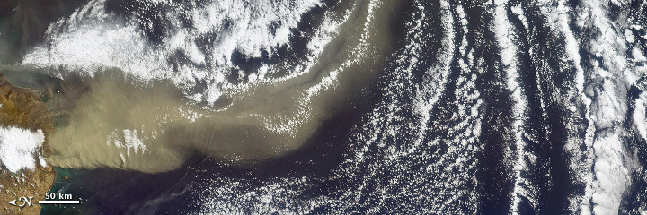
Highlights from 2009-2010 (4)
May 11, 2010: Planned “special” session on the Iceland (Eyjafjallajökull) Volcano
Opportunity to showcase all of NASA’s cool tools
Earth Observatory / MISR

Slide 9
Today’s Agenda
Oral Presentations
12 min (10 min + 2 min for questions)
Huisheng will be your time-keeper
A break in the middle
Poster Presentations
18 posters
Set up will be during 2nd break
Refreshments
During Poster session
Food/Drink MUST STAY IN LOBBY OR OUTSIDE!
Thanks to AeroCenter member donations
Please help (setup/cleanup)

Slide 10
Oral Presentations

Slide 11
Poster Presentations

