Slide 1
MODIS Atmospheres webinar series #3: Collection 6 ‘e-Deep Blue’ aerosol products
Andrew M. Sayer, N. Christina Hsu (PI), Corey Bettenhausen, Nick Carletta, Jaehwa Lee, Colin Seftor, Jeremy Warner
Past team members: Ritesh Gautam, Jingfeng Huang, Myeong-Jae Jeong, Becky Limbacher, Clare Salustro
With thanks to many others: MODIS Characterization Support Team, MODIS Atmospheres Science Team, AERONET group
Climate & Radiation Laboratory, NASA Goddard Space Flight Center
andrew.sayer@nasa.gov
Images from NASA Earth Observatory, http://earthobservatory.nasa.gov/Features/Aerosols/

Slide 2
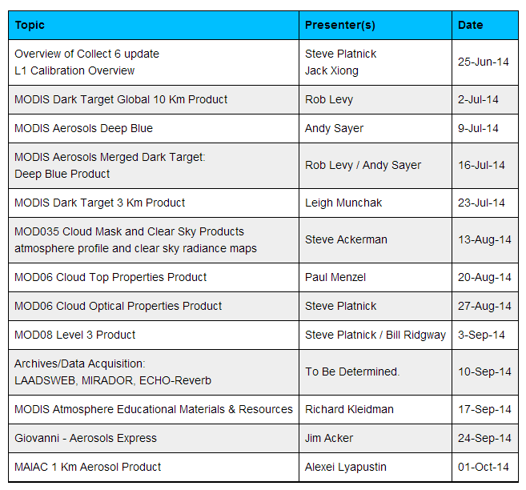
Webinar schedule

Slide 3
Overview
Aerosol terminology
MODIS terminology
e-Deep Blue
Principles
Examples of level 2 data
New for Collection 6
Validation
Summary

Slide 4
Overview
Aerosol terminology
MODIS terminology
e-Deep Blue
Principles
Examples of level 2 data
New for Collection 6
Validation
Summary

Slide 5
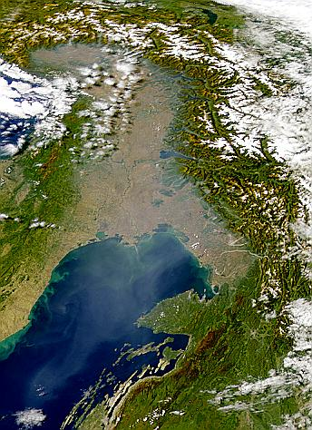
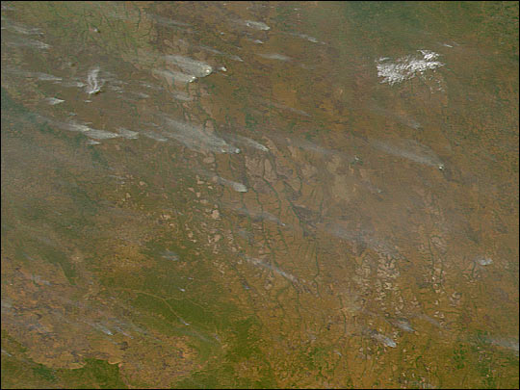
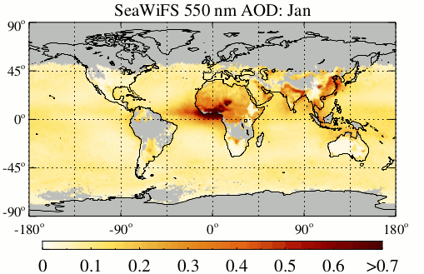
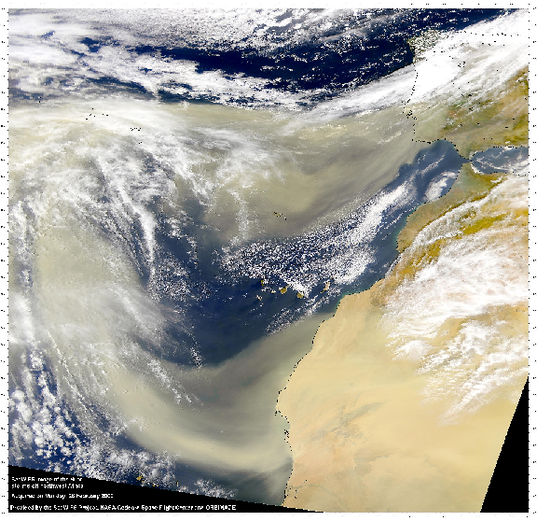
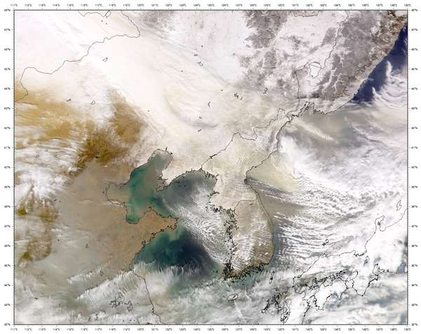
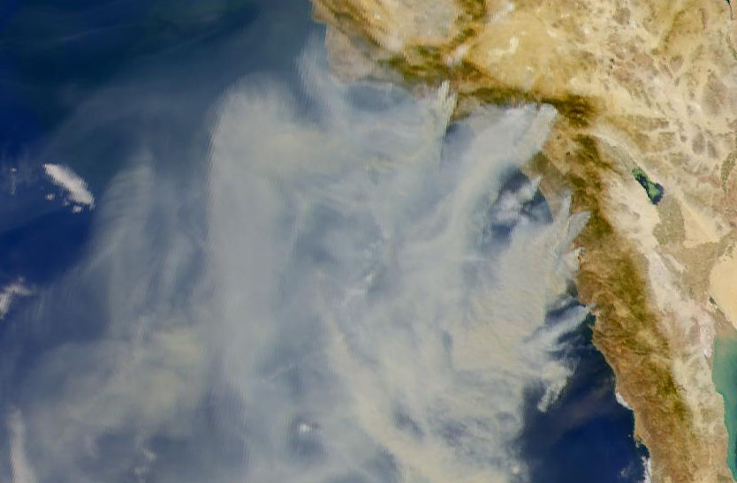
Aerosols and properties of interest: AOD
Aerosol Optical Depth (AOD): total column optical extinction of aerosol at a given wavelength
Most commonly, 550 nm (τ₅₅₀)
Related to how much aerosol is in the atmosphere
Also termed aerosol optical thickness (AOT)

Slide 6
Aerosols can travel a long way
Mineral dust from Taklimakan desert transported to North America
Hsu et al., IEEE TGARS (2006)
Renewed attention in Yu et al., Science/Atmos. Res., (2012)
We also see Asian pollution transported to North America, Saharan dust transported to the Amazon and Europe, African smoke transported to South America, Asian dust to Europe, high-latitude smoke circling the world in both hemispheres, etc...

Slide 7
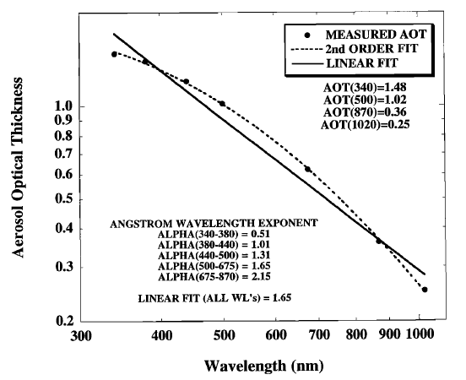
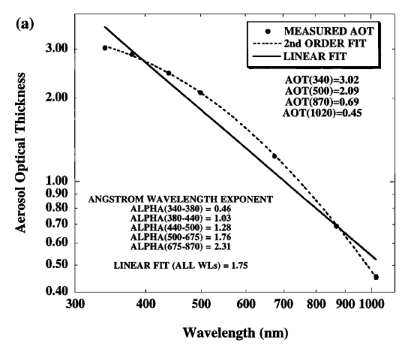
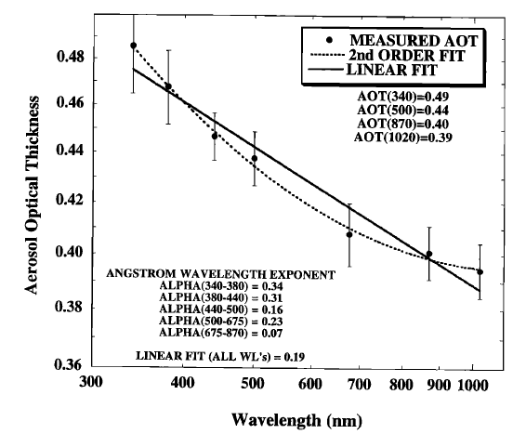
Aerosols and properties of interest: AE
Urban aerosols
(NASA GSFC, USA)
Smoke aerosols
(Bolivia)
Mineral dust aerosols
(Dalanzadgad, Mongolia)
From Eck et al., JGR, 1999
Ångström exponent (AE, α): spectral dependence of AOD
Values < 1 suggest optical dominance of coarse particles (e.g. dust)
Values > 1 suggest optical dominance of fine particles (e.g. smoke)
Depends on wavelength range used to calculate it

Slide 8
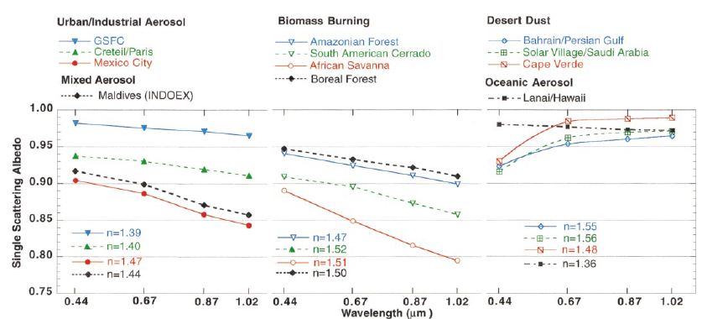
Aerosols and properties of interest: SSA
From Dubovik et al., JAS, 2002
Single Scatter albedo (SSA) : measure of light absorption by aerosols
SSA = 0: Pure absorbing aerosols (never encountered)
SSA = 1: Pure scattering aerosols
Typical range ~0.8 (some industrial/smoke) - 0.99 (‘clean’ continental, marine aerosols)
Also has wavelength dependence

Slide 9
Overview
Aerosol terminology
MODIS terminology
e-Deep Blue
Principles
Examples of level 2 data
New for Collection 6
Validation
Summary

Slide 10
MODIS data product terminology
MODIS: Moderate Resolution Imaging Spectroradiometer
Data product ‘Level’ designations relevant to the MODIS Deep Blue aerosol products
Level 1b (L1b): calibrated/geolocated instrument data
Level 2 (L2): derived geophysical retrieval data (‘pixel’ level)
Level 3 (L3): gridded data (spatiotemporal aggregation of Level 2)
MODIS data “Collection”
A (re)processing production run with consistent baseline algorithms
Collection 5 (C5) reprocessing (2006) was the first to include Deep Blue
Current version is Collection 6 (C6)
Aqua level 2 processing complete
Aqua level 3 imminent
Terra level 2/3 to follow after
This webinar is about MODIS C6 (mostly Aqua Level 2) data

Slide 11
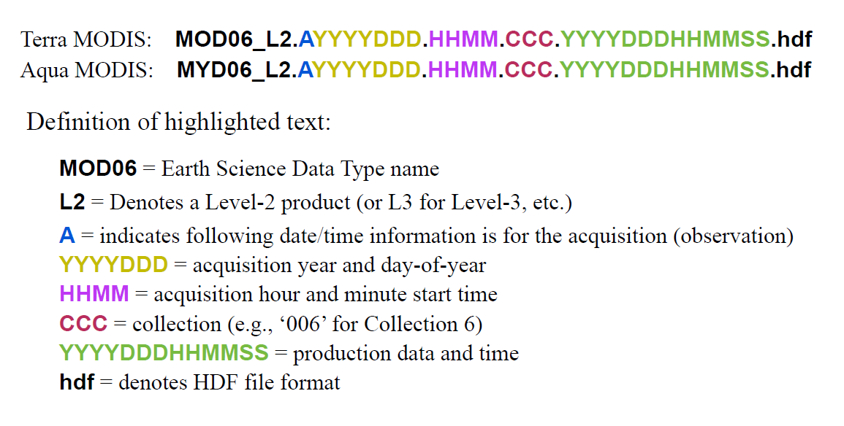
MODIS data product terminology
Data products relevant to this presentation:
MOD04, MYD04 (Level 2 aerosols)
MODATML2, MYDATML2 (Level 2 joint atmospheres)
MOD08, MYD08 (Level 3 joint atmospheres)

Slide 12
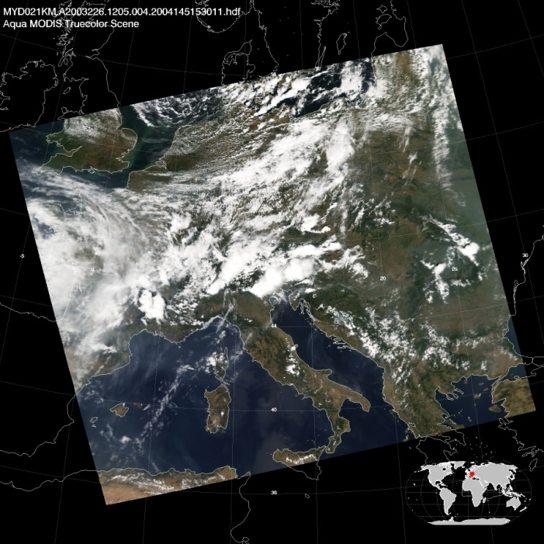
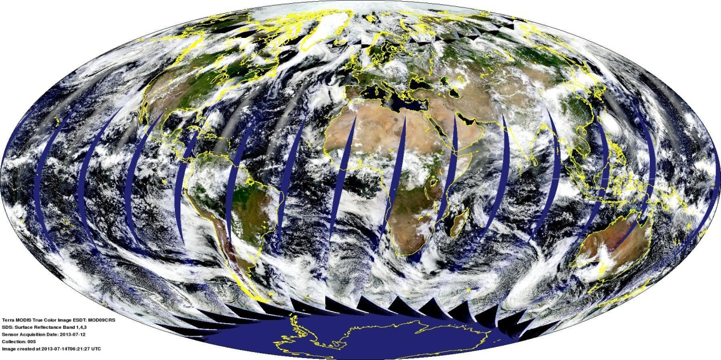
The MODIS sensor
MODIS Terra daytime RGB composite for July 12th, 2013
MODIS Aqua granule RGB composite for August 14th, 2003, 12:05 UTC
Images available online at http://modis-atmos.gsfc.nasa.gov
36 spectral bands from visible to thermal IR
Spatial resolutions (level 1b) 250 m to 1 km at nadir
‘Bowtie effect’ leads to pixel enlargement and distortion near swath edges
Note standard MODIS aerosol products are at nominal 10 km resolution
Swath width 2,300 km, giving near-global daily coverage
Flying on polar-orbiting platforms
Near-constant local solar time of observation ~10:30 am (Terra, descending), ~1:30 pm (Aqua, ascending)
14-15 orbits per day, 16-day orbital repeat cycle
Data organised into 5-minute ‘granules’

Slide 13
Overview
Aerosol terminology
MODIS terminology
e-Deep Blue
Principles
Examples of level 2 data
New for Collection 6
Validation
Summary

Slide 14
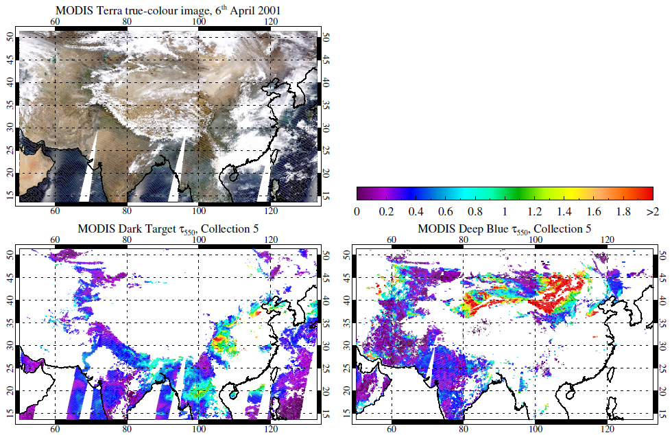
Deep Blue: original motivation
‘Dark Target’ AOD algorithm does not retrieve over bright surfaces
Violates algorithmic assumptions
These are important aerosol sources, especially mineral dust
Deep Blue filled in some gaps
(Now, it does more than that)

Slide 15
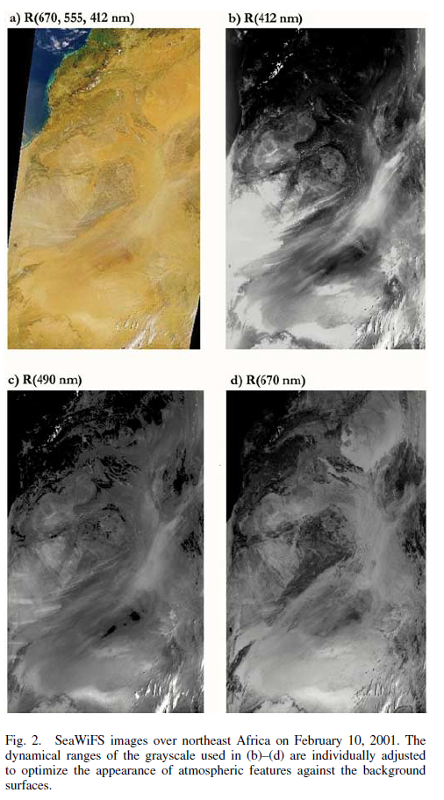
Deep Blue: key concepts
Often, darker surface and stronger aerosol signal in the violet/blue (~400-490 nm) than at longer wavelengths
Prescribe surface reflectance
Retrieve AOD independently at several wavelengths
Advantages:
Avoids regional artefacts arising from e.g. global prescription of surface reflectance ratios
Avoids requirement for auxiliary data (so can run in near real-time)
Can be applied to many sensors
Disadvantages:
Drastic departures from expected surface cover type can lead to localised artefacts
Can’t directly calculate aerosol effective radius, volume etc
Figure from Hsu et al., IEEE TGARS (2004)

Slide 16
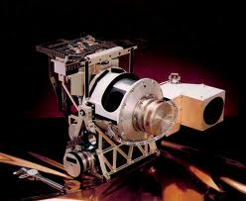
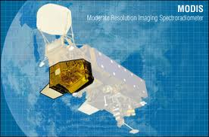
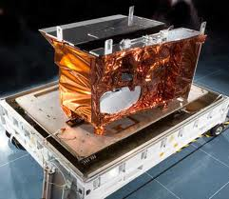
Sensors Deep Blue has been applied to
 |  | 1997 |  |  |  |  |  | 2000 |  |  |  | 2002 |  |  |  |  |  |  |  |  |  |  |  |  |  |  |  | 2010 |  | 2011 |  | Present |  |  | ?
SeaWiFS
MODIS
(Terra)
MODIS
(Aqua)
VIIRS
(Suomi-NPP)
Images courtesy of SeaWiFS/MODIS projects and Raytheon

Slide 17
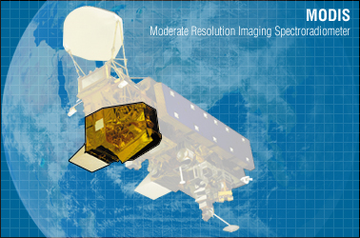
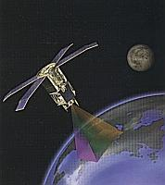
MODIS vs. SeaWiFS Deep Blue
Dataset | MODIS (Collection 6, C6) | SeaWiFS (Version 4, V4)
Time series | MODIS Terra (2000 onwards) MODIS Aqua (2002 onwards) | SeaStar satellite (1997-2010, a few gaps)
Coverage | Daytime cloud-free snow-free land only | Daytime cloud-free snow-free land Daytime cloud-free ice-free non-turbid water
Data products | Main product is AOD at 550 nm Also provides AOD at 412/470/670 nm, Ångström exponent, and SSA (for heavy dust) | Main product is AOD at 550 nm Land: also provides AOD at 412/490/670 nm, Ångström exponent, and SSA (for heavy dust) Water: also provides AOD at 510/670/865 nm, Ångström exponent, fine mode fractional volume
Level 2 | Nominal 10 x 10 km resolution ~2,330 km swath | Nominal 13.5 x 13.5 km resolution ~1,500 km swath
Level 3 | 1°; daily, 8-day, and monthly resolution | 0.5° and 1°; daily and monthly resolution
Data access | Distributed by MODIS LAADS Level 3 visualisation through Giovanni | Distributed by GES DISC Level 3 visualisation through Giovanni
Hsu et al., IEEE TGARS 2004, 2006; JGR 2013; Sayer et al., JGR 2012a,b; AMT 2013

Slide 18
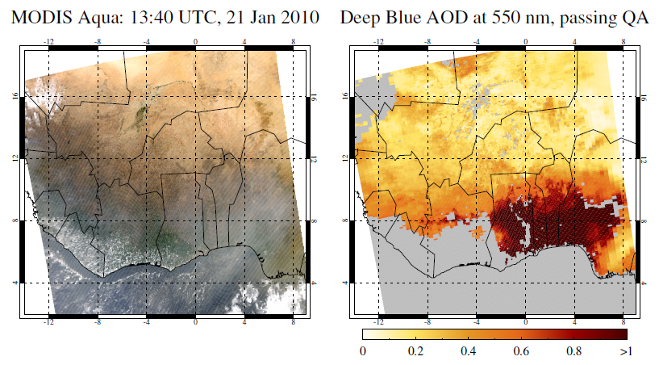
Example Level 2 data
Science Data Set (SDS) names relevant for most users:
Deep_Blue_Aerosol_Optical_Depth_550_Land_Best_Estimate
This has our quality filters applied, i.e. any retrieval not set to the fill value (-9.999) should be usable
For the bulk of applications, quality assurance (QA) filters should be used
Latitude
Longitude
Example granule shown here: MYD021KM.A2010021.1340.006.2012064111514.hdf

Slide 19
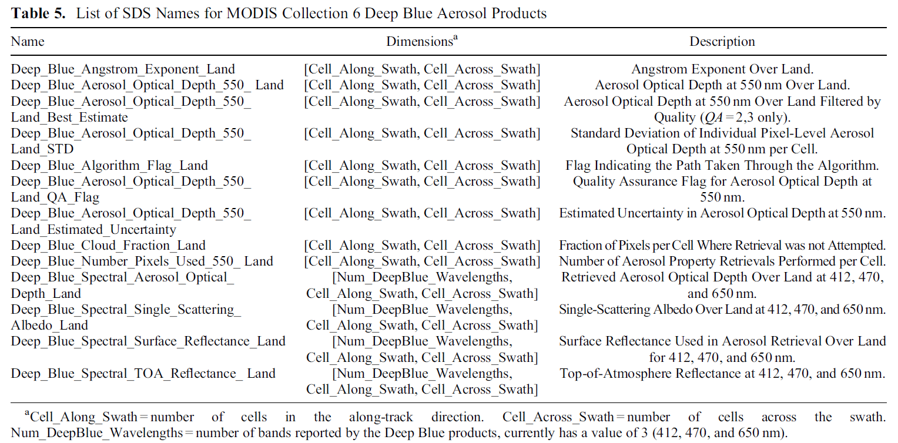
Example Level 2 data
AE (useful in high AOD)
Algorithm flag (indicates surface reflectance method)
QA flag (required if not using prefiltered SDS)
AOD uncertainty estimate
(new for C6!)
Table from Hsu et al., JGR (2013)
Other stuff included in files but not listed above:
Diagnostic information (e.g. geometry, land/sea mask)
Dark Target and ocean aerosol data (cf. Rob Levy’s webinar last week)
Deep Blue/Dark Target ‘merged’ SDS (cf. next week’s webinar)

Slide 20
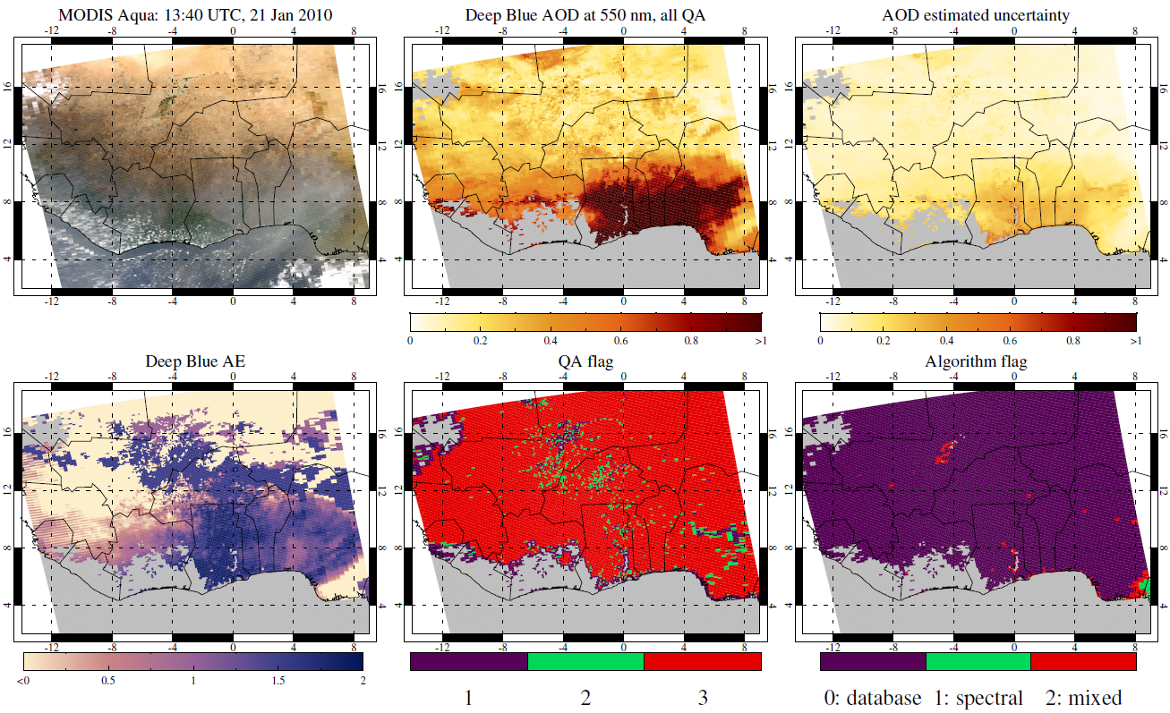
Example Level 2 data

Slide 21
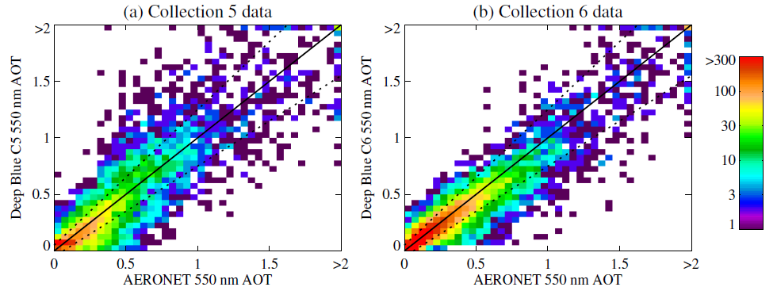
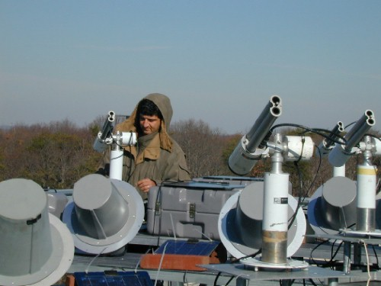
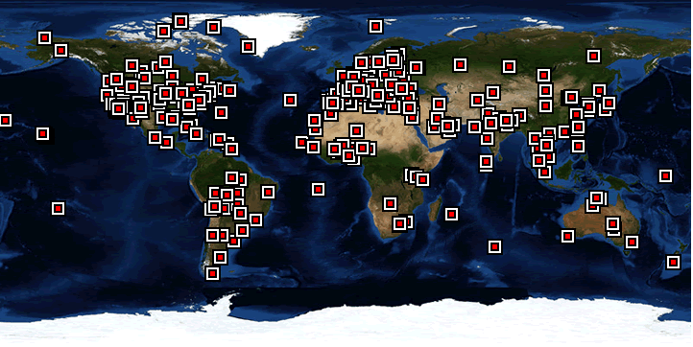
e-Deep Blue: main developments in C6
Described by Hsu et al., JGR (2013); Sayer et al., JGR (2013)
Enhanced Deep Blue (e-Deep Blue)
Summary: more retrievals, better retrievals
Refinements to e-Deep Blue in MODIS Collection 6:
Extended coverage to vegetated surfaces, as well as bright land
Improved surface reflectance models
Improved aerosol optical models
Improved cloud screening
Simplified quality assurance (QA) flag reading
Radiometric calibration improvements
Images from NASA AERONET page, http://aeronet.gsfc.nasa.gov/

Slide 22
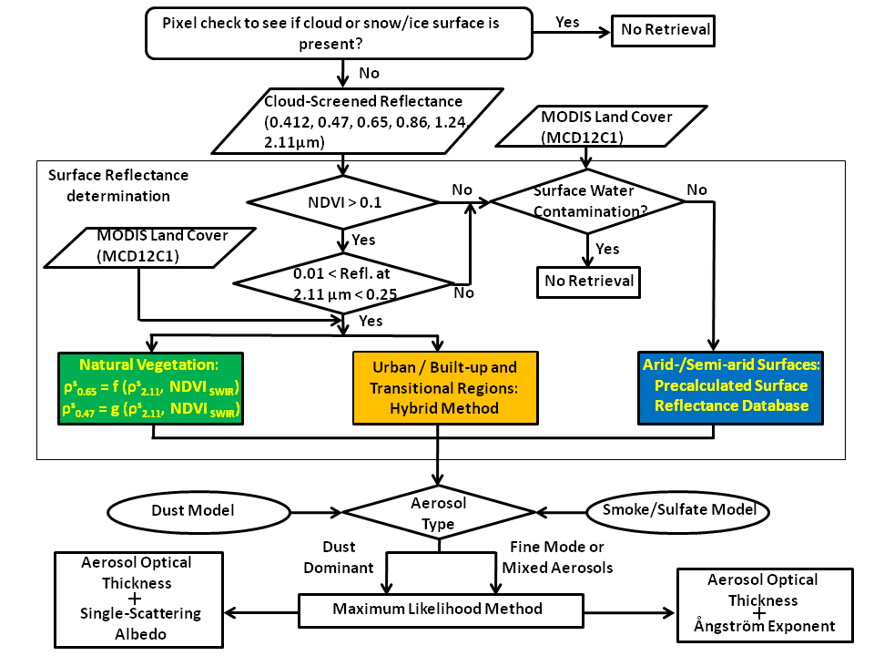
e-Deep Blue: C6 flow chart
Described by Hsu et al., JGR (2013)

Slide 23
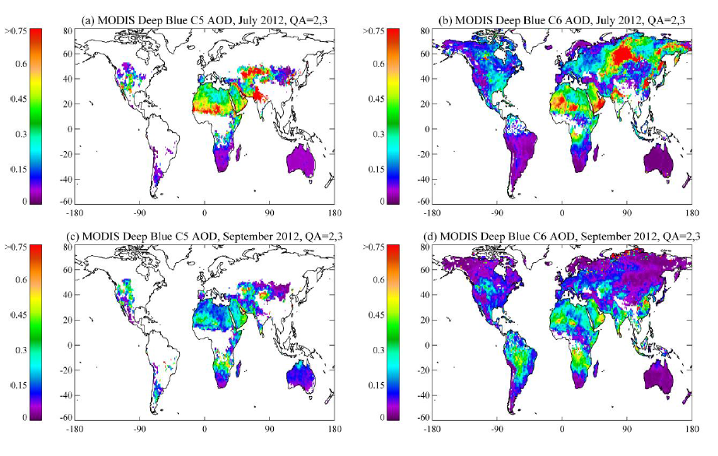
MODIS C6: extended spatial coverage

Slide 24
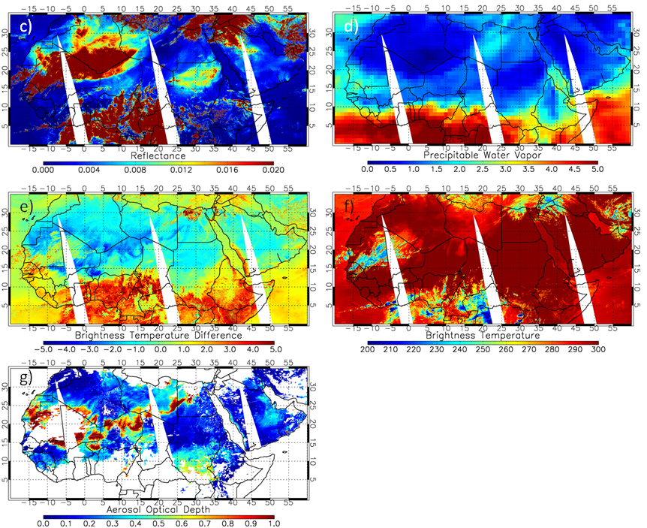
MODIS C6: improved cloud screening
MODIS RGB image over northern Africa on March 7, 2006
MODIS C5 Deep Blue AOD
TOA Reflectance at 1.38 μm
Precipitable water vapor, cm
BTD,
11-12 μm, K
Brightness temperature at 11 μm, K
MODIS C6 Deep Blue AOD
Traditional cirrus detection techniques can fail over moisture-deprived regions

Slide 25
Validation
See Sayer et al., JGR (2013)
AOD at 550 nm well-correlated with AERONET
AOD at other wavelengths shows similar behaviour
AE (denoted α here) shows little skill in low-AOD cases, some skill for higher-AOD cases
Note AERONET AOD also has some uncertainty in low-AOD conditions

Slide 26
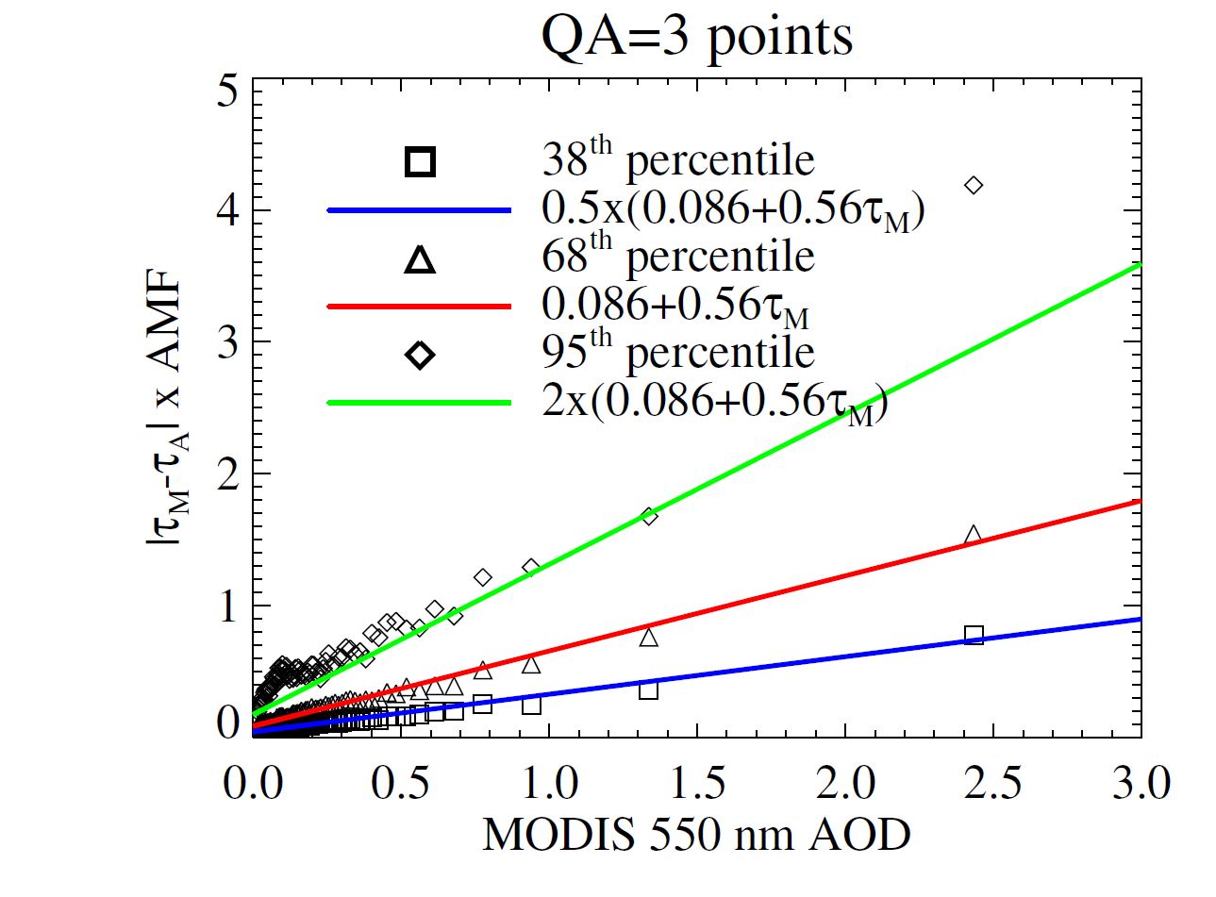
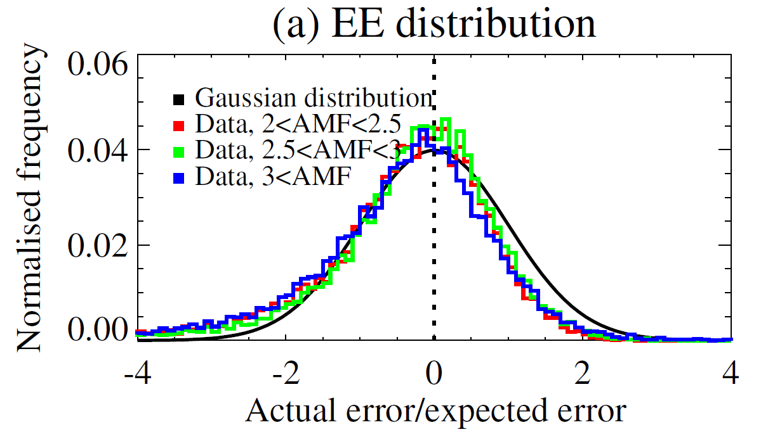
Retrieval-level uncertainty estimates
See Sayer et al., JGR (2013) for Aqua (Terra is similar)
AOD at 550 nm uncertainty estimates as a function of AOD, QA level, and geometric air mass factor (AMF)
For typical AMF, uncertainty of order 0.03+20%
Provided within level 2 products for each individual retrieval
Prognostic, not diagnostic
Determined by validation against AERONET, in line with theoretical values
Estimates designed to represent a Gaussian one standard deviation confidence interval

Slide 27
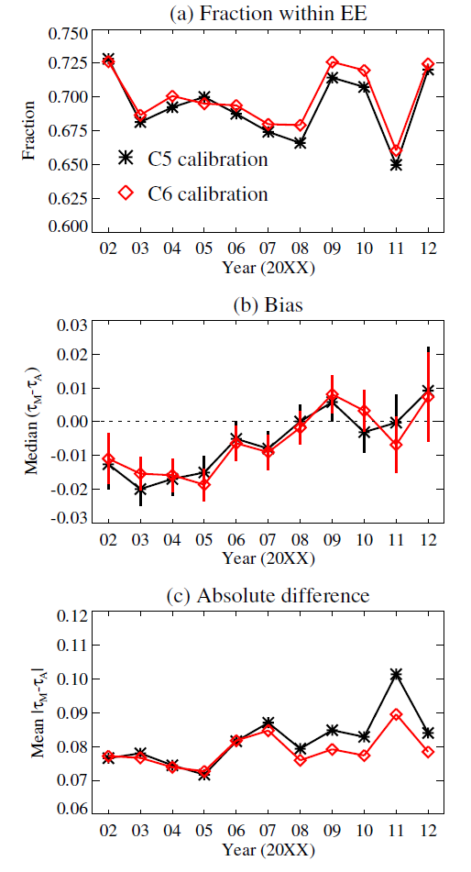
Importance of Level 1 radiometric calibration
Effort by MODIS Characterization Support Team to improve absolute and temporal stability of MODIS level 1 calibration
Important for minimising error in AOD/AE retrieval, especially long-term trends (Sayer et al., JGR 2013)
Assess calibration via long-term stable surface targets, the moon, and intersensor calibration
Verify through validation at long-term AERONET sites
Aqua drift became more noticeable in more recent years (2008+)
MODIS Terra is older and has degraded more strongly, which is why C6 has taken longer for Terra
Collection 6 data for both Terra and Aqua have a better Level 1 calibration, leading to more stable Level 2 data, with lower uncertainties

Slide 28
Overview
Aerosol terminology
MODIS terminology
e-Deep Blue
Principles
Examples of level 2 data
New for Collection 6
Validation
Summary

Slide 29
Summary
e-Deep Blue provides aerosol data at ~10 km spatial resolution over vegetated, urban, and arid land surfaces, in near real time, suitable for quantitative use in scientific applications
Primary data product AOD at 550 nm
Ångström exponent, SSA useful in some situations
Collection 6 has more and better retrievals than Collection 5
Aqua L2 available now, Aqua L3 imminently, Terra L2/L3 shortly after
Please use the data, ask questions, tell us when you find something unusual/exciting
We are happy to help, and it’s nice to hear from users
Links:
MODIS Atmospheres website: modis-atmos.gsfc.nasa.gov
NASA LAADS (data distribution) website: ladsweb.nascom.nasa.gov
MODIS Collection 6 on the NASA LAADS ftp server: ladsweb.nascom.nasa.gov/allData/6/<product name>
Key references: Hsu, N. C., S. C. Tsay, M. D. King, and J. R. Herman (2004), Aerosol properties over bright-reflecting source regions, IEEE Trans. Geosci. Remote Sens., 42, 557–569
Hsu, N. C., S. C. Tsay, M. D. King, and J. R. Herman (2006), Deep blue retrievals of Asian aerosol properties during ACE-Asia, IEEE Trans. Geosci. Remote Sens., 44, 3180–3195
Hsu, N. C., M.-J. Jeong, C. Bettenhausen, A. M. Sayer, R. Hansell, C. S. Seftor, J. Huang, and S.-C. Tsay (2013), Enhanced Deep Blue aerosol retrieval algorithm: The second generation, J. Geophys. Res. Atmos., 118, 9296–9315, doi:10.1002/jgrd.50712
Sayer, A. M., N. C. Hsu, C. Bettenhausen, and M.-J. Jeong (2013), Validation and uncertainty estimates for MODIS Collection 6 “Deep Blue” aerosol data, J. Geophys. Res. Atmos., 118, 7864–7872, doi:10.1002/jgrd.50600

